Slide 1

Obstetric Anesthesia
Subcommittee Meeting
December 3, 2025
Notes:
Wandana

Slide 2
Agenda
Announcements
September Meeting Recap
Neuraxial Catheter Replacement (NCR-01-OB) Discussion
Pregnancy Phenotype Update
In the News
Unintended Dural Puncture (UDP-01-OB) Discussion
PONV Prophylaxis for Cesarean Delivery
Notes:
Wandana

Slide 3
Announcements
2026 Meeting Dates:
February 11th, 1-2pm EST
June 3rd, 1-2pm EST
September 16th, 1-2pm EST
Welcome to new OB Subcommittee members!
The OB Subcommittee is open to anyone, if interested in attending, please email Kate.
Notes:
Wandana- moving to 3 meetings per year in 2026 to align with other committees

Slide 4

Thank you!
Dr. Wandana Joshi will be stepping down as the Obstetric Subcommittee Vice Chair after December 2025
Thank you, Wandana, for your service over the last 2 years as Vice Chair of this committee. We look forward to your return to service as an OB subcommittee member!
Notes:
Nirav

Slide 5
Seeking OB Subcommittee Vice Chair
Actively practicing OB anesthesiologist at current MPOG site
Guide and support the work of the Obstetric Subcommittee​
Lead measure performance review, new measure development, measure revision discussions​
Identify and participate in research opportunities​
Monthly meetings with Chair (Brandon Togioka), Kate, and the MPOG team​
Be able to devote 2 - 4 hours per month to this role for a 2 year term
Interested faculty should submit their interest to MPOG QI Director (Nirav Shah) at nirshah@med.umich.edu and MPOG Obstetric Subcommittee Chair (Brandon Togioka) at Togioka@ohsu.edu
Obstetric Subcommittee Vice Chair Description: here
Notes:
Nirav

Slide 6
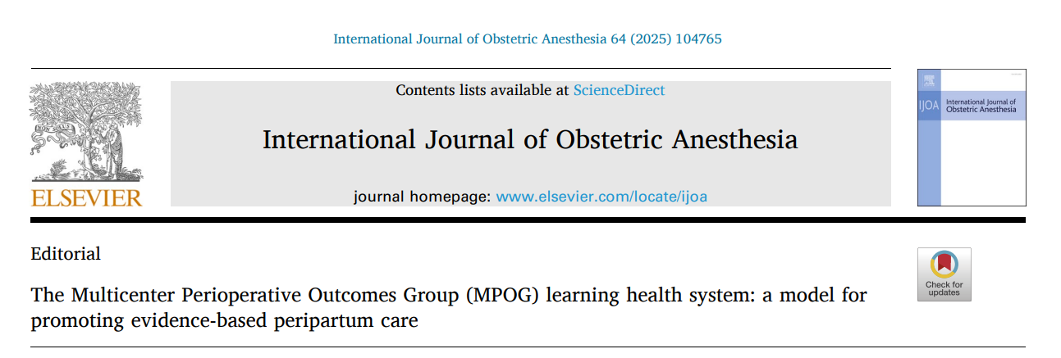
In the News
Editorial recently published in the International Journal of Obstetric Anesthesia describing the MPOG data collection & validation process.
Highlights implications for using MPOG data for obstetric research and QI.
Excellent article to reference for future OB research
Thanks to Drs. Togioka, Reale, Klumpner, Aziz and Mathis for publishing this work!
Notes:
Nirav

Slide 7
September Meeting Recap
Reviewed Clinical Practice Guidelines for PDPH
Voted to define pregnancy phenotype based on a threshold of 42 weeks prior to delivery date/time as found in MPOG database.
Reviewed updates to obstetric antibiotic administration measure time frames for ABX-01-OB and ABX-06-OB.
Voted to no longer consider nitrous oxide administration (alone) as general anesthesia.
Reviewed proposed specifications and preliminary data for two new measures:
  Unintended dural puncture
  Epidural replacement
Notes:
Wandana

Slide 8
Obstetric Phenotype Updates
Obstetric Delivery Date/Time phenotype recently revised – now returns a delivery/date time for 100% of all obstetric cases in MPOG
‘Obstetrics - Is Pregnant’ phenotype published December 1st
Preliminary Data (January – December 2024)
 | Likely Pregnant | Not Pregnant | Postpartum | Unable to Determine Pregnancy Status (No delivery found in MPOG)
# of cases (%) | 102,250 (2.7%) | 1574 (0.0%) | 3078 (0.1%) | 3,731,036 (97.2%)
Notes:
Brandon

Slide 9
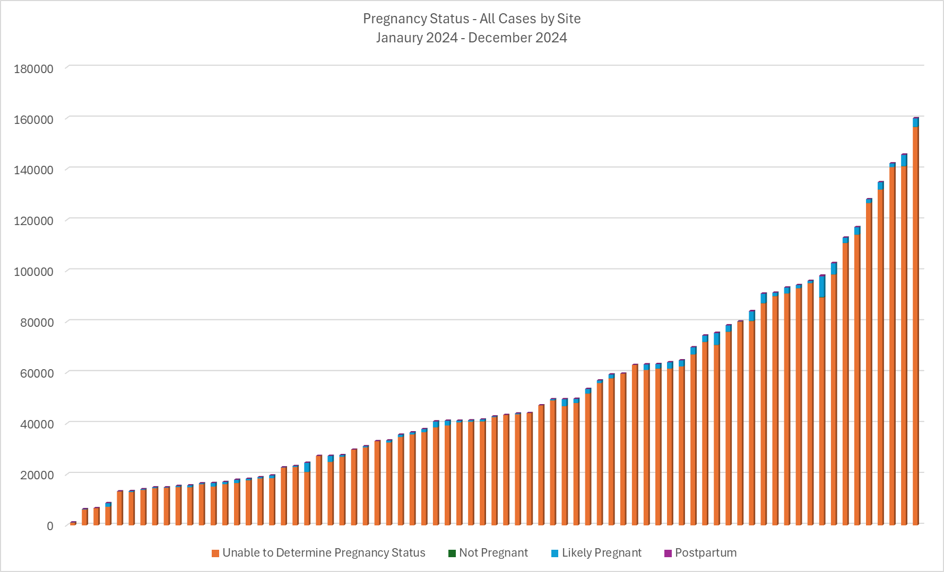
Notes:
Brandon

Slide 10
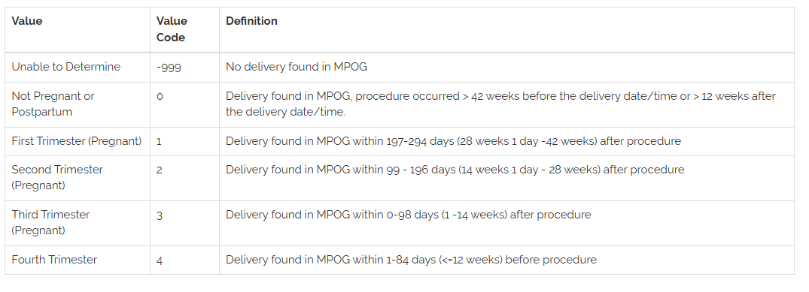
In development: Obstetrics – Pregnancy Trimester
Currently validating an ‘Obstetrics – Pregnancy Trimester’ phenotype
Would return the following values – feedback?
Notes:
Brandon

Slide 11
Estimating obstetric trimester at time of non-obstetric surgery based upon date of delivery
Gestational Age
≤ 12 weeks postpartum
0 w – 13 w 6 d
14 w – 27 w 6 d
28 w – 42 w
1st Trimester
2nd Trimester
3rd Trimester
4th Trimester
Delivery found in MPOG 197 – 294 days after procedure
Delivery found in MPOG 99 – 196 days after procedure
Delivery found in MPOG 0 -98 days after procedure
Delivery found in MPOG 1 – 84 days
(≤ 12 weeks)
before procedure
Date of Non-Obstetric Surgery
Notes:
Brandon

Slide 12
Poll
Would a pregnancy trimester phenotype be helpful for QI or research purposes?
Notes:
Brandon

Slide 13
PONV-05 Cesarean-Specific
Shashank S. Shettar, MD, FASA
Associate Professor of Anesthesiology

Slide 14

Cesarean-Specific PONV Prophylaxis

Slide 15
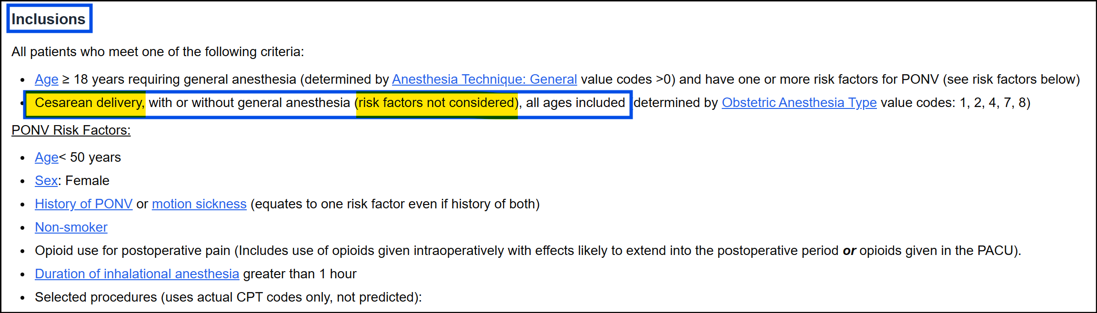
Current MPOG Measure: PONV-05 (Prophylaxis)

Slide 16
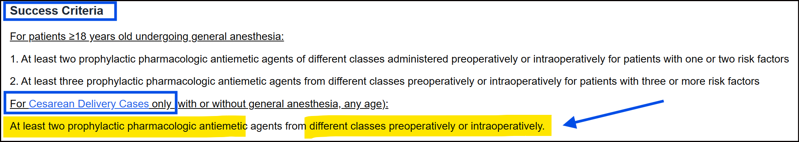
Current MPOG Measure: PONV-05 (Prophylaxis)

Slide 17
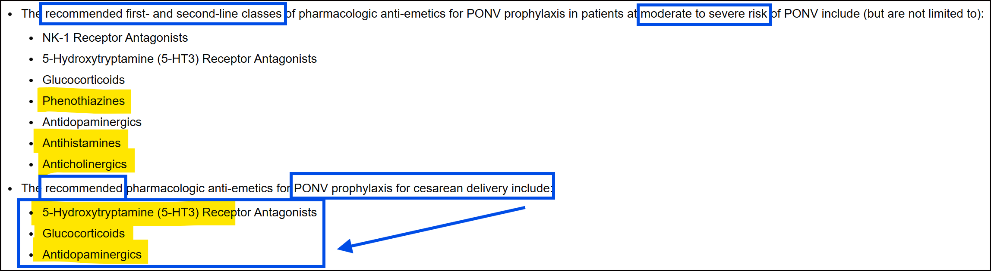
Current MPOG Measure: PONV-05 (Prophylaxis)

Slide 18
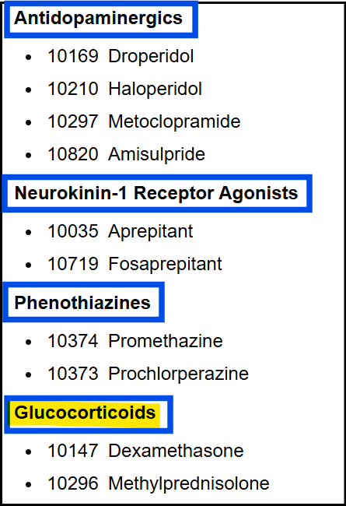
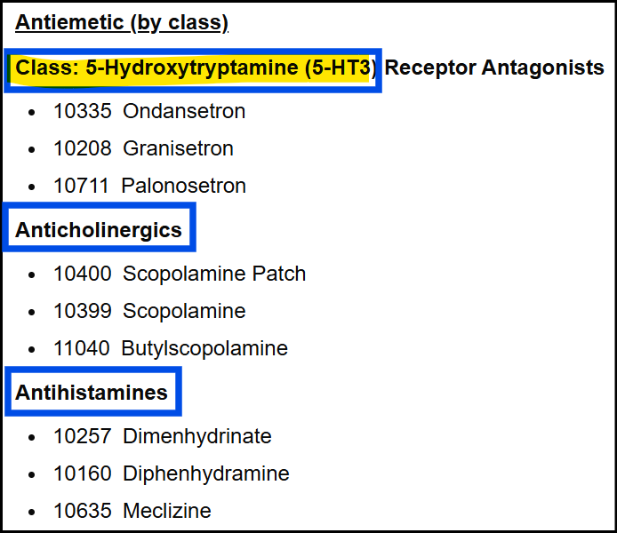
Current MPOG Measure: PONV-05 (Prophylaxis)

Slide 19
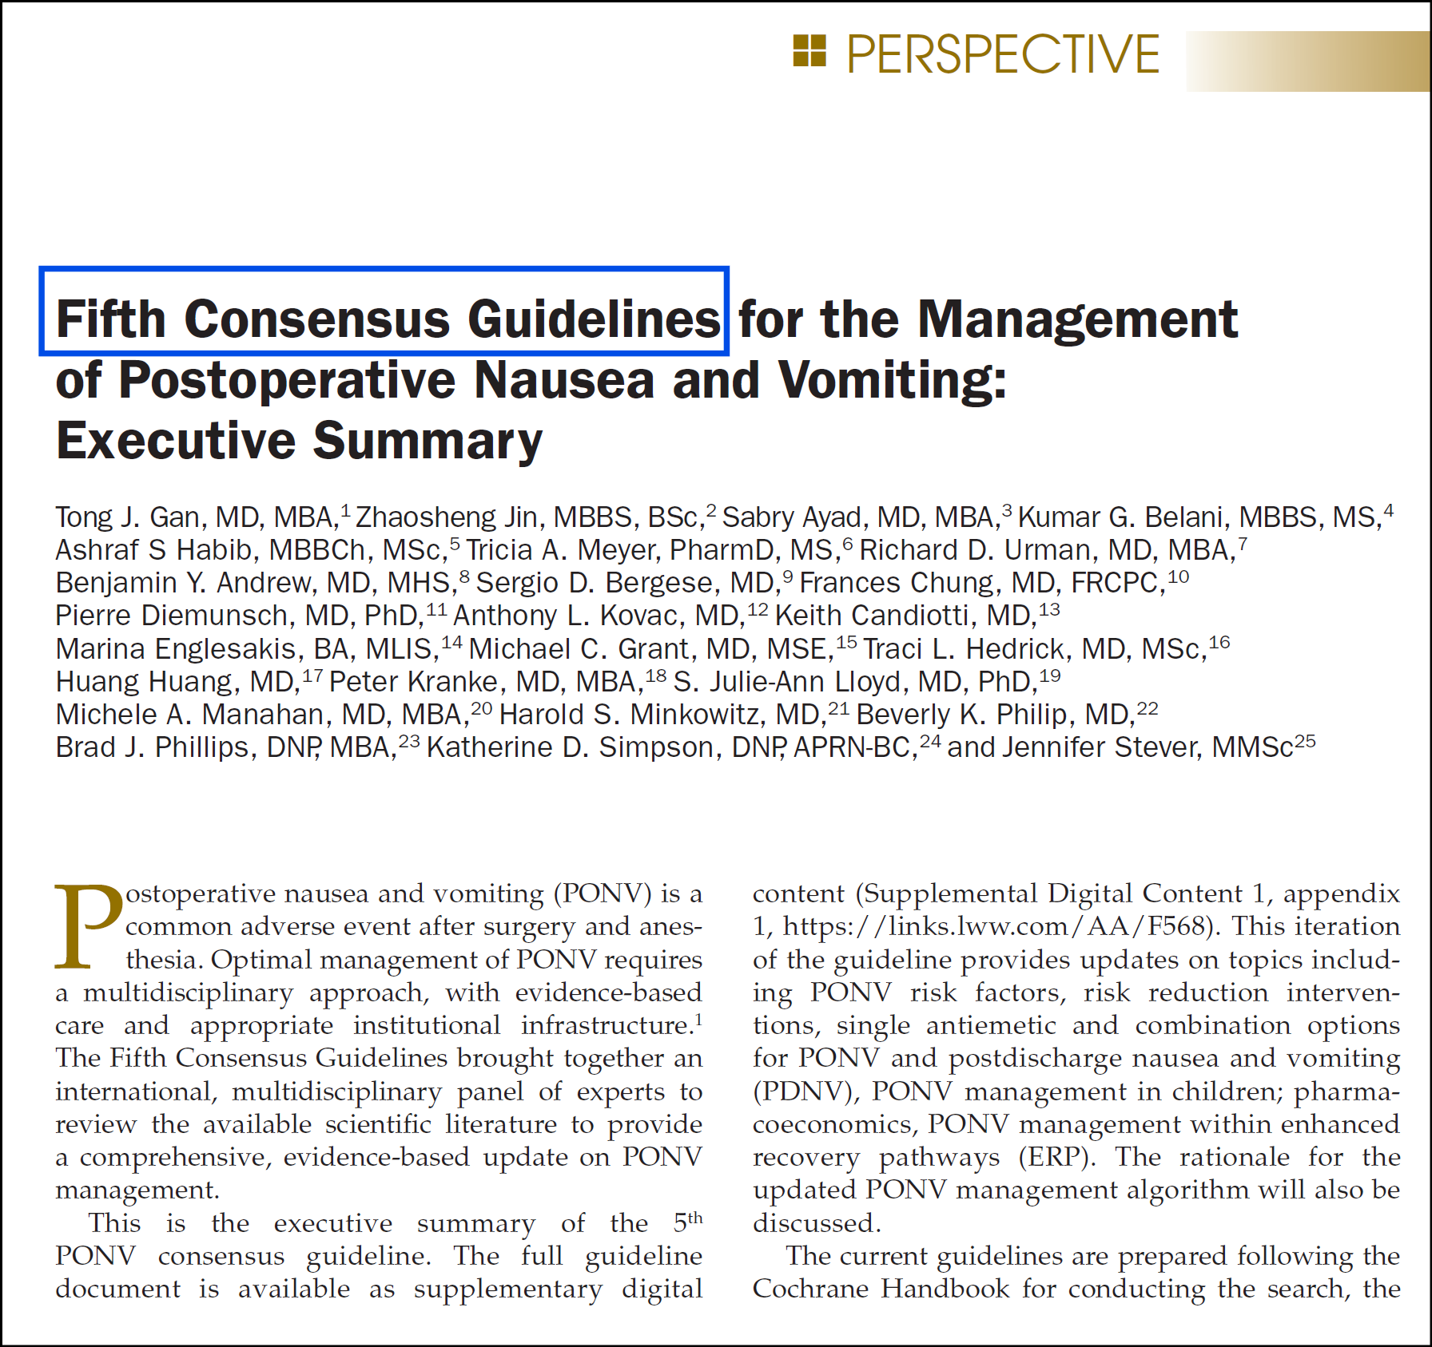

Slide 20
5th Consensus PONV Guidelines
Adds one new, high-value obstetric recommendation
Metoclopramide 10 mg IV after cord clamp: faster onset, IONV vs dexamethasone
The 4th guideline: more clinically actionable for Cesarean

Slide 21
Scopolamine Patch
Included in measure success for GA, but why not for Cesarean ?
2025: Levin D, et al. Effectiveness of P6 Stimulation and Transdermal Scopolamine Patch for the Reduction of Nausea and Vomiting During Caesarean Section Under Combined Spinal-Epidural Anesthesia: A Randomized Clinical Trial. J Clin Med. 2025;14(7):2521. PMID: 40217969 PubMed
2010: Lee HK, et al. The effect of transdermal scopolamine plus intravenous dexamethasone for the prevention of PONV in patients with epidural PCA after major orthopedic surgery. Korean J Anesthesiol. 2010;58(1):50-5. PMID: 20498812 PubMed
1989: Kotelko DM, et al. Transdermal scopolamine decreases nausea and vomiting following cesarean section in patients receiving epidural morphine. Anesthesiology. 1989 Nov;71(5):675-8. PMID: 2817461. PubMed

Slide 22
Glycopyrrolate/Atropine for Spinal induced Vagal Nausea
↓ SVR and hypotension
Relative unopposed vagal tone → bradycardia, increased peristalsis, “gut churning” sensation
Visceral traction also stimulates vagal afferents
So treating the vagal component with an anticholinergic (glycopyrrolate/atropine) can reduce nausea
2019 Article: Lee S, Yoon SW, Choi GJ, et al. Effects of glycopyrrolate as premedication on postoperative nausea and vomiting: A propensity score matching analysis. Open Anesth J 2019; 13:93-9. DOI: 10.2174/2589645801913010093
1999 PubMed: Ure D, et al. Glycopyrrolate reduces nausea during spinal anaesthesia for caesarean section without affecting neonatal outcome. Br J Anaesth. 1999 Feb;82(2):277-9. PMID: 10365009.

Slide 23
Dexamethasone
Perineal burning” / “genital flush” sensation
Known, benign, transient side effect, but it usually occurs only when dexamethasone is given as a rapid bolus or at high concentration
Must wait until spinal level is appropriate or administer slowly with dilution

Slide 24
Ondansetron
Well known to cause headaches
Intracranial vasodilation and also modifies serotonergic pathways involved in pain modulation → resulting in a tension-type headache
Many postpartum patients are already dehydrated, fatigued, or stressed → making headache more noticeable after ondansetron
The benefit obviously outweighs the headache risk – but still risk exists !

Slide 25
Discussion
PONV remains a significant contributor to maternal discomfort during cesarean delivery
Dexamethasone & ondansetron continue to demonstrate strong efficacy and safety
Cesarean-related nausea has a unique pathophysiology that extends beyond traditional risk factors
Multifactorial emetogenic burden: neuraxial-induced parasympathetic activation, uterotonic medications, visceral manipulation, & intrathecal/epidural opioids

Slide 26
Discussion
MPOG’s current antiemetic success metrics: heavily emphasize Dexamethasone & 5-HT3 antagonists, may not fully capture optimal practice in obstetric anesthesia
Anticholinergics (scopolamine patch, glycopyrrolate) and promethazine: demonstrated value
Incorporating these: allow a more CD-specific prophylaxis, better reflect real-world clinical practice, more accurately capture meaningful improvements in maternal experience and quality of care.

Slide 27


Slide 28


Slide 29
5th Consensus Guidelines for PONV November 2025
Identify patient risk factors. Risk stratification tool such as Apfel simplified score
Reduce baseline risk for PONV ie propofol TIVA, multimodal analgesia, neuraxial/regional anesthesia and avoidance of nitrous oxide etc.
Administer prophylaxis using 2 interventions in adults at any risk for PONV
Provide antiemetic treatment to patients with PONV who did not receive prophylaxis or when prophylaxis failed.
PONV prophylactic recommendations in children
Comment on anti-emetic therapy for pregnant women for non-obstetric surgery
No concrete recommendations for obstetric patients.
SOAP recommendations ERAC- 5HT3 antagonist, glucocorticoid, and D2 receptor antagonist, metoclopromide (specifically for IONV).
Notes:
Wandana

Slide 30
PONV Prophylaxis - Vote
Should glycopyrrolate be considered an acceptable medication for PONV prophylaxis for cesarean delivery?
Should atropine be considered an acceptable medication for PONV prophylaxis for cesarean delivery?
Should MPOG develop a new PONV prophylaxis measure to assess cesarean deliveries independent of the existing PONV-05 measure?
Should MPOG develop a new IONV prophylaxis measure for cesarean delivery surgery?
Notes:
Wandana

Slide 31
THANK YOU!
Brandon Togioka, MD
MPOG Obstetric Anesthesia Subcommittee Chair
togioka@ohsu.edu
Wandana Joshi, DO
MPOG Obstetric Anesthesia Subcommittee Vice Chair
wandanaj@comcast.net
Kate Buehler, MS, RN
MPOG Clinical Program Manager
kjbucrek@med.umich.edu
Notes:
Brandon

