Slide 1
Accelerating the Quality Journey
Presentation for Multicenter Perioperative Outcomes Group
Michelle Schreiber, M.D.
Deputy Center Director, Center for Clinical Standards and Quality
Group Director, Quality Measures and Value Based Programs
Centers for Medicare and Medicaid Services (CMS)

Slide 2

US Healthcare Delivery System
Lowest quality scores among industrialized nations
Highest cost among industrialized nations
Goal – bend the cost curve down and improve the quality

Slide 3
Goals of Healthcare Quality - Value = Quality + Safety + Experience / Cost
Improve healthcare outcomes – including quality and safety. Sometimes process measures which are clearly linked to improved outcomes are used as “proxy” measures; ideal measures demonstrate improved outcomes
Reduce Cost and unnecessary utilization
Shift payment from “pay for volume” to “pay for performance” – meaning that providers are meaningfully engaged in being paid in models which have significant percentage of dollars at risk for both upside/downside outcome performance
Ensure patients have a voice in their healthcare, including transparent, useful, easy-to-understand information to help them make best care decisions.
Support transformation to digital … measures, data, information sharing…

Slide 4

Challenges of Current Quality Ecosystem
Too many measures vs. too few measures
Burden of reporting
Multiple programs not aligned
Risk Adjustment including SES
Appropriate Attribution
Public Transparency – Good or bad?
Payment tied to quality – enough or not enough?
New challenges of technology

Slide 5

Many Strategic Quality Frameworks and Ratings
Frameworks
  CMS Meaningful Measures
  IHI
  Military
  National Academies of Medicine
  NQF
Ratings Groups
  CMS Compare and Stars programs
  Leapfrog
  USNWR
  Truven

Slide 6

Our Vision
Utilize impactful quality measures to improve health outcomes and deliver value by empowering patients to make informed care decisions while reducing burden to clinicians.

Slide 7
CMS Quality Measurement Strategies:
Reduce measure burden – reduce measures, improve alignment across all payers
Improve value based programs
Increase voice of patients through transparency and patient reported outcomes
Transition to digital- Leverage digital measures for innovative strategies with advanced analytics/machine learning

Slide 8
Stakeholder Alignment

Slide 9
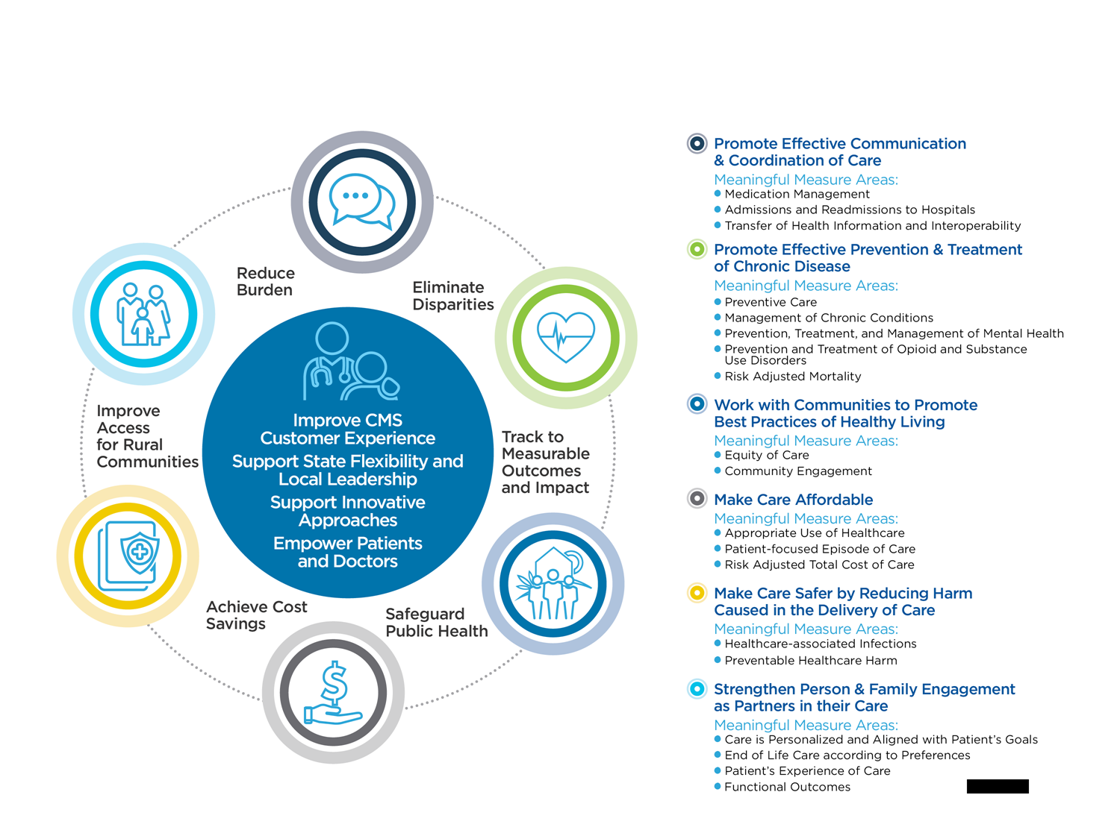
Meaningful Measures Framework 1.0 - 2017
Meaningful Measures Framework 1.0 - 2017

Slide 10



Meaningful Measures 2.0
Goals of MM 2.0
Utilize only quality measures of highest value and impact focused on outcomes of key quality domains
Align measures across value-based programs and across partners, including CMS, federal and private entities
Engage patients through transparency, patient centered measures, and patient reported outcomes
Transform measures to fully-digital by 2030, and incorporate all-payer data
Develop and implements measures that reflect social and economic determinants.

Slide 11
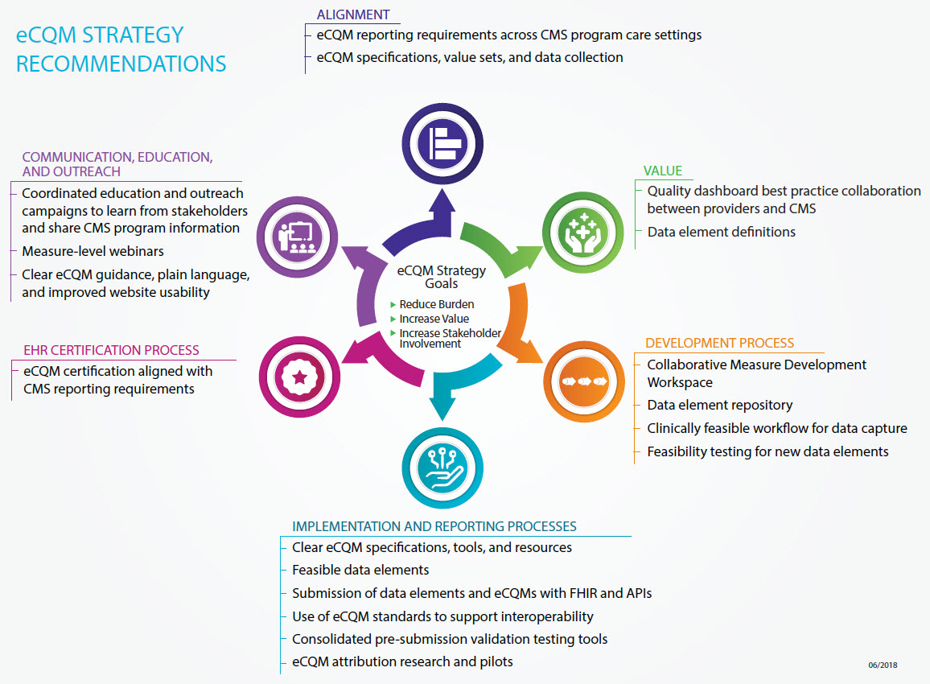
eCQM Strategy Project

Slide 12
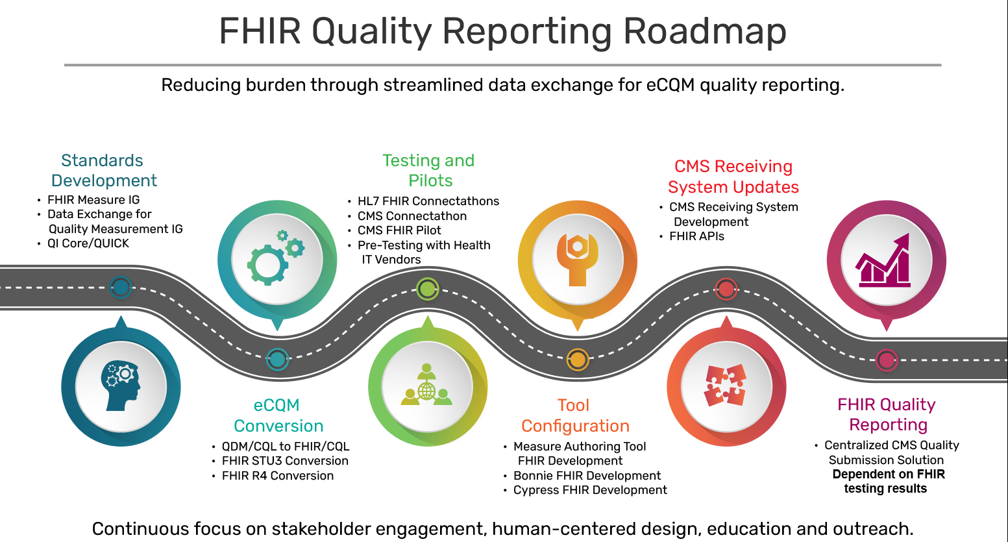
FHIR Quality Reporting Roadmap

Slide 13
Transparency
Transparency important so that patients have access to information to make best healthcare choices. Transparency has also engaged organizations in more quality improvement.
Star ratings and transparency for patients
  My Health e-data for patients
  Nursing Home Compare
  Hospital Compare
  Physician Compare
Price Transparency
Quality Data Strategy
  More rapid feedback to clinicians
  API development for sharing quality data
  Sharing data more broadly for research

Slide 14
Current Alignment Initiatives Across Stakeholders
Alignment within CMS (across Centers – CCSQ, CM, CMCS, CCIIO, CMMI)
Alignment across Federal Government
Alignment through consensus (NQF)
Alignment with other payers and others – Core Quality Measures Collaborative (AHIP/NQF/CMS)
Alignment with measure developers – some already piloting their measures as electronic (NCQA)

Slide 15
Future Innovations in Measures
Use of Advanced Analytics and machine learning to predict performance and issues
Use of Natural Language Processing
Outlier identification
Variances
Should “high performers” receive a “break” in oversight?

Slide 16
Future Strategies in Value Based Programs
Streamline and simplify programs
Ensure quality is embedded in all value based models
Continue focus on public transparency and link to payment
Role of registries in reporting – MIPS
Linkage of payment to performance
Transformation of payment models to value based performance as opposed to pay for volume
Explore linking programs to CME/MOC

Slide 17
MIPS: Quick Overview
Combined legacy programs into a single, improved program.
Physician Quality Reporting System (PQRS)
MIPS
Value-Based Payment Modifier (VM)
Medicare EHR Incentive Program (EHR) for Eligible Professionals

Slide 18
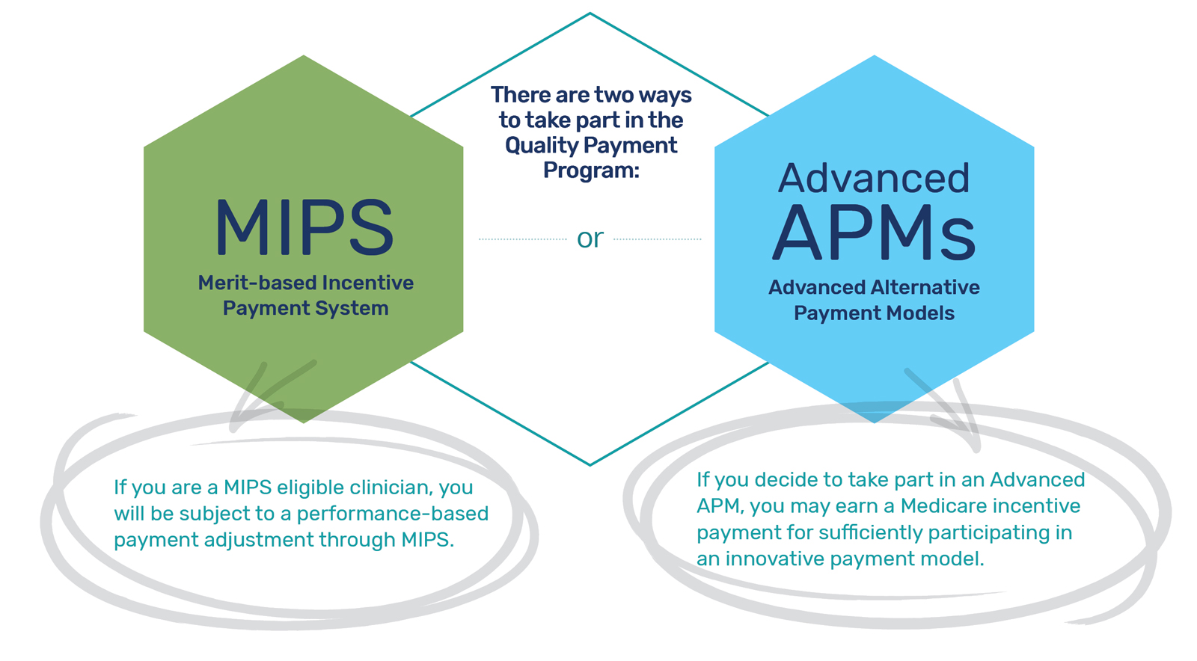
Provider Engagement: Quality Payment Program
The Medicare Access and CHIP Reauthorization Act of 2015 (MACRA) requires CMS by law to implement an incentive program, referred to as the Quality Payment Program:

Slide 19




Merit-based Incentive Payment System (MIPS)
Quick Overview
MIPS Performance Categories
+
+
+
100 Possible Final Score Points
=
Quality
Cost
Improvement
Activities
Promoting
Interoperability
Comprised of four performance categories
So what? The points from each performance category are added together to give you a MIPS Final Score
The MIPS Final Score is compared to the MIPS performance threshold to determine if you receive a positive, negative, or neutral payment adjustment
Notes:
A MIPS eligible clinician with fewer than two performance category scores will receive a final score equal to the performance threshold and a neutral payment adjustment of 0%.

Slide 20
MIPS Value Pathways
Request for Information
CMS is proposing MIPS Value Pathways (MVPs) to create a new participation framework beginning with the 2021 performance year. This new framework would:
Unite and connect measures and activities across the Quality, Cost, Promoting Interoperability, and Improvement Activities performance categories of MIPS
Incorporate a set of administrative claims-based quality measures that focus on population health/public health priorities
Streamline MIPS reporting by limiting the number of required specialty or condition specific measures
Notes:
Goal of MVP is to move away from siloed activities and measures and move towards an aligned set of measure options more relevant to a clinician’s scope of practice that is meaningful to patient care.
Reduce reporting burden… so all clinicians or groups reporting on a clinical area would be reporting the same measure set(s).

Slide 21



MIPS Value Pathways: Surgical Example
Current Structure of MIPS
(In 2020)
New MIPS Value Pathways Framework
(In Next 1-2 Years)
Future State of MIPS
(In Next 3-5 Years)
MIPS moving towards value; focusing participation on specific meaningful measures/activities or public health priorities;
facilitating movement to Advanced APM track
Surgeon chooses from same set of measures as all other clinicians, regardless of specialty or practice area
Surgeon reports same “foundation” of PI and population health measures as all other clinicians but now has a MIPS Value Pathway with surgical measures and activities aligned with specialty
Surgeon reports on same foundation of measures with patient-reported outcomes also included
Four performance categories feel like four different programs
Surgeon reports on fewer measures overall in a pathway that is meaningful to their practice
Performance category measures in Surgical Pathway are more meaningful to the practice
Reporting burden higher and population health not addressed
CMS provides more data; reporting burden on surgeon reduced
CMS provides even more data (e.g. comparative analytics) using claims data and surgeon’s reporting burden even further reduced
Clinician/Group CMS
Clinician/Group CMS
Clinician/Group CMS
MIPS Value Pathways for Surgeons
QUALITY MEASURES
IMPROVEMENT ACTIVITIES
COST MEASURES
Unplanned Reoperation within the 30-Day Postoperative Period (Quality ID: 355)
Use of Patient Safety Tools (IA_PSPA_8)
Medicare Spending Per Beneficiary (MSPB_1)
Quality
Promoting Interoperability
Surgical Site Infection (SSI) (Quality ID: 357)
Implementing the Use of Specialist Reports Back to Referring Clinician or Group to Close Referral Loop (IA_CC_1)
Revascularization for Lower Extremity Chronic Critical Limb Ischemia (COST_CCLI_1)
₆+
Measures
₆+
Measures
Patient-Centered Surgical Risk Assessment and Communication (Quality ID: 358)
Knee Arthroplasty (COST_KA_1)
OR
Completion of an Accredited Safety or Quality Improvement Program (IA_PSPA_28)
*Measures and activities selected for illustrative purposes and are subject to change.
Improvement Activities
Cost
2-4
Activities
1 or More
Measures
Quality
Improvement
Activities
Cost
Cost
Quality and IA aligned
Foundation
Promoting Interoperability
Population Health Measures
Foundation
Promoting Interoperability
Population Health Measures
Enhanced Performance Feedback
Patient-Reported Outcomes
Population Health Measures: a set of administrative claims-based quality measures that focus on public health priorities and/or cross-cutting population health issues; CMS provides the data through administrative claims measures, for example, the All-Cause Hospital Readmission measure.

Slide 22
Potential Role of Registries
QCDR (Qualified Clinical Data Registries – can be used for MIPS participation
Measures in QCDR are not required to seek NQF endorsement
May have newer, innovative measures but sometime need further testing
May be able to generate both group and individual provider feedback to aid attribution
May help generate new evidence and establish standards of care

Slide 23
Role of Individual and Team Measures
Healthcare requires a team
How to Attribute care/accountability
Do all members of a group need to do same quality initiatives (or report same?)
Hospital based physicians

Slide 24
Moving from Volume to Value
Traditional payment is volume – number of cases/care
Value based incentives programs progressively link payment to performance
  “Nice to Do” (please participate - voluntary)
  Incentivize Participation (pay for participation, incentives)
  Pay for Performance
  Penalty Programs
Risk Based Models
Upside Only
Upside and Downside Risk Relationships
How to Determine “Value”

Slide 25
Potential Roles of MPOG
Use your quality measures to help develop MIPS Value Pathway for Anesthesiology, in conjunction with ASA
Advance the use of quality information from the electronic medical record; lead the way in promoting use of electronic infrastructure and promoting interoperability. Get involved in national standards for collection and transmission of anesthesia specific digital information.
Engage providers in quality improvement activities – especially those that may affect their performance in value based programs
Help establish standards for quality measurement in anesthesiology – avoid self reported data
Create evidence
Help establish standards of care

Slide 26
Summary
Improve care and safety outcomes through evidence based quality measurement and quality improvement
Link high quality performance to payment
Reduce cost and eliminate waste
Transform system to digital
Inform and engage patients as active partners

