Slide 1
MPOG Research Process Overview From Real-World Data to Actionable Knowledge
Michael Mathis, MD
Assistant Professor of Anesthesiology
Associate Research Director, MPOG
Shelley Vaughn, MPH
Department of Anesthesiology
Lead Research Facilitator, MPOG
Notes:
(Mike) Title slide
Hi, this is Mike Mathis –
I’m associate research director for MPOG.
If you are watching this presentation, you may be taking first steps towards developing a research project
If that’s the case, then congratulations, and welcome to the MPOG research machine
We are committed to your success for developing high-impact projects using our multicenter database
For those new to the process, we recognize there is a steep but surmountable learning curve to doing MPOG research, that we hope to address in this series of MPOG research presentations beginning with this overview.
In this presentation, I am joined by our MPOG Lead Research Facilitator, Shelley Vaughn.

Slide 2
Outline
MPOG Data Pipeline
Types of MPOG Research
Querying MPOG Data
Writing a Research Proposal
Inspecting/Curating MPOG Data
Submitting a Manuscript
Notes:
(Shelley) Outline slide
Thanks, Mike.
I’m Shelley Vaughn the lead research facilitator for MPOG.
Using my background in epidemiology, I offer methodologic and database feedback on proposed research projects requesting use of MPOG data.
I’m the primary point-of-contact at MPOG Central for helping to develop research projects, once the study team has reviewed the project with their local research champion. Please feel free to reach out to me at any point during the research process.
The goal of this talk is to Introduce you to all components of the MPOG machine – we will give you a high-altitude overview of how all the moving parts of MPOG fit together cohesively.
Subsequent talks in this lecture series will delve more deeply into each of these components and will cover topics such as what is MPOG and how does information flow to and through it
What are the different types of research that can be done using MPOG data
What research tools have we developed at MPOG Central to help collaborators use the data (such as DataDirect and Phenotype Browser)
What is the process for proposing and submitting a research proposal using MPOG data
and what are some tips and tricks for cleaning and analyzing MPOG data in order to produce a final manuscript for submission.

Slide 3
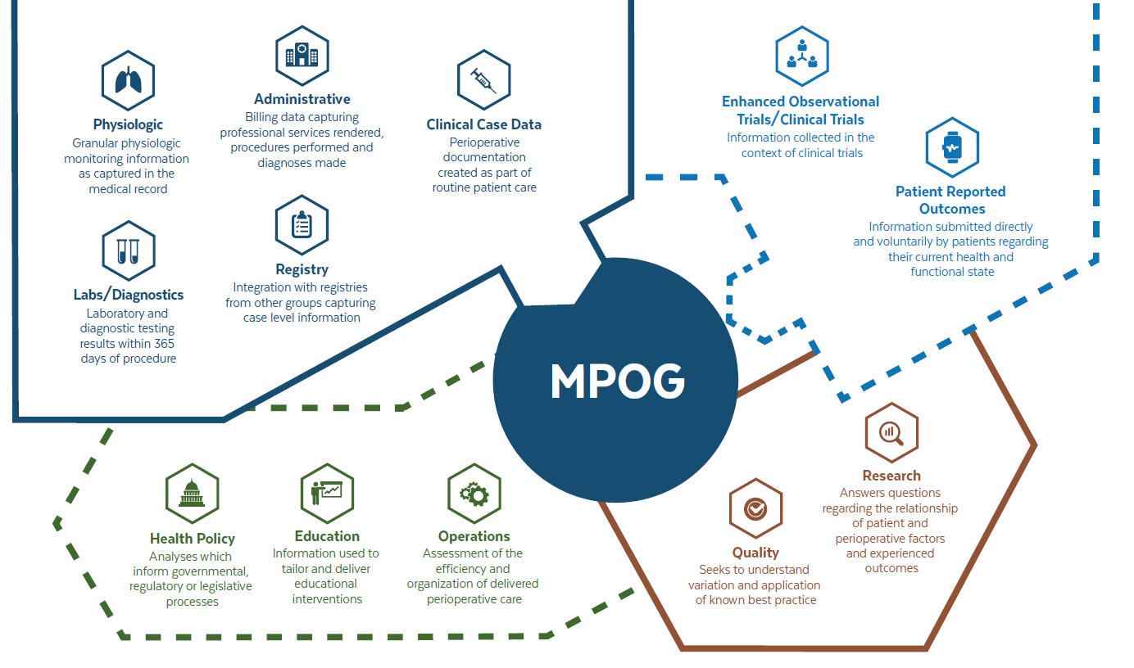
Notes:
(Shelley) - MPOG Methods Mega Figure
Let’s begin this overview by taking a look at what types of data are collected in the MPOG database
MPOG captures granular physiologic data, labs and diagnostics
Administrative data (such as billing codes), integrated registry data that can be linked on a case-level to help provide greater detailed information about the case,
And Clinical case data from the perioperative electronic health record
Additional data sources may include information gathered as part of an enhanced observational trial or a clinical trial
As well as patient reported outcomes concerning their current health and functional states.
So what can we do with this plethora of data?
- Our focus remains on research and quality improvement.
We seek to answer questions regarding the relationship of patient and perioperative factors with various outcomes and to understand variability in practice and how to apply known best practices.
Additionally, we strive to use our data to help inform health policy, education and operations both across our participating sites and on a national and global level.

Slide 4
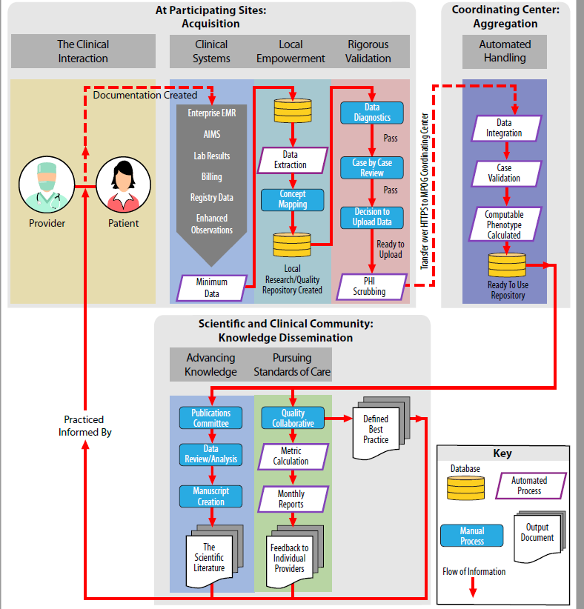
Notes:
(Shelley) - MPOG Methods Information Flow Diagram
This diagram illustrates the flow of information to and through MPOG.
Collaborators at each site work diligently to extract and upload their local data to MPOG Central. This involves mapping, validating and cleaning the data prior to transmission.
MPOG Central Team members at the coordinating center then help to aggregate and curate the data into meaningful and useful formats (such as phenotypes or measures) to help support the quality improvement and research missions of MPOG across the scientific and clinical communities.
As demonstrated by this diagram – the success of MPOG relies on strong collaboration between our local site champions and technical colleagues, MPOG central team members and our researchers and quality improvement supporters who use the data to advance knowledge and pursue higher standards of care.

Slide 5
Types of Research Studies Leveraging MPOG
Descriptive Studies
Operational Analyses
Outcomes Studies
MPOG Data
MPOG + Surgical Registry
Enhanced Observational
Studies (EOS)
Clinical Trials Network
Notes:
(Mike)
Focusing on the Research Outputs of MPOG, it’s important to recognize
That MPOG not only enables a wide range of research across anesthesia clinical subspecialties,
But also that MPOG enables a wide range of research methods
These include Descriptive studies, which may simply aim to characterize practice patterns, or variation in perioperative care
Which may provide anesthesiologists perspective on how their care compares to care by other providers at other institutions
Without necessarily associating these patterns with outcomes
MPOG also enables operations analyses, or studies aimed at informative performance metrics such as cost-effectiveness or efficiency of a particular perioperative care team
These types of studies, may not be traditionally perceived as research given that their primary goal is often quality improvement at the level of an individual MPOG site, rather than generalizable scientific knowledge
However they are nonetheless possible using the MPOG dataset
Next we have outcomes studies – these are the studies most commonly pursued by MPOG researchers
In which risk factors, or perioperative processes of care are associated with events or outcomes
These can be done using MPOG data alone focusing on outcomes derived from lab values, administrative, and mortality data
Or, at selected subset of MPOG sites, can use high-quality, nurse-adjudicated outcomes data from integrated surgical registries such as the STS database or ACS-NSQIP
For more information on how to design a research question, answerable using MPOG data, please refer to the talk by Dr. Douglas Colquhoun, “Developing an Answerable Research Question”
Finally, on a selective, competitive basis, two other types of research include
Enhanced Observational Research – where MPOG sites devote a finite amount of additional time collecting a small number of data elements – such as survey data or patient-reported outcomes – to enhance data traditionally available within MPOG
And Clinical Trials. Through the network of research directors and departmental leadership connected across MPOG sites, with independent research funding it is possible to execute prospective interventional trials.

Slide 6
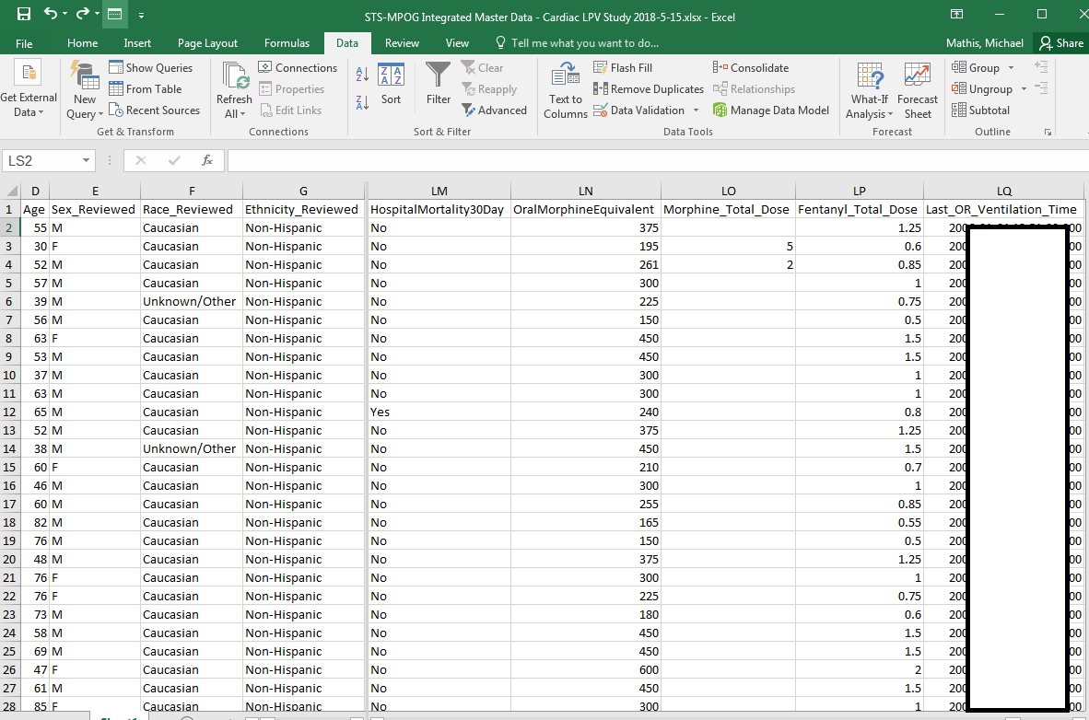
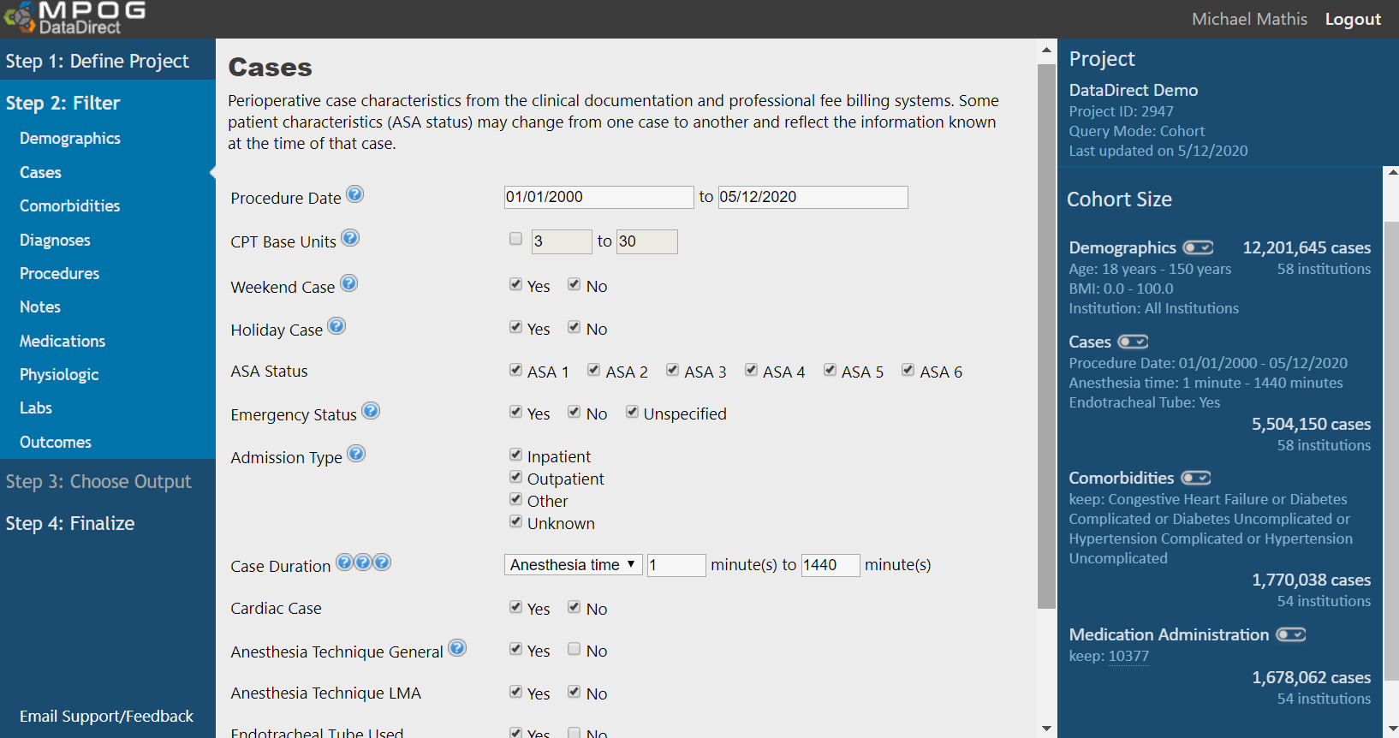
DataDirect: “Democratizing” data access
How many…
…adults…
…undergoing general anesthesia with an endotracheal tube…
…with heart failure, diabetes, or hypertension…
…received propofol during the surgery?
Notes:
(Mike)
When pursuing MPOG research, MPOG provides a wide array of tools to push through the inertia of developing a research question
- and identifying a cohort of MPOG patients which may serve to answer the question
Our goal at MPOG central is to enable researchers to access perioperative EHR data
Without needing to be an expert programmer, or a first-degree relative of your hospital’s CMIO
Part of MPOG solution to this obstacle is DataDirect.
What DataDirect seeks to do, is democratize Data Access…
Through implementing an intuitive, user-friendly tool
which makes a simple assumption that anesthesiologists aren’t all software engineers
Enables users to create a simple cohort of patients within minutes, to understand if a project is feasible.
For example, on this slide is a query created in 2 minutes, which provides a count of patients who were (CLICK) X, Y, Z.
On the right side of the screen, we see that a cohort of X patients meet this criteria, and so a study using this cohort is likely feasible.
To then access a multicenter dataset describing these patients, a researcher can then go through the steps of submitting a research proposal, and then following formal approval, can gain access to the multicenter dataset limited to the data necessary for the proposed research, and housed in a secure data enclave on the MPOG central server.
For more information on how to use MPOG DataDirect, please refer to the “Data Direct User Guide and Demonstration Talk” also available on our website.
For more information on the approach MPOG takes to ensure secure data analyses on a high-performance central server, please refer to the talk on “Big Data Management”.

Slide 7
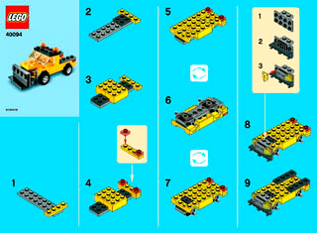
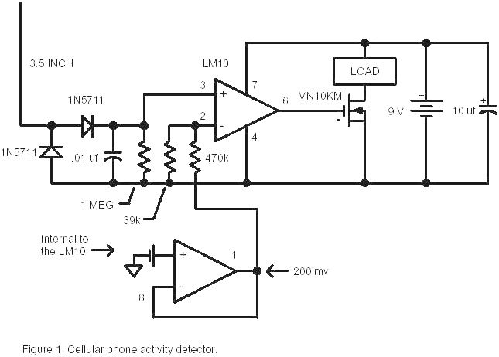
Phenotypes: Structured Inferences from messy data
Standard MPOG Concepts
Fluids Labs Vitals
Meds Times Diagnoses
Outputs Events Outcomes
MPOG Phenotypes
Cardiopulmonary Bypass Used
Anesthesia Technique: General
Oral Morphine Equivalents
Baseline Blood Pressure
….
Notes:
(Mike)
Another obstacle to doing high-quality observational research that MPOG has taken on,
Is the obstacle of wrangling messy, raw data derived from routine clinical care, and transforming this into a reproducible, clinically meaningful format.
For example, any practicing anesthesiologist can walk into an OR, and within a couple seconds can determine if a patient in the OR is under general anesthesia
This is done almost unconsciously by practicing anesthesiologist
And just like this unconscious processing of clinical inputs helps to inform anesthesiologists make rapid clinical decisions in the OR
MPOG has developed a tool – the MPOG phenotype browser
Which rapidly transforms a combination of raw EHR data inputs, into a high-level, clinically meaningful, structured inference known as an MPOG phenotype.
In our general anesthesia example, an MPOG phenotype synthesizes data from
Medication data – specifically use of neuromuscular blockers
Physiologic data – specifically the detection of exhaled volatile anesthetic gases
Clinical intervention data – specifically the use of an advanced airway
Puts this data through a logic circuit, to create a high-confidence, clinically useful Phenotype
Phenotypes are Reusable from project-to-project – researchers don’t re-invent the wheel
Think of them as the “lego building blocks” of MPOG research, promotes rigor and transparency of methods –
Phenotypes are validated, published, and made publicly available on the MPOG website
For more details on this process, please refer to the “MPOG Phenotypes” talk given by Dr. Michael Burns

Slide 8
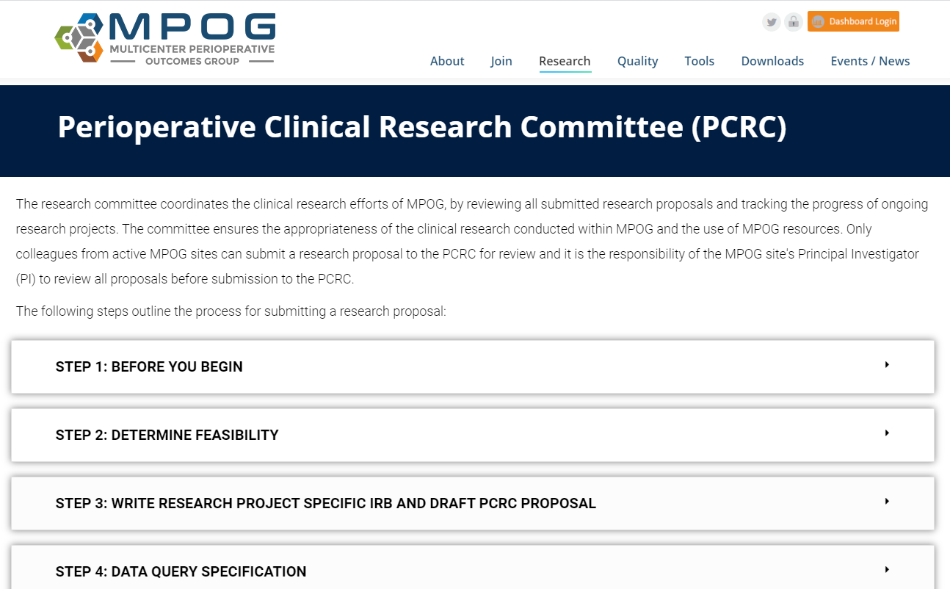
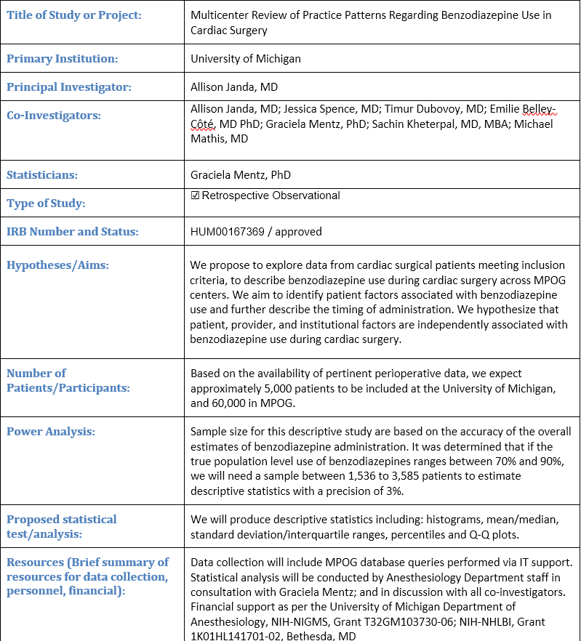
Developing a Research Study
Notes:
(Mike)
Developing a Research Study
At the MPOG coordinating center, we recognize that multicenter observational research using routinely collected, messy EHR data can often be a daunting process
To break this down into digestible chunks for MPOG researchers to follow,
We have a step-by-step playbook on our MPOG website, explicitly outlined in high detail, governed by the MPOG Perioperative Clinical Research Committee (or PCRC).
These tried-and-true steps are designed to help researchers map out a research proposal from start to finish, beginning with reviewing these lectures and consulting your sites local MPOG research PI, and ending with a high-impact journal publication.
For more information on this process, please check out the MPOG PCRC website, under the Research tab.

Slide 9
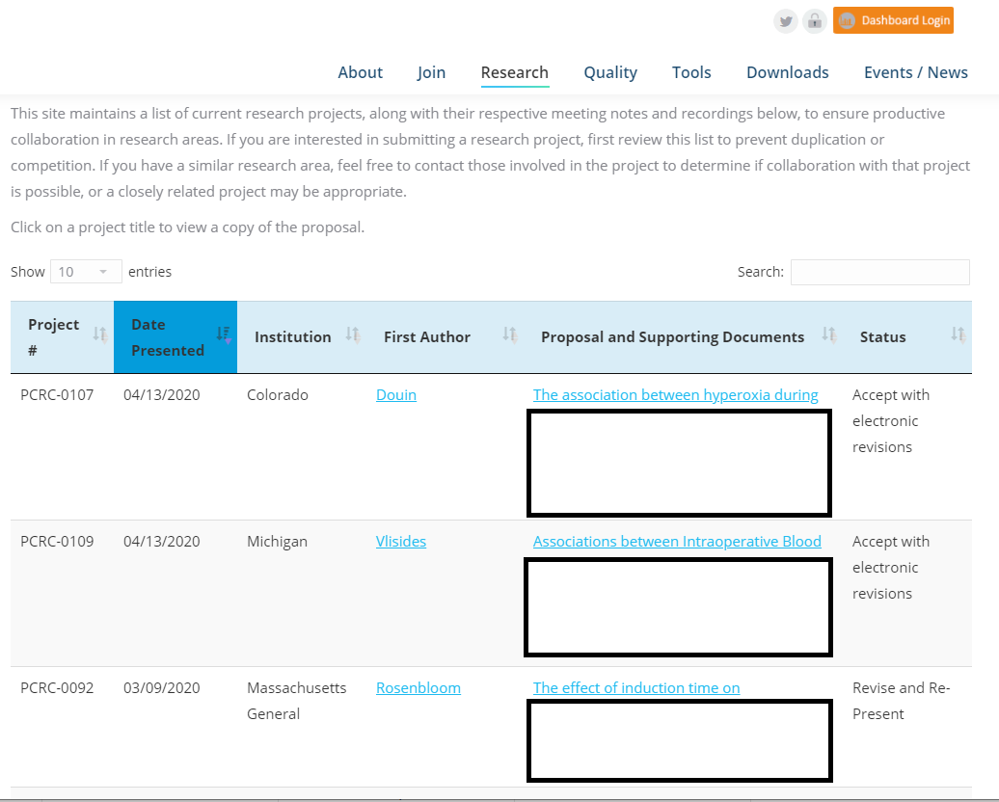
PCRC Community of Peers
Notes:
(Mike)
What is the Perioperative Clinical Research Committee (or PCRC) and how does it enable high-impact research?
The PCRC is a group of research collaborators across all MPOG centers, committed to the success of its peers
through providing feedback over email
at monthly web meetings,
And at annual professional anesthesiology research forums
Members comprising the PCRC committee include anesthesiologist clinician investigators who are though-leaders in our field, and lead journal editors.
And so an additional benefit of PCRC, is getting high-quality feedback from pre-eminent researchers in our field, while your research project remains in malleable, early stages, importantly before journal submission.
For more information of the step-by-step process of presenting a research proposal through PCRC, please refer to the talk provided by Dr. Allison Janda, “Developing a PCRC Presentation”

Slide 10
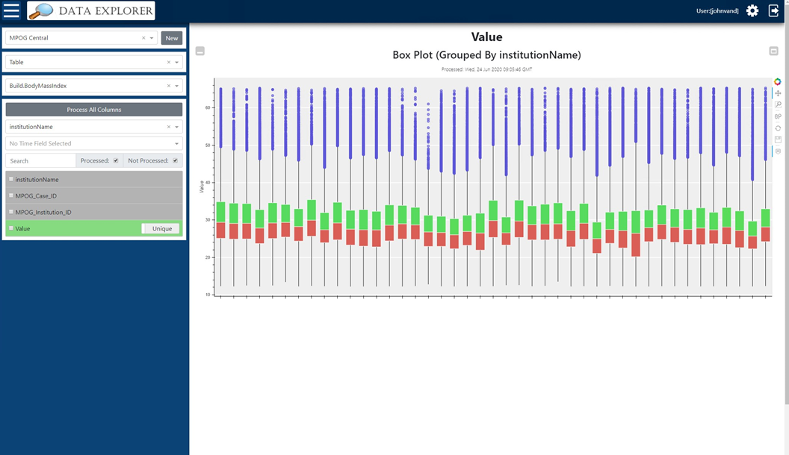
Data Visualization and Curation
Notes:
(Mike)
Following the acceptance of a research proposal by the PCRC committee
MPOG recognizes that additional data inspection, visualization, and cleaning are usually necessary to ensure rigorous research
- MPOG has rigorous validation / concept mapping at local site level
- Use of phenotypes can improve data quality further
- But to achieve a level of confidence in accurate data for being held accountable in scientific community / or to drive clinical practice changes, need extremely high fidelity tools for inspection and curation of data
To this end, the MPOG team provides a Data Explorer tool, which provides a bird’s eye view of MPOG data, and allows users to spot and scrutinize outliers, missing data, and variation in how specific MPOG data elements may be reported across providers and sites.
This step of inspecting and curating MPOG data, we recommend before a researcher conducts statistical analyses on the data.
To learn more about the access and use of MPOG Data Explorer, please refer to the talk by Dr. Nicholas Douville, “Inspecting and Curating MPOG Data”.

Slide 11
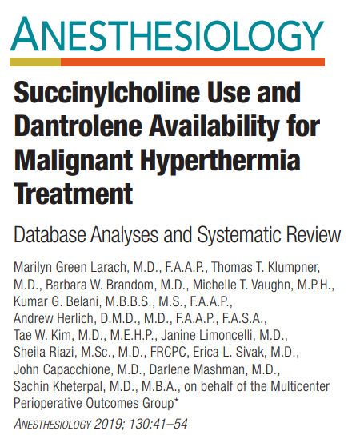
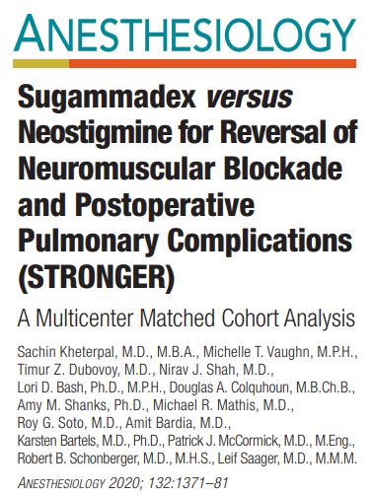
Writing the Manuscript
Notes:
(Shelley) - Writing the Manuscript
And finally, the fun part of MPOG research…a publication in a clinical journal.
Over the past several years, MPOG is proud to report a high acceptance rate at high-impact journals within our field this is in recognition of talent our research community brings, and the unique advantages of MPOG dataset

Slide 12
Writing the Manuscript
Authorship protocol
Byline authors – as per ICMJE guidelines
Acknowledged collaborators – MPOG assists with tracking
Registration of research protocol
Protected version on MPOG website → always
Public access version on Open Science Framework → discretion of PI
iThenticate plagiarism checker
Notes:
(Shelley) - Writing the Manuscript
In preparation for writing a manuscript for publication, we offer the following guidance.
The MPOG coordinating center will help distribute electronic surveys to determine the appropriate roles for co-authors and collaborators in accordance with guidelines published by the International Committee of Medical Journal Editors, or ICMJE. This ensures that the efforts of all are appropriately acknowledged.
All approved PCRC proposals are tracked internally on the MPOG website, with availability restricted to researchers at active MPOG sites
Additionally, we suggest that researchers consider publically registering their study protocol on the Open Science Framework, as this level of documentation rigor – that is to say, an a priori analytic plan – may be expected or required by high-impact journals.
If you choose to register your protocol, then we recommend that this step is completed once you have reviewed and curated your data, but prior to starting any formal analyses.
Finally, once the manuscript is written and prior to submission, we encourage researchers to check for plagiarism using software, such as iThenticate.
If you do not have access to this software, then the MPOG coordinating center will complete this step and share the results with your team.
For more in-depth tips on writing an observational study manuscript using MPOG data, please refer to Dr. Sachin Kheterpal’s lecture.

Slide 13
Thank You
Notes:
Slide 9 (Shelley) - Parting Words
In closing, we want to welcome you to this immensely collaborative community of anesthesiologist researchers and clinical quality champions. We are excited to continue this great work and further our research and quality improvement missions by working with you and your teams. Please feel free to reach out with any questions or concerns during the process.

