Slide 1
MPOG DataDirect: User Access & Demonstration
Michael Mathis, MD
Associate Research Director, MPOG
Assistant Professor, Michigan Medicine

Slide 2
DataDirect Access

Slide 3
DataDirect Access
Pre-requisites:
Security Checklist & Authorization Form
Obtain Login

Slide 4
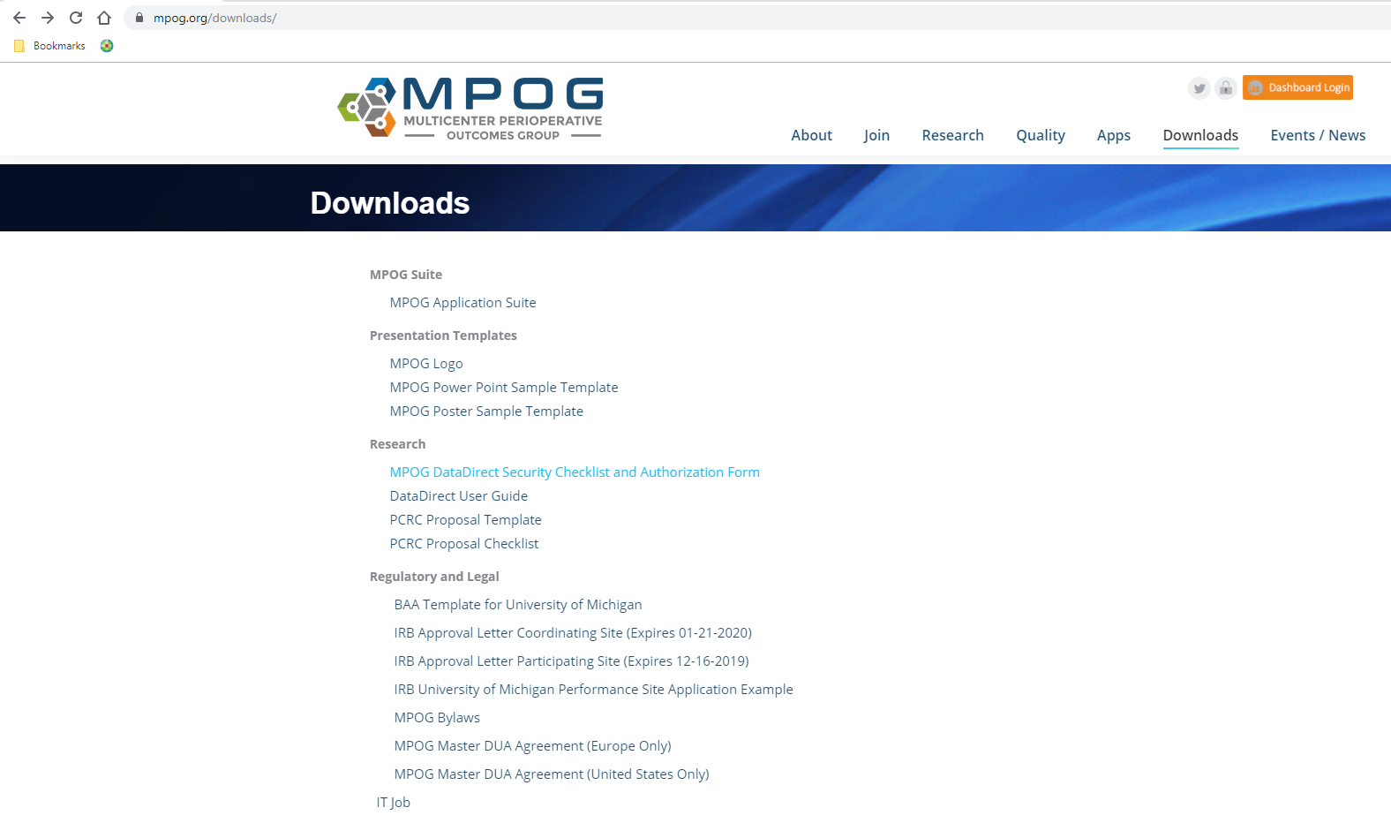
DataDirect Access
Pre-requisites:
Authorization

Slide 5
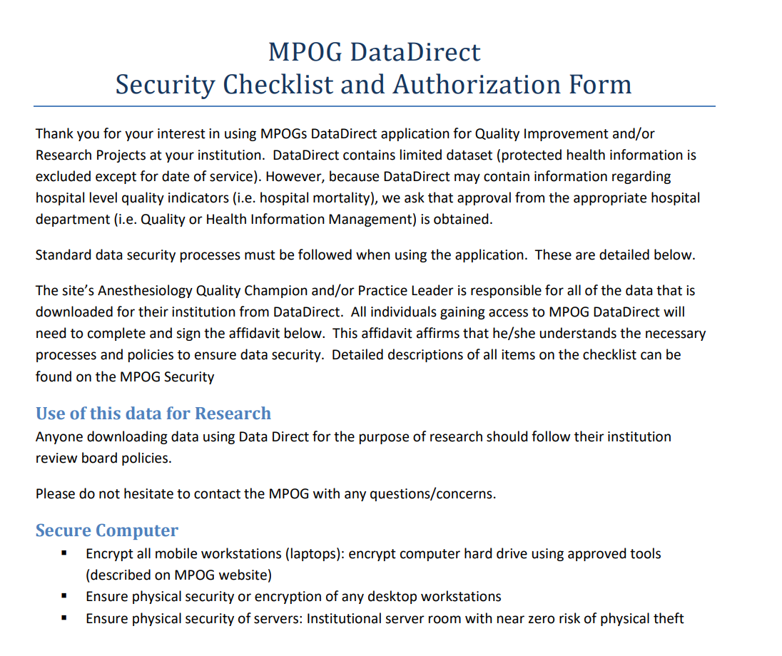
DataDirect Access
Pre-requisites:
Authorization

Slide 6
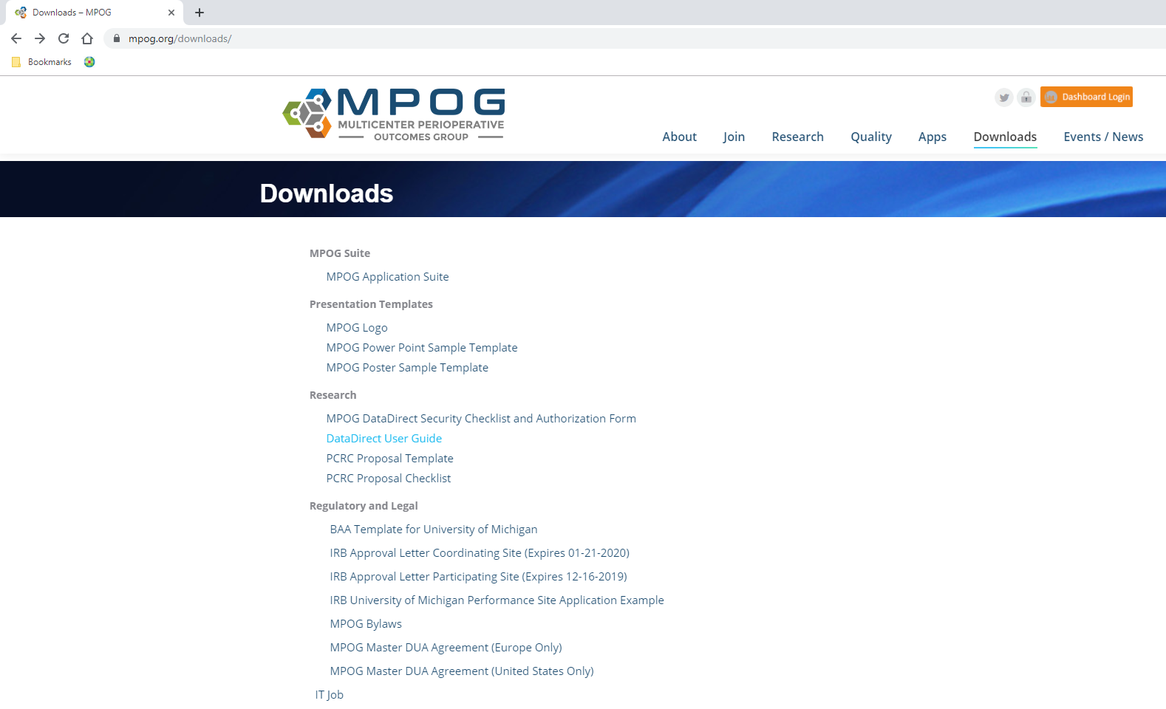
DataDirect Key Features
User Guide

Slide 7
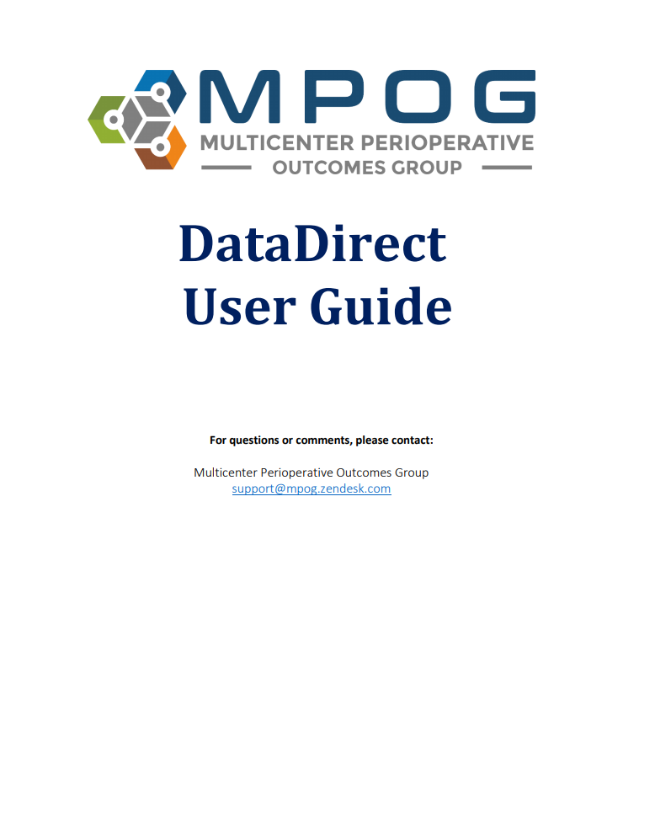
DataDirect Key Features
User Guide

Slide 8
DataDirect Key Features
Query Modes
Cohort Only
Goals:
Determine if a research/QI question is answerable
Sample size → roughly estimate statistical power
Ensure a satisfying experience doing MPOG research or QI
No prior approval
(except login)
Multicenter data (counts only)
Notes:
Fundamental goal = determine if a question is answerable
Can’t access any data, but can get to a sample size of cases/patients/institutions meeting inclusion/exclusion criteria for a specific project
Enables a back-of-envelope estimate of sample size

Slide 9
DataDirect Key Features
Query Modes
Quality Report
Goal:
Review cases, processes of care, and outcomes for local research and QI
Approval from your site leadership
Implied with DataDirect login, but user re-attests at time of access
Single center data
Notes:
Fundamental goal = empower sites to access their own data
Can also be used to complete the preliminary data section of a PCRC proposal to study data from multiple centers

Slide 10
DataDirect Key Features
Query Modes
Research
Goal:
Execute high-impact multicenter research for manuscripts / grants
Approval from PCRC Committee
Formal submission/review process
Single-center data before PCRC review/approval
Multi-center data after PCRC review/approval

Slide 11
DataDirect Key Features
Query Modes
 | Access Requirements | Scope | Goal
Cohort Only | Login | Multicenter (counts) | Determine if question is answerable
Quality Report
Research

Slide 12
DataDirect Key Features
Query Modes
 | Access Requirements | Scope | Goal
Cohort Only | Login | Multicenter (counts) | Determine if question is answerable
Quality Report | Login + Re-attest with download | Single Center | Local QI
Research

Slide 13
DataDirect Key Features
Query Modes
 | Access Requirements | Scope | Goal
Cohort Only | Login | Multicenter (counts) | Determine if question is answerable
Quality Report | Login + Re-attest with download | Single Center | Local QI
Research | PCRC Approval | Single Center → Multicenter | High-impact publications / grants

Slide 14
… some thoughts on data wrangling in MPOG

Slide 15
MPOG Data Wrangling
Commonly structured, or with cleanable artifact:
Demographics – height, weight, gender, age, etc.
Simple case details – ASA class, Anesthesia CPT, duration
Simple anesthetic details – GA, ETT/LMA attempted
Elixhauser comorbidities, ICD-9/10 diagnosis codes
Intraoperative medications
Standard physiologic monitors
Laboratory values

Slide 16
MPOG Data Wrangling
Sometimes unstructured, or with complex artifact:
Surgical diagnosis and/or procedure text
Nuanced intraoperative interventions
e.g. positioning, awake/deep extubation, jet ventilation, partial CPB
Anesthesia H&P comorbidities
Non-intraoperative medications (e.g. home, preop, postop)
Advanced physiologic monitors (e.g. CVP, cerebral oximetry)

Slide 17
MPOG Data Wrangling
Usually Structured, Cleanable | Sometimes Unstructured, Cleaning is Challenging or Intractable
Demographics, Labs

Slide 18
MPOG Data Wrangling
Usually Structured, Cleanable | Sometimes Unstructured, Cleaning is Challenging or Intractable
Demographics, Labs
Simple Case Details (e.g. Anes CPT) | Diagnosis/Procedure Text

Slide 19
MPOG Data Wrangling
Usually Structured, Cleanable | Sometimes Unstructured, Cleaning is Challenging or Intractable
Demographics, Labs
Simple Case Details (e.g. Anes CPT) | Diagnosis/Procedure Text
Simple Anesthetic Details (e.g. ETT) | Nuanced Interventions (e.g. jet vent)

Slide 20
MPOG Data Wrangling
Usually Structured, Cleanable | Sometimes Unstructured, Cleaning is Challenging or Intractable
Demographics, Labs
Simple Case Details (e.g. Anes CPT) | Diagnosis/Procedure Text
Simple Anesthetic Details (e.g. ETT) | Nuanced Interventions (e.g. jet vent)
Comorbidities – Elixhauser | Comorbidities – Anesthesia H&P

Slide 21
MPOG Data Wrangling
Usually Structured, Cleanable | Sometimes Unstructured, Cleaning is Challenging or Intractable
Demographics, Labs
Simple Case Details (e.g. Anes CPT) | Diagnosis/Procedure Text
Simple Anesthetic Details (e.g. ETT) | Nuanced Interventions (e.g. jet vent)
Comorbidities – Elixhauser | Comorbidities – Anesthesia H&P
Medications – Intraoperative | Medications – Home, Preop, Postop

Slide 22
MPOG Data Wrangling
Usually Structured, Cleanable | Sometimes Unstructured, Cleaning is Challenging or Intractable
Demographics, Labs
Simple Case Details (e.g. Anes CPT) | Diagnosis/Procedure Text
Simple Anesthetic Details (e.g. ETT) | Nuanced Interventions (e.g. jet vent)
Comorbidities – Elixhauser | Comorbidities – Anesthesia H&P
Medications – Intraoperative | Medications – Home, Preop, Postop
Standard Monitors (e.g. BP) | Advanced Monitors (e.g. CVP)

Slide 23
DataDirect v2.0 Updates

Slide 24
DataDirect v2.0
Major updates
Intuitive workflow
Step-wise process
Differentiation between inclusion criteria vs. covariates/outcomes
Broader range of data types
MPOG concepts, phenotypes, QI measures all accessible
(Coming soon): Automated, downloadable data summaries
QI: Quality Report
Research: Data Query Spec

Slide 25
DataDirect v2.0 Demo (note: DataDirect continues to be updated…current version not identical to this presentation)

Slide 26
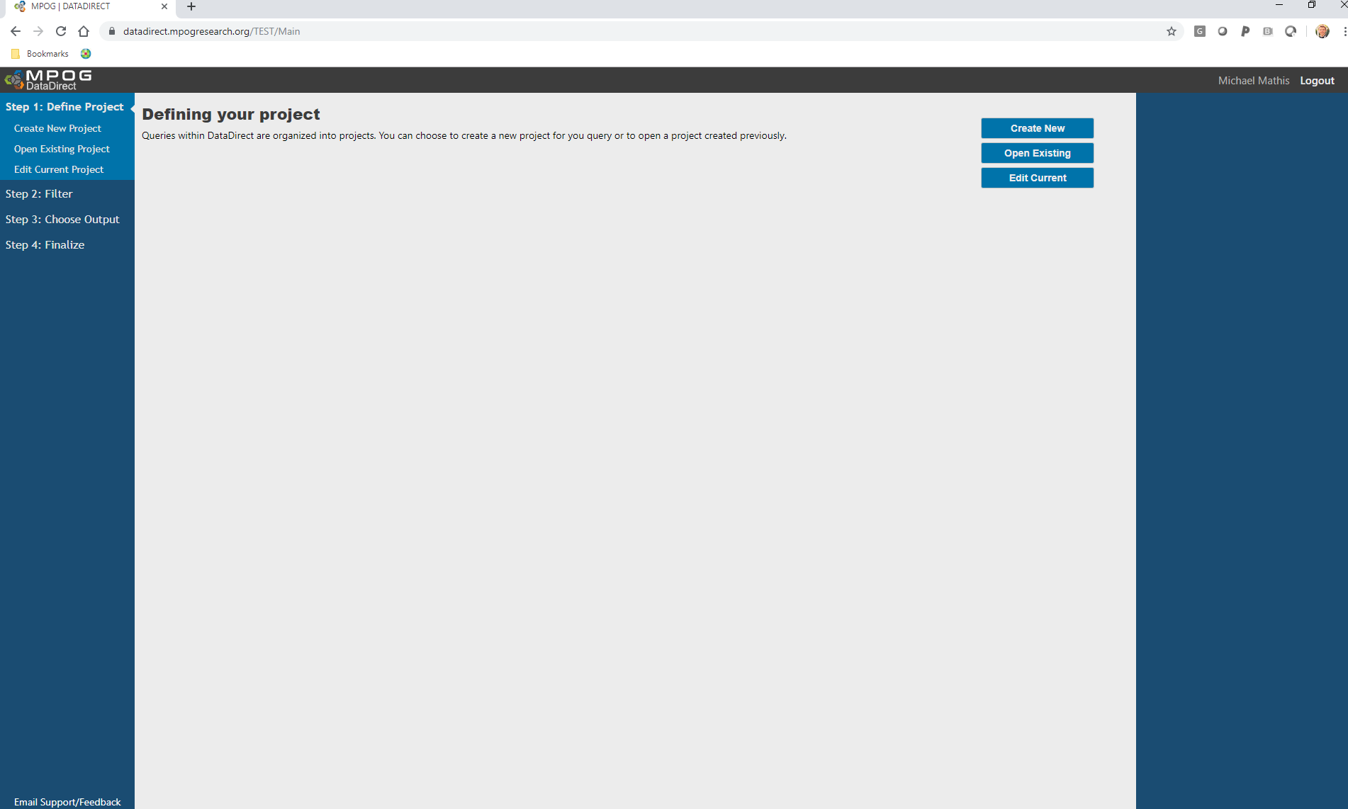

Slide 27
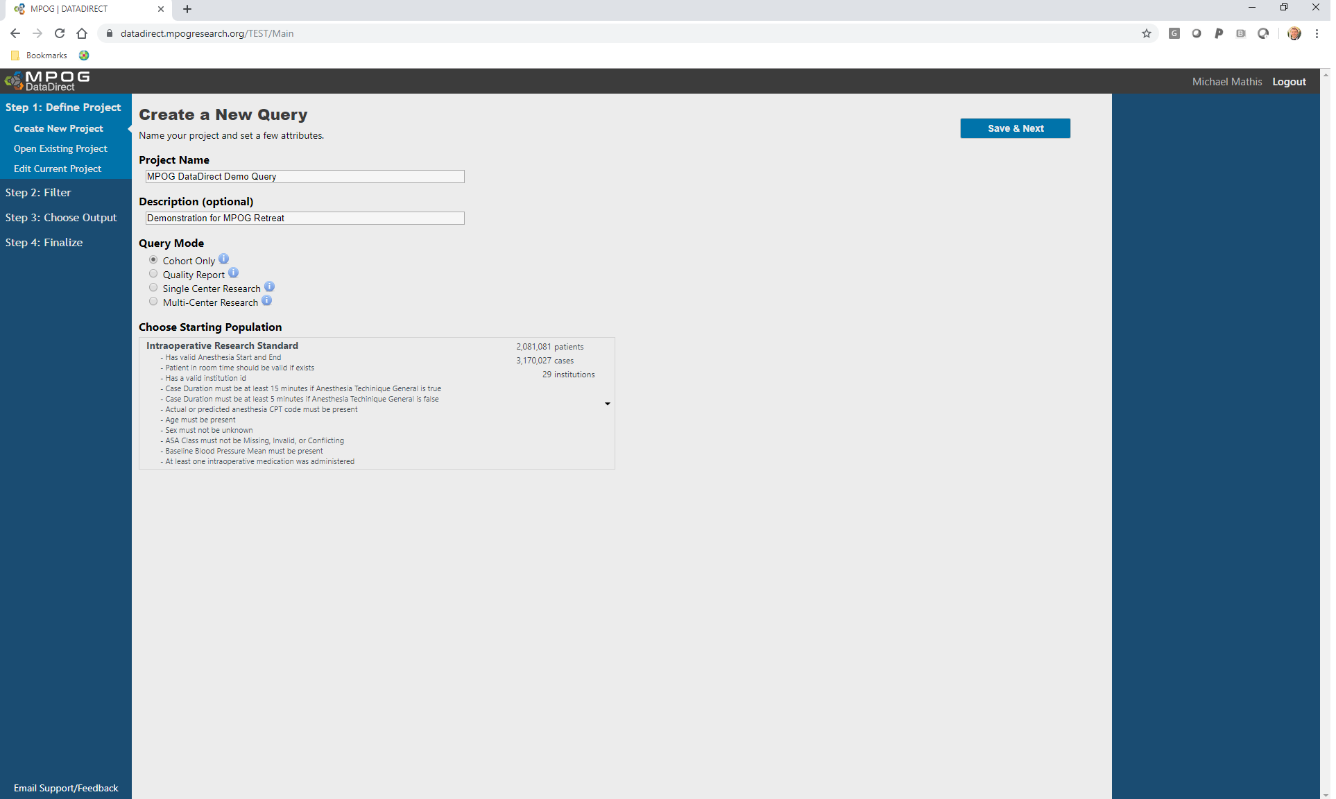

Slide 28
 | All cases
Valid case times, age, sex, CPT, ASA class
ICD-9/10 codes present, labs present
Mortality, discharge diagnoses

Slide 29
 | All cases | Intraop Standard
Valid case times, age, sex, CPT, ASA class |  | X
ICD-9/10 codes present, labs present
Mortality, discharge diagnoses

Slide 30
 | All cases | Intraop Standard | Periop Standard
Valid case times, age, sex, CPT, ASA class |  | X | X
ICD-9/10 codes present, labs present |  |  | X
Mortality, discharge diagnoses

Slide 31
 | All cases | Intraop Standard | Periop Standard | Outcome Standard
Valid case times, age, sex, CPT, ASA class |  | X | X | X
ICD-9/10 codes present, labs present |  |  | X | X
Mortality, discharge diagnoses |  |  |  | X

Slide 32
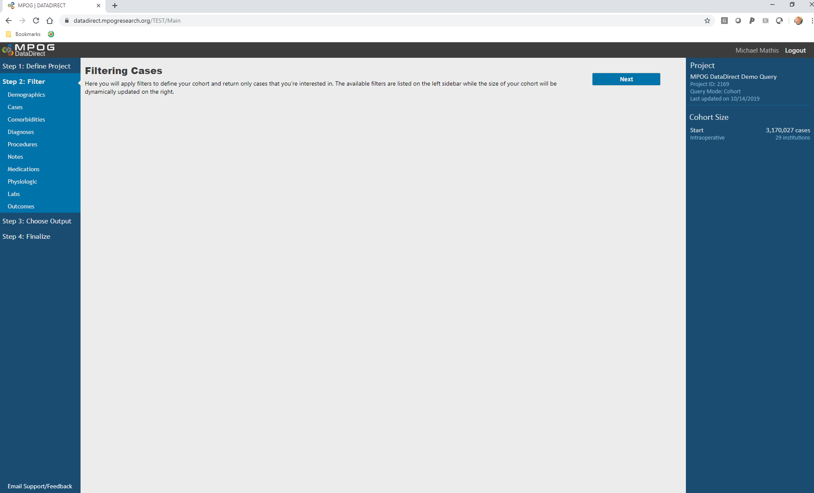

Slide 33
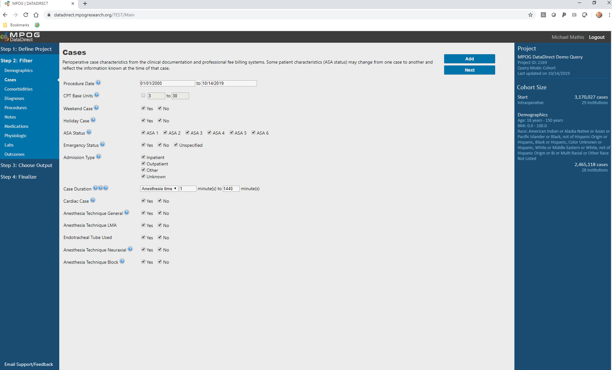
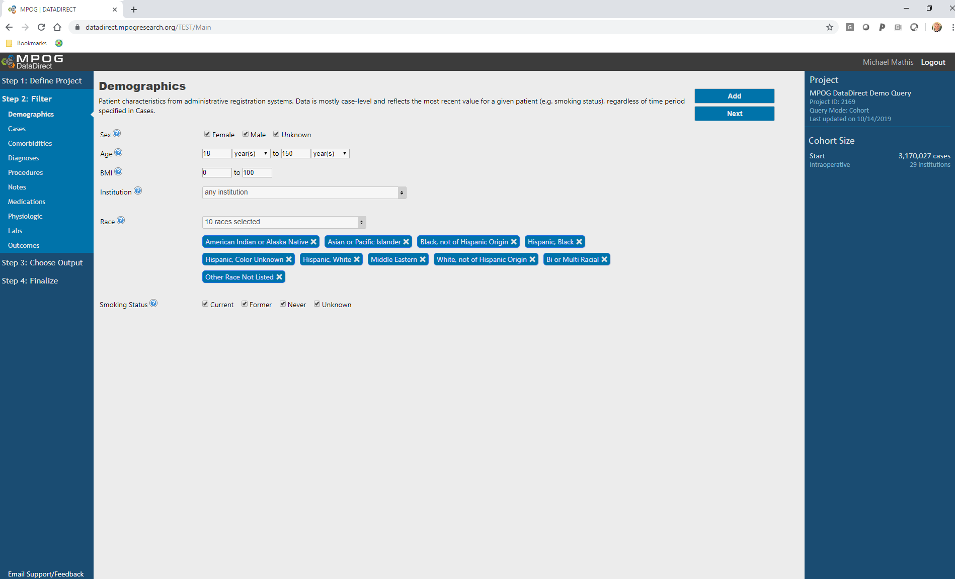

Slide 34
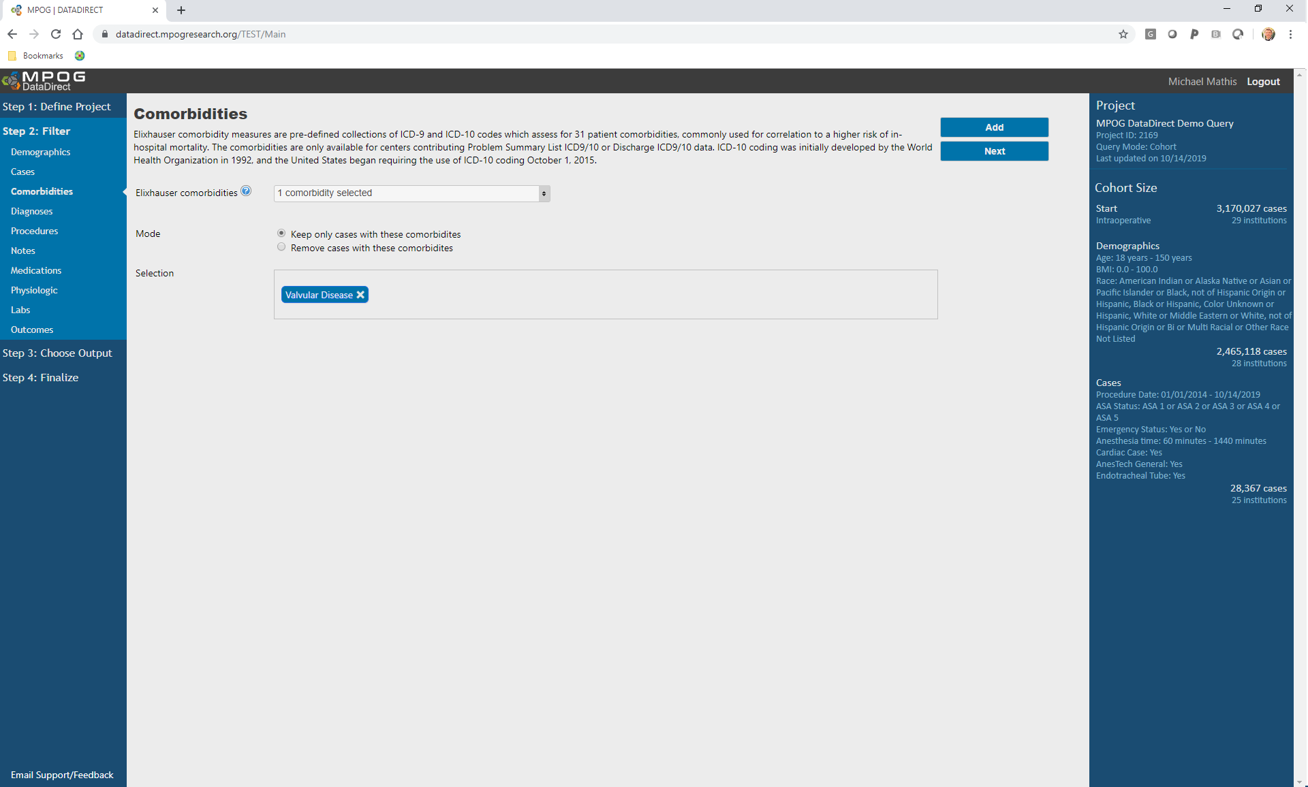
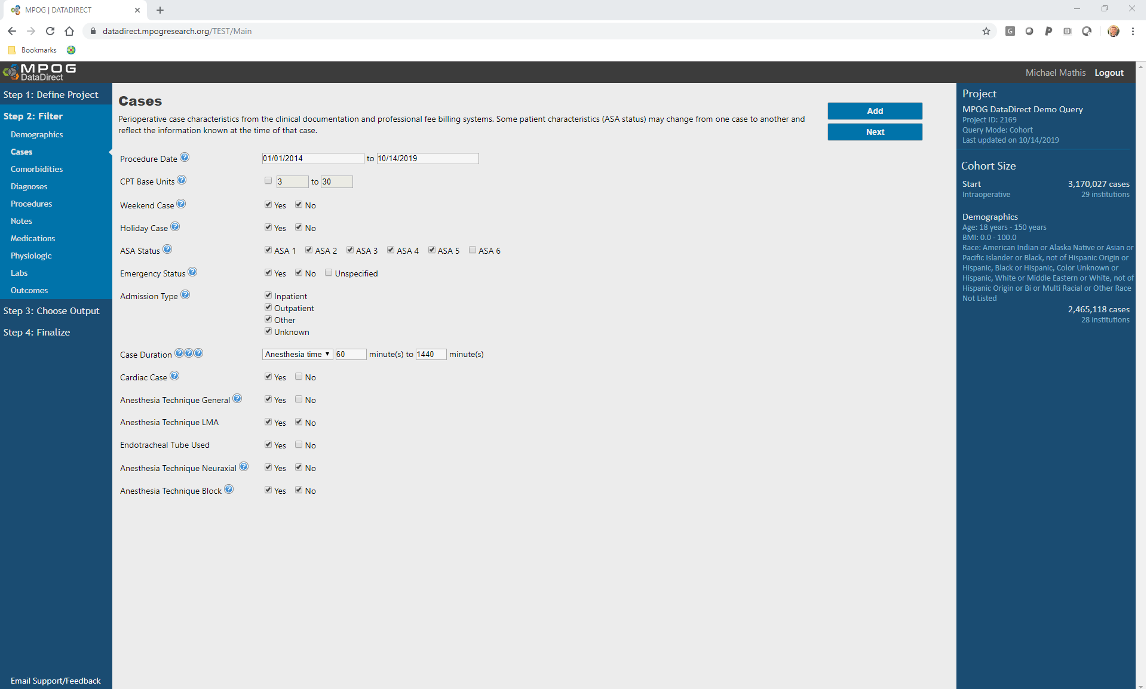

Slide 35
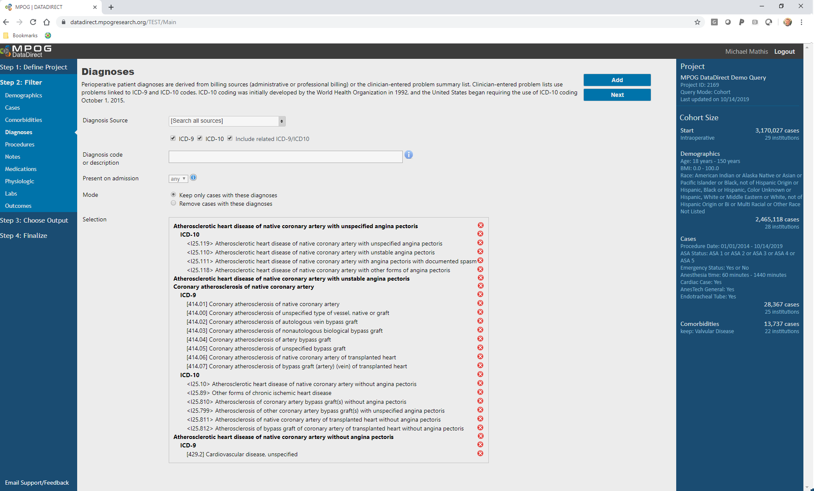

Slide 36
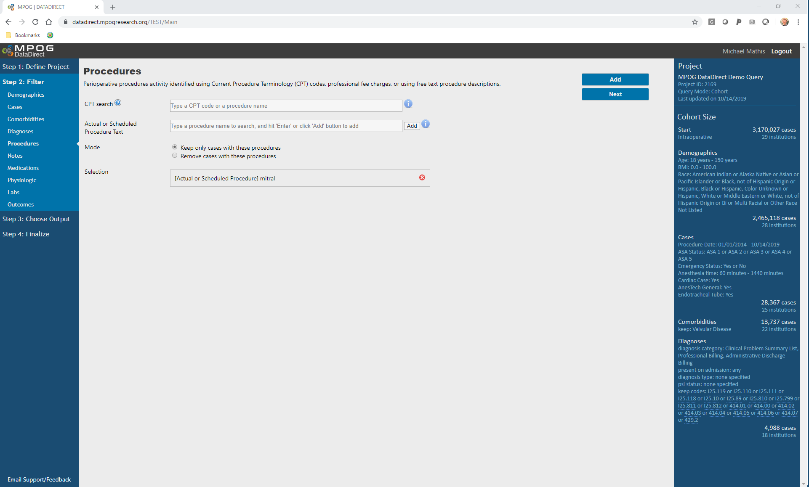

Slide 37
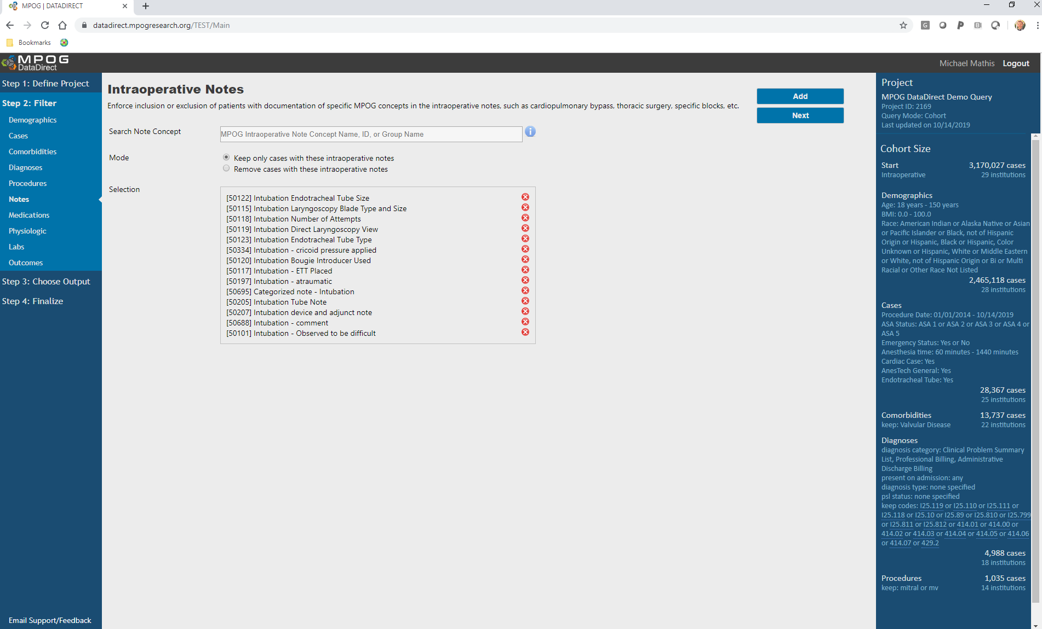

Slide 38
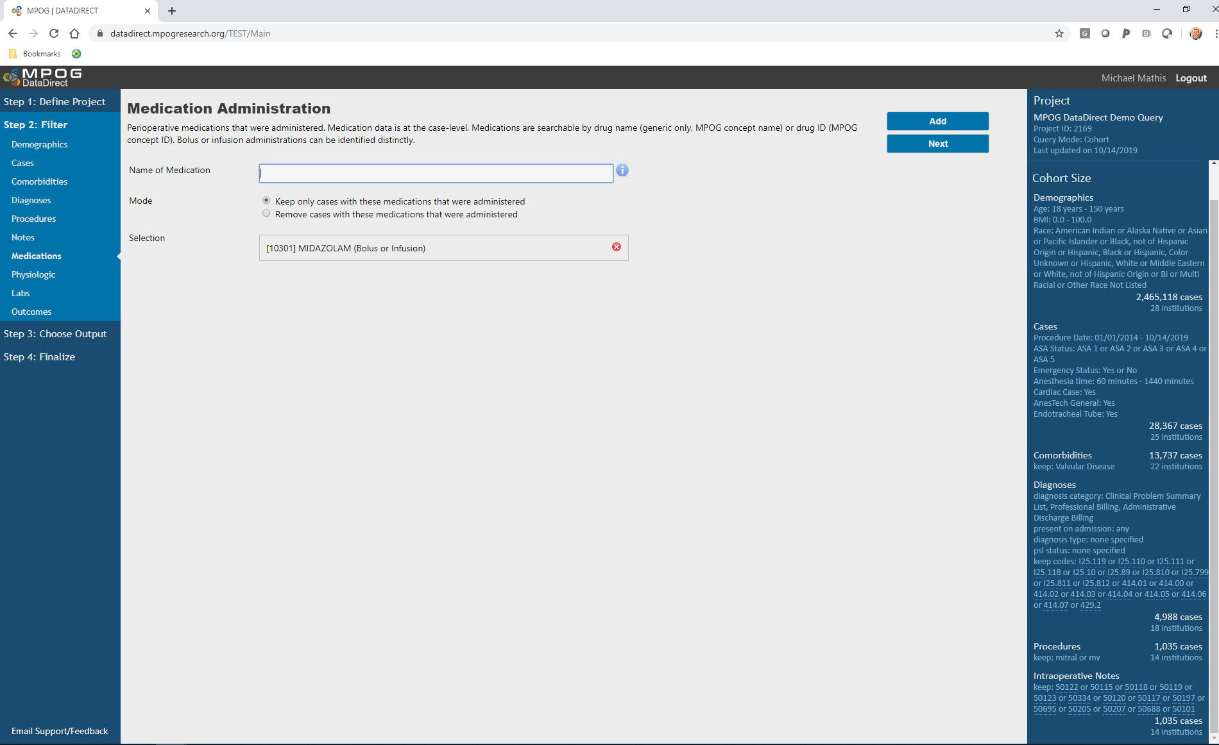

Slide 40
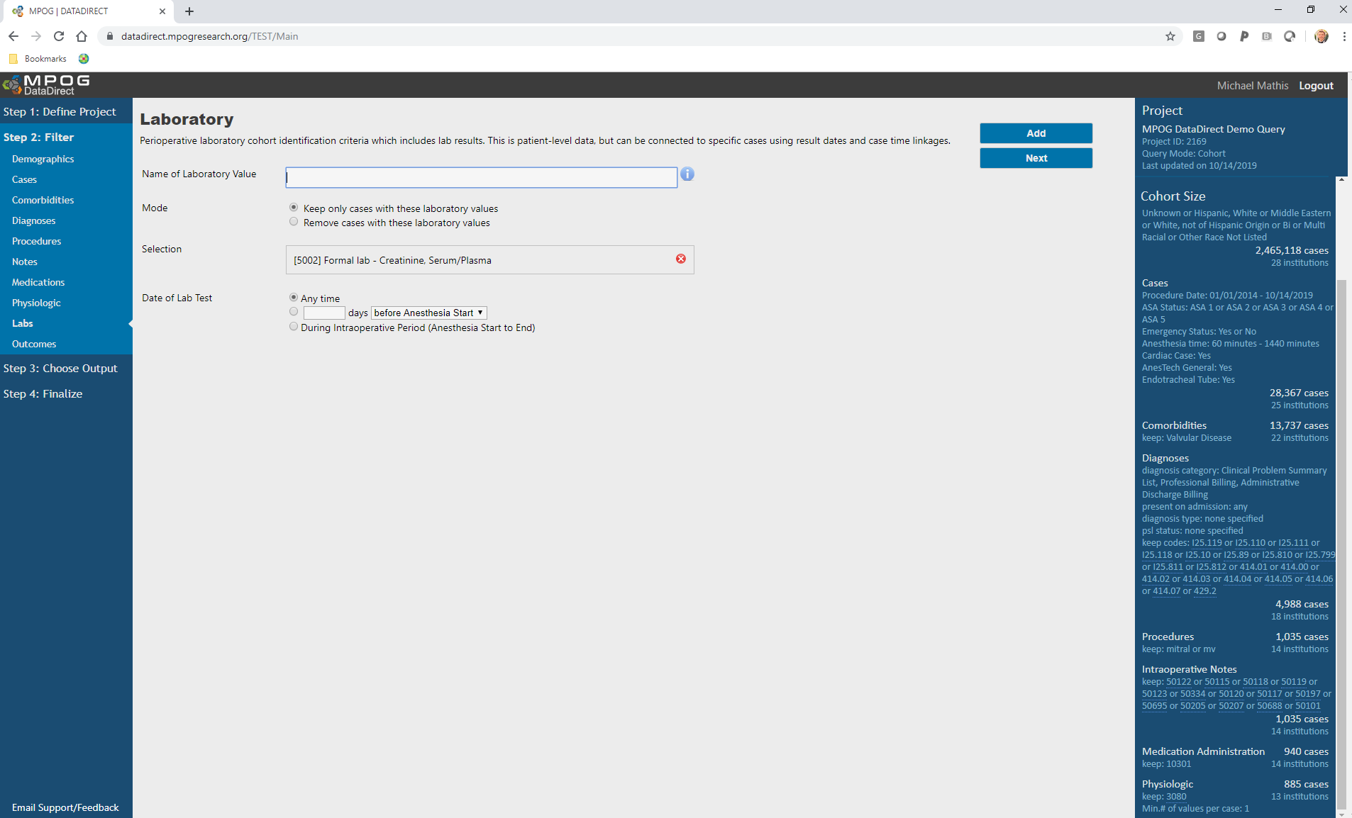

Slide 41
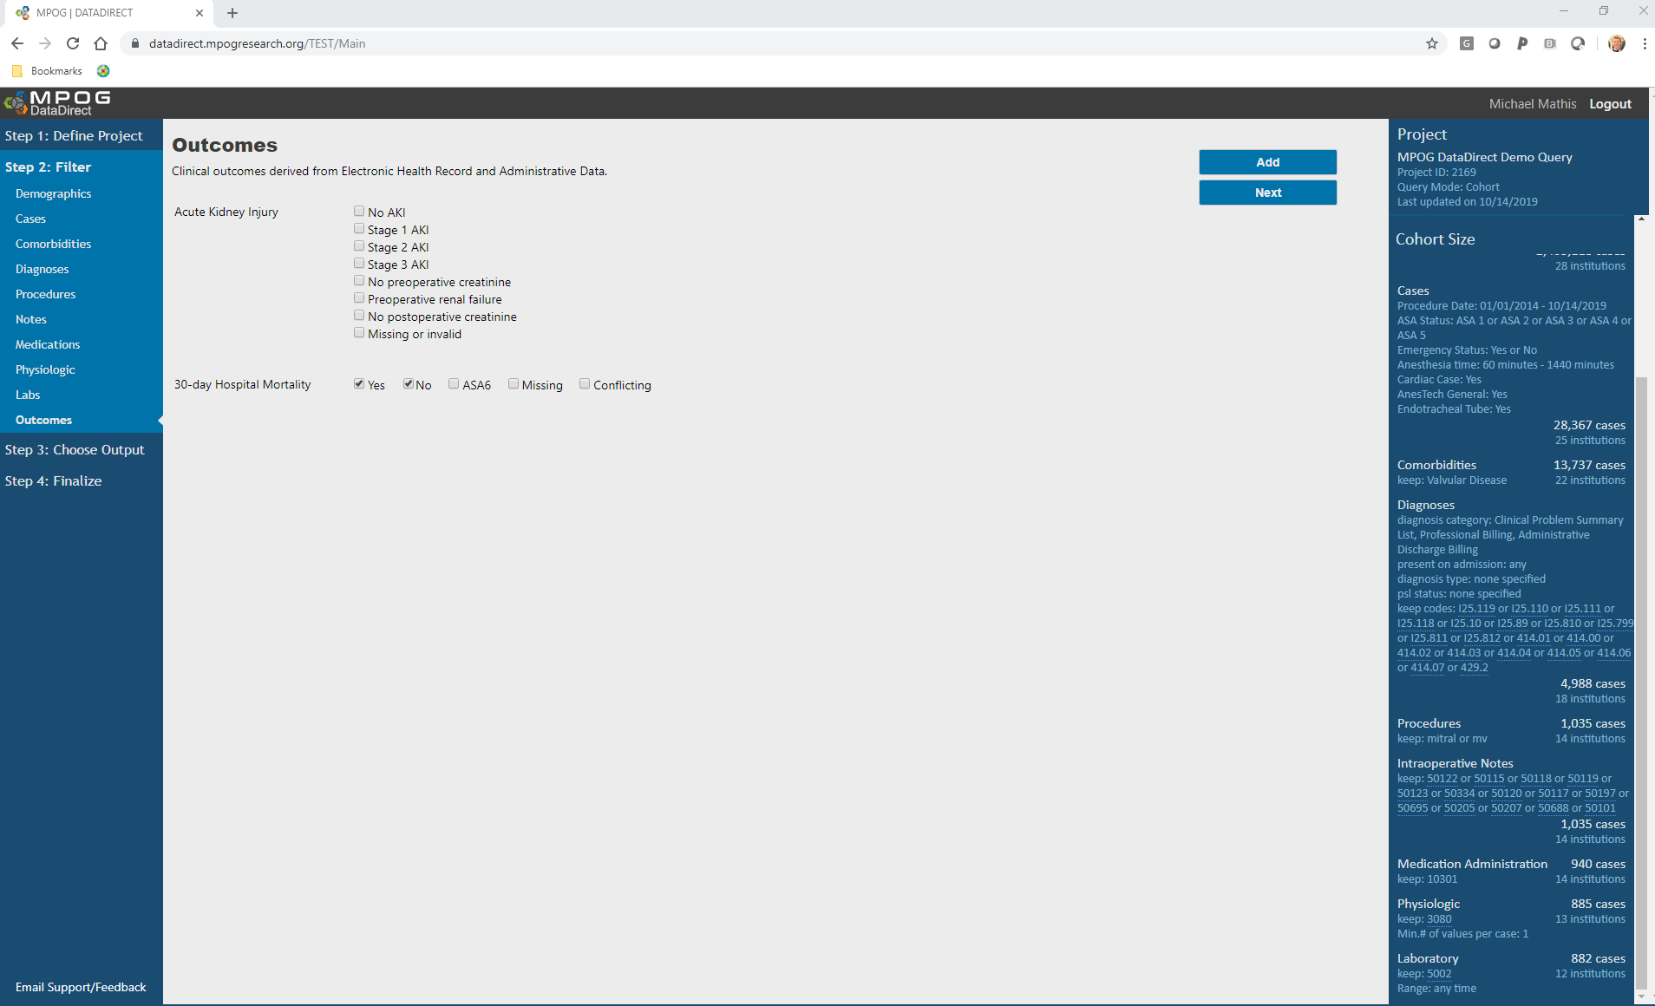

Slide 43
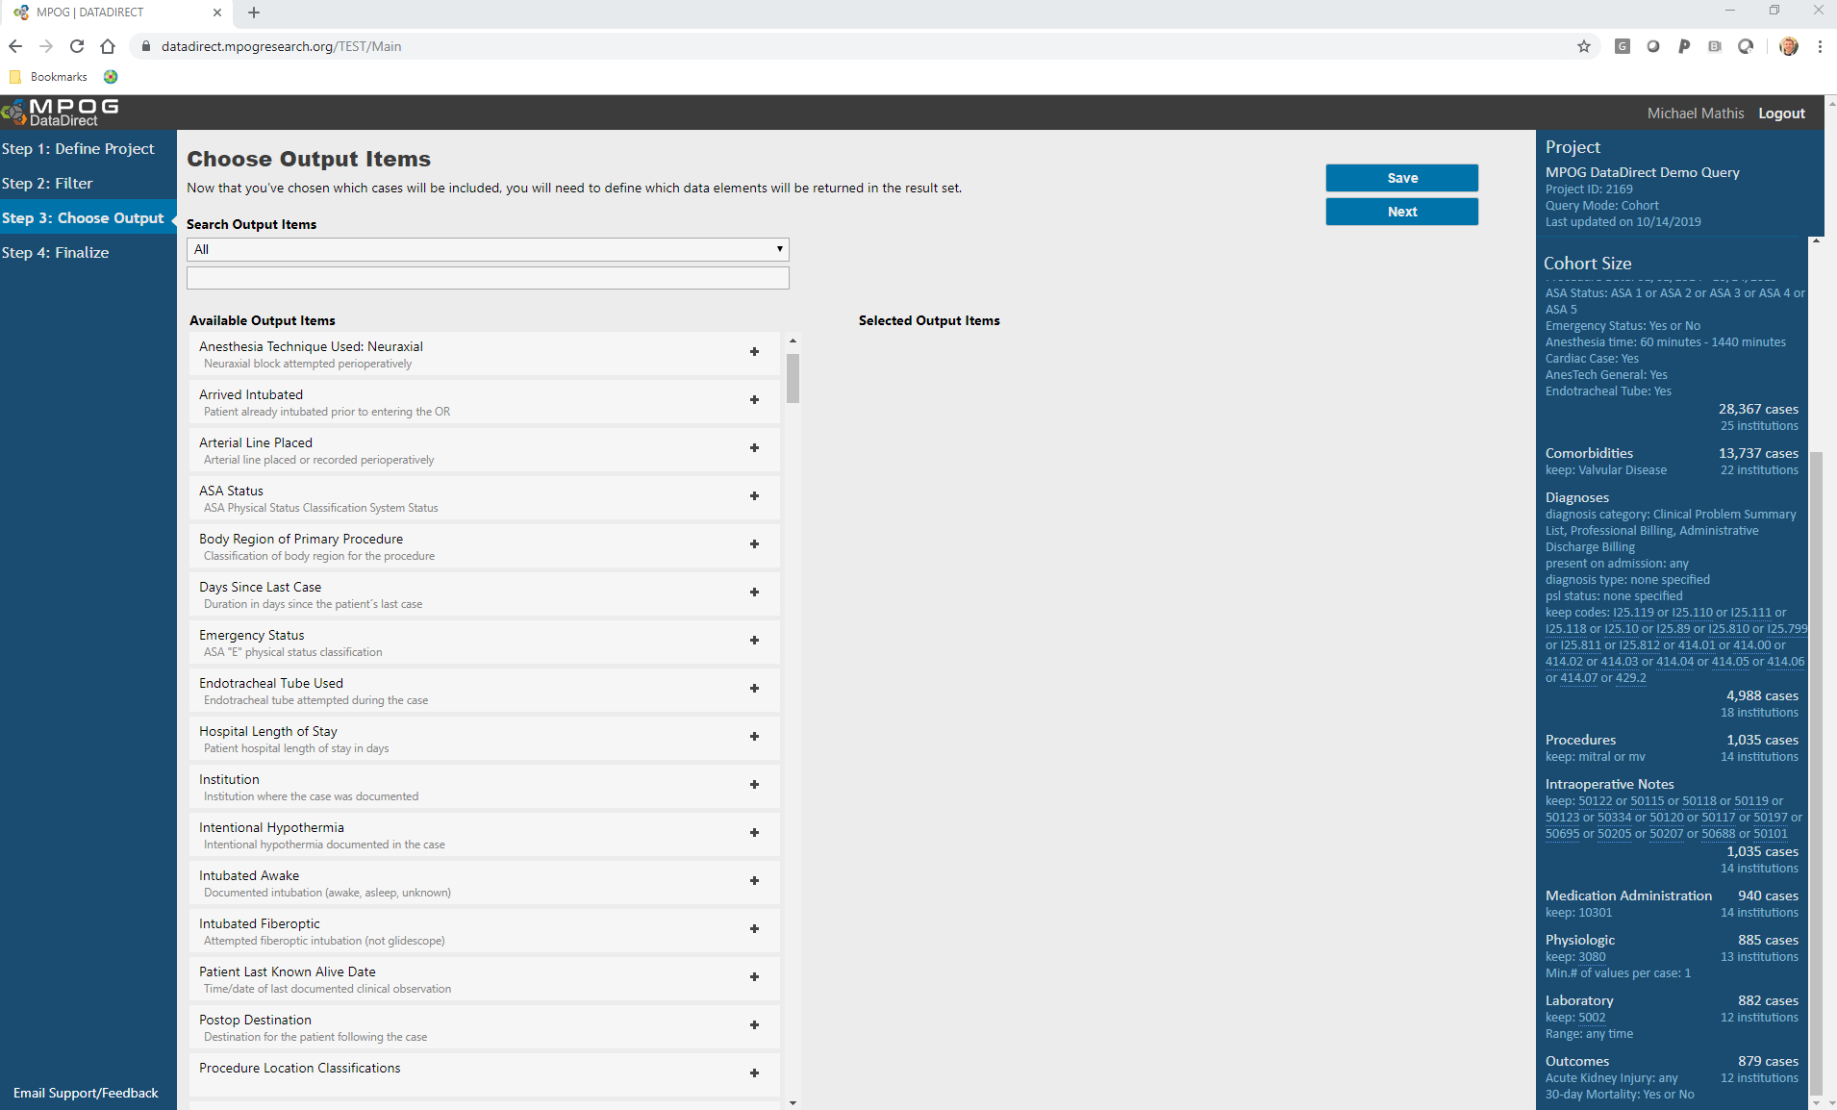

Slide 44
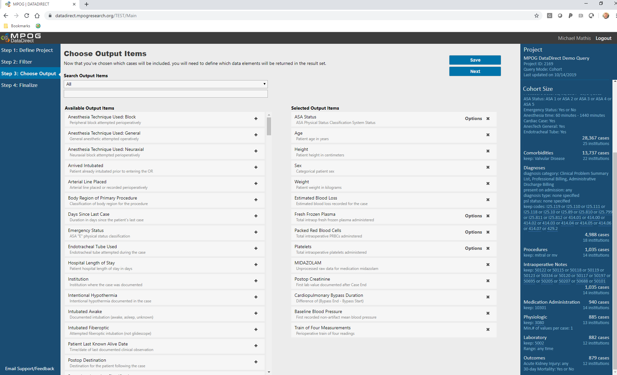

Slide 45
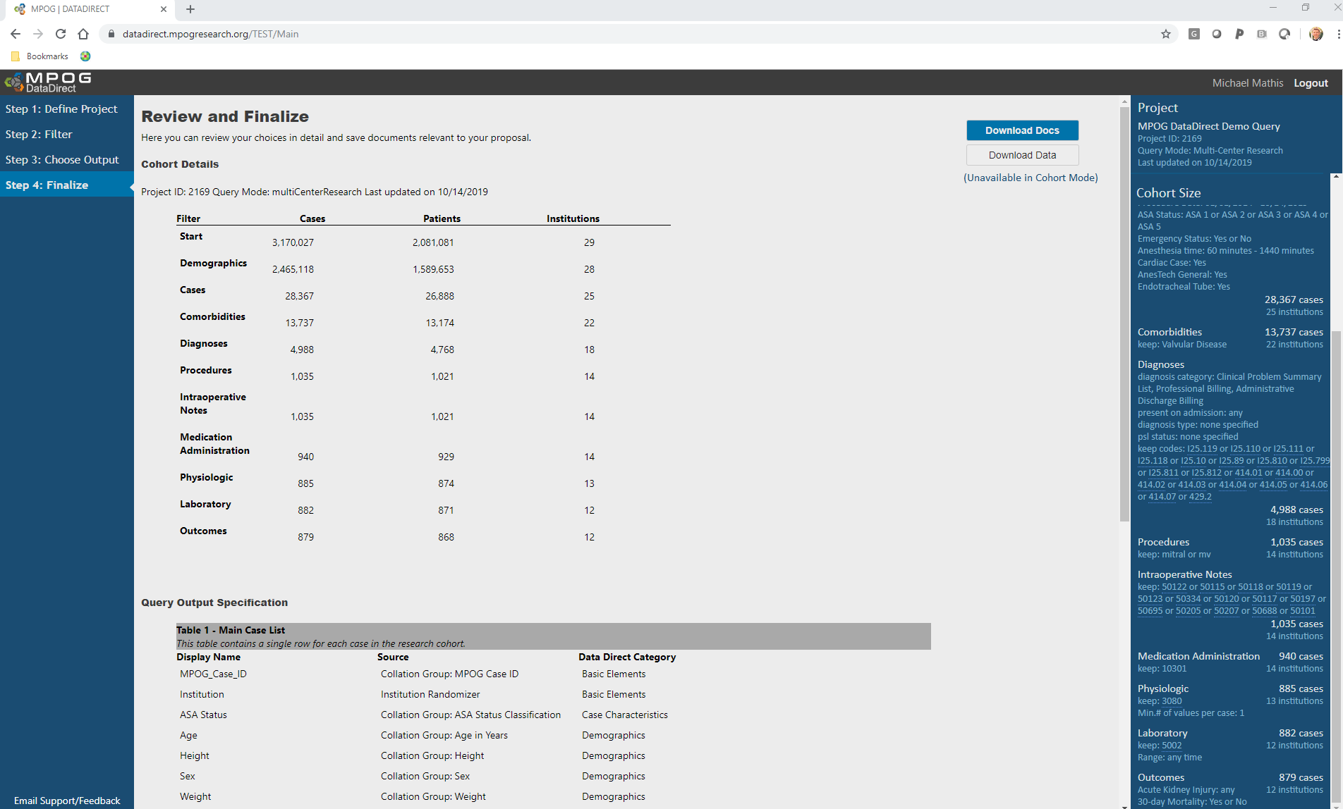

Slide 46
DataDirect v2.0
Outputs
Single vs. Repeated Measures
 | Example | Values Returned
Single Measures (One value per case)
Repeated Measures (Many values per case)
Notes:
Issue of how the data is handed to research team
Need specificity / transparency
Single vs. repeated measures

Slide 47
DataDirect v2.0
Outputs
Single vs. Repeated Measures
 | Example | Values Returned
Single Measures (One value per case) | Age | MPOG Case ID, MPOG Patient ID, Date of Procedure, Value
Repeated Measures (Many values per case)
Notes:
Issue of how the data is handed to research team
Need specificity / transparency
Single vs. repeated measures

Slide 48
DataDirect v2.0
Outputs
Single vs. Repeated Measures
 | Example | Values Returned
Single Measures (One value per case) | Age | MPOG Case ID, MPOG Patient ID, Date of Procedure, Value
Repeated Measures (Many values per case) | Blood pressure | MPOG Case ID, MPOG Patient ID, BP Source, Dates/Times of Measurements, Values
Notes:
Issue of how the data is handed to research team
Need specificity / transparency
Single vs. repeated measures

Slide 49
Take-Home Points
DataDirect can catalyze research/QI, without needing:
… to be a computer programmer
… to be a 1st-degree relative of your hospital’s CMIO
DataDirect query modes can be tailored to use-case:
Cohort ID mode → Research/QI “speed dating”
Quality Report → Improve care at your hospital
Research → High-impact science

Slide 50
Thank You

