Slide 1
Big Data Management Security, Software & Computing
Shelley Vaughn, MPH Nicole Pescatore, MPH
Lead Research Facilitator Clinical Research Project Manager
Notes:
NICOLE
This lecture will cover Big Data Management, specifically the security, software and computing environments within MPOG.
My name is Nicole Pescatore and I am a clinical research project manager. Shelley Vaughn is a lead research facilitator at MPOG - we are excited to share with you some tips and tricks for working with MPOG data.

Slide 2
Outline
MPOG IRBs
PHI / HIPAA Compliance
MPOG Stats Server - Data Access & Security
Data Storage
High-Performance Computing
Notes:
NICOLE
-In this lecture, we will be covering MPOG IRBs, HIPAA compliance in regards to MPOG data, the MPOG statistical server, data storage, and high-performance computing.

Slide 3
Institutional Review Board (IRB) Approvals
Notes:
NICOLE
MPOG currently has individually approved performance site IRBs from each participating institution to allow for data to be transferred to the central MPOG dataset.
Additionally, MPOG has approval for a coordinating center IRB that allows for overall organization and data management of the central dataset.
In order to contribute data to MPOG, each participating institution is required to obtain approval from their local IRB or ethics board to transmit data to the coordinating center. In some circumstances, an institution can cede regulatory oversight to UM’s IRB.
While the previously mentioned approvals are required to contribute data, an additional IRB application from the lead researcher’s institution is required for each specific research project.

Slide 4
HIPAA Protected Health Information - Identifiers
Name
All geographical subdivisions smaller than a state
All elements of dates (except year) related to individual
Phone numbers
Fax numbers
Electronic mail addresses
Social Security numbers
Medical record numbers
Health plan beneficiary numbers
Account numbers
Certificate/license numbers
Vehicle identifiers and serial numbers
Device identifiers and serial numbers
Web Universal Resource Locators (URLs)
Internal Protocol (IP) address numbers
Biometric identifiers, including finger prints
Full face photographic images
Any other unique identifying number
Notes:
NICOLE
A Limited Data Set (LDS) excludes direct identifiers but may include geographic information (except addresses); dates; and other numbers, characteristics, or codes not listed as direct identifiers. The only PHI data elements collected by MPOG Central are dates of service. Therefore the MPOG dataset is a limited dataset rather than a de-identified dataset. All other PHI data elements are stored locally at each institution. Any data transmitted to the coordinating center is required to be “scrubbed” of PHI prior to transmission - we have a tool to help with that called PHI scrubber.
When seeking IRB approval for your research project, make sure to indicate that MPOG datasets are limited. Matching to datasets other than MPOG is possible without using direct identifiers. For this reason, the IRB reviews limited data set applications on a case by case basis. Typically, research conducted on MPOG data sets is considered secondary use of private information or biospecimens. Your local IRB will determine if your research would be considered exempt, not regulated, or requires comprehensive IRB approval.

Slide 5
MPOG Statistical Server
Notes:
SHELLEY
To help with analysis for PCRC projects, we have setup an MPOG statistical server that allows collaborators to analyze MPOG data within a safe and secure environment. Principal investigators and research team members, with an approved PCRC project will be granted access to this HIPAA compliant, private clustered cloud environment, referred to as the Yottabyte Research Cloud, or YBRC. This Research Cloud environment can be accessed using a virtual private network (or VPN) and is maintained and managed by the University of Michigan. Users can remotely login using their individualized usernames and passwords. MPOG Central is responsible for managing all login and access rights for MPOG members.

Slide 6
Accessing MPOG Statistical Server
Provide proof of IRB approval or exemption for research project
Sign and return security affidavit
Obtain a username and password from MPOG Central
Notes:
SHELLEY
Prior to accessing data on the stats server, the following steps must be completed. The study team must provide IRB approval or a copy of the exemption letter from your institutional IRB that allows for analysis of data related to your specific research project.
Any study team member requiring access to the data on the stats server will need to sign and return a security checklist provided by the MPOG Central Team. This checklist outlines proper and safe guidelines for accessing, analyzing and storing data and project related materials within the stats server environment. Please keep in mind that a separate signed security affidavit will be required for each PCRC project, even if you have completed one for a different PCRC project.
To obtain a username and password for logging into the stats server, you will also need to provide additional information requested via an email from an MPOG Central team member. Once a username and password has been assigned to you, a member from the MPOG Central team will forward directions for how to connect to the university virtual private network or VPN along with a remote desktop protocol, or RDP extension file for connecting directly to the MPOG stats server.

Slide 7
Software Available on MPOG Statistical Server
Notes:
SHELLEY
The MPOG stats server contains most of the commonly used statistical software programs such as SAS, Stata, SPSS, R, R Studio, and MATLAB. It also has other useful software such as StatTransfer to seamlessly move between file types. Both the Microsoft Office suite and Microsoft SQL Server are available on there, as well. If your study team requires additional software that is not currently installed for a PCRC project, please just reach out to the MPOG Central Team and we will try to have it added.

Slide 8
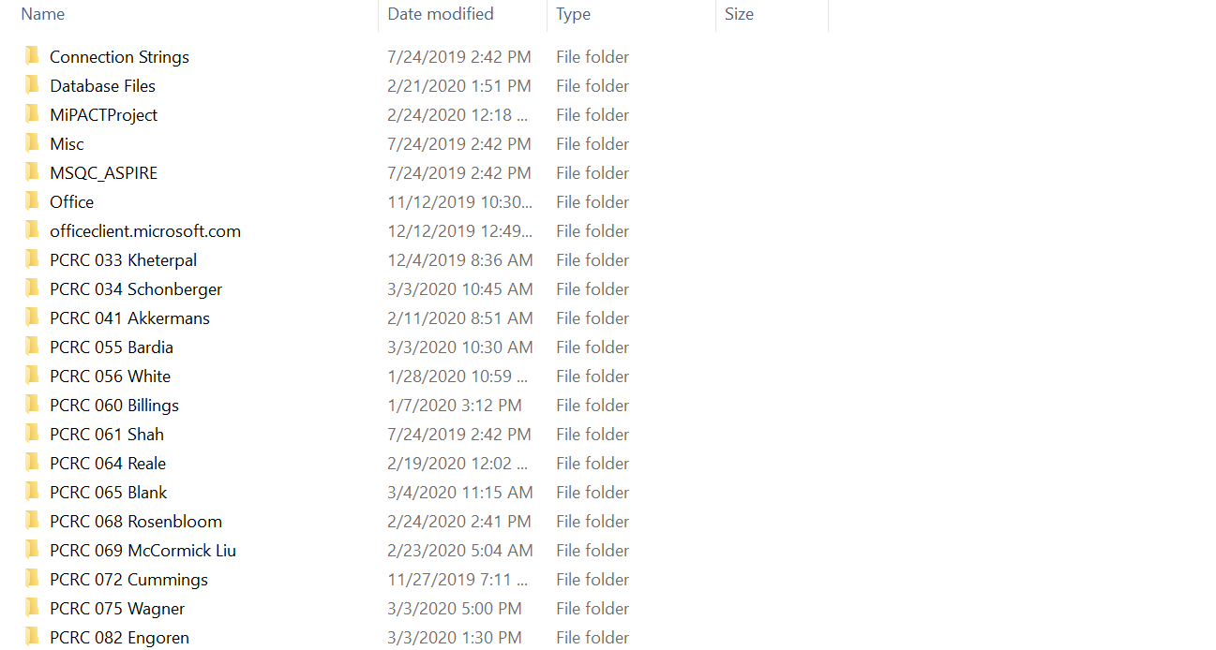
Turbo Storage Volume
Notes:
SHELLEY
Next, we wanted to review where and how your data and any files generated during the analysis will be stored. When the MPOG programmer pulls your data, we will move it onto a Turbo storage drive, which is designed for high-capacity and secure storage. This Turbo drive is mounted onto the stats server. The first time you access the Turbo drive via the stats server, you will need to map it using the pre-loaded icon (CLICK) at the top of the screen. Each time you login after that, this Turbo storage drive should show up as a network drive. Each PCRC project will have an individual folder with users being granted individual access rights to project-specific folders. (CLICK TO OPEN EXAMPLE) Any files that are generated during the analysis will be stored within your specific project folder. All data must remain in Turbo with only aggregate statistics or figures/tables being able to be copied or moved off the server.

Slide 9
Armis 2.0
Fee-based high-performance computing cluster suitable for HIPAA regulated data
Linux-based operating system
Scheduled computational jobs
Data stored on Turbo storage volume
Notes:
SHELLEY
In those rare instances where the MPOG stats server may not be powerful enough for the analysis required by your specific research project, MPOG also has access to an additional high-performance computing environment called Armis 2.0. This is a linux-based operating system where users submit scheduled, batched jobs. Similar to the MPOG stats server, the Turbo storage volume is also mounted on Armis 2.0 for data and file storage. If your project requires access to Armis 2.0, the MPOG Central Team will work with you to obtain access and ensure you have the necessary resources to complete your analysis.

Slide 10
Thank you!
Please reach out with any questions.
MPOG Research - mpog-research@med.umich.edu
Shelley Vaughn – mhousey@med.umich.edu
Nicole Pescatore – nipescat@med.umich.edu
Notes:
NICOLE
Thank you for your time and attention. If you have any questions, please reach out to us.

