Slide 1
Environmental Sustainability QI Toolkit
OVERVIEW AND RECOMMENDATIONS

Slide 2
Acknowledgements
Armaan Patel, BS - University of Michigan
Alexander T. Abess, MD - Dartmouth Health
Megan G. Anders, MD, MS - University of Maryland Medical System
Eva Lu-Boettcher, MD - University of Wisconsin Health
Karen B. Domino, MD - University of Washington Health
Patrick Henson, DO - Vanderbilt University Medical Center
Deirdre Clare Kelleher, MD - Weill Cornell Medicine
Patricia Fogarty Mack, MD - Weill Cornell Medicine
Benjamin Stam, MD - Anesthesia Practice Consultants

Slide 3
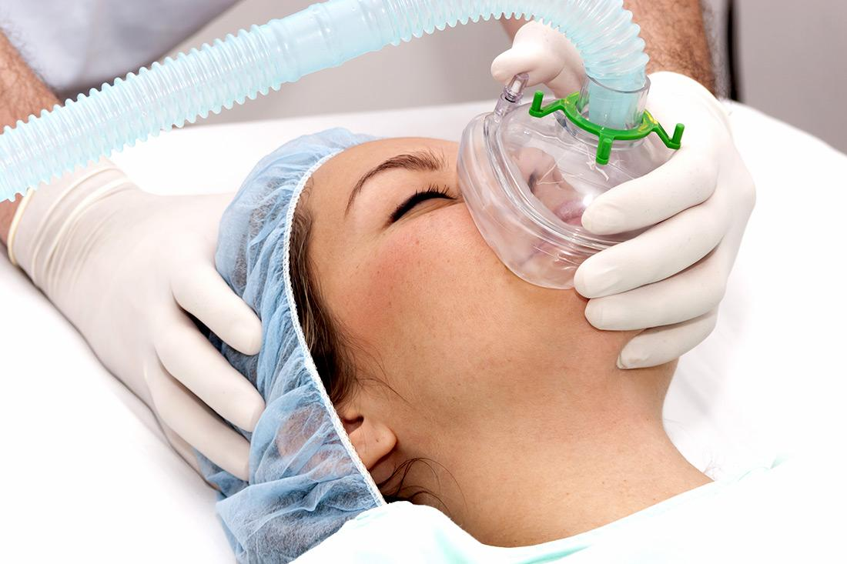
Objectives
Overview environmental sustainability in anesthesia
Discuss selection of anesthetic agent
Discuss management of fresh gas flow
Review ASPIRE sustainability measures

Slide 4
Section I:
Overview of Environmental Sustainability in Anesthesia
Notes:
Watts N, Amann M, Ayeb-Karlsson SA, et al. (2018). Countdown on Health and Climate Change: From 25 Years of Inaction to a Global Transformation for Public Health. Lancet. 391(10120):581–630.

Slide 5
Climate Crisis and Impact on Health
The climate change crisis is the largest and most profound threat to global health ever described (Watts, 2018).
2022 IPCC (Intergovernmental Panel on Climate Change) Report indicates high confidence that climate change is adversely impacting multiple facets of human health, including (IPCC, 2022):
The spread of infectious disease
Malnutrition
Mental health
Displacement of peoples/communities
Notes:
IPCC. (2022). Climate Change 2022: Impacts, Adaptation, and Vulnerability. Contribution of Working Group II to the Sixth Assessment Report of the Intergovernmental Panel on Climate Change (IPCC). https://www.ipcc.ch/report/ar6/wg2/.
Watts N, Amann M, Ayeb-Karlsson SA, et al. (2018). Countdown on Health and Climate Change: From 25 Years of Inaction to a Global Transformation for Public Health. Lancet. 391(10120):581–630.

Slide 6
Urgency of Climate Change
Global surface temperature has increased by 0.2°C per decade over the last 30 years (Hansen, 2006).
The U.N. Climate Report notes that we are on a pathway to more than double the 1.5°C limit set by climate scientists.
“It’s now or never, if we want to limit global warming to 1.5°C; without immediate and deep emissions reductions across all sectors, it will be impossible”
Jim Skea, Co-Chair of IPCC Working Group III (Rich, 2022)
Notes:
Hansen J, Sato M, Ruedy R, Low K, Lea DW, Medina-Elizade M. (2006). Global Temperature Change. Proc Natl Acad Sci USA. 103(39):14288–93.
Rich S. (4/4/2022). UN Climate Report: It’s ‘now or Never’ to Limit Global Warming to 1.5 Degrees. United Nation News. https://news.un.org/en/story/2022/04/1115452.

Slide 7
Environmental Impact of Healthcare
Healthcare emissions are a drop in the bucket, right?
The U.S. health care sector contributes nearly 10% of GHG emissions per year (Pichler, 2019).
If the U.S. health care sector were a country, it would rank 13th in GHG emissions (Eckelman, 2016).
If global healthcare were a country, it would be the fifth largest carbon emitter on the planet (Budd, 2019).
Notes:
Budd K. (10/3/2019). Hospitals Race to Save Patients — and the Planet. AAMCNews. https://www.aamc.org/news-insights/hospitals-race-save-patients-and-planet.
Eckelman MJ, Sherman JD. (2016). Environmental Impacts of the U.S. Health Care System and Effects on Public Health. PloS One 11 (6):e0157014.
Pichler, Peter-Paul, Ingram S. Jaccard, Ulli Weisz, and Helga Weisz. (2019). “International Comparison of Health Care Carbon Footprints.” Environmental Research Letters: ERL [Web Site] 14 (6): 064004.

Slide 8
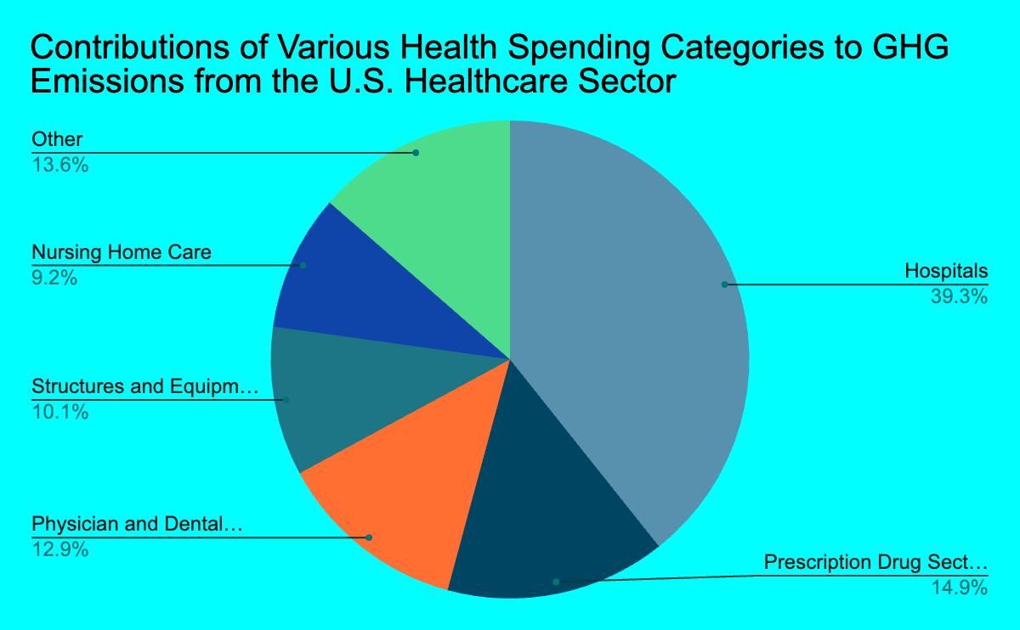
Environmental Impact of U.S. Healthcare System
From a 2007 JAMA Study, the U.S. Healthcare Sector annually contributes approximately (Chung, 2009)
8% of all greenhouse gas emissions
7% of all carbon dioxide emissions
Within the U.S. Healthcare Sector
Hospitals make up the largest contributor of greenhouse gases, followed by prescription drugs, physician and dental services, structures and equipment, and nursing home care.
Notes:
Chung JW, Meltzer DO. (2009). Estimate of the Carbon Footprint of the US Health Care Sector. JAMA. 302 (18):1970–72.

Slide 9
Environmental Impact of U.S. Healthcare System (cont.)
The U.S. healthcare sector is also responsible for significant fractions of national air pollution emissions and impacts, including:
Acid rain (12%), greenhouse gas emissions (10%), smog formation (10%) criteria air pollutants (9%), stratospheric ozone depletion (1%), and carcinogenic and non-carcinogenic air toxics (1–2%) (Eckelman, 2016).
This is attributable to approximately 123,000 to 381,000 DALYs (Disability-Adjusted Life Years) in future health damages (Eckelman, 2018).
Notes:
Eckelman MJ, Sherman JD. (2016). Environmental Impacts of the U.S. Health Care System and Effects on Public Health. PloS One 11 (6):e0157014.
Eckelman MJ, Sherman JD. (2018). Estimated Global Disease Burden From US Health Care Sector Greenhouse Gas Emissions. American Journal of Public Health. 108(S2):S120–22.

Slide 10
Environmental Impact of Anesthesia
Anesthetic gases play a significant role in this contribution.
From the American Society of Anesthesiologists (Devlin-Hegedus, 2022).
Inhaled anesthetics account for 5% of acute hospital CO₂-equivalent emissions and 50% of perioperative department emissions in high-income countries.
Overall, inhaled anesthetic agents are estimated to be responsible for approximately 0.01% to 0.1% of the total global carbon dioxide equivalent emissions per year.
Based on recent research and atmospheric sampling of volatile anesthetics, this accumulation has been and is still currently increasing.
Notes:
Devlin-Hegedus JA, McGain F, Harris RD, Sherman JD. (2022), Action guidance for addressing pollution from inhalational anaesthetics. Anaesthesia. 77:1023-1029.

Slide 11
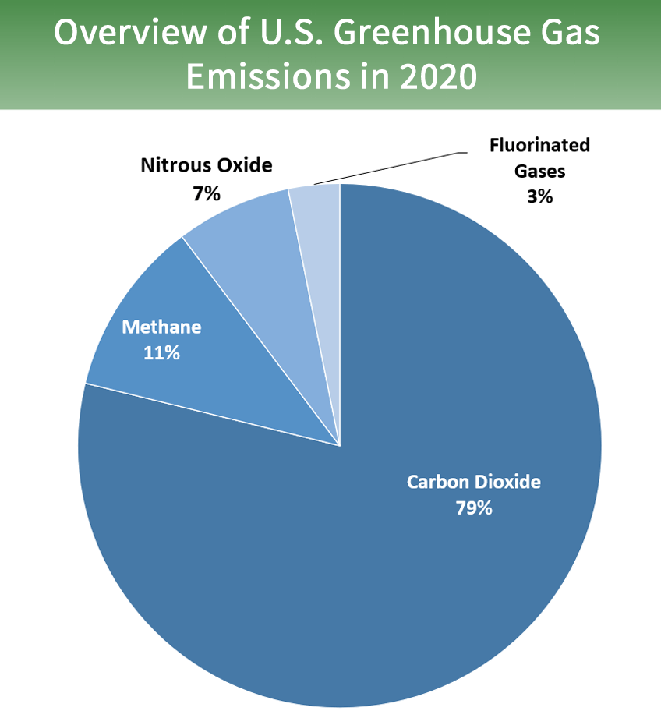
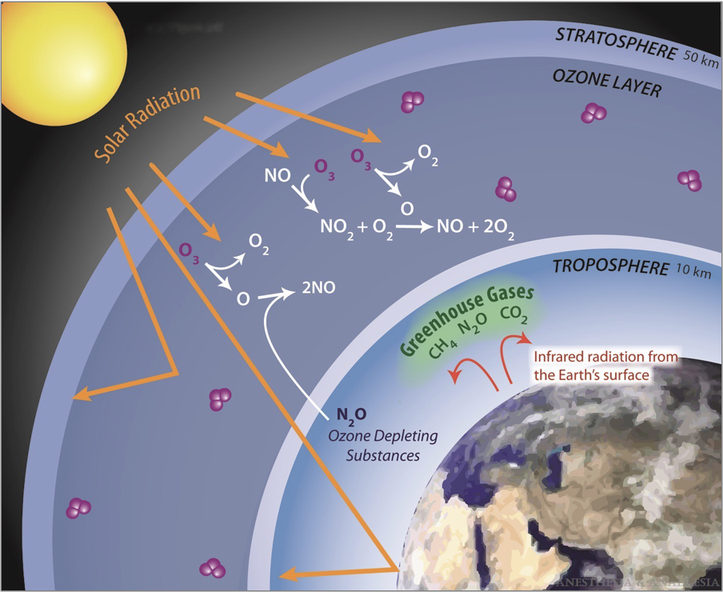
GHGs and the Greenhouse Effect
Greenhouse gases, or GHGs, warm our planet by absorbing/re-radiating the infrared radiation emitted from Earth’s surface (US EPA, 2016).
Common GHGs include:
CO₂
Methane
Nitrous Oxide
Fluorinated Gases
Summary of the Greenhouse Effect
^{(Ishizawa, 2011)}
Image adapted from U.S. Environmental Protection Agency Website (EPA, 2022)
Notes:
EPA. (5/16/2022) Overview of Greenhouse Gases. United States Environmental Protection Agency. https://www.epa.gov/ghgemissions/overview-greenhouse-gases.
Ishizawa Y. (2011). General Anesthetic Gases and the Global Environment. Anesth Analg. 112(1):213-217.
US EPA, (2016). Understanding Global Warming Potentials. United State Environmental Protection Agency. https://www.epa.gov/ghgemissions/understanding-global-warming-potentials.

Slide 12
Global Warming Potential
Global Warming Potential (GWP): A measure of how much energy the emissions of 1 ton of a given greenhouse gas will absorb (over a given period of time) relative to the emissions of 1 ton of carbon dioxide (US EPA, 2016).
The larger the GWP, the more that a given greenhouse gas warms the Earth compared to CO_{2.}
GWP is constituted of two primary factors (McGain, 2020):
Radiative Efficiency: Ability to absorb energy
Atmospheric Lifetime: Estimate of molecular stability in the atmosphere
Notes:
McGain F, Muret J, Lawson C, Sherman JD. (2020). Environmental Sustainability in Anaesthesia and Critical Care. Br J Anaesth. 125(5):680–92.
US EPA, (2016). Understanding Global Warming Potentials. United State Environmental Protection Agency. https://www.epa.gov/ghgemissions/understanding-global-warming-potentials.

Slide 13
GWP for Select Greenhouse Gases
Name | MW (g/mol) | Chemical Formula | Atm Lifetime (years) | GWP 20 | GWP 100
Carbon Dioxide | 44.01 | CO₂ | 5-200 | 1 | 1
Common Inhaled Anesthetics
Sevoflurane | 200.5 | C₄H₃F₇O | 1.4 | 349 | 130, 144, 210
Isoflurane | 184.5 | C₃H₂ClF₅O | 3.2 | 1401 | 510, 565
Desflurane | 168.0 | C₃H₂F₆O | 14 | 3714 | 1620, 2540, 2720
Nitrous Oxide | 44.0 | N₂O | 114 | 289 | 265, 273, 282, 298, 300
GWP 20 and GWP 100: Global warming potential over a 20-year period and 100-year period, respectively
Multiple sources were used, as GWP 100 values are estimates and thus show variability in published literature
Bolded values represent those used by the MPOG SUS-02 measure
References: (Budd, 2019; Chung, 2009; US EPA, 2016; Ishizawa, 2011; EPA, 2022;
McGain, 2020; Yasny, 2012)
Notes:
Budd K. (10/3/2019). Hospitals Race to Save Patients — and the Planet. AAMCNews. https://www.aamc.org/news-insights/hospitals-race-save-patients-and-planet.
Chung JW, Meltzer DO. (2009). Estimate of the Carbon Footprint of the US Health Care Sector. JAMA. 302 (18):1970–72.
EPA. (5/16/2022) Overview of Greenhouse Gases. United States Environmental Protection Agency. https://www.epa.gov/ghgemissions/overview-greenhouse-gases.
Ishizawa Y. (2011). General Anesthetic Gases and the Global Environment. Anesth Analg. 112(1):213-217.
McGain F, Muret J, Lawson C, Sherman JD. (2020). Environmental Sustainability in Anaesthesia and Critical Care. Br J Anaesth. 125(5):680–92.
US EPA, (2016). Understanding Global Warming Potentials. United State Environmental Protection Agency. https://www.epa.gov/ghgemissions/understanding-global-warming-potentials.
Yasny JS, White J. (2012). Environmental Implications of Anesthetic Gases. Anesth Prog 59(4):154–58.

Slide 14
Reducing Environmental Impact of Anesthesia
Based on GWP values, all common inhaled anesthetics have a global warming potential significantly greater than that of carbon dioxide.
These gases are thus potent contributors to global warming, even in small concentrations.
We can reduce this impact in two primary ways:
Selecting environmentally-safer anesthetic agents
Managing fresh gas flow

Slide 15
Section II:
Managing Selection of Inhaled Anesthetic Agent
Notes:
Watts N, Amann M, Ayeb-Karlsson SA, et al. (2018). Countdown on Health and Climate Change: From 25 Years of Inaction to a Global Transformation for Public Health. Lancet. 391(10120):581–630.

Slide 16
Environmental Impact of Inhaled Anesthetics
Halogenated anesthetics (sevoflurane, isoflurane, and desflurane) and nitrous oxide are all recognized greenhouse gases (Yasny, 2012).
Nitrous oxide presents additional environmental concerns:
In addition to being a greenhouse gas, it is also classified as an ozone-depleting agent (Yasny, 2012).
When nitrous oxide is used as a carrier gas along with a halogenated anesthetic, the impact of each gas on the environment is compounded (McGain, 2020; Axelrod, 2022).
Notes:
Axelrod D, Bell C, Feldman J, et al. ​Greening the Operating Room. (9/20/2022). Greening the Operating Room. American Society of Anesthesiologists (ASA). https://www.asahq.org/about-asa/governance-and-committees/asa-committees/environmental-sustainability/greening-the-operating-room.
McGain F, Muret J, Lawson C, Sherman JD. (2020). Environmental Sustainability in Anaesthesia and Critical Care. Br J Anaesth. 125(5):680–92.
Yasny JS, White J. (2012). Environmental Implications of Anesthetic Gases. Anesth Prog 59(4):154–58.

Slide 17
Carbon Dioxide Equivalents
The environmental impact of a specific inhaled anesthetic over a given time period can be standardized by converting the amount of the gas used to carbon dioxide equivalents, or “CO₂ (equiv)(Axelrod, 2022)”
Calculating CO₂ equivalents can be done by multiplying the mass of the anesthetic agent used by its global warming potential (GWP).
Mass used is dependent on both the concentration of gas used and the fresh gas flow rate (see calculation on next slide).
Notes:
Axelrod D, Bell C, Feldman J, et al. ​Greening the Operating Room. (9/20/2022). Greening the Operating Room. American Society of Anesthesiologists (ASA). https://www.asahq.org/about-asa/governance-and-committees/asa-committees/environmental-sustainability/greening-the-operating-room.

Slide 18
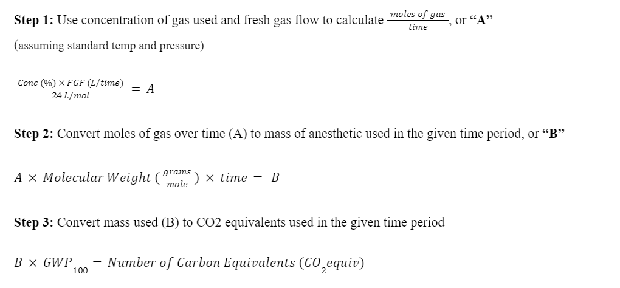
Calculating CO₂ Equivalents

Slide 19
Comparing CO₂ Equivalents for Common Anesthetics
Anesthetic | FGF (L/min) | GWP(100) | CO₂ equiv (x100,000) | Equivalent auto miles driven per hour use of anesthetic (Axelrod, 2022)
Sevoflurane 2% | 2 | 144 | 2.9 | 8
Isoflurane 1.2% | 2 | 565 | 6.2 | 18
Isoflurane 1.2% | 1 | 565 | 3.1 | 9
Desflurane 6% | 2 | 2720 | 137 | 400
Desflurane 6% | 1 | 2720 | 68.5 | 200
Nitrous Oxide 60% | 1 | 282 | 18.6 | 61
Notes:
Axelrod D, Bell C, Feldman J, et al. ​Greening the Operating Room. (9/20/2022). Greening the Operating Room. American Society of Anesthesiologists (ASA). https://www.asahq.org/about-asa/governance-and-committees/asa-committees/environmental-sustainability/greening-the-operating-room.

Slide 20
Recommendation 1: Eliminate Desflurane
Under comparable conditions, desflurane has a significantly greater carbon footprint and thus larger impact on global warming than other halogenated anesthetics such as sevoflurane and isoflurane (McGain, 2020; Axelrod, 2022; Sherman, 2012; Ryan, 2010).
When looking at the full lifecycle of the drug (i.e. from resource extraction to disposal), it’s estimated that desflurane accounts for the largest GHG emissions both in terms of anesthetic gas wasted during a procedure and other life cycle stages (Axelrod, 2022).
Notes:
Axelrod D, Bell C, Feldman J, et al. ​Greening the Operating Room. (9/20/2022). Greening the Operating Room. American Society of Anesthesiologists (ASA). https://www.asahq.org/about-asa/governance-and-committees/asa-committees/environmental-sustainability/greening-the-operating-room.
McGain F, Muret J, Lawson C, Sherman JD. (2020). Environmental Sustainability in Anaesthesia and Critical Care. Br J Anaesth. 125(5):680–92.
Ryan, Susan M., and Claus J. Nielsen. (2010). “Global Warming Potential of Inhaled Anesthetics: Application to Clinical Use.” Anesthesia and Analgesia 111 (1): 92–98.
Sherman, Jodi, Cathy Le, Vanessa Lamers, and Matthew Eckelman. (2012). “Life Cycle Greenhouse Gas Emissions of Anesthetic Drugs.” Anesthesia and Analgesia 114 (5): 1086–90.

Slide 21
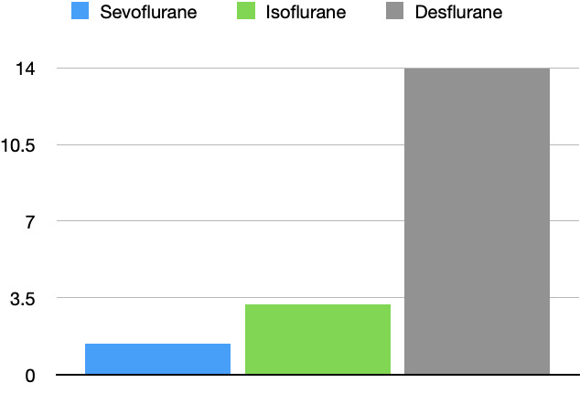
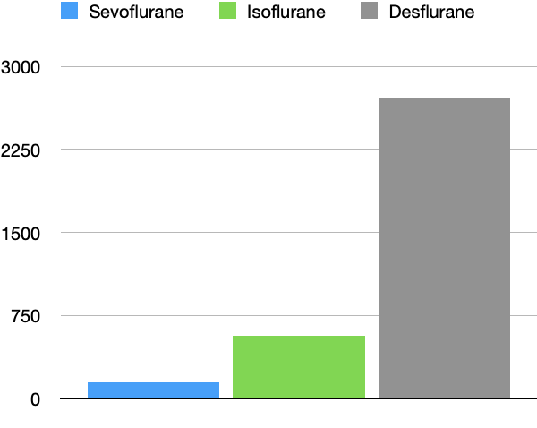
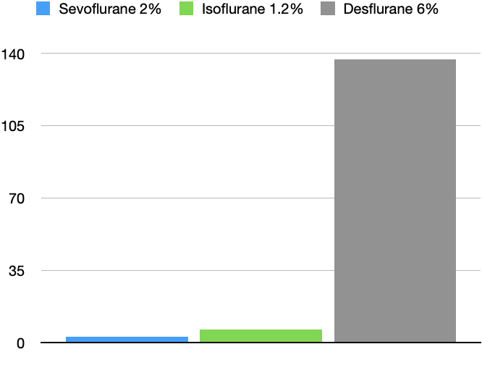
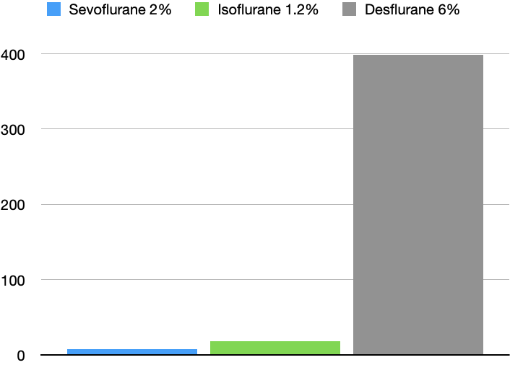
Comparing the Environmental Impact of Common Inhaled Anesthetics
Atm Lifetime (years)
Global Warming Potential (100)
CO₂ Equivalents (at 2 L/min)
Equivalent MPH Driven in a Car

Slide 22
Eliminating Desflurane (cont.)
Clinical Considerations
Economic Considerations
Research suggests negligible clinical differences between desflurane, sevoflurane, and isoflurane.
There appears to be no significant difference in the quality of overall recovery between the 3 agents (see next slide) (White, 2009; Lopez, 2009).
Home readiness, PONV, and airway irritation seem to be comparable between the 3 agents as well (Kurhekar, 2017; Gupta, 2004).
Desflurane is significantly more expensive than sevoflurane and isoflurane (Moody, 2020).
Total cost at 1 L/min:
Sevo: $2.14
Iso: $0.32
Des: $10.32
Total cost at 2 L/min
Sevo: $4.28
Iso: $0.64
Des: $20.64
Notes:
Gupta A, Stierer T, Zuckerman R, Sakima N, Parker SD, Fleisher LA. (2004). Comparison of Recovery Profile after Ambulatory Anesthesia with Propofol, Isoflurane, Sevoflurane and Desflurane: A Systematic Review. Anesth Analg. 98(3):632–41.
Kurhekar P, Vinod J, Krishna JSD, Raghuraman MS. (2017). Randomized Comparison of Isoflurane versus Sevoflurane and Desflurane for Maintenance of Ambulatory Anesthesia. Anesth Essays Res. 11(4):875–80.
Lopez LA, Hofmeister EH, Pavez JC, Brainard BM. (2009). Comparison of Recovery from Anesthesia with Isoflurane, Sevoflurane, or Desflurane in Healthy Dogs. Am J Vet Res. 70(11):1339–44.
Moody A, Beutler BD, Moody CE. (2020). Predicting Cost of Inhalational Anesthesia at Low Fresh Gas Flows: Impact of a New Generation Carbon Dioxide Absorbent. Med Gas Res. 10(2):64–66.
White PF, Tan J, Wender RH, Yumul R, Stokes OJ, Sloninsky A, Naruse R, Kariger R, Norel E, Mandel S, Webb T, Zaentz A. (2009). Desflurane versus Sevoflurane for Maintenance of Outpatient Anesthesia: The Effect on Early versus Late Recovery and Perioperative Coughing. Anesth Analg 109(2):387–93.

Slide 23
Eliminating Desflurane (cont.)
In comparison to sevoflurane and isoflurane, desflurane appears to show no significant clinical advantage in terms of the quality of overall recovery, home readiness, PONV, and post-op airway irritation.
A study from the University of Texas Southwestern (n = 130) suggests that although desflurane may lead to a faster initial recovery, the difference in the quality of overall recovery between the 3 agents is negligible (White, 2009).
Other, more recent studies appear to support this finding (Lopez, 2009; Boggett, 2019).
Studies from John Hopkins University (Kurhekar, 2017) and the Shri Sathya Sai Medical College (Gupta, 2004) suggest that home readiness and incidences of post-op nausea, vomiting, and airway irritation are comparable as well.
Notes:
Boggett S, Ou-Young J, Heiberg J, et al. (2019). “A Randomized Trial of Desflurane or Sevoflurane on Postoperative Quality of Recovery after Knee Arthroscopy.” PloS One 14(8): e0220733.
Gupta A, Stierer T, Zuckerman R, Sakima N, Parker SD, Fleisher LA. (2004). Comparison of Recovery Profile after Ambulatory Anesthesia with Propofol, Isoflurane, Sevoflurane and Desflurane: A Systematic Review. Anesth Analg. 98(3):632–41.
Kurhekar P, Vinod J, Krishna JSD, Raghuraman MS. (2017). Randomized Comparison of Isoflurane versus Sevoflurane and Desflurane for Maintenance of Ambulatory Anesthesia. Anesth Essays Res. 11(4):875–80.
Lopez LA, Hofmeister EH, Pavez JC, Brainard BM. (2009). Comparison of Recovery from Anesthesia with Isoflurane, Sevoflurane, or Desflurane in Healthy Dogs. Am J Vet Res. 70(11):1339–44.
White PF, Tan J, Wender RH, Yumul R, Stokes OJ, Sloninsky A, Naruse R, Kariger R, Norel E, Mandel S, Webb T, Zaentz A. (2009). Desflurane versus Sevoflurane for Maintenance of Outpatient Anesthesia: The Effect on Early versus Late Recovery and Perioperative Coughing. Anesth Analg 109(2):387–93.

Slide 24
Eliminating Desflurane (cont.)
Desflurane has been eliminated at multiple institutions across the country, generating savings on the order of $100,000 to millions of dollars per year (Silva, 2021).
Some hospital systems that have significantly reduced or completely eliminated desflurane include Michigan Medicine, Stanford Medicine, UCSF Health, Cleveland Clinic, Boston Medical Center, Kaiser Permanente, Seattle Children’s Hospital, and many more (Schowtzer, 2020; Zoghbi, 2022).
The EU has formulated a proposal to ban, or at least severely restrict, the use of desflurane starting in January of 2026 (Hendrickx, 2022).
The ASA Environmental Task Force formally recommends the avoidance of desflurane based on the ecological and economic benefits as well as the negligible clinical differences between halogenated anesthetics (Devlin-Hegedus, 2022; Axelrod, 2022).
Notes:
Axelrod D, Bell C, Feldman J, et al. ​Greening the Operating Room. (9/20/2022). Greening the Operating Room. American Society of Anesthesiologists (ASA). https://www.asahq.org/about-asa/governance-and-committees/asa-committees/environmental-sustainability/greening-the-operating-room.
Devlin-Hegedus JA, McGain F, Harris RD, Sherman JD. (2022), Action guidance for addressing pollution from inhalational anaesthetics. Anaesthesia. 77:1023-1029.
Hendrickx, Jan F. A., Ole John Nielsen, Stefan De Hert, and Andre M. De Wolf. (2022). “The Science behind Banning Desflurane: A Narrative Review.” European Journal of Anaesthesiology 39 (10): 818–24.
Schowtzer, Ella, and Kaeleigh Sheehan. 2020. “Healing Patients and Planet with 1 Cost-Saving Anesthesia Adjustment.” Health Care Without Harm. February 18, 2020. https://noharm-uscanada.org/desfluraneelimination.
Silva G, Waberski A, Bryant J. (2021). Eliminating Desflurane. Society of Pediatric Anesthesiology (SPA) Website: https://pedsanesthesia.org/wp-content/uploads/2021/08/Eliminiating-Desflurane.pdf.
Zoghbi V, Lin C, Fahrenbach V. (5/6/2022). Rethinking Desflurane. California Society of Anesthesiologists. https://www.csahq.org/news/blog/csa-online-first/2022/05/16/rethinking-desflurane.

Slide 25
Recommendation 2: Reduce Nitrous Oxide
Estimated Atmospheric Lifetime of Nitrous Oxide (N₂O): 114 years
This value is approximately 8x that of desflurane, 35x that of isoflurane, and more than 100x that of sevoflurane.
Although nitrous oxide has a relatively lower global warming potential, it is used in a much higher concentration in comparison to halogenated anesthetics (Aranake, 2013).
Anesthetic | Sevoflurane | Isoflurane | Desflurane | Nitrous Oxide
MAC | 2 | 1.15 | 6 | 105
MAC-awake | 0.62 | 0.49 | 2.5 | 68
Values expressed as a percentage of 1 atmosphere
Notes:
Aranake AG, Mashour GA, Avidan M. (2013). “Minimum Alveolar Concentration: Ongoing Relevance and Clinical Utility.” Anaesthesia 68:512–22.

Slide 26
Reducing Nitrous Oxide (cont.)
In addition to being a potent greenhouse gas, nitrous oxide is also an ozone-depleting agent.
Anesthetic Agent | ODP (Bosenberg, 2011; Kleeman, 1994)
Sevoflurane | 0
Desflurane | 0
Isoflurane | 0.01*
Nitrous Oxide | 0.017
Ozone Depleting Potential (or ODP): The ratio of the estimated impact on the ozone layer relative to CFC-11 (ODP = 1) (Velders, 2014).
A study into the ozone-depleting effects of nitrous oxide by Dr. Ravi Ravishankara of Colorado State University poses nitrous oxide as “the single most important ozone depleting emission of the 21st century (Ravishankara, 2009).”
29, 49
* Although isoflurane has an ODP of 0.01, the tropospheric lifetime is short and its ozone-depleting effect is thus minimal (Branche, 2017)
Notes:
Bosenberg M. (2011). Anaesthetic Gases: Environmental Impact and Alternatives. Sabinet 17:5, 345-348.
Branche R, Feldman J, Hendrickx J. (2017). Low Flow and CO2 Absorbents. Anesthesia Patient Safety Foundation. https://www.apsf.org/article/low-flow-and-co2-absorbents/
Kleemann PP (1994). Humidity of Anaesthetic Gases with Respect to Low Flow Anaesthesia. Anaesth Intensive Care. 22(4):396–408.
Ravishankara, A. R., John S. Daniel, and Robert W. Portmann. (2009). “Nitrous Oxide (N2O): The Dominant Ozone-Depleting Substance Emitted in the 21st Century.” Science 326 (5949): 123–25.
Velders GJM, Daniel JS. (2014). Uncertainty Analysis of Projections of Ozone-Depleting Substances: Mixing Ratios, EESC, ODPs, and GWPs. Atmospheric Chemistry and Physics. 14(6):2757–76.

Slide 27
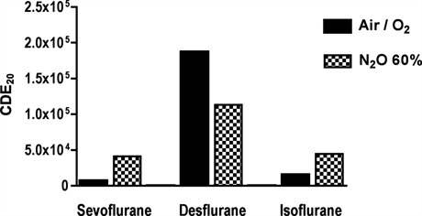
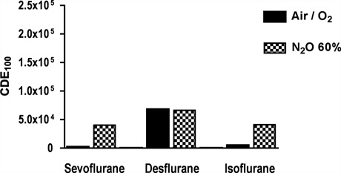
Reducing Nitrous Oxide (cont.)
Nitrous oxide can also increase the carbon footprint of both sevoflurane and isoflurane when nitrous is used as a carrier gas (relative to using medical air).
From a 2010 study from the Journal of Anesthesia and Analgesia (Ryan, 2010):
Carrier Used:
Carrier Used:
“CDEx”: Carbon dioxide equivalents emitted over an x year period
Notes:
Ryan, Susan M., and Claus J. Nielsen. (2010). “Global Warming Potential of Inhaled Anesthetics: Application to Clinical Use.” Anesthesia and Analgesia 111 (1): 92–98.

Slide 28
Reducing Nitrous Oxide (cont.)
The American Society for Anesthesiologists recommends two primary methods of reducing nitrous oxide emissions in the operating room (Axelrod, 2022):
Reserve nitrous oxide for cases in which it is clearly preferred for clinical reasons.
Decommission or avoid installing centralized nitrous oxide and substitute portable tanks that can remain closed between uses.
If logistically feasible, a switch to portable tanks has the potential to dramatically reduce nitrous leakage (Axelrod, 2022; Devlin-Hegedus, 2022).
Notes:
Axelrod D, Bell C, Feldman J, et al. ​Greening the Operating Room. (9/20/2022). Greening the Operating Room. American Society of Anesthesiologists (ASA). https://www.asahq.org/about-asa/governance-and-committees/asa-committees/environmental-sustainability/greening-the-operating-room.
Devlin-Hegedus JA, McGain F, Harris RD, Sherman JD. (2022), Action guidance for addressing pollution from inhalational anaesthetics. Anaesthesia. 77:1023-1029.

Slide 29
Reducing Nitrous Oxide (cont.)
Study from the Providence Portland Medical Center (2016): Compared the nitrous oxide leak from both central and portable systems (Chesebro, 2022)
Central Systems: Cryogenic containers (filled with liquid N₂O) and compressed gas cylinders (filled with gaseous N₂O)
Portable Systems: Open or closed e-cylinders
Results show a significant decrease in nitrous oxide leak (in comparison to clinical usage) in using either type of portable system vs. either type of central system.
Notes:
Chesebro B, Mason A. (2022). Nitrous Oxide: Climate-Smart Anesthesia 2016. Presented at the CleanMed, Kansas City.

Slide 30
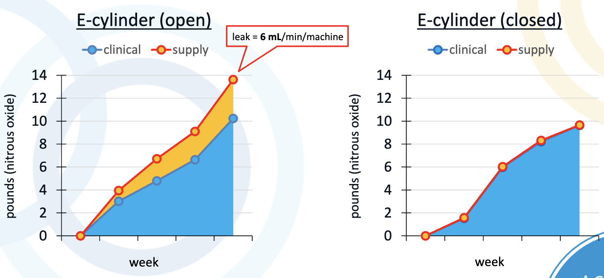
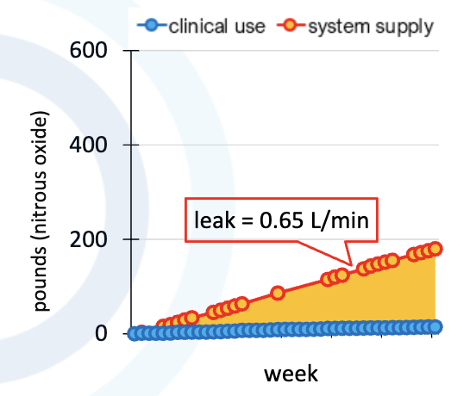
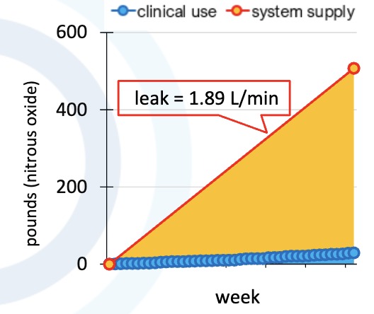
Reducing Nitrous Oxide (cont.)
Central Systems
Portable Systems
Cryogenic
Compressed

Slide 31
Reducing Nitrous Oxide in Pediatric Anesthesia
For pediatric inhalational inductions, limit nitrous oxide use to only medically necessary cases.
Studies show a difference of < 10 seconds to loss of lash reflex when sevoflurane was used without N₂O during single-breath vital capacity inductions (Lee, 2013).
For acceptance of mask induction and sevoflurane, distraction techniques such as conversation, electronic media, and premedication are effective (Gordon, 2020).
Incorporate IV anesthetics, regional, and local techniques to reduce N₂O use during maintenance or emergence.
Notes:
Gordon D. (2020). Sustainability in the Operating Room: Reducing Our Impact on the Planet. Anesthesiol Clin. 38(3):679-692
Lee SY, Cheng SL, Ng SB, Lim SL. (2013). Single-breath vital capacity high concentration sevoflurane induction in children: with or without nitrous oxide? Br J Anaesth. 110(1):81–86.

Slide 32
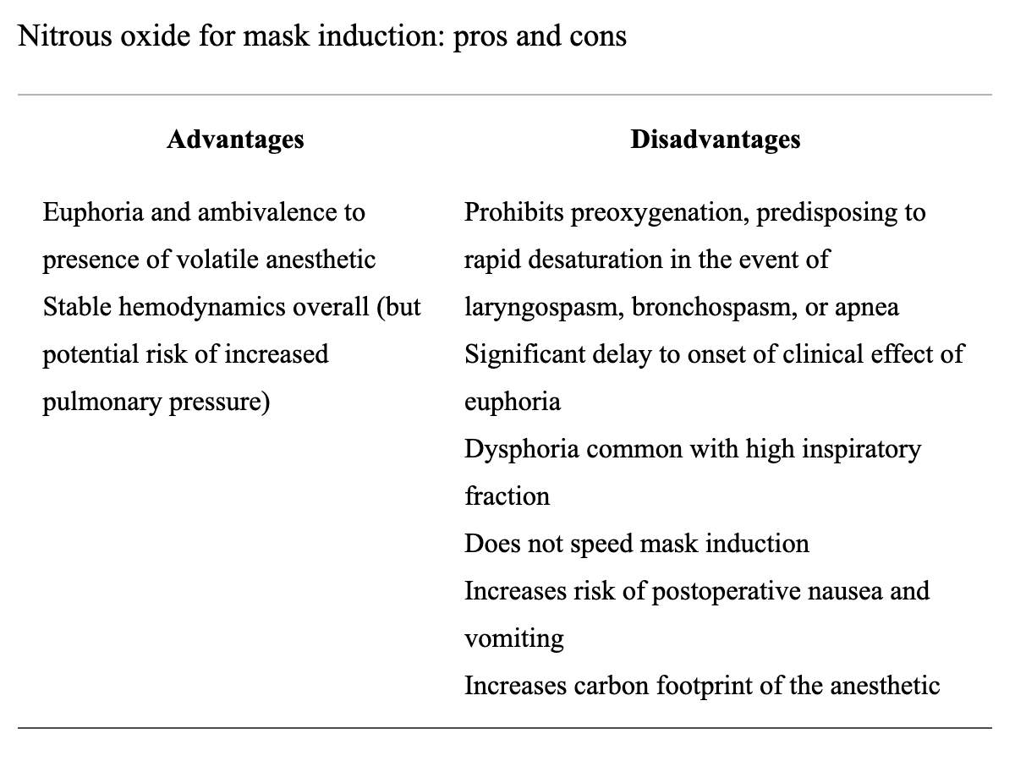
Reducing Nitrous Oxide in Pediatric Anesthesia (cont.)

Slide 33
Summary
Commonly used inhaled anesthetic agents such as halogenated gases and nitrous oxide are greenhouse gases, with nitrous also being an ozone-depleting agent.
The environmental impact of anesthetic gases can be compared by converting to CO₂ equivalents, which both factors in both the amount used in a given time and the global warming potential (or GWP).
We can significantly decrease our carbon footprint in the O.R. by both eliminating desflurane and reducing nitrous oxide usage.

Slide 34
Recommendations
Eliminating Desflurane
Problem: In comparison to other halogenated anesthetics, desflurane has a
significantly greater impact on the environment in terms of atmospheric lifetime, GWP 20, GWP 100, and CO₂ equivalents produced.
Recommendation: Completely eliminate desflurane from the operating room and
elect for environmentally-safer alternatives such as sevoflurane or isoflurane.
Reducing Nitrous Oxide
Problem: Nitrous oxide adversely affects the environment on its own both as a greenhouse
gas and ozone-depleting agent as well as in conjunction with other anesthetics as a carrier.
Recommendation: Only use nitrous oxide when clinical advantages are transparent and, if
feasible, opt for portable cylinders over centralized nitrous oxide piping.

Slide 35
Section III:
Managing Fresh Gas Flow
Notes:
Watts N, Amann M, Ayeb-Karlsson SA, et al. (2018). Countdown on Health and Climate Change: From 25 Years of Inaction to a Global Transformation for Public Health. Lancet. 391(10120):581–630.

Slide 36
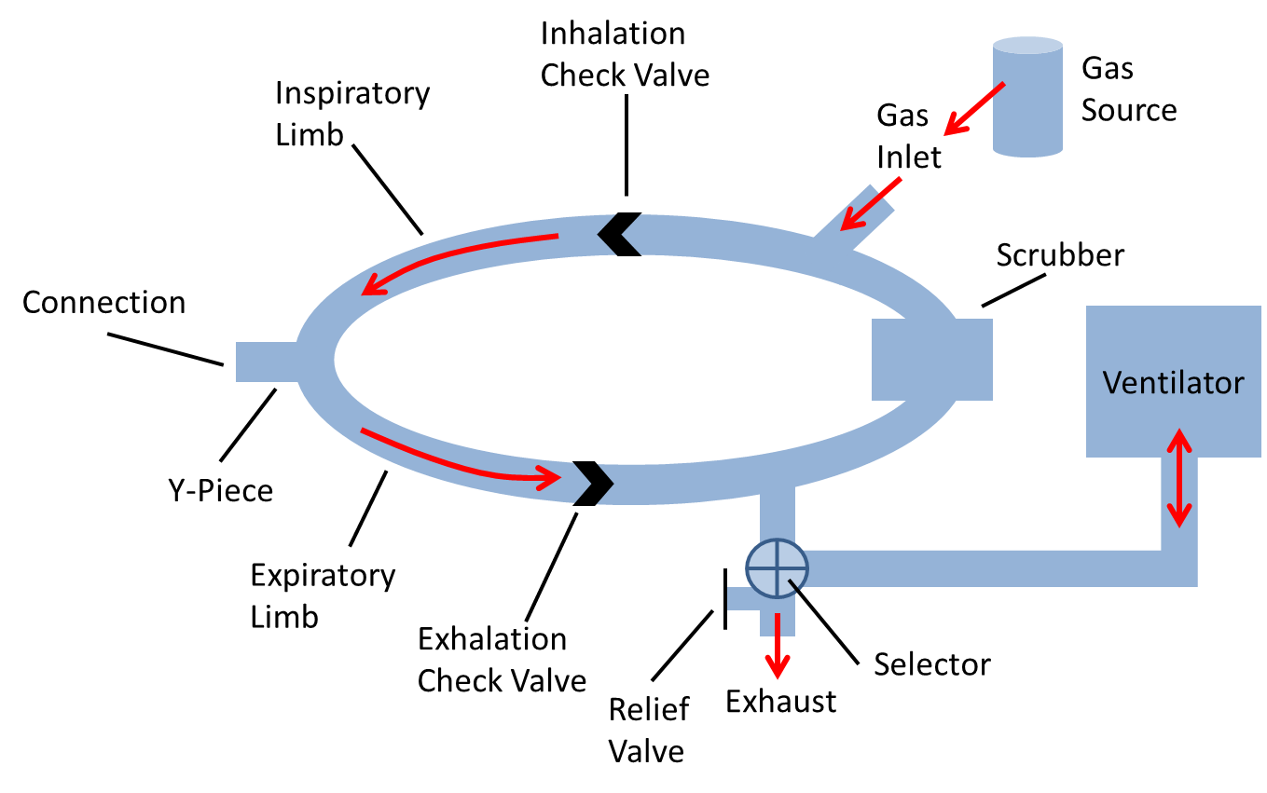
Fresh Gas Flow and Waste
When fresh gas flow exceeds a patient’s needs in a circular anesthesia system, gases and vapors will enter the scavenging system and be vented into the atmosphere.
Thus, the fresh gas flow rate is correlated to the amount of gas that enters the scavenging system and ultimately contaminates the ambient environment.
Image adapted from Pulse Physiology (Pulse Physiology, 2022)
Notes:
“Pulse Physiology Engine.” (2022). n.d. Accessed September 23, 2022. https://pulse.kitware.com/_anesthesia_machine_methodology.html

Slide 37
Fresh Gas Flow and Waste (cont.)
Since all anesthetic gases are greenhouse gases, high fresh gas flows of any inhaled anesthetic can lead to significant environmental contamination.
At high FGFs, it’s estimated that more than 80% of delivered anesthetic is wasted (Kapoor, 2019).
Although the impact of a single case is minimal, the effects are cumulative.
With an estimated worldwide volume of 200 to 300 million surgeries per year, the potential to decrease GHG emissions in the O.R. is considerable (Miller, 2022).
Notes:
Kapoor MC, Sashank A, Vats A, Garg S, Puri A. (2019). Minimal Flow Anesthesia Can Be Initiated Early with the Use of Higher Fresh Gas Flow to Facilitate Desflurane ‘Wash-In.’ J Anaesthesiol Clin Pharmacol. 35(4):487–92.
Miller A, Theodore D, Widrich J. (2022). Inhalational Anesthetic. In StatPearls. Treasure Island (FL):StatPearls Publishing.

Slide 38
Managing Fresh Gas Flow
Regardless of the inhaled anesthetic agent used, managing fresh gas flow can reduce waste from circular anesthesia and decrease the overall carbon footprint of a surgical case.
There are three primary ways to reduce fresh gas flow that minimize ecological impact without compromising patient care:
Minimizing fresh gas flow during induction in pediatric patients
Minimizing fresh gas flow during maintenance
Turning the vaporizer up (and the FGF down) during intubation

Slide 39
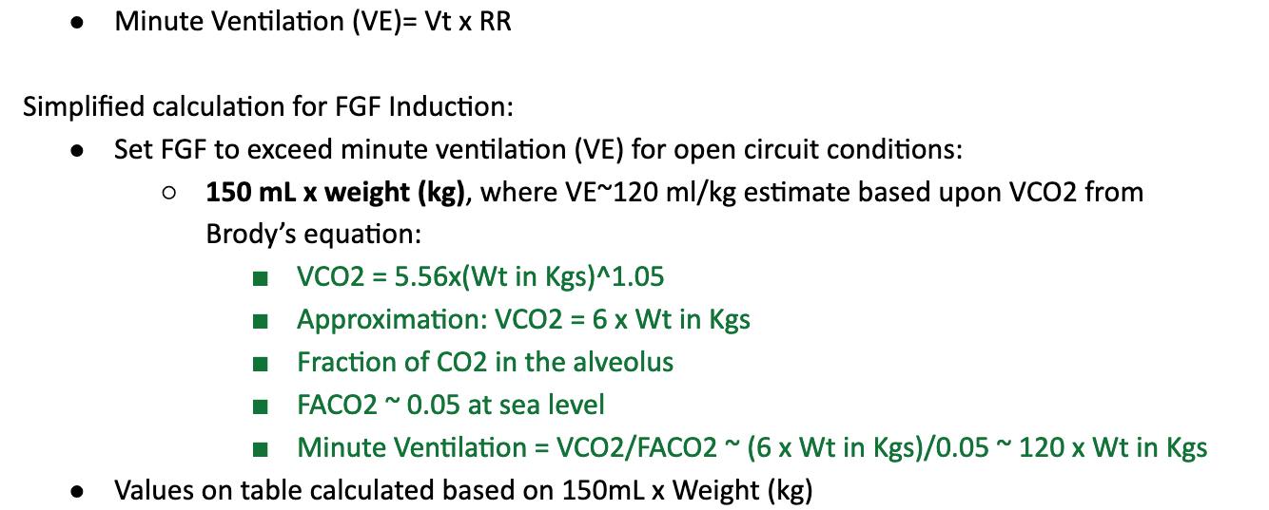
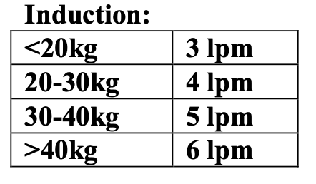
Minimizing FGF during Pediatric Inductions
The Society for Pediatric Anesthesia published guidelines for weight-based FGF during inhalation induction (Glensky, 2022):
Set FGF based on patient weight to exceed minute ventilation (VE) in order to prevent rebreathing
Notes:
Glensky T, Narayanasamy S. (10/4/2022). Low flow anesthesia in pediatric patients. Society for Pediatric Anesthesia. https://pedsanesthesia.org/wp-content/uploads/2021/08/Low-Flow-Anesthesia-in-Pediatric-Patients.pdf.

Slide 40
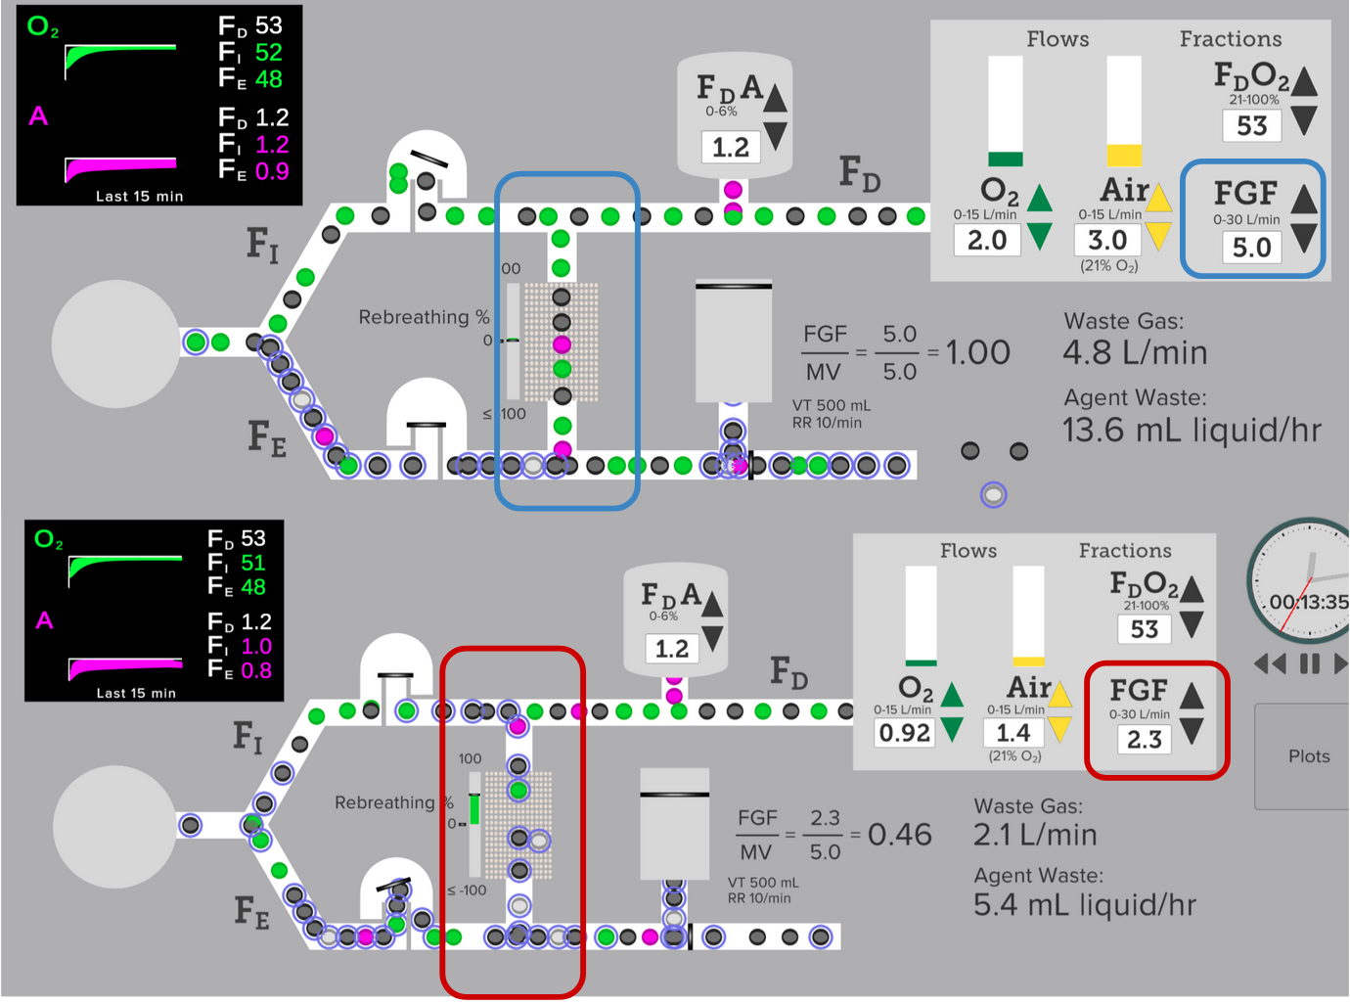
Minimizing FGF during Pediatric Inductions (cont.)
Setting induction FGF to exceed minute ventilation during induction prevents rebreathing and dilution of volatile concentration.
Simulation courtesy of “Low Flow Anesthesia” from the University of Florida Center for Safety, Simulation & Advanced Learning Technologies:
Top diagram: FGF >/= VE with no evidence of rebreathing.
Bottom diagram: FGF<VE with evidence of rebreathing.

Slide 41
Recommendation 1: Reducing FGF During Maintenance
During induction or emergence, it may be necessary to use high fresh gas flow when a rapid change in the concentration of anesthetic gas is required.
However, the maintenance generally relies on a steady concentration of gas.
Thus, the maintenance phase is an opportunity to lower the fresh gas flow to meet the patients needs, allowing for fewer GHG emissions without compromising clinical care.

Slide 42
Literature-Defined Flow Rates (Hönemann, 2013)
Metabolic Fresh Gas Flow
Minimal Fresh Gas Flow
Low Fresh Gas Flow
High Fresh Gas Flow
0.35 L/min
0.5 L/min
1 L/min
2-6 L/min
Notes:
Hönemann, Christian, Olaf Hagemann, and Dietrich Doll. (2013). “Inhalational Anaesthesia with Low Fresh Gas Flow.” Indian J Anaesth. 57(4):345–50.

Slide 43
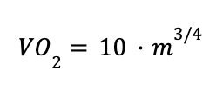
Minimizing Fresh Gas Flow During Maintenance
The minimum safe fresh gas flow supplies both enough oxygen and anesthetic to satisfy patient consumption plus additional gas to compensate for leaks in the circuit and/or via a sidestream gas analyzer (Axelrod, 2022).
The patient oxygen uptake is correlated with body mass (Feldman, 2012) and is conventionally calculated via two different formulas:
Brody’s Formula (Hönemann, 2023)
Linear Formula (Feldman, 2012)
Key:
“VO2”: Volume of oxygen consumed by the patient per min
“m”: Patient mass (in kg)
Notes:
Axelrod D, Bell C, Feldman J, et al. ​Greening the Operating Room. (9/20/2022). Greening the Operating Room. American Society of Anesthesiologists (ASA). https://www.asahq.org/about-asa/governance-and-committees/asa-committees/environmental-sustainability/greening-the-operating-room.
Feldman JM. (2012). Managing Fresh Gas Flow to Reduce Environmental Contamination. Anes Analg. 114(5):1093–1101.
Hönemann, Christian, Olaf Hagemann, and Dietrich Doll. (2013). “Inhalational Anaesthesia with Low Fresh Gas Flow.” Indian J Anaesth. 57(4):345–50.

Slide 44
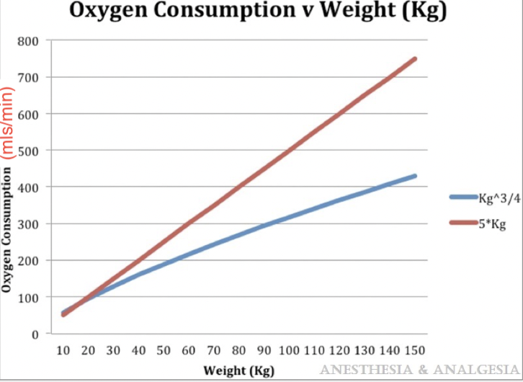
Minimizing Fresh Gas Flow During Maintenance (cont.)
This graph depicts the correlation between weight and oxygen consumption using Brody’s formula (blue) and the linear formula (red).
Although Brody’s formula typically yields a more accurate estimate (Pulse Physiology Engine, 2022), the linear formula is both more simple to calculate and overestimates the oxygen consumption, creating a margin of safety.
Notes:
“Pulse Physiology Engine.” n.d. Accessed September 23, 2022. https://pulse.kitware.com/_anesthesia_machine_methodology.html

Slide 45
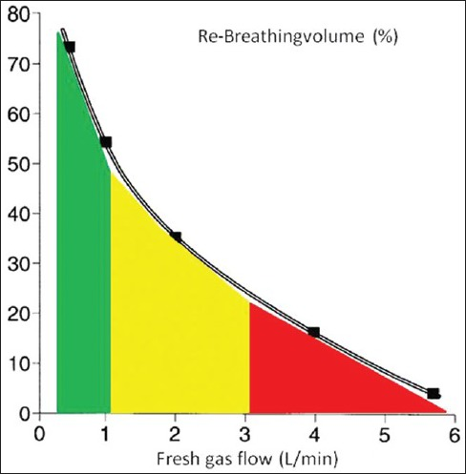
Benefits of Minimizing FGF During Maintenance: Ecological
Minimizing fresh gas flow during maintenance is a safe and effective way to thwart waste anesthetic gases, or “WAGs.”
WAGs are gases that escape from a circular anesthesia system into the outdoor atmosphere, virtually unmetabolized and unregulated (McGain, 2020).
Lower Fresh Gas Flow → Larger Re-Breathed Volume → Smaller WAG Volume Emitted into the Atmosphere
Notes:
McGain F, Muret J, Lawson C, Sherman JD. (2020). Environmental Sustainability in Anaesthesia and Critical Care. Br J Anaesth. 125(5):680–92.

Slide 46
Benefits of Minimizing FGF During Maintenance (cont.)
Clinical Considerations
Economic Considerations
Prior research indicates that minimizing FGF during the maintenance phase can also…
Increase heat and moisture content in the lungs (Kleemann, 1994; Nunn, 2008)
Increase mucociliary clearance and help maintain a steady body temperature (Aldrete, 1981)
Help providers detect small leaks in the circuit and adjust accordingly (CSSALT, 2022)
Reduction of anesthetic gas consumption results in significant institutional savings (Watts, 2018).
“Low-flow anesthesia is a simple but highly effective method of cost minimisation that can be applied to a large number of patients without any compromise in patient care or safety (Suttner, 2000)”
Notes:
Aldrete JA, Cubillos P, Sherrill D. (1981). “Humidity and Temperature Changes during Low Flow and Closed System Anaesthesia.” Acta Anaesthesiologica Scandinavica 25(4):312–14.
CSSALT. (10/13/2022). Low-Flow Anesthesia. The Center for Safety, Simulation, and Advanced Learning Technologies (CSSALT), University of Florida Health. https://simulation.health.ufl.edu/education-training/apsf-technology-education-
Kleemann PP (1994). Humidity of Anaesthetic Gases with Respect to Low Flow Anaesthesia. Anaesth Intensive Care. 22(4):396–408.
Nunn G. (2008). Low-Flow Anaesthesia. Continuing Education in Anaesthesia Critical Care & Pain. 8(1):1–4.
initiative/low-flow-anesthesia/.
Suttner S, Boldt J. (2000). Low-Flow Anaesthesia. Does It Have Potential Pharmacoeconomic Consequences? Pharmacoeconomics. 17(6):585–90.
Watts N, Amann M, Ayeb-Karlsson SA, et al. (2018). Countdown on Health and Climate Change: From 25 Years of Inaction to a Global Transformation for Public Health. Lancet. 391(10120):581–630.

Slide 47
Concerns of Minimizing FGF During Maintenance
Inadequate Oxygen Delivery
As the fresh gas flow is lowered, the amount of exhaled gas (with a higher carbon dioxide concentration) returned to the patient increases (Feldman, 2022).
This can lead to inadvertent low inspired concentration and hypoxemia.
Inadequate Anesthetic Agent Delivery
A decrease FGF risks an inadequate anesthetic concentration, especially during early procedural stages in which there is significant uptake of anesthetic from the lungs (Axelrod, 2022; Feldman, 2022.
Wasted Emissions
Lowering FGF still results in significant WAG emission (unlike a true closed circuit in which fresh gas flow directly equates what is consumed by the patient) (Sherman, 2012).
Toxicity Associated with CO₂ Absorbents
As FGF decreases, a higher concentration of CO₂ absorbent is required.
Depending on the absorbent used, the risk of toxicity from Compound A and/or carbon monoxide production may increase as well (Feldman, 2021; Branche, 2017).
Notes:
Axelrod D, Bell C, Feldman J, et al. ​Greening the Operating Room. (9/20/2022). Greening the Operating Room. American Society of Anesthesiologists (ASA). https://www.asahq.org/about-asa/governance-and-committees/asa-committees/environmental-sustainability/greening-the-operating-room.
Branche R, Feldman J, Hendrickx J. (2017). Low Flow and CO2 Absorbents. Anesthesia Patient Safety Foundation. https://www.apsf.org/article/low-flow-and-co2-absorbents/
Feldman JM, Hendrickx J, Kennedy RR. (2021). Carbon Dioxide Absorption During Inhalation Anesthesia: A Modern Practice. Anes Analg. 132(4):993–1002.
Feldman J, Lampotang S. (2022). “Patient Safety and Low-Flow Anesthesia.” Anesthesia Patient Safety Foundation. June 1, 2022. https://www.apsf.org/article/patient-safety-and-low-flow-anesthesia/
Sherman, Jodi, Cathy Le, Vanessa Lamers, and Matthew Eckelman. (2012). “Life Cycle Greenhouse Gas Emissions of Anesthetic Drugs.” Anesthesia and Analgesia 114 (5): 1086–90.

Slide 48
Safely Minimizing FGF: Setting a Buffer
Once minimum FGF is calculated, the utilized FGF can be set slightly above this value to reduce the risk of inadequate oxygen/anesthetic delivery.
Even a small reduction in FGF can make a significant ecological difference.
Assuming 500 cases over 35 years, reducing the maintenance flow of isoflurane from 2 liters/min to 1 liter/min prevents an estimated 18,900 liters from entering the atmosphere (Feldman, 2012).
The ASA recommends total oxygen flow to be 20% greater than oxygen consumption.
Courses such as the University of Florida’s “Low Flow Anesthesia” can educate on how to set a flow buffer and balance ecological impact with clinical safety(CSSALT, 2022).
Notes:
CSSALT. (10/13/2022). Low-Flow Anesthesia. The Center for Safety, Simulation, and Advanced Learning Technologies (CSSALT), University of Florida Health. https://simulation.health.ufl.edu/education-training/apsf-technology-education-initiative/low-flow-anesthesia/.
Feldman JM. (2012). Managing Fresh Gas Flow to Reduce Environmental Contamination. Anes Analg. 114(5):1093–1101.

Slide 49
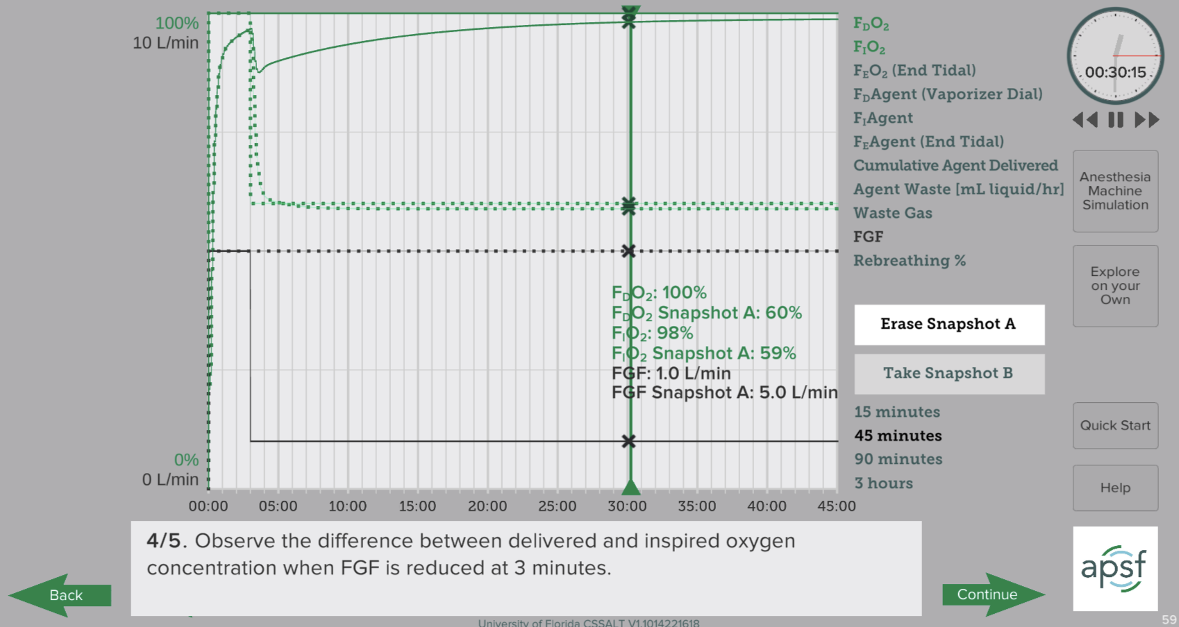
Safely Minimizing FGF: Setting a Buffer
“Low Flow Anesthesia” from the University of Florida Center for Safety, Simulation & Advanced Learning Technologies
https://simulation.health.ufl.edu/education-training/apsf-technology-education-initiative/low-flow-anesthesia/

Slide 50
Safely Minimizing FGF: Monitoring
Monitoring gas and anesthetic concentrations by the provider throughout the maintenance phase is essential for reducing the risks of hypercapnia/hypoxia and inadequate anesthetic delivery (Axelrod, 2022; Honemann, 2013; Feldman, 2012; Feldman 2022; Garg, 2012).
Inspired/expired carbon dioxide, oxygen, and anesthetic agent concentration should be consistently observed and fresh gas flow should be adjusted accordingly.
Note: Managing inspired anesthetic concentration may be more challenging since uptake of anesthetic falls exponentially over time (Feldman, 2022).
Notes:
Axelrod D, Bell C, Feldman J, et al. ​Greening the Operating Room. (9/20/2022). Greening the Operating Room. American Society of Anesthesiologists (ASA). https://www.asahq.org/about-asa/governance-and-committees/asa-committees/environmental-sustainability/greening-the-operating-room.
Feldman JM. (2012). Managing Fresh Gas Flow to Reduce Environmental Contamination. Anes Analg. 114(5):1093–1101.
Feldman J, Lampotang S. (2022). “Patient Safety and Low-Flow Anesthesia.” Anesthesia Patient Safety Foundation. June 1, 2022. https://www.apsf.org/article/patient-safety-and-low-flow-anesthesia/
Garg R. (2012). Low Flow Anesthesia and Volatile Anesthetic Agents - Concerns. J Anaesthesiol Clin Pharmacol. 28(4):475–76.
Hönemann, Christian, Olaf Hagemann, and Dietrich Doll. (2013). “Inhalational Anaesthesia with Low Fresh Gas Flow.” Indian J Anaesth. 57(4):345–50.

Slide 51
Safely Minimizing FGF: CO₂ Absorbent Choice
Although some CO₂ absorbents present the possibility of toxicity when mixed with anesthetic gas, it’s suggested that choosing absorbents containing no potassium chloride and less than 2% sodium chloride would eliminate this risk (Feldman, 2022).
In absorbents containing KOH and NaOH, the strong base can react with sevoflurane or desflurane to produce Compound A or carbon monoxide, respectively.
Without these bases present, however, Compound A and carbon monoxide production are no longer a concern, eliminating the risk of toxicity.
Thus, these CO₂ absorbent formulations can be used safely to minimize anesthetic waste by allowing the reduction of fresh gas flow during the maintenance phase without the risk of toxic gas production.
Notes:
Feldman J, Lampotang S. (2022). “Patient Safety and Low-Flow Anesthesia.” Anesthesia Patient Safety Foundation. June 1, 2022. https://www.apsf.org/article/patient-safety-and-low-flow-anesthesia/

Slide 52
Intubation: Vaporizer vs. FGF
Common Misconception: Turning off the vaporizer while turning on fresh gas flow during intubation prevents pollution of the operating room by the anesthetic agent.
Rather, the anesthetic vapor that has accumulated in the circuit during mask ventilation is washed into the room by fresh gas flow (Axelrod, 2022; Feldman, 2012; Scott, 2005).
Thus, room contamination is not avoided and vapor in the circuit is wasted.
Notes:
Axelrod D, Bell C, Feldman J, et al. ​Greening the Operating Room. (9/20/2022). Greening the Operating Room. American Society of Anesthesiologists (ASA). https://www.asahq.org/about-asa/governance-and-committees/asa-committees/environmental-sustainability/greening-the-operating-room.
Feldman JM. (2012). Managing Fresh Gas Flow to Reduce Environmental Contamination. Anes Analg. 114(5):1093–1101.
Scott, J. R., and T. G. Ruttman. (2005). “‘Gas off’ or ‘Vaporizer off.’” British Journal of Anaesthesia 95 (6): 838.

Slide 53
Recommendation 2: Vaporizer On/FGF Off During Intubation
Alternate Strategy: Leave the vaporizer on and turn the fresh gas flow off during the intubation process.
This could mean temporarily switching FGF off or using the 60-second “pause flow” feature on your anesthesia machine during intubation
This practice would completely eliminate the discharge of the anesthetic gas mixture into the O.R. environment during intubation (Scott, 2005).
In the absence of fresh gas flow, none of the anesthetic vapor is washed into the room and the reservoir that has built up in the circuit is preserved (Axelrod, 2022).
Notes:
Axelrod D, Bell C, Feldman J, et al. ​Greening the Operating Room. (9/20/2022). Greening the Operating Room. American Society of Anesthesiologists (ASA). https://www.asahq.org/about-asa/governance-and-committees/asa-committees/environmental-sustainability/greening-the-operating-room.
Scott, J. R., and T. G. Ruttman. (2005). “‘Gas off’ or ‘Vaporizer off.’” British Journal of Anaesthesia 95 (6): 838.

Slide 54
Vaporizer On/FGF Off During Intubation: Benefits
Ecological
Economic
Clinical
No environmental contamination during intubation (Feldman, 2012)
A lower FGF can be used to maintain the circuit concentration subsequent to intubation (Feldman, 1999)
Higher alveolar concentration can be achieved at the same vapor cost (Feldman, 1999)
Additional cost savings when FGF is kept paused or off immediately after intubation
A greater alveolar concentration speeds up induction (Feldman, 1999)
Would also prevent a fall in concentration within the circuit, thus reducing the likelihood of awareness post-intubation (Scott, 2005)
Notes:
Feldman JM. (1999). A Simple Strategy for Faster Induction and More Cost-Effective Use of Anesthetic Vapor. J Clin Monit Comput. 15(1):17–21.
Feldman JM. (2012). Managing Fresh Gas Flow to Reduce Environmental Contamination. Anes Analg. 114(5):1093–1101.
Scott, J. R., and T. G. Ruttman. (2005). “‘Gas off’ or ‘Vaporizer off.’” British Journal of Anaesthesia 95 (6): 838.

Slide 55
Vaporizer On/FGF Off During Intubation: Other Considerations
Note: Pausing or turning off the fresh gas flow during intubation may not be appropriate for all cases.
In the event of difficult airway, fresh gas flow may need to be turned back on to continue mask ventilation (Axelrod, 2022; Feldman, 2012).
Each practitioner should make a decision about their own comfort level with airway management and fresh gas flow changes.
Notes:
Axelrod D, Bell C, Feldman J, et al. ​Greening the Operating Room. (9/20/2022). Greening the Operating Room. American Society of Anesthesiologists (ASA). https://www.asahq.org/about-asa/governance-and-committees/asa-committees/environmental-sustainability/greening-the-operating-room.
Feldman JM. (2012). Managing Fresh Gas Flow to Reduce Environmental Contamination. Anes Analg. 114(5):1093–1101.

Slide 56
Summary
Circular anesthetic systems allow leaks of anesthetic vapor into the ambient environment through the scavenging system.
Managing fresh gas by both reducing FGF during maintenance and turning FGF off during intubation when clinically appropriate can help minimize this waste while also providing both economic and clinical benefits.

Slide 57
Recommendations
Minimizing Fresh Gas Flow During Maintenance
Using minimum fresh gas flow that still satisfies the patient’s anesthetic and oxygen needs provides ecological, economical, and clinical benefits.
To ensure adequate anesthetic and oxygen concentrations, a buffer should be set that overestimates minimum FGF and both gas and anesthetic concentrations should be monitored throughout the case.
Turning Off Fresh Gas Flow During Intubation
Keeping the vaporizer on and turning the FGF off during mask intubation does not contaminate the operating room but actually provides numerous ecological and non-ecological advantages.
However, this technique may not be appropriate for all procedures and should ultimately be a provider-led decision.

Slide 58
Promoting Environmentally Sustainable Anesthesia: Recommendations
Selection of Anesthetic Agent
Management of Fresh Gas Flow
Eliminate usage of desflurane
Reduce usage of nitrous oxide
Minimize fresh gas flow during maintenance
Turn off fresh gas flow during intubation

Slide 59
Section IV:
MPOG QI Measures
Notes:
Watts N, Amann M, Ayeb-Karlsson SA, et al. (2018). Countdown on Health and Climate Change: From 25 Years of Inaction to a Global Transformation for Public Health. Lancet. 391(10120):581–630.

Slide 60
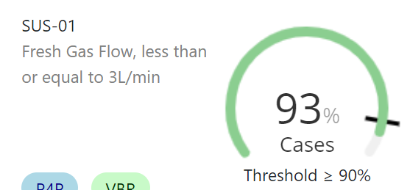
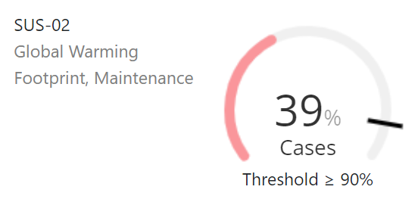
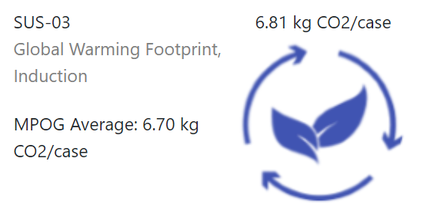
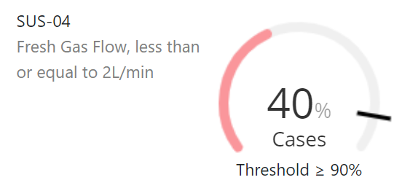
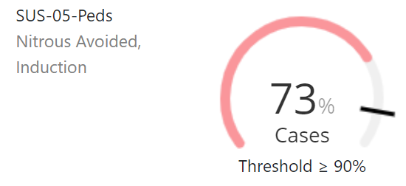
MPOG: Sustainability Dashboard (sample)

Slide 61
SUS-01: Mean Fresh Gas Flow ≤ 3L/min
Description: Percentage of cases with mean fresh gas flow (FGF) equal to, or less than 3L/min, during administration of halogenated hydrocarbons and/or nitrous oxide.
Inclusion Criteria:
Cases with an ETT or LMA as determined by Anesthesia Technique: General value_codes 1,2,3,6 (Feldman, 2022)
Patients administered halogenated hydrocarbons and/or nitrous oxide, for greater than or equal to 30 minutes from placement of the airway device to removal of the airway device.
Success: Mean FGF equal to, or less than 3L/minute when inspired halogenated hydrocarbons is > 0.2%, or nitrous oxide FGF > 0.2 L/min, during the maintenance period of anesthesia.
Notes:
Feldman J, Lampotang S. (2022). “Patient Safety and Low-Flow Anesthesia.” Anesthesia Patient Safety Foundation. June 1, 2022. https://www.apsf.org/article/patient-safety-and-low-flow-anesthesia/

Slide 62
SUS-01: Percentage Passed Across MPOG Sites

Slide 63
SUS-02: Global Warming Footprint (Maintenance)
Description: Percentage of cases where carbon dioxide equivalents (CO₂ eq) normalized by hour for cases receiving halogenated agents and/or nitrous oxide is less than CO₂ eq of 2% sevoflurane at 2L FGF = 2.83 kg CO₂/hr during the maintenance period of anesthesia.
Inclusion Criteria:
Cases with an ETT or LMA as determined by MPOG phenotype Anesthesia Technique: General (value codes 1,2,3,6) (Feldman, 2022).
Cases where halogenated hydrocarbons and/or nitrous oxide were administered during the maintenance phase of anesthesia.
Success: Mean efficiency less than or equal to carbon dioxide equivalents of 2% sevoflurane at 2L FGF = 2.83 kg CO₂/hr.
Notes:
Feldman J, Lampotang S. (2022). “Patient Safety and Low-Flow Anesthesia.” Anesthesia Patient Safety Foundation. June 1, 2022. https://www.apsf.org/article/patient-safety-and-low-flow-anesthesia/

Slide 64
SUS-02: Percentage Passed Across MPOG Sites

Slide 65
SUS-03: Global Warming Footprint (Induction)
Description: Total carbon dioxide equivalents per induction for cases where halogenated agents and/or nitrous oxide was administered during the induction period of anesthesia
Inclusion Criteria:
Cases with an ETT or LMA (Feldman, 2022)
Cases where halogenated hydrocarbons and/or nitrous oxide were administered during the maintenance phase of anesthesia.
Success: Not applicable - informational measure.
Carbon dioxide equivalents reported as kilograms of carbon dioxide equivalents per case
Emissions data are also converted to other meaningful equivalencies & reported as:
Miles driven by an average gasoline-powered passenger vehicle
Gallons of gasoline consumed
Notes:
Feldman J, Lampotang S. (2022). “Patient Safety and Low-Flow Anesthesia.” Anesthesia Patient Safety Foundation. June 1, 2022. https://www.apsf.org/article/patient-safety-and-low-flow-anesthesia/

Slide 66
SUS-03: Average CO2 eq (Induction) Across MPOG Sites

Slide 67
SUS-04: Fresh Gas Flow ≤ 2L/min
Description: Percentage of cases with mean fresh gas flow (FGF) equal to, or less than 2L/min, during administration of halogenated hydrocarbons and/or nitrous oxide.
Inclusion Criteria:
Cases with an ETT or LMA as determined by Anesthesia Technique: General value_codes 1,2,3,6 (Feldman, 2022).
Patients administered halogenated hydrocarbons and/or nitrous oxide, for greater than or equal to 30 minutes from placement of the airway device to removal of the airway device.
Success: Mean FGF equal to, or less than 2L/minute when inspired halogenated hydrocarbons is >0.2%, or nitrous oxide FGF >0.2L/min, during the maintenance period of anesthesia.
Notes:
Feldman J, Lampotang S. (2022). “Patient Safety and Low-Flow Anesthesia.” Anesthesia Patient Safety Foundation. June 1, 2022. https://www.apsf.org/article/patient-safety-and-low-flow-anesthesia/

Slide 68
SUS-04: Percentage Passed Across MPOG Sites

Slide 69
SUS-05-Peds: Nitrous Avoided During Induction (Pediatrics)
Description: Percentage of pediatric cases where nitrous oxide gas was avoided during induction of anesthesia.
Inclusion Criteria:
Patients < 18yo who undergo general anesthesia as defined by Anesthesia Technique: General (Feldman, 2022).
Success: Nitrous oxide was not administered during the induction period of anesthesia.
Notes:
Feldman J, Lampotang S. (2022). “Patient Safety and Low-Flow Anesthesia.” Anesthesia Patient Safety Foundation. June 1, 2022. https://www.apsf.org/article/patient-safety-and-low-flow-anesthesia/

Slide 70
SUS-05: Percentage Passed Across MPOG Sites

Slide 71
References
Aldrete JA, Cubillos P, Sherrill D. (1981). “Humidity and Temperature Changes during Low Flow and Closed System Anaesthesia.” Acta Anaesthesiol Scand. 25(4):312–14.
Aranake AG, Mashour GA, Avidan M. (2013). “Minimum Alveolar Concentration: Ongoing Relevance and Clinical Utility.” Anaesthesia. 68:512–22.
Axelrod D, Bell C, Feldman J, et al. ​(9/20/2022). Greening the Operating Room. American Society of Anesthesiologists (ASA). https://www.asahq.org/about-asa/governance-and-committees/asa-committees/environmental-sustainability/greening-the-operating-room.
Boggett S, Ou-Young J, Heiberg J, et al. (2019). “A Randomized Trial of Desflurane or Sevoflurane on Postoperative Quality of Recovery after Knee Arthroscopy.” PloS One 14(8): e0220733.
Bosenberg M. (2011). Anaesthetic Gases: Environmental Impact and Alternatives. Sabinet 17:5, 345-348.
Branche R, Feldman J, Hendrickx J. (2017). Low Flow and CO2 Absorbents. Anesthesia Patient Safety Foundation. https://www.apsf.org/article/low-flow-and-co2-absorbents/
Budd K. (10/3/2019). Hospitals Race to Save Patients — and the Planet. AAMCNews. https://www.aamc.org/news-insights/hospitals-race-save-patients-and-planet.

Slide 72
References
Campbell M, Pierc T. (2014). Atmospheric Science, Anaesthesia, and the Environment. Continuing Education in Anaesthesia Critical Care & Pain. 15(4):173–79. -- https://www.bjaed.org/article/S2058-5349(17)30142-7/fulltext.
Chesebro B, Mason A. (2022). Nitrous Oxide: Climate-Smart Anesthesia 201. Presented at the CleanMed, Kansas City. https://www.youtube.com/watch?v=KRBajNxKo4A.
Chung JW, Meltzer DO. (2009). Estimate of the Carbon Footprint of the US Health Care Sector. JAMA. 302 (18):1970–72.
CSSALT. (10/13/2022). Low-Flow Anesthesia. The Center for Safety, Simulation, and Advanced Learning Technologies (CSSALT), University of Florida Health. https://simulation.health.ufl.edu/education-training/apsf-technology-education-initiative/low-flow-anesthesia/.
Devlin-Hegedus JA, McGain F, Harris RD, Sherman JD. (2022), Action guidance for addressing pollution from inhalational anaesthetics. Anaesthesia. 77:1023-1029.
Eckelman MJ, Sherman JD. (2016). Environmental Impacts of the U.S. Health Care System and Effects on Public Health. PloS One 11 (6):e0157014.
Eckelman MJ, Sherman JD. (2018). Estimated Global Disease Burden From US Health Care Sector Greenhouse Gas Emissions. Am J Public Health. 108(S2):S120–22.

Slide 73
References
EPA. (5/16/2022) Overview of Greenhouse Gases. United States Environmental Protection Agency. https://www.epa.gov/ghgemissions/overview-greenhouse-gases.
Feldman JM. (1999). A Simple Strategy for Faster Induction and More Cost-Effective Use of Anesthetic Vapor. J Clin Monit Comput. 15(1):17–21.
Feldman JM. (2012). Managing Fresh Gas Flow to Reduce Environmental Contamination. Anesth Analg. 114(5):1093–1101.
Feldman JM, Hendrickx J, Kennedy RR. (2021). Carbon Dioxide Absorption During Inhalation Anesthesia: A Modern Practice. Anesth Analg. 132(4):993–1002.
Feldman J, Lampotang S. (2022). “Patient Safety and Low-Flow Anesthesia.” Anesthesia Patient Safety Foundation. June 1, 2022. https://www.apsf.org/article/patient-safety-and-low-flow-anesthesia/.
Garg R. (2012). Low Flow Anesthesia and Volatile Anesthetic Agents - Concerns. J Anaesthesiol Clin Pharmacol. 28(4):475–76.
Glensky T, Narayanasamy S. (10/4/2022). Low flow anesthesia in pediatric patients. Society for Pediatric Anesthesia. https://pedsanesthesia.org/wp-content/uploads/2021/08/Low-Flow-Anesthesia-in-Pediatric-Patients.pdf.

Slide 74
References
Gordon D. (2020). Sustainability in the Operating Room: Reducing Our Impact on the Planet. Anesthesiol Clin. 38(3):679-692
Gupta A, Stierer T, Zuckerman R, et al. (2004). Comparison of Recovery Profile after Ambulatory Anesthesia with Propofol, Isoflurane, Sevoflurane and Desflurane: A Systematic Review. Anesth Analg. 98(3):632–41.
Hansen J, Sato M, Ruedy R, et al. (2006). Global Temperature Change. Proc Natl Acad Sci USA. 103(39):14288–93.
Hendrickx, Jan F. A., Ole John Nielsen, et. al (2022). “The Science behind Banning Desflurane: A Narrative Review.” Eur J Anaesthesiol. 39 (10): 818–24.
Hönemann C, Hagemann O, Doll D. (2013). “Inhalational Anaesthesia with Low Fresh Gas Flow.” Indian J Anaesth. 57(4):345–50.
IPCC. (2022). Climate Change 2022: Impacts, Adaptation, and Vulnerability. Contribution of Working Group II to the Sixth Assessment Report of the Intergovernmental Panel on Climate Change (IPCC). https://www.ipcc.ch/report/ar6/wg2/.
Ishizawa Y. (2011). General Anesthetic Gases and the Global Environment. Anesth Analg. 112(1):213-217.
Kapoor MC, Sashank A, Vats A, et. al. (2019). Minimal Flow Anesthesia Can Be Initiated Early with the Use of Higher Fresh Gas Flow to Facilitate Desflurane ‘Wash-In.’ J Anaesthesiol Clin Pharmacol. 35(4):487–92.

Slide 75
References
Kleemann PP. (1994). Humidity of Anaesthetic Gases with Respect to Low Flow Anaesthesia. Anaesth Intensive Care. 22(4):396–408.
Kurhekar P, Vinod J, Krishna JSD, Raghuraman MS. (2017). Randomized Comparison of Isoflurane versus Sevoflurane and Desflurane for Maintenance of Ambulatory Anesthesia. Anesth Essays Res. 11(4):875–80.
Lee SY, Cheng SL, Ng SB, Lim SL. (2013). Single-breath vital capacity high concentration sevoflurane induction in children: with or without nitrous oxide? Br J Anaesth. 110(1):81–86.
Lopez LA, Hofmeister EH, Pavez JC, Brainard BM. (2009). Comparison of Recovery from Anesthesia with Isoflurane, Sevoflurane, or Desflurane in Healthy Dogs. Am J Vet Res. 70(11):1339–44.
McGain F, Muret J, Lawson C, Sherman JD. (2020). Environmental Sustainability in Anaesthesia and Critical Care. Br J Anaesth. 125(5):680–92.
Miller A, Theodore D, Widrich J. (2022). Inhalational Anesthetic. In: StatPearls (Internet). Treasure Island (FL): StatPearls Publishing.
Moody A, Beutler BD, Moody CE. (2020). Predicting Cost of Inhalational Anesthesia at Low Fresh Gas Flows: Impact of a New Generation Carbon Dioxide Absorbent. Med Gas Res. 10(2):64–66.

Slide 76
References
Nunn G. (2008). Low-Flow Anaesthesia. Continuing Education in Anaesthesia Critical Care & Pain. 8(1):1–4. https://www.bjaed.org/article/S1743-1816(17)30433-X/fulltext.
Pichler, Peter-Paul, Ingram S. Jaccard, et. al (2019). “International Comparison of Health Care Carbon Footprints.” Environmental Research Letters: ERL [Web Site] 14 (6): 064004. https://iopscience.iop.org/article/10.1088/1748-9326/ab19e1.
“Pulse Physiology Engine.”(2022). n.d. Accessed September 23, 2022. https://pulse.kitware.com/_anesthesia_machine_methodology.html
Ravishankara, A. R., John S. Daniel, and Robert W. Portmann. (2009). “Nitrous Oxide (N2O): The Dominant Ozone-Depleting Substance Emitted in the 21st Century.” Science 326 (5949): 123–25.
Rich S. 2022. (4/4/2022). UN Climate Report: It’s ‘now or Never’ to Limit Global Warming to 1.5 Degrees. United Nation News. https://news.un.org/en/story/2022/04/1115452.
Ryan, Susan M., and Claus J. Nielsen. (2010). “Global Warming Potential of Inhaled Anesthetics: Application to Clinical Use.” Anesth Analg. 111 (1): 92–98.
Schowtzer, Ella, and Kaeleigh Sheehan. 2020. “Healing Patients and Planet with 1 Cost-Saving Anesthesia Adjustment.” Health Care Without Harm. February 18, 2020. https://noharm-uscanada.org/desfluraneelimination.

Slide 77
References
Scott, J. R., and T. G. Ruttman. (2005). “‘Gas off’ or ‘Vaporizer off.’” Br J Anaesth. 95 (6): 838.
Sherman, Jodi, Cathy Le, Vanessa Lamers, and Matthew Eckelman. (2012). “Life Cycle Greenhouse Gas Emissions of Anesthetic Drugs.” Anesth Analg. 114 (5): 1086–90.
Silva G, Waberski A, Bryant J. (2021). Eliminating Desflurane. Society of Pediatric Anesthesiology (SPA) Website: https://pedsanesthesia.org/wp-content/uploads/2021/08/Eliminiating-Desflurane.pdf.
Suttner S, Boldt J. (2000). Low-Flow Anaesthesia. Does It Have Potential Pharmacoeconomic Consequences? Pharmacoeconomics. 17(6):585–90.
US EPA, (2016). Understanding Global Warming Potentials. United State Environmental Protection Agency. https://www.epa.gov/ghgemissions/understanding-global-warming-potentials.
Velders GJM, Daniel JS. (2014). Uncertainty Analysis of Projections of Ozone-Depleting Substances: Mixing Ratios, EESC, ODPs, and GWPs. Atmospheric Chemistry and Physics. 14(6):2757–76. https://acp.copernicus.org/articles/14/2757/2014/.
Watts N, Amann M, Ayeb-Karlsson SA, et al. (2018). Countdown on Health and Climate Change: From 25 Years of Inaction to a Global Transformation for Public Health. Lancet. 391(10120):581–630.

Slide 78
References
White PF, Tan J, Wender RH, et al. (2009). Desflurane versus Sevoflurane for Maintenance of Outpatient Anesthesia: The Effect on Early versus Late Recovery and Perioperative Coughing. Anesth Analg 109(2):387–93.
Yasny JS, White J. (2012). Environmental Implications of Anesthetic Gases. Anesth Prog 59(4):154–58.
Zoghbi V, Lin C, Fahrenbach V. (5/6/2022). Rethinking Desflurane. California Society of Anesthesiologists. https://www.csahq.org/news/blog/csa-online-first/2022/05/16/rethinking-desflurane.

