Slide 1
Postoperative Nausea & Vomiting QI Toolkit
Recommendations for treatment

Slide 3
Objectives
PONV Overview: Impact, Pathophysiology, & Risk Factors
PONV Prophylaxis Recommendations
Summarize recommendations for the treatment of PONV
Provide overview of literature for treatment of PONV, including antiemetics and alternative therapies
Provide brief overview of postoperative nausea and vomiting (PONV) risk factors
Discuss treatment considerations, including obstetric and older adult patient populations

Slide 4
Who is at risk?
Postoperative Nausea & Vomiting (PONV) risk scoring tools are used to identify high-risk patients and guide the administration of multimodal treatments. ¹⁻⁴
Such tools have been proven to significantly reduce the incidence of PONV and PDNV. ¹⁻⁴

Slide 5
Guidelines: PONV Risk Assessment & Management
ASA Task Force on Postanesthetic Care (2013):
‘Routine assessment and monitoring of nausea and vomiting should be done during emergence and recovery.’⁵
Fourth Consensus Guidelines for the Management of Postoperative Nausea and Vomiting (2020):
‘PONV risk factors should be used for risk assessment and to guide PONV management.’¹

Slide 6
PONV Risk Scoring Tools for Adults
PONV prevention and treatment are recommended to be based upon determined risk. ¹
Total number of Risk Factors | Risk Category
0-1 | Low
2 | Medium
3 or more | High
Apfel Simplified Risk Score for PONV⁶
Risk Factor | Points
Female Gender | 1
Non-Smoker | 1
History of PONV and/or Motion Sickness | 1
Postoperative Opioids | 1
Sum of Points | 0-4
Risk categories per the American Society for Enhanced Recovery & SAMBA

Slide 7
Treatment Considerations
Considerations when managing symptoms of PONV in a variety of patient populations

Slide 8
Considerations
Widespread antiemetic use may lead to increased healthcare costs, especially if expensive proprietary medications are selected.
As with any medication administration, there is potential for side effects & adverse drug reactions with antiemetic use. ⁴

Slide 9
Treatment Considerations
If a patient begins to experience PONV, treatment should be immediate to prevent further complications. ^{1,4}
If prophylaxis was given but ineffective resulting in PONV within the immediate postoperative period (<6 hours), the rescue antiemetic should be from a different pharmacologic class than the medication given for prophylaxis. ^{1,4}
If PONV occurs >6 hours after surgery, the same medication given for prophylaxis can be re-dosed. ^{1,4}
If no prophylaxis was given, low-dose 5-HT3 receptor antagonist (ondansetron, ramosetron, or tropisetron) should be administered as the rescue medication. ^{1,4,7}

Slide 10
Treatment Considerations
Multimodal therapy should be employed for PONV prior to discharge as subsequent recurrence within the next 24 hours is 35-50%. ⁸
Scopolamine patch and dexamethasone should not be re-dosed in the treatment of PONV. ⁴
Availability of antiemetics should also be considered given current drug shortage issues. ^{1,9}

Slide 11
Treatment algorithm
If PONV persists beyond initial treatment, evaluate causative factors to determine appropriate intervention strategies: ^{4,10}
Excessive opioid use
Hypotension
Hypoxia
Gastrointestinal abnormality (ileus, draining blood into stomach)
Unnecessary NG tube
Mobilization (orthostatic hypotension or positional changes)
Increased eye pressure
Figure from article published by Jokinen et al., 2012

Slide 12
Considerations for Older Adults
Consider the American Geriatrics Society Beers® Criteria medication list as you develop recommendations for PONV prophylaxis and treatment in older adults as many antiemetics are associated with delirium. ¹¹
A detailed table with a list of medications to avoid is provided in the summary section of this presentation – refer to the AGS Beers® list for most up-to-date criterion.

Slide 13
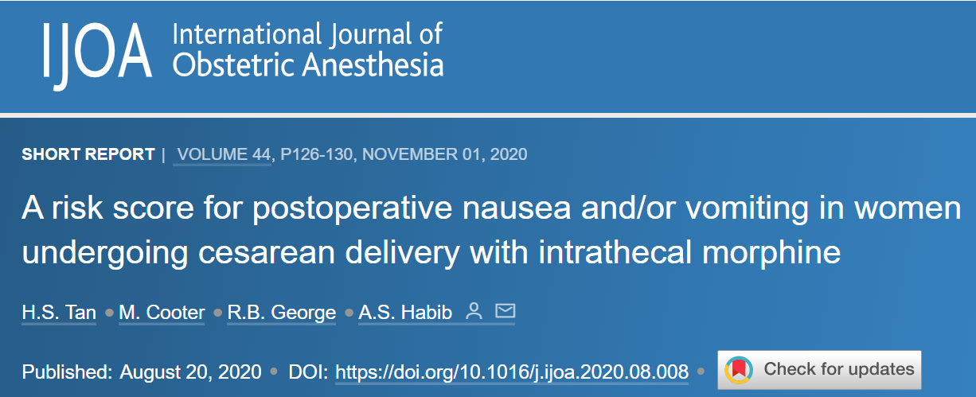
Obstetric Considerations
There is no risk score for postoperative nausea and/or vomiting (PONV) in parturients.
Assessed potential parturient and peri-operative risk factors for PONV.
Duke score: Non-smoking, history of PONV after cesarean, and/or morning sickness included factors
*Both Duke and Apfel risk scores performed poorly in prediction of PONV.¹²

Slide 14
Recommendations for Cesarean Delivery¹³

Slide 15
PONV Treatment: Medications
Pharmacologic options for treating PONV

Slide 16
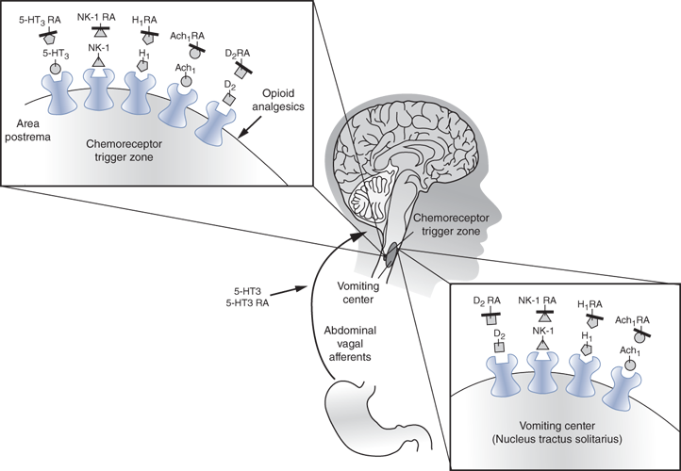
Receptor sites involved in PONV Prophylaxis and/or treatment ¹⁴
Ach₁ = acetylcholine
D₂ = dopamine
H₁ = histamine
5-HT₃, serotonin
NK-1, neurokinin
RA, receptor antagonist.
Copyright © 2022 McGraw-Hill Education. All rights reserved

Slide 17
Serotonin (5-HT₃) Receptor Antagonists
Serotonin (5-HT3) antagonists inhibit vagal nerve response in the central nervous system and intestinal mucosa. ¹⁵⁻¹⁶
The 4th Consensus Guidelines for the Management of Postoperative Nausea and Vomiting label ondansetron as the ‘gold standard’ in PONV management. ¹
In a randomized, open-label, multicenter trial, 98 patients were treated with rescue antiemetics for PONV:
Palonosetron and ondansetron did not show differences in efficacy when compared for treatment. ¹⁷

Slide 18
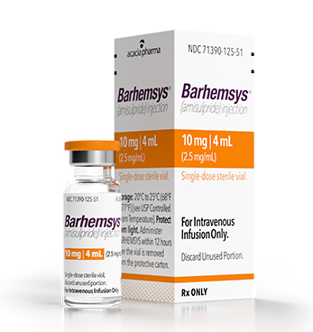
Dopamine Receptor Antagonists: Amisulpride
Amisulpride: D2, D3 receptor antagonist & oral antipsychotic
IV formulation recently approved for PONV management ¹
10 mg dose safe & more effective in treating established PONV for adult patients failing prophylaxis when compared to 5 mg dose or placebo ¹⁸
No evidence in recent studies of any of the side effects typically associated with the D2 class (extrapyramidal symptoms, sedation, cardiotoxicity, psychological disturbances, QT prolongation) ^{1,9,19}

Slide 19
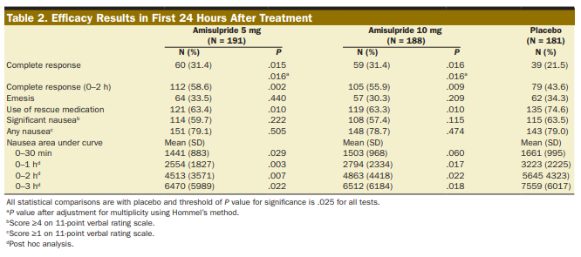
Dopamine Receptor Antagonists: Amisulpride
In a randomized, double-blind, placebo-controlled study of IV amisulpride for treatment of PONV, 560 patients were evaluated for complete response in the 24 hours after surgery.
IV amisulpride 5 or 10 mg were both found to be safe and more effective than placebo in treating PONV. ¹⁷
Limitation: Only patients who had not had any PONV prophylaxis were included in the study.

Slide 20
Dopamine Receptor Antagonists: Droperidol
When used for the treatment of PONV, droperidol resulted in similar QTc interval prolongations as compared to ondansetron. (n=85) ²⁰
Most studies have examined the effectiveness of droperidol in reducing incidence of PONV when used for prophylaxis. ¹
Additional research needed to investigate the effectiveness of droperidol use as a rescue antiemetic.

Slide 21
Dopamine Receptor Antagonists: Haloperidol
Haloperidol is not FDA approved as an antiemetic ¹
However, low doses have been used for PONV prophylaxis ¹
QTc prolongation similar to 5-HT3 antagonists
When used for treatment, 1 mg haloperidol IV was not inferior to ondansetron 4mg when comparing patients without PONV at 4 & 24 hours after administration (n=120).
Adverse effect: sedation ²¹

Slide 22
Dopamine Receptor Antagonist: Metoclopramide
In a double-blind, controlled, randomized study of 746 adult patients undergoing general anesthesia for surgery & experiencing PONV were randomized to be treated with either ondansetron or metoclopramide. ²²
Complete control of vomiting in the 24-hour period was achieved more often in the ondansetron group (59% vs. 41%; p<0.001)
Complete control of nausea: ondansetron, 44% vs. metoclopramide, 34% (p=0.006)
Greater patient satisfaction with ondansetron reported also (49% vs. 32%; p<0.001)
Similar adverse events between the 2 groups
Though both are effective, ondansetron proved more effective compared to metoclopramide for treatment Metoclopramide is often used to treat PONV when other antiemetics have been used for prophylaxis and been unsuccessful. ⁴

Slide 23
NK-1 Receptor Antagonists
Aprepitant is typically used for PONV prevention rather than treatment since it is administered PO. ¹
Fosaprepitant (IV form of aprepitant) has been proposed for the treatment of refractory postoperative nausea & vomiting. ²³
Randomized, controlled trials are needed to determine effectiveness of fosaprepitant as a rescue antiemetic.
However, vesipitant (doses 4-36mg) proved to have non-inferior efficacy when compared to ondansetron for treating breakthrough PONV in patients who received prophylaxis
(RCT including 130 patients) ²⁴

Slide 24
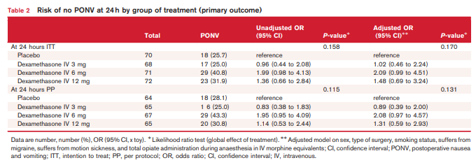
Corticosteroids: Dexamethasone
The DexPonv multicenter, placebo-controlled, randomized, double-blind, dose-finding trial found dexamethasone to be ineffective during the first 24 hours in treating established PONV in adults (n=260) ²⁵
Though dexamethasone is widely used for PONV prophylaxis preoperatively, there are limited studies examining effectiveness in the treatment of PONV. ¹

Slide 25
Antihistamines: Dimenhydrinate & promethazine
In an analysis by Habib and Gan using previously collected RCT data (n=1543): ²⁶
Patients who failed prophylaxis with droperidol (0.625 & 1.25 mg) experienced significantly higher complete response rates with dimenhydrinate (25 of 32 patients; 78%) vs. rescue with an additional dose of droperidol (34 of 61 patients; 56%) p=0.04
Similarly, patients had better complete response rates with promethazine (46 of 60 patients; 77%) vs. rescue with droperidol. (p=0.02)
Patients who failed prophylaxis with ondansetron (4mg) experienced significantly higher complete response rates with promethazine (28 of 36 patients; 78%) vs. rescue with ondansetron (13 of 28 patients; 46%) p= 0.02

Slide 26
Antihistamines: Promethazine
In addition, Habib and colleagues conducted a retrospective data analysis including 3,814 patients who experienced breakthrough PONV despite ondansetron for prophylaxis: ²⁷
Promethazine 6.25 mg was administered to 752 patients as a rescue antiemetic: 68% had no additional PONV or rescue meds after
Ondansetron 4 mg was administered to 3,062 patients experiencing PONV: 50% had no additional PONV/rescue meds
(p<0.0001)

Slide 27
Antihistamines: Promethazine
In a double-blind, randomized, controlled trial (n=120), two different doses of promethazine were compared in the treatment of PONV: ²⁸
6.25 mg dose found to be as effective in controlling PONV as a 12.5 mg dose with less sedation as a result
**Note: In 2009, the FDA issued a block box warning for promethazine. IV injection into the vein may leach into the surrounding tissue and cause serious damage. IM is the preferred route.
If IV administration is used, a properly functioning IV should be confirmed and concentration infused should be no greater than 25 mg/ml at rate of less than or equal to 25 mg/minute.** ¹

Slide 28
Antihistamines: Diphenhydramine
Though commonly used for both prophylaxis and treatment of PONV, there is limited research examining effectiveness of diphenhydramine as a rescue antiemetic.

Slide 29
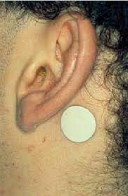
Anticholinergics: Scopolamine Transdermal Patch
Due to slow onset of action (2-4 hours), scopolamine is typically used for prophylaxis rather than treatment of PONV. ^{1,4}
In the postoperative period, patients given scopolamine for prophylaxis may experience side effects:
Dry mouth
Visual disturbances
Dizziness ¹

Slide 30
Gabapentinoids: Gabapentin & pregabalin
Several studies have examined the effect of gabapentinoids given perioperatively for the prevention of PONV but there is limited data on gabapentin or pregabalin and their efficacy in treating PONV.

Slide 31
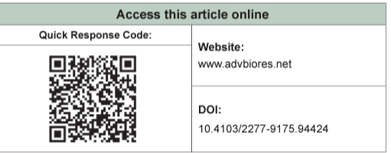
Midazolam
There is limited data investigating midazolam as a rescue antiemetic, however, one study suggests it may have similar efficacy to ondansetron in the treatment of PONV after cesarean delivery.
According to the study, midazolam (30 micrograms/kg) + ondansetron was superior to either medication alone in the treatment of postoperative nausea at 6 hours after administration.
*No additional adverse effects in the combination group as compared to the ondansetron or midazolam alone groups. (n=132) ²⁹

Slide 32
PONV Treatment: Combination Therapy
Recommended options for treating PONV

Slide 33
Combination Antiemetics for Treatment
In a randomized study of 228 adult patients, a combination of low-dose ondansetron plus dexamethasone and droperidol or haloperidol has been found to be superior to monotherapy alone for the treatment of PONV in the PACU ³⁰
Palonsetron + dexamethasone is more effective than palonsetron alone when given for prevention of PONV in patients receiving PCA with fentanyl. (RCT: 202 adult patients) ³¹
There is limited evidence exploring the optimal combination therapy for the treatment of PONV. ¹
Select antiemetics from different classes & clinical discretion is advised

Slide 34
PONV Treatment: Alternative Therapy
Non-pharmacologic options for managing PONV

Slide 35
Carb Loading
In a meta-analysis of 21 studies examining preoperative carbohydrate treatment (PCT) and impact on length of stay. PONV was a secondary outcome in 5 of the studies. ³²
3 studies resulted in no difference in PONV between the PCT group and the control
1 study had a higher incidence of PONV
1 study had a lower incidence of PONV
Though carbohydrate drinks have grown in popularity as Enhanced Recovery Protocols have expanded, current evidence suggests no impact on PONV incidence. ¹

Slide 36
Aromatherapy: Limited evidence to support
A Cochrane review evaluated 16 studies including 979 adult & 39 pediatric patients: ³³
Aromatherapy interventions assessed in the studies:
Isopropyl alcohol
Peppermint oil
Ginger oil
Essential oil blends of peppermint, spearmint, ginger, and cardamom
Essential oil blends of peppermint, spearmint, ginger, and lavender
Limitation: All studies except one measured PONV only up to 60 minutes after intervention.

Slide 37
Aromatherapy: Isopropyl alcohol
When compared to placebo, the Cochrane review found isopropyl alcohol to be effective in reducing the number of patients requiring rescue antiemetics. (4 studies)
When compared to standard antiemetic treatment, isopropyl alcohol was found to reduce the number of instances requiring rescue antiemetics & faster relief of symptoms. (7 studies)
Also, when compared to placebo, pediatric patients experienced short-term relief of PONV symptoms when exposed to isopropyl alcohol aromatherapy. (1 study)
Note: Low quality of data included in Cochrane review -> incomplete reporting of outcomes ³³

Slide 38
Aromatherapy: Peppermint
According to the Cochrane review, peppermint may lead to little or no difference in nausea severity when compared to placebo. (11 studies) ³³
In a clinical trial including 60 patients undergoing cardiac surgery, half of the patients were exposed to peppermint essential oil vapor 30 minutes before extubation, 4 & 8 hours after extubation. ³⁴
Less patients experienced nausea in the first 4 hours after extubation when compared to the control group (p=0.005)
Duration of nausea was shorter in the first 4 hours after extubation (p=0.005)
All other time periods (>4 hours after extubation through 12 hours post) did not result significant differences in nausea and vomiting outcomes for either group (peppermint vs. control)

Slide 39
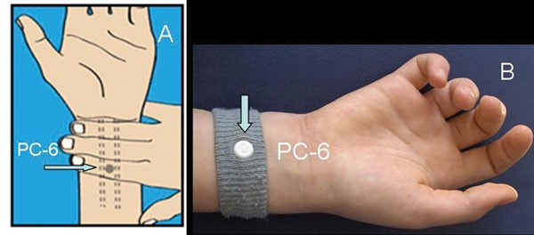
Pericardium (PC6) Stimulation – Acupressure or acupuncture
Acupuncture at the PC6 acupoint has been effective in preventing PONV & PDNV ³⁵
In a Cochrane review by Lee, Chan, & Fan, 59 trials including 7,667 pediatric and adult patients established that PC6 acupoint stimulation was as effective as an antiemetic prophylaxis therapy for reducing incidence of PONV. ³⁶
Combination of PC6 stimulation with antiemetics was more effective at reducing vomiting and need for antiemetics but not in reducing incidence of nausea.
10 types of PC6 acupoint stimulation included in Cochrane review

Slide 40
PC6 Acupressure
In a randomized, prospective, double-blind and placebo-controlled study of 150 adult patients undergoing laparoscopic cholecystectomy: ³⁷
50 patients were assigned to control (no antiemetics or acupressure)
50 patients were administered ondansetron 4 mg before induction
50 patients had acupressure bands applied to the P6 point on both forearms
Incidence of PONV in the first 6 hours after surgery:
Control group: 44%
Ondansetron: 8%
Acupressure band: 10%
(p<0.05)

Slide 41
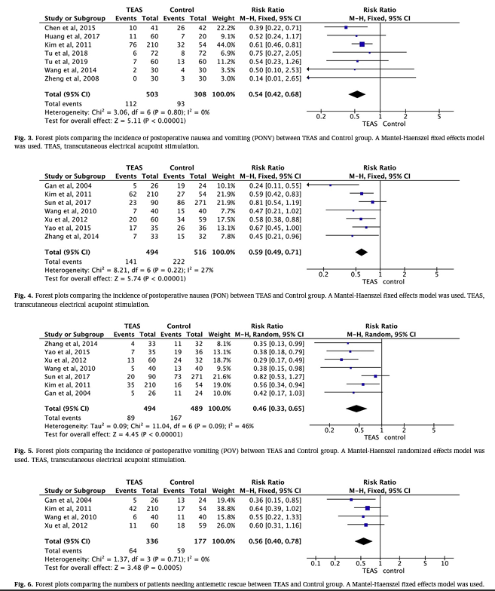
PC6 Transcutaneous Electrical Acupoint Stimulation (TEAS)
In a meta-analysis of 14 RCTs including 1,653 patients, use of transcutaneous electrical acupoint stimulation of Neiguan (PC6) was found to be associated with:
PONV
PON
POV
Rescue antiemetic use
Adverse effects ³⁸
*within 24 hours postoperatively

Slide 42
Music Therapy
Although music therapy may be effective in reducing analgesia requirements, data does not suggest statistically significant difference in occurrence or severity of PONV. ^{1, 39-40}

Slide 43
Hypnosis Therapy
Hypnosis has been used to reduce the effects of postoperative nausea and vomiting by playing recordings of therapeutic suggestions while the patient is under anesthesia. ³⁵
Unfortunately, these techniques have not proven effective in the limited data currently available. ^{1, 40}
Nilsson and colleagues (2001) examined intraoperative exposure to music and therapeutic suggestion as part of a double-blind randomized clinical trail of 90 patients undergoing hysterectomy.
No significant differences in the incidence of PONV in the intervention group ⁴⁰

Slide 44
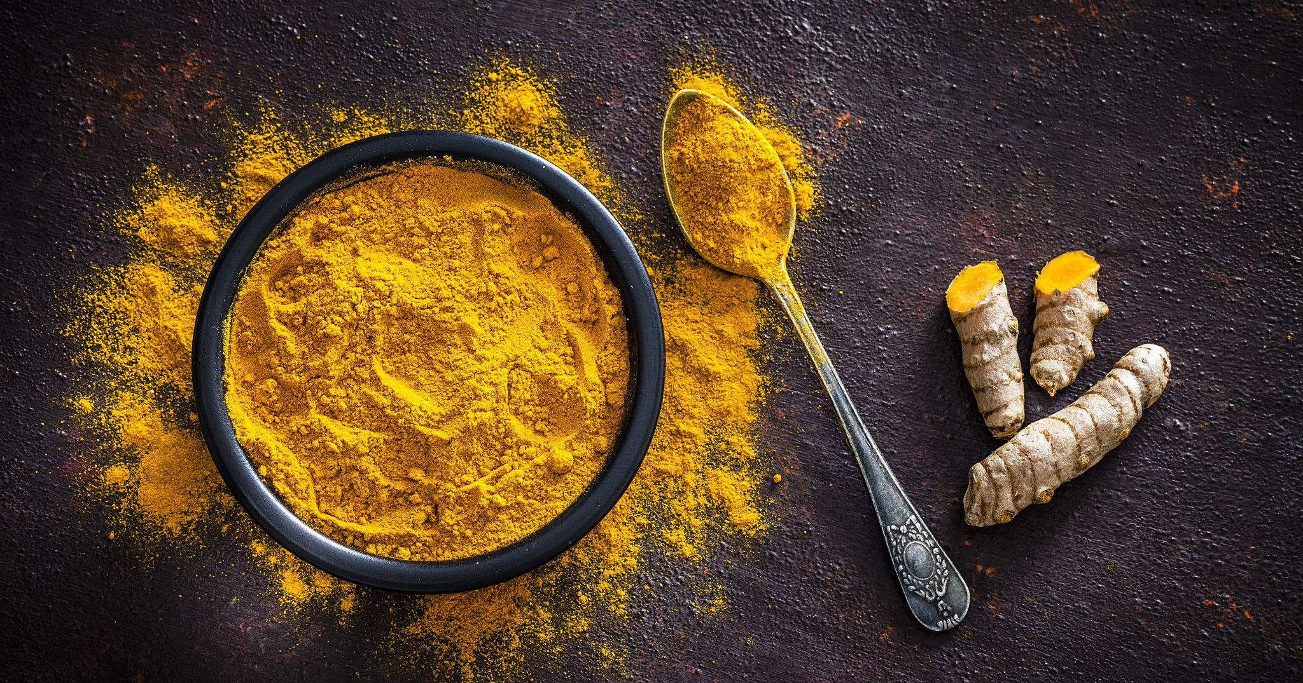
Ginger
In a randomized, controlled trial of 66 patients undergoing limb surgery, the intervention group received 1000mg of ginger (capsules) 2 hours before surgery & experienced lower incidence and severity of PONV. ⁴¹

Slide 45
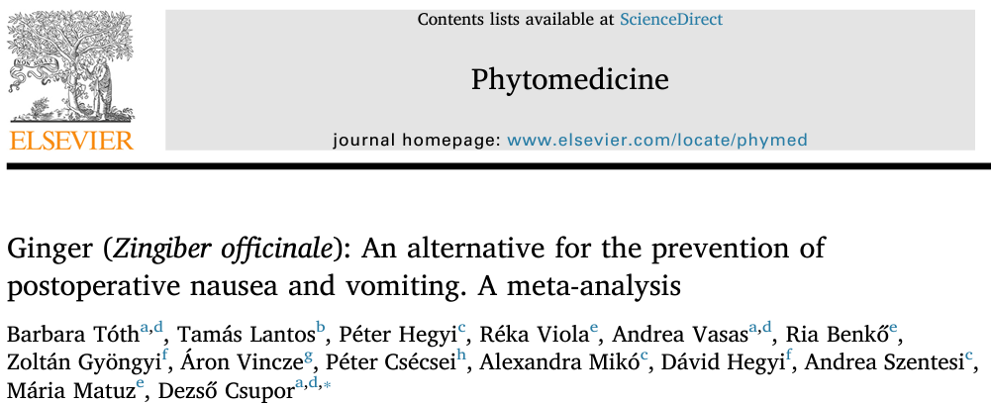
Ginger
In a meta-analysis of 10 randomized trials including 918 total patients, pharmacological doses of ginger (100-2000 mg) decreased severity and incidence of PONV compared to placebo but were not statistically significant. ⁴²

Slide 46
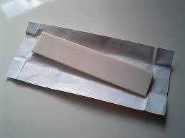
Chewing Gum
In a pilot study of adult female patients undergoing laparoscopic gynecological surgery (n=41), 78% were deemed high-risk for PONV and all received antiemetic prophylaxis. ⁴³
75.6% (n=31) successfully chewed peppermint gum in the postoperative period (median start time: 17 min after arrival in PACU; medium chew time: 15 min)
Only 22.6% of the patients who chewed gum experienced PONV as compared to 39% in the overall group
Though this pilot study is promising for the efficacy of chewing gum as an adjunct to standard PONV prophylaxis with antiemetics, a larger randomized, controlled trial is needed to determine true significance…

Slide 47
Chewing Gum
Chewy Trial underway currently (2022) to recruit 272 female patients undergoing breast or laparoscopic surgery ⁴⁴
Primary Hypothesis: Chewing 1 stick of peppermint chewing gum for 15 minutes is non inferior to 4mg IV ondansetron in achieving complete cessation of nausea, retching, and vomiting postoperatively, within 2 hours of administration- no recurrence, or need for rescue meds.
Multicenter RCT in New Zealand and Australia
Results pending…
Follow on Twitter: @ChewyTrial

Slide 48
Summary: Recommendations for Treatment of PONV
Administer treatment
Assess patient for symptoms of PONV
Identify if prophylaxis was given
Do not re-dose Scopolamine patch for treatment
Assess for causes of PONV
Consider multimodal therapy

Slide 49
Recommendation #1: Assess patient for symptoms of PONV
To properly manage and treat PONV, it must first be identified in the postoperative period.
If a patient begins to experience PONV, treatment should be immediate to prevent further complications. ^{1,4}

Slide 50
Recommendation #2: Identify if prophylaxis was given
If prophylaxis was given but ineffective resulting in PONV within the immediate postoperative period (<6 hours), the rescue antiemetic should be from a different pharmacologic class than the medication given for prophylaxis. ^{1,4}
If no prophylaxis was given, low-dose 5-HT3 receptor antagonist (ondansetron, ramosetron, or tropisetron) should be administered as the rescue medication. ^{1,4,7}
If PONV occurs >6 hours after surgery, the same medication given for prophylaxis can be re-dosed. ^{1,4}

Slide 51
Recommendation #3: Administer treatment*
5-HT₃ Receptor antagonists:
Ondansetron considered ‘gold standard’
Amisulpride 5-10 mg IV
Promethazine 6.25 mg IM
Metoclopramide 10-20 mg IV
Dimenhydrinate – Must consider increased risk of sedation
*Dependent on medication administered for prophylaxis, see Recommendation #2 & #4 for restrictions.

Slide 52
Recommendation #4: Do not re-dose scopolamine patch for treatment of PONV.

Slide 53
Recommendations #5: Assess possible causes, especially for refractory PONV
If PONV persists beyond initial treatment, evaluate causative factors to determine appropriate intervention strategies: ^{(4, 10)}
Excessive opioid use
Hypotension
Hypoxia
Gastrointestinal abnormality (ileus, draining blood into stomach)
Unnecessary NG tube
Mobilization (orthostatic hypotension or positional changes)
Increased eye pressure
Figure: Management of postoperative nausea and vomiting: how to deal with refractory PONV. Anesthesiol Clin 2012; 30:481–93

Slide 54
Recommendation #6: Consider multi-modal therapy
Multimodal therapy should be employed for PONV prior to discharge as subsequent recurrence within the next 24 hours is 35-50%. ⁸
Alternative therapies such as PC6 stimulation, aromatherapy with isopropyl alcohol, or chewing gum may prove effective for some patients in reducing the effects of PONV. ^{33-34, 36-38, 43}

Slide 55
Supplemental Information
Additional references for postoperative nausea and vomiting management

Slide 56
Other Risk Scoring Tools for Adults
Apfel Simplified Risk Score for Post-Discharge Nausea & Vomiting (outpatient procedures)⁴⁵
Koivorunta Risk Score for PONV⁴⁶
Risk Factor​ | Points​
Female Gender​ | 1​
Age <50​ | 1​
History of PONV​ | 1​
Use of Opioids in PACU​ | 1​
Nausea in PACU​ | 1​
Sum of Points​ | 0-5​
Risk Factor​ | Points​
Female Gender​ | 1​
Non-Smoker​ | 1​
History of PONV and/orMotion Sickness​ | 1​
Postoperative Opioids​ | 1​
Surgery >60 minutes​ | 1​
Sum of Points​ | 0-5​

Slide 57
Pediatric PONV Risk Scores
Vomiting in Postoperative Period (VPOP-Score)⁴⁷
Risk Factor | Points
Duration of Anesthesia > 45min | 1
Age: 3-6y or 13-18y | 1
Age: 6-13y | 2
Surgery Type (Strabismus, Tonsillectomy, Tympanoplasty) | 1
History of POV (personal or family) | 1
Opioid Administration (post-induction or in recovery) | 1
Total Score | 0 - 6
Postoperative Vomiting in Children (POVOC-Score)⁴⁸
Risk Factor
Surgery > 30 min
Age 3 – 14y
Strabismus
History of PONV/POV (personal or family)
*Respective incidences of POV was 9%, 10%, 30%, 55%, and 70% when 0, 1, 2, 3, and 4 risk factors observed
*Respective incidences of POV were 5%, 6%, 13%, 21%, 36%, 48%, and 52% when the risk score ranged from 0 to 6.

Slide 58
References
Gan TJ, Diemunsch P, Habib AS, Kovac A, Kranke P, Meyer TA, Watcha M, Chung F, Angus S, Apfel CC, Bergese SD, Candiotti KA, Chan MT, Davis PJ, Hooper VD, Lagoo-Deenadayalan S, Myles P, Nezat G, Philip BK, Tramèr MR, Society for Ambulatory Anesthesia: Consensus guidelines for the management of postoperative nausea and vomiting. Anesth Analg 2014; 118:85–113
Mayeur C, Robin E, Kipnis E, Vallet B, Andrieu G, Fleyfel M, Petillot P, Lebuffe G: Impact of a prophylactic strategy on the incidence of nausea and vomiting after general surgery. Ann Fr Anesth Reanim 2012; 31:e53–7
Myklejord DJ, Yao L, Liang H, Glurich I: Consensus guideline adoption for managing postoperative nausea and vomiting. WMJ 2012; 111:207–13; quiz 214
Elvir-Lazo OL, White PF, Yumul R, Cruz Eng H: Management strategies for the treatment and prevention of postoperative/postdischarge nausea and vomiting: an updated review. F1000Res 2020; 9
Apfelbaum JL, Silverstein JH, Chung FF, Connis RT, Fillmore RB, Hunt SE, Nickinovich DG, Schreiner MS, Silverstein JH, Apfelbaum JL, Barlow JC, Chung FF, Connis RT, Fillmore RB, Hunt SE, Joas TA, Nickinovich DG, Schreiner MS, American Society of Anesthesiologists Task Force on Postanesthetic Care: Practice guidelines for postanesthetic care: an updated report by the American Society of Anesthesiologists Task Force on Postanesthetic Care. Anesthesiology 2013; 118:291–307
Apfel CC, Läärä E, Koivuranta M, Greim CA, Roewer N: A simplified risk score for predicting postoperative nausea and vomiting: conclusions from cross-validations between two centers. Anesthesiology 1999; 91:693–700
Kovac AL: Comparative Pharmacology and Guide to the Use of the Serotonin 5-HT3 Receptor Antagonists for Postoperative Nausea and Vomiting. Drugs 2016; 76:1719–35
Eberhart LHJ, Frank S, Lange H, Morin AM, Scherag A, Wulf H, Kranke P: Systematic review on the recurrence of postoperative nausea and vomiting after a first episode in the recovery room - implications for the treatment of PONV and related clinical trials. BMC Anesthesiol 2006; 6:14
Tan HS, Dewinter G, Habib AS: The next generation of antiemetics for the management of postoperative nausea and vomiting. Best Pract Res Clin Anaesthesiol 2020; 34:759–69
Jokinen J, Smith AF, Roewer N, Eberhart LHJ, Kranke P: Management of postoperative nausea and vomiting: how to deal with refractory PONV. Anesthesiol Clin 2012; 30:481–93
By the 2019 American Geriatrics Society Beers Criteria® Update Expert Panel: American Geriatrics Society 2019 Updated AGS Beers Criteria® for Potentially Inappropriate Medication Use in Older Adults. J Am Geriatr Soc 2019; 67:674–94

Slide 59
References
Tan HS, Cooter M, George RB, Habib AS: A risk score for postoperative nausea and/or vomiting in women undergoing cesarean delivery with intrathecal morphine. Int J Obstet Anesth 2020; 44:126–30
Bollag L, Lim G, Sultan P, Habib AS, Landau R, Zakowski M, Tiouririne M, Bhambhani S, Carvalho B: Society for Obstetric Anesthesia and Perinatology: Consensus Statement and Recommendations for Enhanced Recovery After Cesarean. Anesth Analg 2021; 132:1362–77
Chapter 15 Antiemetics, Johnson KB. Clinical Pharmacology for Anesthesiology; 2015.
Constenla M: 5-HT3 receptor antagonists for prevention of late acute-onset emesis. Ann Pharmacother 2004; 38:1683–91
Tricco AC, Soobiah C, Blondal E, Veroniki AA, Khan PA, Vafaei A, Ivory J, Strifler L, Ashoor H, MacDonald H, Reynen E, Robson R, Ho J, Ng C, Antony J, Mrklas K, Hutton B, Hemmelgarn BR, Moher D, Straus SE: Comparative efficacy of serotonin (5-HT3) receptor antagonists in patients undergoing surgery: a systematic review and network meta-analysis. BMC Med 2015; 13:136
Candiotti KA, Ahmed SR, Cox D, Gan TJ: Palonosetron versus ondansetron as rescue medication for postoperative nausea and vomiting: a randomized, multicenter, open-label study. BMC Pharmacol Toxicol 2014; 15:45
Habib AS, Kranke P, Bergese SD, Chung F, Ayad S, Siddiqui N, Motsch J, Leiman DG, Melson TI, Diemunsch P, Fox GM, Candiotti KA: Amisulpride for the Rescue Treatment of Postoperative Nausea or Vomiting in Patients Failing Prophylaxis: A Randomized, Placebo-controlled Phase III Trial. Anesthesiology 2019; 130:203–12
Kranke P, Eberhart L, Motsch J, Chassard D, Wallenborn J, Diemunsch P, Liu N, Keh D, Bouaziz H, Bergis M, Fox G, Gan TJ: I.V. APD421 (amisulpride) prevents postoperative nausea and vomiting: a randomized, double-blind, placebo-controlled, multicentre trial. Br J Anaesth 2013; 111:938–45
Charbit B, Albaladejo P, Funck-Brentano C, Legrand M, Samain E, Marty J: Prolongation of QTc interval after postoperative nausea and vomiting treatment by droperidol or ondansetron. Anesthesiology 2005; 102:1094–100
Yazbeck-Karam VG, Siddik-Sayyid SM, Barakat HB, Korjian S, Aouad MT: Haloperidol Versus Ondansetron for Treatment of Established Nausea and Vomiting Following General Anesthesia: A Randomized Clinical Trial. Anesth Analg 2017; 124:438–44

Slide 60
References
Diemunsch P, Conseiller C, Clyti N, Mamet JP: Ondansetron compared with metoclopramide in the treatment of established postoperative nausea and vomiting. The French Ondansetron Study Group. Br J Anaesth 1997; 79:322–6
Tran LH, Cudny M, Ngo D, Patel S, Lam MY. Fosaprepitant for the Treatment of Refractory Postoperative Nausea and Vomiting. Hosp Pharm. 2015;50(3):221-223. doi:10.1310/hpj5003-221
Kranke P, Thompson JP, Dalby PL, Eberhart LH, Novikova E, Johnson BM, Russ SF, Noble R, Brigandi RA: Comparison of vestipitant with ondansetron for the treatment of breakthrough postoperative nausea and vomiting after failed prophylaxis with ondansetron. Br J Anaesth 2015; 114:423–9
Czarnetzki C, Albrecht E, Desmeules J, Kern C, Corpataux J-B, Gander S, Kuijk SMJ van, Tramèr MR: Dexamethasone for the treatment of established postoperative nausea and vomiting: A randomised dose finding trial. Eur J Anaesthesiol 2022; 39:549–57
Habib AS, Gan TJ: The effectiveness of rescue antiemetics after failure of prophylaxis with ondansetron or droperidol: a preliminary report. J Clin Anesth 2005; 17:62–5
Habib AS, Reuveni J, Taguchi A, White WD, Gan TJ: A comparison of ondansetron with promethazine for treating postoperative nausea and vomiting in patients who received prophylaxis with ondansetron: a retrospective database analysis. Anesth Analg 2007; 104:548–51
Deitrick CL, Mick DJ, Lauffer V, Prostka E, Nowak D, Ingersoll G: A comparison of two differing doses of promethazine for the treatment of postoperative nausea and vomiting. J Perianesth Nurs 2015; 30:5–13
Jabalameli M, Honarmand A, Safavi M, Chitsaz M: Treatment of postoperative nausea and vomiting after spinal anesthesia for cesarean delivery: A randomized, double-blinded comparison of midazolam, ondansetron, and a combination. Adv Biomed Res 2012; 1:2
Rüsch D, Arndt C, Martin H, Kranke P: The addition of dexamethasone to dolasetron or haloperidol for treatment of established postoperative nausea and vomiting. Anaesthesia 2007; 62:810–7
Cho E, Kim D-H, Shin S, Kim SH, Oh YJ, Choi YS: Efficacy of Palonosetron-Dexamethasone Combination Versus Palonosetron Alone for Preventing Nausea and Vomiting Related to Opioid-Based Analgesia: A Prospective, Randomized, Double-blind Trial. Int J Med Sci 2018; 15:961–8
Awad S, Varadhan KK, Ljungqvist O, Lobo DN: A meta-analysis of randomised controlled trials on preoperative oral carbohydrate treatment in elective surgery. Clin Nutr 2013; 32:34–44
Hines S, Steels E, Chang A, Gibbons K: Aromatherapy for treatment of postoperative nausea and vomiting. Cochrane Database Syst Rev 2018; 3:CD007598

Slide 61
References
Maghami M, Afazel MR, Azizi-Fini I, Maghami M: The effect of aromatherapy with peppermint essential oil on nausea and vomiting after cardiac surgery: A randomized clinical trial. Complement Ther Clin Pract 2020; 40:101199
Stoicea N, Gan TJ, Joseph N, Uribe A, Pandya J, Dalal R, Bergese SD: Alternative Therapies for the Prevention of Postoperative Nausea and Vomiting. Front Med 2015; 2:87
Lee A, Chan SKC, Fan LTY: Stimulation of the wrist acupuncture point PC6 for preventing postoperative nausea and vomiting. Cochrane Database Syst Rev 2015:CD003281
Agarwal A, Bose N, Gaur A, Singh U, Gupta MK, Singh D: Acupressure and ondansetron for postoperative nausea and vomiting after laparoscopic cholecystectomy. Can J Anaesth 2002; 49:554–60
Chen J, Tu Q, Miao S, Zhou Z, Hu S: Transcutaneous electrical acupoint stimulation for preventing postoperative nausea and vomiting after general anesthesia: A meta-analysis of randomized controlled trials. Int J Surg 2020; 73:57–64
Kurdi MS, Gasti V: Intraoperative Meditation Music as an Adjunct to Subarachnoid Block for the Improvement of Postoperative Outcomes Following Cesarean Section: A Randomized Placebo-controlled Comparative Study. Anesth Essays Res 2018; 12:618–24
Nilsson U, Rawal N, Uneståhl LE, Zetterberg C, Unosson M: Improved recovery after music and therapeutic suggestions during general anaesthesia: a double-blind randomised controlled trial. Acta Anaesthesiol Scand 2001; 45:812–7
Beiranvand S, Alvani M, Sorori MM: The Effect of Ginger on Postoperative Nausea and Vomiting Among Patients Undergoing Upper and Lower Limb Surgery: A Randomized Controlled Trial. J Perianesth Nurs 2022; 37:365–8
Tóth B, Lantos T, Hegyi P, Viola R, Vasas A, Benkő R, Gyöngyi Z, Vincze Á, Csécsei P, Mikó A, Hegyi D, Szentesi A, Matuz M, Csupor D: Ginger (Zingiber officinale): An alternative for the prevention of postoperative nausea and vomiting. A meta-analysis. Phytomedicine 2018; 50:8–18
Darvall JN, Simmons SW, Leslie K: Acceptability of chewing gum for postoperative nausea and vomiting prevention in high risk patients: a pilot study. Anaesth Intensive Care 2011; 39:515–6
Darvall J, Ungern-Sternberg BS von, Braat S, Story D, Davidson A, Allen M, Tran-Duy A, Middleton D, Leslie K: Chewing gum to treat postoperative nausea and emesis in female patients (CHEWY): rationale and design for a multicentre randomised trial. BMJ Open 2019; 9:e027505
Apfel CC, Philip BK, Cakmakkaya OS, Shilling A, Shi Y-Y, Leslie JB, Allard M, Turan A, Windle P, Odom-Forren J, Hooper VD, Radke OC, Ruiz J, Kovac A: Who is at risk for postdischarge nausea and vomiting after ambulatory surgery? Anesthesiology 2012; 117:475–86

Slide 62
References
Koivuranta M, Läärä E, Snåre L, Alahuhta S: A survey of postoperative nausea and vomiting. Anaesthesia 1997; 52:443–9
Eberhart LHJ, Morin AM, Guber D, Kretz FJ, Schäuffelen A, Treiber H, Wulf H, Geldner G: Applicability of risk scores for postoperative nausea and vomiting in adults to paediatric patients. Br J Anaesth 2004; 93:386–92​
Bourdaud N, Devys JM, Bientz J, Lejus C, Hebrard A, Tirel O, Lecoutre D, Sabourdin N, Nivoche Y, Baujard C, Nikasinovic L, Orliaguet GA: Development and validation of a risk score to predict the probability of postoperative vomiting in pediatric patients: the VPOP score. Paediatr Anaesth 2014; 24:945–52

