Slide 1
An Introduction to the Multicenter Perioperative Outcomes Group
Version: 2026

Slide 2
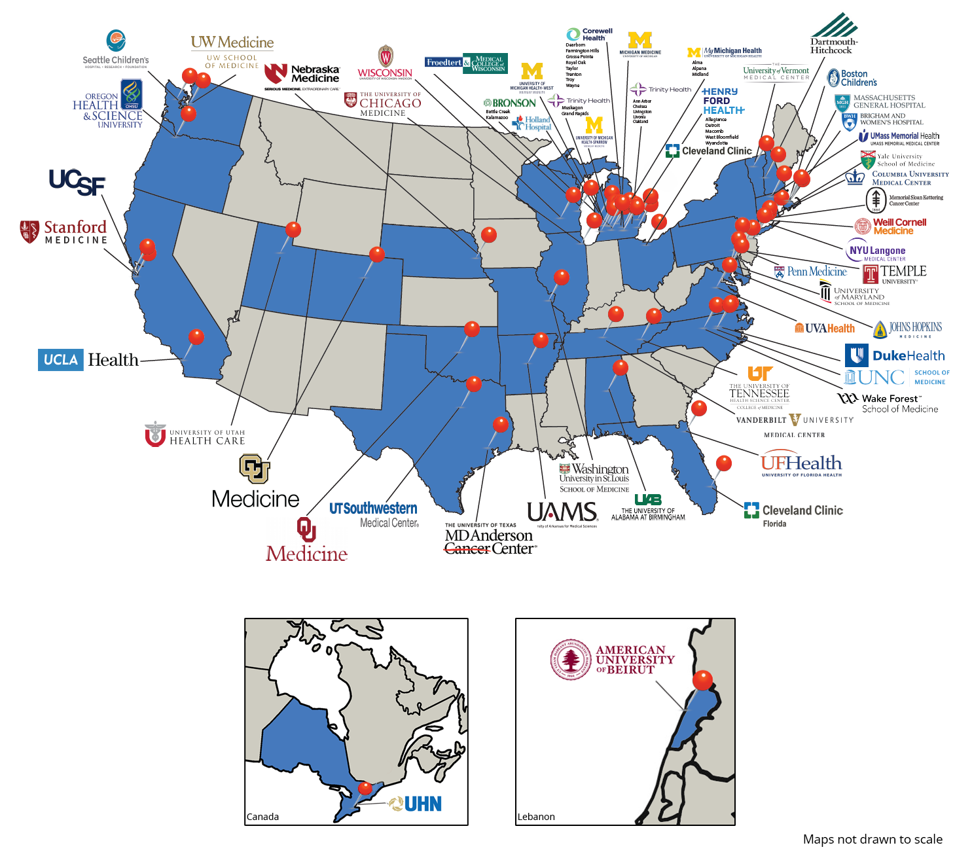
What is MPOG?
Formed in 2008
Academic and community hospital consortium that includes 150+ hospitals across the United States, Canada (1) and Lebanon (1)
Platform for collaboration for research and QI
Data: Perioperative focused EHR data extracted using automated tools
Notes:
Academic and community hospital consortium seeking to improve patient care using data
MPOG aggregates inpatient EHR data, and data from other complementary data sources
Formed in 2008, initial mission to develop the processes and technical infrastructure required for multicenter perioperative outcomes research
Has evolved into dual mission of research and quality improvement over last couple of years

Slide 3
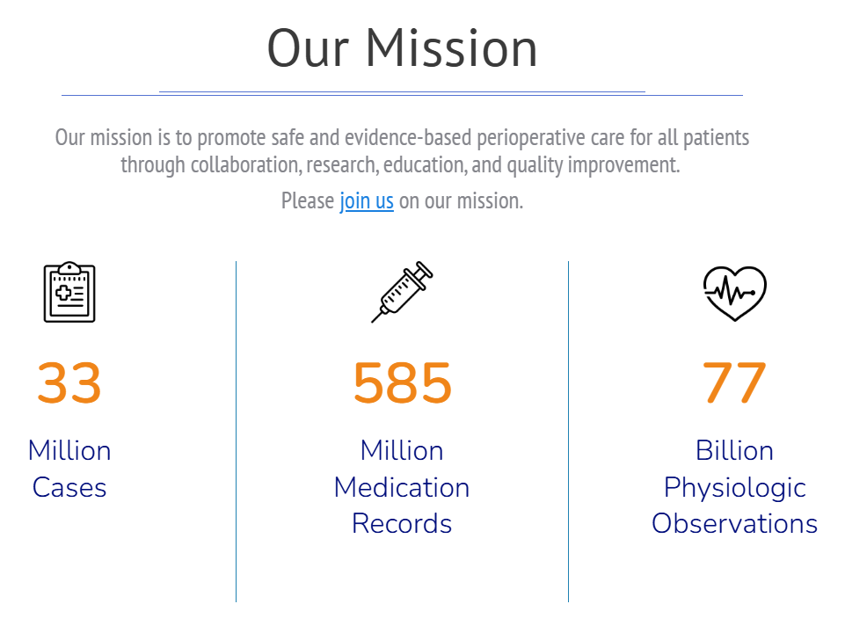
Data included in the MPOG Registry
  Preop/Intraop/Postop Data:
    4 hours prior Anes. Start → 6 hours after Anes. End (limited # of sites)
  Demographic Information
  Medications/Infusions/Fluids/Outputs
  Physiologic/Laboratory values
  Intraoperative events
  Line Access
  Staff in/out
  Billing (CPT and Discharge codes)
  Outcome record / Outcome registry
    NSQIP, STS

Slide 4
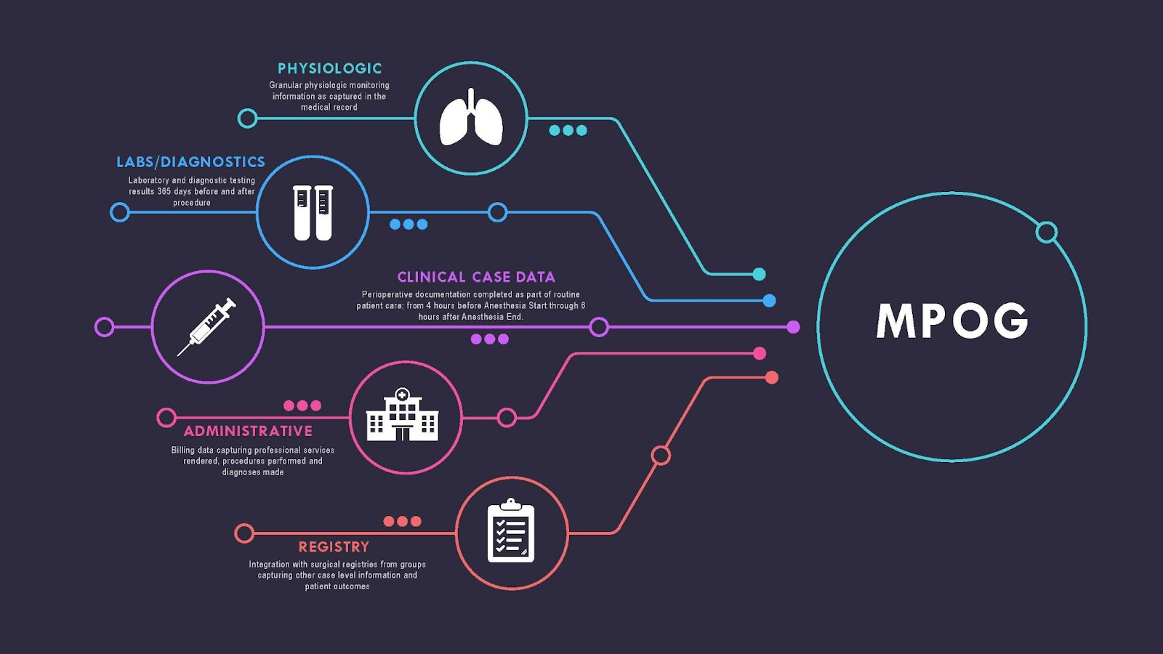

Slide 5

Overlapping mission of QI and Research is the basis of MPOG as a Learning Health System
MPOG
Research
BCBSM funded program
Quality
(MPOG QI)
*Not drawn to scale

Slide 6
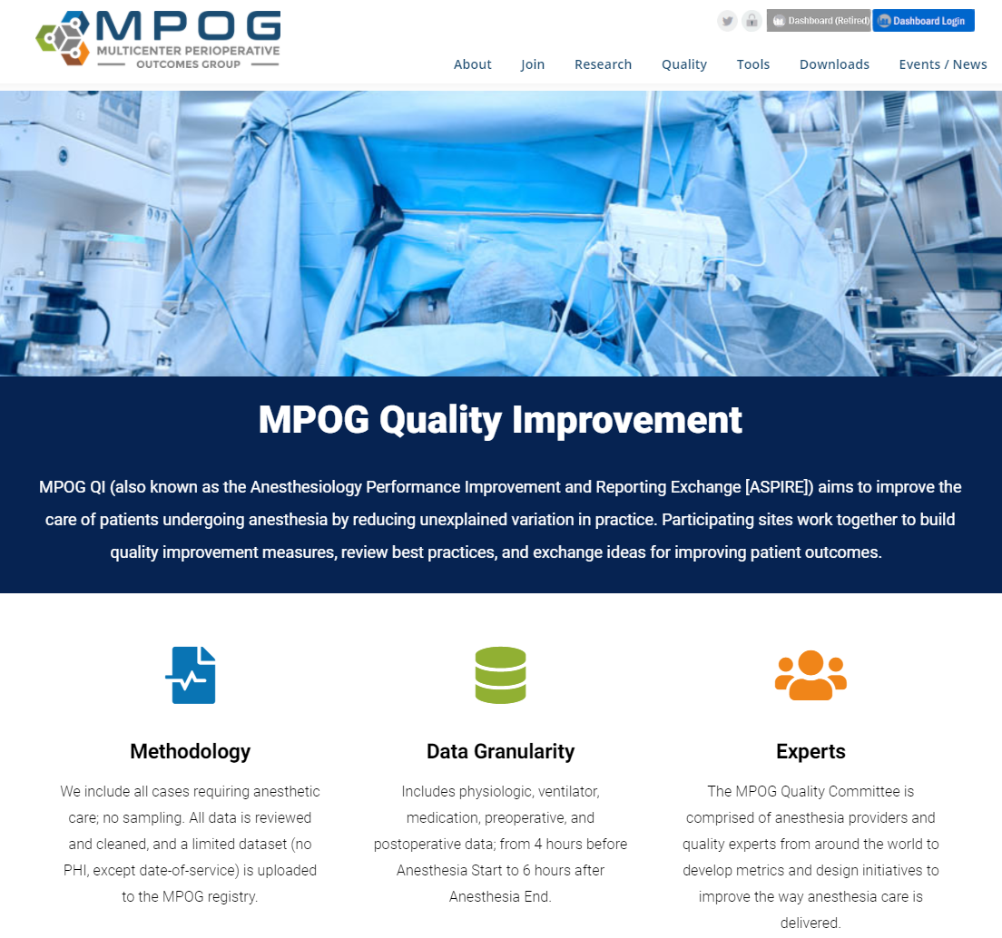
MPOG QI
Anesthesiology quality improvement group
Goal is to study unexplained variation in practice and determine best practices for anesthesia providers
Governed by the MPOG Quality Committee which consists of members of each institution.
Built on infrastructure of the Multicenter Perioperative Outcomes Group (MPOG)

Slide 7
What Does MPOG QI do?
Collaboration through monthly Quality Committee meetings (tele-conference)
In person meetings 3x/year, including annual MPOG Retreat before ASA
Builds Quality Measures based on feedback from Quality Committee and Subcommittees and data from MPOG Registry
Shares performance data at practice and provider lever through our QI Reporting Tool and Individual Provider Feedback emails
Builds Toolkits to help sites implement QI Initiatives related to MPOG QI Measures
Partnership with ABA to award MOCA IV credit through provider feedback program

Slide 8
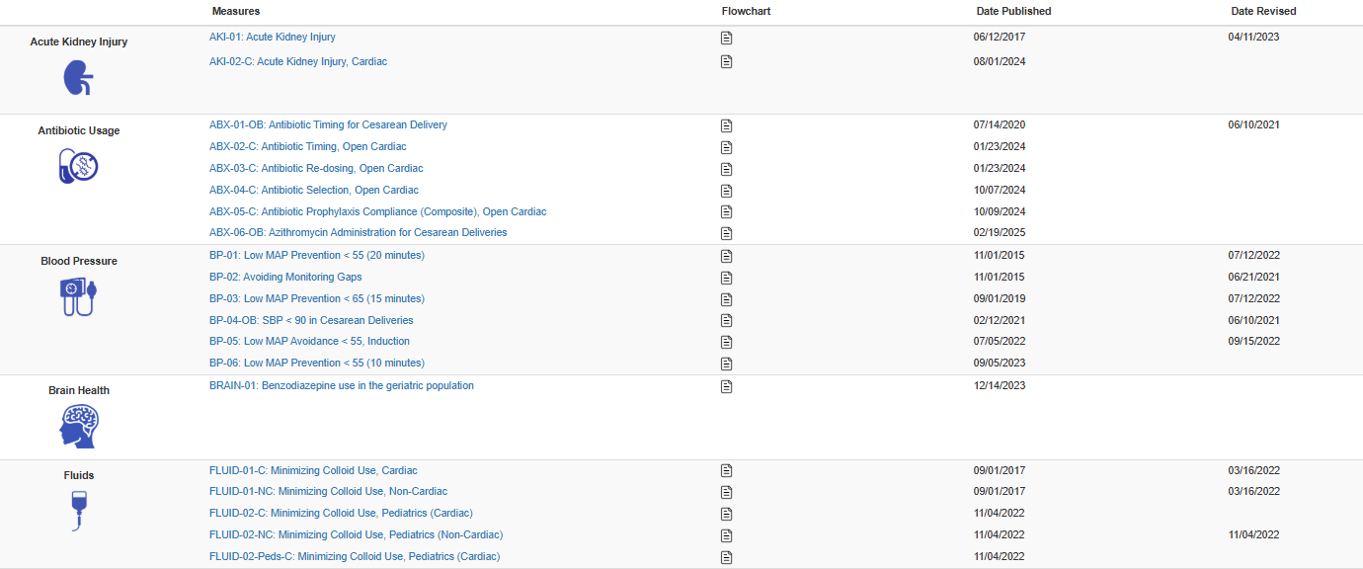
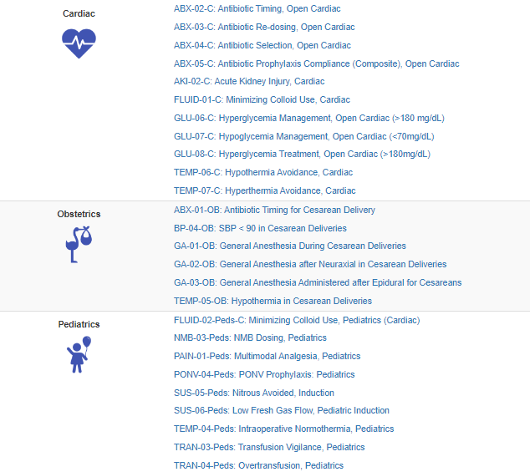
MPOG QI Measures
MPOG has over 70 measures available on the QI measure page.
The flowchart icon indicates a flowchart is available for that measure.
Measures that are part of a Toolkit will have a green checkmark on the right column.
Three measure domains are available for providers who practice in Pediatrics, Cardiac and Obstetrics.

Slide 9
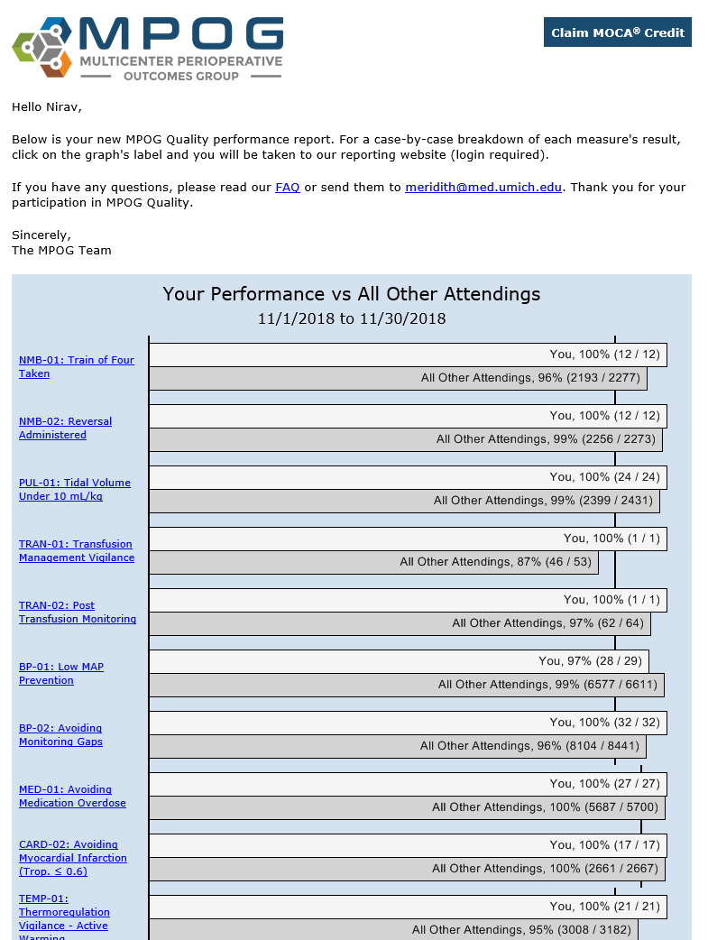
Individual Performance Feedback Email
Automated emails from central MPOG server
Sent every month to ~11,000 providers across the nation
“Fresh” – last month’s patients
Easy access to case review
*MOCA credit available
*USA Only
Notes:
In addition to access to dashboards, sites also can opt into sending feedback emails to providers

Slide 10
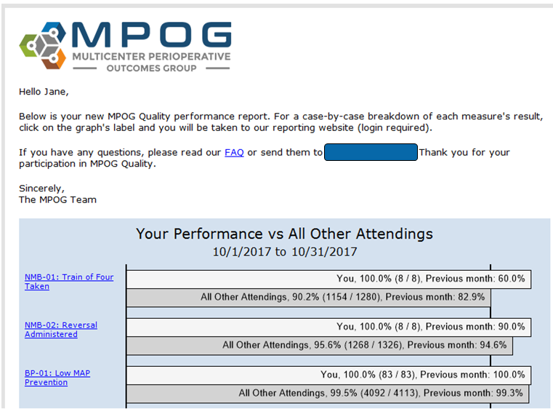
Individual Provider Feedback
Non-punitive
Spirit of quality improvement
Each hospital/ department chooses measures to focus on
Providers compared to peer group within their organization:
  CRNAs to CRNAs
  Attendings to Attendings
  Residents to Residents

Slide 11
Accessing your Individual MPOG Dashboard

Slide 12
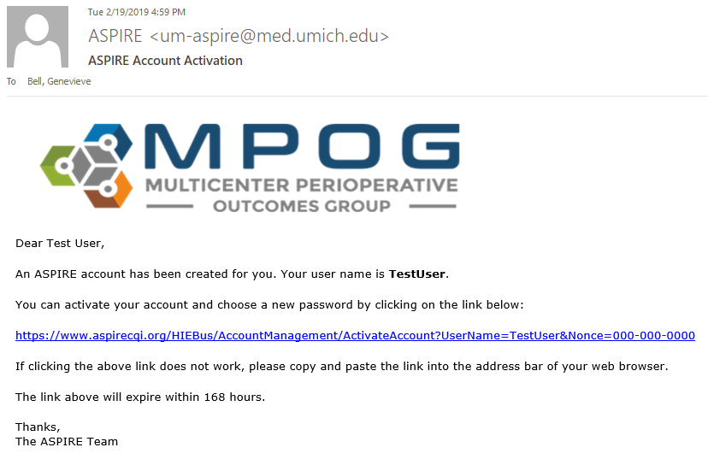
MPOG Provider Access
Receive activation email from mpog-quality@med.umich.edu
Click on link to activate account. Link expires in 7 days
Create password & select 3 security questions.

Slide 13

How providers access the MPOG QI Dashboard
1) Via the MPOG Website: https://mpog.org/
2) Via Provider Feedback Emails:
Click on any measure hyperlink

Slide 14
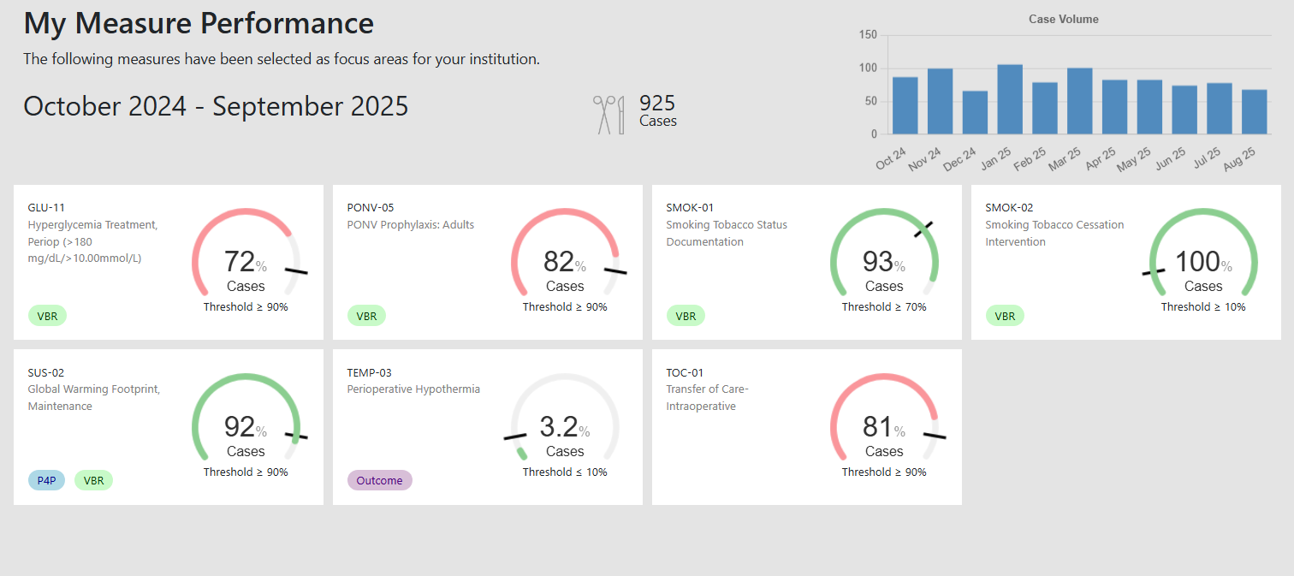
Provider Dashboard

Slide 15
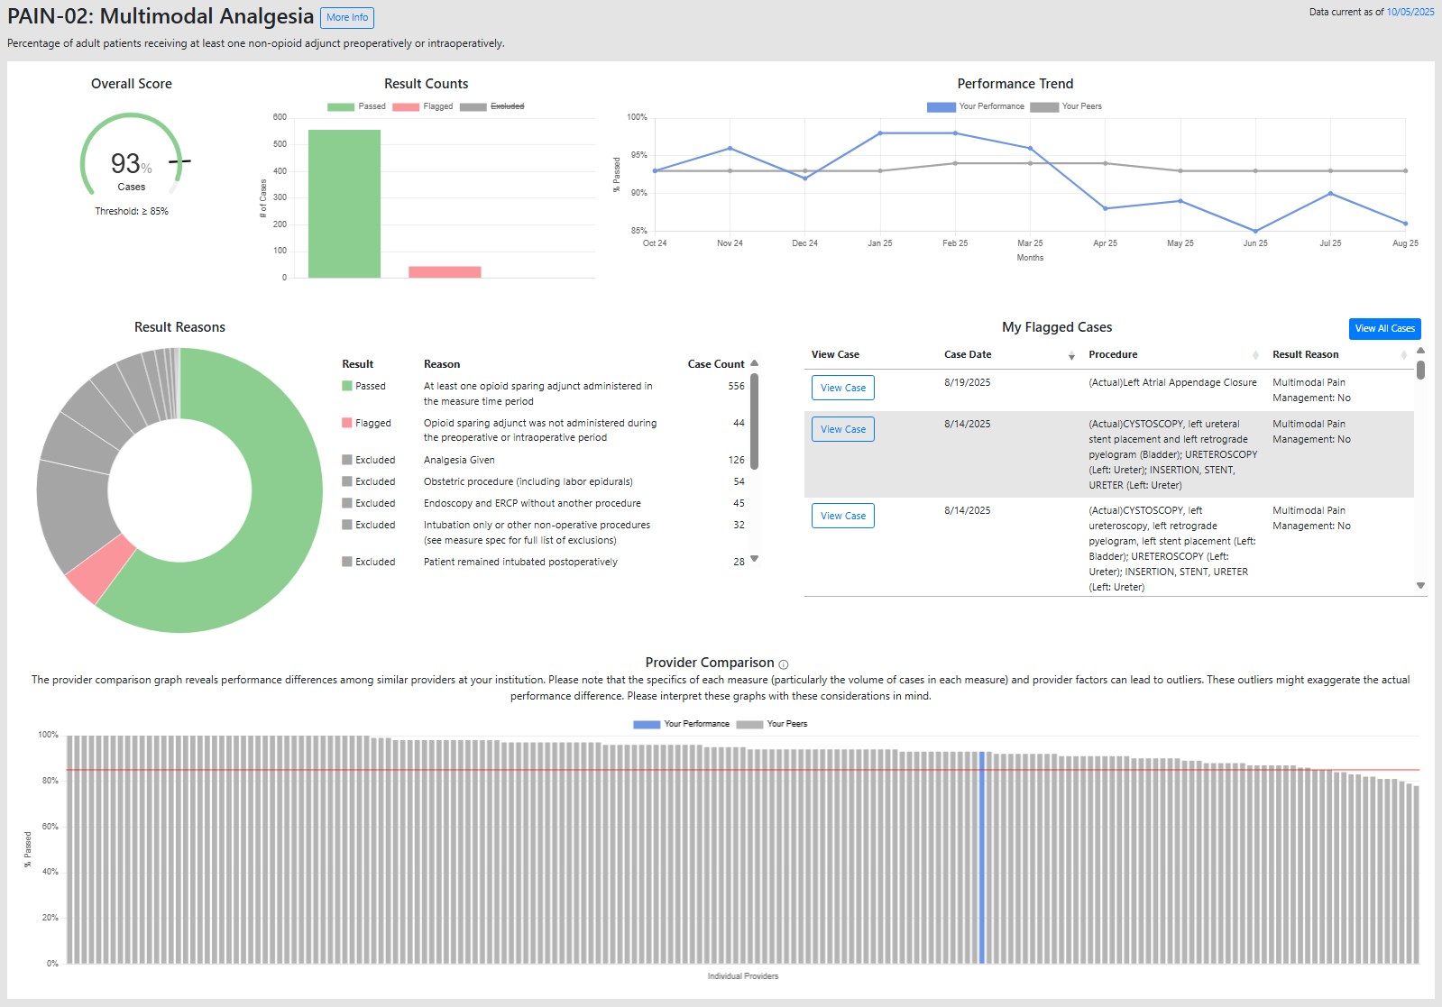
Measure Overview
Clicking on the measure card will open a measure overview page, which includes
Aggregate performance
Case List snapshot
Performance trend and
Benchmarking against your peers

Slide 16
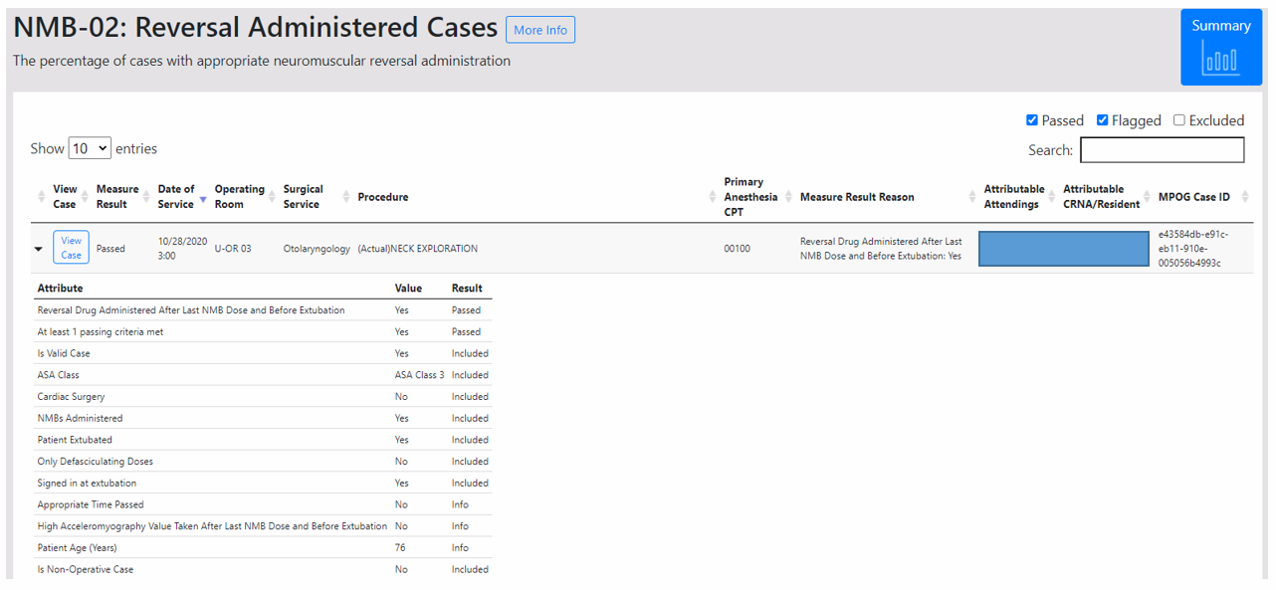
By selecting the ‘Case Lists’ tab, all flagged, passed, and excluded will appear for the specific measure.

Slide 17
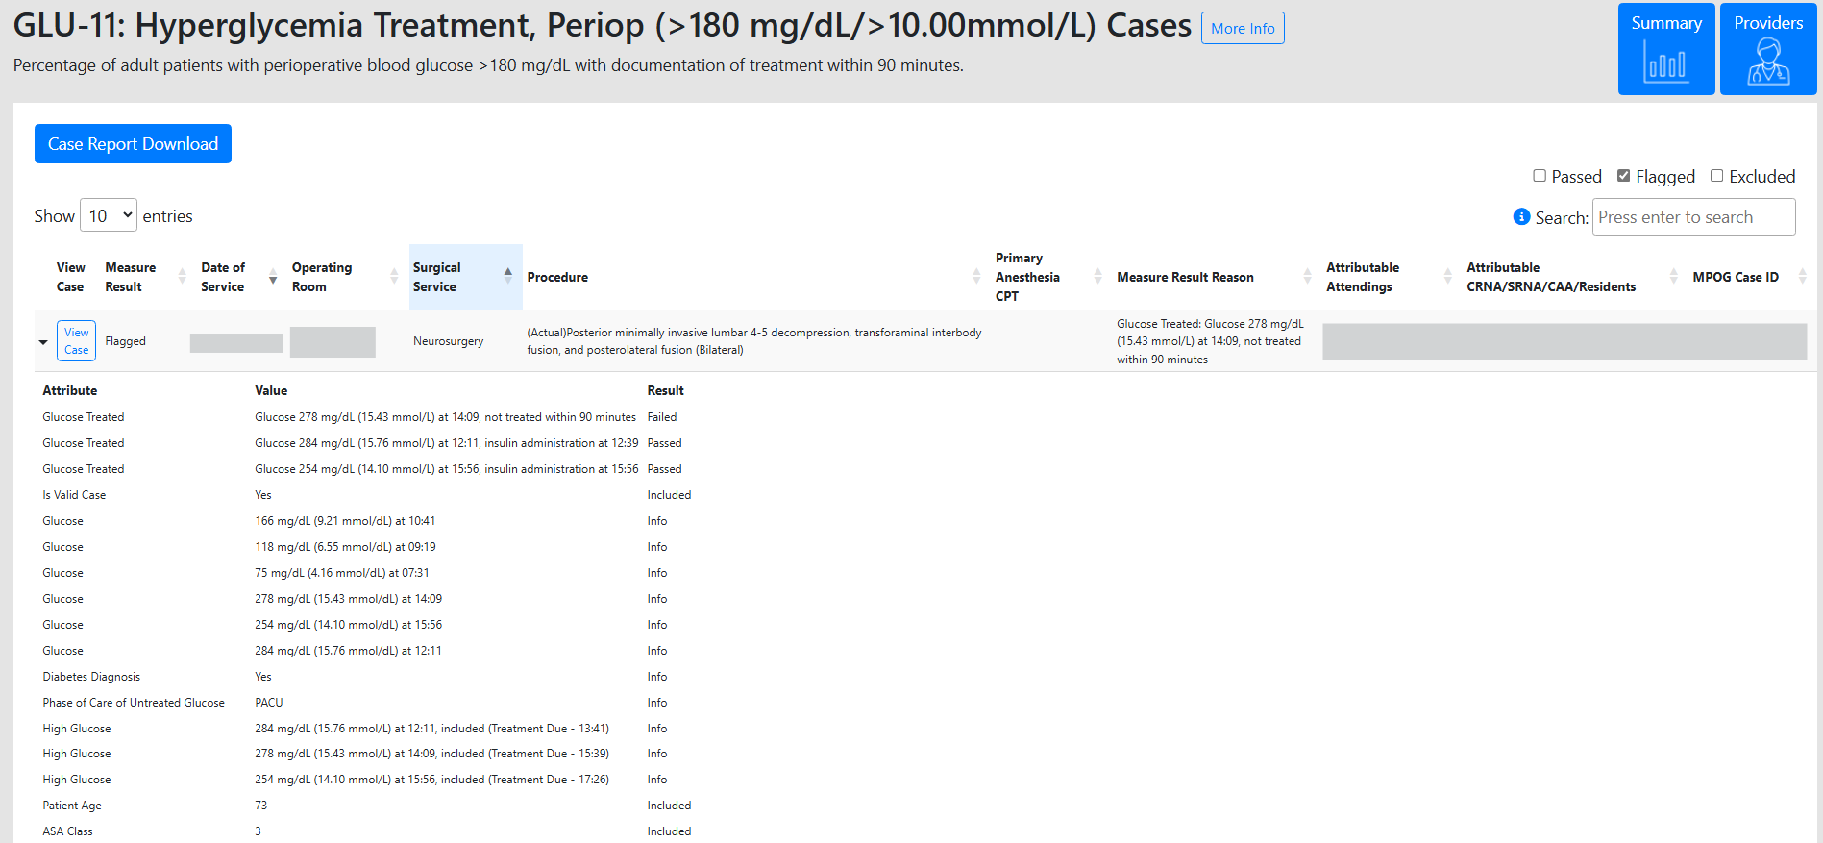
Case List and Details

Slide 18
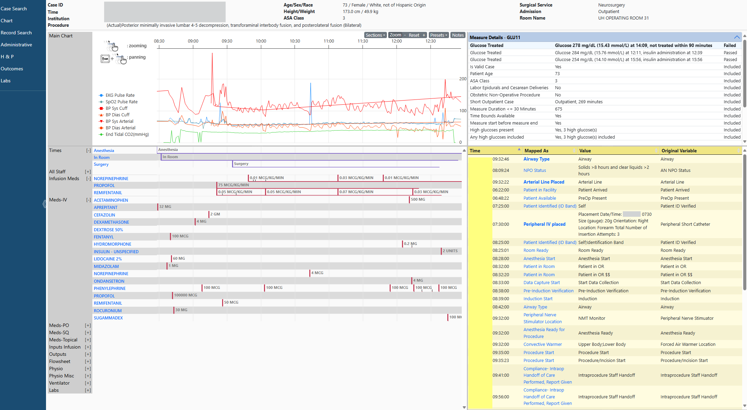
Easy access to actual intraoperative record via MPOG Case Viewer

Slide 19
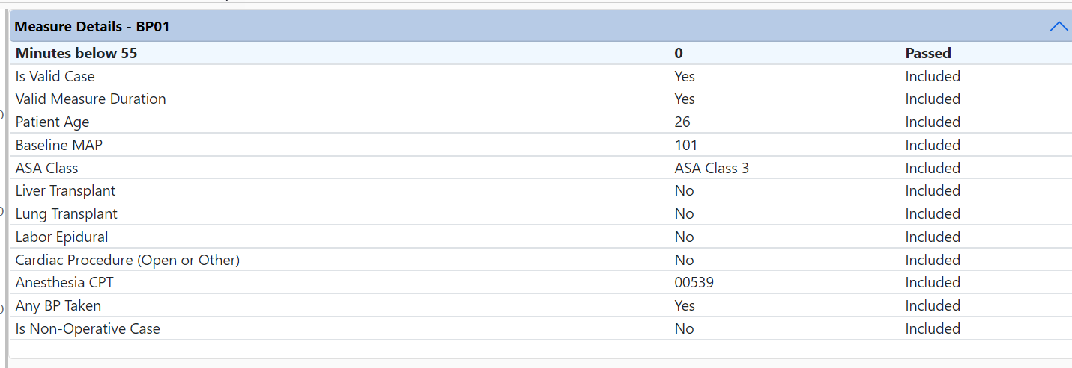
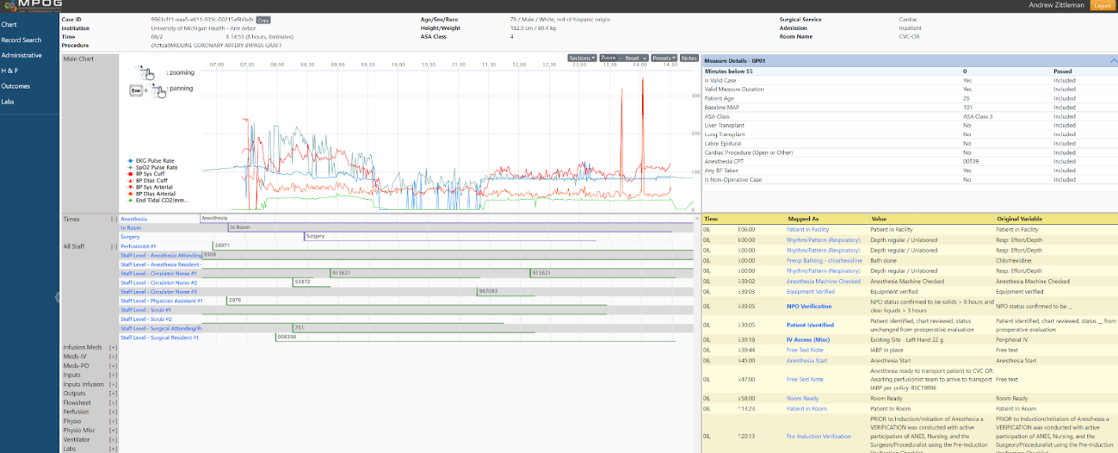
Measure Details
The concepts used in the measure are brought to the top above the notes section for easy review

Slide 20
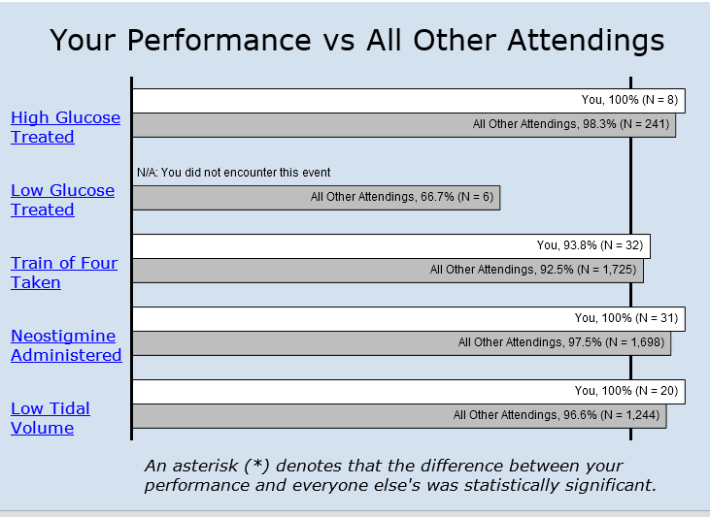
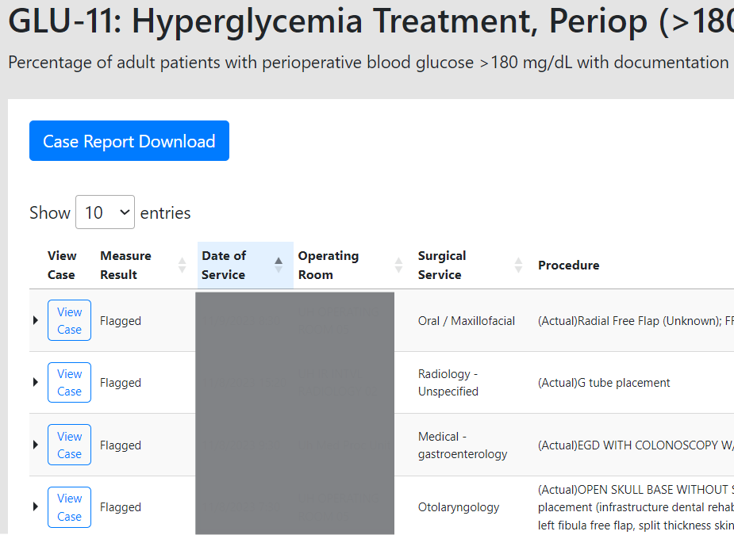
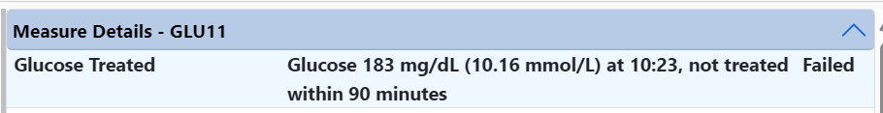
Our goal is to easily enable clinicians to understand why certain cases did not pass a measure.
1
2
3

Slide 21
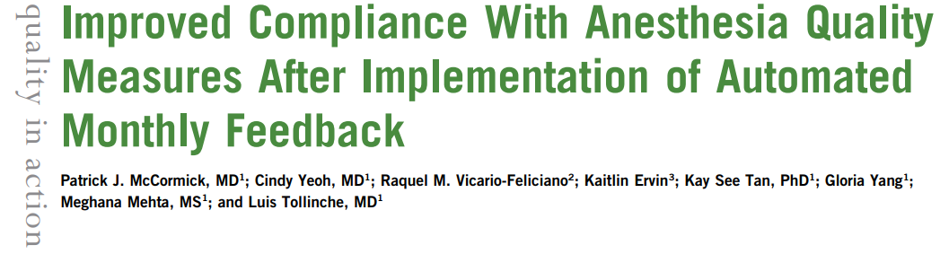
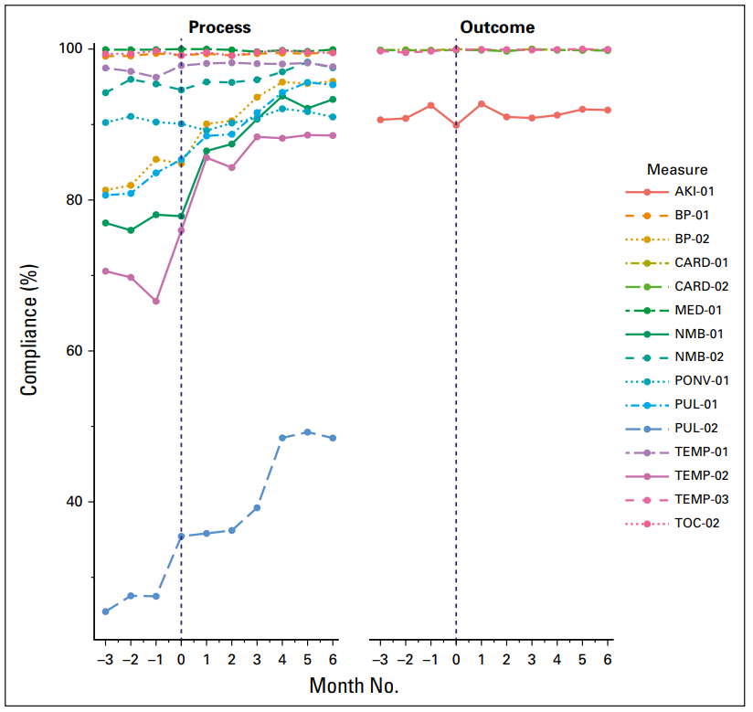
McCormick et al., 2019
Notes:
All measures showed improved compliance in the post-implementation phase compared with the pre-implementation phase. Of the 11 process measures, 7 demonstrated statistically significant improvements.

Slide 22

Thank you

Slide 23
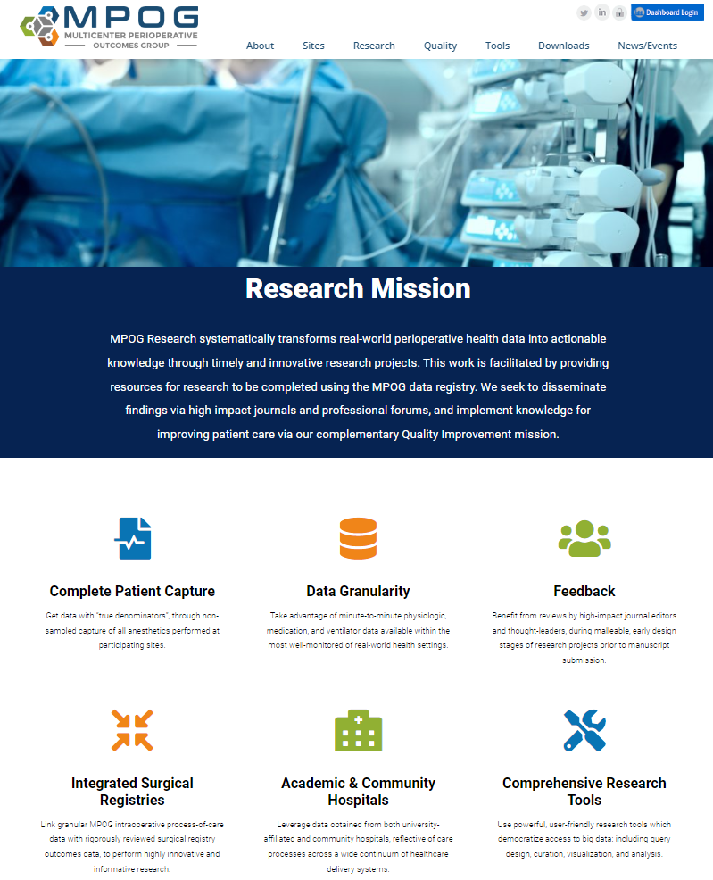
MPOG Research
Goal is to systematically transform real-world perioperative health data into actionable knowledge
Governed by the Perioperative Clinical Research Committee (PCRC)
Deep expertise in observational research, with extensive infrastructure for multicenter analyses
Clinical trials platform, with MPOG Registry as data platform for multicenter pragmatic clinical trials

Slide 24
What does MPOG Research do?
Collaboration through monthly PCRC meetings (tele-conference)
Annual retreat before ASA
High quality data
  Complete patient capture
  Data granularity
  Integrated surgical registries
Academic and community hospitals
Comprehensive research tools
  Use powerful, user-friendly research tools which democratize access to big data; including query design, curation, visualization, and analysis

Slide 25
Submit a Proposal
Only colleagues from active MPOG sites can submit a research proposal
Steps to submit a proposal
  Determine feasibility
  Write research project specific IRB and draft proposal
  Data query specification
  Estimate MPOG cohort sample size / refine inclusion and exclusions
  Institutional PI preview and test data download
  Submit proposal to MPOG Coordinating Center
  PCRC Review
  Inspect and clean data, register study and perform analysis
  Create project manuscript

Slide 26
MPOG Research Tools
Access to research tools
  MPOG DataDirect
    Application that allows users to create queries using data submitted to MPOG
    Contains multiple filters that can easily identify cohort of patients
    Identify patient, case, and institutional counts
  MPOG Concept Browser
    Complete list of concepts in MPOG registry
  MPOG Phenotype Browser
    Sharable, reproducible algorithm (derived from EHR data) precisely defining a patient characteristic or clinical event

Slide 27
Perioperative Clinical Research Committee (PCRC)
Meets virtually once a month to review proposals
  Benefit from reviewers by journal editors, thought leaders and anesthesiology colleagues during malleable, early design stages of research projects prior to manuscript submission
PCRC Moderator Committee
  Panel of clinical content and methods experts, serving to enhance the PCRC research review process via invited critiques of research proposals

Slide 28
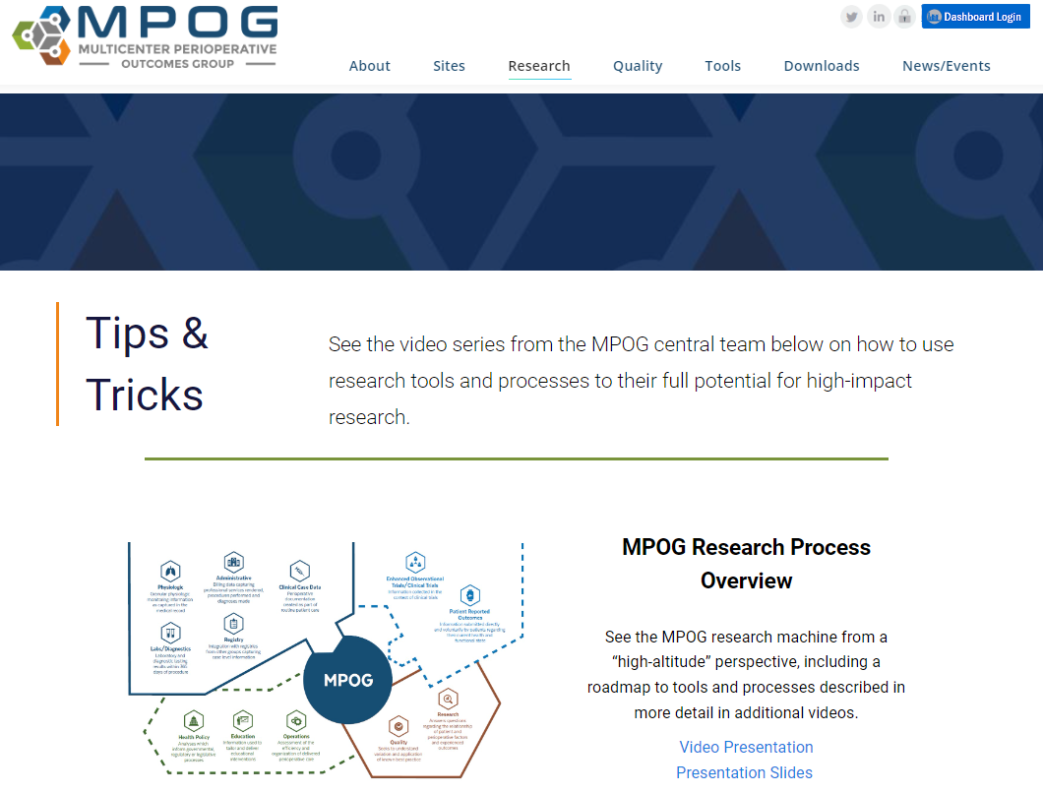
Tips & Tricks
Videos created by MPOG team describing how to use research tools and processes for high-impact research
  MPOG research process overview
  Developing a research question and answerable with MPOG data
  Using DataDirect for self-serve access
  Developing a research proposal
  Transforming raw data into clinical inferences: Phenotypes
  Inspecting and curating MPOG data
  Big data management
  Statistics for large database research

Slide 29
What are BCBSM Collaborative Quality Initiatives?
Organizations that are developed and administered by providers and hospital partners, and funded in part, by BCBS of Michigan
Support continuous quality improvement and the development of best practices
Leverage multicenter data registries
Able to track performance and provide incentives
Focus on reduction of errors, prevention of complications, and improvement of patient outcomes
Notes:
How we get this large amount of good/diverse data?
BCBSM has funded quality improvement in MI via CQIs
Anesthesiology CQI is ASPIRE
One tool that has worked well for others are the collaborative quality initiatives.
Support continuous quality improvement and the development of best practices for areas of care that are highly technical, rapidly-evolving and associated with scientific uncertainty

Slide 30
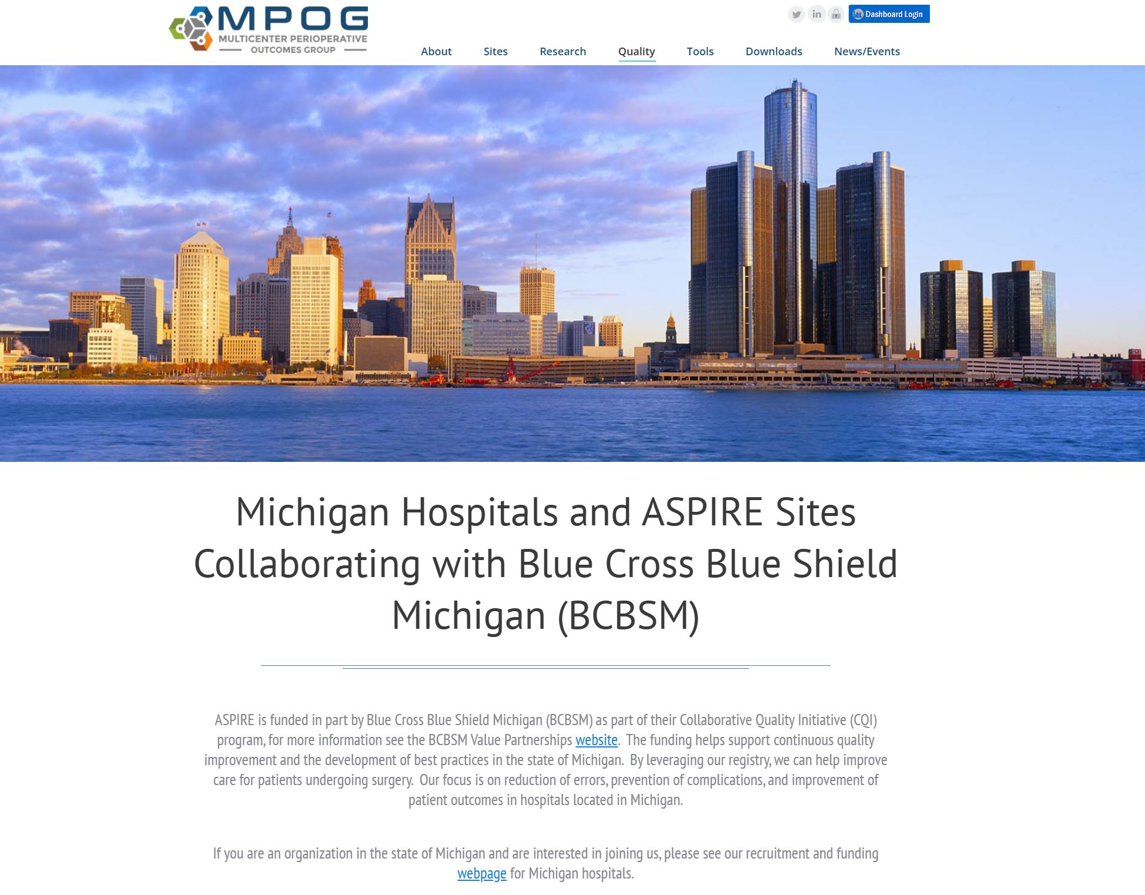
ASPIRE is the BCBSM funded CQI for Anesthesiology
Anesthesiology quality improvement group
Goal is to study unexplained variation in practice and determine best practices for anesthesia providers
Established with support of BCBSM and other funding sources
Governed by the MPOG Quality Committee which consists of members of each institution.
Built on infrastructure of the Multicenter Perioperative Outcomes Group (MPOG)

