Slide 1
Provider Contacts Tool

Slide 2
Provider Contacts Tool – Table of Contents
Provider Contacts Overview
Updating Provider Contact Data
Performing Updates in Bulk
Creating Provider Accounts via Provider Contacts Tool
Managing Performance Feedback Email Recipients
Utilizing the Education View

Slide 3
Provider Contacts Tool
Overview

Slide 4
Provider Contacts Overview
Provider Contacts, often referred to as ‘User Management Tool’, allows MPOG sites to manage provider accounts and update provider information for the purpose of sending feedback emails.
Displays two different types of views:
  Default View: Provider information based on case data submitted to MPOG
  Education View: Residency or Fellowship Program Information
Generates individualized provider dashboards for the QI Reporting Tool
NOTE: The Provider Contacts tool cannot be populated until data has been submitted to MPOG Central. Provider information will only become available after a site has successfully transferred their data to the Coordinating Center.

Slide 5
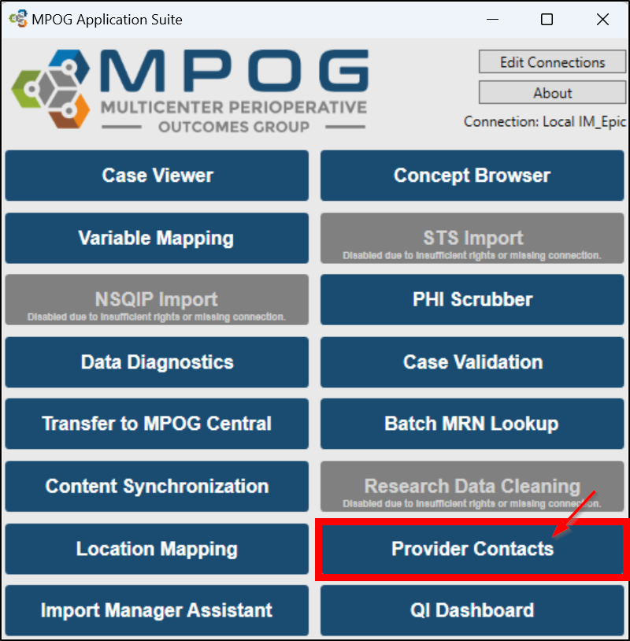

Accessing Provider Contacts
MPOG Desktop Application Suite |  | MPOG website

Slide 6
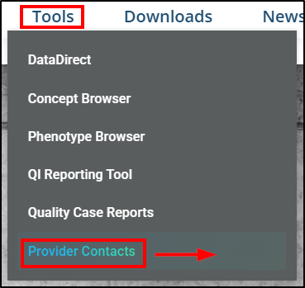
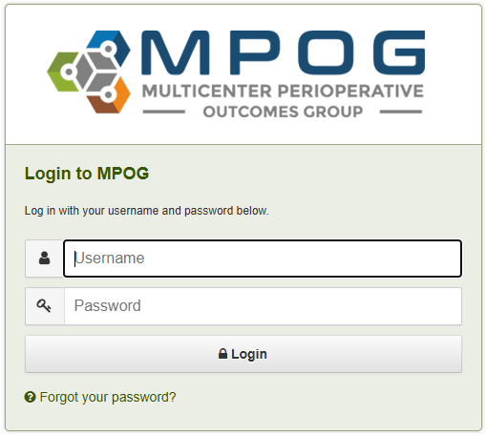
Accessing Provider Contacts
On the MPOG website, click on
  Tools menu >
  Provider Contacts hyperlink >
  Login to MPOG window >
  Fill in Username and Password >
  Click Login.
If your MPOG username and password do not grant access at this stage, please contact the Coordinating Center at support@mpog.zendesk.com
to request the necessary permissions.

Slide 7
Provider Contacts Tool - Default View
Displays individual anesthesia provider data using various filtering and display options
  Database Instance
  Provider Feedback Email Status
  Provider Roles: Attending, Resident, Fellow, CAA, CRNA, SRNA
Actions Available:
  Update provider details (Role, Name, email address, NPI)
  Configure which providers receive feedback emails
  Import/Export provider data using Excel or CSV
Additional individual provider information displayed
  MOCA enrollment and status information
  First/Last Case Dates
  Case Counts

Slide 8
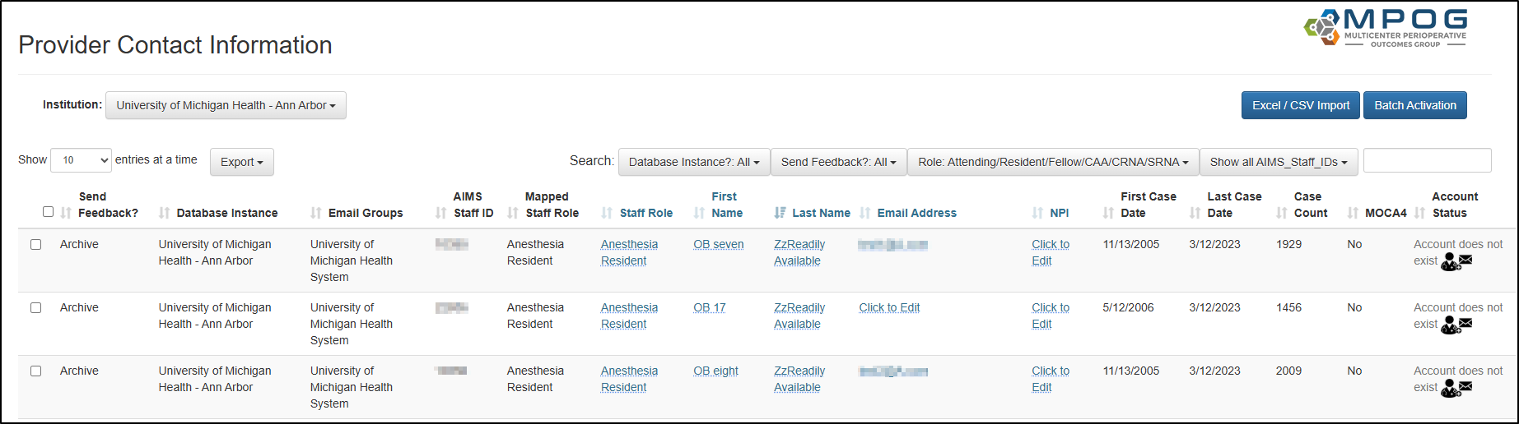

Provider Contacts Tool – Filters & Functionality
Send account activation emails in batch form
Export an excel/csv of your provider data to update/modify provider information
Upload the excel/csv previously exported to apply the updated provider data
Select your Institution (Database Instance)
Various Filters to help narrow down to a focused list of providers
Toggle between ‘Default’ and ‘Education’ Views
Update to see more rows at a time.

Slide 9
Provider Contacts Tool – Default View Columns
Provider Roles to select:
Attending, Resident, Fellow, CAA, CRNA, SRNA
Provider case data
Configure which providers receive feedback emails;
Database Instance
Can update provider details manually
MOCA enrollment and status information
MPOG Account Status

Slide 10
Column Definitions
COLUMN | DEFINITION
Send Feedback? | Indicates whether the provider is set to receive feedback emails: • Yes – Feedback emails will be sent • No – Feedback emails will not be sent • Archive – Feedback emails will not be sent; Inactive provider instance
Database Instance | The database where the provider/case information were uploaded from
Email Groups | Email distribution groups the provider belongs to
AIMS Staff Identifiers | • AIMS Staff ID – Unique staff identifiers configured by site technical team • NPI – Provider’s National Provider Identifier; Editable NPI field
Provider Role | • Mapped Staff Role – Role derived from case data • Staff Role – Editable role field; overrides mapped staff role if different
Case Information | • First Case – Provider's earliest case uploaded to MPOG • Last Case – Provider's most recent case uploaded to MPOG • Case Count – Provider's total cases uploaded to MPOG
MOCA4 | Indicates the provider’s MOCA Part IV status: • Yes – Has enrolled in MOCA • No – Has not enrolled in MOCA
Account Status | Status of the provider's MPOG account

Slide 11
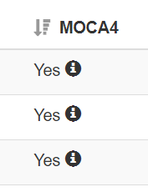
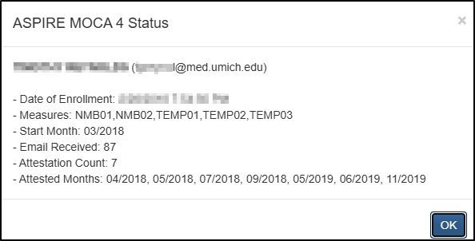
MOCA 4 Status
Information regarding a provider’s MOCA Part IV Status is also available using the Provider Contacts tool by clicking the information icon within the MOCA column

Slide 12
Updating Provider Contact Data

Slide 13
Updating Provider Data
The following columns can be manually updated directly within the application by simply clicking the data fields in ‘blue’.
All fields in the blue hyperlink section are required for sending provider feedback email.

Slide 14
Updating Provider Data
All other columns (in black) are automatically populated based on the data submitted to the MPOG Central database. One exception is the ‘Send Feedback’ column which can be managed directly within the application.

Slide 15
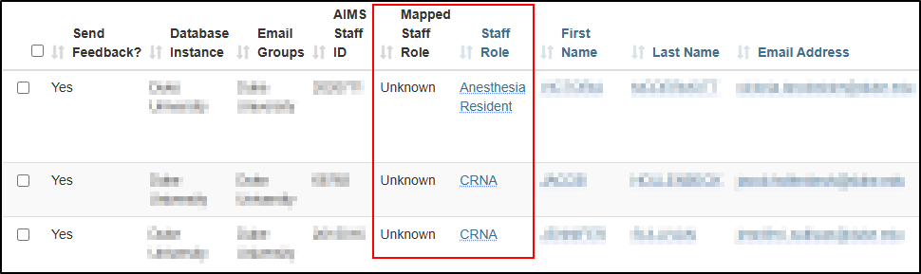
Assessing Mapped Staff Role & Staff Role Columns
For sites that have a generic sign-in role of ‘Anesthesia Provider’ or ‘Unknown’ in the Mapped Staff Role column, the Staff Role column acts as an ‘override.’
Staff Role can be populated with more granular information regarding the provider’s actual role (i.e., CRNA, attending, resident).

Slide 16
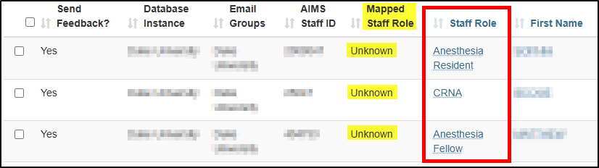
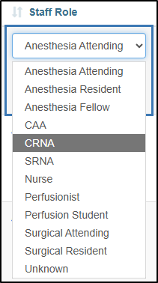
Updating Mapped Staff Role & Staff Role Columns
If 'Unknown' appears in the ‘Mapped Staff Role’ column, update the ‘Staff Role’ field with the appropriate role.
Correct the ‘Mapped Staff Role’ column by selecting the appropriate role from the Staff Role drop-down menu.
Reach out to your site’s MPOG contact person to update the Staff Role mapping in variable mapping.
Notes:
‘Unknown’ appears in the Mapped Staff Role field for providers when a site uses a single AIMS variable for all anesthesia providers, which maps to the MPOG Staff Role ‘Staff Level – Unable to Determine Anesthesia Provider’, resulting in ‘Unknown’ being displayed in the Mapped Staff Role column. This can be seen in the Primary Provider phenotype, for a patient from Duke University - see 59eb8001-3f4f-f011-817c-005056ad0e71 as an example (All Staff >

Slide 17
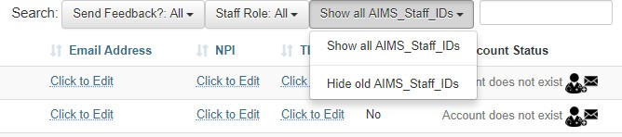
Sites with a Legacy and IM Instance
Sites who convert from MPOG’s Legacy Production method to Manager may see 2 AIMS Staff IDs listed for each provider in the Provider Contacts tool.
To manage the AIMS Staff IDs affiliated with Import Manager only, select ‘Hide old AIMS_Staff_IDs’ in the dropdown menu seen below.
NPIs are critical for the Legacy instance to enable linking of provider data over time.

Slide 18
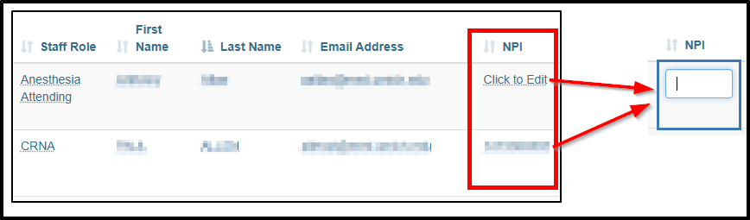
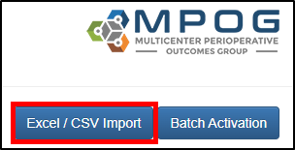
Entering National Provider Identifier (NPI) numbers
NPI numbers allow for linking provider data across multiple EHR systems within the MPOG database and linking provider data across institutions. This linking ensures accuracy and continuity in tracking and measuring provider performance.
How to Enter an NPI Number:
If updating for a few contacts: Direct entry is recommended. Click on the NPI field in the row you need to edit and type the number. |  | If updating several contacts: Use the import option by clicking on the Excel/CSV Import button. For more information, please refer to the next section ‘Performing Updates in Bulk.’

Slide 19
Tips and Tricks
Tips for Populating NPI Data
  Collaborate with the credentialing department to compile a comprehensive list.
  Partner with the administrative team from the anesthesiology department to maintain NPIs in Provider Contacts.
  Reach out to your IT department to query the local provider database for an up-to-date list of anesthesia provider NPIs.

Slide 20
Performing Updates in Bulk

Slide 21
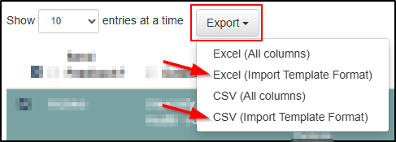
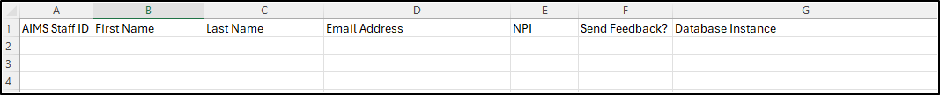
1. Exporting Provider Contact Data
To edit or add information for multiple providers at once, we recommend exporting the data.
To export the provider contacts data for the purposes of updating and re-importing, click on Export. Then select either ‘Excel (Import Template Format)’ or ‘CSV (Import Template Format)’.
The Export List contains the following columns:

Slide 22
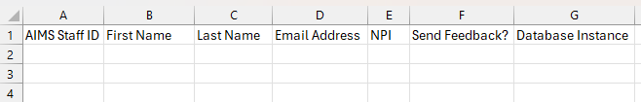
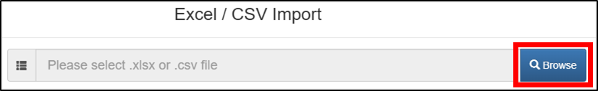
2. Importing Provider Contact Data
Update the spreadsheet with the required data. DO NOT ALTER THE COLUMN ORDER or THE FIRST ROW. Save the file to your local drive.
Return to provider contacts page and click the Excel/CSV Import button.
Click the Browse button, then locate and select the saved file on your computer. Click ‘Open’ to proceed. Ensure the file is not open on your desktop before uploading. Files currently in use cannot be loaded into the Provider Contacts Tool.

Slide 23
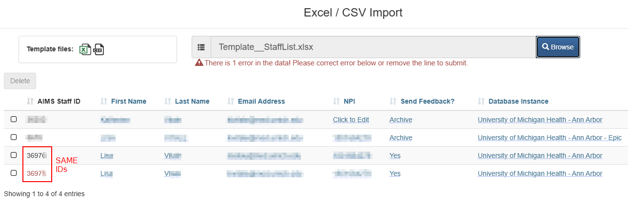
2. Importing Provider Contact Data
The Provider Contacts Tool will process the selected file and display any errors encountered during import. Review the errors, make corrections in the spreadsheet, and re-upload the file. Click Submit to finalize the update.
Example Error: Duplicate IDs
How to Fix:
Select and delete one of the rows using the import tool

Slide 24
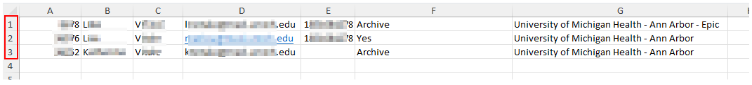
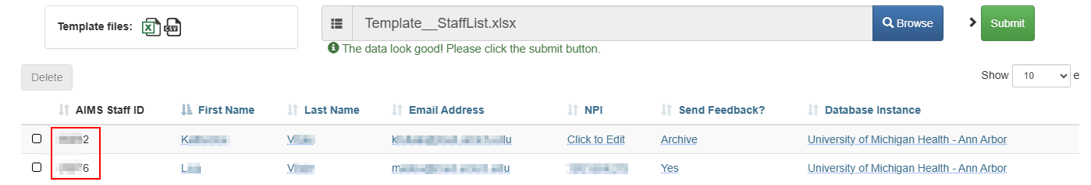
Resolving Potential Errors on Import
Example Error: The number of uploaded rows does not match the rows in the Excel file.
How to Fix:
Ensure the first row of the import file contains the required header and format information.

Slide 25
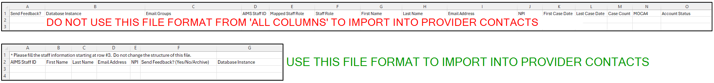
Tips and Tricks
Some Things to Note About Exporting Using ‘All Columns’:
The two ‘(All Columns)’ options will export
all columns in the Provider Contacts Tool and should be used for informational purposes only.
EXPORT USE CASE: Send technical lead a list of the AIMS Staff IDs for them to add provider names.
The ‘(All Columns)’ format will not work when trying to import first/last names, emails, and
NPI numbers into the Provider Contacts Tool. Use either of the (Import Template Format) files.

Slide 26
Creating Provider Accounts via
Provider Contacts Tool

Slide 27

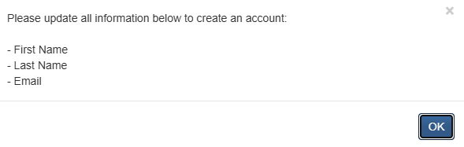
Creating an MPOG Provider Account
New provider MPOG accounts can be created via the Account Status column in the Provider Contacts Tool.
Step 1 – Initial Account Status
  When a new provider is added, the Account Status will display “No Account".
  Click on ‘No Account’ to begin the activation process.
Step 2 – Missing Information Prompt
  If any required fields (First Name, Last Name, or Email) are missing, a pop-up window will appear prompting you to complete the missing information.
  Click OK to close the window.
  Enter the missing details in the Provider Contacts Tool.

Slide 28
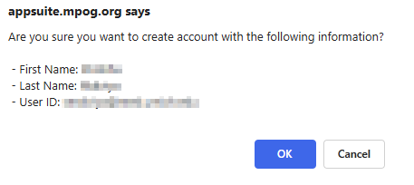

Creating an MPOG Provider Account
Step 3 – Confirm Provider Details
  After updating the provider’s information, click "Account does not exist" again.
  A confirmation pop-up will display the provider’s First Name, Last Name, and User ID (which is the provider’s email address).
  Click OK to proceed.
Step 4 – Account Status Update
  The Account Status will change to "Not activated", and the cell will briefly turn yellow before fading.
  An activation email is automatically sent in the background.

Slide 29



Creating an MPOG Provider Account
Step 5 – Email Sent Confirmation
  Once the email is successfully sent, the Account Status will automatically update to “Email Sent". Then number in parentheses is the number of times the email has been sent.
Step 6a – Account Activated
  After the provider activates their account from the email, the Account Status will change to "Activated".
Step 6b – Expired Activation Email
  If the provider does not activate their account within 7 days, the status will change to “Email Expired".
  To resend the activation email, click on “Email Expired" and repeat the activation process. Then number in parentheses is the number of times the email has been sent.

Slide 30

MPOG Account Status
The Account Status column:
No account |  | No account has been created for the provider.
Not active |  | Activation email has not been sent. An activation email is automatically sent in the background.
Email Sent ([# of emails sent so far]) |  | Activation email sent successfully. Provider has yet to click on the activation link to set up their account.
Active |  | Activation email has been sent, and provider has successfully set up their account.
Email Expired ([# of emails sent so far]) |  | Activation email expired. To resend an activation email, click ‘Activation email expired’ and follow prompts.

Slide 31
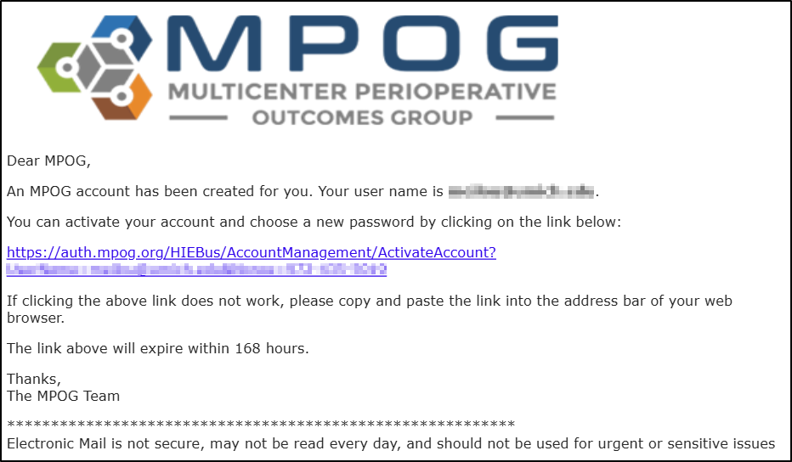
MPOG Account Activation
Sample Provider Contact Activation Email
The Activation link in each email will expire in 7 days.

Slide 32
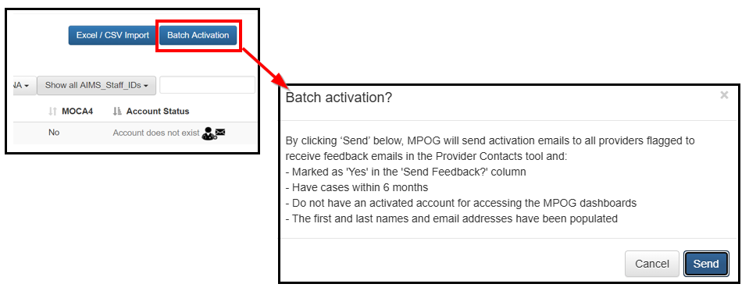
Create a Batch of Provider MPOG Accounts
Batch Activation
Automatically creates an account for providers if one does not already exist
Sends an activation email to all providers who have not yet activated their accounts

Slide 33
Managing Performance Feedback Email Recipients

Slide 34
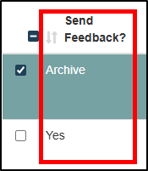
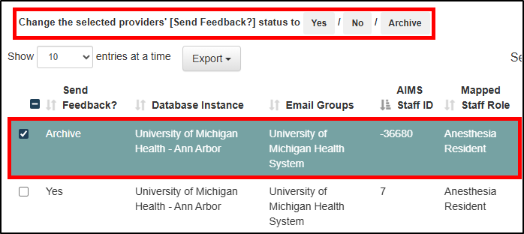
Managing Feedback Email Recipients
Each row (provider instance) can have one of three ‘Send Feedback?’ statuses:
  ‘Yes’ – I want this provider to receive feedback emails
  ‘No’ - I do not want this provider to feedback emails
  ‘Archive’ - this provider instance is inactive or no longer works at my institution and should not receive feedback emails.
To update the ‘Send Feedback?’ status for one provider
  Click the checkbox at the start of the provider row.
  The row will turn green, and
  A prompt appears above the table asking to Change the selected providers’ [Send Feedback?] status.
  Click ‘Yes’, ‘No’, or ‘Archive’.

Slide 35
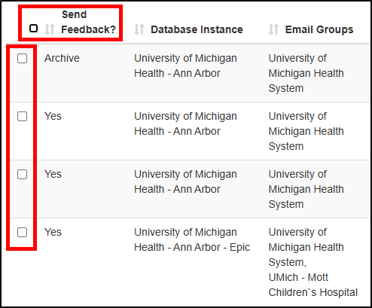
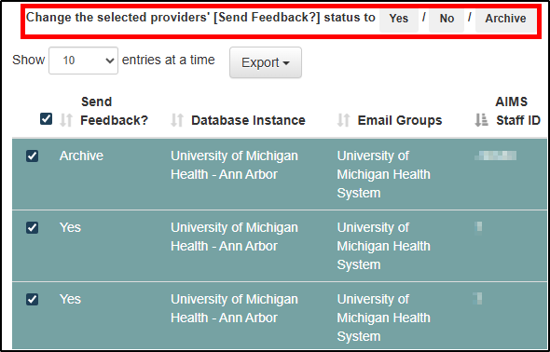
Managing Feedback Email Recipients
Updating the ‘Send Feedback?’ status for multiple providers:
  First:
    Select all rows by clicking the checkbox next to “Send Feedback”, OR
    Select multiple rows by clicking the checkboxes at the start of selected each provider row
  Then:
    The selected rows will turn green, and
    A prompt appears asking above the table to Change the selected providers’ [Send Feedback?] status.
    Clicking ‘Yes’, ‘No’, or ‘Archive’ applies the same status to all providers in the green rows.

Slide 36
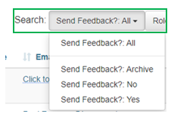
Managing Feedback Email Recipients
Some things to note about ‘Send Feedback?’ Status:
  Update the ‘Send Feedback?’ Status to reflect the provider’s current status at any time.
    If a provider:
      No longer practices at your institution, change the status from ‘Yes’ → ‘Archive’.
      Returns later, change the status back to ‘Yes’.
      Does not want to receive emails, change the status to ‘No’.
  Filter the list of providers by Feedback Status:

Slide 37
Utilizing the Education View

Slide 38
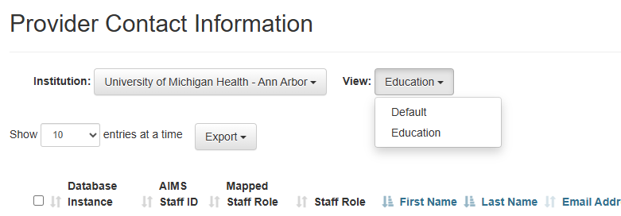
Education View
The ‘Education’ view can be used to track and manage start dates, graduation dates, and current year for residents and fellows.
To change views, select ‘Education’ from the dropdown in the upper left of the screen

Slide 39
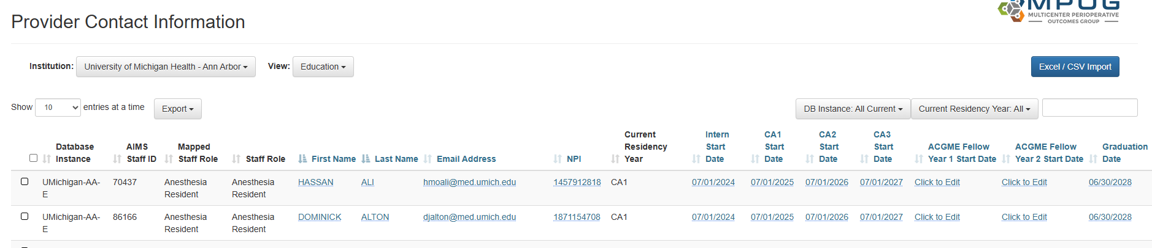

Education View
Tip: Any of the blue text is editable by clicking on the text or editing via the import tool.
These columns sync between the ‘Default’ and ‘Education’ views. Any changes to the editable columns will be reflected in both views
These columns are unique to the ‘Education’ view. All columns are editable except for ‘Current Residency Year’ which is calculated based on start dates

Slide 40
Autofill Rules
After entering a date in either ‘Intern Start Date’ or ‘CA1 Start Date’, the tool will automatically fill in the remaining CA1 Start, CA2 Start, CA3 Start, and Graduation Date if the fields are empty.
For residents who start the program as a CA1, the ‘Intern Start Date’ column can be marked ‘N/A’.
July 1 is used as the default date for autofill start dates. Users can click on any date to edit after its has been auto-populated.
June 30 is used as the default graduation date. Users can click to edit after a field has been auto-populated.
Dates entered in CA2 Start, CA3 Start, or Graduation Date prior to entering an ‘Intern Start Date’ or ‘CA1 Start Date’ will not be over-ridden by auto fill.

Slide 41
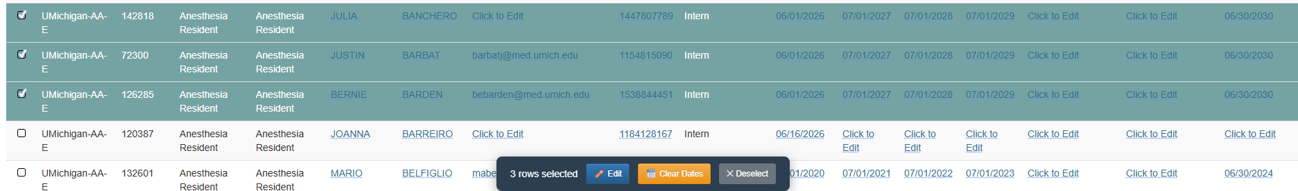
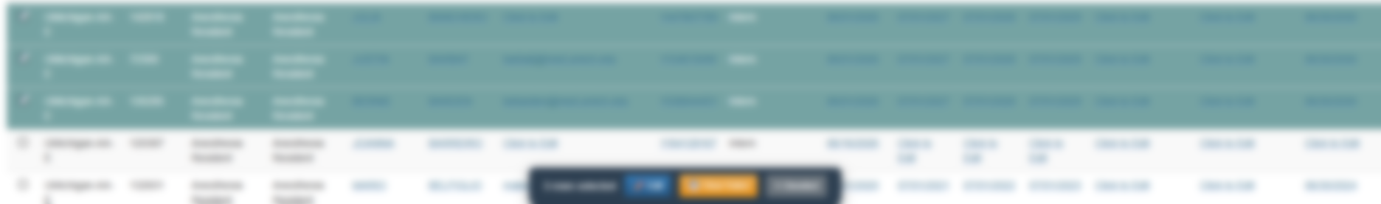
Editing Multiple Rows
A multi-select function allows users to edit multiple rows at a time.
To use, select applicable rows using the check boxes on the left.
Use ‘clear dates’ to erase any existing dates if necessary. Multi select editing will not work if the selected rows have mismatched dates in them.

Slide 42
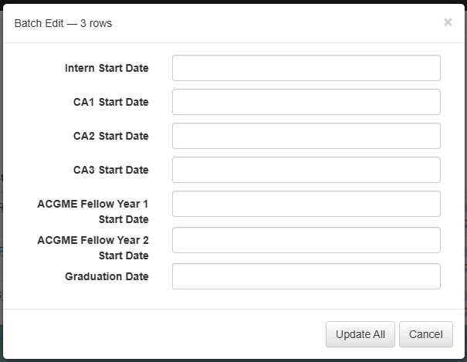
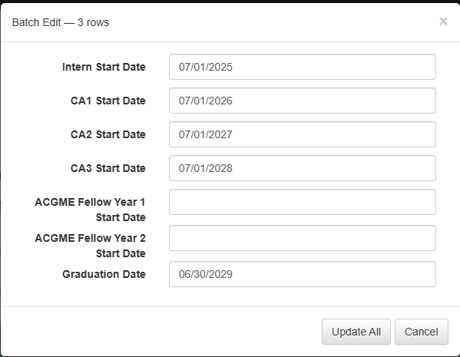
Editing Multiple Rows
‘Auto fill’ will be applied when a user enters an ‘Intern Start’ or ‘CA1 Start’ date. Auto filled dates can be edited by clicking the date. Click ‘Update All’ to save changes.
Click ‘Edit’ to open a dialogue box and edit multiple rows at a time.

Slide 43
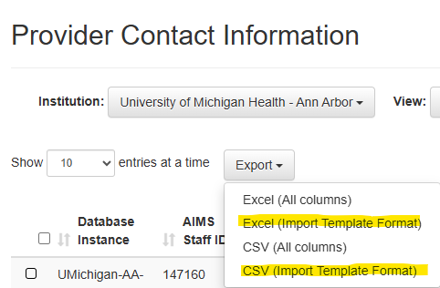
Batch Editing via Excel
To batch edit for multiple providers in Excel, use the ‘Export’ dropdown and select one of the options listed as ‘Import Template Format’.

Slide 44
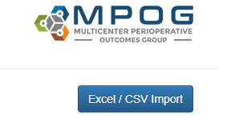
Importing Batch Edits
Update the spreadsheet with the required data. DO NOT ALTER THE COLUMN ORDER or THE FIRST ROW. Save the file to your local drive.
Return to provider contacts education page and click the Excel/CSV Import button.
Click the Browse button, then locate and select the saved file on your computer. Click ‘Open’ to proceed. Ensure the file is not open on your desktop before uploading. Files currently in use cannot be loaded into the Provider Contacts Tool.

Slide 45
Importing Batch Edits
The Provider Contacts Tool will process the selected file and display any errors encountered during import. Review the errors, make corrections in the spreadsheet, and re-upload the file. Click Submit to finalize the update.
Example Error: Duplicate IDs
How to Fix:
Select and delete one of the rows using the import tool

