Slide 1
Getting Started:
Downloading and Accessing the MPOG Application Suite

Slide 2
Contents
Downloading and Installing the MPOG App Suite
Connection Setup and Confirming Access
MPOG App Suite Upgrades

Slide 3
Downloading and Installing the MPOG App Suite

Slide 4
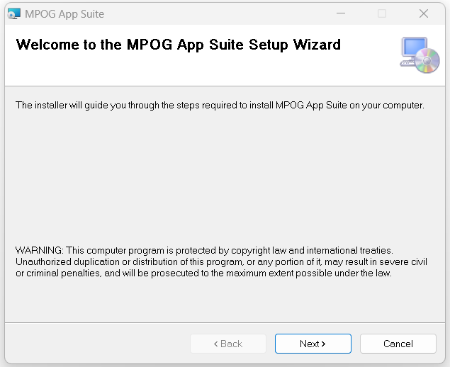
Downloading and Installing the MPOG Application Suite
For new installations:
The MPOG App Suite package will be sent to each site’s IT contact.
  For sites using Desktop Virtualization (e.g. Citrix), your IT team will install the App Suite.
  For sites where the App Suite is installed on PCs, your IT team will distribute the installer to each individual to download to their local computer.
Once downloaded, double-click on the installer to run it.

Slide 5
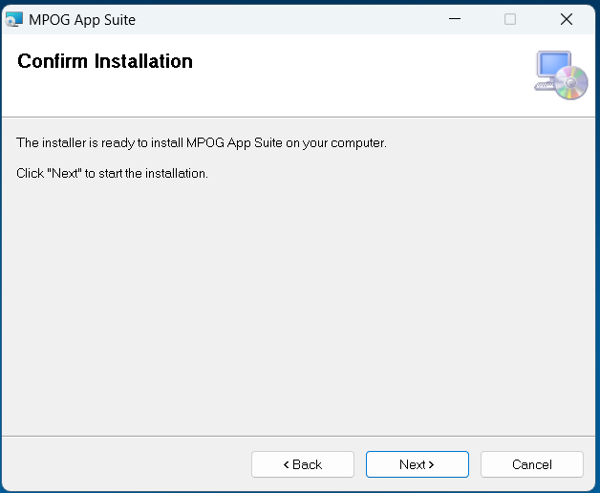
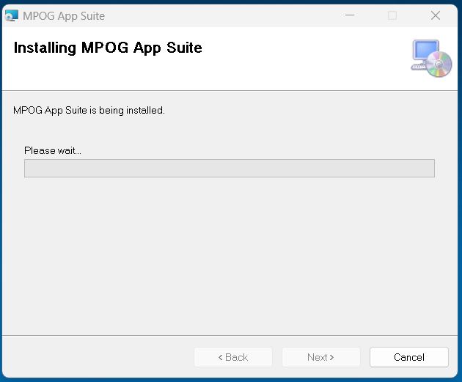
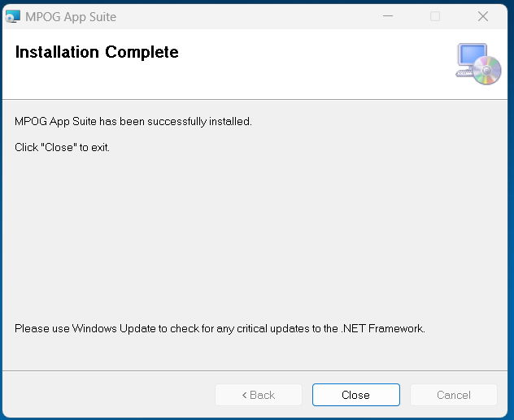
MPOG Application Suite: Setup Wizard
Follow the instructions in the Setup Wizard
This will overwrite any other versions of the MPOG App Suite that you have on your desktop

Slide 6

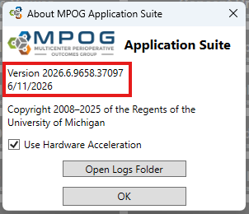
MPOG Application Suite: Installation
The install process creates an “MPOG App Suite” desktop shortcut. Use this to launch the application.
Confirm the version by clicking the ‘About’ button:

Slide 7
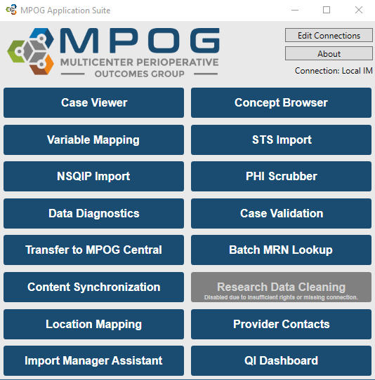
MPOG Application Suite: App Menu
Follow steps to download the suite to your computer. The MPOG Application Suite should automatically open. Some tools may display in gray.

Slide 8
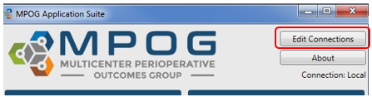
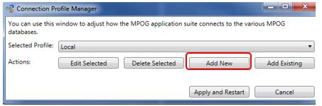
MPOG Application Suite: Connection Setup
Next, set up a connection to your local MPOG database by clicking: ‘Edit Connections’
Click “Add New” if there are no profiles available for connection. Otherwise, choose the appropriate connection, typically labeled as ‘Local’ or ‘Hospital Name’
Click “Edit Selected”

Slide 9
Connection Setup and Confirming Access

Slide 10
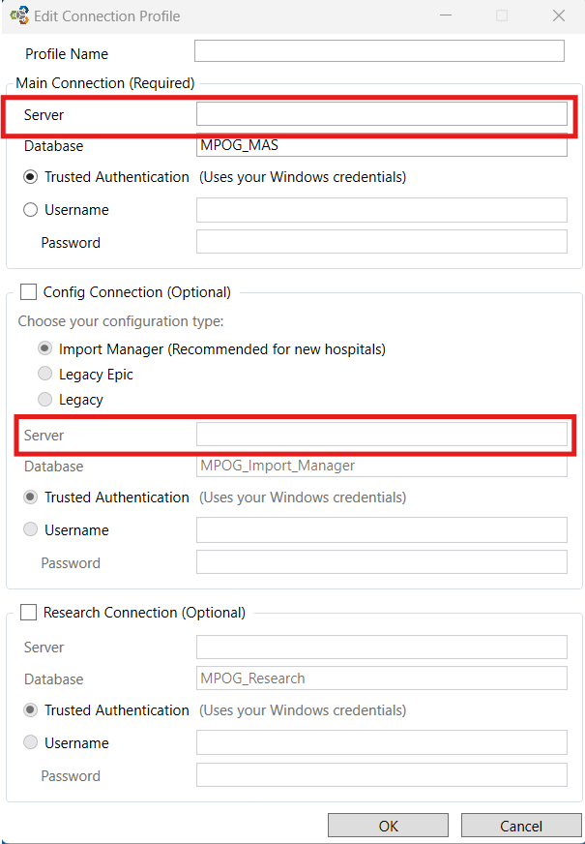
MPOG Application Suite: Connection Profile Setup
Ask the MPOG technical lead at your site for the server connection information.
  This is managed by your site’s technical team. MPOG Central staff does not have your site’s server or database information
  Fill in the server address in both the top and middle sections of this form.
  Update the database name as directed by your technical team
In the Config Connection section:
  Select ‘Import Manager’
  Verify that the database name is listed as MPOG_Import_Manager.
Click ‘OK’

Slide 11
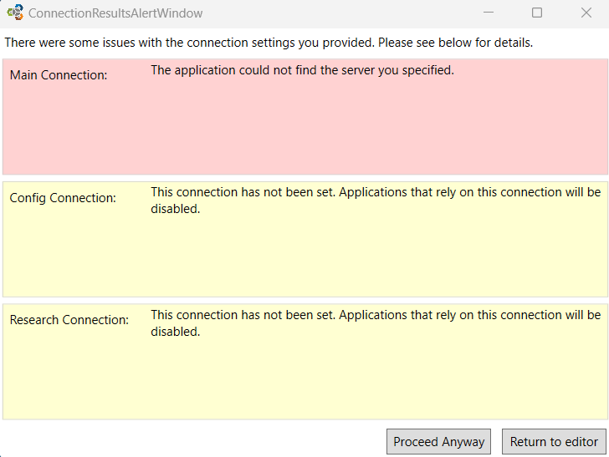
MPOG Application Suite: Troubleshooting
If you see this screen after filling out the Connection Profile
  Click ‘Return to Editor’ and confirm that the connection information was entered correctly.
If Connections were entered correctly, contact the MPOG Technical Lead at your site.

Slide 12
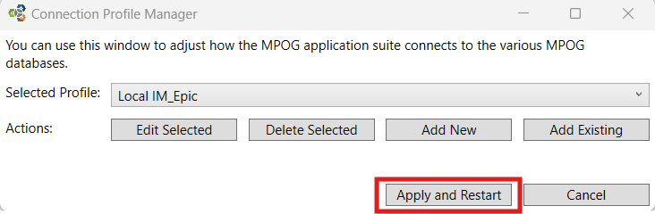
MPOG Application Suite: Connection Access
The ‘Connection Profile Manager’ form will repopulate as follows. Click “Apply and Restart.”
The MPOG Application should run again and open as follows.
  More tools should have turned blue. If not, contact your site technical team to update your database roles.

Slide 13
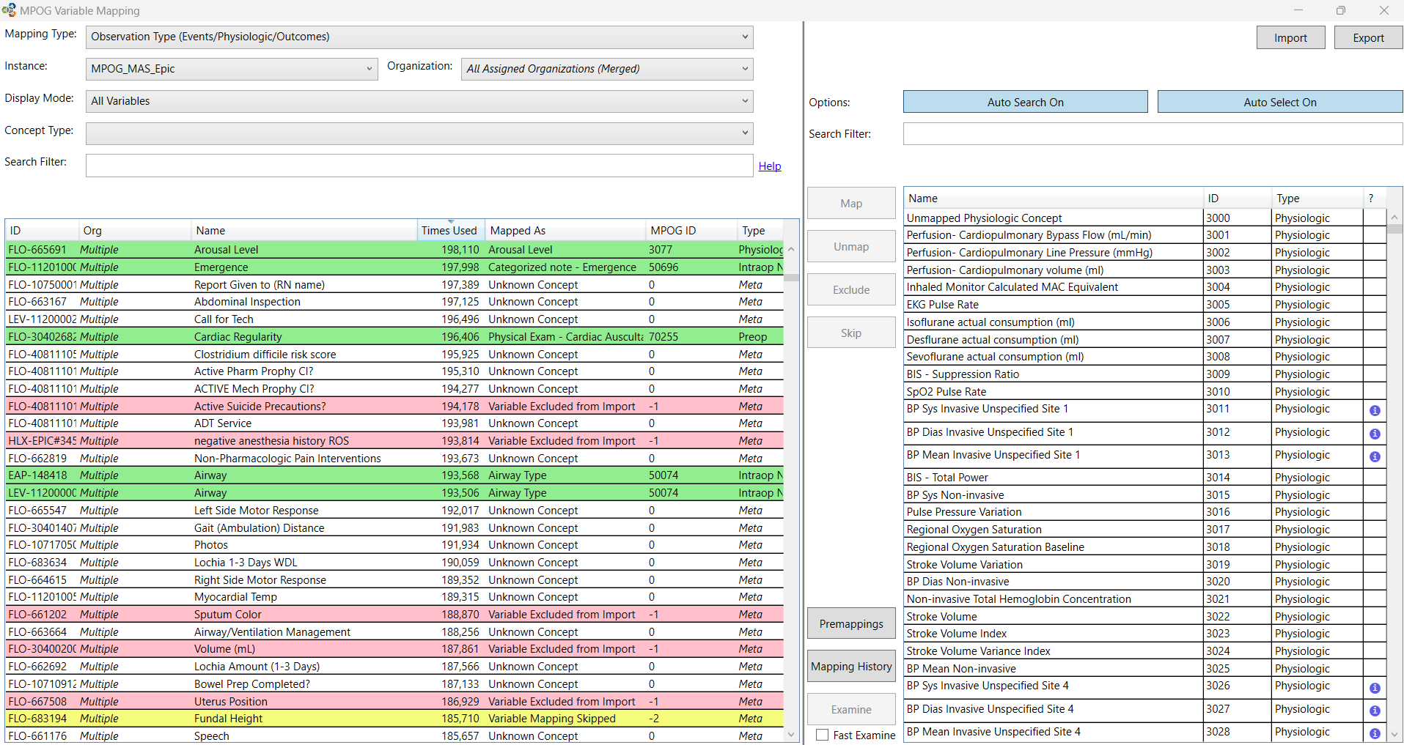
MPOG Application Suite: Confirming Access
Click on ‘Variable Mapping’ to test connection.
  Choose the Mapping Type: Observation Type
  If you see something similar to this, the MPOG Application is ready to go!

Slide 14
MPOG App Suite Upgrades

Slide 15
MPOG Application Suite: Upgrades
MPOG releases upgrades to the MPOG App Suite twice per year, typically in the Spring and Fall. Release notes will be posted to our website
How to apply the upgrade:
The upgrade package will be sent to each site’s IT contact.
  For sites using Desktop Virtualization (e.g. Citrix), your IT team will upgrade the App Suite.
  For sites where the App Suite is installed on PCs, your IT team will distribute the installer to each individual to download after the database upgrade has been applied.
    Once you receive the installer from your IT team, click the link and follow the instructions in the Setup Wizard.
After applying the upgrade, please confirm that you are using the current version by clicking ‘About’ in the upper right corner.

