Slide 1
Data Review:
Import Manager Assistant

Slide 2
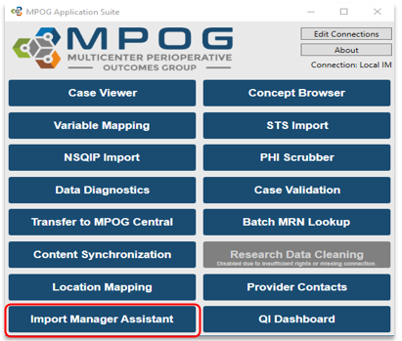
Contents
Import Manager Assistant Overview
Log Viewer
Overview Tab
Organizations Tab
Check File Columns Tab
Parse File Data Tab
Handoff Settings Tab
*Note: Technical teams supporting the MPOG project should also download the application suite to use IM Assistant.

Slide 3
Import Manager Assistant Overview
IM Assistant offers clear, organized details about file processing errors and shows their current position within the Import Manager pipeline.

Slide 4
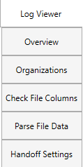
Import Manager Assistant Tabs Summary
Log Viewer: This tab displays the various import manager logs and the handoff queue.
Overview: This tab contains a color-coded grid representing the current status of import manager.
Organizations: This tab shows counts and dates to allow sites to view database tables and to monitor name changes of revenue sources
Check File Columns: This tab enables the user to see which rows in an imported file have the incorrect number of columns.
Parse File Data: This tab enables the user to view the contents of an imported file.
Handoff Settings: This tab contains the current settings for handoff for this instance.

Slide 5
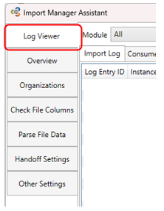
Log Viewer Tab

Slide 6
Log Viewer – Filters
The filters at the top of the window allow the user to filter by a variety of criteria:
  Module: refers to the type of data.
    Please see next two slides for definitions of each type of data available.
  Target date range*: filters the data based on case date of service.
  Error filtering: allows the user to view log records with or without errors.
    Please keep in mind that an error that has occurred may have since been resolved.
  Execution date range*: filters the data based on date file processing occurred. Default is set to the previous 30 days.
  *Spring/Summer 2026 Update: Date filters are now inclusive of dates entered

Slide 7
Log Viewer – Module Definitions
The following tables provide information on each module name and type of data included
Module | Data Included
Cases | Date of Service Operating Room Admission Type Surgical Service Procedure Text Diagnosis Text Organizations (used to determine which MPOG_MAS database to use)
Diagnoses | Hospital Discharge Diagnosis and Professional Fee Diagnosis Codes
Hospital Mortality | Date of Death (in hospital only)
Labs | Formal Labs and Point-of-care Labs

Slide 8
Log Viewer – Module Definitions, continued
Module | Data Included
Patients | Patient Name MRN Gender Ethnicity Race
Payers | Insurance and other payer data
PeriopAdministrations | Fluids and Medications
PeriopObservations | Preoperative Notes Intraoperative Notes Monitor Data
Procedures | Professional Fee Procedure Codes Hospital Discharge Procedure Codes
StaffTracking | Staff sign ins/outs and role (eg attending)

Slide 9
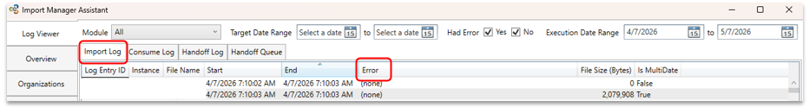
Log Viewer – Import Log
Import Log
  Shows a list of all imported files, including any with errors
  Files with recent errors may still be in the Import Utility folder
  These files will keep retrying until they are fixed or removed

Slide 10
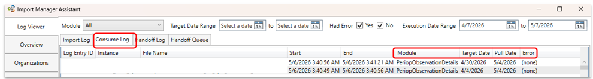
Log Viewer – Consume Log
Consume Log
  Shows a list of Modules and Target Dates that have been processed, including any with errors
  Fixed errors will still appear in the log
  New errors may indicate missing data and need attention

Slide 11
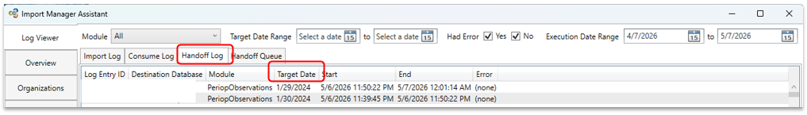
Log Viewer – Handoff Log
Handoff Log
  Displays the modules (and corresponding Target Dates) that have been exported to the MPOG_MAS database(s).
  Errors that have been resolved will still show in the log,
  Any recent errors may indicate missing data and require attention.

Slide 12
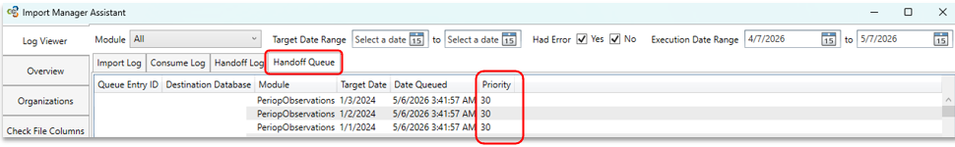
Log Viewer – Handoff Queue
Handoff Queue
  Displays any modules (and corresponding Target Dates) currently queued to be exported to the MPOG_MAS database(s).
  The assigned Priority helps indicate why the item was queued:
    Priority 10 = New Data
    Priority 20 = Re-Imported Data
    Priority 30 = New Mappings
    Priority 50 = Missing from MPOG_MAS, Reason Unknown
    Priority 60 = Missing from MPOG_MAS, Reason Unknown (Patient Level Data)

Slide 13
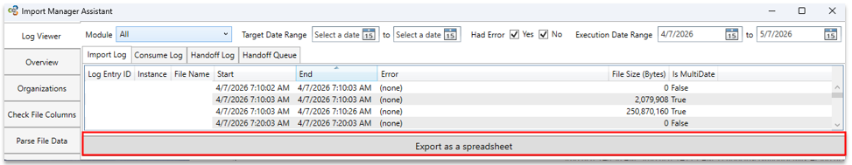
Log Viewer – Export Logs
The Log Viewer shows only the most recent 10,000 rows from each log
Exporting the logs as a spreadsheet removes this limit and includes all rows.
To export, click the “Export as a spreadsheet” button at the bottom of the Import Manager Assistant window.
Please include this log when contacting MPOG support about any errors encountered during the Import/Consume/Handoff processes.

Slide 14
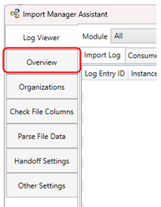
Overview Tab

Slide 15
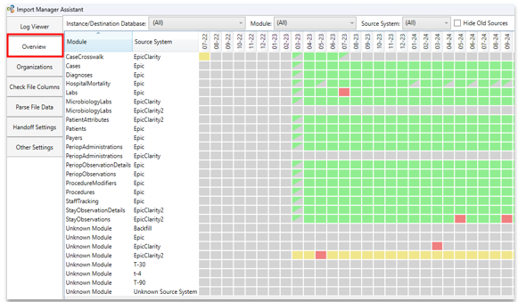
Overview Tab - Summary
Provides a color-coded* grid representing the status of files that were imported.
  *See next slide for color indicators
Rows show module status, columns show month and year
  Most recent months display on the far right, may need to scroll left to see historical data
Each box represents data for one month

Slide 16
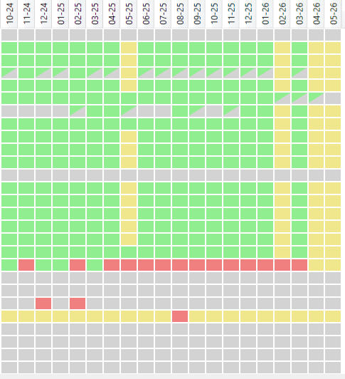
Overview Tab – Color Indicators
The color of each box shows the data status for that month:
Green: All data has successfully completed every Import Manager step; every day in the month is fully processed
Yellow: Data has completed some steps but still has more to finish; no errors, but processing is still underway for one or more days
Red: One or more errors occurred; if any day in the month has an error, the whole month appears red
Grey: Data is missing; there are no errors and no active processing, but one or more days have no data
Green/Grey: Some data is missing; some days are complete (green) while others are missing (grey)

Slide 17
Overview Tab – Old Sources
When a source stops sending data (for example, due to a change in billing vendor), its boxes will appear gray to show no data for that month
The user can click the “Hide Old Sources” checkbox to hide sources that have not submitted data in more than 12 months (see next slide for example)
When this option is enabled, any source with no data during this period will be hidden
This setting can be turned on or off by the user and is off by default

Slide 18
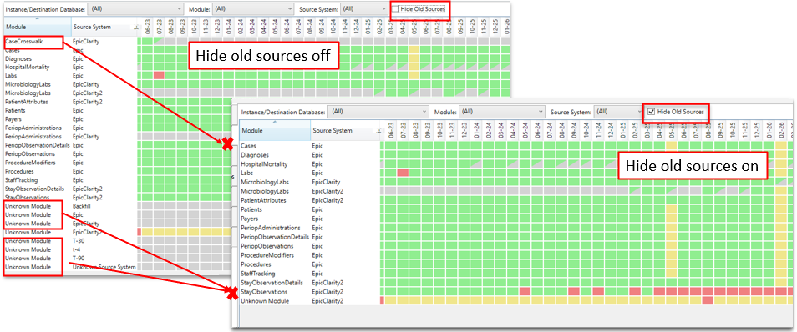
Overview Tab – Old Sources Visualization

Slide 19
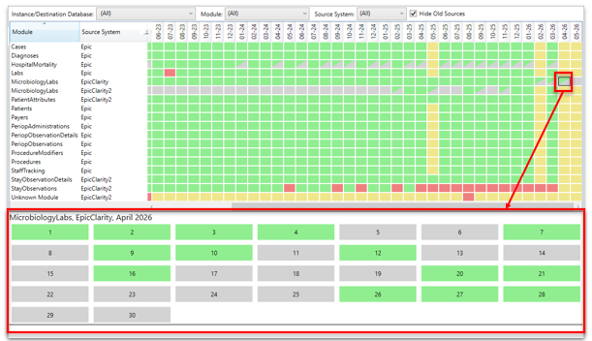
Overview Tab – Monthly Examination
Clicking a box in the grid shows that module’s status in the panel at the bottom of the window
Each day of the month is displayed and marked with a color-coded status

Slide 20
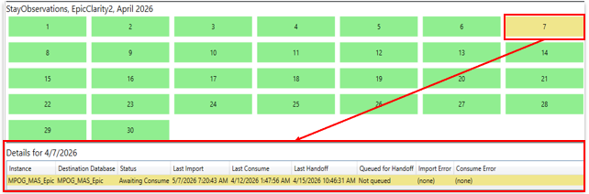
Overview Tab – Monthly Examination Details
Select a day to see a breakdown by source system
The source system shows where the data came from (such as an electronic health record or billing system)
You can view more details about any errors that occurred
The status column shows where the data is in the transfer process

Slide 21
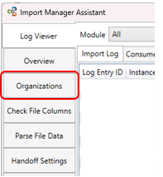
Organizations Tab

Slide 22
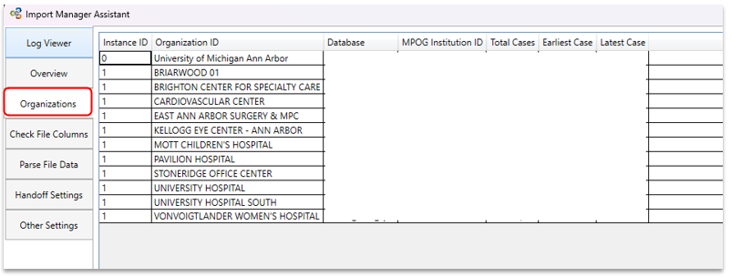
Organizations Tab - Summary
Allows sites to monitor for location name updates
Provides an overview of which locations are submitting data to MPOG, along with case counts and case dates

Slide 23
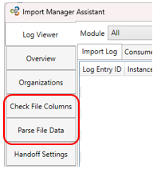
Check File Columns and
Parse File Data Tabs

Slide 24
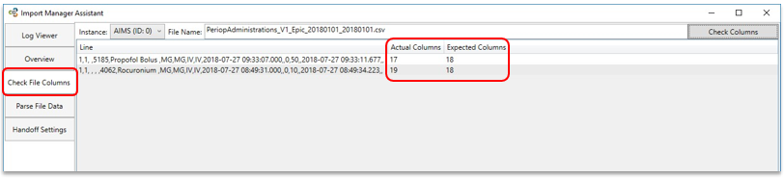
Check File Columns Tab
Useful for checking which rows in a particular file that may contain too many or too few columns.

Slide 25
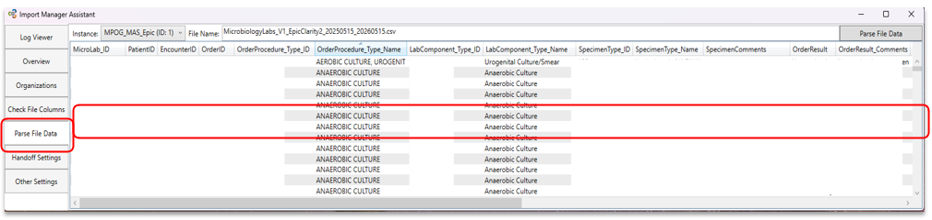
Parse File Data Tab
Allows the user to see the contents* of an imported file.
*May need to use scroll bar at bottom of window to view all columns.

Slide 26
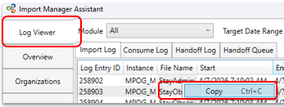
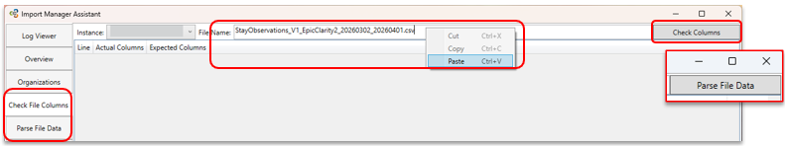
Copy/Paste File
File names can be obtained by copying from the Log Viewer tab.
  Right click on any file name and click “Copy”.
Paste into the File Name field in appropriate tab
  Right click in the field and click “paste”
Then click “check columns” or “parse file data”

Slide 27
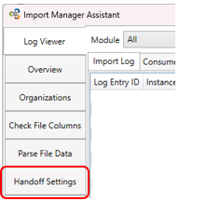
Handoff
Settings Tabs

Slide 28
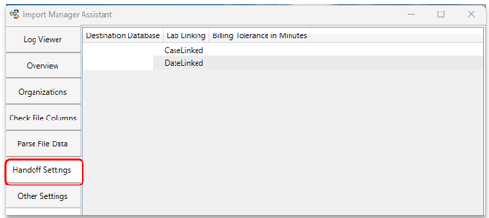
Handoff Settings
Lab linking refers to which labs are included in a given target date.
  CaseLinked should be used if all labs for the patients that had a case that day were pulled.
  DateLinked should be used if all labs taken that day are included in the file.
Billing tolerance in minutes adjusts how close timing of a billing code and a case start time can be to be considered a match.
Do NOT change these values without consulting MPOG staff

