Slide 1
Data Review:
Data Diagnostics

Slide 2
Data Diagnostics Table of Contents
Data Diagnostics Overview and Requirements
Accessing Data Diagnostics and Basic Functions
Data Diagnostics Interpretation
Data Diagnostics Investigation
Attestation
Special Considerations: Billing
Additional Tools

Slide 3
Data Diagnostics Overview
MPOG sites may contribute information from various sections of an EHR: preoperative, intraoperative, and postoperative notes and physiologic data, demographic information, laboratory values, and procedure codes.
Two separate strategies are employed to improve data quality and ensure data accuracy.
  First, data diagnostics are used by technical and clinical staff to detect systematic errors with data extraction, transformation, or mappings. Diagnostic visualizations represent specific pass/failure thresholds to determine compliance at a macro level.
  Second, clinicians at each site are required to manually validate between 5 and 10 cases per month to ensure that the data that have been extracted into MPOG matches the original EHR information utilizing the Case Validator utility (see Module: Data Review - Case Validation)

Slide 4
Data Diagnostics Requirements
Data Diagnostic review and attestation are required for all sites before uploading to the Central MPOG database.
All funded sites are required to conduct this attestation process on a monthly basis.
Non-funded sites are required to complete before each upload to MPOG Central. If submission is on a monthly basis, then attestation should also occur on a monthly basis.

Slide 5
Accessing Data Diagnostics and Basic Functions

Slide 6
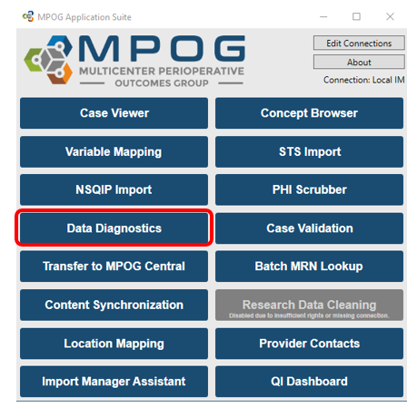
Accessing Data Diagnostics

Slide 7
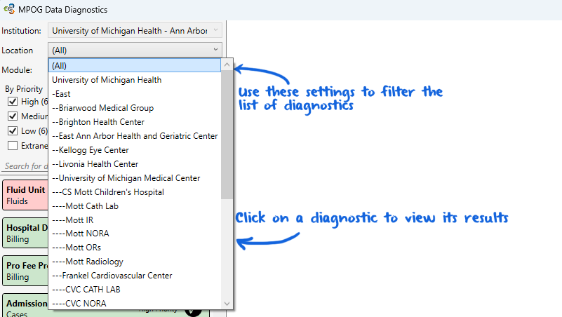
Data Diagnostics: Basics
Your institution/site should be defaulted in the top field.
The Location filter is defaulted to (All). This filter allows you to view location specific results down to the unit level as specified in Location Mapping.
Some diagnostics cannot be filtered by location
  Case to Patient Ratio
  Cases per Month
  Formal Lab Count
  POC Lab Count
  Patient Gender Ratio
  Peds Cases per Month

Slide 8
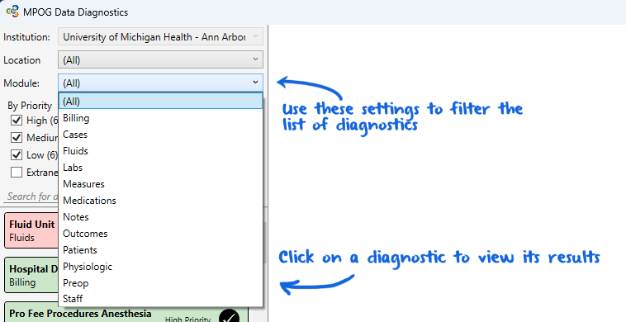
Data Diagnostics: Selections
Institution: This is defaulted to your institution and cannot be changed
Location: This is based on Location Mapping and allows the user to drilldown on specific locations within the institution
Module: Select a module to filter the diagnostic list to accommodate the type of data to review.
If planning to review all data diagnostics for the monthly attestation process, click “(All)” from the dropdown menu for both Location and Module.

Slide 9
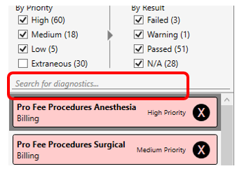
Diagnostic Search
If searching for a specific diagnostic, a free text search is available on the left-hand side

Slide 10

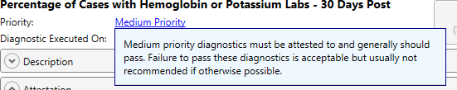
Data Diagnostics: Priorities
Diagnostics are labeled by priority type. A definition for each priority type is listed below. These definitions are also available when clicking on the priority type
Step 1: Click on the blue priority level.
Step 2: A definition window will present with the priority definition.

Slide 11
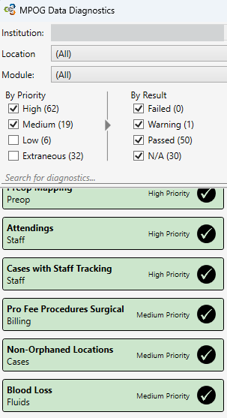
Priorities: High and Medium
* High Priority: High priority diagnostics must be attested to and it is strongly recommended that any detected issues are fixed prior to submission. Failure to pass these diagnostics can severely impact the quality assessment and research capabilities of your institution.
*Medium Priority: Medium priority diagnostics must be attested to and generally should pass. Failure to pass these diagnostics is acceptable but usually not recommended if otherwise possible.

Slide 12
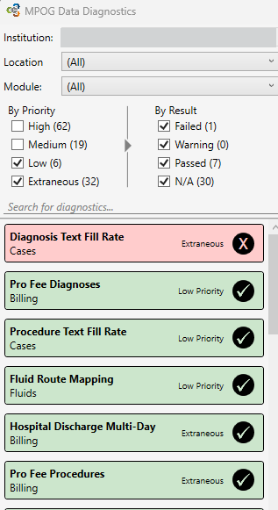
Priorities: Low and Extraneous
*Low Priority: Low priority diagnostics apply to areas of the MPOG database with relatively limited impact.
*Extraneous Priority: Extraneous diagnostics are intended solely as supplemental information. Review of these items is optional, and they are hidden by default.
The priority classification for each diagnostic can be readily viewed on the right side of the corresponding diagnostic entry.

Slide 13
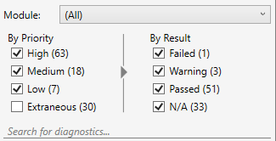
Filtering Diagnostics
Filters can be applied by Priority or by Result. Filtering allows the user to limit the number of diagnostics listed and improve the selection process for tailored and purposeful review of the data.
Data Diagnostics is configured by default to display all High, Medium, and Low priority diagnostics, along with all results. During your review, you may select or deselect any Priority or Result categories as needed.

Slide 14
Data Diagnostics Interpretation

Slide 15
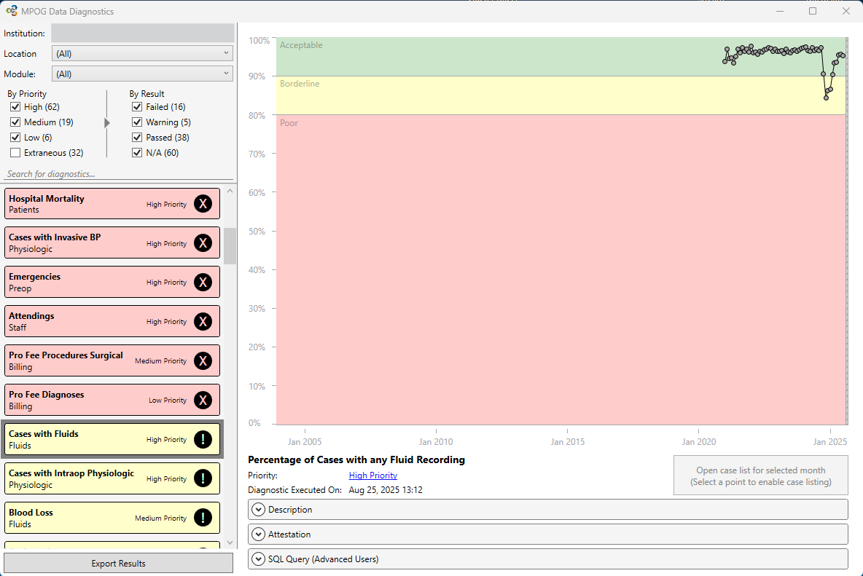
Interpreting Diagnostics
Click on the name of the Data Diagnostic in the left column to display the graphical results on the right.
The graph for 'Cases with Fluids' displays the percentage of cases with fluid inputs and outputs recorded, sorted by month.

Slide 16
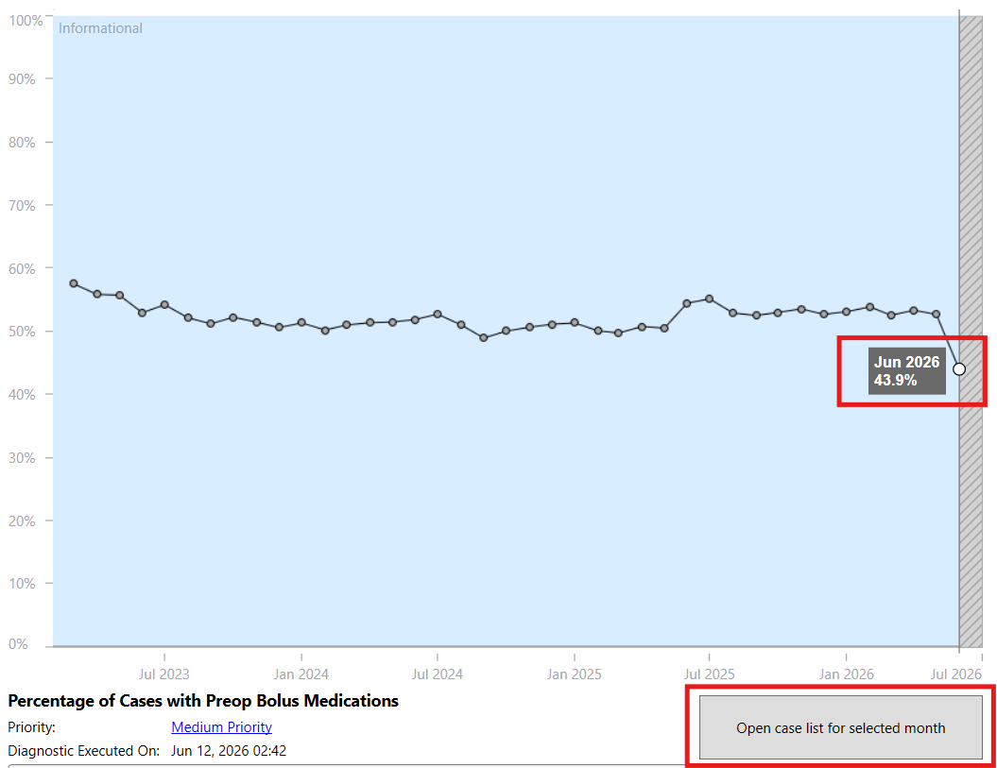
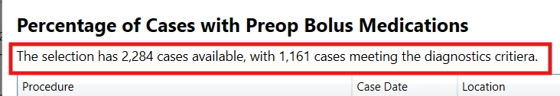
Interpreting Diagnostics: Graph
The graph shows a snapshot of the data at the time the Diagnostic was last executed. See date and time indicated below the graph as ‘Diagnostic Executed On.’ The data may have updated since the diagnostic last refreshed and may no longer reflect the current state.
To view the current data, click on the dot representing the month you would like to review, then click on ‘Open case list for selected month’.
  The current number of total cases and cases passing the diagnostic are at the top of the screen. Use these counts to determine the current percentage.
  In this example, the graph shows 48.3%, but the case list shows 50.8%
    1161/2284=0.508
    0.508 x 100 = 50.8%

Slide 17
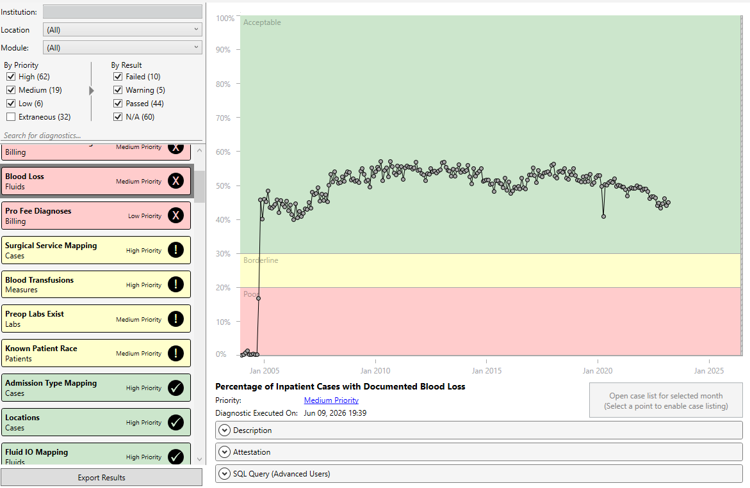
Interpreting Diagnostics: Thresholds
Thresholds assigned to the diagnostics reflect standard practices used across numerous sites.
  Green = Acceptable
  Yellow = Borderline
  Red = Poor (Non-standard)
  Blue = No Threshold
The graph indicates where each individual month falls within the threshold range.
The diagnostics list indicates where the full set of data falls within the threshold range.
  If any month falls within the Borderline or Poor range, the diagnostic list will display that color consistently, even if more recent data falls within the Acceptable range.
MPOG reviews diagnostic thresholds every two years, or more frequently as needed. Thresholds may be updated during one of the biannual MPOG App Suite upgrades (Spring and Fall).

Slide 18
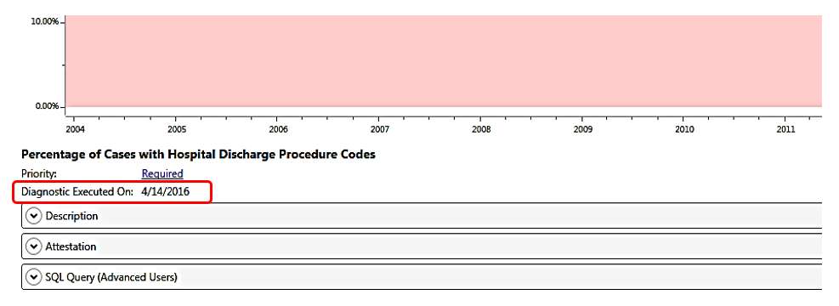
Interpreting Diagnostics: Last Update
To understand when the Diagnostic was last updated, view the ‘Diagnostic Executed On: MM/DD/YYYY’ date listed beneath the graph.
Data Diagnostics are typically scheduled to be Executed (or Refreshed) daily, but it may be scheduled to run on a different cadence. Contact your technical support team if the diagnostic is not refreshing regularly.

Slide 19
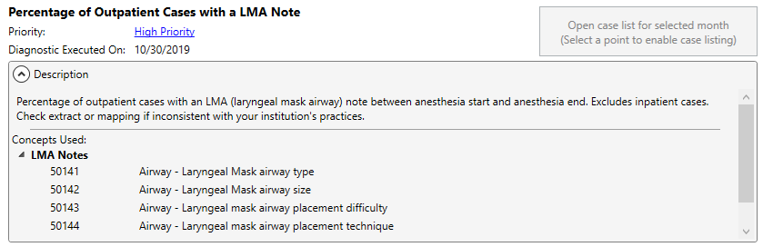
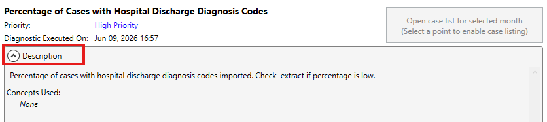
Interpreting Diagnostics: Description
To seek further clarification for the diagnostic selected, click on the “Description” header beneath the graph.
Clicking on the Description will expand the box to display the definition of the Data Diagnostic shown, along with where to look if the graph is inaccurate.
  Most diagnostics also include the MPOG Concept IDs that impact that diagnostic. Variable Mapping updates can affect the diagnostic performance.
  Diagnostics that do not include a list of MPOG Concepts are not impacted by Variable Mapping.

Slide 20
Data Diagnostics Investigation

Slide 21
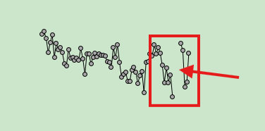
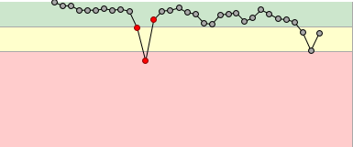
When to Investigate
When data is not accurately represented (gaps in the data or values are higher or lower than expected), further investigation is needed.
Gaps in data will require help from your site’s technical support team to troubleshoot the cause of the gap
Investigation and drilldown should occur when values are higher or lower than expected, or when some months dip or peak into another threshold range.
The data should be in the green area. The months that dip into the yellow (or red) areas should be reviewed for accuracy.
The lower scores could be related to a practice change, new variables that need to be mapped (see Module: Getting Started – Variable Mapping), or consume/handoff errors (see Module: Data Review – IM assistant).

Slide 22
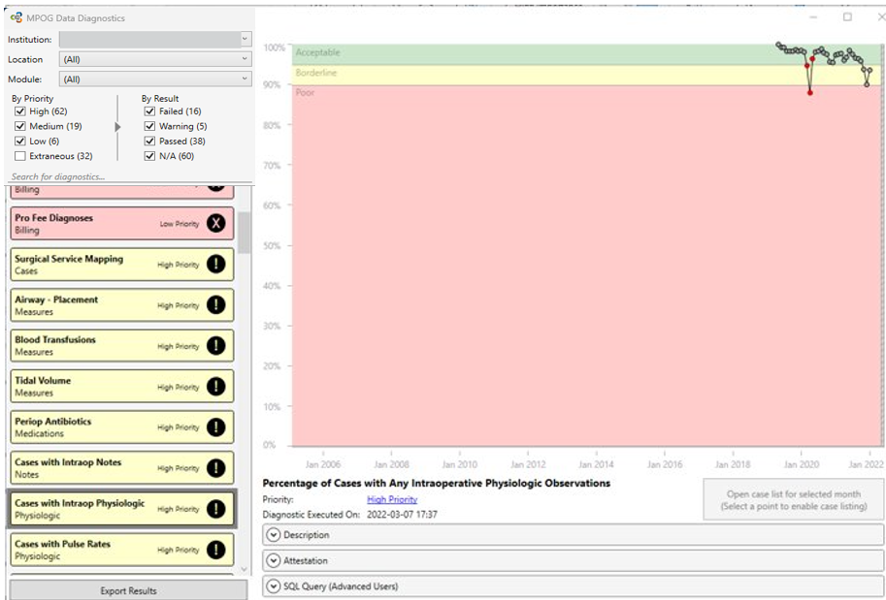
Investigating Diagnostics
According to the diagnostic shown, this site has Intraop Physiologic Observations in the database for 95-100% of cases through November 2021 at which point the number of cases with intraop physiologic observations decreases. This example shows that further investigation is needed prior to attesting to the accuracy of the data.

Slide 23
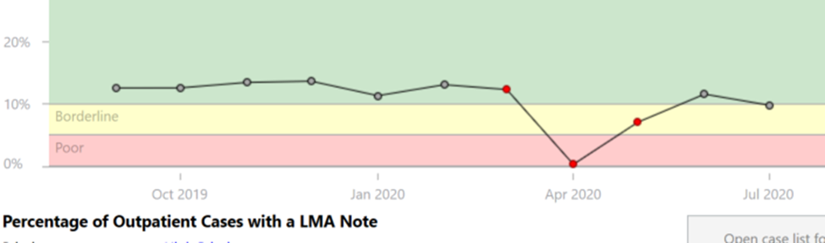
COVID-19 Adjustments
For some diagnostics, the months of March/April/May 2020 are now excluded from diagnostic pass/fail consideration due to COVID-19’s impact on case volume and will not impact the threshold color in the Diagnostics list.
These months will appear as red data points on the graph

Slide 24
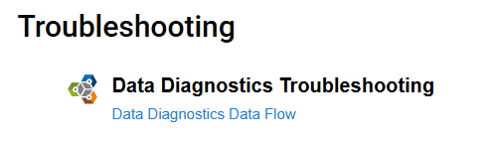
Diagnostics Investigation
If the data is below the threshold, with data in the ‘Borderline’ or ‘Poor (Non-standard)’ areas of the graph, please verify the accuracy of the data.
  Follow the instructions in the next 3 slides to determine if the data is accurate.
  For additional help, see the Data Diagnostics Troubleshooting tools on our website, https://mpog.org/mpog-app-suite-troubleshooting/
If the data is not accurate, investigate further with the site technical team to identify if extract or mapping issues exist.

Slide 25
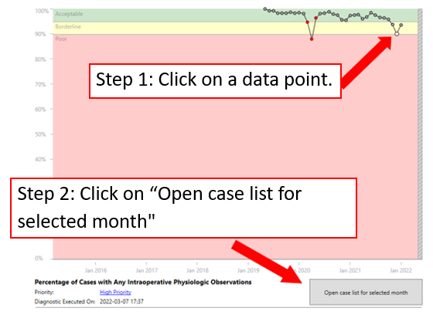
Diagnostics Investigation: Drilldown
Click on the data point associated with the time period in question and select ‘Open case list for selected month’ to display a list of cases for that time period.

Slide 26
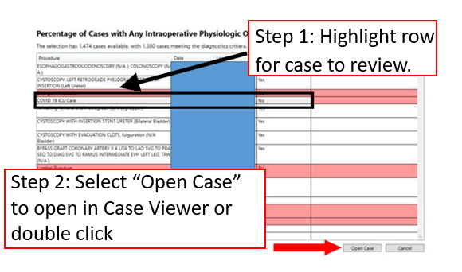
Diagnostics Investigation: Case List
A case list will open showing a random sampling of cases from the selected month
Open cases as needed in case viewer for further investigation
Clicking on the column names will allow you to sort based on Procedure, date, location, and Pass diagnostic Yes/No
  Hold Shift key and click on a column name to sort by multiple columns

Slide 27
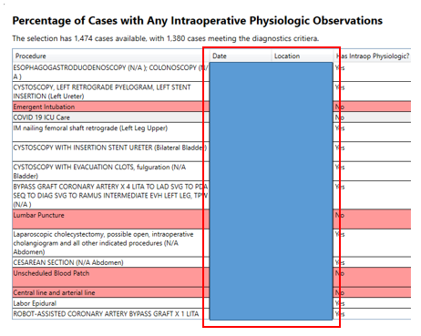
Diagnostics Investigation: Sorting Case List
The Case Date column allows users to quickly see any trends to missing data by date on which the cases occurred
The Location column allows users to quickly see any trends in specific rooms based on Location Mapping (see Module: Getting Started – Location Mapping).
By reviewing individual cases, it may be possible to determine if a mapping issue exists. Compare the data in MPOG Case Viewer to the EHR documentation.
Contact your MPOG contact for guidance regarding next steps to improve data quality.

Slide 28
Attestation

Slide 29
Attesting Diagnostics
In the Attestation section, the site Anesthesia Clinical Quality Reviewer (ACQR) or Quality Champion can review the diagnostic and determine if the data accurately represents the documentation present at the site (either in the EHR or billing software).
Attestation is important to verify that the diagnostic reflects your organization’s case mix, population, practice, and distribution.
The Attestation section is below the graph after the Description section. Click on the dropdown arrow next to ‘Attestation’ to open.

Slide 30
Attestation Requirements
You can attest to the accuracy of your data multiple times throughout the month, but Attestation is required to be completed at least once per month prior to upload to MPOG Central.
Attestation should be completed either by the ACQR (Michigan Sites) or by a Clinical Provider (e.g., Anesthesiologist, CRNA, Resident, CAA).
Minimal Monthly Diagnostics to Attest:
  All diagnostics assigned to High Priority, Medium Priority, and Low Priority
  Diagnostics under the Location: All
    You can attest diagnostics for individual locations as needed to track data issues at those sites
Extraneous Diagnostics should be attested at least once per quarter, but it can be completed more often as needed.

Slide 31
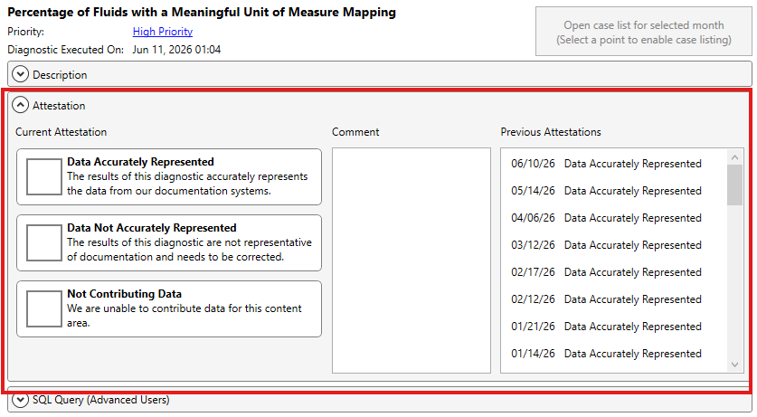
Completing Attestation
There are 3 options for attesting. Click the box next to the attestation selection that most represents the analysis conducted on the Data Diagnostic under review.
  Data Accurately Represented – choose this if the graph accurately represents the data at your site. This is determined through investigation and drilldown.
  Data Not Accurately represented – choose this if investigation and drilldown showed that there was an issue with the data (e.g., missing data or variable mapping updates required)
  Not Contributing Data – choose this only if your site is not contributing data for that specific diagnostic. (e.g., Anesthesia Assistants)
Comments can be added to the middle section as needed. Comments are not transferred to MPOG Central. MPOG Staff do not see comments.

Slide 32
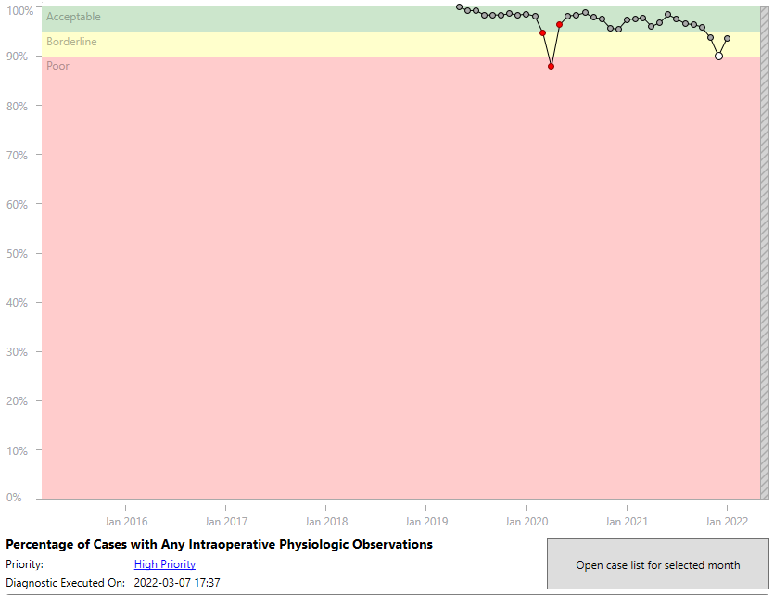
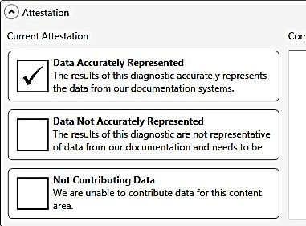
Example Attestation
In this example, investigation found that the dip in data is accurate. “Data Accurately Represented” would be chosen since the data reflects the documentation for the cases that have been loaded to date.

Slide 33
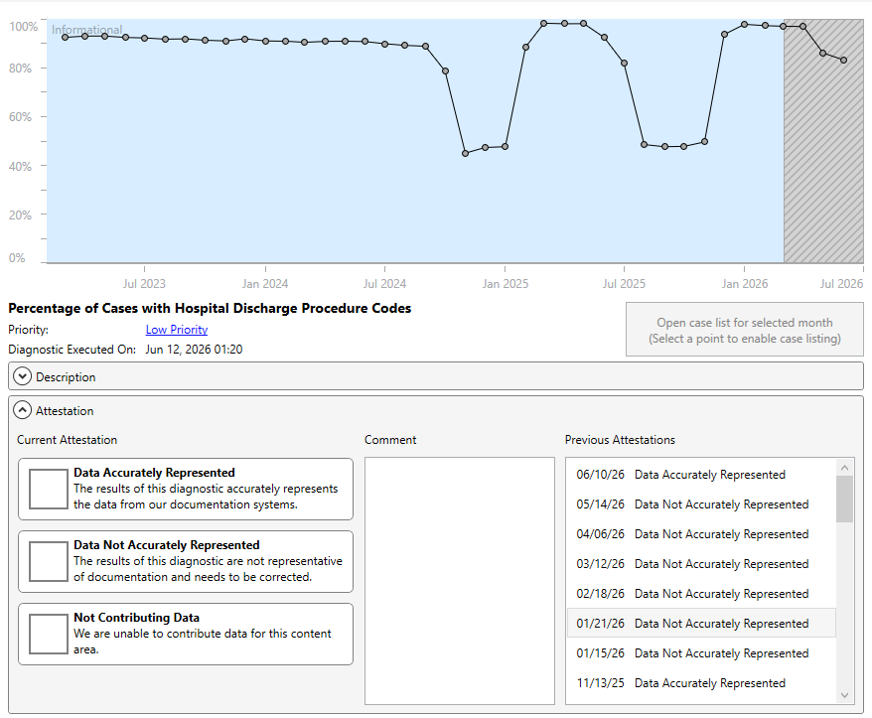
Previous Attestations
When the Data Diagnostic application is updated (typically scheduled to run overnight), the current attestation will move to the ‘Previous Attestation’ box on right side of the screen with an associated date.
To view diagnostic graphs from a previous attestation, double-click on the row of the attestation to review and a new window will display with the previous graph

Slide 34
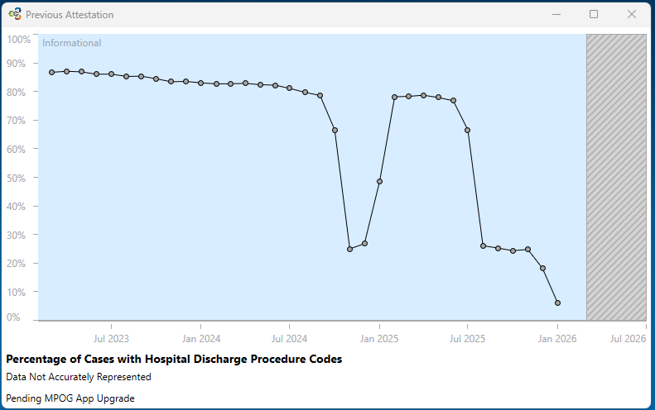
Viewing Previous Attestations
Previous attestation graph will display in a new window
The graph is a snapshot of how it looked at the time of the last attestation.
The name of the diagnostic is displayed below the graph
The previous attestation selection and any comments are displayed below the diagnostic name.
  Comments are not visible to MPOG Central.

Slide 35
Special Considerations: Billing

Slide 36
Billing Diagnostics
Required Billing Diagnostics | Optional Billing Diagnostics | Epic Sites Only
Pro Fee Procedures Anesthesia | Discharge Procedure Codes | Cases with PMH Code (ICD-9/10)
Pro Fee Procedures Surgical | Hospital Discharge Procedures
Pro Fee Procedures | Pro Fee Diagnoses
Hospital Discharge Diagnoses | Hospital Discharge Multi-Day

Slide 37
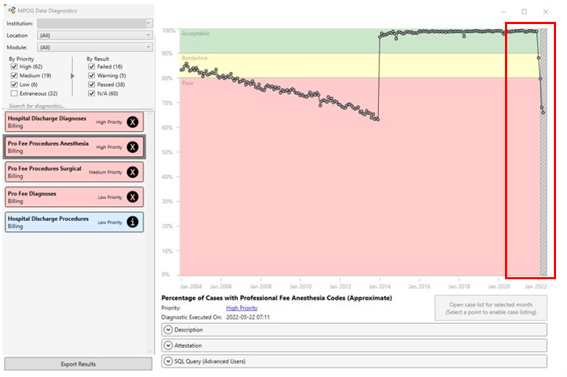
Billing Diagnostics: Grace Period
Since there can be a delay in completing billing, we allow a 3-month grace period for the billing diagnostics.
The gray section to the right of the graph represents the 3-month delay period
Dips into the yellow or red areas are expected during this time frame, but should be investigated

Slide 38
Additional Tools

Slide 39
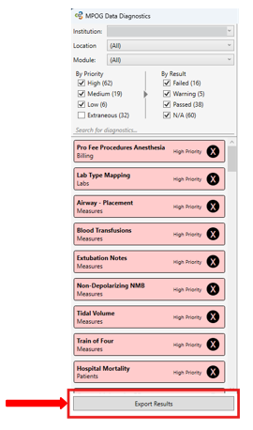
Exporting Diagnostics
Click on the “Export Results” button at the bottom of the Diagnostic listings
Will export ALL diagnostics at once
Save file to a location you an easily retrieve from
If the Coordinating Center requests a copy of recent Diagnostics, simply attach the file to an email and send to your contact person at the Coordinating Center. This report does not contain PHI and can be sent through email.
  This is helpful when comparing local diagnostics to MPOG Central Diagnostics

Slide 40
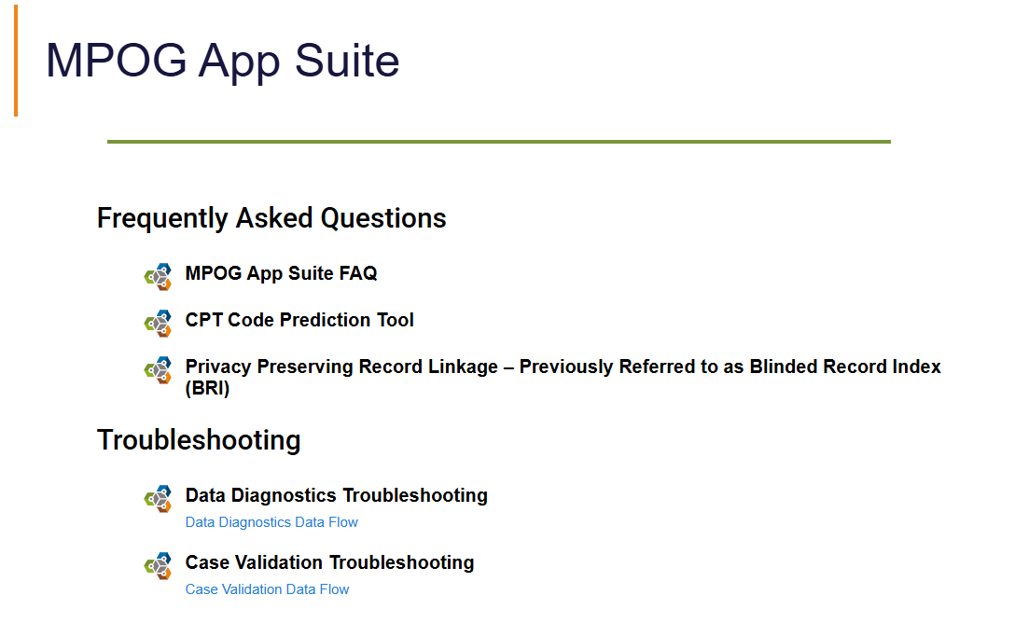
Additional Resources
  For additional help, see the Frequently Asked Questions and Troubleshooting tools on our website, https://mpog.org/mpog-app-suite-troubleshooting/

