Slide 1
Data Review:
Case Viewer

Slide 2
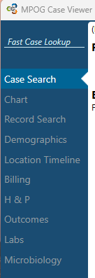
Case Viewer – Table of Contents
Case Viewer Overview
Case Search
Chart View
Record Search
Demographics
Location Timeline
Billing
H&P & Outcomes
Labs & Microbiology
*PHI has been removed for the purposes of this guide.

Slide 3
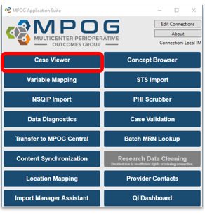
Case Viewer Overview
The MPOG Case Viewer application displays individual case data in a standardized way, similar to an anesthesia information management system (AIMS) but agnostic to the electronic health record used by the participating site.
*PHI has been removed for the purposes of this guide.

Slide 4
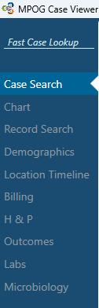
Case Search

Slide 5
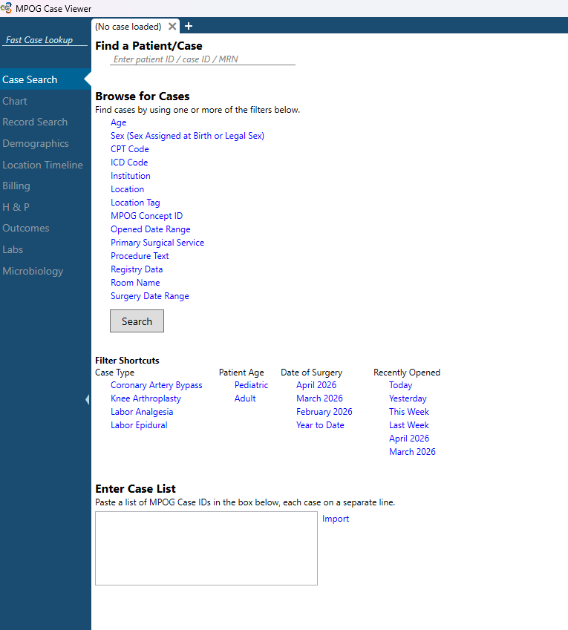
Case Search Page
Default page Case Viewer opens to is the case search page
Tabs on left menu will be gray and unable to open until case is opened either through the “fast case lookup” or the full search functions
To open a specific case, search by MPOG Patient ID, MPOG Case ID, AIMS Case ID, or MRN in either location
*PHI has been removed for the purposes of this guide.

Slide 6
Case Search Page – Applying Filters
Option to browse for cases by using one or more filters listed under “browse for cases”
Filter short cuts are available as quick links to apply specific filters as needed
Copy/paste a list of MPOG case IDs here if interested in viewing multiple specific cases from a list; click “import” when ready to view the cases
*PHI has been removed for the purposes of this guide.

Slide 7
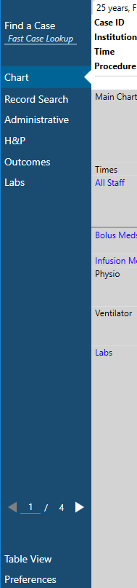
Using the Case List
When using the case list to view multiple cases:
  Arrows appear along the bottom of the left-hand column to scroll between cases.
  If a case number is known (ex: you want to go to case 50 of 100), use the text field to input that number and go to the desired case.
When scrolling through cases using this feature, any ‘Sections’ opened in the case view (see ‘Sections’ slide) will remain open for each case
*PHI has been removed for the purposes of this guide.

Slide 8
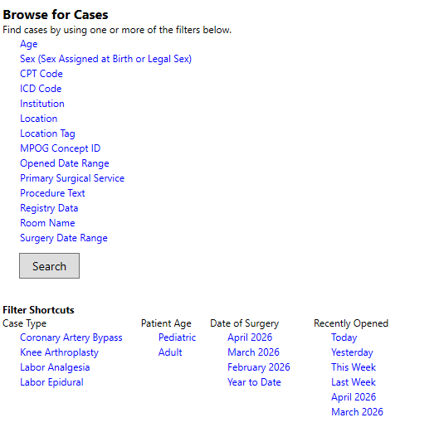
Search by Filter – Definitions
Age – Search for cases by specific age ranges
Sex (Sex Assigned at Birth or Legal Sex) – Search for cases by gender, based on Variable Mapping. This will only result cases if you are submitting Patient Attributes data (optional data type).
CPT code – Search for cases that include a specific CPT code.
ICD code – Search for cases that include a specific ICD code
MPOG Concept ID – Lists all cases that have a specific MPOG concept documented.
  Without other filters, searching by MPOG Concept ID may take awhile. Consider adding a date range filter.
Location – Allows users to search for procedures done at a specific location at their site based on Location Mapping (Module: Getting Started: Location Mapping)
Location Tag – Allows users to search by tags applied in Location Mapping
Opened Date Range - This will generate a list of cases that the user previously opened during that time period.
Primary Surgical Service – Allows users to search by the primary surgical service associated with each case
Procedure Text – Searches for matches in the Procedure Text field associated with a case (e.g., CABG)
Registry Data – Lists all cases that include data from MSQC, NSQIP, STS Adult Cardiac, STS Congenital Heart and STS General Thoracic
Room Name – Allows user to search for cases based on room (based on room names in Location Mapping)
Surgery Date Range – Search for cases that occurred between specific dates.
*PHI has been removed for the purposes of this guide.

Slide 9
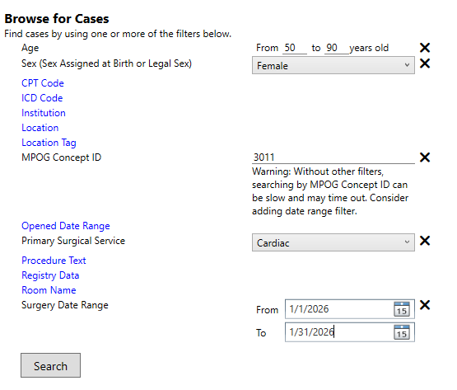

Applying Search Filters
Multiple filters may be applied at a time to narrow down a case list.
Click “Search” when appropriate filters have been applied
*PHI has been removed for the purposes of this guide.

Slide 10
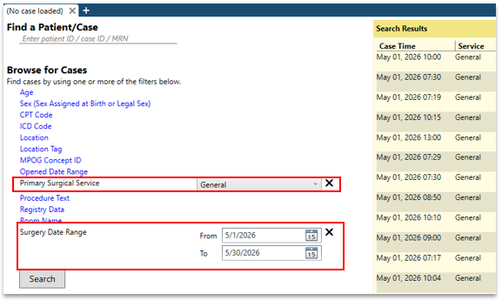
Applying Filters – Example
Example: to find a General Surgery case from May click “Primary Surgical Service” and choose General from the dropdown box.
Next, filter down to May cases by clicking “Surgery Date Range” and specifying 5/1/2026 to 5/31/2026.
Click ‘Search’
General Surgery cases in May will display in the Search Results Pane on the Right
*PHI has been removed for the purposes of this guide.

Slide 11
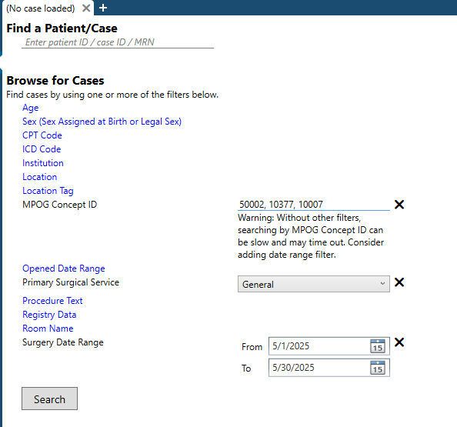
Search By Concepts
“MPOG Concept ID” filter* allows for finding cases based on one or multiple concepts being present on the case
To search by multiple concept IDs, use a comma between IDs
*To avoid search time-out errors, it is suggested to add additional filters (like date, and surgical service) when searching by concept IDs
*PHI has been removed for the purposes of this guide.

Slide 12
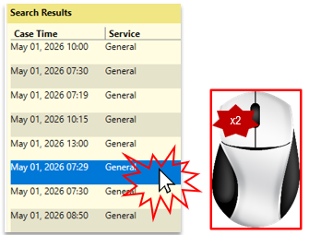
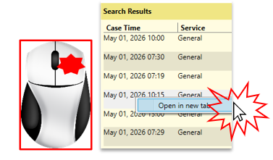
Opening a Case
Double click on a case in the Search Results pane to open.
  Or right click → Open in new tab
Case viewer will open to the “Chart” Tab.
*PHI has been removed for the purposes of this guide.

Slide 13
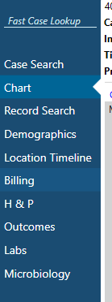
Chart View

Slide 14
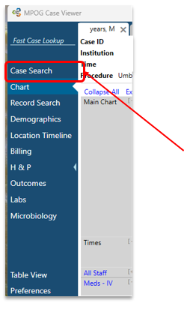
Chart View - Navigation
To return to the case list generated in the previous step, click “Case Search” in the upper left-hand corner at any time while the case is open
*PHI has been removed for the purposes of this guide.

Slide 15
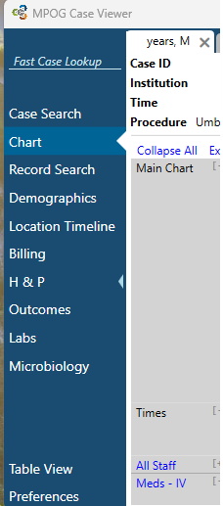
Chart View – Menu Navigation
The left side pane allows users to toggle between different views:
Chart
Record Search
Administrative
Billing
H&P
Outcomes
Labs
Microbiology
*Current view is highlighted in a lighter blue with white arrow indicator
Use the small arrow to collapse the blue panel and save space on smaller screens.
*PHI has been removed for the purposes of this guide.

Slide 16
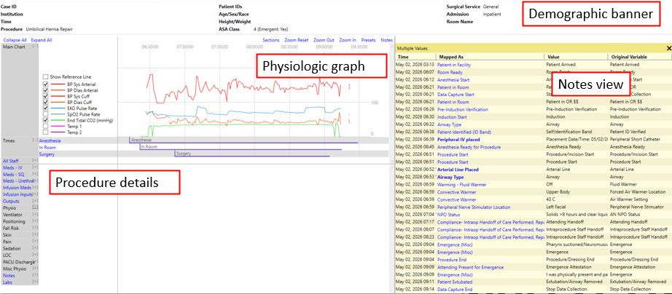
Chart View – Components
The main chart view has 4 parts (explained in detail on following slides) :
*PHI has been removed for the purposes of this guide.

Slide 17
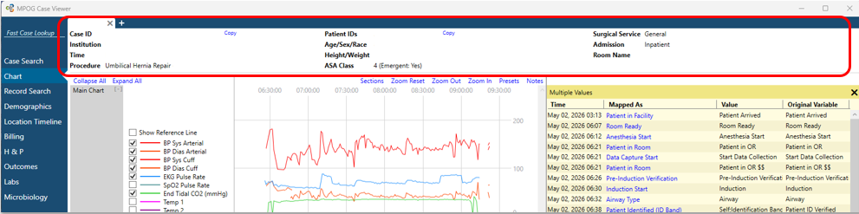
Chart View – Demographic Banner
The white header at the top of the screen provides basic demographic information:
  MPOG Case ID
  Institution
  Procedure
  Patient IDs (Patient Name and MRN)
  Patient demographics (Age/Sex/Race)
  Height/Weight
  ASA Class
  Emergent Status
  Surgical Service
  Admission Status
  Room Name
  Date of Death (if known)
*PHI has been removed for the purposes of this guide.

Slide 18

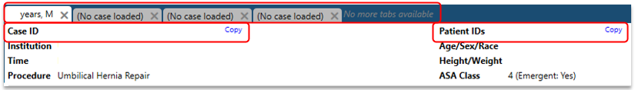
Chart View – Banner Navigation
MRN and MPOG Case IDs can be copied using the ‘Copy’ button to the right of each number
New tabs can be opened by clicking the ‘+’ (plus) sign at the top of the banner
  Up to 4 tabs can be open at a time
  Each tab will show the age and sex of the patient if a case is opened
*PHI has been removed for the purposes of this guide.

Slide 19
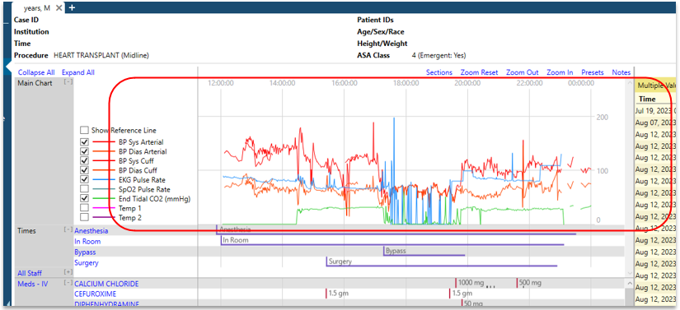
Chart View – Physiologic Graph
The top of chart view shows physiologic data in a graphical format
A legend is available to the left
  Data lines can be toggled off or on by selecting the checkbox next to the measure
This section is fixed, so the graph stays at the top as you scroll through the data.
*PHI has been removed for the purposes of this guide.

Slide 20
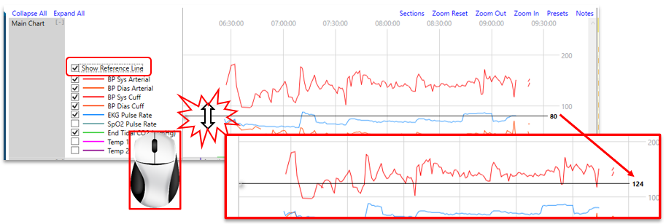
Chart View – Graph Reference Line
Choosing “Show Reference Line” from legend on the left adds an adjustable horizontal line across the grid
  Adjust by placing mouse pointer over line, clicking, and then moving up or down
*PHI has been removed for the purposes of this guide.

Slide 21
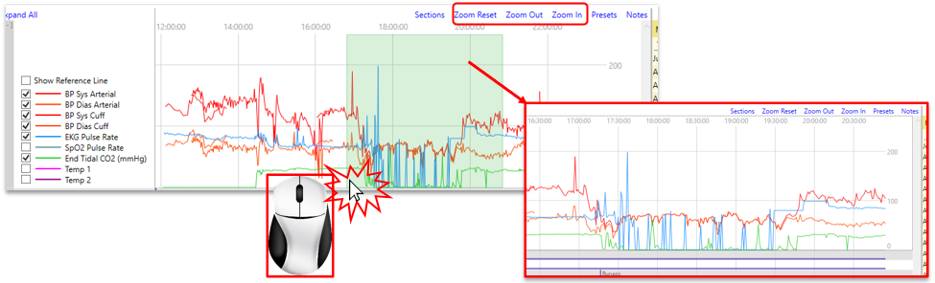
Chart View – Zoom In/Out
Zoom In:
Either use the zoom in button on the top right of the graph, or
Click and drag mouse of specific time frame to zoom in on
Can zoom to 30-, 15-, 10-, 5-, 2-, or 1-minute increments
Zoom Out:
  Either use the zoom out button (for incremental), or
  Zoom reset button (returns to default view)
*PHI has been removed for the purposes of this guide.

Slide 22
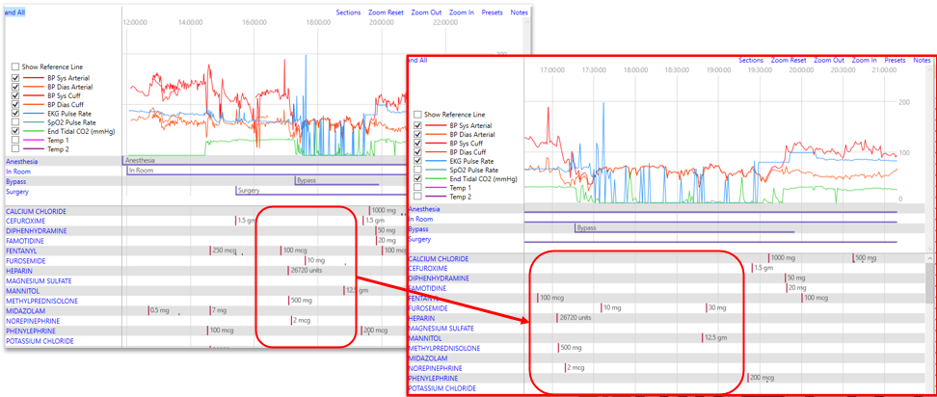
Chart View – Zoom In/Out, continued
Chart data aligns with the timeline shown at the top and will automatically adjust with zoom in/out
*PHI has been removed for the purposes of this guide.

Slide 23
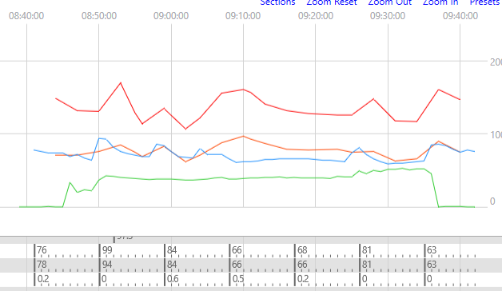
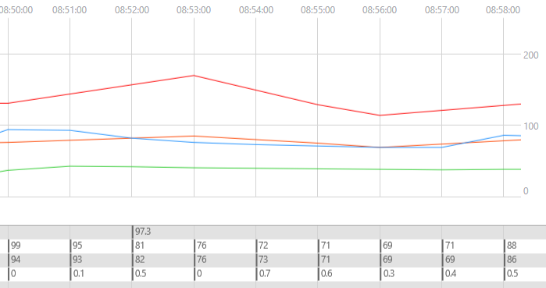
Chart View – Zoom In – additional
Tick marks on the flowsheet let users know that more information is available if you zoom in.
*PHI has been removed for the purposes of this guide.

Slide 24
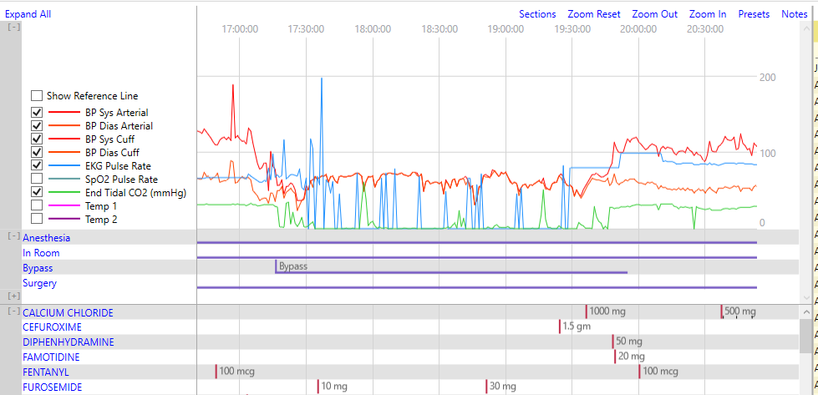
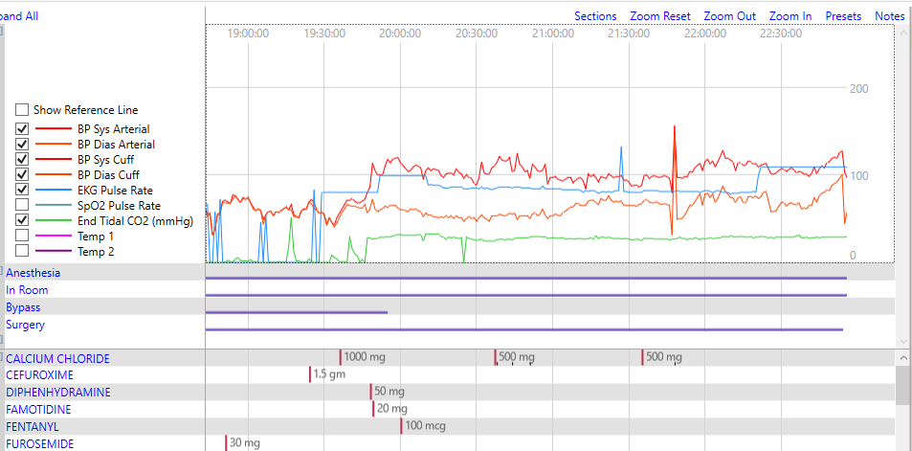
Chart View – Scrolling
Click and hold the mouse wheel, then drag left or right to scroll through the timeline.
*PHI has been removed for the purposes of this guide.

Slide 25
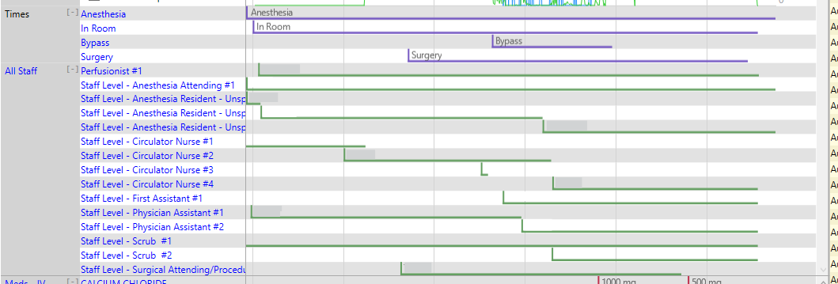
Chart View – Times and Staff
Directly under the graph, also fixed in place, is a timeline representation of key times in the case:
Anesthesia Start to End
In room to out of rom
Length of surgery
Staff sign in/out times
*PHI has been removed for the purposes of this guide.

Slide 26
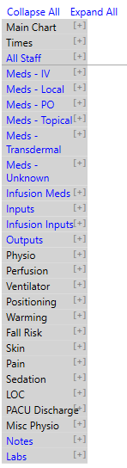
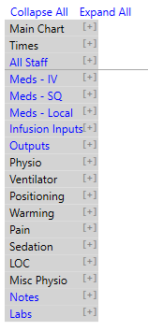
Chart View – Main Chart Menu
The grey column to the left divides the case into the following sections:
Meds – separated by route
  (IV, IM, SQ, PO, Transdermal, Infusion, Epidural, etc.)
Inputs
Outputs
Physiologic
Ventilator
Flowsheet
Notes
Labs
*Additional sections may appear depending on case (ex. perfusion in cardiac cases). Main Chart, Times and All Staff display for all cases.
Each section can be expanded or collapsed by clicking the [+] or [-] next to section title
  Can also select “expand all” or “collapse all” as needed from the top
*PHI has been removed for the purposes of this guide.

Slide 27
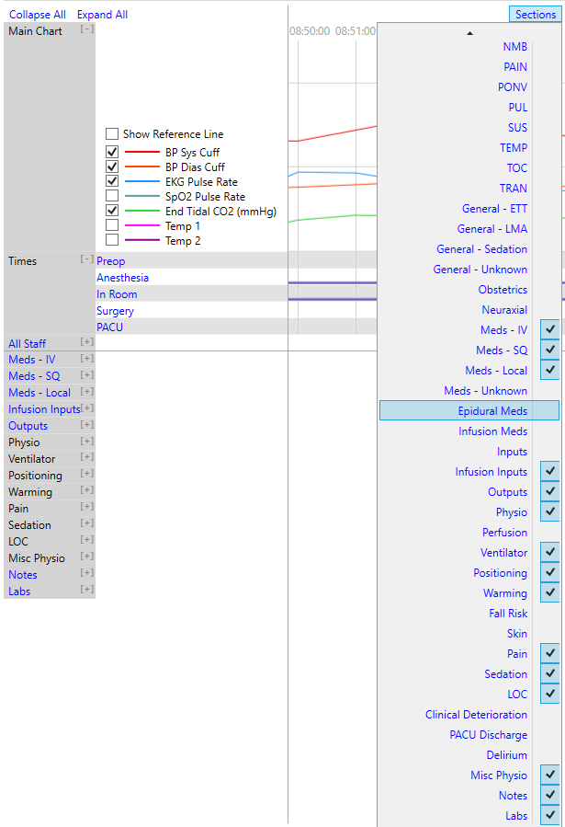
Chart View – Adding Sections
Sections Menu:
Upper right-hand corner of main chart graph
Add and remove sections from the body of the chart as needed
See next page for MPOG measure related sections
*PHI has been removed for the purposes of this guide.

Slide 28
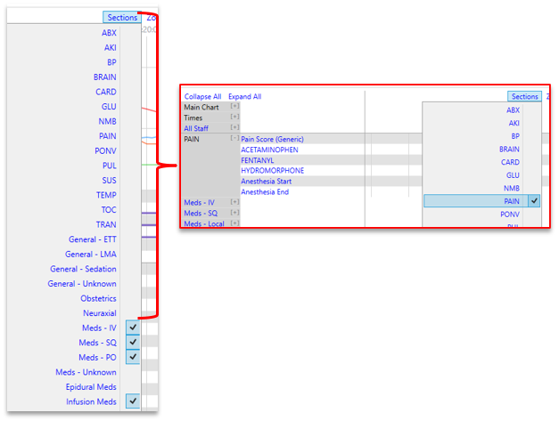
Chart View – Sections Menu
Selecting an MPOG measure‑related section adds a new chart section that includes all relevant concepts for the selected measure category.
For example, the PAIN section summarizes PAIN relevant information.
*PHI has been removed for the purposes of this guide.

Slide 29
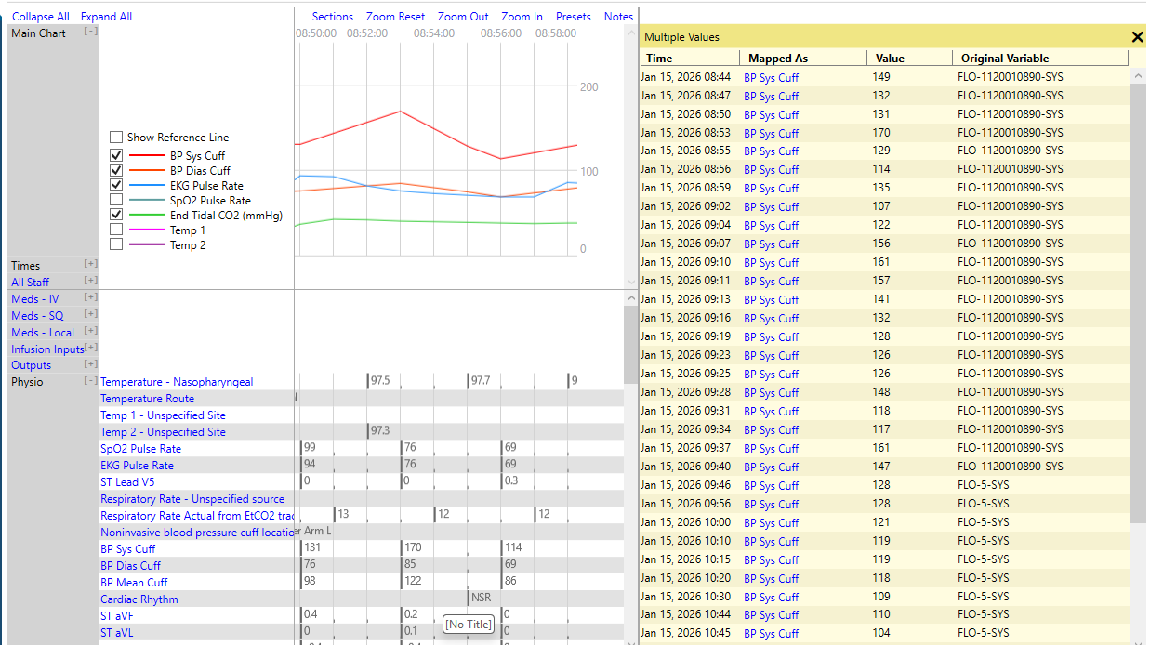
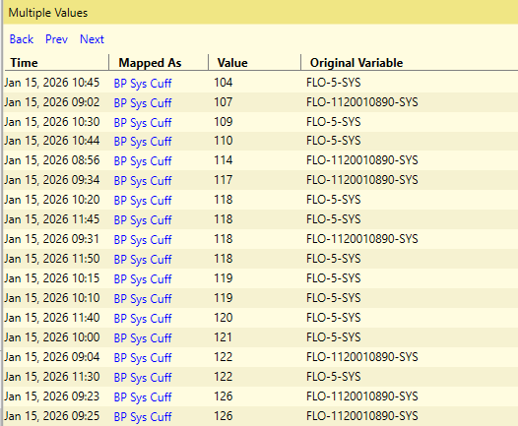
Chart View – Section Headers
Any of the section headers that are blue can be clicked and the information will be displayed in the yellow notes box on the right
Clicking the header will sort the column as needed
*PHI has been removed for the purposes of this guide.

Slide 30
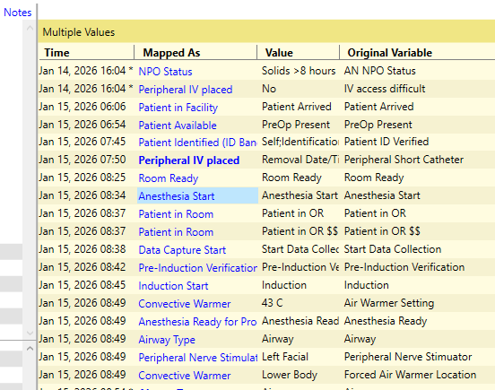
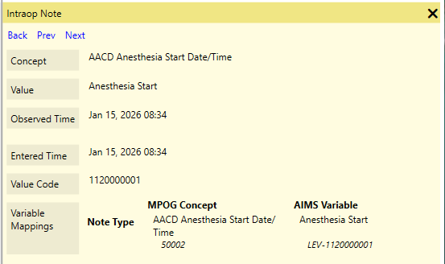
Chart View – Additional Information
Clicking any blue link brings up more information
Allows for further drill down of the information
When applicable, you can view the note’s entered time to compare it with the observed time.
  Observed Time: Time when the event/note occurred
    An * (asterisk) indicates no observed time was documented
  Entered Time: Time when the information was documented in the electronic health record
*PHI has been removed for the purposes of this guide.

Slide 31
Chart View – Variable Mapping Check
Users can also see what the original AIMS variable is and what MPOG concept it is mapped to
This is useful for determining incorrect mappings
*PHI has been removed for the purposes of this guide.

Slide 32
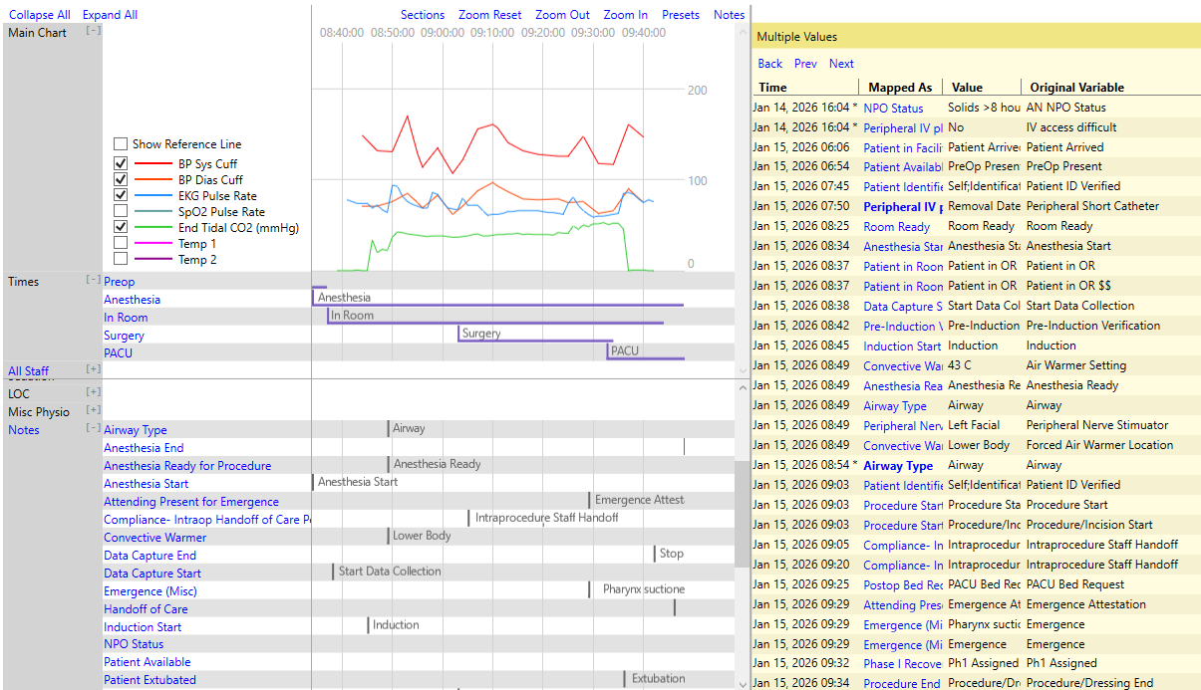
Chart View – Notes View
Notes view helps you see entries in order by time, similar to EMR systems
Also available in the body of the flowsheet
Can be accessed by clicking “Notes” in the top right corner above the graph
*PHI has been removed for the purposes of this guide.

Slide 33
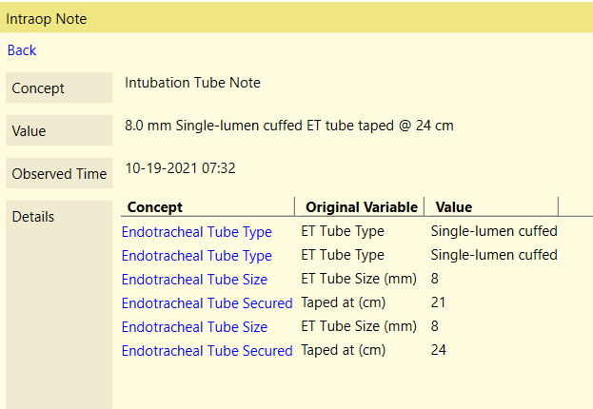
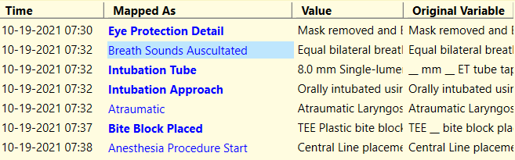
Chart View – Parent Notes
Bolded “parent” notes have associated “child” detail notes. Clicking on a bolded note will give the additional details as well
The original variable as well as the value are displayed in the note details
*PHI has been removed for the purposes of this guide.

Slide 34
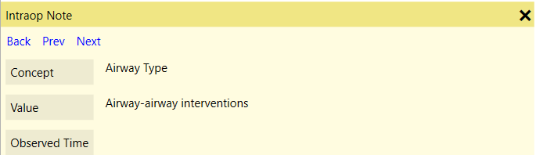
Chart View – Notes View Navigation
Navigating through notes
  ‘Back’ – Return to previous list or Parent Note ​
  ‘Prev’ – Go to the previous note in the list ​
  ‘Next’ – Go to the next note in the list
*PHI has been removed for the purposes of this guide.

Slide 35
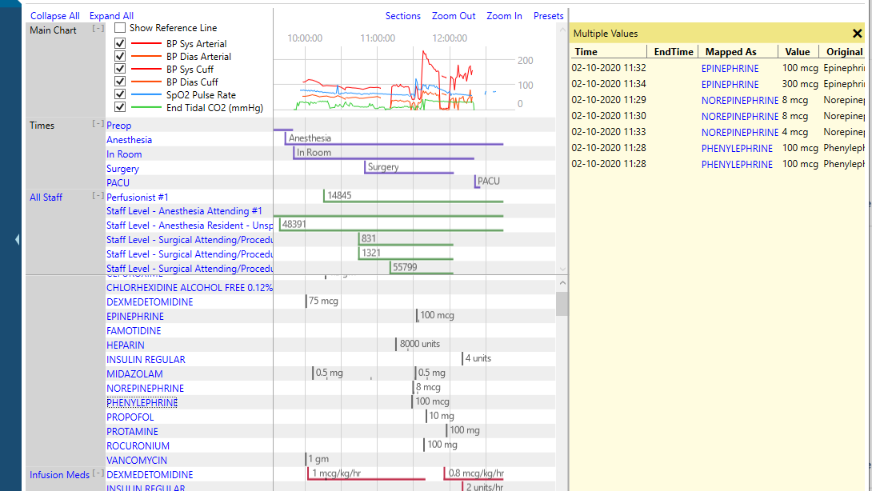
Chart View – Opening Multiple Sections
Holding down ‘Shift’ and selecting multiple headers will open those headers together in the notes pane
*PHI has been removed for the purposes of this guide.

Slide 36
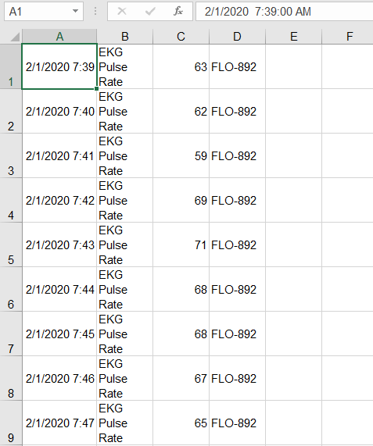
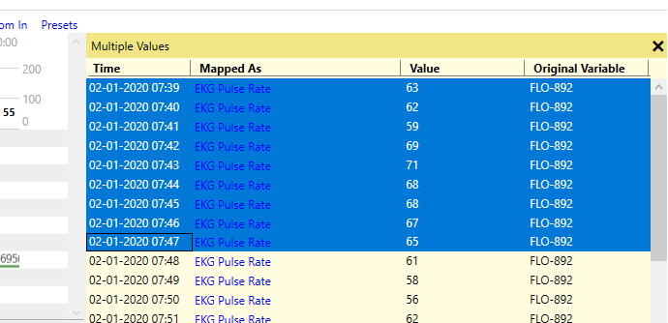
Chart View – Copy/Paste Notes
Data can be copied out of the notes view and pasted into Excel for purposes of chart review
  Highlight desired rows
  Use Ctrl + C to copy
  Use Ctrl + V to paste in Excel
*PHI has been removed for the purposes of this guide.

Slide 37
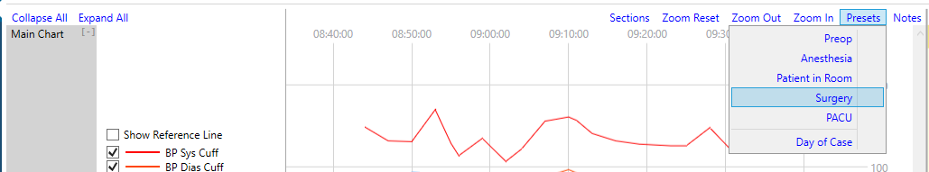
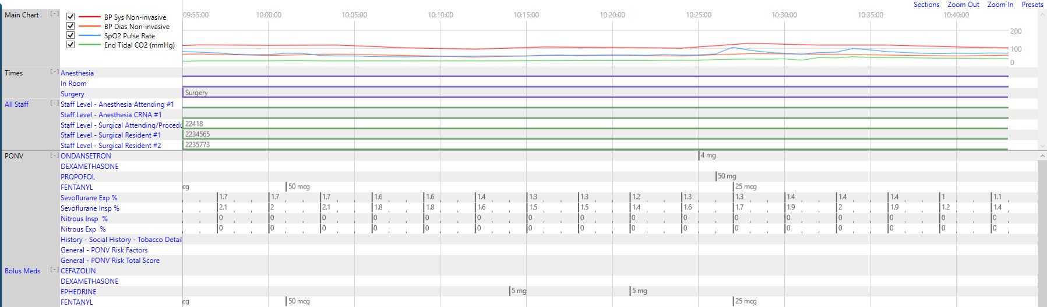
Chart View – Preset View
The “Preset” menu in the upper right corner shows users preset views of the chart based on their choice.
For example, choosing “Surgery Duration” zooms the chart to show the times between surgery start and end. Users can see the rest of the chart by zooming in or out or clicking and dragging as usual.
*PHI has been removed for the purposes of this guide.

Slide 38


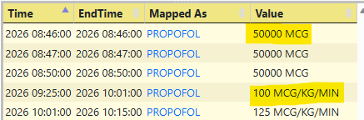
Infusion vs. Non-Infusion Administrations
  If an end time is not populated, infusion dose will continue until the start time of the next administration for the same medication.
  If an end time is not populated and there is not an additional administration, the infusion will continue until anesthesia end time.
  If the infusion start time is after anesthesia end and there is no documented infusion end time, it will default to 5 minutes later.
  Definitions:
  Infusion: If the administered unit is mapped to a concept that is over time (i.e., mcg/kg/min).
  Bolus: If the administered unit is mapped to a concept that is not over time (i.e., mcg)
*PHI has been removed for the purposes of this guide.

Slide 39
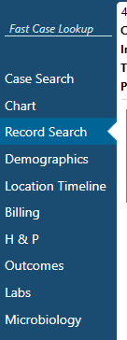
Record Search Tab

Slide 40
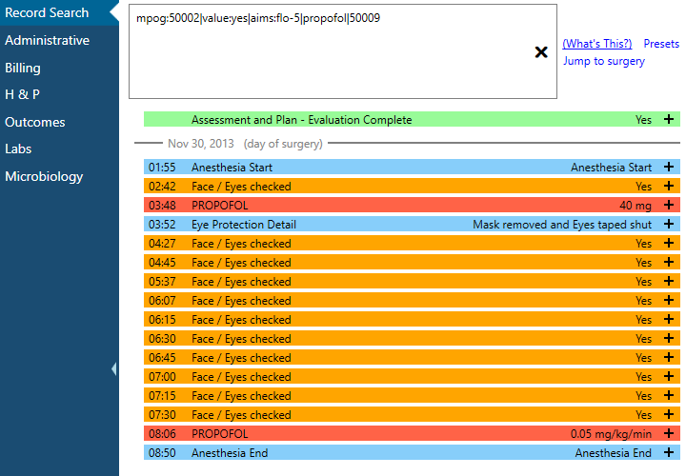
Record Search
Utilize Record Search to look at information relevant to a chart evaluation in one location
Search relevant information, including by MPOG Concept ID (exact match required for Concept ID) and original variable ID/name
  Use “mpog:” in front of a keyword in order to only consider the MPOG concept ID or name (e.g., mpog:50002)
  Use “aims:” in front of a keyword in order to only consider the original variable ID or name (e.g., aims:Flo-5)
  Use “value:” in front of a keyword in order to only consider the value of the record (e.g., value:yes)
*PHI has been removed for the purposes of this guide.

Slide 41
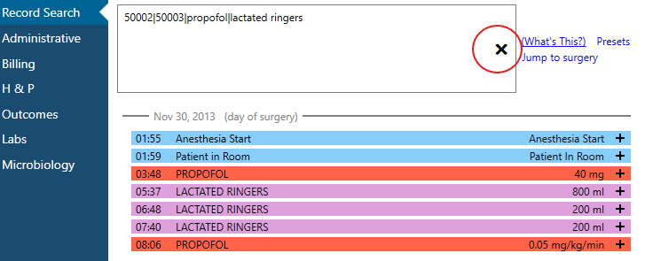
Record Search - Searching
Search for multiple terms/variables at the same time using either a comma (,) or a pipe ‘|’ symbol between variables
  Hint: | is found on the same key as \, use ‘Shift’ to type |
Ex: 50002 | 50003 | Propofol | lactated ringers
  This will pull in everything mapped to those two concept IDs and everything including the words ‘propofol’ and ‘lactated ringers’
CTRL + Z or clicking on the ‘X’ in the search box will undo searches in record search
*PHI has been removed for the purposes of this guide.

Slide 42
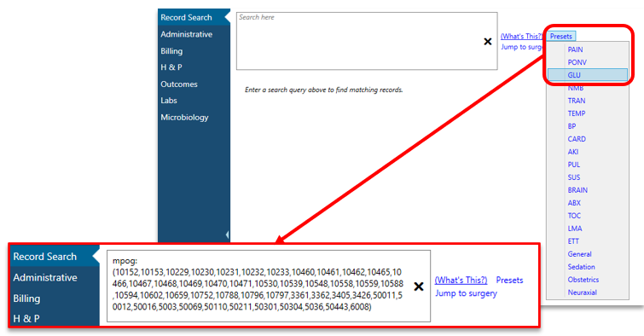
Record Search - Presets
Presets will auto populate the search area with all MPOG concepts related to chosen preset
Presets represent MPOG measures
*PHI has been removed for the purposes of this guide.

Slide 43
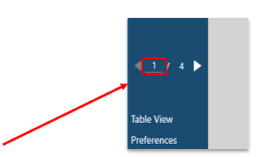
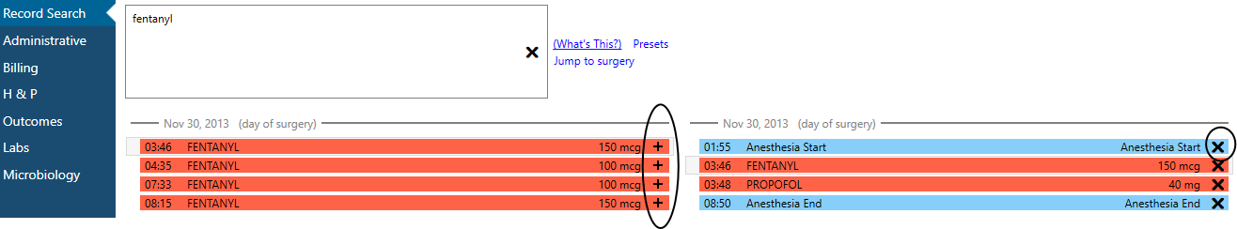
Record Search – Saving Search
Temporarily save search results together in the “Shopping cart” to the right using the “+”
Remove information from the shopping cart using the “X”
  Ctrl + Click or Shift + Click allows for multi-select and the ability to add more than one row of information into the “Shopping Cart”
Search will remain open and “saved” as you scroll through multiple cases (if loaded)
“Shopping cart” saves results from previous searches
Results from current search
*PHI has been removed for the purposes of this guide.

Slide 44

Record Search – Jump to Surgery
If a case is showing multiple search results from before the surgery date, choose “Jump to Surgery” to quickly scroll down to the day of the case
*PHI has been removed for the purposes of this guide.

Slide 45


Record Search – Copy/Paste
Users can copy and paste select information from the Shopping Cart into an Excel file if needed
Select the desired rows and use Ctrl + C to copy information
In an Excel spreadsheet, Paste the information
*PHI has been removed for the purposes of this guide.

Slide 46
Record Search – Search String Examples
Example search strings for flagged case review. Copy and paste into “Record Search.” This information can also be found under 'Presets' in the Chart Section. Presets are updated during the MPOG Suite Upgrades. If you are reviewing data and the preset doesn't exist, you can reach out to the Coordinating Center for the search string to use.
Glucose Measures:
Glucose, insulin, anesthesia start, anesthesia End, dextrose, diabetes, 10796, 10797, 3426, 3361, 3362, 3405, 5003, 5036, 10152, 10153, 10229, 10230, 10231, 10232, 10233, 10460, 10461, 10462, 10465, 10466, 10467, 10468, 10469, 10470, 10471, 10530, 10539, 10548, 10558, 10559, 10588, 10594, 10602, 10659, 10752, 50012, 50304, 6008, 50301, 50443, 50011, 50069, 50110, 50211, 10788, 50016
Transfusion Measures:
anesthesia start | anesthesia end | HCT | hematocrit | hemoglobin | HGB | Red blood cells | Estimated blood loss | Saline 0.9% | lactated ringers | albumin | platelets | phenylephrine | ephedrine | epinephrine| 3415 \ 3435 | 3440 | 3450 | 5005 |5006 | 5038 | 5080 | 5081 | 10489 | 10490 | 10492 | 10493 | 10494 | 10496 | 10499 | 10616 | 10617 | 10618 | 10658 | 10660 | 10661 | 10017 | 10018 | 10557 | 10454 | 10456 | 10457 | 10354 | 10176 | 10326 | 10175 | 10445 | 10145 | 3502 | 3504 | 3505 | 3510
*PHI has been removed for the purposes of this guide.

Slide 47

Demographics,
Location Timeline, and Billing

Slide 48

Demographics
Demographics tab includes patient specific information including date of birth, diagnosis, and surgical service.
If your site does not contribute Patient Attributes data, that section will show as ‘No Data Found’
*PHI has been removed for the purposes of this guide.

Slide 49

Location Timeline – General
For those sites submitting ADT data information: the location timeline displays the location of the patient on a given date/time and is grouped by each admission
Location details shows the hospital system hierarchy as completed by location mapping
A star indicates the admission associated with current case
*PHI has been removed for the purposes of this guide.

Slide 50

Location Timeline – Expanding Views
Expanding the row will reveal the patient’s movements during that admission
Any procedures will be linked out and will display the associated MPOG case ID. Clicking on the link will open the case in an additional tab within Case Viewer.
*PHI has been removed for the purposes of this guide.

Slide 51

Location Timeline – Jumping to New Case
If patient has multiple procedures, can select desired procedure from drop down
This will expand corresponding row
*PHI has been removed for the purposes of this guide.

Slide 52

Billing
Billing data displays all professional fee and facility billing codes submitted for the patient. Codes associated with other cases may be present in the billing tab. Refer to the ‘Case-Linked?’ column to determine if the code was associated with the current case.
*PHI has been removed for the purposes of this guide.

Slide 53

Billing - Columns
The billing section shows all billing codes that have been associated with the patient, including all encounters other than the procedure.
The Professional Fee Billing and the Hospital Discharge Billing sections include a description of what the codes are.
The Case-Linked column flags the billing codes that are linked to the case that you are viewing.
The Diagnosis Codes Sections also have a column that flags diagnoses that were present on admission.
*PHI has been removed for the purposes of this guide.

Slide 54

H & P and
Outcomes

Slide 55

History and Physical
The H&P View shows perioperative assessment data.
Similar to Chart view, any blue text can be clicked to show more information in the right yellow pane
MPOG concept
Value
AIMS description
*PHI has been removed for the purposes of this guide.

Slide 56

Outcomes
The Outcomes view shows documented outcomes and mortality if available. The blue text in this view also remains clickable to reveal more information in the yellow right pane.
Most cases will show ‘No Data Found’ for Registry Data. You will only see data here if your site submits this data to MPOG and it is one of the sampled cases from that registry.
More information can be found on our website at https://mpog.org/surgicalregistries/
*PHI has been removed for the purposes of this guide.

Slide 57

Labs and
Microbiology

Slide 58

Labs
Shows labs in clinical groupings and chronological order
Info is also available in chart view
Blue shading across the top shows the day of surgery
*PHI has been removed for the purposes of this guide.

Slide 59

Labs – Expanding View
Clicking on the lab name on the right will show all labs in that category in the right-hand yellow pane.
Clicking a lab value itself will give more information about that lab value.
*PHI has been removed for the purposes of this guide.

Slide 60

Labs – Details
Clicking a value brings up more information
*PHI has been removed for the purposes of this guide.

Slide 61

Microbiology
Adding microbiology lab data is currently optional for participation with MPOG and requires a supplemental extract to include.
If your site does not extract this data, you will not see microbiology values in Case Viewer.
*PHI has been removed for the purposes of this guide.

Slide 62

Microbiology – More Details
If ‘Has Susceptibility Results’ is True, click on the row to see more details
*PHI has been removed for the purposes of this guide.

Slide 63

Table View and
Preferences

Slide 64

Table View
Displays all data submitted to MPOG central that was documented for a particular case regardless of if it was mapped to an MPOG concept or not.
The dropdown menu allows to view data in specific storage tables.
The search bar below the drop down allows for text search of the information in table view
*PHI has been removed for the purposes of this guide.

Slide 65

Preferences
The preferences option on the bottom of the left pane lets users turn on/off PHI viewing and deleted record information
Values marked as ‘Artifact’ are not shown when the option to not show Deleted data is selected
*PHI has been removed for the purposes of this guide.

