Slide 1
Almost there….
ASPIRE Updates and Wrap up

Slide 2
Blue Cross Blue Shield of Michigan – Potential Value Based Reimbursement Opportunity

Slide 3
Current Specialist VBR Opportunity
Standard BCBSM Value-Based Reimbursement
Ranked in top third of practices | Ranked in second third of practices | Ranked in bottom third of practices | Percent of Standard Fee Schedule
 |  | x | 100%
 | x |  | 105%
x |  |  | 110%
Current BCBSM Specialist Value-based Reimbursement Model
VBR applies to all professional relative value unit (RVU) based procedure codes and the anesthesia time and base codes*
VBR applies to commercial claims only
Specialists must be enrolled in PGIP to be eligible (must be in PGIP 1 year prior to receiving the VBR)
Based on population health metrics
Measurement Period for Specialist VBR | Reimbursement Period (applicable to claims for the dates of service below)
July 1, 2016 – June 30, 2017 | March 1, 2018 – February 28, 2019
*Applies to virtually all codes except those for ambulance service, durable medical equipment, prosthetics and orthotics, anesthesia, immunizations, hearing, vision, lab, dental and most injections
Notes:
Applies to virtually all codes except those for ambulance service, durable medical equipment, prosthetics and orthotics, anesthesia, immunizations, hearing, vision, lab, dental and most injections

Slide 4
Types of Metrics Used in Current Specialist VBR
Practice level
Evaluates care provided directly by the practice
Population level
Evaluates care provided to shared populations treated by the practice
Calculated at PO level and weighted at the practice level based on shared populations
Rarely used in specialist VBR methodology
Most commonly used in specialist VBR methodology

Slide 5
Potential CQI VBR Opportunity Being Evaluated for 2018/2019
Standard BCBSM Value-Based Reimbursement |  |  | New CQI VBR
Ranked in top third of practices | Ranked in second third of practices | Ranked in bottom third of practices | CQI Participants that met target | Percent of Standard Fee Schedule
 |  | x |  | 100%
 |  | x | x | 103%
 | x |  |  | 105%
 | x |  | x | 108%
x |  |  |  | 110%
x |  |  | x | 113%
Would complement, not replace, the Specialist VBR
Performance measures, targets and methodology designed by the Coordinating Center
Utilize CQI registry data
Eligible physicians would receive an additional 3% increase over the standard fee schedule (no PO nomination, similar to specialist VBR)
Currently being proposed by BCBSM CQI administration for a 2018 VBR
RVU – based PPO commercial claims only – similar to Specialist VBR

Slide 6
Eligibility for Specialist VBR (or any potential BCBSM VBR)
To be eligible for a Specialist VBR, a physician:
Must be enrolled in Blue Cross Blue Shield of Michigan’s PGIP program through one of the affiliated PGIP physician organization (PO)
Must be enrolled in a PGIP PO at least one year prior -
2018 VBR - If not on the January ‘17 and July ’17 PGIP physician lists, then the physician is NOT eligible for any 2018 VBR
2019 VBR – the physician must be enrolled in a PGIP PO by first week of January 2018
Must be nominated by their affiliated PGIP PO annually (for Specialist VBR) –
Nomination does not necessarily mean you will receive VBR (bottom third of physicians will not receive Specialist VBR)

Slide 7
Specialist VBR results for ASPIRE CQI Participating physicians
Number of physicians contributing data to the CQI - 437
Number of CQI physicians that are in a PGIP PO (as of July 2017) - 335
Number of physicians that are NOT currently in a PGIP PO (as of July 2017) - 102
Number of physicians that are currently receiving Specialist VBR - 286
A list of PGIP Physician Organizations will be made available by the Coordinating Center

Slide 8
PGIP Enrollment of Specialists Participating in CQIs – Who’s Involved
BCBSM Value Partnerships
Notifies the PGIP POs quarterly (July, Oct, Jan, Apr) of physicians not enrolled in PGIP
Notifies POs on who’s participating in CQIs to support PO nomination of the physician for specialist VBR
PGIP Physician Organization (PO)
Responsible for enrolling the physician in PGIP
May communicate to the physician(s) regarding interest in enrolling them in the PO
CQI Coordinating Center
Aware of who’s in and not in PGIP and may be able to notify the physician or physician champion of Non-PGIP enrolled physicians
CQI Physician Champions or Engaged Physicians
Nominates physicians within the PO for Specialist VBR
Notify any affiliated physicians participating in the CQI that are non-enrolled in PGIP
Those physicians not enrolled in PGIP may inform their colleagues to enroll in their affiliated PO

Slide 9
Next Steps Towards PGIP Enrollment
If a physician is not in PGIP currently –
Need to be enrolled by the first week in January 2018 to be eligible for 2019 VBR
POs have been notified by BCBSM Value Partnerships of physicians not in PGIP as of July 2017
A list of POs’ contact information will be made available to the Coordinating Center to assist PGIP enrollment
No PGIP Enrollment = No Specialist VBR Eligibility

Slide 10
What we talked about last year….

Slide 11
What we have done and what we’re working on….
Integration with other CQIs (MVC, MARCQI, MSQC…) – yes
MVC, MSQC
Less total effort adding sites – yes
New Epic extract (“flatfile”)
More effort working with existing sites on programs, measures, data quality – maybe
ARC toolkit released, no education modules, pace of new measure release slower
More effort improving Application Suite – yes
Updated Case Viewer, Data Diagnostics, Variable Mapping, Location Mapping, NSQIP/STS Import, Transfer, Case by Case Validation
Patient-centered iOS application - yes

Slide 12
Why should we PROSPER?
We have a good understanding of medical “outcomes” – complications that we as providers believe are not the ideal result
Working to integrate data from registries, labs, administrative data to improve reporting to you
We still don’t understand daily patient postop experience or baseline
Surgeons doing decent job of collecting procedure-specific patient reporting outcomes
Anesthesia providers must understand overall patient experience across procedure – patient report outcomes (PROs)
Long term, PROs may serve as
quality measures (pain, etc) or
ways to assess impact of existing process of care metrics

Slide 13
PROSPER
An application that collects active survey data and passive data (from smart devices) from patients
Initial use will be to understand how this type of data correlates with perioperative care processes
Will use combination of NIH PROMIS measures and passive data collection
Collect preoperative baseline data and postoperative data
Episodic active survery data
“Continuous” passive activity, heart rate, and location data
ResearchKit application building upon experience from hundreds of patients using the Framingham Heart Study iOS application developed by CareEvolution (our Galileo analytics vendor)

Slide 14
PROMIS® (Patient-Reported Outcomes Measurement Information System) is a set of person-centered measures that evaluates and monitors physical, mental, and social health in adults and children.
Developed and validated with state-of-the-science methods to be psychometrically sound and to transform how life domains are measured
Designed to enhance communication between clinicians and patients in diverse research and clinical settings
Created to be relevant across all conditions for the assessment of symptoms and functions
Available in multiple formats and easily integrated into diverse data collection tools.
Translations available in Spanish and many other languages
http://www.healthmeasures.net/explore-measurement-systems/promis

Slide 15
Our plan
Pilot enrollment and data integration with UM patients
Expand to interested ASPIRE sites, work with you to implement process to allow patients to download application
Centralized UM IRB (just like all online ResearchKit apps), explicit patient consent
Track active and passive data collected from smart device
Link to surgical procedure/episode using central MPOG EHR data
Develop analytics and feedback for the patient AND each participating site and research teams
Do not interfere with existing care management/clinical applications
Will not recommend clinical decisions or actions (NPO status, etc)
Continue with your mobile Health strategy

Slide 16
PROSPER Demo

Slide 17
Measure Timeliness Analysis
Questions from sites – should we delay reporting of some/all measures because measure performance is changing due to submissions of billing codes
Goal: to decide if we should delay reporting of measure performance
Methodology – We picked a month (March 2017) and compared results with and without billing code exclusions
NMB 01
-.05% to .13%
GLU 01
No Change
BP 01
0% to 1.21%
Temp 01
-.37% to 15.72%
AKI 01
-.66% to 1.38%

Slide 18
CPT Prediction Tool: An Example of Machine Learning in Anesthesiology
There are several opportunities to implement ML in ASPIRE
One example: Assigning CPT codes to submitted data automatically
Overcomes the time gap in the process of assigning CPT to cases
Streamline the process of excluding/including cases in ASPIRE
Definition: Machine learning is a method of data analysis that automates analytical model building. Using algorithms that iteratively learn from data, machine learning allows computers to find hidden insights without being explicitly programmed where to look.

Slide 19
Machine learning examples in everyday life:
Notes:
Netflix - List of suggestions, and from searches, created original Netflix content. House of Cards and Kevin Spacey – political drama
Google – self-driving cars, mapping
Uber

Slide 20
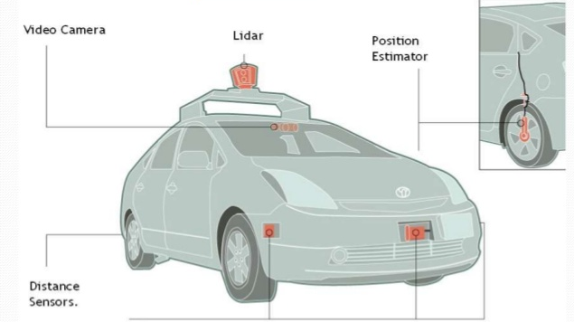
Self-driving Cars
Notes:
Initial training models were developed, requiring thousands of iterations of human drivers where the machines recorded their actions to build the foundation for models.
Models are built through these iterations to make decision cut-offs. The more samples you have for training the more accurate you can make your model (ML Learning Curve)
Sensors fixed to the cars to capture, record, and interpret information from their surroundings.
LIDAR, which stands for Light Detection and Ranging, is a remote sensing method that uses light in the form of a pulsed laser to measure ranges (variable distances) to the Earth.

Slide 21
Typical Machine Learning Process
Notes:
Specific example: self-driving cars

Slide 22
Assigning CPT codes to submitted data automatically
Site inputs: Gender, age, procedure text, case duration, assigned anesthesia CPT values
Find correlations in assignment - build model from these correlations
Test and train model
Improve model over time with new data
End result: real-time initial CPT assignment

Slide 23
Notes:
Correlation word map from procedure text data from individual cases submitted to ASPIRE

Slide 24
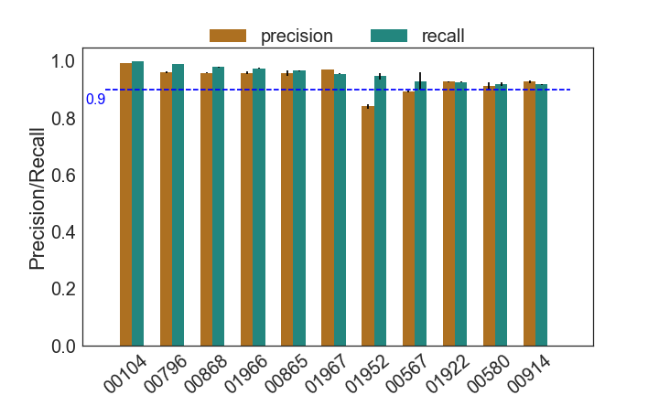
Notes:
Recall is sensitivity, or true positive rate: [tp / (tp+fn)]
Precision is positive predictive value (PPV): [tp / (tp+fp)]
Accuracy is (tp+tn)/(tp+tn+fp+fn)

Slide 25
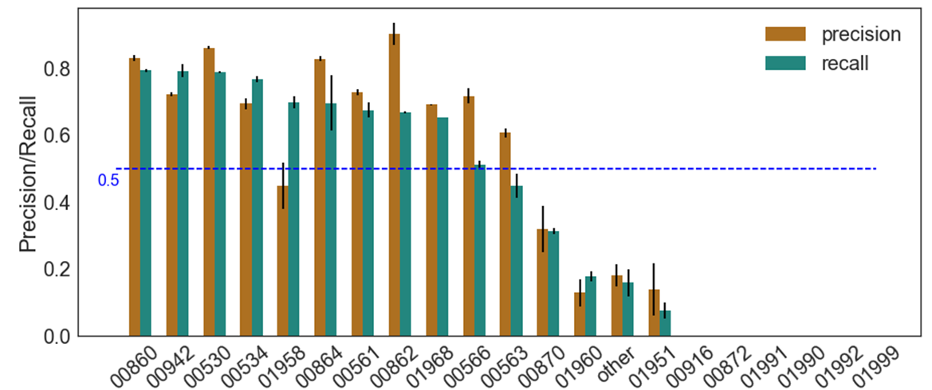

Slide 26
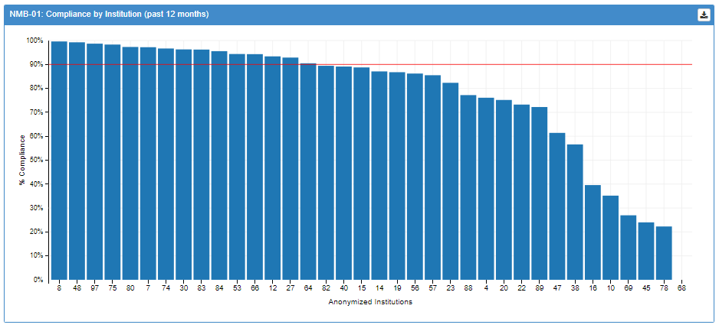
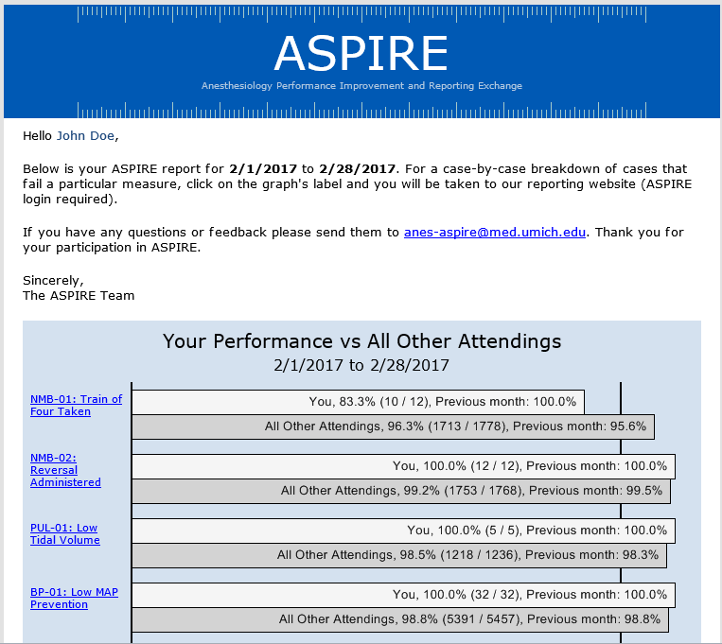
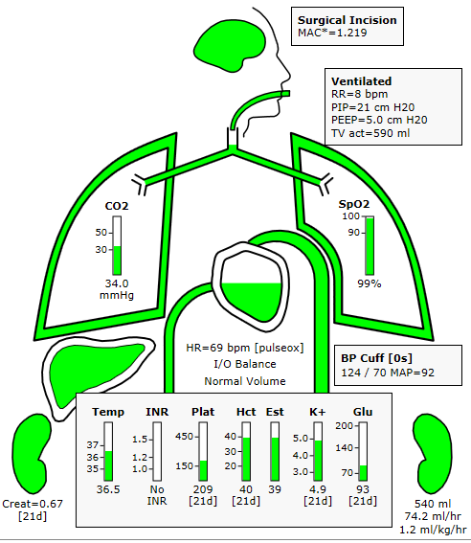

Slide 27
Wrap-up
Plan is to continue one ASPIRE only meeting/ year (plus 2 others)
Meeting location and times – Lansing work?
Combined meeting with other CQIs?
Content?
Thank you!

