Slide 1
Quality Payment Program Updates

Slide 2
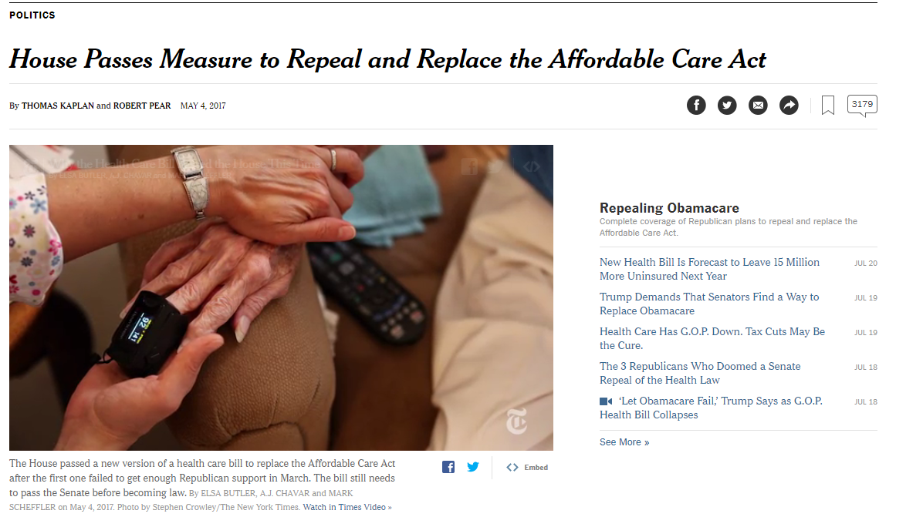
Quality Payment Program Status

Slide 3
What does this mean for MACRA?
Medicare Access and CHIP Reauthorization Act of 2015 (MACRA) separate from ACA
Bipartisan support when approved
Remains in effect
Updates will continue…

Slide 4
MACRA & the Quality Payment Program
Medicare Access and CHIP Reauthorization Act (MACRA) of 2015:
Ends the Sustainable Growth Rate (SGR) formula for determining Medicare payments for health care providers’ services.
2017 performance will dictate payment adjustments in 2019
Penalties up to -4%; incentives up to +4%. (+3x upward adjustment possible)
2 pathways: MIPS & Advanced Alternative Payment Models

Slide 5
Advanced Alternative Payment Models
Providers & hospitals are rewarded for improving quality of care while reducing Medicare costs
Next Generation Accountable Care Organizations (ACOs)
Shared Savings Program Track 2 & 3
Minority of sites across ASPIRE
Quality data is required to be submitted through the Advanced APM
Graphic courtesy of: https://qpp.cms.gov/

Slide 6
Merit-Based Incentive Payment Program
For anesthesia providers:
85%
(0%)
(15%)
(0%)
QUALITY*
6 measures
1 outcome measure
Advancing Care Information
Clinical Practice Improvement Activities (CPIA)*
Resource Use
(Cost)
MIPS replaces PQRS, Meaningful Use, EHR Incentive Program, and VM.
*ASPIRE reports for ‘Quality’ and ‘Improvement Activity’ components of MIPS. Group practice or individual reporting options available.

Slide 7
Quality Category Reporting
Report data for 6 measures including 1 outcome measure
13 available measures for QCDR reporting through ASPIRE
*Outcome Measure

Slide 8
ASPIRE QCDR Quality Measures
MIPS measures (3)
MIPS 424 (Perioperative Temperature Management)*
MIPS 426 (Post-anesthetic Transfer of Care: PACU)
MIPS 430 (Prevention of PONV)
ASPIRE Measures (10)
NMB 01
NMB 02
GLU 01
PUL 01
TEMP 02
TRAN 02*
BP 01
CARD 01*
AKI 01*
MED 01*

Slide 9
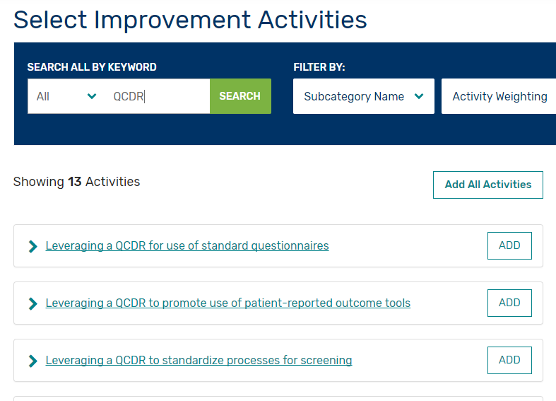
Improvement Activities
Anesthesia providers are required to attest to 2 medium-weighted or 1 high-weighted activity
List of improvement activities available on CMS QPP website: https://qpp.cms.gov/mips/improvement-activities
Graphic courtesy of: https://qpp.cms.gov/

Slide 10
Activities related to ASPIRE
IA_BE_8: Participation in a QCDR, that promotes collaborative learning network opportunities that are interactive (Medium)
IA_PSPA_7: Use of QCDR data for ongoing practice assessment and improvements (Medium)
IA_PM_7: Use of QCDR for feedback reports that incorporate population health (High)
IA_CC_6: Use of QCDR to promote standard practices, tools and processes in practice for improvement in care coordination (Medium)
IA_BE_2: Use of QCDR to support clinical decision making (Medium)

Slide 11
QCDR To-Do List
QCDR Agreements distributed – please review, sign, and submit
Select Improvement Activities relevant to your site’s practice
Educate Providers regarding chosen activities
For individual reporting sites: Complete consents
Contact Katie Buehler (kjbucrek@med.umich.edu) with questions

Slide 12
ASPIRE Dashboard
Modifications

Slide 13
Objectives
Reduce time dedicated to failed case review for Quality Champions and ACQRs
Identify potential quality improvement opportunities
Standardize how performance scores are calculated across measures (per case)

Slide 14
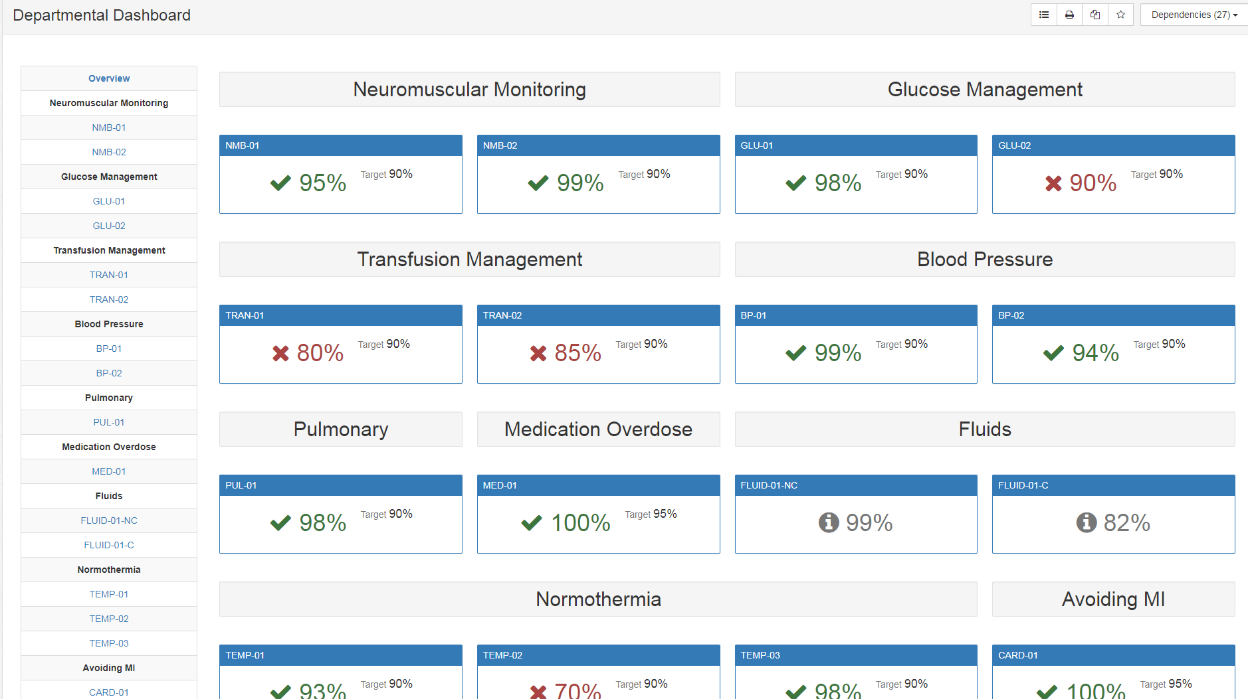

Slide 15
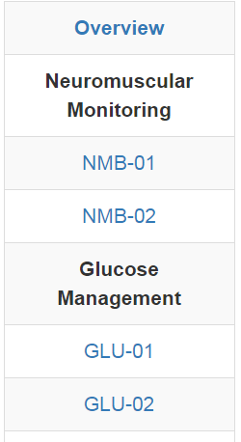
New Navigation Bar
New Format:
NMB 01
NMB 02
GLU 01
GLU 02
BP 01
PUL 01
TEMP 03
‘Old’ Format:
BP 02
TRAN 01
TRAN 02
MED 01
FLUID 01- NC
FLUID 01- C
TEMP 01
TEMP 02
CARD 01
AKI 01
TOC 02

Slide 16
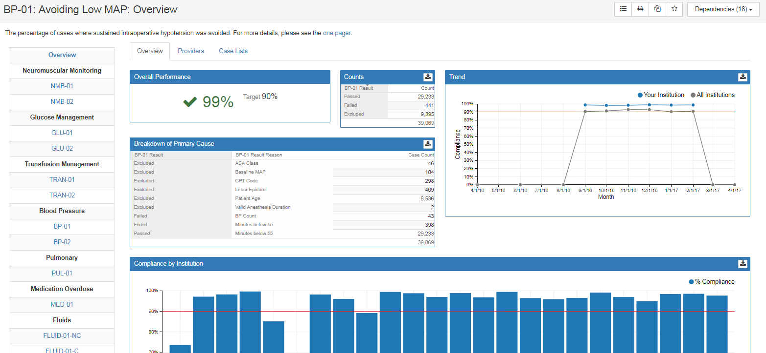

Slide 17
Providers Tab
% Passed
Cases Passed
Cases Failed
Cases Included
Institution Fails (%)
Provider
Role

Slide 18
Case Lists
Result Reason listed for Passed/Failed/Excluded Cases
Institution view:
Only one row per case: Can view all providers attributed on the same row
Click on ‘Link to Case’ to open case in Web Case Viewer
Click on row to view passed/failed/exclusion details

Slide 19
All Lists include the same elements:
Link to Details
MPOG Case ID
Date of Service
Operating Room
Procedure
Attending
CRNA/Resident
Result Reason

Slide 20
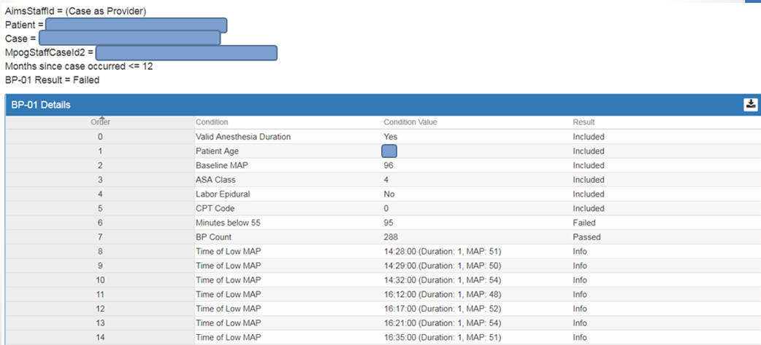
Exclusions
Case Details

Slide 21
Provider Feedback Email Schedule
Dashboard conversion to occur next week (July 26)
July provider feedback emails to be delayed one week to July 31st
Remaining Measures will be converted to new format by September
Emails will include links to passed/failed/excluded lists once all measures converted
Coordinating Center will notify QI Champions and ACQRs when emails will ‘link’ to passed and excluded case lists (in addition to failed lists)

Slide 22
Questions?
Contact Information:
Katie Buehler, MS, RN
kjbucrek@med.umich.edu
734-936-7525

Slide 23
LUNCH TIME!
Walk to the back of the Auditorium- Lunch will be served directly outside the Auditorium on the second floor.
Return around 12:25pm
Afternoon session will begin at 1230

