Slide 1
Quarterly Meeting – Breakfast Session
Kalamazoo, Michigan
June 10th, 2016

Slide 2
Agenda
Executive board notes/ membership
Provider email update
Site visits discussion
Provider Contacts tool – Katie Buehler, RN
Education Module – Jamie Osborne, RN
IARS update
Cohort 3 planning
Site QI projects – a survey

Slide 3
Welcome!

Slide 4
MPOG Executive Board Meeting – May 2016
New Board Members
Timothy Cahill, MD - St. Joseph Mercy
Robert Craft, MD – University of Tennessee
Hugh C. Hemmings, MD, PhD – Weill Cornell
Jeffrey Kirsch, MD – Oregon Health Sciences

Slide 5
Provider Email Update - All Cohort 1 sites receiving emails
Institution | Earliest Email
University of Michigan Health System | July 2015
Trinity - St. Joseph Mercy Ann Arbor, Chelsea, Livingston | November 2015
Beaumont Royal Oak and Troy | January 2016
Trinity - Mercy Health Muskegon | April 2016
Beaumont Dearborn and Taylor | April 2016

Slide 6
When will the randomization end?
Approximately 6 months after each site starting receiving the current slate of measures in Galileo (ie not including Temp or AKI)
Statistical experts analyzing data to confirm adequate numbers
Will be able to inform sites in next couple of weeks

Slide 7
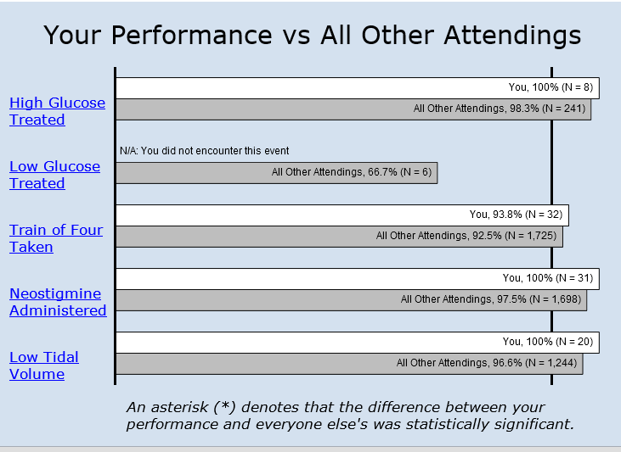
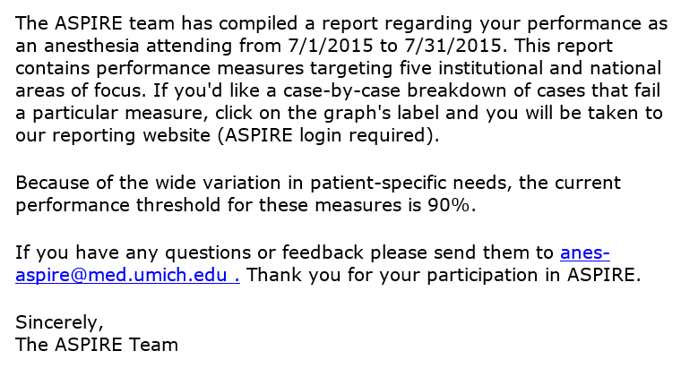
Cohort 2 Reminder: Individual Performance e-mail

Slide 8
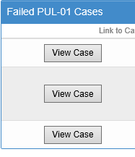
Single click from email to list of failures

Slide 9
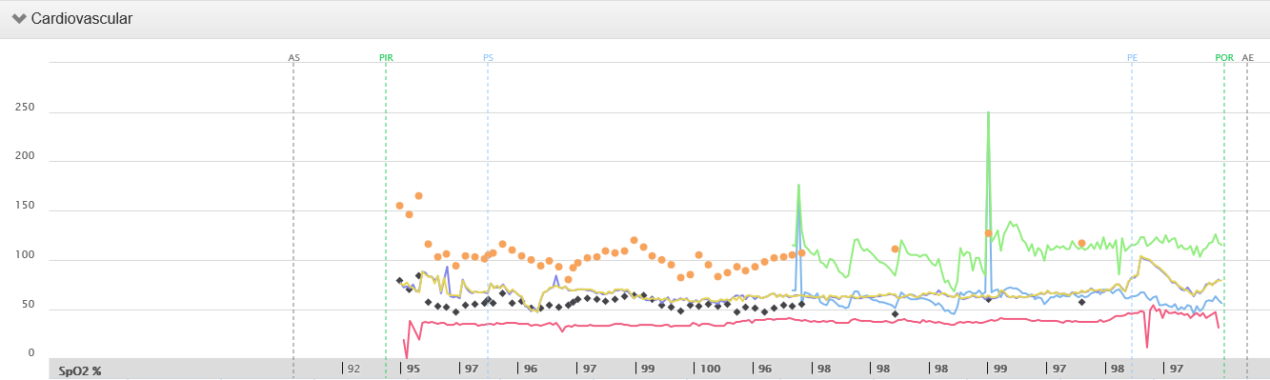
Easy access to actual intraoperative record of failure

Slide 10
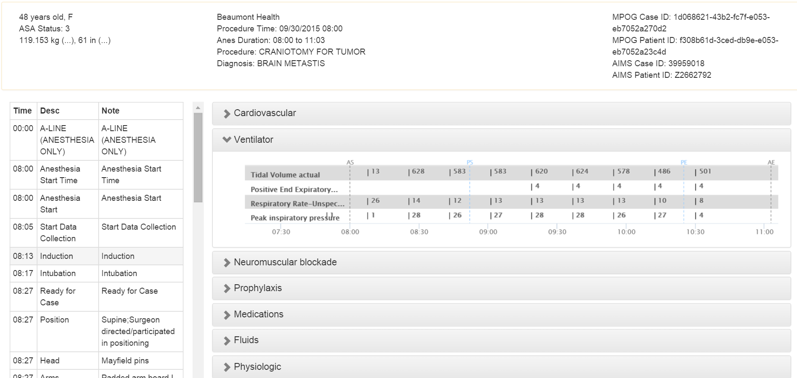
Pul 01 Case Viewer

Slide 11
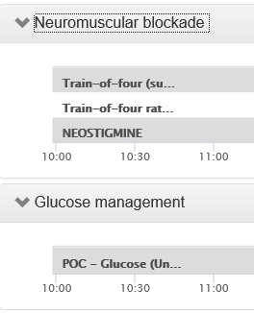
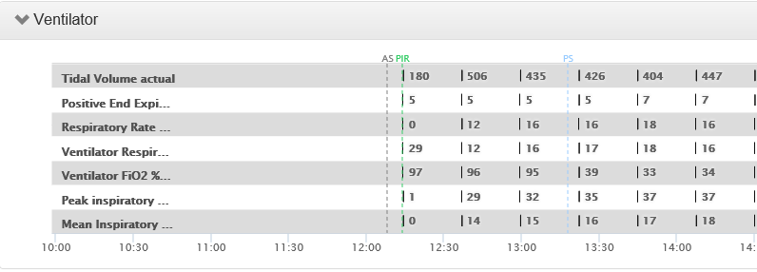
Each measure has a specific case viewer template

Slide 12
Feedback from Cohort 1 sites on emails?

Slide 13
Site Visits - completed
University of Michigan – March 2015
St. Joseph Ann Arbor, Chelsea, Livingston – January 2016
Beaumont Dearborn and Taylor – January 2016
Beaumont Royal Oak and Troy – January 2016
Mercy Muskegon – April 2016

Slide 14
Site visits to be planned
Beaumont – Farmington Hills
St. Joseph – Oakland
St. Mary Mercy – Livonia
Bronson – Kalamazoo/Battle Creek
Holland Hospital – Holland
Sparrow

Slide 15
Provider Contact Application – Katie Buehler, RN
Also known as the ‘User Management Tool’
Access granted to each Quality Champion and ACQR
Provider information previously sent to ASPIRE already uploaded

Slide 16
Provider Contact Application
ASPIRE provides information in these columns. Export option available for future updates.

Slide 17
Provider Contacts Application
Template available for import.
Site populates these columns using AIMS Case ID as identifier.
*Mark those providers who should no longer receive feedback as inactive (Active: No).

Slide 18
Tips for Successful Upload
Technical team to identify provider AIMS Staff ID.
ACQR or Quality Champion to populate using template:
First Name
Last Name
Email Address
NPI
TIN (Required for QCDR sites only.)
Template now allows for ‘null’ cells.
All columns must be populated to show as complete
(Exception: TIN for non-QCDR sites).
Continue to update at least quarterly.
‘Provider Contacts’ button on the MPOG suite: Coming soon!

Slide 19
Education Module Updates - Jamie Osborne, RN
Former PPAI group currently completing the first module for the NMB measure
Current members:
Lead: Dr. Leslie Jameson, University of Colorado
Dr. Jaime Hyman, Mount Sinai
Dr. Francine Yudkowitz, Mount Sinai
Dr. Dawn Dillman, Oregon Health & Science University
Dr. Mohammed Minhaj, University of Chicago
Dr. Tim Dubovoy, University of Michigan, ASPIRE QI Champion
More ASPIRE membership is encouraged, needed. If interested, please contact Jaime Osborne jsulek@med.umich.edu or Katie Buehler kjbucrek@med.umich.edu

Slide 20
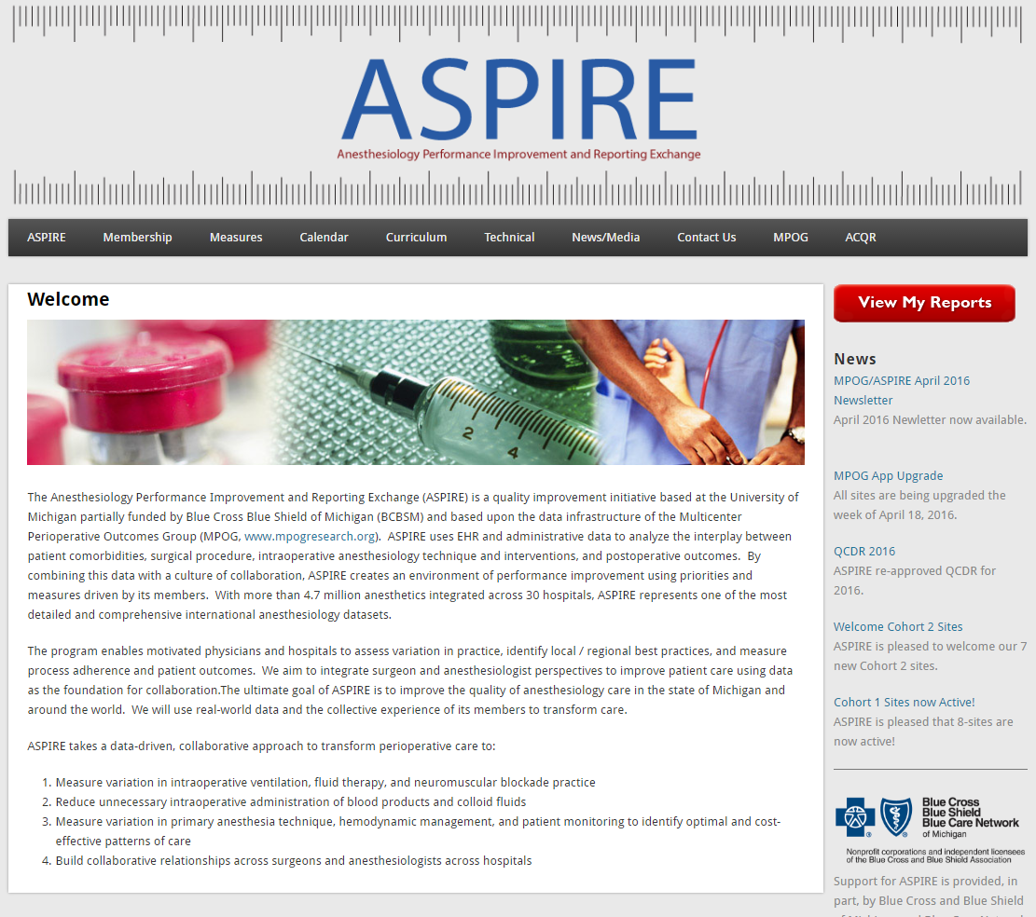
Plan for module roll-out
Will be adding section to curriculum tab on our website
Publicly accessible within the month
Available for staff distribution as part of plan for performance improvement for measures

Slide 21
Education Module Updates
First version of modules will be PowerPoint and Word Doc including an educational activity.
Example: the NMB Module contains an additional Suggamadex educational activity.
Entire NMB Module is about 50-60 slides and 20-30 pages (Module approx. 2-3 hours for provider to complete)
Future versions will have formatting to enable MOCA Part IV and CME credit
More information to follow in the Fall/Winter 2016/2017

Slide 22
Measure Update – Pul 01 – IARS Panel on LPV
Extensive research (both basic science and clinical) has been performed examining the relationship between lung ventilation parameters and outcomes (e.g. ARDS, hospital stay, mortality).
Both increased PEEP (>5 cm H2O) and decreased tidal volumes (<6-10 mL/kg IBW) have been investigated individually, demonstrating associations with improved outcomes.
Bender et al. demonstrated using MPOG data from 2008 to 2012, a reduction in tidal volume and an increased use of PEEP >= 5 cm H2O. However, to date, there is no consensus on which level of tidal volume and PEEP – when assessed together rather than in isolation – constitutes optimal LPV.
Furthermore, the effect of driving pressure (plateau pressure – PEEP) has been largely uninvestigated until recently.
This panel focused on presenting recent research in the field, which suggests that perhaps the key to LPV is driving pressure, rather than tidal volume or PEEP.

Slide 23
Cohort 3 planning – Limited sites
Henry Ford Hospital – Detroit and West Bloomfield
Beaumont - Grosse Pointe

Slide 24
Site QI projects – a survey
UMHS
Handovers
Various enhanced recovery protocols
Antibiotic timing

Slide 25
Thank you!
Meet again at 12:45…

