Slide 1
Blood Management for the Obstetric Patient An overview with recommendations for managing patients experiencing obstetric hemorrhage
For more information, please visit: MPOG Patient Blood Management Toolkit
Publication Date: October 2024

Slide 2
Toolkit Overview
This presentation is part of a Patient Blood Management Toolkit offering an overview of transfusion practices and considerations for cardiac and pediatric surgery as well as general recommendations for patient blood management.
For other patient blood management recommendations please reference additional toolkit components:
Perioperative Transfusion - Overview of Incidence, Risks, and Costs Associated with Transfusion
Patient Blood Management - Transfusion Considerations for Adult Surgical Patient
Blood Management for the Cardiac Surgical Patient (Coming soon!)
Blood Management for the Pediatric Surgical Patient (Coming soon!)

Slide 3
Acknowledgements
Thomas Klumpner, MD – University of Michigan
Brandon Togioka, MD – Oregon Health and Sciences University
Nirav Shah, MD – MPOG
Nicole Barrios, MHA, BSN – MPOG
Kate Buehler, MS, RN - MPOG
Kimberly Finch, MS, RN – Henry Ford Health System

Slide 4
Objectives
Provide an overview of obstetric (OB) hemorrhage
Explain the primary causes and risk factors associated with obstetric hemorrhage
Discuss risks and outcomes associated with transfusion in the obstetric population
Share general recommendations when caring for the OB hemorrhage patient based on the American College of Obstetricians and Gynecologists (ACOG) guidelines
Discuss methods for evaluating and monitoring practices within the healthcare setting to ensure continuous improvement
Describe MPOG QI measures in this domain
Review massive transfusion / OB hemorrhage protocols

Slide 5
Sections
Obstetric Hemorrhage: Incidence and Impact
Definitions of OB Hemorrhage
Management of Obstetric Hemorrhage
Additional Recommendations
MPOG Transfusion QI Measures

Slide 6
Section I: Obstetric Hemorrhage – Incidence & Impact

Slide 7
Pregnancy Related Mortality in the US
Data from CDC Pregnant Mortality Surveillance System
Postpartum hemorrhage remains a leading cause of maternal mortality¹
Many deaths from PPH may be preventable.
References:
Pregnancy-related deaths data. (May 2024). Maternity Mortality Prevention. Centers for Disease Control and Prevention. https://www.cdc.gov/maternal-mortality/php/pregnancy-mortality-surveillance/?CDC_AAref_Val=https://www.cdc.gov/reproductivehealth/maternal-mortality/pregnancy-mortality-surveillance-system.htm
Notes:
The CDC conducted national surveillance to help understand the cause of pregnancy related deaths. Over the past 30 years, the US has seen an increase in pregnancy related deaths.
In 2020, infection was the most common cause of pregnancy related deaths, caused by pregnancy related COVID-19 deaths¹.
https://www.cdc.gov/maternal-mortality/php/pregnancy-mortality-surveillance/?CDC_AAref_Val=https://www.cdc.gov/reproductivehealth/maternal-mortality/pregnancy-mortality-surveillance-system.htm

Slide 8
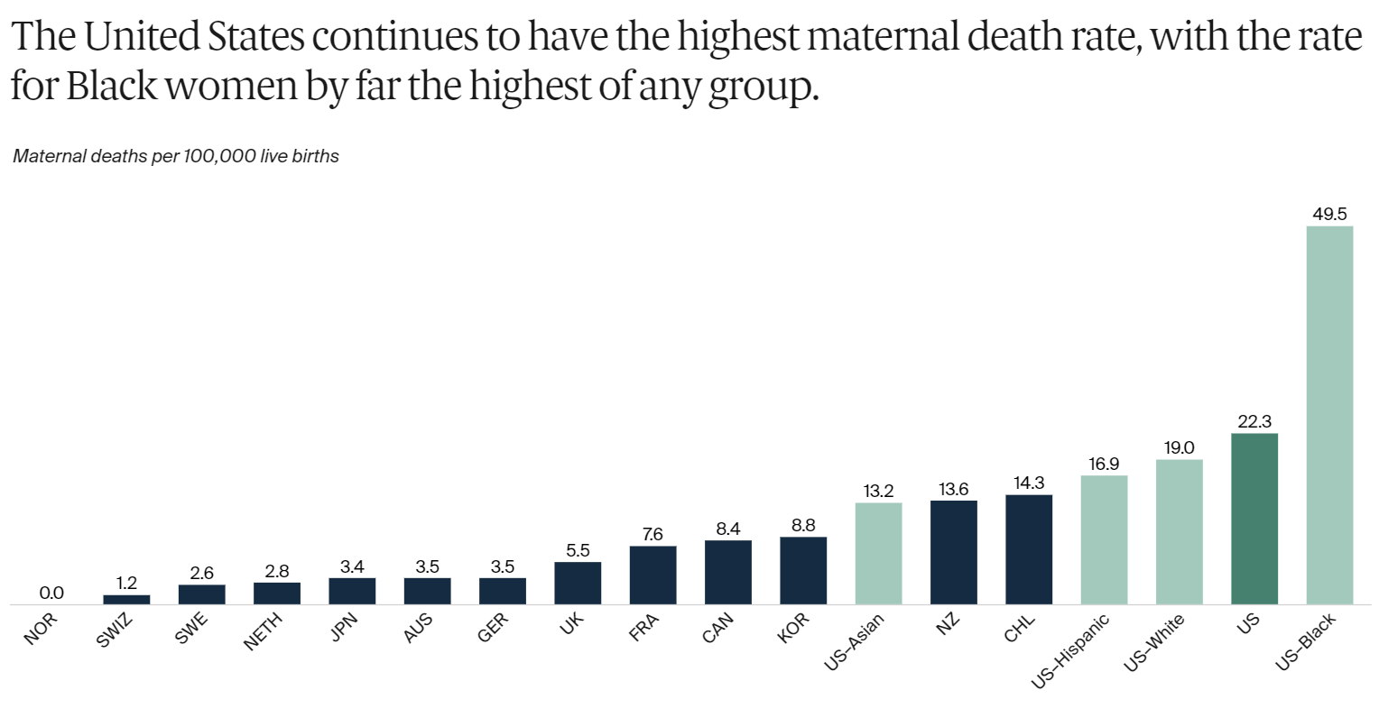
Maternal Death Rate by Country
*Maternal deaths per 100,000 live births
Rates of maternal mortality in the United States are more than double compared to other developed countries¹.
Black women have the highest maternal death rate¹.
Studies suggest that positive patient experiences correlate with lower mortality rates².
References:
Munira Z. Gunja et al., Insights into the U.S. Maternal Mortality Crisis: An International Comparison (Commonwealth Fund, June 2024). https://doi.org/10.26099/cthn-st75
Guan, T., Chen, X., Li, J., & Zhang, Y. (2024). Factors influencing patient experience in hospital wards: a systematic review. BMC Nursing, 23(1), 527. https://doi.org/10.1186/s12912-024-02054-0
Notes:
The maternal mortality ratio is defined as the death of a woman while pregnant or within 42 days of termination of pregnancy, irrespective of the duration and site of the pregnancy, from any cause related to or aggravated by the pregnancy or its management but not from accidental or incidental causes.’’
When patients feel well-cared-for, it positively impacts their health³.
Lower Mortality: Studies suggest that better patient experience correlates with lower mortality rates. When patients feel well-cared-for, it positively impacts their overall health.

Slide 9
Incidence & Impact of Postpartum Hemorrhage
The prevalence of PPH in the United States is currently at 11% and is on the rise.¹
Approximately 14 million women experience PPH annually, resulting in approximately 70,000 maternal deaths (globally).¹
According to the World Health Organization (WHO), many survivors are often left with lifelong reproductive disability.²
Uterine atony is the primary cause of PPH and accounts for 70-80% of all hemorrhages.¹
References:
Wormer, K. C., Jamil, R. T., & Bryant, S. B. (2023). Acute Postpartum Hemorrhage. StatPearls Publishing. https://www.ncbi.nlm.nih.gov/books/NBK499988/
Postpartum haemorrhage. (May 29, 2023). Life Saving Solution dramatically reduces severe bleeding after childbirth. https://www.who.int/teams/sexual-and-reproductive-health-and-research-(srh)/areas-of-work/maternal-and-perinatal-health/postpartum-haemorrhage

Slide 10
Postpartum Hemorrhage - figures and facts
Primary PPH is 1L of blood loss within 24 hours of delivery or blood loss accompanied by signs or symptoms of hypovolemia.¹
Uterine atony, the primary cause of PPH, accounts for approximately 80% of PPH.²
Postpartum hemorrhage can cause a reduction in blood pressure and perfusion to the brain and other vital organs.
Many deaths from PPH are likely preventable.²⁻³
References:
Menard MK, Main EK, Currigan SM. Executive summary of the reVITALize initiative: standardizing obstetric data definitions. Obstet Gynecol 2014;124:150–3.
Lagrew D, McNulty J, Sakowski C, Cape V, McCormick E, Morton CH. Improving Health Care Response to Obstetric Hemorrhage, a California Maternal Quality Care Collaborative Toolkit, 2022.
A Roadmap to combat postpartum haemorrhage between 2023 and 2030. Geneva: World Health Organization; 2023. Licence: CC BY-NC-SA 3.0 IGO.

Slide 11
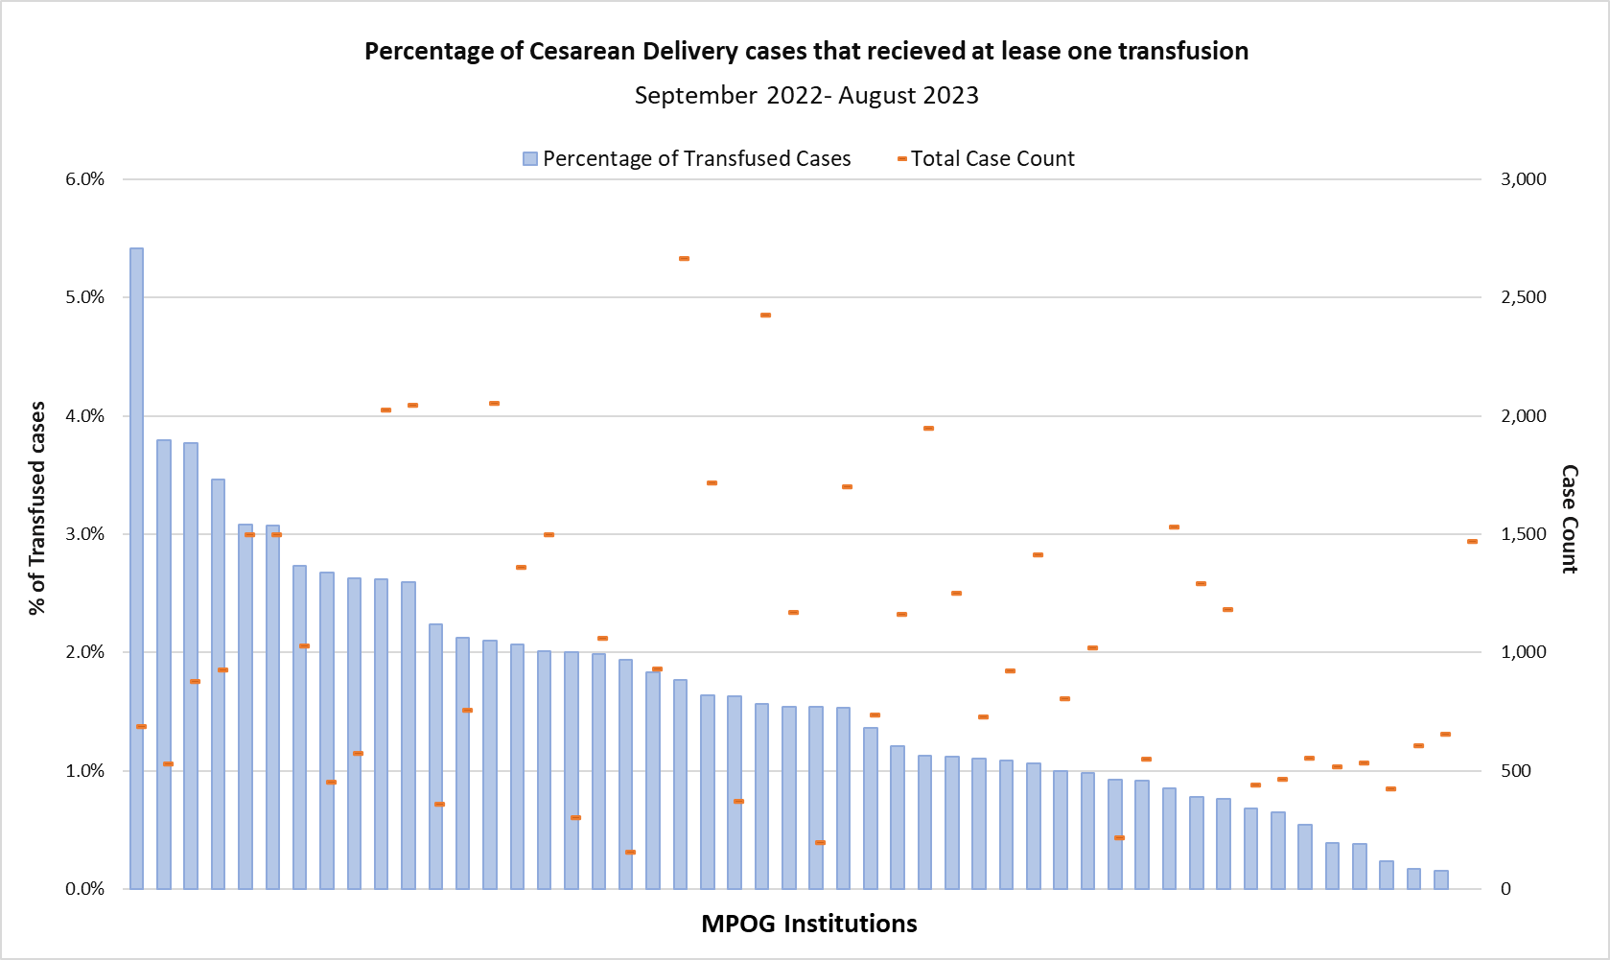
MPOG Data: Transfusion during cesarean delivery
For MPOG sites where cesarean deliveries are performed, 1-4% of cases received a blood transfusion in the perioperative time period.

Slide 12
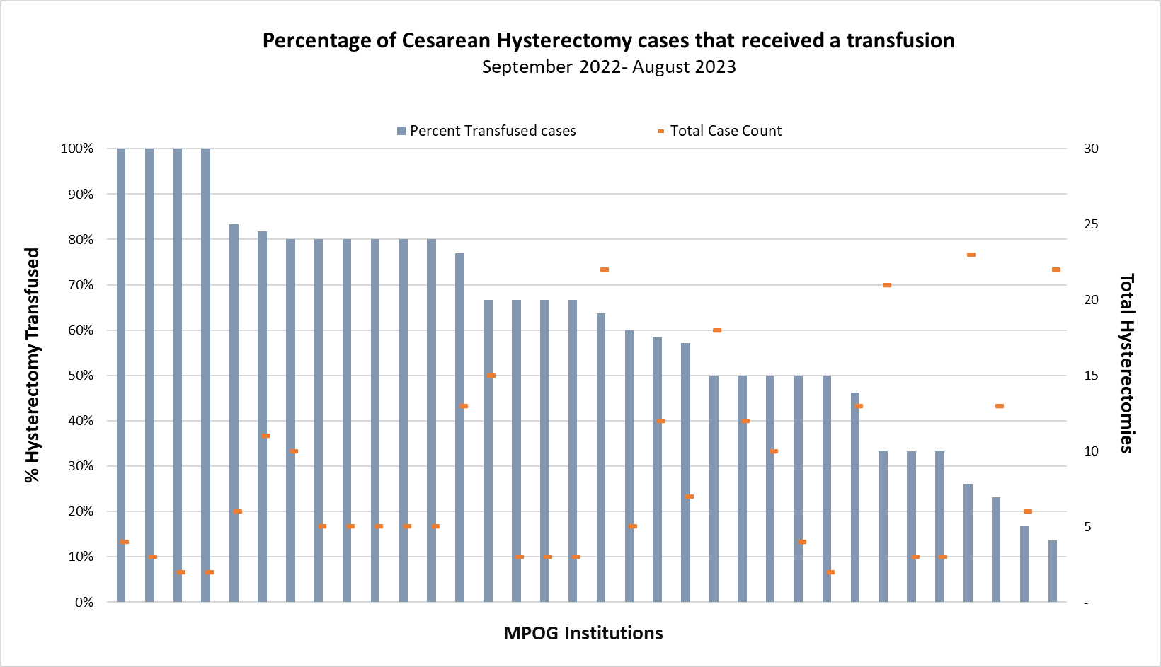
MPOG Data: Transfusions during Cesarean Hysterectomy
Across MPOG sites, more than half of cesarean hysterectomies received a blood transfusion.
A common indication for unplanned cesarean hysterectomy is uterine atony, which can lead to PPH. Higher rates of transfusion for this patient population is expected due to the patient's acuity.

Slide 13
Section II: Obstetric Hemorrhage Defined

Slide 14
Obstetric Hemorrhage Categories
Bellamy, C. (2024, February 14). Black women may prefer Black OBs due to fear of discrimination, dying during pregnancy. NBC News. https://www.nbcnews.com/health/health-news/black-woman-may-prefer-black-obs-due-fear-discrimination-dying-pregnan-rcna138456
Antepartum hemorrhage (APH) - before delivery¹
Postpartum hemorrhage (PPH) - after delivery²
Primary vs. Secondary
Severe vs. Life-threatening
References:
Wormer, K. C., Jamil, R. T., & Bryant, S. B. (2023). Acute Postpartum Hemorrhage. StatPearls Publishing. https://www.ncbi.nlm.nih.gov/books/NBK499988/
Munoz, M., Stensballe,. J., Ducloy-Bouthors, A., Bonnet, M., DeRobertis, E., Fornet, I., Goffinet, F., Hofer, S., Holzgreve, W., Manrique, S., Nizard, J., Christoru, F., Samama, C., Hardy, J. (2019) Blood Transfusion Vol 17; 112-36. “Patient Blood Management in Obstetrics: Prevention and Treatment of Postpartum Haemorrhage. A NATA Consensus Statement.
Lagrew D, McNulty J, Sakowski C, Cape V, McCormick E, Morton CH. Improving Health Care Response to Obstetric Hemorrhage, a California Maternal Quality Care Collaborative Toolkit, 2022.
Bellamy, C. (2024, February). Black women may prefer Black OBs due to fear of discrimination, dying during pregnancy. NBC News. https://www.nbcnews.com/health/health-news/black-woman-may-prefer-black-obs-due-fear-discrimination-dying-pregnan-rcna138456

Slide 15
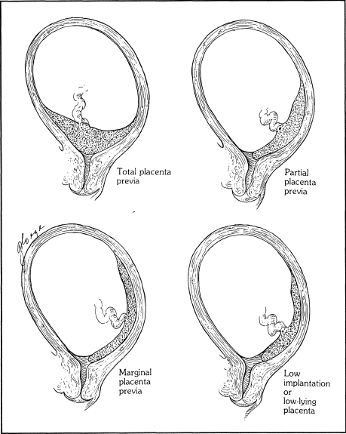
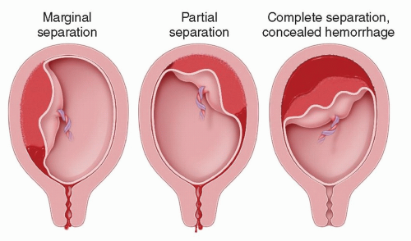
Antepartum Hemorrhage Considerations
Common causes of APH include placenta previa, cervical bleeding and placental abruption¹.
Treatment may include antenatal corticosteroid (once bleeding is controlled) between 24 and 32 weeks if preterm birth is anticipated¹. Type and crosscheck should be completed at admission to avoid delays in receiving blood if needed.
Immediate delivery of fetus if fetal or maternal health is compromised/suspected¹.
The OB anesthesia team will plan for PPH and may notify the blood bank for potential Massive Transfusion Protocol¹.
Types of Placenta Previa ²
Placental abruption ³
References:
Linder, Grace E., and Tina S. Ipe. 2022. “Pregnancy and Postpartum Transfusion.” Annals of Blood 7 (March): 12–12
Hacker NF, Moore JG, editors: Essentials of obstetrics and gynecology, 2nd ed. Philadelphia, WB Saunders, 1992, p 156.
Casanova R, Beckmann CRB, Ling FW, et al. Beckmann and Ling’s Obstetrics and Gynecology. 8th ed. Philadelphia, PA: Wolters Kluwer; 2018.

Slide 16
PPH: Primary vs. Secondary
Primary (PPH): Blood loss > 1000 ml regardless of mode of delivery or bleeding associated with signs of hypovolemia within 24 hours of the birth process.¹
Secondary PPH: Blood loss of more than 500ml > 24 hours after delivery¹
ACOG states that blood loss > 500 ml at time of delivery is abnormal and may warrant intervention.¹
References:
Wormer, K. C., Jamil, R. T., & Bryant, S. B. (2023). Acute Postpartum Hemorrhage. StatPearls Publishing. https://www.ncbi.nlm.nih.gov/books/NBK499988/

Slide 17
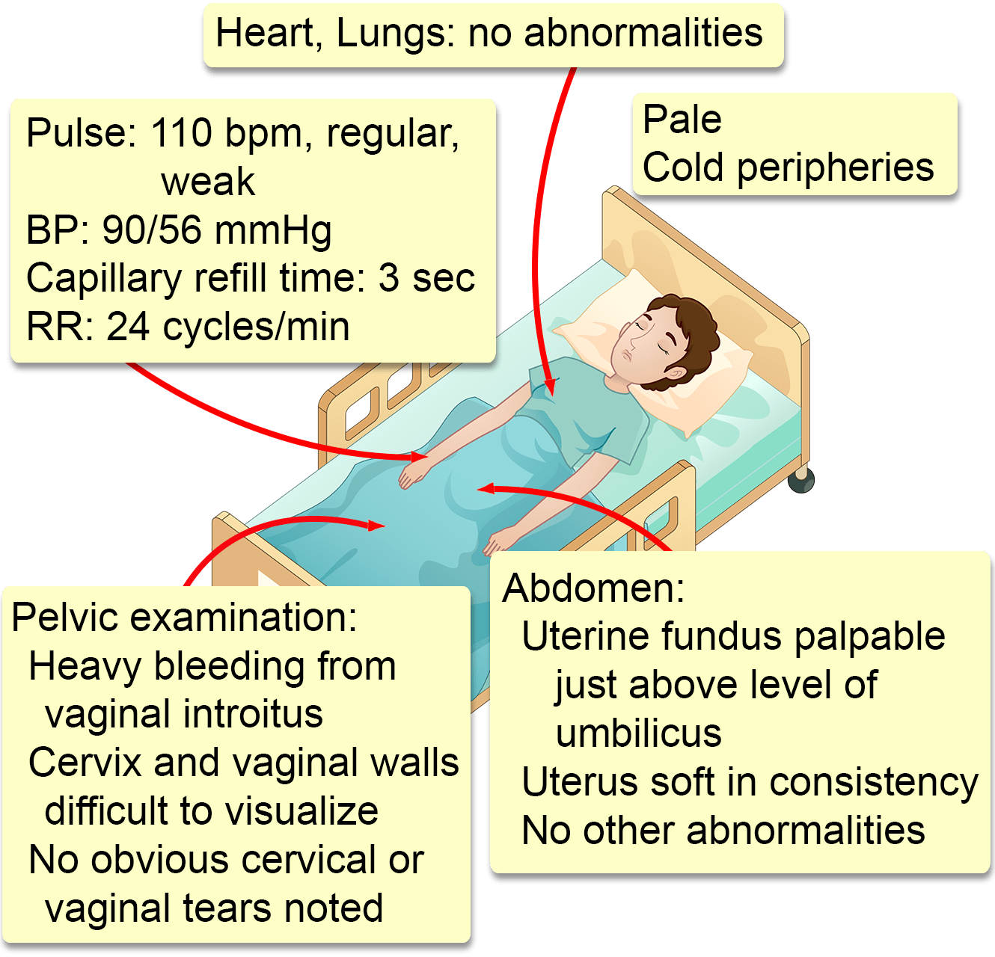
PPH: Severe vs. Life-threatening
Signs of hypovolemia³
Severe: Ongoing blood loss of > 1,000 mL within 24 hours or blood loss accompanied by signs/symptoms of hypovolemia.¹
Life-threatening: Ongoing blood loss of >2,500 mL, or hypovolemic shock, no matter the mode of delivery.²
References:
Wormer, K. C., Jamil, R. T., & Bryant, S. B. (2023). Acute Postpartum Hemorrhage. StatPearls Publishing. https://www.ncbi.nlm.nih.gov/books/NBK499988/
Munoz, M., Stensballe,. J., Ducloy-Bouthors, A., Bonnet, M., DeRobertis, E., Fornet, I., Goffinet, F., Hofer, S., Holzgreve, W., Manrique, S., Nizard, J., Christoru, F., Samama, C., Hardy, J. (2019) Blood Transfusion Vol 17; 112-36. “Patient Blood Management in Obstetrics: Prevention and Treatment of Postpartum Haemorrhage. A NATA Consensus Statement.” Accessed April 17, 2024.
Clinical Odyssey: Interactive case study. (November 29, 2020.). Retrieved October 7, 2024, from https://clinicalodyssey.com/lm/pd-after-birth-postpartum-hemorrhage
Notes:
Abnormal uterine or vaginal bleeding, unspecified (ICD-10: N93.9)
Cesarean hysterectomy (OBAT 4)
Emergency cesarean delivery with diagnosis of placental abruption (ICD-10: O45*)
Placenta previa case (see measure spec for full details)
Newborn affected by intrauterine blood loss from ruptured cord (ICD-10: P50.1)
Rupture of uterus (spontaneous) before onset of labor (ICD-10: O71.0).

Slide 18
Stages of Postpartum Hemorrhage (PPH)
Stage 1:
Blood Loss > 500 mL vaginal or > 1000 mL cesarean with normal labs and vitals ^{1,2}
1
Stage 2:
Continued bleeding (up to 1500 mL or > 2 uterotonics) with normal labs and vitals¹
2
Stage 3:
Continued bleeding EBL >1500 mL or > 2 RBCs administered or risk for occult bleeding coagulopathy or abnormal vitals/labs/oliguria¹
3
Stage 4:
Cardiovascular collapse (massive hemorrhage, profound hypovolemic shock)¹
4
Obstetric hemorrhage care guidelines flowchart: CMQCC Toolkit
References:
Lagrew D, McNulty J, Sakowski C, Cape V, McCormick E, Morton CH. Improving Health Care Response to Obstetric Hemorrhage, a California Maternal Quality Care Collaborative Toolkit, 2022.
ACOG. Practice Bulletin #183. Obstet & Gynecol 2017;130(4):e168-186.
Notes:
Stage 0 – All Births
Stage 1 –
CBL ≥ 500mL vaginal / ≥ 1000 mL cesarean with continued bleeding or
Signs of concealed hemorrhage: VS abnormal or trending (HR ≥ 110, BP < 85/45, O2 sat < 95%, shock index 0.9) or
Confusion
Stage 2 –
Continued bleeding w/ CBL < 1500 mL or
VS remain abnormal
Stage 3 –
Continued bleeding with CBL > 1500mL or
> 2 units PRBCs given or
Abnormal VS or
Suspicion of DIC

Slide 19
Section III: Management of Obstetric Hemorrhage

Slide 20
Overview of Management of OB Hemorrhage
Assessment & management of risk factors in each phase of pregnancy
Care of Patients Refusing Blood Products
Preparation of hemorrhage cart and checklist
Readiness among team members to prepare for obstetric hemorrhage
Recognizing stages of hemorrhage
Familiarity with interventions associated with each stage.
Culture of learning.
Host team debrief sessions after hemorrhage event.
Conduct multidisciplinary review after severe and life-threatening hemorrhage events.
Monitor outcomes associated with obstetric hemorrhage.
Labor and Delivery teams have developed policies and processes to manage OB hemorrhage.

Slide 21
#1 Assessment of Risk Factors

Slide 22
Clinical Assessment
Antepartum
Upon Admission
+ Coagulation disorders and anemia assessed. Risk stratification performed. Blood bank notified as indicated for scheduled or unscheduled birth.³
Postpartum
+ Uterine atony assessed: will feel soft, boggy, non-contracted.⁶⁻⁷
+ Imaging reviewed to assess patient for placenta previa, accreta, increta, or precreta.¹
+ Plan developed to admit patient to higher lever of care if placenta accreta spectrum disorders are identified.¹
+ Anemia assessed and treated as appropriate.²⁻⁵
+ Multidisciplinary consultation for patients with hematologic disorders for delivery and anesthetic planning.
+ Genital lacerations or retained placenta assessed which may be source of bleeding.⁷
⁺ Ongoing surveillance after hemostasis is achieved to identify worsening/delayed PPH.¹
References:
Lagrew D, McNulty J, Sakowski C, Cape V, McCormick E, Morton CH. Improving Health Care Response to Obstetric Hemorrhage, a California Maternal Quality Care Collaborative Toolkit, 2022.
Smith, C, Teng, F., Branch, E., Chu, S., and K. S. Joseph. 2019. “Maternal and Perinatal Morbidity and Mortality Associated With Anemia in Pregnancy.” Obstetrics and Gynecology 134 (6): 1234–44.
ASCLS. August 2022. Volume 36, Number 4. “Improving Obstetric Patient Safety with Better Massive Transfusion Protocols - ASCLS.” Accessed December 22, 2023. https://ascls.org/improving-obstetric-patient-safety-with-better-massive-transfusion-protocols/.
Iron. (2023). Retrieved May 13, 2024, from https://ods.od.nih.gov/factsheets/Iron-HealthProfessional/
Qassim, A., Grivell, R. M., Henry, A., Kidson-Gerber, G., Shand, A., & Grzeskowiak, L. E. (2019). Intravenous or oral iron for treating iron deficiency anemia during pregnancy: systematic review and meta-analysis. The Medical Journal of Australia, 211(8), 367–373. https://doi.org/10.5694/mja2.50308
Gill, P., Patel, A., & Van Hook, J. W. (2023). Uterine Atony. StatPearls Publishing. https://www.ncbi.nlm.nih.gov/books/NBK493238/
Wormer, K. C., Jamil, R. T., & Bryant, S. B. (2023). Acute Postpartum Hemorrhage. StatPearls Publishing. https://www.ncbi.nlm.nih.gov/books/NBK499988/
Notes:
References:
Lagrew D, McNulty J, Sakowski C, Cape V, McCormick E, Morton CH. Improving Health Care Response to Obstetric Hemorrhage, a California Maternal Quality Care Collaborative Toolkit, 2022.
Smith, C, Teng, F., Branch, E., Chu, S., and K. S. Joseph. 2019. “Maternal and Perinatal Morbidity and Mortality Associated With Anemia in Pregnancy.” Obstetrics and Gynecology 134 (6): 1234–44.
ASCLS. August 2022. Volume 36, Number 4. “Improving Obstetric Patient Safety with Better Massive Transfusion Protocols - ASCLS.” Accessed December 22, 2023. https://ascls.org/improving-obstetric-patient-safety-with-better-massive-transfusion-protocols/.
Iron. (2023). Retrieved May 13, 2024, from https://ods.od.nih.gov/factsheets/Iron-HealthProfessional/
Qassim, A., Grivell, R. M., Henry, A., Kidson-Gerber, G., Shand, A., & Grzeskowiak, L. E. (2019). Intravenous or oral iron for treating iron deficiency anemia during pregnancy: systematic review and meta-analysis. The Medical Journal of Australia, 211(8), 367–373. https://doi.org/10.5694/mja2.50308
Linder, Grace E., and Tina S. Ipe. 2022. “Pregnancy and Postpartum Transfusion.” Annals of Blood 7 (March): 12–12.
Gill, P., Patel, A., & Van Hook, J. W. (2023). Uterine Atony. StatPearls Publishing. https://www.ncbi.nlm.nih.gov/books/NBK493238/
Wormer, K. C., Jamil, R. T., & Bryant, S. B. (2023). Acute Postpartum Hemorrhage. StatPearls Publishing. https://www.ncbi.nlm.nih.gov/books/NBK499988/

Slide 23
Risk Assessment during pregnancy
Placenta Accreta Spectrum
Assess patient for possible placenta previa/accreta/increta/precreta- these conditions increase patients’ risk for PPH. Obtain necessary imaging studies for the conditions. Transfer to appropriate level of care if accreta is suspected.¹
Anemia
Early treatment of anemia can reduce morbidity and mortality.²
Anemia in pregnancy is a worldwide health concern. WHO estimates 40% of pregnant women are anemic.
During pregnancy women experience physiologic anemia, due to an increase in plasma volume that causes a dilutional effect.³
During pregnancy and lactation, the recommended daily allowance for Iron is 27 mg. This can be obtained by eating a whole foods diet and taking prenatal vitamins.⁴
Qassim et al found no significant difference in first line therapy with IV iron vs oral administration for treating Iron Deficiency Anemia (IDA) in pregnancy.⁵
References:
Lagrew D, McNulty J, Sakowski C, Cape V, McCormick E, Morton CH. Improving Health Care Response to Obstetric Hemorrhage, a California Maternal Quality Care Collaborative Toolkit, 2022.
Smith, C, Teng, F., Branch, E., Chu, S., and K. S. Joseph. 2019. “Maternal and Perinatal Morbidity and Mortality Associated With Anemia in Pregnancy.” Obstetrics and Gynecology 134 (6): 1234–44.
ASCLS. August 2022. Volume 36, Number 4. “Improving Obstetric Patient Safety with Better Massive Transfusion Protocols - ASCLS.” Accessed December 22, 2023. https://ascls.org/improving-obstetric-patient-safety-with-better-massive-transfusion-protocols/.
Iron. (2023). Retrieved May 13, 2024, from https://ods.od.nih.gov/factsheets/Iron-HealthProfessional/
Qassim, A., Grivell, R. M., Henry, A., Kidson-Gerber, G., Shand, A., & Grzeskowiak, L. E. (2019). Intravenous or oral iron for treating iron deficiency anemia during pregnancy: systematic review and meta-analysis. The Medical Journal of Australia, 211(8), 367–373. https://doi.org/10.5694/mja2.50308

Slide 24
Risk Factors for OB Hemorrhage
Before Pregnancy | Antepartum | Intra/Post-Partum
Grand Multiparity (≥ 5 births) Maternal Age <19 Maternal Age >35 Prior Cesarean Delivery | Placenta accreta spectrum Diabetes Fibroids Hypertensive Disease of Pregnancy Infection Macrosomia (>4,000g) Multiple Gestation Placenta Previa/Abruption Polyhydramnios | Cesarean Delivery Instrumental Vaginal Delivery Medical Induction of Labor
References:
Linder, Grace E., and Tina S. Ipe. 2022. “Pregnancy and Postpartum Transfusion.” Annals of Blood 7 (March): 12–12.
Munoz, M., Stensballe,. J., Ducloy-Bouthors, A., Bonnet, M., DeRobertis, E., Fornet, I., Goffinet, F., Hofer, S., Holzgreve, W., Manrique, S., Nizard, J., Christoru, F., Samama, C., Hardy, J. (2019) Blood Transfusion Vol 17; 112-36. “Patient Blood Management in Obstetrics: Prevention and Treatment of Postpartum Haemorrhage. A NATA Consensus Statement.” Accessed April 17, 2024.

Slide 25
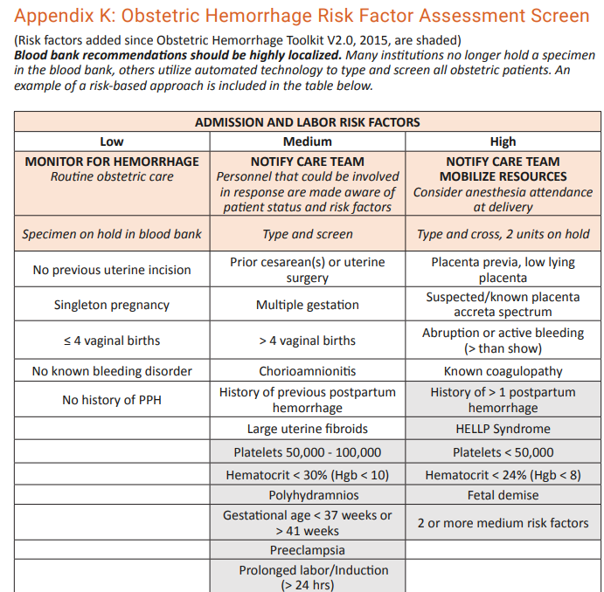
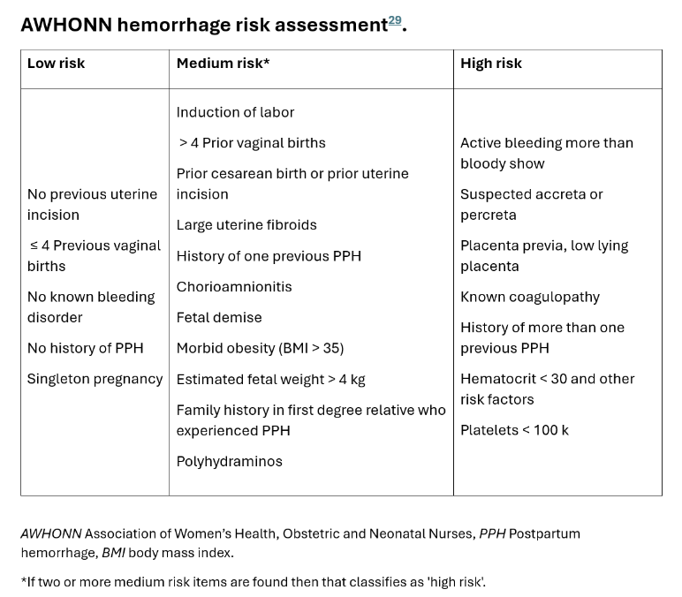
OB Hemorrhage Risk Assessment Tools
Association of Women’s Health, Obstetric and Neonatal Nurses (AWHONN)²
American College of Obstetricians and Gynecologists Safe Motherhood Initiative³
California Maternal Quality Care Collaborative¹
References:
Lagrew D, McNulty J, Sakowski C, Cape V, McCormick E, Morton CH. Improving Health Care Response to Obstetric Hemorrhage, a California Maternal Quality Care Collaborative Toolkit, 2022.
Colalillo EL, Sparks AD, Phillips JM, Onyilofor CL, Ahmadzia HK. Obstetric hemorrhage risk assessment tool predicts composite maternal morbidity. Sci Rep. 2021 Jul 19;11(1):14709. doi: 10.1038/s41598-021-93413-3. PMID: 34282160; PMCID: PMC8289851.
ACOG. January 2019. Obstetric Hemorrhage. Risk Assessment Tables. https://www.acog.org/-/media/project/acog/acogorg/files/forms/districts/smi-ob-hemorrhage-bundle-risk-assessment-ld-admin-intrapartum.pdf
Notes:
There are three main Risk Assessment Tools available for OB anesthesiologists.
Assessments are typically conducted upon admission.

Slide 26
California Maternal Quality Care Collaborative¹
Reference
Lagrew D, McNulty J, Sakowski C, Cape V, McCormick E, Morton CH. Improving Health Care Response to Obstetric Hemorrhage, a California Maternal Quality Care Collaborative Toolkit, 2022.

Slide 27
Association of Women’s Health, Obstetric and Neonatal Nurses (AWHONN)¹
Reference:
Colalillo EL, Sparks AD, Phillips JM, Onyilofor CL, Ahmadzia HK. Obstetric hemorrhage risk assessment tool predicts composite maternal morbidity. Sci Rep. 2021 Jul 19;11(1):14709. doi: 10.1038/s41598-021-93413-3. PMID: 34282160; PMCID: PMC8289851.

Slide 28
American College of Obstetricians and Gynecologists Safe Motherhood Initiative¹
Reference:
ACOG. January 2019. Obstetric Hemorrhage. Risk Assessment Tables. https://www.acog.org/-/media/project/acog/acogorg/files/forms/districts/smi-ob-hemorrhage-bundle-risk-assessment-ld-admin-intrapartum.pdf

Slide 29
#2: Care of Patients Refusing Blood Products

Slide 30
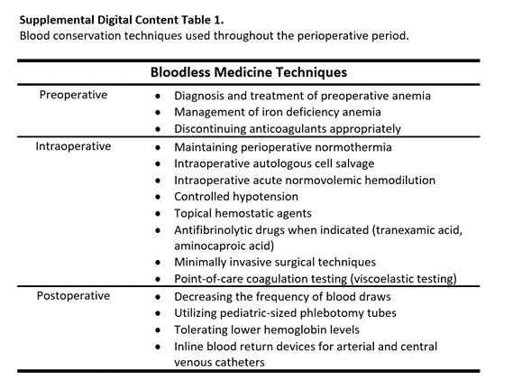
Standard Protocols and Processes
Detailed discussion and documentation of each blood product as accepted or refused
Plan for blood conservation techniques and hemorrhage discussed early among OB, anesthesia, and nursing teams
Early intervention to prevent bleeding, hypothermia, and fluid deficits
May need to move to surgical management quicker in this population.¹
References:
Maternal Safety Bundle for OB Hemorrhage. American College of Obstetrician and Gynecologists. (2020). https://www.acog.org/community/districts-and-sections/district-ii/programs-and-resources/safe-motherhood-initiative/obstetric-hemorrhage

Slide 31
#3: Preparation of Hemorrhage Cart & Checklist

Slide 32
Standard Medications and Supplies
Oxytocin: administered via infusion (10-40 units in 500 mL or 20-60 in 1000 mL solution) or
IV Bolus -1-3 units to initiate tone, followed by an infusion of 30 units in 500 mL at 125 mL/hr.
If no IV access: Oxytocin 10 units IM ^{1,2}
Note: Oxytocin dosing strategies are varied and will differ based on patient needs/presentation.
15-methyl PGF2a (Carboprost / Hemabate): 250 mcg/ml IM. Avoid in patients with severe asthma.¹ ²
Misoprostol (Cytotec): 200 mcg tablets administered in 600 mcg or 800 mcg doses sublingually. (Rectal administration is no longer recommended due to late onset of action).¹
Methylergonovine (Methergine): 0.2 mg/mL IM. Avoid in patients with poorly controlled hypertension¹
Calcium: consider 1 gram IV infused over 10 minutes after cord clamping³
Tranexamic acid (TXA): 1 gram IV, can repeat in 30 minutes, max dose: 2 grams in 24 hours^{4,5}
Hysterectomy Tray and Intrauterine Balloon⁶
References:
Lagrew D, McNulty J, Sakowski C, Cape V, McCormick E, Morton CH. Improving Health Care Response to Obstetric Hemorrhage, a California Maternal Quality Care Collaborative Toolkit, 2022.
Jones AJ, Federspiel JJ, Eke AC. Preventing postpartum hemorrhage with combined therapy rather than oxytocin alone. Am J Obstet Gynecol MFM. 2023 Feb;5(2S):100731. doi: 10.1016/j.ajogmf.2022.100731. Epub 2022 Aug 24. PMID: 36028160; PMCID: PMC9941051.
Ansari, Jessica R., Alla Yarmosh, Guillermina Michel, Deirdre Lyell, Haley Hedlin, David N. Cornfield, Brendan Carvalho, and Brian T. Bateman. 2024. “Intravenous Calcium to Decrease Blood Loss During Intrapartum Cesarean Delivery: A Randomized Controlled Trial.” Obstetrics and Gynecology 143 (1): 104–12.
Shakur, H., Roberts, I., Fawole, B., Chaudhri, R., El-Sheikh, M., Akintan, A., Qureshi, Z., Kidanto, H., Vwalika, B., Abdulkadir, A., Etuk, S., Noor, S., Asonganyi, E., Alfirevic, Z., Beaumont, D., Ronsmans, C., Arulkumaran, S., Grant, A., Afsana, K., … Faye, G. E. (2017). Effect of early tranexamic acid administration on mortality, hysterectomy, and other morbidities in women with post-partum haemorrhage (WOMAN): an international, randomised, double-blind, placebo-controlled trial. The Lancet, 389(10084), 2105–2116. https://doi.org/10.1016/S0140-6736(17)30638-4
Chauncey, J. M., & Wieters, J. S. (2023). Tranexamic Acid. StatPearls Publishing. https://www.ncbi.nlm.nih.gov/books/NBK532909/
Maternal Safety Bundle for OB Hemorrhage. American College of Obstetrician and Gynecologists. (2020).
https://www.acog.org/community/districts-and-sections/district-ii/programs-and-resources/safe-motherhood-initiative/obstetric-hemorrhage

Slide 33
Hemorrhage Cart
A well stocked Hemorrhage Cart should contain:
Emergency hemorrhage supplies:
IV start supplies
hemorrhage balloons and supplies
urinary catheters
sutures
pressure infuser bags
policy and procedure binder and laminated handouts that are easy to read easily accessible
Associated equipment
stepstool
bright task light on wheels
ultrasound machine
crash cart- stocked and routinely checked by staff responsible ²
References:
Lagrew D, McNulty J, Sakowski C, Cape V, McCormick E, Morton CH. Improving Health Care Response to Obstetric Hemorrhage, a California Maternal Quality Care Collaborative Toolkit, 2022.
Designating an Effective Emergency Coordinator Environment of Care. (2021). The Joint Commission. Emergency Management, 24(7). https://store.jcrinc.com/assets/1/7/ECN_24_2021_07.pdf

Slide 34
Treating Uterine Atony
The rule of threes was developed due to variation in initial doses of oxytocin, lack of an existing protocol for step-wise increase in uterotonic agents, and normalization of deviance from standard dosages of oxytocin.¹
Oxytocin protocol for cesarean delivery: Rule of threes
3 IU oxytocin intravenous loading dose administered no faster than 15 seconds
3 min assessment intervals. If inadequate uterine time, give 3- IU oxytocin intravenous rescue dose.
3 total doses of oxytocin (initial load + 2 rescue doses)
3 IU oxytocin intravenous maintenance dose (3 IU/L at 100 mL/hr)
3 Pharmacologic options (e.g. ergonovine, carboprost and misoprostol) if inadequate uterine tone persists
**An initial dose of 3 IU oxytocin is sufficient for effective uterine contractions for both non-laboring and laboring women. Preferably this dose should be administered in the form of a rapid infusion, rather than a bolus. Maintenance oxytocin infusion can be administered for up to 8 hr following delivery.
References:
Tsen, L. C., & Balki, M. (2010). Oxytocin protocols during cesarean delivery: time to acknowledge the risk/benefit ratio? International Journal of Obstetric Anesthesia, 19(3), 243–245. https://doi.org/10.1016/j.ijoa.2010.05.001

Slide 35
#4: Ensure Readiness of Team Members

Slide 36
Team Readiness
#1: Understanding stages of hemorrhage
#2: Familiarity with interventions associated with each stage
# 3: Evaluation and monitoring practices available within team’s healthcare setting
#4: Regular review of hospital’s policy on massive transfusion protocol and PPH treatment

Slide 37
Stage 1: blood loss > 500 mL vaginal or > 1000 mL cesarean with normal labs and vitals
Initial steps:
Ensure 16- or 18-gauge IV access.
Increase IV fluid (crystalloid without oxytocin)
Insert urinary catheter.
Begin fundal massage ¹
Medications:
Increase oxytocin if indicated
Consider Methylergonovine, 15-methyl PGF or Misoprostol
Contact Blood Bank:
Contact Blood Bank- (early) ²
Type and Crossmatch 2 units RBCs ¹
Action:
Determine cause and treatment. Continually assess tone, trauma, tissue and thrombin, or coagulation dysfunction.
Prepare for OR if clinically indicated ¹
References:
Lagrew D, McNulty J, Sakowski C, Cape V, McCormick E, Morton CH. Improving Health Care Response to Obstetric Hemorrhage, a California Maternal Quality Care Collaborative Toolkit, 2022.
ASCLS. August, 2022. Volume 36, Number 4. “Improving Obstetric Patient Safety with Better Massive Transfusion Protocols - ASCLS.” Accessed December 22, 2023. https://ascls.org/improving-obstetric-patient-safety-with-better-massive-transfusion-protocols/.

Slide 38
Stage 2: continued bleeding up to 1500 mL or > 2 uterotonics with normal labs and vitals
Initial steps
Request additional help/resources (RRT, Anesthesiologist, OB, RN, Hemorrhage cart, record scribe, assign one person to communicate with blood bank and one person to communicate with family)¹
Place second IV
Draw stat labs (CBC, coags, fibrinogen), use point of care viscoelastic testing if available.
Prepare OR
Medications (See slide 32)
Continue stage 1 medications: consider TXA
TXA dose: 1 gram over 10 minutes. Add 1 gram vial to 10 mL NS or 100 ml NS and give over 10 minutes, may be repeated once after 30 min
Blood Bank
Patient currently bleeding and at risk for uncontrollable bleeding
Review steps of MTP and call Blood bank and initiate massive transfusion protocol
Nursing/anesthesia draw stat labs
Immediate need for transfusion (type and crossmatch not yet available)
Action
Uterine Atony: consider uterine balloon or packing, possible surgical intervention.
Consider moving patient to OR
Escalate therapy with goal of hemostasis ¹
All obstetric units need a massive transfusion protocol for the initial management of life threatening PPH and consider early therapy of RBCs and FFP. ¹
References:
Lagrew D, McNulty J, Sakowski C, Cape V, McCormick E, Morton CH. Improving Health Care Response to Obstetric Hemorrhage, a California Maternal Quality Care Collaborative Toolkit, 2022.
ASCLS. August 2022. Volume 36, Number 4. “Improving Obstetric Patient Safety with Better Massive Transfusion Protocols - ASCLS.” Accessed December 22, 2023. https://ascls.org/improving-obstetric-patient-safety-with-better-massive-transfusion-protocols/.
Notes:
Continued bleeding (up to 1500 mL or > 2 uterotonics) with normal labs and vitals
Initial steps
Request additional help/resources (RRT, Anesthesiologist, OB, RN, Hemorrhage cart, record scribe, assign one person to communicate with blood bank and one person to communicate with family) 1
Place second IV
Draw stat labs (CBC, coags, fibrinogen)
Prepare OR
Medications (See slide X)
Continue stage 1 medications: consider TXA
TXA dose: 1 gram over 10 minutes. Add 1 gram vial to 10 mL NS or 100 ml NS and give over 10 minutes, may be repeated once after 30 min
Blood Bank
Patient currently bleeding and at risk for uncontrollable bleeding
Review steps of MTP and call Blood bank and initiate massive transfusion protocol
Nursing/anesthesia draw stat labs
Immediate need for transfusion (type and crossmatch not yet available)
Action
Uterine Atony: consider uterine balloon or packing, possible surgical intervention.
Consider moving patient to OR
Escalate therapy with goal of hemostasis 1

Slide 39
Stage 3: bleeding > 1500 mL or > 2 RBCs or at risk for occult bleeding/coagulopathy or abnormal vitals/labs/oliguria
Initial steps
Request additional help and resources/staff
continue communication with family.
Reidentify team leadership
Move patient to OR
Announce clinical status (vitals, cumulative blood loss, etiology)
Outline and communicate plan
Medications (See slide 32)
Continue stage 1 medications; consider TXA
Contact Blood Bank
Clinical signs of blood loss > 1500
Hypotension, narrowed pulse pressure, marked tachycardia, tachypnea, pale, cool extremities, restlessness, decreased urine output
Initiate Massive Transfusion protocol
If clinical coagulopathy, add cryoprecipitate, consult for additional agents ¹
Action
Achieve hemostasis, intervention at this stage will be based on the cause of bleeding.
Escalate interventions and prevent hypothermia ²
Possible interventions:
Bakri balloon
Compression suture/B-Lunch suture
Uterine artery ligation
Hysterectomy
References:
Lagrew D, McNulty J, Sakowski C, Cape V, McCormick E, Morton CH. Improving Health Care Response to Obstetric Hemorrhage, a California Maternal Quality Care Collaborative Toolkit, 2022.
ASCLS. August 2022. Volume 36, Number 4. “Improving Obstetric Patient Safety with Better Massive Transfusion Protocols - ASCLS.” Accessed December 22, 2023. https://ascls.org/improving-obstetric-patient-safety-with-better-massive-transfusion-protocols/

Slide 40
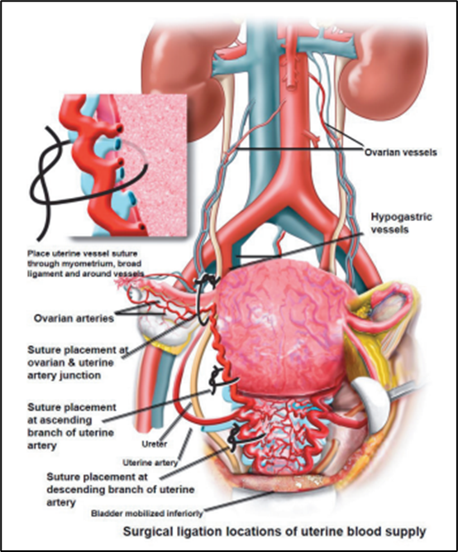
Stage 4: cardiovascular collapse (massive hemorrhage, profound hypovolemic shock)
Initial Step
Request additional help and resources (Additional provider, charge RN, RRT Staff) ¹
Medications
ACLS Medications ²
Blood Bank
Clinical signs/symptoms: profound hypotension, worsening tachycardia and tachypnea, negligible urine output or anuria, altered level of consciousness ¹
Simultaneous aggressive massive transfusion
Action
Immediate surgical intervention to ensure hemostasis- possible hysterectomy ¹
Post-hemorrhage management
Determine disposition of patient
Debrief with entire team
Debrief with patient and family (continuous through event)
Document events ¹
References:
Lagrew D, McNulty J, Sakowski C, Cape V, McCormick E, Morton CH. Improving Health Care Response to Obstetric Hemorrhage, a California Maternal Quality Care Collaborative Toolkit, 2022.
ASCLS. August 2022. Volume 36, Number 4. “Improving Obstetric Patient Safety with Better Massive Transfusion Protocols - ASCLS.” Accessed December 22, 2023. https://ascls.org/improving-obstetric-patient-safety-with-better-massive-transfusion-protocols/

Slide 41
Viscoelastometric Testing
Rotational Thromboelastometry (ROTEM)
Point of care testing device
Provides a global assessment of hemostasis by using a whole blood sample to demonstrate how platelets, coagulation factors, RBCs, and other elements work together to:
initiate a clot
determine clot strength; and
investigate if there is any fibrinolysis¹.
Used in the management of bleeding because it can quickly assess the state of hemostasis and can direct care.
References:
Drotarova M, Zolkova J, Belakova KM, Brunclikova M, Skornova I, Stasko J, Simurda T. Basic Principles of Rotational Thromboelastometry (ROTEM®) and the Role of ROTEM-Guided Fibrinogen Replacement Therapy in the Management of Coagulopathies. Diagnostics (Basel). 2023 Oct 16;13(20):3219. doi: 10.3390/diagnostics13203219. PMID: 37892040; PMCID: PMC10606358.
Notes:
ROTEM provides a global assessment of hemostasis by using a whole
blood sample to demonstrate how platelets, coagulation factors, RBCs,
and other elements are working together to 1) initiate a clot; 2) determine
clot strength; and 3) investigate if there is any fibrinolysis.

Slide 42
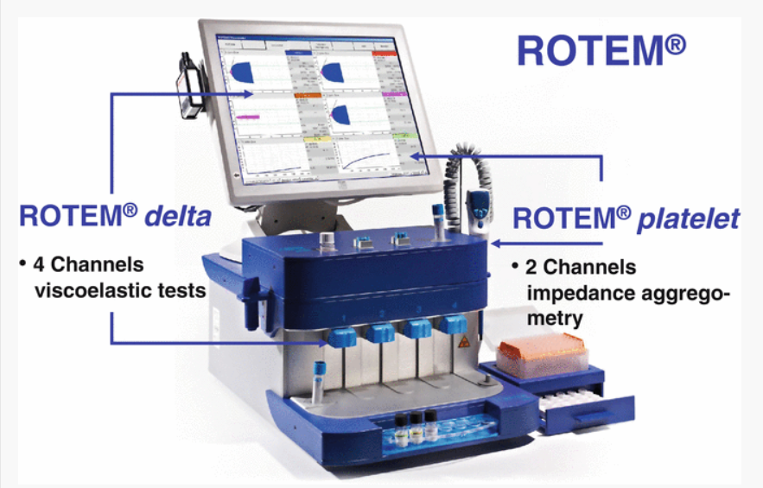
Viscoelastometric Testing
Used to analyze various aspects of clotting cascade.
INTEM
Intrinsic system screening test
EXTEM
Extrinsic system screening test
FIBTEM
Isolated fibrinogen contribution to clot firmness
Point-of-care viscoelastic testing (ROTEM) helps reduce unnecessary transfusions¹
MPOG TEG & ROTEM Concepts
References:
Gonzalez E, Moore EE, Moore HB. Management of Trauma-Induced Coagulopathy with Thrombelastography. Crit Care Clin. 2017 Jan;33(1):119-134. doi: 10.1016/j.ccc.2016.09.002. PMID: 27894492; PMCID: PMC5142763 Department of Anesthesiology

Slide 43
#5: Foster a Culture of Learning

Slide 44
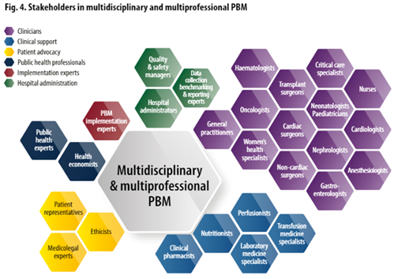
Organizational Preparedness
Establish a culture of debriefs/huddles and multidisciplinary reviews.¹
Monitor outcomes and trends for your department and patient population.
Conduct drills at least once a year to ensure staff are prepared for an OB emergency.²
References:
Lagrew D, McNulty J, Sakowski C, Cape V, McCormick E, Morton CH. Improving Health Care Response to Obstetric Hemorrhage, a California Maternal Quality Care Collaborative Toolkit, 2022.
ASCLS. August 2022. Volume 36, Number 4. “Improving Obstetric Patient Safety with Better Massive Transfusion Protocols - ASCLS.” Accessed December 22, 2023. https://ascls.org/improving-obstetric-patient-safety-with-better-massive-transfusion-protocols/
World Health Organization “WHO Policy Brief.” 2021 https://iris.who.int/bitstream/handle/10665/346655/9789240035744-eng.pdf?sequence

Slide 45
Educational Resources for Clinicians and Patients
Center for Disease Control and Prevention – Hear Her Campaign¹
Resources available for people who are pregnant or post-partum, their care takers or healthcare workers.
Aim: Raise awareness regarding maternal warning signs during and after pregnancy and improve communication between health care providers and patients.
18 languages available
Association of Women’s Health, Obstetric and Neonatal Nurses (AWHONN) – Post-Birth discharge education program for clinicians²
Online course with resources to educate nurses and clinicians about postpartum maternal morbidity and mortality in the US.
Alliance for Innovation on Maternal Health (right) ³
Quality Improvement initiative identifying best practices to make birth safer & improve maternal health outcomes.
80 languages available.
References:
CDC. (2024, May 20). Hear Her Campaign: An Overview. HEAR HER Campaign. https://www.cdc.gov/hearher/about/index.html
Doolin, S. (2020, January 5). POST-BIRTH Warning Signs Education Program. AWHONN. https://www.awhonn.org/education/hospital-products/post-birth-warning-signs-education-program/
Urgent Maternal Warning Signs. (2024, August 6). AIM. https://saferbirth.org/aim-resources/aim-cornerstones/urgent-maternal-warning-signs-2/
Notes:
https://www.cdc.gov/hearher/index.html
https://www.awhonn.org/education/hospital-products/post-birth-warning-signs-education-program/
https://saferbirth.org/aim-resources/aim-cornerstones/urgent-maternal-warning-signs-2/

Slide 46
Section IV: Additional Recommendations
Notes:
OB Transfusion Toolkit- Adding components to enable quality champs to enable them to provide QI and how to apply it to role of ACQR.

Slide 47
ACOG Maternal Safety Recommendations
References:
Maternal Safety Bundle for OB Hemorrhage. American College of Obstetrician and Gynecologists. (2020). https://www.acog.org/-/media/project/acog/acogorg/files/forms/districts/smi-ob-hemorrhage-bundle-slides.pdf

Slide 48
Society for Obstetric Anesthesia and Perinatology (SOAP) Guidelines
In 2019, SOAP published a summary of their Enhanced Recovery After Cesarean Delivery (ERAC) protocol, developed by six providers and approved by the SOAP Board of Directors. The goal of the consensus statement was to provide practical and evidence-based recommendations regarding ERAC. The recommendations are as follows¹:
Use the lowest effective dose of oxytocin for cesarean delivery:
Scheduled Cesarean Delivery: 1 unit bolus + 2.5-7.5 U/hr
Intrapartum Cesarean Delivery: 3 U bolus + 7.5-15 U/hr
Limit IV fluids to < 3 L for routine cases.
References:
Bollag L, Lim G, Sultan P, Habib AS, Landau R, Zakowski M, Tiouririne M, Bhambhani S, Carvalho B. Society for Obstetric Anesthesia and Perinatology: Consensus Statement and Recommendations for Enhanced Recovery After Cesarean. Anesth Analg. 2021 May 1;132(5):1362-1377. doi: 10.1213/ANE.0000000000005257. PMID: 33177330
Notes:
https://www.cdc.gov/hearher/index.html
https://www.awhonn.org/education/hospital-products/post-birth-warning-signs-education-program/
https://saferbirth.org/aim-resources/aim-cornerstones/urgent-maternal-warning-signs-2/

Slide 49
Council on Patient Safety in Women’s Health Care
Recommendations from the Alliance for Innovation on Maternal Health
Prepare hemorrhage cart
Ensure emergency release blood available
Perform regular risk assessments for hemorrhage
Reference
Obstetric Emergency Readiness Resource Kit. (2023). https://saferbirth.org/wp-content/uploads/FINAL_AIM_OERRK.pdf
Notes:
This presentation includes info from the alliance for innovation on maternal health including a mobile hemorrhage cart, immediate availability of emergency release blood, regular assessments of hemorrhage risk, quantitative blood loss measurements and surveillance of unit adherence to our protocol.
FINAL_AIM_OERRK.pdf (saferbirth.org)

Slide 50
Summary
Maternal mortality rates in the US continue to rise while it is decreasing in other developed countries.
Early identification of PPH is important in reducing maternal mortality because many deaths are preventable.
Point-of-care viscoelastic testing (ROTEM) helps reduce unnecessary transfusions.
Review your hospitals Blood Bank and Emergency Release policies to ensure staff are prepared to treat PPH
Establish a process to review your site’s MPOG specific outcome and process measures
For more information, please visit the Patient Blood Management Transfusion Toolkit page on the MPOG website

