Slide 1
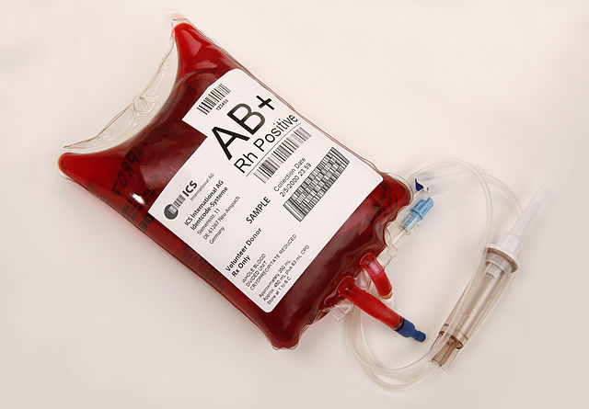
Perioperative Transfusion Stewardship

Slide 2
Objectives
Discuss risks and outcomes associated with transfusion
Describe ASPIRE transfusion measures
Provide general recommendations based on American Society of Anesthesiologists (ASA) Transfusion Guidelines (2015)
Share procedure-specific considerations presented in the literature for orthopedic, cardiac, oncologic, and general surgery
Review best practices when transfusion cannot be avoided:
Massive Transfusion Protocols
Obstetric Hemorrhage Protocols (ACOG Recommendations)
Summarize ASPIRE recommendations based on literature presented

Slide 3
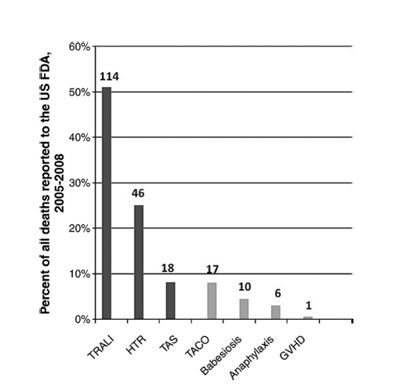
Risks Associated with Transfusion
Anaphylaxis
Hemolytic transfusion reaction (HTR)
Transfusion-associated sepsis (TAS)
Transfusion-related acute lung injury (TRALI)
Transfusion-associated circulatory overload (TACO)
Transfusion-associated graft-versus-host disease (TA-GVHD). (ASA Task Force, 2015)
(Goodnough LT, 2012)
Notes:
ASA Task Force on Perioperative Blood Management. (2015). Practice guidelines for perioperative blood management: an updated report by the American Society of Anesthesiologists Task Force on Perioperative Blood Management*. Anesthesiology. 122(2):241-75.
Goodnough LT, Shander A. (2012). Patient blood management. Anesthesiology. 116(6):1367-76.

Slide 4
Approximate Risk Per-Unit Transfusion of RBCs
(Carson, 2016)
Notes:
Carson JL, Guyatt G, Heddle NM, et al. (2016). Clinical Practice Guidelines From the AABB: Red Blood Cell Transfusion Thresholds and Storage. JAMA. 15;316(19):2025-2035

Slide 5
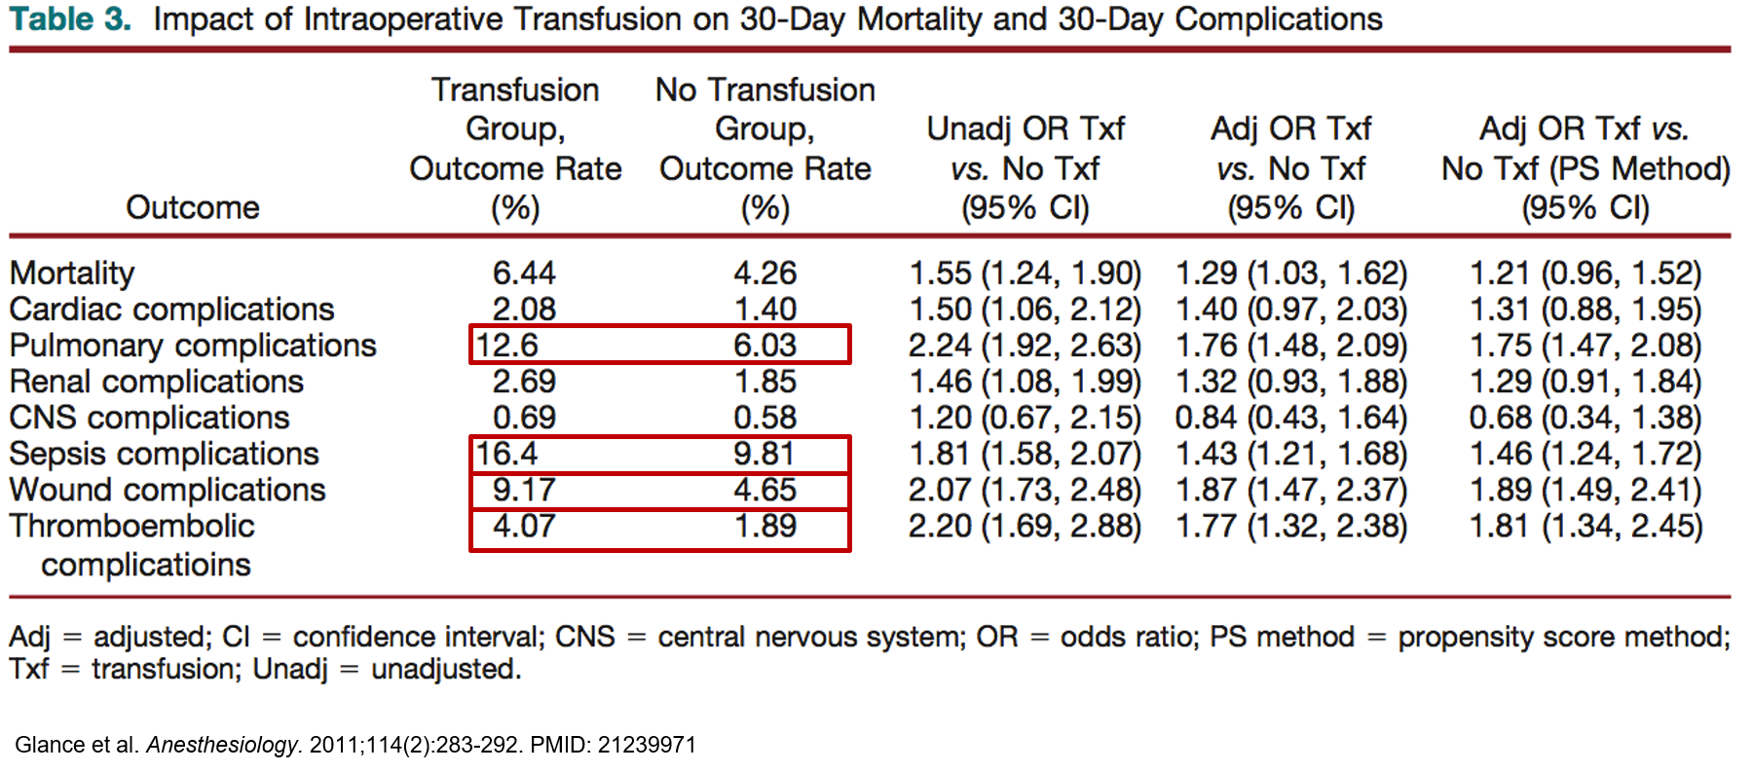
Risks of Transfusion for Noncardiac Surgery
(Glance, 2011)
Notes:
Glance LG, Dick AW, Mukamel DB, et al. (2011). Association between intraoperative blood transfusion and mortality and morbidity in patients undergoing noncardiac surgery. Anesthesiology. 11;114(2):283-92.

Slide 6
Outcomes Associated with Perioperative Blood Transfusion
More than 1 in 10 patients undergoing hepatic, pancreatic, or colorectal resection were transfused under a liberal trigger, which was associated with worse patient outcomes and increased institutional cost compared with the restrictive trigger group. (Ejaz, 2015)
Patients who received one or two units of erythrocytes had a 29% increased odds of death and a 40-90% increased odds of pulmonary, sepsis, wound, and thromboembolic. (Glance, 2011)
30-day mortality rate for patients who were transfused was 6.44% versus 4.26% for patients who were not transfused. (Glance, 2011)
Restricting blood transfusions using a restrictive trigger of ≤ 7 g/dL results in a significant reduction in total mortality, acute coronary syndrome, pulmonary edema, re-bleeding, and bacterial infection compared with more liberal transfusion strategy. (Salpeter, 2014)
Notes:
Ejaz A, Frank SM, Spolverato G, et al. (2015). Potential Economic Impact of Using a Restrictive Transfusion Trigger Among Patients Undergoing Major Abdominal Surgery. JAMA Surg. 150(7):625-30.
Glance LG, Dick AW, Mukamel DB, et al. (2011). Association between intraoperative blood transfusion and mortality and morbidity in patients undergoing noncardiac surgery. Anesthesiology. 11;114(2):283-92.
Salpeter SR, Buckley JS, Chatterjee S. (2014). Impact of more restrictive blood transfusion strategies on clinical outcomes: a meta-analysis and systematic review. AM J Med. 127(2):124-131.e3.

Slide 7
Financial Impact: Total cost of a single unit of PRBCs
Actual institutional acquisition costs approximately $220 per unit
Estimated mean activity-based cost of transfusion: $760 per unit ($522-$1183) takes into account acquiring, delivering, administering, and monitoring each transfusion. (Ejaz, 2015)
Notes:
Ejaz A, Frank SM, Spolverato G, et al. (2015). Potential Economic Impact of Using a Restrictive Transfusion Trigger Among Patients Undergoing Major Abdominal Surgery. JAMA Surg. 150(7):625-30.

Slide 8
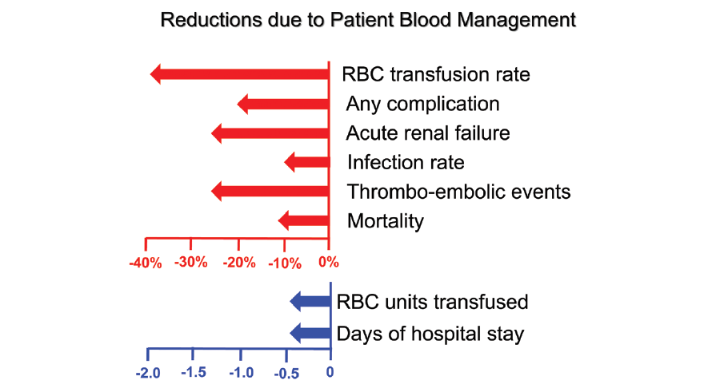
Implementing Patient blood management measures has shown to reduce transfusion of blood products and improve patient outcomes
(Spahn, 2020)
Notes:
Spahn DR, Muñoz M, Klein AA, et al. (2020). Patient Blood Management: Effectiveness and Future Potential. Anesthesiology. 133(1):212-222.

Slide 9
How do we measure transfusion management quality in ASPIRE?
TRAN 01 – measuring hematocrit (or hemoglobin) before every unit transfused
TRAN 02 – monitoring over-transfusion by ensuring that post transfusion hematocrit (or hemoglobin) is less than 30%
Why did we choose these measures?
Apply to most cases where transfusions were administered
Relatively straightforward to understand
Data in widely contained in EHR

Slide 10
Transfusion Recommendations & Guidelines

Slide 11
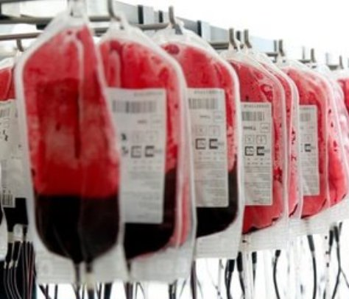
ASA Practice Guidelines for Perioperative Blood Management
Preoperative Evaluation
Preadmission Patient Preparation
Pre-procedure Preparation
Intraoperative and Postoperative Management of Blood Loss. (ASA Task Force, 2015).
Notes:
ASA Task Force on Perioperative Blood Management. (2015). Practice guidelines for perioperative blood management: an updated report by the American Society of Anesthesiologists Task Force on Perioperative Blood Management*. Anesthesiology. 122(2):241-75.

Slide 12
Preoperative Evaluation
Perform several days to weeks in advance, if possible.
Review Previous Medical Records & conduct a Patient/Family Interview
Previous blood transfusion?
History of drug-induced coagulopathy?
Presence of congenital coagulopathy?
Risk factors for organ ischemia?
History of thrombotic events?
Review existing lab results (hemoglobin, hematocrit, coagulation profiles)
Order additional lab tests based on patient’s condition (anemia, coagulopathy)
Conduct physical exam (ecchymosis, petechiae, pallor)
Prior to surgery, inform patient of potential risks vs. benefit of blood transfusion and identify patient preferences.
(ASA Task Force, 2015).
Notes:
ASA Task Force on Perioperative Blood Management. (2015). Practice guidelines for perioperative blood management: an updated report by the American Society of Anesthesiologists Task Force on Perioperative Blood Management*. Anesthesiology. 122(2):241-75.

Slide 13
Preadmission Patient Prep Recommendations (ASA Task Force on Perioperative Blood Management, 2015)
Prevention or reduction of perioperative anemia
Administration of erythropoietin can reduce need for RBC transfusions in patients with perioperative hemoglobin 10-13 g/dL who are at high risk for perioperative blood loss from elective, noncardiac, nonvascular surgery. (Pfizer Medical Information)
Iron (IV infusion or daily oral administration)
Discontinue anticoagulants/antithrombotic agents (Consider patient condition and risk factors)
Warfarin: 5 days before surgery; check PT/INR day of surgery.
Clopidogrel or other thienopyridines: Discontinue 5 days before surgery.
Aspirin: Discontinue 7-10 days before surgery.
Preadmission autologous blood donation (PAD)
Though autologous blood donation can reduce the use of allogenic blood transfusion by 40-52%, PAD is not found to be cost-effective as compared to other blood sparing strategies. (Birkmeyer, 1993)
Notes:
ASA Task Force on Perioperative Blood Management. (2015). Practice guidelines for perioperative blood management: an updated report by the American Society of Anesthesiologists Task Force on Perioperative Blood Management*. Anesthesiology. 122(2):241-75.
Birkmeyer JD, Goodnough LT, AuBuchon JP, et al. (1993). The cost-effectiveness of preoperative autologous blood donation for total hip and knee replacement. Transfusion. 33(7):544-51.
Pfizer Medical Information. Retacrit Indications and Usage (epoetin alfa-epbx). https://www.pfizermedicalinformation.com/en-us/retacrit/indications-usage

Slide 14
Pre-procedure Preparation Recommendations
Adopt Blood Management Protocols. (ASA Task Force, 2015)
Multimodal protocol or algorithm
Restrictive vs liberal transfusion protocol
Non-transfusion protocol (bloodless surgery)
Massive transfusion protocol
Maximum surgical blood ordering schedule for elective procedures
Reversal of anticoagulants
Vitamin K
Prothrombin Complex Concentrates
Antifibrinolytics for prophylaxis of excessive blood loss
Aminocaproic acid
Tranexamic acid
Acute Normovolemic Hemodilution: Consider for cardiac and ortho procedures. (Shander, 2004)
Notes:
Protocols should incorporate bundle of interventions including consultation with multiple medical specialties, POC testing in ORs available, trigger guidelines, blood conservation strategies in addition to ‘when to transfuse’ protocols
ASA Task Force on Perioperative Blood Management. (2015). Practice guidelines for perioperative blood management: an updated report by the American Society of Anesthesiologists Task Force on Perioperative Blood Management*. Anesthesiology. 122(2):241-75.
Shander A, Rijhwani TS. (2004). Acute normovolemic hemodilution. Transfusion. 44(12 Suppl):26S-34S.

Slide 15
Intraoperative and Postoperative Management of Blood Loss
Allogenic Red Blood Cell Transfusion
Age of Stored Blood (controversial- no conclusion)
Leukocyte reduction: reduces complications associated with transfusion
Reinfusion of recovered red blood cell transfusion (cell saver administration supported)
Intraoperative and postoperative patient monitoring
Monitor blood loss
Perfusion of vital organs
Anemia
Coagulopathy
Adverse effects of transfusion
Treatment of excessive bleeding. (ASA Task Force, 2015)
Notes:
ASA Task Force on Perioperative Blood Management. (2015). Practice guidelines for perioperative blood management: an updated report by the American Society of Anesthesiologists Task Force on Perioperative Blood Management*. Anesthesiology. 122(2):241-75.

Slide 16
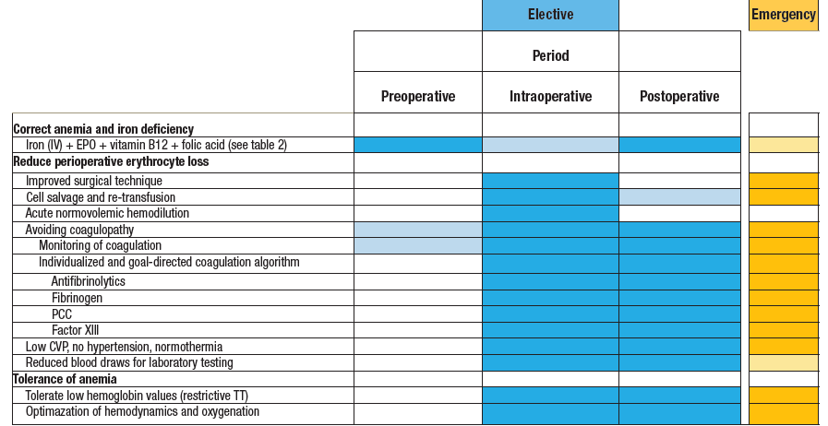
Suggested Perioperative Blood Management
(Spahn, 2020)
Notes:
Spahn DR, Muñoz M, Klein AA, et al. (2020). Patient Blood Management: Effectiveness and Future Potential. Anesthesiology. 133(1):212-222.

Slide 17
Treatment of Excessive Bleeding
ASA Practice Guidelines for Perioperative Blood Management
Transfusion of Platelets: Obtain platelet count before transfusion
Transfusion of FFP: Obtain coagulation tests (INR or PT and aPTT) before transfusing FFP
Transfusion of Cryoprecipitate: Assess fibrinogen levels before giving cryo
Pharmacologic Treatment of bleeding
Desmopressin
Antifibrinolytics (tranexamic acid, aminocaproic acid)
Topical hemostatics (fibrin glue, thrombin gel)
PCCs
Coagulation factor concentrates (recombinant factor VIIa)
Treatments for hypofibrinogenemia (cryoprecipitate, fibrinogen). (ASA Task Force, 2015)
Notes:
ASA Task Force on Perioperative Blood Management. (2015). Practice guidelines for perioperative blood management: an updated report by the American Society of Anesthesiologists Task Force on Perioperative Blood Management*. Anesthesiology. 122(2):241-75.

Slide 18
Transfusion Triggers: Literature Review
Clinical Practice Guidelines from AABB (American Association of Blood Banks)
Recommendation #1: Transfusion is not indicated until hemoglobin level is 7 g/dL for hospitalized adult patients who are hemodynamically stable, including critically ill patients.*
Recommendation #2: Transfusion threshold of 7-8 g/dL is indicated for patients undergoing orthopedic or cardiac surgery, and those with preexisting cardiovascular disease.*
Recommendation #3: Patients, including neonates, should receive RBC units selected at any point within their licensed dating period rather than limiting patients to transfusion of only fresh (≤10 days) RBC units.
*Recommendations do not apply to patients with Acute Coronary Syndrome, severe thrombocytopenia, and chronic transfusion-dependent anemia. (Carson, 2016; Mueller, 2019)
Notes:
Carson JL, Guyatt G, Heddle NM, et al. (2016). Clinical Practice Guidelines From the AABB: Red Blood Cell Transfusion Thresholds and Storage. JAMA. 15;316(19):2025-2035.
Mueller MM, Remoortel HV, Meybohm P, et al. (2019). Patient Blood Management: Recommendations From the 2018 Frankfurt Consensus Conference. JAMA. 321(10):983-997.

Slide 19
Transfusion Triggers: Literature Review
Red Cross Transfusion Guidelines:
RBCs should be administered based on signs and symptoms, Hgb level, and hematologic results
In the absence of acute hemorrhage, RBCs should be administered as single units, followed by appropriate evaluation to justify additional units.
Complete administration of a single unit within 4 hours
Post-transfusion Considerations:
In a non-bleeding, non-hemolyzing adult, the hemoglobin should equilibrate within 15 minutes after transfusion of RBCs.
It is estimated that one RBC unit should increase Hgb by approximately 1g/dL or Hct by 3%. (American Red Cross, 2017)
Notes:
American Red Cross. (2017). A Compendium of Transfusion Practice Guidelines Third Edition 2017. https://www.laboratoryalliance.com/assets/Uploads/Transfusion-Services/TransfusionPractices-Compendium-3rdEdition.pdf

Slide 20
Transfusion Triggers: Literature Review
National Institute for Health and Care Excellence (NICE) Guidelines:
Use Restrictive RBC Hgb Thresholds (7 g/dL) for patients who need RBC transfusions but do not have:
- Major hemorrhage
- Acute Coronary Syndrome
- A need for regular blood transfusions for chronic anemia
Post-transfusion Hgb target (goal) for restrictive therapy: 7-9 g/dL
In patients with acute coronary syndrome, consider transfusion threshold of Hgb: 8 g/dL and target of 8-10 g/dL
Set individual thresholds and targets for patients with chronic anemia
Consider single unit red blood cell transfusions for adults who do not have active bleeding
After each single unit of RBC transfusion, clinically reassess and check Hgb levels before administering additional units. (National Clinical Guideline Centre, 2015; Mueller, 2019)
Notes:
Mueller MM, Remoortel HV, Meybohm P, et al. (2019). Patient Blood Management: Recommendations From the 2018 Frankfurt Consensus Conference. JAMA. 321(10):983-997.
National Clinical Guideline Centre (UK). (2015). Blood Transfusion. London: National Institute for Health and Care Excellence (NICE). Nov 2015. PMID: 26632625 Bookshelf: NBK327570.

Slide 21
Transfusion Trigger Considerations by Surgical Specialty
Transfusion Trigger Recommendations
General Surgery
Cardiac Surgery
Orthopedic Surgery

Slide 23
Transfusion Literature: Cardiac Surgery
Conflicting definitions of restrictive transfusion presented in the literature:
In a review article by Curley et al., there was no significant increase in rates of myocardial infarction, stroke, acute renal failure, or mortality using restrictive transfusion thresholds (Hgb: 7-9 g/dL) in patients undergoing cardiovascular surgery. (Curley, 2014)
Low Hgb (<7) values are associated with increased operative mortality, increased likelihood of prolonged intensive care stay and greater likelihood of postoperative hospitalization of 9 or more days. (Habib, 2003)
Restrictive transfusion thresholds (Hgb: 7-8 g/dL) associated with higher rates of acute coronary syndrome in anemic patients compared with more liberal transfusion thresholds (9-10 g/dL). (Docherty, 2016)
Notes:
Curley GF, Shehata N, Mazer CD, et al. (2014). Tranfusion triggers for guiding RBC transfusion for cardiovascular surgery: a systematic review and meta-analysis*. Crit Care Med. 42(12):2611-24.
Docherty AB, O’Donnell R, Brunskill S, et al. (2016). Effect of restrictive versus liberal transfusion strategies on outcomes in patients with cardiovascular disease in a non-cardiac surgery setting: systematic review and meta-analysis. BMJ. 352:i1351.
Habib R, Zacharias A, Schwann TA, et al. (2003). Adverse effects of low hematocrit during cardiopulmonary bypass in the adult: should current practice be changed? J Thorac Cadiovasc Surg. 125(6):1438-50.

Slide 24
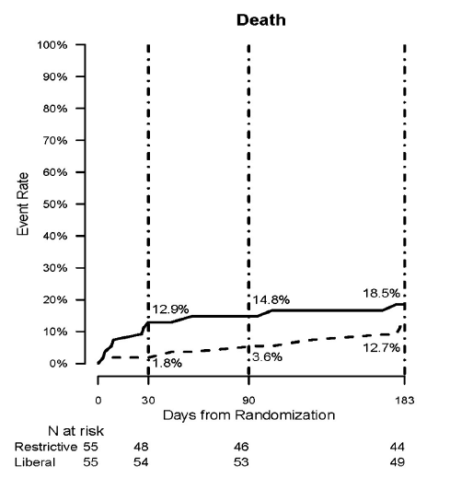
Liberal vs. Restrictive Transfusion Strategy in Cardiac Patients
110 Patients
Restrictive: <8 g/dL
Liberal: <10 g/dL
Restrictive transfusion strategy resulted in increased rate of death (18.5% vs. 12.7%).
P value: 0.032
(Carson, 2013)
Notes:
Carson JL, Brooks MM, Abbott JD, et al. (2013). Liberal versus restrictive transfusion thresholds for patients with symptomatic coronary artery disease. Am Heart J. 165(6):964-971.e1.

Slide 25
Transfusion Recommendations: Cardiac Surgery
Cell Saver
Transfusion through cell saver is safe and results in a significant reduction in homologous transfusion while not causing a clinically significant coagulopathy. Pts who receive intraoperative cell saver transfusion (ICT) also have decreased mediastinal drainage 12 hours postoperatively. (Cote, 2016)
Hgb levels fell significantly in patients on day 1 post-op however 24 hour postop Hgb was significantly higher in the auto-transfusion group. (Niranjan, 2006)
Major concerns regarding the use of cell saver include:
Possible increase in the systemic inflammatory response. (Sandoval, 2001; Amand, 2002)
Coagulopathy postoperatively. (Daane, 2003)
An increased risk of fat and air emboli. (Engelhardt, 1991)
Organ Failure. (Casey, 1993; Reents, 1999)
Notes:
Amand T, Pincemail J, Blaffart F, et al. (2002). Levels of inflammatory markers in the blood processed by autotransfusion devices during cardiac surgery associated with cardiopulmonary bypass circuit. Perfusion. 17(2):117-23.
Casey LC. (1993). Role of cytokines in the pathogenesis of cardiopulmonary – induced multisystem organ failure. Ann Thorac Surg. 56(5 Suppl):S92-6.
Côté CL, Yip AM, MacLeod JB, et al. (2016). Efficacy of intraoperative cell salvage in decreasing perioperative blood transfusion rates in first-time cardiac surgery patients: a retrospective study. Can J Surg. 59(5):330-6.
Daane CR, Golab HD, Meeder JHJ, et al. (2003). Processing and transfusion of residual cardiopulmonary bypass volume: effects on haemostasis, complement activation, postoperative blood loss and transfusion volume. Perfusion. 18(2):115-21.
Engelhardt W, Blumenberg D. (1991). Risk and side effects of intraoperative autotranfusion. Beitr Infusionsther. 28:317-21
Niranjan G, Asimakopoulos G, Karagounis A, et al. (2006). Effects of cell saver autologous blood transfusion on blood loss and homologous blood transfusion requirements in patients undergoing cardiac surgery on – versus off – cardiopulmonary bypass: a randomised trial. Eur J Cardiothorac Surg. 30(2):271-7.
Reents W, Babib-Ebell J, Misoph MR, et al. (1999). Influence of different autotransfusion devices on the quality of salvaged blood. Ann Thorac Surg. 68(1)58-62.
Sandoval S, Alrawi S, Samee M, et al. (2001). A cytokine analysis of the effect of cell saver on blood in coronary bypass surgery. Heart Surg Forum. 4(2):113-7.

Slide 26
Michigan Society of Thoracic and Cardiovascular Surgeons (MSTCVS) & Society of Thoracic Surgeons (STS): Transfusion Considerations

Slide 27
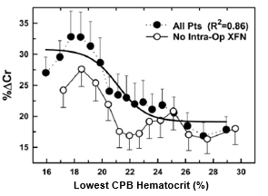
Optimizing Perfusion: Anemia Tolerance & Transfusion
Transfusion Trigger during CPB was 22%
% Cr = The peak postoperative change in serum creatinine level relative to pre-CPB values.
Acute renal injury and failure (ARF) after cardiopulmonary bypass (CPB) has been linked to low on-pump hematocrit.
Increasing rates of AKI are seen as the HCT dips below 20-21% during CPB. Occurs whether the patient is transfused or not. Transfusion itself does increase the risk of AKI.
(Habib, 2005)
Notes:
Habib R, Zacharias A, Schwann, TA, Riordan CJ, et al. (2005). Role of hemodilutional anemia and transfusion during cardiopulmonary bypass in renal injury after coronary revascularization: implications on operative outcome. Crit Care Med. 33(8):1749-56.

Slide 28
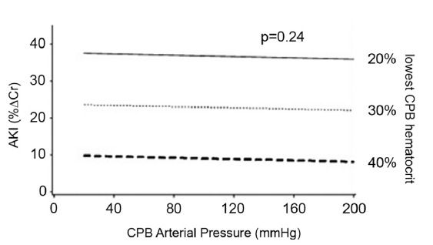
Anemia and Hypotension: Co-Occurrence during CPB
The likelihood of acute kidney injury with CPB anemia does not change with different blood pressure values as measured at the time when the lowest CPB hematocrit occurred.
Hypotension, Anemia Tolerance during CPB and Postoperative Acute Kidney Injury
(Haase, 2012; Sickeler, 2014)
Notes:
Haase M, Bellomo R, Story D, et al. (2012). Effect of mean arterial pressure, haemoglobin and blood transfusion during cardiopulmonary bypass on post-operative acute kidney injury. Nephrol Dial Transplant. 27(1):153-60.
Sickeler R, Phillips-Bute, B, Kertai MD, et al. (2014). The risk of acute kidney injury with co-occurrence of anemia and hypotension during cardiopulmonary bypass relative to anemia alone. Ann Thorac Surg. 97(3):865-71.

Slide 29
Hemodilution and Transfusion
Minimizing hemodilution and avoiding unnecessary transfusion is best practice.
STS Guideline Recommendations
Multidisciplinary and multi modality:
Mini-circuits
Microplegia
Modified ultrafiltration
Blood salvage
(Society of Thoracic Surgeons Blood Conservation Guideline Task Force, 2011)
Notes:
Society of Thoracic Surgeons Blood Conservation Guideline Task Force, Ferraris VA, Brown JR, et al. (2011). 2011 update to the Society of Thoracic Surgeons and the Society of Cardiovascular Anesthesiologists blood conservation clinical practice guidelines. Ann Thorac Surg. 91(3):944-82.

Slide 30
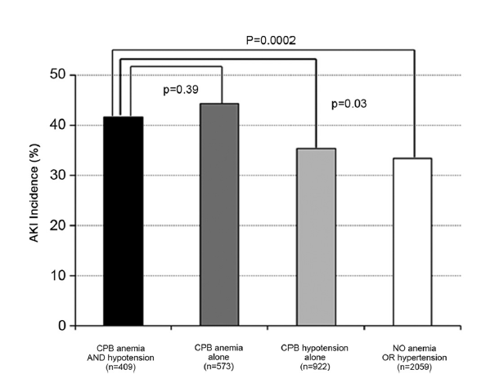
Cardiopulmonary Bypass: Anemia, Hypotension, and AKI
Patients with both anemia and hypotension during CPB did not differ in rates of AKI with those of anemia alone but did differ from patients with hypotension alone and patients with neither anemia or hypotension. (Sickeler, 2014)
Notes:
Sickeler R, Phillips-Bute, B, Kertai MD, et al. (2014). The risk of acute kidney injury with co-occurrence of anemia and hypotension during cardiopulmonary bypass relative to anemia alone. Ann Thorac Surg. 97(3):865-71.

Slide 31
Transfusion Trigger Considerations by Surgical Specialty
Transfusion Trigger Recommendations
General Surgery
Cardiac Surgery
Orthopedic Surgery

Slide 33
Literature Review: Orthopedic Surgery
Total Knee Replacement: Restrictive <8 g/dl and Liberal <10 g/dl
Randomized trial looked at patients with a history of cardiovascular disease whose Hgb level was <10 after hip fracture surgery. Randomly assigned 2016 patients to restrictive (<8) vs liberal (<10). A liberal strategy did NOT reduce rates of death or inability to walk independently on 60 day follow up or reduce in hospital morbidity in elderly pts at high cardiovascular risk
No evidence found that maintaining the Hgb above 10 is superior to maintaining level of 8 with respect to primary outcomes (death or inability to walk across the room without assistance. ¹
Restrictive group received 65% fewer units than liberal group. Also did not find increased rates of MI or CHF in the liberal group.
Hip Fracture: Restrictive: 7.3 g/dL and Liberal: 8.6 g/dL
Liberal group was associated with a statistically significantly faster TUG (Timed Up and Go test) after hip revision surgery compared to restrictive. The clinical importance is questionable and the groups did not differ in Hgb at the time of testing. (Carson, 2011)
Notes:
Carson JL, Terrin ML, Noveck H, et al. (2011) Liberal or restrictive transfusion in high-risk patients after hip surgery. N Engl J Med. 365(26):2453-62.

Slide 34
MARQCI Transfusion Recommendations

Slide 35
Literature Review: Orthopedic Surgery-Spine
Purvis et al. examined 1204 patients receiving at least 1 unit of PRBCs during spine surgery. Perioperative complications occurred in 234 patients. (Purvis, 2018)
Findings suggest the percentage change of Hgb is independently associated with a higher risk of developing any perioperative complication and hospital related infection.
An Hgb decline of 50% or more was associated with an increased risk of ischemic complications and hospital related infections.
An additional study by Purvis et al. investigated the effects of liberal blood transfusion on clinical outcomes of 2,374 spine surgical patients receiving transfusions. (Purvis, 2017)
Transfusion using a liberal trigger is associated with increased morbidity, even after controlling for possible confounders. Morbidity rates were doubled when liberal transfusions were given.
Liberal intraop trigger: ≥10 g/dL
Liberal postop trigger: ≥8 g/dL
Length of stay was longer in patients transfused compared to no transfusion (5-10 days vs. 2-5 days).
Notes:
Purvis TE, Goodwin CR, Garza-Ramos R, et al. (2017). Effect of liberal blood transfusion on clinical outcomes and cost in spine surgery patients. Spine J. 17(9):1255-1263.
Purvis TE, Goodwin CR, Molina CA, et al. (2018). Percentage change in hemoglobin level and morbidity in spine surgery patients. J Neurosurg Spine. 28(3):345-351.

Slide 36
Transfusion Trigger Considerations by Surgical Specialty
Transfusion Trigger Recommendations
General Surgery
Cardiac Surgery
Orthopedic Surgery

Slide 37
Literature Review: General Surgery
Patients with a nadir Hgb of 8-10 undergoing colorectal, pancreatic or liver resection who underwent a PRBC transfusion had a significantly higher LOS and overall in hospital morbidity than those patients who were not transfused. (Ejaz, 2015)
Among patients undergoing gastrointestinal surgery, a percentage change Hgb of 50% or more was associated with a higher risk of postop adverse events and in particular ischemic complications. This was true even in patients whose nadir Hgb did not drop to a restrictive trigger concentration. (Spolverato, 2015)
Incidence of death was significantly lower in patients receiving restrictive transfusion compared to those receiving liberal transfusion for GI Bleed. (Villanueva, 2013; Blair, 1986)
Notes:
Blair SD, Janvrin SB, McCollum CN, Greenhalgh RM. (1986). Effect of early blood transfusion on gastrointestinal haemorrhage. Br J Surg. 73(10):783-5.
Ejaz A, Frank SM, Spolverato G, et al. (2015). Potential Economic Impact of Using a Restrictive Transfusion Trigger Among Patients Undergoing Major Abdominal Surgery. JAMA Surg. 150(7):625-30.
Spolverato G, Kim Y, Ejaz A, et al. (2015). Effect of Relative Decrease in Blood Hemoglobin Concentrations on Postoperative Morbidity in Patients Who Undergo Major Gastrointestinal Surgery. JAMA Surg. 150(10):949-56.
Villanueva C, Colomo A, Bosch A, et al. (2013). Transfusion strategies for acute upper gastrointestinal bleeding. N Engl J Med. 368(1):11-21.

Slide 39
Literature Review: Oncology
Periop transfusions are administered in up to 85% of patients with colorectal cancer and have been shown to increase perioperative and postoperative morbidity and mortality. (Jakobsen, 1990)
Preoperative anemia has been identified as an independent risk factor of poorer prognosis after colon surgery. (Leichtle, 2011)
de Almeida et al. studied 198 surgical oncology patients and found that 30-day mortality was decreased in the liberal strategy group compared to the restrictive transfusion group (8.2% vs. 22.8%). (de Almeida, 2015)
Wehry et al. examined 415 patients undergoing surgery for abdominal malignancy and found that a restrictive transfusion protocol resulted in reduction of percentage of patients transfused with no change in outcomes (mortality, infection, hemorrhage, LOS). (Wehry, 2015)
Notes:
de Almeida JP, Vincent J-L, Galas F, et al. (2015). Transfusion requirements in surgical oncology patients: a prospective, randomized controlled trial. Anesthesiology. 122(1):29-38.
Jakobsen EB, Eickhoff JH, Andersen J, et al. (1990). Perioperative blood transfusion and recurrence and death after resection for cancer of the colon and rectum. Scand J Gastroenterol. 25(5):435-42.
Leichtle SW, Mouawad NJ, Lampman R, et al. (2011). Does preoperative anemia adversely affect colon and rectal surgery outcomes? J Am Coll Surg. 212(2):187-94.
Wehry J, Agle S, Philips P, et al. (2015). Restrictive blood transfusion protocol in malignant upper gastrointestinal and pancreatic resections patients reduces blood transfusions with no increase in patient morbidity. Am J Surg. 210(6):1197-204.

Slide 40
ASPIRE Measure: TRAN 01
Inclusions: All surgical patients receiving anesthetics who receive a transfusion of red blood cells.
Success: Documentation of hemoglobin and/or hematocrit prior to blood transfusion
For the first unit of transfusion, a hemoglobin or hematocrit of any value should be checked in a time period of 0 to 90 minutes before the transfusion, or the most recent documented hemoglobin or hematocrit of less than 8/24 should be within 36 hours of the transfusion
If the last hemoglobin or hematocrit drawn before the first transfusion is ≤ 5/16, a second unit could be administered without rechecking hemoglobin/hematocrit
If multiple units are administered, documentation of a hemoglobin or hematocrit value must be present within 90 minutes before each administration
For pediatric cases (patients < 12 years old): Pre-transfusion hemoglobin/hematocrit required before the first unit and an additional recheck after 15cc/kg of PRBCs have been administered
For cardiopulmonary bypass cases, all transfusions administered between cardiopulmonary bypass start and end will not be included for determining measure results for the case
Responsible Provider: Provider(s) who administered blood product

Slide 41
ASPIRE Measure: TRAN 01
Exclusions:
Massive Transfusion: Transfusion of 4 or more units of blood.
EBL ≥ 2000 ml
Patients < 2 years of age
Patients <12 years old undergoing a cardiac procedure
Patients <12 years old where either transfused PRBC or EBL was greater than 30cc/kg
Burn cases
ASA 5 & 6
Labor Epidurals
Cesarean sections with an EBL > 1500cc.
Cesarean sections with a HR>110, SBP<85, DBP<45, or O2Sat <95%
Postpartum hemorrhage cases

Slide 42
ASPIRE Measure: TRAN 02
Inclusions: Any patient that receives a red blood cell transfusion. Transfusion is defined as packed red blood cells or whole blood
Success: Hematocrit value documented as less than or equal to 30% and/or hemoglobin value documented as less than or equal 10 g/dL
All hemoglobin/hematocrit lab values drawn after the last transfusion and before anesthesia end will be evaluated. If the lowest of these values is ≤10g/dL or ≤30%, the case will pass
If no hemoglobin or hematocrit is drawn after the last transfusion and before anesthesia end, then the first hemoglobin/hematocrit after anesthesia end will be evaluated. If this value is ≤10/30, the case will pass. This measure will only examine lab values up to 6 hours after anesthesia end to identify a hemoglobin or hematocrit value. Once the first hemoglobin or hematocrit value is identified after anesthesia end, additional values will not be considered
No hematocrit or hemoglobin checked within 6 hours of anesthesia end
Responsible Provider: Individual who administered the transfusion

Slide 43
ASPIRE Measure: TRAN 02
Exclusions:
Patients < 2 years of age
Patients <12 years old undergoing a cardiac procedure
Pediatric cases (<12 years old) where either the transfused PRBC or EBL was greater than 30cc/kg
ASA 5 & 6
EBL ≥ 2000ml
Massive Transfusion: Transfusion of 4 or more units of blood
Labor Epidurals
Cesarean sections with an EBL > 1500cc
Cesarean sections with a HR>110, SBP<85, DBP<45, or O2Sat <95%
Postpartum hemorrhage cases

Slide 44
MTQIP Transfusion Measure
For more information, visit MTQIP.

Slide 45
Massive Transfusion Protocols
Develop with multi-disciplinary committee that includes:
Transfusion service/blood bank
Emergency department
Anesthesia
Trauma Service
Massive Transfusion Protocol should address:
Triggers for initiating massive transfusion in trauma
Resuscitation in the trauma bay
MTP Product Availability
MTP Product Delivery
MTP Blood Product Transfusion
Continuing MTP in OR, Angiography suite, ICU
Transfusion service processes for delivery of blood products
Transfusion targets
Use of adjuncts for massive transfusion patients
Termination of MTP
Performance Improvement Monitoring
For more information: American College of Surgeons

Slide 46
Obstetric Hemorrhage Protocol
American College of Obstetrics and Gynecology (ACOG) released the Safe Motherhood Initiative in 2013.
Blood transfusion or cross-matching should not be used as a negative quality marker and is warranted for certain obstetric events.
In cases of severe obstetric hemorrhage, ≥4 units of blood products may be necessary to save the life of a maternity patient.
Hospitals are encouraged to coordinate efforts with their laboratories, blood banks, and quality improvement departments to determine the appropriateness of transfusion and quantity of blood products necessary for these patients.
For more information and resources, please visit the ACOG website: ACOG Obstetric Hemorrhage Bundle

Slide 47
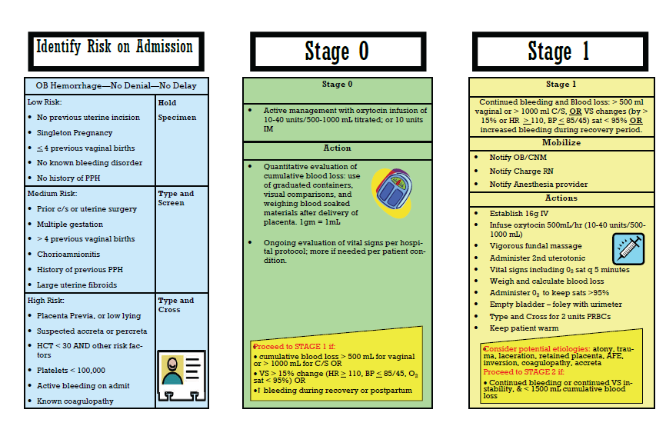
Obstetric Hemorrhage Protocol Pocket Card
(CMQCC, 2015)
Notes:
CMQCC. (03/24/2015). Obstetric Hemorrhage Toolkit. Version 2.0. https://www.scdhhs.gov/sites/default/files/CMQCC%20OB%20Hemorrhage%20Toolkit%20Pocket%20Card.pdf

Slide 48
ASPIRE Recommendations
Use the literature to develop evidence-based institution transfusion protocols and guidelines
Restrictive transfusion protocols should be considered for asymptomatic patients
There is rarely an indication to transfuse any patient with a Hgb >10g/dL
Decision to transfuse should be based on objective assessment of the patient, including Hgb/Hct
In the absence of acute hemorrhage, transfuse one unit at a time
Reassess post-transfusion to determine if additional units are required

Slide 49
Additional Transfusion Resources
ASPIRE Transfusion Toolkit
American College of Obstetrics and Gynecology: Maternal Safety Bundle for Obstetric Hemorrhage
American College of Surgeons: Massive Transfusion Protocol
MARCQI: Blood Transfusion Project- Reducing Transfusion in the MARCQI Population
MTQIP: Proposal for monitoring site performance for massive transfusions (MT)
Blood Conservation in Thoracic Surgery: STS Clinical Guidelines
STS Renal Failure After Cardiac Surgery: Webinar, May 2018

Slide 50
References
Amand T, Pincemail J, Blaffart F, et al. (2002). Levels of inflammatory markers in the blood processed by autotransfusion devices during cardiac surgery associated with cardiopulmonary bypass circuit. Perfusion. 17(2):117-23.
American Red Cross. (2017). A Compendium of Transfusion Practice Guidelines Third Edition 2017. https://www.laboratoryalliance.com/assets/Uploads/Transfusion-Services/TransfusionPractices-Compendium-3rdEdition.pdf
ASA Task Force on Perioperative Blood Management. (2015). Practice guidelines for perioperative blood management: an updated report by the American Society of Anesthesiologists Task Force on Perioperative Blood Management*. Anesthesiology. 122(2):241-75.
Birkmeyer JD, Goodnough LT, AuBuchon JP, et al. (1993). The cost-effectiveness of preoperative autologous blood donation for total hip and knee replacement. Transfusion. 33(7):544-51.
Blair SD, Janvrin SB, McCollum CN, Greenhalgh RM. (1986). Effect of early blood transfusion on gastrointestinal haemorrhage. Br J Surg. 73(10):783-5.
Carson JL, Terrin ML, Noveck H, et al. (2011) Liberal or restrictive transfusion in high-risk patients after hip surgery. N Engl J Med. 365(26):2453-62.

Slide 51
References
Carson JL, Brooks MM, Abbott JD, et al. (2013). Liberal versus restrictive transfusion thresholds for patients with symptomatic coronary artery disease. Am Heart J. 165(6):964-971.e1.
Carson JL, Guyatt G, Heddle NM, et al. (2016). Clinical Practice Guidelines From the AABB: Red Blood Cell Transfusion Thresholds and Storage. JAMA. 15;316(19):2025-2035.
Casey LC. (1993). Role of cytokines in the pathogenesis of cardiopulmonary – induced multisystem organ failure. Ann Thorac Surg. 56(5 Suppl):S92-6.
CMQCC. (03/24/2015). Obstetric Hemorrhage Toolkit. Version 2.0. https://www.scdhhs.gov/sites/default/files/CMQCC%20OB%20Hemorrhage%20Toolkit%20Pocket%20Card.pdf
Côté CL, Yip AM, MacLeod JB, et al. (2016). Efficacy of intraoperative cell salvage in decreasing perioperative blood transfusion rates in first-time cardiac surgery patients: a retrospective study. Can J Surg. 59(5):330-6.
Curley GF, Shehata N, Mazer CD, et al. (2014). Tranfusion triggers for guiding RBC transfusion for cardiovascular surgery: a systematic review and meta-analysis*. Crit Care Med. 42(12):2611-24.
Daane CR, Golab HD, Meeder JHJ, et al. (2003). Processing and transfusion of residual cardiopulmonary bypass volume: effects on haemostasis, complement activation, postoperative blood loss and transfusion volume. Perfusion. 18(2):115-21.

Slide 52
References
de Almeida JP, Vincent J-L, Galas F, et al. (2015). Transfusion requirements in surgical oncology patients: a prospective, randomized controlled trial. Anesthesiology. 122(1):29-38.
Docherty AB, O’Donnell R, Brunskill S, et al. (2016). Effect of restrictive versus liberal transfusion strategies on outcomes in patients with cardiovascular disease in a non-cardiac surgery setting: systematic review and meta-analysis. BMJ. 352:i1351.
Ejaz A, Frank SM, Spolverato G, et al. (2015). Potential Economic Impact of Using a Restrictive Transfusion Trigger Among Patients Undergoing Major Abdominal Surgery. JAMA Surg. 150(7):625-30.
Engelhardt W, Blumenberg D. (1991). Risk and side effects of intraoperative autotranfusion. Beitr Infusionsther. 28:317-21
Glance LG, Dick AW, Mukamel DB, et al. (2011). Association between intraoperative blood transfusion and mortality and morbidity in patients undergoing noncardiac surgery. Anesthesiology. 11;114(2):283-92.
Goodnough LT, Shander A. (2012). Patient blood management. Anesthesiology. 116(6):1367-76.
Haase M, Bellomo R, Story D, et al. (2012). Effect of mean arterial pressure, haemoglobin and blood transfusion during cardiopulmonary bypass on post-operative acute kidney injury. Nephrol Dial Transplant. 27(1):153-60.

Slide 53
References
Habib R, Zacharias A, Schwann TA, et al. (2003). Adverse effects of low hematocrit during cardiopulmonary bypass in the adult: should current practice be changed? J Thorac Cadiovasc Surg. 125(6):1438-50.
Habib R, Zacharias A, Schwann, TA, Riordan CJ, et al. (2005). Role of hemodilutional anemia and transfusion during cardiopulmonary bypass in renal injury after coronary revascularization: implications on operative outcome. Crit Care Med. 33(8):1749-56.
Jakobsen EB, Eickhoff JH, Andersen J, et al. (1990). Perioperative blood transfusion and recurrence and death after resection for cancer of the colon and rectum. Scand J Gastroenterol. 25(5):435-42.
Leichtle SW, Mouawad NJ, Lampman R, et al. (2011). Does preoperative anemia adversely affect colon and rectal surgery outcomes? J Am Coll Surg. 212(2):187-94.
Mueller MM, Remoortel HV, Meybohm P, et al. (2019). Patient Blood Management: Recommendations From the 2018 Frankfurt Consensus Conference. JAMA. 321(10):983-997.
National Clinical Guideline Centre (UK). (2015). Blood Transfusion. London: National Institute for Health and Care Excellence (NICE). Nov 2015. PMID: 26632625 Bookshelf: NBK327570.
Niranjan G, Asimakopoulos G, Karagounis A, et al. (2006). Effects of cell saver autologous blood transfusion on blood loss and homologous blood transfusion requirements in patients undergoing cardiac surgery on – versus off – cardiopulmonary bypass: a randomised trial. Eur J Cardiothorac Surg. 30(2):271-7.
.

Slide 54
References
Pfizer Medical Information. Retacrit Indications and Usage (epoetin alfa-epbx). https://www.pfizermedicalinformation.com/en-us/retacrit/indications-usage
Purvis TE, Goodwin CR, Garza-Ramos R, et al. (2017). Effect of liberal blood transfusion on clinical outcomes and cost in spine surgery patients. Spine J. 17(9):1255-1263.
Purvis TE, Goodwin CR, Molina CA, et al. (2018). Percentage change in hemoglobin level and morbidity in spine surgery patients. J Neurosurg Spine. 28(3):345-351.
Reents W, Babib-Ebell J, Misoph MR, et al. (1999). Influence of different autotransfusion devices on the quality of salvaged blood. Ann Thorac Surg. 68(1)58-62.
Salpeter SR, Buckley JS, Chatterjee S. (2014). Impact of more restrictive blood transfusion strategies on clinical outcomes: a meta-analysis and systematic review. AM J Med. 127(2):124-131.e3.
Sandoval S, Alrawi S, Samee M, et al. (2001). A cytokine analysis of the effect of cell saver on blood in coronary bypass surgery. Heart Surg Forum. 4(2):113-7.
Shander A, Rijhwani TS. (2004). Acute normovolemic hemodilution. Transfusion. 44(12 Suppl):26S-34S.
Sickeler R, Phillips-Bute, B, Kertai MD, et al. (2014). The risk of acute kidney injury with co-occurrence of anemia and hypotension during cardiopulmonary bypass relative to anemia alone. Ann Thorac Surg. 97(3):865-71.

Slide 55
References
Society of Thoracic Surgeons Blood Conservation Guideline Task Force, Ferraris VA, Brown JR, et al. (2011). 2011 update to the Society of Thoracic Surgeons and the Society of Cardiovascular Anesthesiologists blood conservation clinical practice guidelines. Ann Thorac Surg. 91(3):944-82.
Spahn DR, Muñoz M, Klein AA, et al. (2020). Patient Blood Management: Effectiveness and Future Potential. Anesthesiology. 133(1):212-222.
Spolverato G, Kim Y, Ejaz A, et al. (2015). Effect of Relative Decrease in Blood Hemoglobin Concentrations on Postoperative Morbidity in Patients Who Undergo Major Gastrointestinal Surgery. JAMA Surg. 150(10):949-56.
Villanueva C, Colomo A, Bosch A, et al. (2013). Transfusion strategies for acute upper gastrointestinal bleeding. N Engl J Med. 368(1):11-21.
Wehry J, Agle S, Philips P, et al. (2015). Restrictive blood transfusion protocol in malignant upper gastrointestinal and pancreatic resections patients reduces blood transfusions with no increase in patient morbidity. Am J Surg. 210(6):1197-204.

