Slide 1
Avoiding Surgical Site Infections

Slide 2
Objectives
Define surgical site infection classifications and related pathophysiology
Discuss risks and outcomes associated with surgical site infections (SSIs)
Provide overview of anesthesia related elements in the SSI Prevention Bundle:
Describe ASPIRE measures supporting SSI prevention
Summarize recommendations based on literature presented

Slide 3
Surgical Site Infections (SSIs) Definitions
CDC definition: an infection that occurs after surgery in the part of the body where the surgery took place. (CDC, 2010)
SSIs are classified by depth and tissue spaces involved: (CDC, 2010; Anderson, 2014)
Superficial Incisional: Involves only skin and subcutaneous tissue
Deep Incisional: Involves the fascia or muscle tissue
Organ Space: Involves any part of the body opened or manipulated during a procedure (excluding the skin or muscle tissue)
Notes:
Anderson DJ, Podgorny K, Berrios-Torres SI, et al. (2014). Strategies to prevent surgical site infections in acute care hospitals: 2014 update. Infect Control Hosp Epidemiol. 35 Suppl 2:S66-88. PMID: 25376070.
Centers for Disease Control and Prevention. (November 24, 2010). Surgical Site Infection (SSI). Centers for Disease Control and Prevention. Accessed on July 9, 2019. https://www.cdc.gov/hai/ssi/ssi.html.

Slide 4
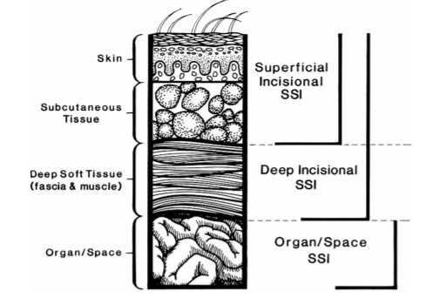
SSI Classification
(Horan, 1992)
Notes:
Horan TC, Gaynes RP, Martone WJ, et al. (1992). CDC definitions of nosocomial surgical site infections, 1992: a modification of CDC definitions of surgical wound infections. Infect Control Hosp Epidemiol. 13(10):606-608.

Slide 5
Impact of Surgical Site Infections
Incidence: 2-5% in patients undergoing inpatient surgery. (Anderson, 2014)
Between 160,000 and 300,000 infections per year in the United States. (Anderson, 2014; Magill, 2014)
A single SSI is associated with 7-11 additional postoperative hospital days. (Anderson, 2014)
Greater than 90,000 readmissions annually in the US
75% of deaths among patients with SSI are directly attributable to SSI
Annual cost of SSI in the US: $3.5 to $10 billion
Increases cost of hospital admission by $20,000 per admission
Notes:
Anderson DJ, Podgorny K, Berrios-Torres SI, et al. (2014). Strategies to prevent surgical site infections in acute care hospitals: 2014 update. Infect Control Hosp Epidemiol. 35 Suppl 2:S66-88. PMID: 25376070.
Magill SS, Edwards JR, Bamberg W, et al. (2014). Multistate point-prevalence survey of health care-associated infections. N Engl J Med. 370(13):1198-208.

Slide 6
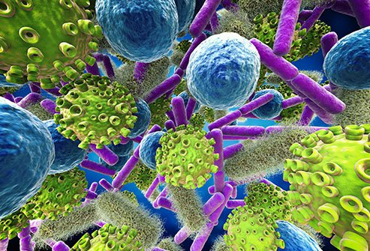
Pathophysiology Overview
Surgical incision exposes tissue to:
Endogenous flora, including common bacteria of the skin, gastrointestinal tract, gynecologic tract
External bacteria from OR staff, equipment, environment, materials (implant or mesh). (Bratzler, 2013)
Predominant organisms causing SSI after clean procedures are skin flora, including Staphylococcus aureus (30%) and coagulase-negative staphylococci. (Hidron, 2008)
Of the S. aureus infections, 49.2% were found to methicillin-resistant staphyloccus aureus (MRSA)
MRSA infections are associated with higher mortality rates, longer hospital stays, and higher hospital costs. (Weigelt, 2010)
In clean-contaminated procedures (abdominal procedures, kidney, liver transplants): gram-negative rods and enterococci + skin flora are the most common isolates. (Bratzler, 2013)
Notes:
Bratzler DW, Dellinger EP, Olsen KM, et al. (2013). Clinical practice guidelines for antimicrobial prophylaxis in surgery. Surg Infect (Larchmt). 14(1):73-156.
Hidron AI, Edwards JR., Patel J, et al. (2008). NHSN annual update: antimicrobial-resistant pathogens associated with healthcare-associated infections: annual summary of data reported to the National Healthcare Safety Network at the Centers for Disease Control and Prevention, 2006-2007. Infect Control Hosp Epidemiol. 29(11):996-1011
Weigelt JA, Lipsky BA, Tabak YP, et al. (2010). Surgical site infections: Causative pathogens and associated outcomes. Am J Infect Control. 38(2):112-20.

Slide 7
Pathophysiology
Temperature:
Hypothermia triggers vasoconstriction and subsequent tissue hypoxia which impairs wound healing. In addition, hypothermia may also impair neutrophil function, reducing the bodies natural protection against infection. (Sessler, 1997; Sessler, 2000; Sessler 2016)
Glucose:
Stress of surgery triggers cortisol release which creates an imbalance between hepatic glucose production/utilization resulting in Hyperglycemia. Elevated blood glucose levels impair neutrophil function and cause an overproduction of inflammatory mediators and immune dysfunction. The amount of imbalance depends on the severity of surgery & type of anesthesia. (Clarke, 1970; Duggan, 2017; Farrokhi, 2011)
Fluid Management:
Hypovolemia leads to insufficient circulation with decreased oxygen delivery to organs and peripheral tissues. Hypervolemia causes interstitial edema, local inflammation and impairs collagen regeneration. Either fluid imbalance in surgical patients can therefore result in impaired wound healing and subsequent surgical site infections.(Jonsson, 1991)
OR Traffic:
Each person sheds millions of particles per day and 5-10% of skin debris is known to carry bacteria and opening the OR door increases the number of bacteria in the air. (Scaltriti, 2007)
Surgical Prep:
Shaving at the surgical site causes micro-abrasions on the skin’s surface, creating another opportunity for bacteria to enter the surgical site and cause an infection. (Mangram, 1999) Chlorhexidine gluconate (CHG) molecules are able to attach to bacterial cell walls, disturbing its osmotic equilibrium which inhibits further cell growth.(Edmiston, 2013)
Notes:
Clarke RS. (1970). The hyperglycaemic response to different types of surgery and anaesthesia. Br J Anaesth. 42(1):45-53.
Duggan EW, Carlson K, Umpierrez GE. (2017). Perioperative Hyperglycemia Management: An Update. Anesthesiology. 126(3):547-560.
Edmiston CE Jr, Bruden B, Rucinski MC, et al. (2013). Reducing the risk of surgical site infections: does chlorhexidine gluconate provide a risk reduction benefit? Am J Infect Control. 41(5 Suppl): S49-55.
Farrokhi F, Smiley D, Umpierrez GE. (2011). Glycemic control in non-diabetic critically ill patients. Best Pract Res Clin Endocrinol Metab. 25(5):813-824.
Jonsson K, Jensen JA., Goodson WH 3rd, et al. (1991). Tissue oxygenation, anemia, and perfusion in relation to wound healing in surgical patients. Ann Surg, 214(5):605-613.
Mangram AJ, Horan TC, Pearson ML, et al. (1999). Guideline for Prevention of Surgical Site Infection, 1999. Centers for Disease Control and Prevention (CDC) Hospital Infection Control Practices Advisory Committee. Am J Infect Control. 27(2):97-132; quiz 133-134; discussion 196.
Scaltriti S, Cencetti S, Rovesti S, et al. (2007). Risk factors for particulate and microbial contamination of air in operating theatres. J Hosp Infect. 66(4):320-6.
Sessler DI. (1997). Mild perioperative hypothermia. N Engl J Med. 336(24):1730-7.
Sessler DI. (2000). Perioperative heat balance. Anesthesiology. 92(2):578-96.
Sessler DI. (2016). Perioperative thermoregulation and heat balance. Lancet. 387(10038):2655-2664.

Slide 8
Risk Factors: Intrinsic
Modifiable
Glycemic Control
Non-Modifiable
Age
Alcohol/Smoking Status
Preop Albumin <3.5 mg/dL
Obesity
Recent Radiotherapy
History of skin/soft tissue infection
(Ban, 2017)
Notes:
Ban KA, Minei JP, Laronga C, et al. (2017). Executive Summary of the American College of Surgeons/Surgical Infection Society Surgical Site Infection Guidelines-2016 Update. Surg Infect (Larchmt). 18(4):379-382.

Slide 9
Impact of Smoking
Smoking increases oxidative stress which reduces tissue perfusion/oxygenation, impairs the bactericidal mechanisms of neutrophils and decreases overall proliferation of inflammatory cells.
High reactivity of neutrophils (20% increase in cell count) with an overall deficiency of neutrophils and deranged monocyte-macrophage behavior.
Inflammatory cellular response is delayed, chemotaxis and migration of neutrophils is impaired.
Cigarette smoke significantly impairs the phagocytic activity of neutrophils
Primary bactericidal mechanism impaired by smoking: The release of oxygen radicals by neutrophils and monocyte-macrophages. The oxidative burst of white blood cells and the release of oxygen radicals is how surgical pathogens such as Staphylococcus aureus and Escherichia coli are eliminated.
The concentration of fibronectin is higher in smokers due to the oxidative injury of vascular endothelial cells and is suggestive of a decrease in inflammatory stimulatory wound components. (Sorensen, 2012)
Notes:
Sorensen LT. (2012). Wound healing and infection in surgery: the pathophysiological impact of smoking, smoking cessation, and nicotine replacement therapy: a systematic review. Ann Surg. 255(6):1069-79.

Slide 10
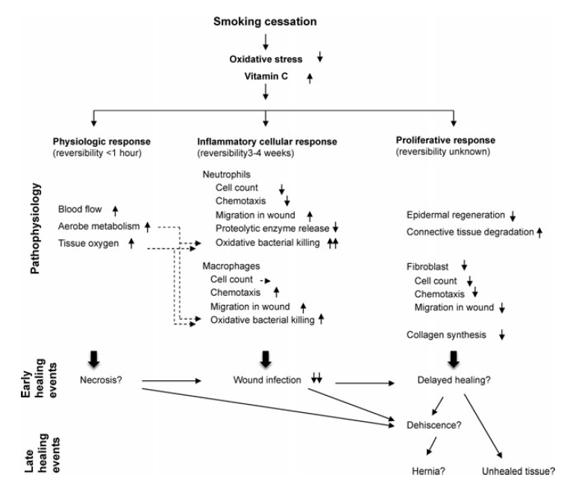
Impact of Smoking Cessation
Within one hour of smoking cessation, tissue oxygenation, aerobe metabolism and blood flow are normalized.
Within 3-4 weeks of smoking cessation inflammatory cell function is restored increasing proteolytic enzyme release and oxidative killing mechanism.
The damage to fibroblasts, epidermal regeneration and collagen degradations from smoking is not affected by smoking cessation. (Sorensen, 2012)
Notes:
Sorensen LT. (2012). Wound healing and infection in surgery: the pathophysiological impact of smoking, smoking cessation, and nicotine replacement therapy: a systematic review. Ann Surg. 255(6):1069-79.

Slide 11
Impact of Obesity
Patients who are obese (BMI 30-40 kg/m2) or morbidly obese (BMI ≥ 40 kg/m2) have a higher incidence of both deep and superficial SSIs when compared to patients with a normal weight.
A retrospective analysis of ACS-NSQIP data (n = 89,148) found obese/morbidly obese patients undergoing clean or clean-contaminated procedures to have a significant increased risk of developing superficial or deep tissue SSIs. There was no significant increase in organ/space SSIs.
BMI has been shown to influence an increased risk of deep SSIs in 6 surgery types.
Cardiothoracic, Breast, Gastrointestinal, Orthopedics, Gynecology/Obstetrics, Neurosurgery
Increased thickness of subcutaneous tissue raises the risk of SSIs. Adipose tissue is less vascularized and therefore poorly oxygenated causing delayed wound healing and necrosis of local tissue. Poor tissue vascularization may also prevent adequate tissue concentrations of prophylactic antibiotics.
Technical Difficulties during surgery on patients with a high BMI relating to SSI risk:
Increased wound surface area with consistent tension pulling on the healing wound increasing the risk of wound dehiscence.
A large amount of adipose tissue near the incision can result in longer operation times. (Meijs, 2019; Winfield, 2016)
Notes:
Meijs AP, Koek MBG, Vos MC, et al. (2019). The effect of body mass index on the risk of surgical site infection. Infect Control Hosp Epidemiol. 40(9):991-996.
Winfield RD, Reese S, Bochicchio K, et al. (2016). Obesity and the Risk for Surgical Site Infection in Abdominal Surgery. Am Surg. 82(4):331-6.

Slide 12
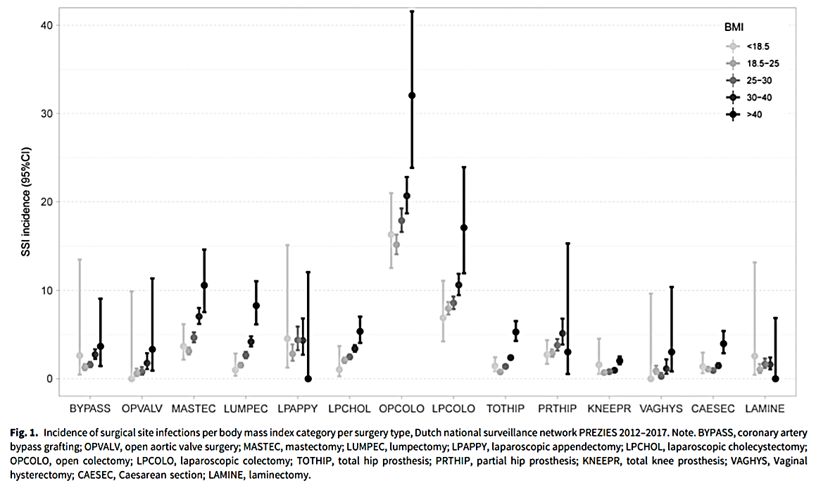
SSI Incidence and BMI
(Meijs, 2019)
Notes:
Meijs AP, Koek MBG, Vos MC, et al. (2019). The effect of body mass index on the risk of surgical site infection. Infect Control Hosp Epidemiol. 40(9):991-996.

Slide 13
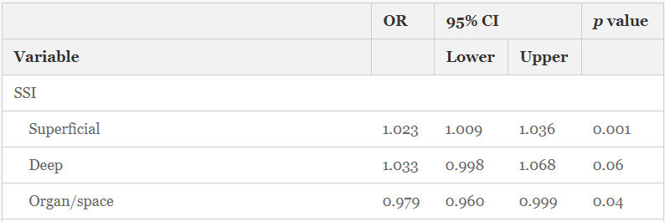
Impact of Obesity
Findings from the largest retrospective study to evaluate weight loss in relation to 30-day postoperative outcomes (n = 394,016) utilized data from the Metabolic and Bariatric Surgery Accreditation and Quality Improvement Program (MBSAQIP)
Unsafe weight loss prior to bariatric surgery increases the risk of superficial SSIs and is most likely due to a compromised nutrition status.
Each additional percent body weight loss was associated with a 2.3% increase in superficial SSIs. There was no correlation between preoperative weight loss and organ/space or deep tissue SSIs. (Tewkesbury, 2019)
Notes:
Tewksbury C, Crowley N, Parrott JM, et al. (2019). Weight Loss Prior to Bariatric Surgery and 30-Day Mortality, Readmission, Reoperation, and Intervention: an MBSAQIP Analysis of 349,016 Cases. Obes Surg. 29(11):3622-3628.

Slide 14
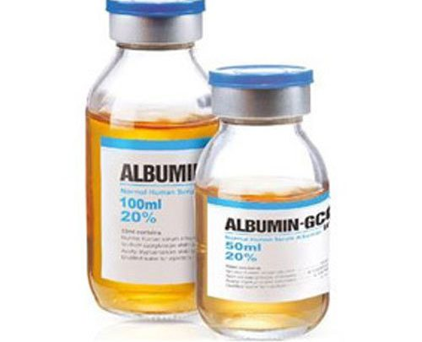
Low Albumin Lab Values
Low serum albumin levels associated with dehydration, inflammation, infection and poor nutritional status.
Impaired immune response: decreased proliferation of lymphocytes, macrophages, and fibroblast proliferation.
Decrease in collagen synthesis and granulation formation.
During the proliferative phase of wound healing, vascular permeability is increased allowing collagen crosslinking to occur.
Collagen increases the strength of wounds and the remodeling of collagen is adversely impacted by protein deficiency → Increases the risk of dehiscence of surgical wound.
Serum albumin as a preoperative marker related to 6 mo. mortality in patients aged >65 undergoing major surgery
A meta-analysis conducted by Yuwen et. al (2017) demonstrated that patients undergoing orthopedic surgery who have a preoperative albumin level <3.5 g/dL had a 2.5x increased risk of developing an SSI postoperatively. This outcome was statistically significant (p < 0.05). (Banz, 2011; Quain, 2015; Son, 2018; Yuwen, 2017)
Notes:
Banz VM, Jakob SM, Inderbitzin D. (2011). Review article: improving outcome after major surgery: pathophysiological considerations. Anesth Analg. 112(5):1147-55.
Quain AM, Khardori NM. (2015). Nutrition in Wound Care Management: A Comprehensive Overview. Wounds. 27(12):327-35.
Son HJ, Roh JL, Choi SH, et al. (2018). Nutritional and hematologic markers as predictors of risk of surgical site infection in patients with head and neck cancer undergoing major oncologic surgery. Head Neck. 40(3):596-604.
Yuwen P, Chen W, Lv H, et al. (2017). Albumin and surgical site infection risk in orthopaedics: a meta-analysis. BMC Surg. 17(1):7.

Slide 15
Non-Modifiable Risk Factors
Age: Older patients at higher risk for SSIs
Cardiac muscle in older patients limits the heart’s contractile ability decreasing stroke volume and cardiac output. Minimizing cardiac output limits the delivery of nutrients and neutrophils to the incision site
Reduced ability to overcome hypoxia due to reduced lung surface area
Malnutrition and involuntary weight loss are common hindering the immune response
Recent Radiotherapy
Causes inflammation and limits microcirculation of blood to tissues
History of skin/soft tissue infection
Independent preoperative risk factor and strongly predictive for SSI
Open wound or skin infection serves as a host for bacteria which can progress to a secondary infection
Skin infections should be treated prior to a scheduled procedure. (Banz, 2011; Moreno Elola-Olaso, 2012; Thorgersen, 2017)
Notes:
Banz VM, Jakob SM, Inderbitzin D. (2011). Review article: improving outcome after major surgery: pathophysiological considerations. Anesth Analg. 112(5):1147-55.
Moreno Elola-Olaso A, Davenport DL, Hundley JC, et al. (2012). Predictors of surgical site infection after liver resection: a multicentre analysis using National Surgical Quality Improvement Program data. HPB (Oxford). 14(2):136-41.
Thorgersen EB, Goscinski MA, Spasojevic M, et al. (2017). Deep Pelvic Surgical Site Infection After Radiotherapy and Surgery for Locally Advanced Rectal Cancer. Ann Surg Oncol. 24(3):721-728.

Slide 16
Strategies for SSI Prevention
The use of care bundles is widely supported in the SSI prevention literature:
Tanner et al. (2015) examined 13 studies and found that the most common bundle elements included antibiotic administration, (clipper) hair removal, glycemic control, and normothermia. Meta-analysis found the SSI rate in the bundle group to be 7% as compared to the standard group at 15.1%. (Tanner, 2015)
In a prospective quality improvement study, Lippitt et al. (2017) found the bundle approach to be successful in reducing surgical site infections for women undergoing cytoreductive surgery for ovarian cancer. A total of 219 women were enrolled in the study. Prebundle SSI rate was 20% and postbundle the rate was reduced to 3%. (Lippitt, 2017)
However, there is a lack of consensus on the components of an effective bundle to prevent SSIs. (Anderson, 2014; Ban, 2017; Lippitt, 2017; Tanner, 2015)
Notes:
Anderson DJ, Podgorny K, Berrios-Torres SI, et al. (2014). Strategies to prevent surgical site infections in acute care hospitals: 2014 update. Infect Control Hosp Epidemiol. 35 Suppl 2:S66-88. PMID: 25376070.
Ban KA, Minei JP, Laronga C, et al. (2017). Executive Summary of the American College of Surgeons/Surgical Infection Society Surgical Site Infection Guidelines-2016 Update. Surg Infect (Larchmt). 18(4):379-382.
Lippitt MH, Fairbairn MG, Matsuno R, et al. (2017). Outcomes Associated With a Five-Point Surgical Site Infection Prevention Bundle in Women Undergoing Surgery for Ovarian Cancer. Obstet Gynecol. 130(4):756-764.
Tanner J, Padley W, Assadian O, et al. (2015). Do surgical care bundles reduce the risk of surgical site infections in patients undergoing colorectal surgery? A systematic review and cohort meta-analysis of 8,515 patients. Surgery. 158(1):66-77.

Slide 17
Common SSI Bundle Elements
Majority of bundles include the following elements & will be the focus of our toolkit:
Antibiotic Dosing, Timing, and Selection. (Anderson, 2014; Ban, 2017; Berrios-Torres, 2017; Dellinger, 2005; Tanner, 2015)
Normothermia. (Anderson, 2014; Ban, 2017; Berrios-Torres, 2017; Dellinger, 2005; Tanner, 2015)
Glycemic Control. (Anderson, 2014; Ban, 2017; Berrios-Torres, 2017; Dellinger, 2005; Tanner, 2015)
Oxygenation. (Anderson, 2014; Ban, 2017; Berrios-Torres, 2017; Dellinger 2005)
Fluid Management. (Anderson, 2014)
Hair Removal. (Anderson, 2014; Ban, 2017; Dellinger, 2005; Tanner, 2015)
Reducing OR Traffic. (Anderson, 2014)
Skin Prep. (Anderson, 2014; Ban, 2017; Berrios-Torres, 2017)
Notes:
Anderson DJ, Podgorny K, Berrios-Torres SI, et al. (2014). Strategies to prevent surgical site infections in acute care hospitals: 2014 update. Infect Control Hosp Epidemiol. 35 Suppl 2:S66-88. PMID: 25376070.
Ban KA, Minei JP, Laronga C, et al. (2017). Executive Summary of the American College of Surgeons/Surgical Infection Society Surgical Site Infection Guidelines-2016 Update. Surg Infect (Larchmt). 18(4):379-382.
Berríos-Torres SI, Umscheid CA, Bratzler DW, et al. (2017). Centers for Disease Control and Prevention Guideline for the Prevention of Surgical Site Infection, 2017. JAMA Surg. 152(8):784-791.
Dellinger EP, Hausmann SM, Bratzler DW, et al. (2005). Hospitals collaborate to decrease surgical site infections. Am J Surg. 190(1):9-15.
Tanner J, Padley W, Assadian O, et al. (2015). Do surgical care bundles reduce the risk of surgical site infections in patients undergoing colorectal surgery? A systematic review and cohort meta-analysis of 8,515 patients. Surgery. 158(1):66-77.

Slide 18
Bundle Element #1: Antimicrobial Prophylaxis

Slide 19
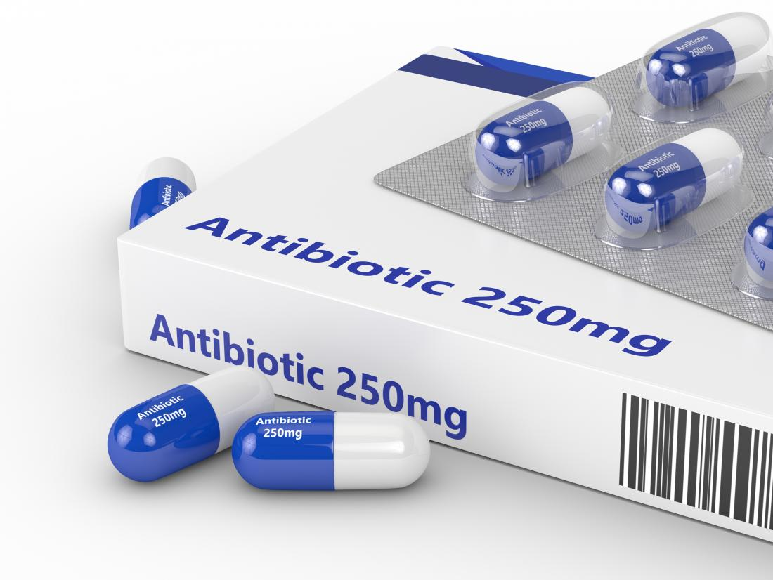
Overview of Antibiotics
Administration of surgical antimicrobial prophylaxis reduces the risk of SSI after various procedures. (Alexander, 2011; Anderson, 2014; Ban, 2017; Baum, 1981; Berrios-Torres, 2017; Bratzler, 2013; Hasselgren, 1984; Platt, 1990; Steinberg, 2009)
Timing should aim to establish bactericidal concentrations in the serum and tissue at time of incision. (Berrios-Torres, 2017)
Most guidelines suggest administration within 60 minutes before surgical incision (120 minute for vancomycin or fluoroquinolones). (Anderson, 2014; Ban, 2017; Bratzler, 2013)
Some studies recommend administration of cephalosporins within 30 minutes before surgical incision. (Alexander, 2011; Hasselgren, 1984)
Selection of the appropriate antimicrobial agents should be based on procedure to target the most common pathogens to cause SSI for indicated procedure. (Anderson, 2014; Ban, 2017; Bratzler, 2013)
Notes:
Alexander JW, Solomkin JS, Edwards MJ. (2011). Updated recommendations for control of surgical site infections. Ann Surg. 253(6):1082-1093.
Anderson DJ, Podgorny K, Berrios-Torres SI, et al. (2014). Strategies to prevent surgical site infections in acute care hospitals: 2014 update. Infect Control Hosp Epidemiol. 35 Suppl 2:S66-88. PMID: 25376070.
Ban KA, Minei JP, Laronga C, et al. (2017). Executive Summary of the American College of Surgeons/Surgical Infection Society Surgical Site Infection Guidelines-2016 Update. Surg Infect (Larchmt). 18(4):379-382.
Baum ML, Anish DS, Chalmers TC, et al. (1981). A survey of clinical trials of antibiotic prophylaxis in colon surgery: evidence against further use of no-treatment controls. N Engl J Med. 305(14):795-9.
Berríos-Torres SI, Umscheid CA, Bratzler DW, et al. (2017). Centers for Disease Control and Prevention Guideline for the Prevention of Surgical Site Infection, 2017. JAMA Surg. 152(8):784-791.
Bratzler DW, Dellinger EP, Olsen KM, et al. (2013). Clinical practice guidelines for antimicrobial prophylaxis in surgery. Surg Infect (Larchmt). 14(1):73-156.
Hasselgren PO, Ivarsson L, Risberg B, Seeman T. (1984). Effects of prophylactic antibiotics in vascular surgery. A prospective, randomized, double-blind study. Ann Surg. 200(1):86-92.
Platt R, Zaleznik DF, Hopkins CC, et al. (1990). Perioperative antibiotic prophylaxis for herniorrhaphy and breast surgery. N Engl J Med. 322(3):153-160.
Steinberg JP, Braun BI, Hellinger WC, et al. (2009). Timing of antimicrobial prophylaxis and the risk of surgical site infections: results from the Trial to Reduce Antimicrobial Prophylaxis Errors. Ann Surg. 250(1):10-16.

Slide 20
Society for Healthcare Epidemiology of America (SHEA) Guidelines 2014 ⁴
Antimicrobial Prophylaxis Recommendations:
Administer antimicrobial prophylaxis according to evidence-based standards and guidelines
Timing: Begin administration within 1 hour before incision (within 2 hours for vancomycin and fluoroquinolones)
Select appropriate antimicrobial agents based on procedure: target the most common pathogens to cause SSI for procedure
Discontinue antimicrobial agent within 24 hours of surgery
No added efficacy beyond 24 hours
Increased risk of C-diff and resistance
Adjust dosing based on patient weight
Redose prophylactic antimicrobial agents for long procedures or excessive blood loss
Colorectal procedures: Use parenteral and oral antimicrobials agents. (Anderson, 2014)
Notes:
Anderson DJ, Podgorny K, Berrios-Torres SI, et al. (2014). Strategies to prevent surgical site infections in acute care hospitals: 2014 update. Infect Control Hosp Epidemiol. 35 Suppl 2:S66-88. PMID: 25376070.

Slide 21
CDC Guideline for the Prevention of SSI- Antimicrobial Prophylaxis ¹⁰
Administer preoperative antimicrobial agents according to clinical practice guidelines (Category 1B- strong recommendation-accepted practice)
Timing should aim to establish bactericidal concentrations in the serum and tissue at time of incision (Category 1B- strong recommendation- accepted practice)
Cesarean sections: administer prophylaxis before surgical incision (Category 1A- strong recommendation; high quality evidence)
In clean and clean-contaminated procedures: do not administer additional antimicrobial prophylaxis after surgical incision is closed, even if drain is placed. (Category 1A- strong recommendation; high-quality evidence)
Do not apply antimicrobial agents (solutions, ointments, powders) to the surgical incision to prevent SSI. (Category 1B- strong recommendation; low-quality evidence). (Berrios-Torres, 2017)
Notes:
Berríos-Torres SI, Umscheid CA, Bratzler DW, et al. (2017). Centers for Disease Control and Prevention Guideline for the Prevention of Surgical Site Infection, 2017. JAMA Surg. 152(8):784-791.

Slide 22
American College of Surgeons and Surgical Infection Society- 2016 ⁶
Administer antimicrobial prophylaxis only when indicated
Select appropriate antimicrobial agents based on procedure: target the most common pathogens to cause SSI for procedure
Prophylaxis should be administered within 1 hour before incision or within 2 hours for vancomycin or fluoroquinolones
Prophylactic antibiotic dosing should be weight based
Re-dose antibiotics to maintain adequate tissue levels based on agent half-life or for every 1,500 mL blood loss
Prophylactic antibiotics should be discontinued at time of incision closure (possible exceptions: implant-based breast reconstructions, joint arthroplasty, cardiac procedures). (Ban, 2017)
Notes:
Ban KA, Minei JP, Laronga C, et al. (2017). Executive Summary of the American College of Surgeons/Surgical Infection Society Surgical Site Infection Guidelines-2016 Update. Surg Infect (Larchmt). 18(4):379-382.

Slide 23
Clinical Practice Guidelines for Antimicrobial Prophylaxis - ASHP
Timing: Within 60 minutes before surgical incision (within 120 minutes for vancomycin and fluoroquinolones)
Dosing:
Dosing should be weight-based, specifically in obese patients
All patients require re-dosing if the duration of the procedure extends beyond 2 half-lives of the drug or if there is excessive blood loss
Selection: ASHP Guidelines provide recommendations for antimicrobial agents for specific surgical procedures as well as alternative agents
Duration of prophylaxis: Single dose is sufficient in most instances; continue for less than 24 hours even if drains or catheters are present
Routine use of vancomycin prophylaxis is not recommended for any procedure. (Bratzler, 2013)
Notes:
Bratzler DW, Dellinger EP, Olsen KM, et al. (2013). Clinical practice guidelines for antimicrobial prophylaxis in surgery. Surg Infect (Larchmt). 14(1):73-156.

Slide 24
World Health Organization Recommendations - 2016
Perioperative surgical antibiotic prophylaxis should not be continued after the completion of the operation, even if a wound drain is present
Intraoperative antibiotic incisional wound irrigation should not be used. (WHO, 2018)
Notes:
WHO Guidelines Approved by the Guidelines Review Committee. (2018). Global Guidelines for the Prevention of Surgical Site Infection. Geneva: World Health Organization.

Slide 25
Summary of Antibiotic Recommendations
Selection:
Administer antimicrobial prophylaxis according to evidence-based standards and guidelines
Select appropriate antimicrobial agents based on procedure: target the most common pathogens to cause SSI for procedure
Dosing:
Weight-based dosing, specifically in obese patients
All patients require re-dosing if the duration of the procedure extends beyond 2 half-lives of the drug or if there is excessive blood loss (>1500mL)
Timing:
Begin administration within 1 hour before incision (within 2 hours for vancomycin and fluoroquinolones)
Duration:
Discontinue antimicrobial agent within 24 hours of surgery, even in the presence of drains

Slide 26
Bundle Element #2: normothermia

Slide 27
Hypothermia Explained
Hypothermia commonly occurs during and after surgery due to impairment of thermoregulation caused by anesthesia medications and exposure to the cold environment of the operating room. (Sessler, 1997; Sessler, 2000; Sessler 2016)
Redistribution of body heat from the core to the periphery decreases the core temperature 1-1.5 degrees Celsius during the first hour of anesthesia.
After hour one of surgery, core temperature decreases at a slower rate.
Pre-warming allows the peripheries to warm and decrease the overall impact to core temperature changes when redistribution occurs.
Notes:
Sessler DI. (1997). Mild perioperative hypothermia. N Engl J Med. 336(24):1730-7.
Sessler DI. (2000). Perioperative heat balance. Anesthesiology. 92(2):578-96.
Sessler DI. (2016). Perioperative thermoregulation and heat balance. Lancet. 387(10038):2655-2664.

Slide 28
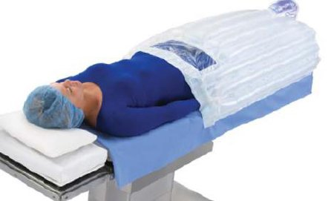
Normothermia Literature
In a study performed by Kurz et al. (1996), 200 colorectal surgery patients were randomized to two groups:
Intraoperative warming group received warm fluids and forced air warming to maintain 36.5 degrees
Standard (hypothermia) group received standard warming to maintain temperature of 34.5 degrees
Wound infections were higher in the standard warming group as compared to the active warming group: 19% vs. 6% (P=.009). (Kurz, 1996)
Melling et al. (2001) conducted a similar study in 421 patients undergoing breast, vascular, or hernia surgery.
Routine care (no warming) group had more wound infections as compared to the two other groups in which pre-warming was administered (local and systemic): 14 to 5% (P=.007). (Melling, 2001)
Notes:
Kurz A, Sessler DI, Lenhardt R. (1996). Perioperative normothermia to reduce the incidence of surgical-wound infection and shorten hospitalization. Study of Wound Infection and Temperature Group. N Engl J Med. 334(19):1209-15.
Melling AC, Ali B, Scott EM, Leaper DJ. (2001). Effects of preoperative warming on the incidence of wound infection after clean surgery: a randomised controlled trial. Lancet. 358(9285):876-80.

Slide 29
Recommendations for Maintaining Normothermia
Society for Healthcare Epidemiology of America (SHEA) Guidelines 2014. (Anderson, 2014)
Maintain normothermia (temperature of 35.5 degrees Celsius or greater) during periop period
CDC Guidelines for the Prevention of SSIs 2017. (Berrios-Torres, 2017)
Maintain perioperative normothermia- target temperature undefined (Category 1A- strong recommendation)
WHO Recommendations. (Ban, 2017)
Warming devices are recommended for use in the operating room to maintain core temperature greater than or equal to 36.0 degrees Celsius
American College of Surgeons and Surgical Infection Society: SSI Guidelines 2016. (WHO, 2018)
Maintain intraoperative normothermia – target temperature undefined
Preoperative warming is recommended for all cases and intraoperative warming methods should be employed for all but short, clean cases
For longer cases, both preoperative warming and ongoing temperature monitoring and warming measures are recommended.
Notes:
Anderson DJ, Podgorny K, Berrios-Torres SI, et al. (2014). Strategies to prevent surgical site infections in acute care hospitals: 2014 update. Infect Control Hosp Epidemiol. 35 Suppl 2:S66-88. PMID: 25376070.
Ban KA, Minei JP, Laronga C, et al. (2017). Executive Summary of the American College of Surgeons/Surgical Infection Society Surgical Site Infection Guidelines-2016 Update. Surg Infect (Larchmt). 18(4):379-382.
Berríos-Torres SI, Umscheid CA, Bratzler DW, et al. (2017). Centers for Disease Control and Prevention Guideline for the Prevention of Surgical Site Infection, 2017. JAMA Surg. 152(8):784-791.
WHO Guidelines Approved by the Guidelines Review Committee. (2018). Global Guidelines for the Prevention of Surgical Site Infection. Geneva: World Health Organization.

Slide 30
ASPIRE Measure: TEMP 01
Measure Summary: The percentage of cases in which an active warming device was applied between Case Start and Case End or the patient maintained a temperature above 36.0 degrees Celsius without active warming.
Active Warming includes:
Convective warming: forced air
Conductive warming: circulating water mattress, resistive heating electrical blankets
Endovascular warming, using a heat exchanging catheter (very rarely used)
Radiant heaters
Inclusions: Cases with general or neuraxial anesthetic technique.
Success:
Cases with documentation of an active warming device applied OR
Cases with at least one temperature greater than or equal to 36.0°C within the 30 minutes before case end.
For patients undergoing cesarean section, fluid warmer is accepted as an active warming device.
Responsible Provider: Provider present at induction end.
https://mpog.org/files/quality/measures/TEMP-01_spec.pdf

Slide 31
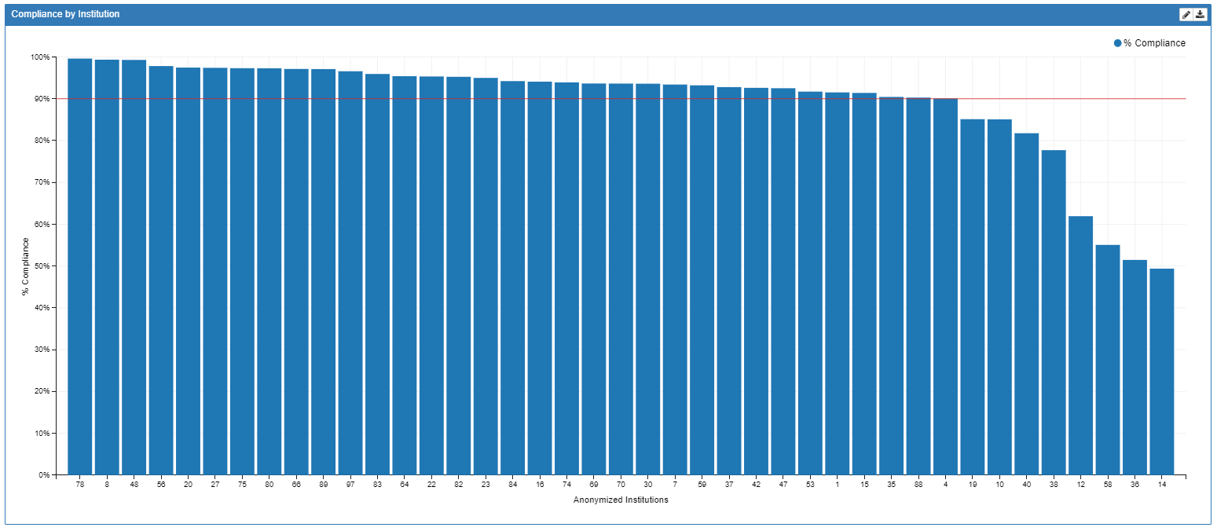
TEMP 01 Performance

Slide 32
ASPIRE Measure: TEMP 02
Measure Summary: The percentage of cases where the anesthesia provider documented at least one core temperature intraoperatively for any patient receiving a general anesthetic.
Core or Near Core Temperature Monitoring Includes:
Pulmonary Artery Temperature
Distal Esophageal Temperature
Nasopharyngeal Temperature
Tympanic Membrane Temperature
Bladder Temperature
Rectal Temperature
Axillary Temperature (arm must be at patient side)
Oral Temperature
Inclusions: All surgical patients receiving general anesthesia
Success: Cases with at least one core temperature documented between Anesthesia Start and Patient out of Room.
Responsible Provider: Provider present at induction end
https://mpog.org/files/quality/measures/TEMP-02_spec.pdf

Slide 33
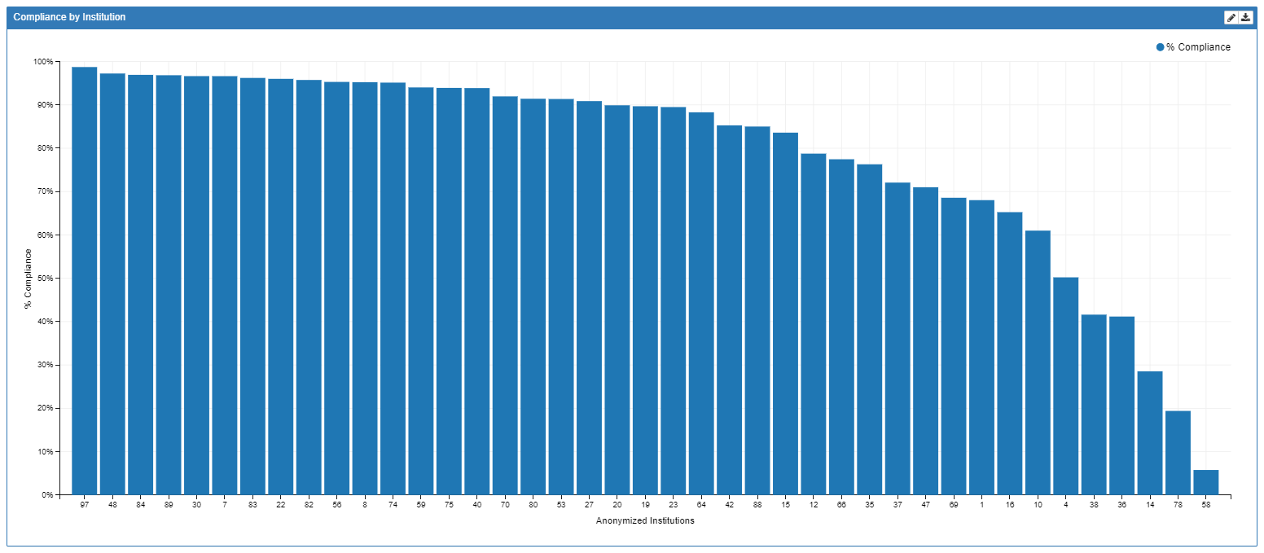
TEMP 02 Performance

Slide 34
ASPIRE Measure: TEMP 03
Measure Summary: The percentage of patients who undergo procedures under general or neuraxial anesthesia greater than or equal to 60 minutes or longer for whom at least one body temperature greater than or equal to 36 degrees Celsius (or 96.8 degrees Fahrenheit) was recorded within 30 minutes immediately before or 15 minutes after anesthesia end time.
Inclusions: All patients, regardless of age, who undergo surgical or therapeutic procedures under general or neuraxial anesthesia of 60 minutes duration or longer.
Success: At least one body temperature measurement equal to or greater than 36 degrees Celsius (or 96.8 degrees Fahrenheit) achieved within the 30 minutes immediately before or the 15 minutes immediately after anesthesia end time.
Responsible Provider: Provider present for longest duration of the case per staff role.
https://mpog.org/files/quality/measures/TEMP-03_spec.pdf

Slide 35
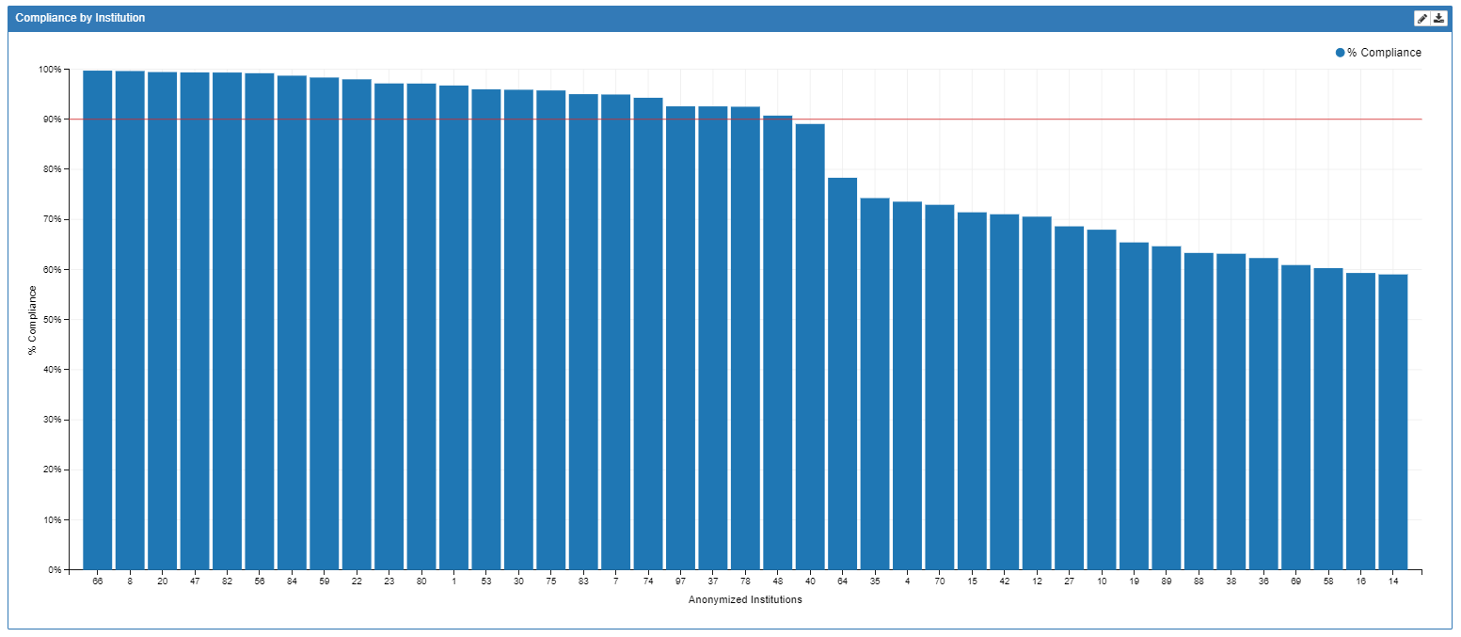
TEMP 03 Performance

Slide 36
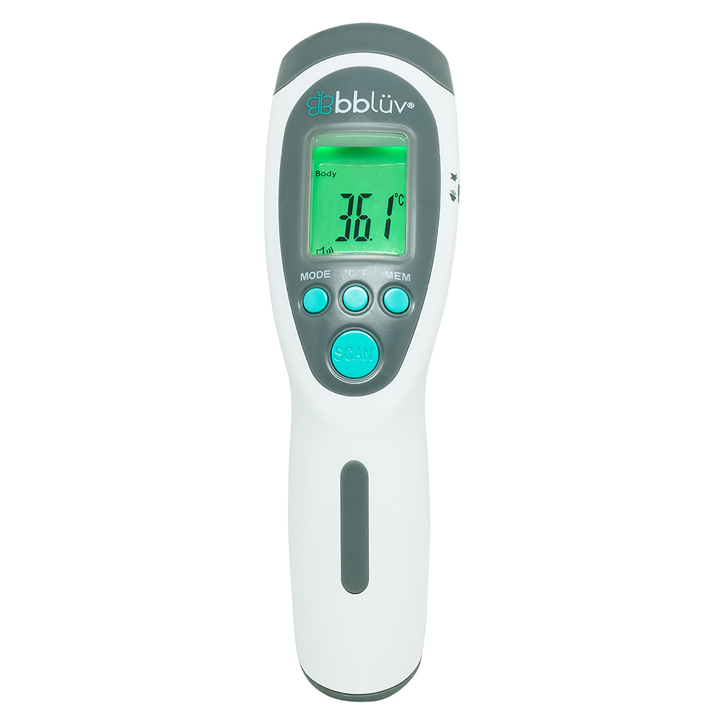
Summary of Recommendations: Normothermia
Apply active warming to maintain core body temperature of 36.0 degrees Celsius. (Allegranzi, 2016; Ban, 2017; Kurz, 2008; Kurz, 1996)
Surgical patients often experience hypothermia within the first hour after induction of general anesthesia due to the anesthetic induced vasodilation. (Sessler, 2016)
Maintaining a core temperature below 36 degrees Celsius increases the rate of surgical site infections. (Kurz, 1996)
Notes:
Allegranzi B, Zayed B, Bischoff P, et al. (2016). New WHO recommendations on intraoperative and postoperative measures for surgical site infection prevention: an evidence-based global perspective. Lancet Infect Dis. 16(12):e288-e303.
Ban KA, Minei JP, Laronga C, et al. (2017). Executive Summary of the American College of Surgeons/Surgical Infection Society Surgical Site Infection Guidelines-2016 Update. Surg Infect (Larchmt). 18(4):379-382.
Kurz A. (2008). Thermal care in the perioperative period. Best Pract Res Clin Anaesthesiol. 22(1):39-62.
Kurz A, Sessler DI, Lenhardt R. (1996). Perioperative normothermia to reduce the incidence of surgical-wound infection and shorten hospitalization. Study of Wound Infection and Temperature Group. N Engl J Med. 334(19):1209-15.
Sessler DI. (2016). Perioperative thermoregulation and heat balance. Lancet. 387(10038):2655-2664.

Slide 37
Bundle Element #3: glycemic control

Slide 38
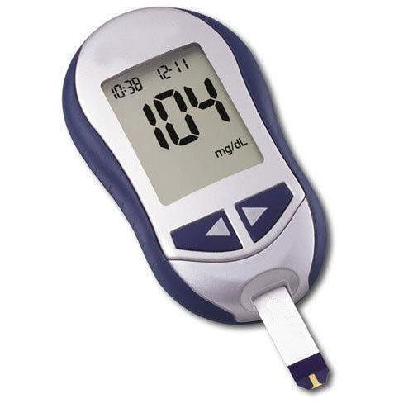
Hyperglycemia and Surgical Site Infections
Hruska et al. (2005) studied 761 cardiac surgery patients and found that diabetics were at increased risk of infection and glucose control (120-160 mg/dL) reduced the risk of wound infection in diabetics. (Hruska, 2005)
Kwon et al. (2013) evaluated the relationship between perioperative hyperglycemia (>180 mg/dL) and subsequent insulin administration on morality, reoperation, and infections for patients undergoing colorectal and bariatric surgery. (Kwon, 2013)
Of the 11,633 patients, 29.1% of patients were hyperglycemic on DOS, POD1, and/or POD2
13.5% of non-diabetic patients had hyperglycemia; 58% of diabetic patients had hyperglycemia
Patients with hyperglycemia had a 2-fold higher risk of infection
Notes:
Hruska LA, Smith JM, Hendy MP, et al. (2005). Continuous insulin infusion reduces infectious complications in diabetics following coronary surgery. J Card Surg. 20(5):403-7.
Kwon S, Thompson R, Dellinger P, et al. (2013). Importance of perioperative glycemic control in general surgery: a report from the Surgical Care and Outcomes Assessment Program. Ann Surg. 257(1):8-14.

Slide 39
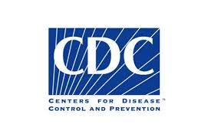
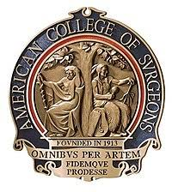
Bundle Element #3: Glycemic Control
Society for Healthcare Epidemiology of America (SHEA) Guidelines 2014. (Anderson, 2014)
Control blood glucose levels during the immediate postoperative period: ≤180 mg/dL
CDC Guidelines for the Prevention of SSIs 2017. (Ban, 2017)
Maintain blood glucose levels less than 200 mg/dL during the perioperative period for patients with and without diabetes (Category 1A-strong recommendation; high to moderate quality evidence)
American College of Surgeons and Surgical Infection Society: SSI Guidelines 2016. (Berrios-Torres, 2017)
Target perioperative blood glucose should be between 110-150 mg/dL in all patients regardless of diabetic status, except in cardiac surgery where target should be <180 mg/dL
Notes:
Anderson DJ, Podgorny K, Berrios-Torres SI, et al. (2014). Strategies to prevent surgical site infections in acute care hospitals: 2014 update. Infect Control Hosp Epidemiol. 35 Suppl 2:S66-88. PMID: 25376070.
Ban KA, Minei JP, Laronga C, et al. (2017). Executive Summary of the American College of Surgeons/Surgical Infection Society Surgical Site Infection Guidelines-2016 Update. Surg Infect (Larchmt). 18(4):379-382.
Berríos-Torres SI, Umscheid CA, Bratzler DW, et al. (2017). Centers for Disease Control and Prevention Guideline for the Prevention of Surgical Site Infection, 2017. JAMA Surg. 152(8):784-791.

Slide 40
Bundle Element #3: Glycemic Control
World Health Organization Recommendations. (WHO, 2018)
Strict protocols should be implemented to control blood glucose levels in both diabetic and non-diabetic patients undergoing surgical procedures
Blood glucose target and perioperative timing of glucose control could not be defined
Society for Ambulatory Anesthesia (SAMBA) Consensus Guidelines-2010. (Joshi, 2010)
Postpone elective surgery in patients with significant complications of hyperglycemia (severe dehydration, ketoacidosis, hyperosmolar nonketotic states)
In patients with well-controlled diabetes, maintain intraop blood glucose levels <180mg/dL
In patients with poorly controlled diabetes, maintain intraop blood glucose levels around their preop baseline values rather than normalizing them
Notes:
Joshi GP, Chung F, Vann MA, et al. (2010). Society for Ambulatory Anesthesia consensus statement on perioperative blood glucose management in diabetic patients undergoing ambulatory surgery. Anesth Analg. 111(6):1378-87.
WHO Guidelines Approved by the Guidelines Review Committee. (2018). Global Guidelines for the Prevention of Surgical Site Infection. Geneva: World Health Organization.

Slide 41
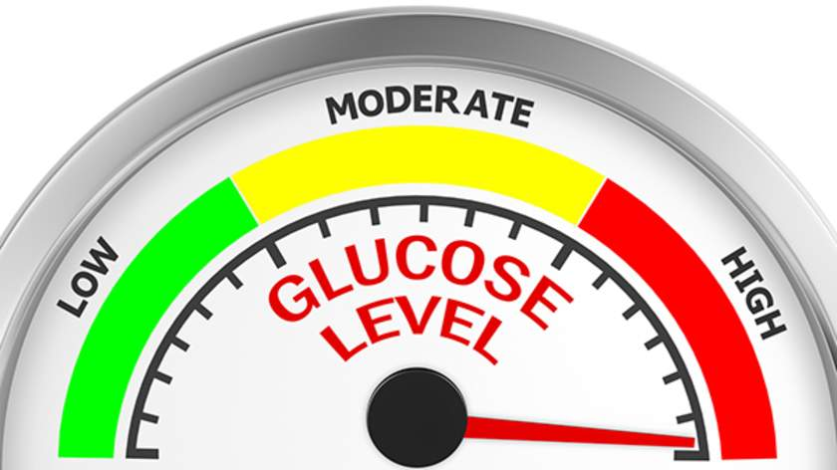
Preoperative Hyperglycemia Management
Preoperative Recommendations for Diabetics. (Duggan, 2017)
Continue oral anti-diabetic agents up to the day before surgery
Discontinue sulfonylurea on day of surgery to prevent risk of hypoglycemia
Hold metformin only if patient is having a procedure with IV contrast dye, particularly if GFR<45 ml/min
Insulin recommendations vary based on Type 1 vs. Type 2 DM
Nutritional support with dextrose-containing solutions is not indicated if fasting <24-48 hours
For non-diabetics undergoing surgical procedures, consider checking blood glucose upon arrival to assess for hyperglycemia in the non-diabetic patient. (Kwon, 2013)
Notes:
Duggan EW, Carlson K, Umpierrez GE. (2017). Perioperative Hyperglycemia Management: An Update. Anesthesiology. 126(3):547-560.
Kwon S, Thompson R, Dellinger P, et al. (2013). Importance of perioperative glycemic control in general surgery: a report from the Surgical Care and Outcomes Assessment Program. Ann Surg. 257(1):8-14.

Slide 42
Intraoperative Hyperglycemia Management
Society for Ambulatory Anesthesia (SAMBA) recommends intraoperative blood glucose <180mg/dL for patients with controlled diabetes. (Joshi, 2010)
Endocrine Society and the American Diabetes Association/AACE Practice Guidelines recommend a target primal glucose of <140 mg/dL and a random blood glucose <180mg/dL for patients treated with insulin. (Umpierrez, 2012)
Target levels depend on:
Duration of Surgery
Invasiveness of surgical procedure
Type of anesthetic technique
Expected time to resume oral intake and antidiabetic therapy
Notes:
Joshi GP, Chung F, Vann MA, et al. (2010). Society for Ambulatory Anesthesia consensus statement on perioperative blood glucose management in diabetic patients undergoing ambulatory surgery. Anesth Analg. 111(6):1378-87.
Umpierrez GE, Hellman R, Korytkowski MT, et al. (2012). Management of hyperglycemia in hospitalized patients in non-critical care setting: an endocrine society clinical practice guideline. J Clin Endocrinol Metab. 97(1):16-38.

Slide 43
ASPIRE Measure: GLU 01
Measure Summary: Percentage of intraoperative glucose labs with perioperative glucose >200 with administration of insulin or glucose recheck within 90 minutes of original glucose measurement for the time period between Anesthesia Start and Anesthesia End.
Inclusions: All patients with glucose level greater than 200 mg/dL between Anesthesia Start and Anesthesia End; Patients with and without diagnosis of diabetes.
Success: Administration of insulin within 90 minutes (either IV or sub Q routes) or Recheck of glucose level within 90 minutes
Responsible Provider: The provider signed in at the first glucose recheck or first administration of insulin. If neither occurred, then the responsible provider is the one signed in 90 minutes after the high glucose measurement.
https://mpog.org/files/quality/measures/GLU-01_spec.pdf

Slide 44
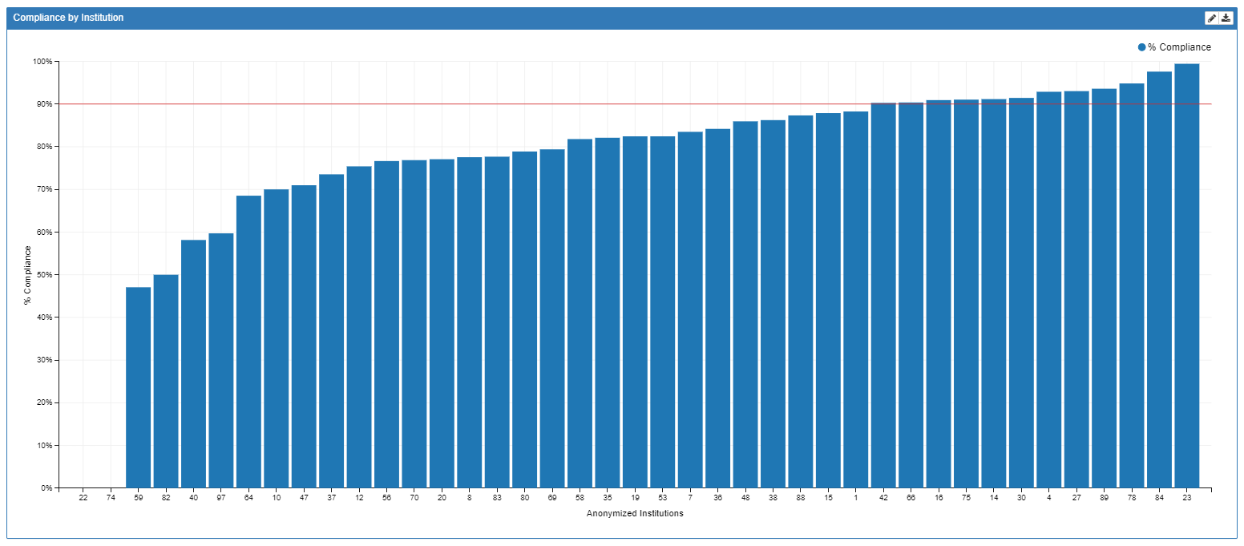
GLU 01 Performance

Slide 45
ASPIRE Measure: GLU 02
Measure Summary: Percentage of intraoperative glucose labs with perioperative glucose <60 with administration of dextrose containing solution or glucose recheck within 90 minutes of original glucose measurement for the time period between Anesthesia Start and Anesthesia End.
Inclusions: All patients with glucose level less than 60 mg/dL between Anesthesia Start and Anesthesia End; Patients with and without diagnosis of diabetes.
Success: Administration of dextrose containing solution within 90 minutes (IV) OR Recheck of glucose level within 90 minutes
Responsible Provider: The provider signed in at the first glucose recheck or first administration of dextrose. If neither occurred, then the responsible provider is the one signed in 90 minutes after the low glucose measurement.
https://mpog.org/files/quality/measures/GLU-02_spec.pdf

Slide 46
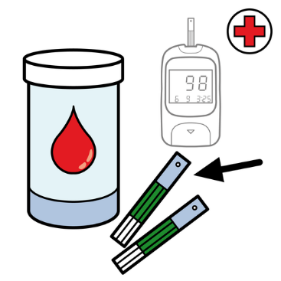
Summary of Recommendations: Glycemic Control
Maintain blood glucose levels less than 180 mg/dL throughout the perioperative period for patients with and without diabetes. (Anderson, 2014; Berrios-Torres, 2017; Duggan, 2017; Joshi, 2010; Umpierrez, 2012)
Use subcutaneous (SC) rapid-acting insulin treatment for: (Duggan, 2017; Joshi, 2010; Umpierrez, 2012)
Ambulatory surgery patients
Procedures of short duration (<4h):
Inpatient procedures that are minimally invasive, hemodynamically stable, and early resumption of oral intake is predicted
Check blood glucose (BG) at least every 2 hours when administering SC insulin. (Duggan, 2017; Joshi, 2010; Umpierrez, 2012)
Use IV insulin infusion for patients undergoing procedures with: (Duggan, 2017)
Hemodynamic instability/Inotrope use
Significant fluid shifts
Changes in temperature
Duration >4 hours
Critical illness
Cardiac surgery patients
Check blood glucose hourly when administering insulin infusion. (Duggan, 2017)
Notes:
Anderson DJ, Podgorny K, Berrios-Torres SI, et al. (2014). Strategies to prevent surgical site infections in acute care hospitals: 2014 update. Infect Control Hosp Epidemiol. 35 Suppl 2:S66-88. PMID: 25376070.
Berríos-Torres SI, Umscheid CA, Bratzler DW, et al. (2017). Centers for Disease Control and Prevention Guideline for the Prevention of Surgical Site Infection, 2017. JAMA Surg. 152(8):784-791.
Duggan EW, Carlson K, Umpierrez GE. (2017). Perioperative Hyperglycemia Management: An Update. Anesthesiology. 126(3):547-560.
Joshi GP, Chung F, Vann MA, et al. (2010). Society for Ambulatory Anesthesia consensus statement on perioperative blood glucose management in diabetic patients undergoing ambulatory surgery. Anesth Analg. 111(6):1378-87.
Umpierrez GE, Hellman R, Korytkowski MT, et al. (2012). Management of hyperglycemia in hospitalized patients in non-critical care setting: an endocrine society clinical practice guideline. J Clin Endocrinol Metab. 97(1):16-38.

Slide 47
Bundle Element #4: fluid management

Slide 48
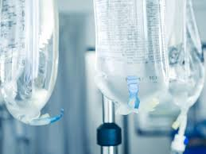
Bundle Element #4: Fluid Management
Kabon et. al. (2005) demonstrated infection rates did not differ between patients who were assigned a small or large fluid management protocol. Fluid replacement between 3.1 mL to 5.7 mL did not have a major impact on SSI risk.
“Wound repair and resistance to infection both depend in part on wound tissue oxygen tension and can potentially be improved by increasing arterial oxygen tension, even of fully saturated blood…Colloid administration titrated to maximize cardiac output reduces complications, including those related to wound healing.”
Trials without standardized volume replacement protocols reported an increase in SSIs.
Fluid management is most effective in minimizing SSI rates when paired with optimization of tissue oxygenation. (Anderson, 2014; Kabon, 2005)
Notes:
Anderson DJ, Podgorny K, Berrios-Torres SI, et al. (2014). Strategies to prevent surgical site infections in acute care hospitals: 2014 update. Infect Control Hosp Epidemiol. 35 Suppl 2:S66-88. PMID: 25376070.
Kabon B, Akça O, Taguchi A, et al. (2005). Supplemental intravenous crystalloid administration does not reduce the risk of surgical wound infection. Anesth Analg. 101(5):1546-1553.

Slide 49
Summary of Recommendations: Fluid Management
There is conflicting evidence on whether restrictive or liberal fluid management protocols put patients at risk for developing an SSI postoperatively.
Healthcare institutions should adopt and implement a standardized fluid management protocol for surgical patients
Maximizing cardiac output through crystalloid, colloid or blood administration can improve the migration of neutrophils and other inflammatory cells to the incision site, however, use caution not to place the patient in a hypervolemic state.
“Maintain patients in a state of zero fluid balance by providing them with the right amount of the right fluid at the right time”. (Varadhan, 2010)
Notes:
Varadhan KK, Lobo DN. (2010). A meta-analysis of randomised controlled trials of intravenous fluid therapy in major elective open abdominal surgery: getting the balance right. Proc Nutr Soc. 69(4: 488-498.

Slide 50
Bundle Element #5: oxygenation

Slide 51
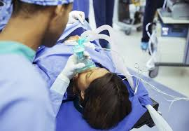
Bundle Element #5: Oxygenation
CDC Guidelines for the Prevention of SSIs 2017. (Berrios-Torres, 2017)
For patients with normal pulmonary function undergoing general anesthesia with ETT, administer increased FiO2 during surgery and after extubation in the immediate postop period.
No clear evidence to support administration of increased FiO2 via ETT during the intraoperative phase only.
No clear evidence to support administration of FiO2 via face mask or nasal cannula during the perioperative period.
American College of Surgeons and Surgical Infection Society: SSI Guidelines. (Ban, 2017)
Administration of supplemental oxygen (80% FiO2) is recommended during surgery and in the immediate postop period for procedures performed under general anesthesia.
Notes:
Ban KA, Minei JP, Laronga C, et al. (2017). Executive Summary of the American College of Surgeons/Surgical Infection Society Surgical Site Infection Guidelines-2016 Update. Surg Infect (Larchmt). 18(4):379-382.
Berríos-Torres SI, Umscheid CA, Bratzler DW, et al. (2017). Centers for Disease Control and Prevention Guideline for the Prevention of Surgical Site Infection, 2017. JAMA Surg. 152(8):784-791.

Slide 52
Bundle Element #5: Oxygenation
SHEA Guidelines 2014. (Anderson, 2014)
Administer supplemental oxygen during and immediately following surgical procedures involving mechanical ventilation
Supplemental oxygenation is most effective when combined with normothermia and appropriate fluid management
World Health Organization Recommendations 2016. (WHO, 2018)
Adult patients undergoing general anesthesia with an ETT for surgical procedures should receive an 80% FiO2 intraoperatively and 2-6 hours postoperatively, if possible
Notes:
Anderson DJ, Podgorny K, Berrios-Torres SI, et al. (2014). Strategies to prevent surgical site infections in acute care hospitals: 2014 update. Infect Control Hosp Epidemiol. 35 Suppl 2:S66-88. PMID: 25376070.
WHO Guidelines Approved by the Guidelines Review Committee. (2018). Global Guidelines for the Prevention of Surgical Site Infection. Geneva: World Health Organization.

Slide 53
Oxygenation – maybe not so effective…
“In a recent analysis investigating the scientific integrity of the work published by Schietroma et al., evidence was found for potential data fabrication in 38 trials reporting on a variety of perioperative interventions, including supplemental oxygen to reduce surgical site infections.
While some of these studies have been retracted, others have now come under scrutiny and require further investigation. Major concerns were raised about the impact of these compromised data on the World Health Organization recommendations on surgical site infections, which included two trials published by Schietroma et al.
The World Health Organization recommended the use of 80% inspired oxygen fraction. In contrast, two recently published meta-analyses found no argument in favor of high oxygen concentrations when trials by Schietroma et al. were excluded.”
https://anesthesiology.pubs.asahq.org/article.aspx?articleid=2739196&utm_source=silverchair&utm_medium=email&utm_campaign=article_alert-Anesthes&utm_content=olf&utm_term=071919

Slide 54
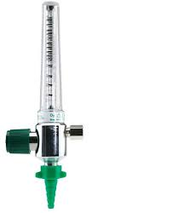
Summary of Recommendations: Oxygenation
1. Administer supplemental oxygen in the immediate postop period for procedures performed under general anesthesia.
2. Combine supplemental oxygenation with normothermia and appropriate fluid management. (Ban, 2017; Belda, 2005; Berrios-Torres, 2017; Greif, 2000; Qadan, 2009)
Notes:
Ban KA, Minei JP, Laronga C, et al. (2017). Executive Summary of the American College of Surgeons/Surgical Infection Society Surgical Site Infection Guidelines-2016 Update. Surg Infect (Larchmt). 18(4):379-382.
Belda FJ, Aguilera L, García de la Asunción K, Alberti J, et al. (2005). Supplemental perioperative oxygen and the risk of surgical wound infection: a randomized controlled trial. Jama. 294(16): 2035-42.
Berríos-Torres SI, Umscheid CA, Bratzler DW, et al. (2017). Centers for Disease Control and Prevention Guideline for the Prevention of Surgical Site Infection, 2017. JAMA Surg. 152(8):784-791.
Greif R, Akça O, Horn EP, et al. (2000). Supplemental perioperative oxygen to reduce the incidence of surgical-wound infection. N Engl J Med. 342(3):161-167.
Qadan M, Akça O, Mahid SS, et al. (2009). Perioperative supplemental oxygen therapy and surgical site infection: a meta-analysis of randomized controlled trials. Arch Surg. 144(4):359-66; discussion 366-7.

Slide 55
Bundle Element #6: hair removal

Slide 56
Bundle Element #6: Hair Removal
SHEA Guidelines 2014. (Anderson, 2014)
Do not remove hair at the operative site unless the presence of hair will interfere with the operation. Do not use razors.
If hair removal is necessary, remove hair outside of the operating room and use clippers or a depilatory agent.
American College of Surgeons & Surgical Infection Society 2016. (Ban, 2017)
Hair removal should be avoided unless hair interferes with surgery
Use clippers instead of razor if hair removal is necessary.
Notes:
Anderson DJ, Podgorny K, Berrios-Torres SI, et al. (2014). Strategies to prevent surgical site infections in acute care hospitals: 2014 update. Infect Control Hosp Epidemiol. 35 Suppl 2:S66-88. PMID: 25376070.
Ban KA, Minei JP, Laronga C, et al. (2017). Executive Summary of the American College of Surgeons/Surgical Infection Society Surgical Site Infection Guidelines-2016 Update. Surg Infect (Larchmt). 18(4):379-382.

Slide 57
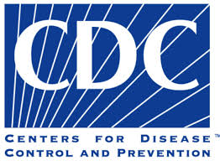
Hair Removal Literature
CDC Guidelines for the Prevention of SSIs- 1999: (Mangram, 1999)
Do not remove hair preoperatively unless the hair at or around the incision site with interfere with the operation. If hair must be removed, do so immediately before the operation, preferably with clippers.
Note: This recommendation was not included in the updated version of the CDC Guidelines for SSI Prevention in 2017
In a meta-analysis performed by Tanner et al. in 2011, there was no statistical significance in SSI rates in the four trials that examined shaving vs. no hair removal. However, there were more SSIs in the shaving group as compared to the no hair removal group. Suggested that the comparison may be underpowered. (Tanner, 2011)
Notes:
Mangram AJ, Horan TC, Pearson ML, et al. (1999). Guideline for Prevention of Surgical Site Infection, 1999. Centers for Disease Control and Prevention (CDC) Hospital Infection Control Practices Advisory Committee. Am J Infect Control. 27(2):97-132; quiz 133-134; discussion 196.
Tanner J, Norrie P, Melen, K. (2011). Preoperative hair removal to reduce surgical site infection. Cochrane Database Sys Rev. (11):CD004122.

Slide 58
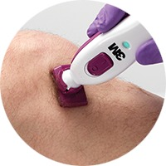
Summary of Recommendations: Hair Removal
1. Do not remove hair at the operative site unless the presence of hair will interfere with the operation. Do not use razors.
2. If hair removal is necessary, remove hair outside of the operating room and use clippers or a depilatory agent. (Anderson, 2014; Ban, 2017; Mangram, 1999)
Notes:
Anderson DJ, Podgorny K, Berrios-Torres SI, et al. (2014). Strategies to prevent surgical site infections in acute care hospitals: 2014 update. Infect Control Hosp Epidemiol. 35 Suppl 2:S66-88. PMID: 25376070.
Ban KA, Minei JP, Laronga C, et al. (2017). Executive Summary of the American College of Surgeons/Surgical Infection Society Surgical Site Infection Guidelines-2016 Update. Surg Infect (Larchmt). 18(4):379-382.
Mangram AJ, Horan TC, Pearson ML, et al. (1999). Guideline for Prevention of Surgical Site Infection, 1999. Centers for Disease Control and Prevention (CDC) Hospital Infection Control Practices Advisory Committee. Am J Infect Control. 27(2):97-132; quiz 133-134; discussion 196.

Slide 59
Bundle Element #7: operating room traffic

Slide 60
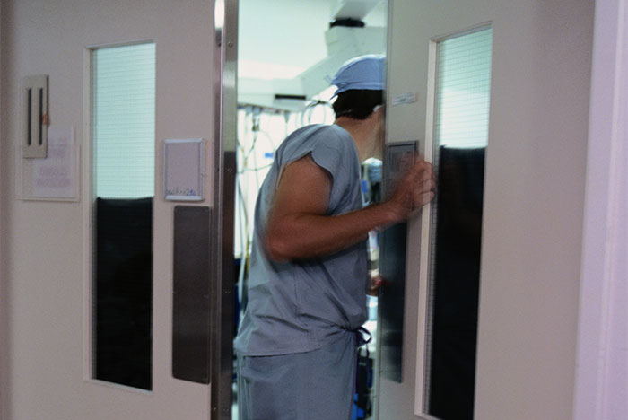
Bundle Element #7: OR Traffic Overview
Personnel are main contributors to particles in the operating room air. (Mitchell, 1978)
In a study conducted by Teter et al. (2017): (Teter, 2017)
13.4 door openings per hour during cases
Total of 660 air measurements were obtained
Overall air particulate counts increased 13% when the door was open. Larger particles that correlated to bacterial size were elevated significantly during door opening (P<.001).
Notes:
Mitchell NJ, Evans DS, Kerr A. (1978). Reduction of skin bacteria in theatre air with comfortable, non-woven disposable clothing for operating-theatre staff. Br Med J. 1(6114):696-8.
Teter J, Guajardo I, Al-Rammah T, et al. (2017). Assessment of operating room airflow using air particle counts and direct observation of door openings. Am J Infect Control. 45(5):477-482.

Slide 61
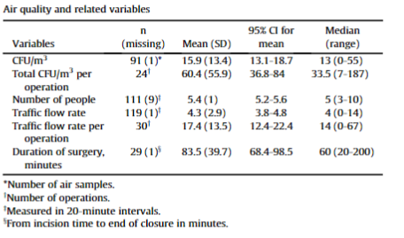
OR Traffic Overview
Research linking a specific culture of airborne bacteria to SSIs is lacking. Current studies have shown airborne bacteria is related to an increase in OR traffic but not necessarily to SSIs.
“A significant negative impact on the OR environment was demonstrated by the air quality, expressed as colony-forming units per cubic meter (CFU/m³) during orthopedic trauma surgery in a displacement-ventilated OR”
Air contamination rate increases near surgical wounds
After controlling for duration of surgery, there was a strong correlation between the total CFU/m³ of bacteria and OR traffic flow. (Andersson, 2012; Alizo, 2019)
Notes:
Andersson AE, Bergh I, Karlsson J, et al. (2012). Traffic flow in the operating room: an explorative and descriptive study on air quality during orthopedic trauma implant surgery. Am J Infect Control. 40(8):750-755.
Alizo G, Onayemi A, Sciarretta JD, Davis JM. (2019). Operating Room Foot Traffic: A Risk Factor for Surgical Site Infections. Surg Infect (Larchmt). 20(2):146-150.

Slide 62
Summary of Recommendations: OR Traffic
OR Traffic increases the rate of airborne contaminants
Current research does not demonstrate a positive correlation between the rate of airborne bacteria and subsequent SSI rates.

Slide 63
Bundle Element #8: Skin prep

Slide 64
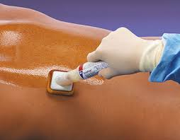
Bundle Element #8: Skin Prep Overview
Iodine based prep
Povidone-Iodine: Povidone works to prolong iodine’s bactericidal effects
Effective against bacteria, fungi and viruses.
Sterile iodine should be used when prepping open surgical wounds
Iodine Povacrylex: combined with alcohol to heighten the antimicrobial effect.
Alcohol based prep
“Provides the most rapid reduction in bacterial count of all antiseptic solutions”
Proven to be most effective in reducing SSI rates when compared to aqueous preparations and should be used unless contraindicated.
Highly bactericidal and effective for skin antisepsis but does not have persistent activity when used alone.
Contraindicated for procedures where the prep may pool and not dry and those that involve mucosa, cornea or ear. Increased surgical fire risk as well. (Ban, 2017; Letzelter, 2018)
Notes:
Ban KA, Minei JP, Laronga C, et al. (2017). Executive Summary of the American College of Surgeons/Surgical Infection Society Surgical Site Infection Guidelines-2016 Update. Surg Infect (Larchmt). 18(4):379-382.
Letzelter J, Hill JB, Hacquebord J. (2018). An Overview of Skin Antiseptics Used in Orthopaedic Surgery Procedures. J Am Acad Orthop Surg. 27(16):599-606.

Slide 65
Skin Prep Literature
Chlorhexidine gluconate (CHG)
CHG molecules are able to attach to the cell walls of bacteria, disturbing its osmotic equilibrium and inhibits further cell growth.
Using 2% or 4% CHG through a standardized protocol results in concentrations high enough to kill skin colonizing flora including MRSA.
Lower infection rates have been reported in several studies including patients who use 2% CHG-impregnated wipes the night prior to surgery.
A prospective comparative study for patients undergoing posterior spine surgeries found no difference in surgical site infection rates between patients treated with CHG based prep vs. iodine based prep. The rates of positive bacterial cultures were significantly higher after wound closure in patients prepped with iodine (14.1%) vs. CHG (5.1%). (Edmiston, 2013; Yoshii, 2018)
Notes:
Edmiston CE Jr, Bruden B, Rucinski MC, et al. (2013). Reducing the risk of surgical site infections: does chlorhexidine gluconate provide a risk reduction benefit? Am J Infect Control. 41(5 Suppl): S49-55.
Yoshii T, Hirai T, Yamada T, et al. (2018). A Prospective Comparative Study in Skin Antiseptic Solutions for Posterior Spine Surgeries: Chlorhexidine-Gluconate Ethanol Versus Povidone-Iodine. Clin Spine Surg. 31(7):E353-E356.

Slide 66
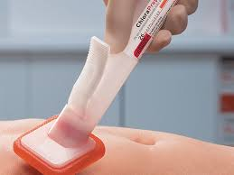
Summary of Recommendations: Surgical Prep
Alcohol based prep should be used unless contraindicated
Avoid for procedures where prep may pool and not dry (fire risk!)
Contraindicated for use in mucosa, cornea, or ear
CHG scrub is superior to iodine based prep when alcohol preparations are contraindicated.
Implementing a standardized surgical prep protocol that includes the use of CHG wipes preoperatively significantly reduces the incidence of infection.
Sterile iodine should be used when prepping open surgical wounds

Slide 67
Summary of Recommendations
Surgical Site Infections are a complex problem requiring a multi-modal approach.
Anesthesia providers play an integral role in reducing the risk of SSIs.
Measure and provide feedback to providers regarding rates of compliance with process measures.
Specific recommendations are outlined on the next few slides and are categorized by phase of care; italics are used to indicate elements the anesthesia team may be responsible for.
For information and access this presentation, please visit our website: https://mpog.org/quality/toolkits/

Slide 68
Preoperative Recommendations: Prior to Day of Surgery
Recommend patient to shower with soap or an antiseptic agent on at least the night before surgery, preferably day of surgery
Consider CHG shower/bath or wipes for patients with MRSA colonization, on the night before and day of surgery
Provide patient education regarding smoking cessation & consider nutrition and exercise counseling, specifically in patients with BMI>30
Check albumin, HgbA1c as part of lab panel
If HgbA1C is greater than or equal to 6.5, consider surgical risk and create glycemic control plan
MRSA screening, as indicated

Slide 69
Preoperative Recommendations: Day of Surgery
Check baseline glucose in all patients who are diabetic or at risk of stress hyperglycemia preoperatively
Antimicrobial prophylaxis
Selection:
Administer antimicrobial prophylaxis according to evidence-based standards and guidelines
Select appropriate antimicrobial agents based on procedure: target the most common pathogens to cause SSI for procedure
Dosing:
Weight-based dosing, specifically in obese patients
Timing:
Begin administration within 1 hour before incision (within 2 hours for vancomycin and fluoroquinolones)

Slide 70
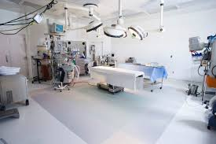
Intraoperative Recommendations
Hair removal should be avoided unless hair interferes with surgery
Use clippers instead of razor if hair removal is necessary.
Alcohol based prep should be used unless contraindicated
Avoid for procedures where prep may pool and not dry (fire risk!)
Contraindicated for use in mucosa, cornea, or ear
CHG scrub is superior to iodine based prep when alcohol preparations are contraindicated.
Sterile iodine should be used when prepping open surgical wounds
Apply active warming to maintain core body temperature of 36.0 degrees Celsius
Body temperature should be monitored in most patients undergoing general anesthesia exceeding 30 minutes in duration and in all patients whose surgery lasts longer than one hour.

Slide 71
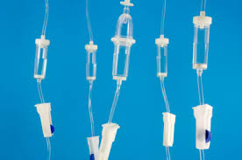
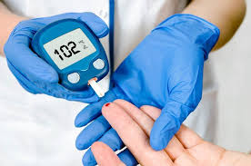
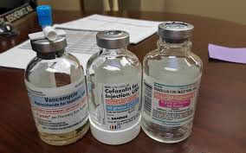
Intraoperative Recommendations
Maintain blood glucose levels less than 180 to 200 mg/dL throughout the perioperative period for patients with and without diabetes
Adopt and implement a standardized fluid management protocol for surgical patients
All patients require re-dosing of antibiotics if the duration of the procedure extends beyond 2 half-lives of the drug or if there is excessive blood loss (>1500mL)

Slide 72
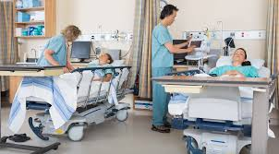
Postoperative Recommendations
Discontinue antimicrobial agent within 24 hours of surgery, even in the presence of drains
Administer supplemental oxygen in the immediate postop period for procedures performed under general anesthesia.
Maintain blood glucose levels less than 180 – 200 mg/dL throughout the perioperative period for patients with and without diabetes

Slide 73
References
Alexander JW, Solomkin JS, Edwards MJ. (2011). Updated recommendations for control of surgical site infections. Ann Surg. 253(6):1082-1093.
Alizo G, Onayemi A, Sciarretta JD, Davis JM. (2019). Operating Room Foot Traffic: A Risk Factor for Surgical Site Infections. Surg Infect (Larchmt). 20(2):146-150.
Allegranzi B, Zayed B, Bischoff P, et al. (2016). New WHO recommendations on intraoperative and postoperative measures for surgical site infection prevention: an evidence-based global perspective. Lancet Infect Dis. 16(12):e288-e303.
Anderson DJ, Podgorny K, Berrios-Torres SI, et al. (2014). Strategies to prevent surgical site infections in acute care hospitals: 2014 update. Infect Control Hosp Epidemiol. 35 Suppl 2:S66-88. PMID: 25376070.
Andersson AE, Bergh I, Karlsson J, et al. (2012). Traffic flow in the operating room: an explorative and descriptive study on air quality during orthopedic trauma implant surgery. Am J Infect Control. 40(8):750-755.
Ban KA, Minei JP, Laronga C, et al. (2017). Executive Summary of the American College of Surgeons/Surgical Infection Society Surgical Site Infection Guidelines-2016 Update. Surg Infect (Larchmt). 18(4):379-382.
Banz VM, Jakob SM, Inderbitzin D. (2011). Review article: improving outcome after major surgery: pathophysiological considerations. Anesth Analg. 112(5):1147-55.

Slide 74
References
Baum ML, Anish DS, Chalmers TC, et al. (1981). A survey of clinical trials of antibiotic prophylaxis in colon surgery: evidence against further use of no-treatment controls. N Engl J Med. 305(14):795-9.
Belda FJ, Aguilera L, García de la Asunción K, Alberti J, et al. (2005). Supplemental perioperative oxygen and the risk of surgical wound infection: a randomized controlled trial. Jama. 294(16): 2035-42.
Berríos-Torres SI, Umscheid CA, Bratzler DW, et al. (2017). Centers for Disease Control and Prevention Guideline for the Prevention of Surgical Site Infection, 2017. JAMA Surg. 152(8):784-791.
Bratzler DW, Dellinger EP, Olsen KM, et al. (2013). Clinical practice guidelines for antimicrobial prophylaxis in surgery. Surg Infect (Larchmt). 14(1):73-156.
Centers for Disease Control and Prevention. (November 24, 2010). Surgical Site Infection (SSI). Centers for Disease Control and Prevention. Accessed on July 9, 2019. https://www.cdc.gov/hai/ssi/ssi.html.
Clarke RS. (1970). The hyperglycaemic response to different types of surgery and anaesthesia. Br J Anaesth. 42(1):45-53.
Dellinger EP, Hausmann SM, Bratzler DW, et al. (2005). Hospitals collaborate to decrease surgical site infections. Am J Surg. 190(1):9-15.
Duggan EW, Carlson K, Umpierrez GE. (2017). Perioperative Hyperglycemia Management: An Update. Anesthesiology. 126(3):547-560.

Slide 75
References
Edmiston CE Jr, Bruden B, Rucinski MC, et al. (2013). Reducing the risk of surgical site infections: does chlorhexidine gluconate provide a risk reduction benefit? Am J Infect Control. 41(5 Suppl): S49-55.
Farrokhi F, Smiley D, Umpierrez GE. (2011). Glycemic control in non-diabetic critically ill patients. Best Pract Res Clin Endocrinol Metab. 25(5):813-824.
Greif R, Akça O, Horn EP, et al. (2000). Supplemental perioperative oxygen to reduce the incidence of surgical-wound infection. N Engl J Med. 342(3):161-167.
Hasselgren PO, Ivarsson L, Risberg B, Seeman T. (1984). Effects of prophylactic antibiotics in vascular surgery. A prospective, randomized, double-blind study. Ann Surg. 200(1):86-92.
Hidron AI, Edwards JR., Patel J, et al. (2008). NHSN annual update: antimicrobial-resistant pathogens associated with healthcare-associated infections: annual summary of data reported to the National Healthcare Safety Network at the Centers for Disease Control and Prevention, 2006-2007. Infect Control Hosp Epidemiol. 29(11):996-1011.
Horan TC, Gaynes RP, Martone WJ, et al. (1992). CDC definitions of nosocomial surgical site infections, 1992: a modification of CDC definitions of surgical wound infections. Infect Control Hosp Epidemiol. 13(10):606-608.
Hruska LA, Smith JM, Hendy MP, et al. (2005). Continuous insulin infusion reduces infectious complications in diabetics following coronary surgery. J Card Surg. 20(5):403-7.

Slide 76
References
Jonsson K, Jensen JA., Goodson WH 3rd, et al. (1991). Tissue oxygenation, anemia, and perfusion in relation to wound healing in surgical patients. Ann Surg, 214(5):605-613.
Joshi GP, Chung F, Vann MA, et al. (2010). Society for Ambulatory Anesthesia consensus statement on perioperative blood glucose management in diabetic patients undergoing ambulatory surgery. Anesth Analg. 111(6):1378-87.
Kabon B, Akça O, Taguchi A, et al. (2005). Supplemental intravenous crystalloid administration does not reduce the risk of surgical wound infection. Anesth Analg. 101(5):1546-1553.
Kurz A. (2008). Thermal care in the perioperative period. Best Pract Res Clin Anaesthesiol. 22(1):39-62.
Kurz A, Sessler DI, Lenhardt R. (1996). Perioperative normothermia to reduce the incidence of surgical-wound infection and shorten hospitalization. Study of Wound Infection and Temperature Group. N Engl J Med. 334(19):1209-15.
Kwon S, Thompson R, Dellinger P, et al. (2013). Importance of perioperative glycemic control in general surgery: a report from the Surgical Care and Outcomes Assessment Program. Ann Surg. 257(1):8-14.
Letzelter J, Hill JB, Hacquebord J. (2018). An Overview of Skin Antiseptics Used in Orthopaedic Surgery Procedures. J Am Acad Orthop Surg. 27(16):599-606.
Lippitt MH, Fairbairn MG, Matsuno R, et al. (2017). Outcomes Associated With a Five-Point Surgical Site Infection Prevention Bundle in Women Undergoing Surgery for Ovarian Cancer. Obstet Gynecol. 130(4):756-764.

Slide 77
References
Magill SS, Edwards JR, Bamberg W, et al. (2014). Multistate point-prevalence survey of health care-associated infections. N Engl J Med. 370(13):1198-208.
Mangram AJ, Horan TC, Pearson ML, et al. (1999). Guideline for Prevention of Surgical Site Infection, 1999. Centers for Disease Control and Prevention (CDC) Hospital Infection Control Practices Advisory Committee. Am J Infect Control. 27(2):97-132; quiz 133-134; discussion 196.
Meijs AP, Koek MBG, Vos MC, et al. (2019). The effect of body mass index on the risk of surgical site infection. Infect Control Hosp Epidemiol. 40(9):991-996.
Melling AC, Ali B, Scott EM, Leaper DJ. (2001). Effects of preoperative warming on the incidence of wound infection after clean surgery: a randomised controlled trial. Lancet. 358(9285):876-80.
Mitchell NJ, Evans DS, Kerr A. (1978). Reduction of skin bacteria in theatre air with comfortable, non-woven disposable clothing for operating-theatre staff. Br Med J. 1(6114):696-8.
Moreno Elola-Olaso A, Davenport DL, Hundley JC, et al. (2012). Predictors of surgical site infection after liver resection: a multicentre analysis using National Surgical Quality Improvement Program data. HPB (Oxford). 14(2):136-41.
Platt R, Zaleznik DF, Hopkins CC, et al. (1990). Perioperative antibiotic prophylaxis for herniorrhaphy and breast surgery. N Engl J Med. 322(3):153-160.

Slide 78
References
Qadan M, Akça O, Mahid SS, et al. (2009). Perioperative supplemental oxygen therapy and surgical site infection: a meta-analysis of randomized controlled trials. Arch Surg. 144(4):359-66; discussion 366-7.
Quain AM, Khardori NM. (2015). Nutrition in Wound Care Management: A Comprehensive Overview. Wounds. 27(12):327-35.
Scaltriti S, Cencetti S, Rovesti S, et al. (2007). Risk factors for particulate and microbial contamination of air in operating theatres. J Hosp Infect. 66(4):320-6.
Sessler DI. (1997). Mild perioperative hypothermia. N Engl J Med. 336(24):1730-7.
Sessler DI. (2000). Perioperative heat balance. Anesthesiology. 92(2):578-96.
Sessler DI. (2016). Perioperative thermoregulation and heat balance. Lancet. 387(10038):2655-2664.
Son HJ, Roh JL, Choi SH, et al. (2018). Nutritional and hematologic markers as predictors of risk of surgical site infection in patients with head and neck cancer undergoing major oncologic surgery. Head Neck. 40(3):596-604.
Sorensen LT. (2012). Wound healing and infection in surgery: the pathophysiological impact of smoking, smoking cessation, and nicotine replacement therapy: a systematic review. Ann Surg. 255(6):1069-79.
Steinberg JP, Braun BI, Hellinger WC, et al. (2009). Timing of antimicrobial prophylaxis and the risk of surgical site infections: results from the Trial to Reduce Antimicrobial Prophylaxis Errors. Ann Surg. 250(1):10-16.

Slide 79
References
Steiner HL, Strand EA. (2017). Surgical-site infection in gynecologic surgery: pathophysiology and prevention. Am J Obstet Gynecol. 217(2):121-128.
Tanner J, Norrie P, Melen, K. (2011). Preoperative hair removal to reduce surgical site infection. Cochrane Database Sys Rev. (11):CD004122.
Tanner J, Padley W, Assadian O, et al. (2015). Do surgical care bundles reduce the risk of surgical site infections in patients undergoing colorectal surgery? A systematic review and cohort meta-analysis of 8,515 patients. Surgery. 158(1):66-77.
Teter J, Guajardo I, Al-Rammah T, et al. (2017). Assessment of operating room airflow using air particle counts and direct observation of door openings. Am J Infect Control. 45(5):477-482.
Tewksbury C, Crowley N, Parrott JM, et al. (2019). Weight Loss Prior to Bariatric Surgery and 30-Day Mortality, Readmission, Reoperation, and Intervention: an MBSAQIP Analysis of 349,016 Cases. Obes Surg. 29(11):3622-3628.
Thorgersen EB, Goscinski MA, Spasojevic M, et al. (2017). Deep Pelvic Surgical Site Infection After Radiotherapy and Surgery for Locally Advanced Rectal Cancer. Ann Surg Oncol. 24(3):721-728.
Umpierrez GE, Hellman R, Korytkowski MT, et al. (2012). Management of hyperglycemia in hospitalized patients in non-critical care setting: an endocrine society clinical practice guideline. J Clin Endocrinol Metab. 97(1):16-38.

Slide 80
References
Varadhan KK, Lobo DN. (2010). A meta-analysis of randomised controlled trials of intravenous fluid therapy in major elective open abdominal surgery: getting the balance right. Proc Nutr Soc. 69(4: 488-498.
Weigelt JA, Lipsky BA, Tabak YP, et al. (2010). Surgical site infections: Causative pathogens and associated outcomes. Am J Infect Control. 38(2):112-20.
WHO Guidelines Approved by the Guidelines Review Committee. (2018). Global Guidelines for the Prevention of Surgical Site Infection. Geneva: World Health Organization.
Winfield RD, Reese S, Bochicchio K, et al. (2016). Obesity and the Risk for Surgical Site Infection in Abdominal Surgery. Am Surg. 82(4):331-6.
Yoshii T, Hirai T, Yamada T, et al. (2018). A Prospective Comparative Study in Skin Antiseptic Solutions for Posterior Spine Surgeries: Chlorhexidine-Gluconate Ethanol Versus Povidone-Iodine. Clin Spine Surg. 31(7):E353-E356.
Yuwen P, Chen W, Lv H, et al. (2017). Albumin and surgical site infection risk in orthopaedics: a meta-analysis. BMC Surg. 17(1):7.

