Slide 1
Avoiding Respiratory Complications

Slide 2
Objectives
Define Postoperative Pulmonary Complications (PPCs)
Discuss the incidence of pulmonary complications
Describe the impact of PPCs relative to anesthesia care
Neuromuscular blockade (NMB) administration considerations
Recommend lung protective ventilation strategies to reduce the incidence of pulmonary complications
Identify ASPIRE measures that support protective mechanical ventilation strategies
Propose practical solutions to prevent pulmonary complications

Slide 3
Postoperative Pulmonary Complications Defined
Need for reintubation or prolonged postoperative intubation (Guldner A et al. 2015)
New need for noninvasive ventilation (BiPAP/CPAP) (Guldner, A et al. 2015)
Need for invasive or noninvasive ventilation for acute respiratory failure developing within 5-7 days after surgery (Futier, Constantin et al. 2013; Hemmes, Gama de Abreu et al. 2014; Jammer, Wickboldt et al. 2015)

Slide 4
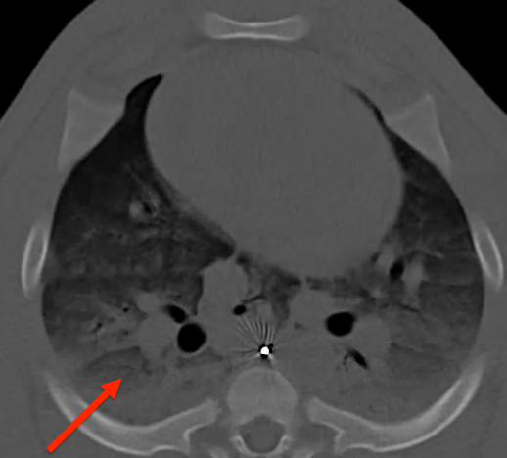
Common Postoperative Pulmonary Complications
Hypoxemia
Atelectasis
Pleural effusion
Bronchospasm
Pulmonary infiltrate
Aspiration
Pneumonia
Pulmonary infection
Pneumothorax
ARDS
Pulmonary edema caused by cardiac failure
Image Courtesy Patrick Bender
(Futier, Constantin et al. 2013; Hemmes, Gama de Abreu et al. 2014; Jammer, Wickboldt et al. 2015)

Slide 5
Incidence of Pulmonary Complications
Postoperative pulmonary complications (PPCs) are the second most common postoperative surgical complication following wound infections (Dimick, Chen et al. 2004; Khuri, Henderson et al. 2005)
20-30% of patients undergoing general anesthesia are at intermediate to high risk of experiencing pulmonary complications after surgery (Arozullah, Daley et al. 2000)
PCCs known to be affected by many surgical factors, including the patient’s preoperative condition.

Slide 6
Impact of Pulmonary Complications
18% of patients develop respiratory failure (Fernandez-Perez, Keegan et al. 2006)
1 in 5 patients who develop a PPC will die within 30 days of surgery (Canet, Gallart et al. 2010)
40-50% mortality rate from acute lung injury and acute respiratory distress syndrome (Brower, Matthay et al. 2000)

Slide 7
Financial Impact
Each reintubation costs $60K (Dimick, Chen et al. 2004; Khuri, Henderson et al. 2005; Ramachandran, Nafiu et al. 2011; Smetana, Lawrence et al. 2006)
Average surgical cost is $5,015 for patients without respiratory complications, increasing 12-fold to $62,704 for patients with a respiratory complication (Dimick, Chen et al. 2004; Khuri, Henderson et al. 2005; Ramachandran, Nafiu et al. 2011; Smetana, Lawrence et al. 2006)
PPCs impact the morbidity and mortality of patients undergoing major surgery (Bulka, Terekhov et al. 2016; Khuri, Henderson et al. 2005)

Slide 8
Ventilator Induced Lung Injury (VILI)
Volutrauma
Overdistention
Atelectrauma
Repeated recruitment and collapse
Biotrauma
Inflammatory Mediators
Barotrauma
High-Pressure Induced Damage
(Guldner, Kiss et al. 2015)

Slide 9
Summary of Recommendations
Balance potential benefits of Neuromuscular Blockade (NMB) against increased risk of PPCs
Avoid residual neuromuscular blockade
Train of Four monitoring before reversal
Administration of reversal agents before extubation
3) Apply lung protective ventilation strategies
Lower tidal volumes (6-8 mL/kg for ideal body weight)
Apply PEEP (amount less clear)
Consider Recruitment Maneuvers (not strong evidence)

Slide 10
Neuromuscular Blockade Considerations

Slide 11
Neuromuscular Blockade Considerations
Balance the potential benefits of NMB administration against the increased risk of postoperative pulmonary complications.
POPULAR study concludes administration of NMB is associated with increased risk of postoperative pulmonary complications despite the use of neuromuscular monitoring or reversal agents.
POPULAR study suggests patients undergoing minor surgical procedures might benefit from the use of supraglottical devices during anesthesia and avoidance of NMB drugs. (Kirmeier, Eva et al. 2018)

Slide 12
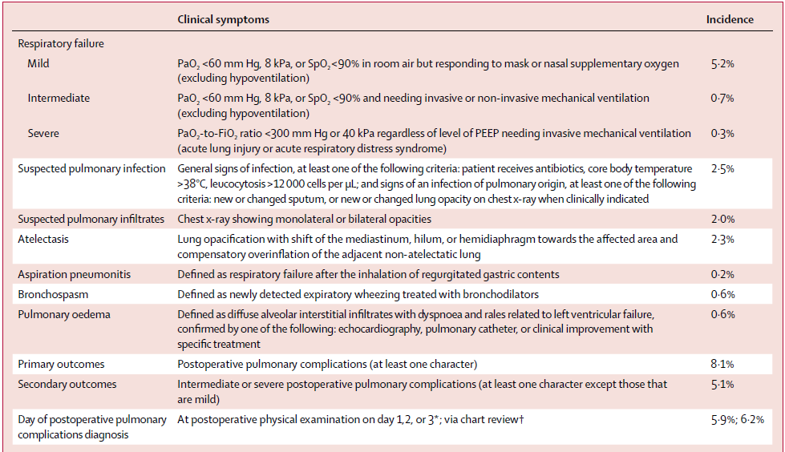
Post-anesthesia Pulmonary Complications after use of Muscle Relaxants; POPULAR study

Slide 13
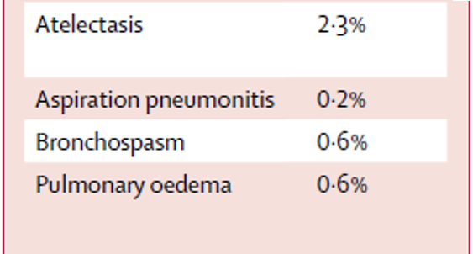
POPULAR study (European centers; 22,165 patients)
*Enlarged image from previous slide

Slide 14
Residual Neuromuscular Blockade

Slide 15
Residual Neuromuscular Blockade
Definition:
Presence of signs or symptoms of muscle weakness in the postoperative period in patients who received neuromuscular blocking agents
TOF ratio < 0.9 (Fortier, McKeen et al. 2015)
Incidence:
Approximately 40% of patients receiving NMB agents arrive in PACU with postoperative residual block (TOF ratio < 0.9) (Naguib, Kopman et al. 2007)
Impact:
Tracheal extubation with TOF ratios < 0.9 are associated with hypoxia, upper airway obstruction, O2 desaturation, aspiration, and reintubation (Eikermann, Blobner et al. 2006; Grosse-Sundrup, Henneman et al. 2012; Murphy, Szokol et al. 2013; Murphy, Szokol et al. 2008)

Slide 16
Residual NMB and Pulmonary Complications
Impaired Breathing
Increased Aspiration Risk
Upper Airway Muscle Weakness
Partial Upper Airway Obstruction
Impaired Pharyngeal Function
(Bulka, Terekhov et al. 2016)

Slide 17
Train of Four Monitoring
Train of Four monitoring or acceleromyography is recommended to optimize the timing of reversal agents and reduce incidence of residual NMB (Lien and Kopman 2014)
Rates of pulmonary complications are higher without accelerometric monitoring of NMB and reversal (Eikermann, Groeben et al. 2003; Murphy, Szokol et al. 2008).
Clinical tests (head lift, hand grip, leg lift, eye opening ) NOT sufficient to infer adequacy of respiratory muscle function (Brull and Murphy 2010)
11 of 12 (91.6%) patients could sustain > 5 second head lift at TOF ratio of 0.5
(Eikermann, Groeben et al. 2003)
16 of 19 (84.2%) patients could sustain 5 second head lift with TOF ratio < 0.5
(Pedersen, Viby-Mogensen et al. 1990)

Slide 18
TOF vs. Acceleromyography
Though acceleromyography is found to be superior in monitoring to prevent respiratory events in PACU (Murphy, Szokol et al. 2008), qualitative monitoring (TOF) is still beneficial.
Qualitative TOF monitoring can guide the timing of NMB reversal to reduce the incidence and severity of residual paralysis (Thilen and Bhananker 2016)

Slide 19
Neuromuscular Blocker Reversal
Cases utilizing non-depolarizing NMBs without neostigmine reversal were associated with increased incidence of respiratory events compared with patients reversed with neostigmine (Bronsert, Henderson et al. 2017)
In another study, patients who did not receive reversal were more likely to experience pneumonia postoperatively (11% vs. 5%)
Sugammadex can be used for rescue in failed rapid sequence induction & cases where large doses of NMBA were administered.
 | Reversal Administered (Neostigmine) | No Reversal Administered
Total patients with pneumonia: 219/1320 | 70 surgical cases (5%) | 149 surgical cases (11%)
(Bulka, Terekhov et al. 2016)

Slide 20
ASPIRE Neuromuscular Blockade Measures

Slide 21
ASPIRE Measure: NMB 01
Measure Summary: NMB 01 is a monitoring measure that identifies the percentage of cases that had a documented Train of Four or acceleromyography result after the last dose of non-depolarizing neuromuscular blocker. The purpose of this quality measure is to help reduce the number of patients who have residual neuromuscular blockade after extubation.
Inclusions: All patients that have received either by bolus or infusion a non-depolarizing neuromuscular blocker (NMB) AND were extubated post-operatively or in the PACU.
Success: Documentation of a Train of Four count (1, 2, 3, or 4), sustained tetany, or TOF ratio provided by acceleromyography AFTER last dose or stopping of infusion of neuromuscular blocker and before earliest extubation. Note: A Train of Four value of ‘0’ is accepted for cases in which sugammadex is administered for reversal.
Responsible Provider: The provider signed in at time of earliest extubation.
https://mpog.org/files/quality/measures/NMB-01_spec.pdf

Slide 22
ASPIRE Measure: NMB 02
Measure Summary: The neuromuscular blocker reversal measure tells you the percentage of your patients that receive a reversal agent after you have given a non-depolarizing neuromuscular blocker. The purpose of this quality measure is to help reduce the number of patients who have residual neuromuscular blockade after extubation. To account for cases where a dose of muscle relaxant was given early in the case, and then not redosed, this measure does not require that neostigmine to be given if a non-depolarizer was not administered for 3 hours before extubation for adults and 2 hours for pediatric patients.
Inclusions:
All patients that have received either by bolus or infusion a non-depolarizing neuromuscular blocker (NMB) AND were extubated post-operatively.
Success: Documentation of neostigmine, Sugammadex, and/or edrophonium before earliest extubation, OR A period of greater than 3 hours exists between last dose of non-depolarizing medication and extubation for patients ≥ 12 years old, OR A period of greater than 2 hours exists between last dose of non-depolarizing medication and extubation for patients <12 years old, OR An acceleromyography ratio of ≥ 0.9 documented after last dose of NMB and before earliest extubation.
Responsible Provider: The provider signed in at time of earliest extubation.
https://mpog.org/files/quality/measures/NMB-02_spec.pdf

Slide 23
Protective Ventilation Strategies

Slide 24
Protective Ventilation Strategies
Reduce Tidal Volume: 6-8 mL/kg for Ideal Body Weight
Administer PEEP (optimal amount still undefined)
Consider recruitment maneuvers every 30 minutes after intubation
Reduce modified driving pressures (PIP-PEEP ≤ 16 cmH₂O) (Ladha K et al. 2015)
(Futier, Constantin et al. 2013)
Image Courtesy of UMHS Anesthesiology

Slide 25
Benefits of Low Tidal Volumes
Patients receiving lower tidal volumes (<8 mL/kg for PBW) had fewer occurrences of postoperative pulmonary complications as compared to patients receiving conventional ventilation (>8 mL/kg for PBW) (Serpa Neto, Hemmes et al. 2015)
Mortality rates were lower in patients with lower tidal volumes as compared to patients receiving traditional tidal volumes (31 percent vs. 39.8 percent) (Brower, Matthay et al. 2000)
Low tidal volumes were determined to be the most important protective ventilation strategy for preventing postoperative pulmonary complications (Guldner, Kiss et al. 2015)

Slide 26
Benefits of Optimal Positive End-Expiratory Pressure
Application of individualized optimal PEEP intraoperatively:
Improves respiratory compliance and oxygenation
Lowers driving pressure
Reduces incidence and severity of postoperative atelectasis
Optimal PEEP values for patients with normal lungs and under general anesthesia vary significantly.
(Pereira SM, Tucci, MR, Morais CCA, et al. 2018)

Slide 27
PEEP & Recruitment Maneuvers
Lung protective ventilation is often considered as a bundle including low tidal volumes, PEEP, and/or recruitment maneuvers to prevent PPCs (Futier, Constantin et al. 2013; Severgnini, Selmo et al. 2013)
Very high levels of PEEP (>12 cm of water) is not necessarily better as patients can experience circulatory depression (hypotension) and hyperinflation (Hemmes, Gama de Abreu et al. 2014)
Overall, less evidence regarding PEEP and recruitment maneuvers than low tidal volumes

Slide 28
ASPIRE Pulmonary Measures

Slide 29
ASPIRE Measure: PUL 01
Measure Summary: PUL 01 measures performance in lung protective ventilation techniques. PUL 01 will measure the median tidal volume (in mL/kg ideal body weight) across a case.
Inclusions:
Patients undergoing endotracheal intubation.
Success: Median tidal volume < 10 ml/ kg ideal body weight for the time period between Case Start and Case End.
Responsible Provider: Provider signed in for largest portion of case. See ‘Other Measure Build Details’ section of this specification to view the algorithm used for determining case duration.
*Original low Tidal Volume ASPIRE Measure
https://mpog.org/files/quality/measures/PUL-01_spec.pdf

Slide 30
ASPIRE Measure: PUL 02
Measure Summary: PUL 02 measures performance in lung protective ventilation techniques. PUL 02 will measure the median tidal volume (in ml/kg ideal body weight) across a case.
Inclusions:
Patients undergoing endotracheal intubation.
Success: Median tidal volume ≤ 8 ml/ kg ideal body weight for the time period between Case Start and Case End.
Responsible Provider: Provider signed in for largest portion of case. See ‘Other Measure Build Details’ section of this specification to view the algorithm used for determining case duration.
*Updated ASPIRE Measure incorporating more recent evidence supporting lower TV 6-8 mL/kg
https://mpog.org/files/quality/measures/PUL-02_spec.pdf

Slide 31
ASPIRE Measure: PUL 03
Measure Summary: PUL 03 is an informational measure that analyzes PEEP usage across patients undergoing mechanical ventilation during anesthesia. PUL 03 will determine if PEEP was administered (as defined by median PEEP ≥ 2) and also analyze distribution of PEEP levels:
No PEEP (<2 cm H₂O)
Low PEEP (2-4 cm H₂O)
Moderate PEEP (≥ 4 to < 8 cm H₂O)
High PEEP (≥8 cm H₂O)
Inclusions: Patients undergoing endotracheal intubation.
Success: Median PEEP ≥ 2 cm H2O (Assuming values less than 2cm H2O is equivalent to no PEEP administered)
Responsible Provider: This measure if informational only. Attribution not yet determined by the Quality Committee.
https://mpog.org/files/quality/measures/PUL-03_spec.pdf

Slide 32
Practical Applications

Slide 33
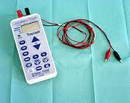
Practical Application: Residual NMB
Train of Four Monitor (acceleromyography or Peripheral Nerve Stimulators) in every operating room
Replacement batteries for monitor easily accessible
Consider real-time alerting options to trigger NMB reversal and Train of Four monitoring documentation
Image Retrieved from: https://upload.wikimedia.org/wikipedia/commons/thumb/6/60/Relaxometer_fisher.jpg/220px-Relaxometer_fisher.jpg

Slide 34
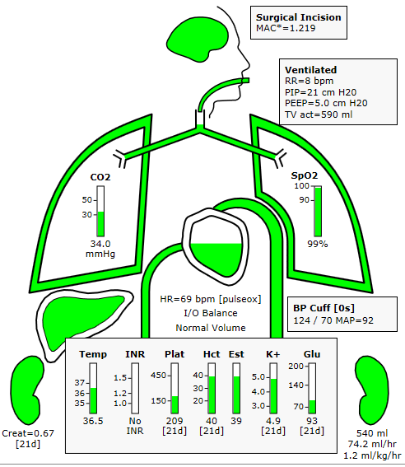
Practical Application: Protective Ventilation Strategies
Tidal volume for ideal body weight reference cards available on each anesthesia cart and online
Change default ventilator settings to:
400-500cc tidal volume
Rate: 10-12
PEEP ~ 5 cm H2O
Build Ideal Body Weight Calculations into electronic health record
Consider real-time alerting options for tidal volume>10cc/kg
Image Courtesy of AlertWatch, Ann Arbor, MI

Slide 35
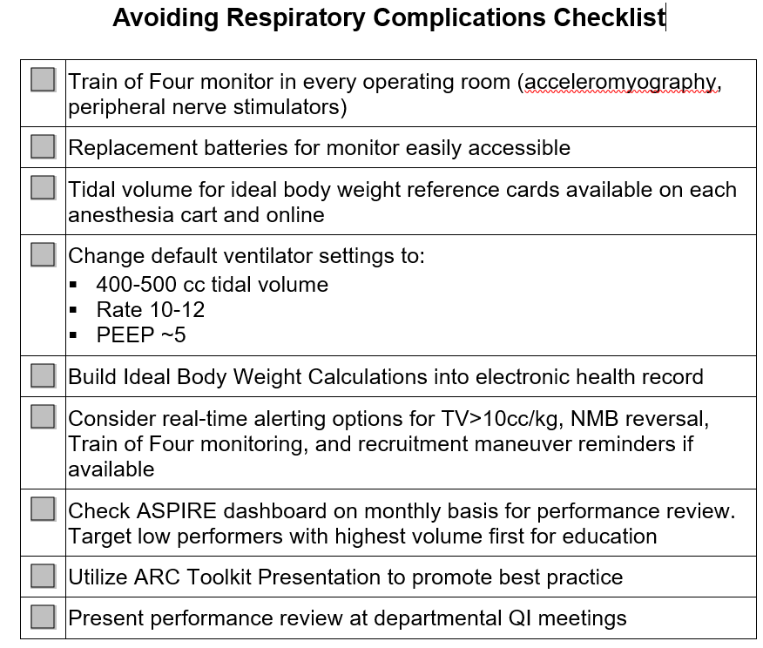
Checklist

Slide 36
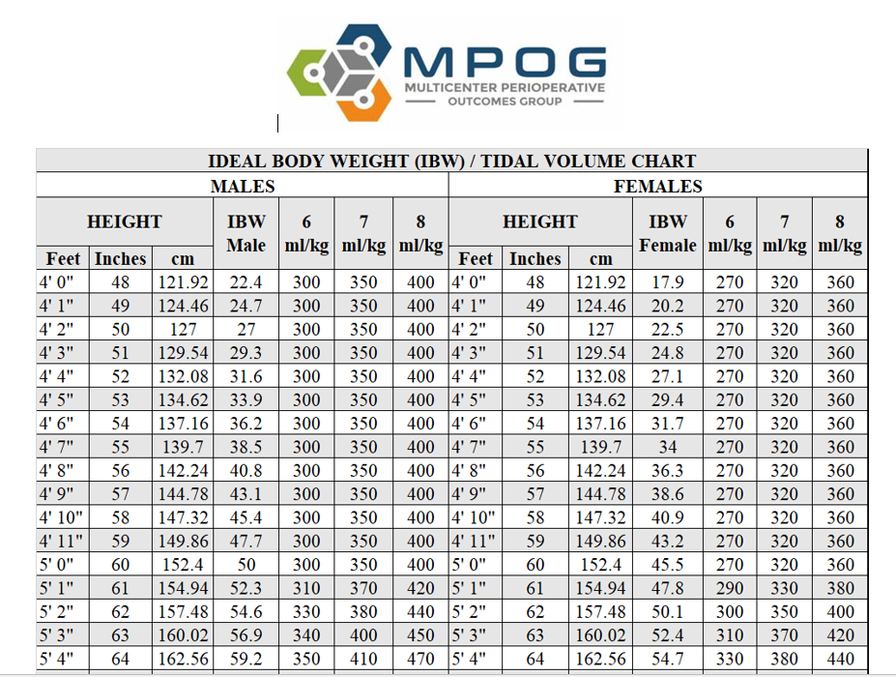
Tidal Volume for Ideal Body Weight Tool
*Revert to 5 feet when assigning Tidal Volume for all patients < 5 feet tall.
Rationale: Ideal Body Weight calculator loses validity at < 5 feet.
https://mpog.org/files/quality/toolkit/ibw_tv_chart1.pdf

Slide 37
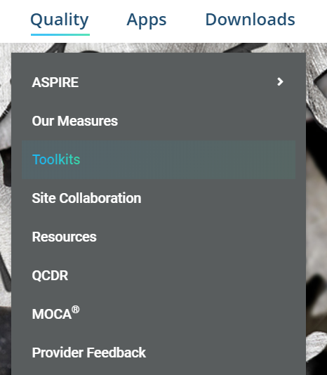
ASPIRE Toolkit for Avoiding Respiratory Complications accessible online
Access the ASPIRE Quality Improvement Toolkit:
https://mpog.org/quality/toolkits/

Slide 38
References
Arozullah AM, Daley J, Henderson WG, Khuri SF. Multifactorial risk index for predicting postoperative respiratory failure in men after major noncardiac surgery. The National Veterans Administration Surgical Quality Improvement Program. Annals of surgery. 2000;232(2):242-253.
Bronsert MR, Henderson WG, Monk TG, et al. Intermediate-Acting Nondepolarizing Neuromuscular Blocking Agents and Risk of Postoperative 30-Day Morbidity and Mortality, and Long-term Survival. Anesthesia and analgesia. 2017;124(5):1476-1483.
Brower RG, Matthay MA, Morris A, Schoenfeld D, Thompson BT, Wheeler A. Ventilation with lower tidal volumes as compared with traditional tidal volumes for acute lung injury and the acute respiratory distress syndrome. The New England journal of medicine. 2000;342(18):1301-1308.
Brull SJ, Murphy GS. Residual neuromuscular block: lessons unlearned. Part II: methods to reduce the risk of residual weakness. Anesthesia and analgesia. 2010;111(1):129-140
Bulka CM, Terekhov MA, Martin BJ, Dmochowski RR, Hayes RM, Ehrenfeld JM. Nondepolarizing Neuromuscular Blocking Agents, Reversal, and Risk of Postoperative Pneumonia. Anesthesiology. 2016;125(4):647-655.
Canet J, Gallart L, Gomar C, et al. Prediction of postoperative pulmonary complications in a population-based surgical cohort. Anesthesiology. 2010;113(6):1338-1350.
Dimick JB, Chen SL, Taheri PA, Henderson WG, Khuri SF, Campbell DA, Jr. Hospital costs associated with surgical complications: a report from the private-sector National Surgical Quality Improvement Program. Journal of the American College of Surgeons. 2004;199(4):531-537.
Eikermann M, Blobner M, Groeben H, et al. Postoperative upper airway obstruction after recovery of the train of four ratio of the adductor pollicis muscle from neuromuscular blockade. Anesthesia and analgesia. 2006;102(3):937-942.
Eikermann M, Groeben H, Husing J, Peters J. Accelerometry of adductor pollicis muscle predicts recovery of respiratory function from neuromuscular blockade. Anesthesiology. 2003;98(6):1333-1337.

Slide 39
References
Fernandez-Perez ER, Keegan MT, Brown DR, Hubmayr RD, Gajic O. Intraoperative tidal volume as a risk factor for respiratory failure after pneumonectomy. Anesthesiology. 2006;105(1):14-18.
Futier E, Constantin JM, Paugam-Burtz C, et al. A trial of intraoperative low-tidal-volume ventilation in abdominal surgery. The New England journal of medicine. 2013;369(5):428-437.
Grosse-Sundrup M, Henneman JP, Sandberg WS, et al. Intermediate acting non-depolarizing neuromuscular blocking agents and risk of postoperative respiratory complications: prospective propensity score matched cohort study. BMJ (Clinical research ed). 2012;345:e6329.
Guldner A, Kiss T, Serpa Neto A, et al. Intraoperative protective mechanical ventilation for prevention of postoperative pulmonary complications: a comprehensive review of the role of tidal volume, positive end-expiratory pressure, and lung recruitment maneuvers. Anesthesiology. 2015;123(3):692-713.
Hemmes SN, Gama de Abreu M, Pelosi P, Schultz MJ. High versus low positive end-expiratory pressure during general anaesthesia for open abdominal surgery (PROVHILO trial): a multicentre randomised controlled trial. Lancet (London, England). 2014;384(9942):495-503.
Jammer I, Wickboldt N, Sander M, et al. Standards for definitions and use of outcome measures for clinical effectiveness research in perioperative medicine: European Perioperative Clinical Outcome (EPCO) definitions: a statement from the ESA-ESICM joint taskforce on perioperative outcome measures. European journal of anaesthesiology. 2015;32(2):88-105.
Khuri SF, Henderson WG, DePalma RG, Mosca C, Healey NA, Kumbhani DJ. Determinants of long-term survival after major surgery and the adverse effect of postoperative complications. Annals of surgery. 2005;242(3):326-341; discussion 341-323.
Kirmeier E, Eriksson LI, Lewald H, et al. Post-anesthesia pulmonary complications after use of muscle relaxants (POPULAR): a multicentre, prospective observational study. 2018;7(2):129-140.
Ladha K, Vidal Melo MF, McLean DJ, Wanderer JP et al. Intraoperative protective mechanical ventilation and risk of postoperative respiratory complications: hospital based registry study. BMJ. 2015; 351.
Lien CA, Kopman AF. Current recommendations for monitoring depth of neuromuscular blockade. Current opinion in anaesthesiology. 2014;27(6):616-622.

Slide 40
References
Murphy GS, Szokol JW, Avram MJ, et al. Postoperative residual neuromuscular blockade is associated with impaired clinical recovery. Anesthesia and analgesia. 2013;117(1):133-141.
Murphy GS, Szokol JW, Marymont JH, et al. Intraoperative acceleromyographic monitoring reduces the risk of residual neuromuscular blockade and adverse respiratory events in the postanesthesia care unit. Anesthesiology. 2008;109(3):389-398.
Murphy GS, Szokol JW, Marymont JH, Greenberg SB, Avram MJ, Vender JS. Residual neuromuscular blockade and critical respiratory events in the postanesthesia care unit. Anesthesia and analgesia. 2008;107(1):130-137.
Naguib M, Kopman AF, Ensor JE. Neuromuscular monitoring and postoperative residual curarisation: a meta-analysis. British journal of anaesthesia. 2007;98(3):302-316.
Pedersen T, Viby-Mogensen J, Bang U, Olsen NV, Jensen E, Engboek J. Does perioperative tactile evaluation of the train-of-four response influence the frequency of postoperative residual neuromuscular blockade? Anesthesiology. 1990;73(5):835-839.
Pereira SM, Tucci MR, Morais CA, Simoes CM, Tonelotto BFF, Pompeo MS, Kay FU, Pelosi P, Vieira JE, Amato MB. Individual positive end-expiratory pressure settings optimize intraoperative mechanical ventilation and reduce postoperative atelectasis. Anesthesiology. 2018;129(6):1070-1081.
Ramachandran SK, Nafiu OO, Ghaferi A, Tremper KK, Shanks A, Kheterpal S. Independent predictors and outcomes of unanticipated early postoperative tracheal intubation after nonemergent, noncardiac surgery. Anesthesiology. 2011;115(1):44-53.
Serpa Neto A, Hemmes SN, Barbas CS, et al. Protective versus Conventional Ventilation for Surgery: A Systematic Review and Individual Patient Data Meta-analysis. Anesthesiology. 2015;123(1):66-78.
Severgnini P, Selmo G, Lanza C, et al. Protective mechanical ventilation during general anesthesia for open abdominal surgery improves postoperative pulmonary function. Anesthesiology. 2013;118(6):1307-1321.
Smetana GW, Lawrence VA, Cornell JE. Preoperative pulmonary risk stratification for noncardiothoracic surgery: systematic review for the American College of Physicians. Annals of internal medicine. 2006;144(8):581-595.

