Slide 1
Avoiding Kidney Injury Pediatrics

Slide 2
Pediatric patient population: Postoperative AKI
Majority of pediatric research focused on acute kidney injury after cardiac surgery & liver transplant
More pediatric research is required to examine intraoperative management of non-cardiac surgical patients & impact on renal outcomes
Disclaimer: Evidence provided in this presentation is based on literature from both critical care and perioperative research.

Slide 3
Objectives
Discuss incidence and impact of Acute Kidney Injury & Chronic Kidney Disease in pediatric surgical patients
Review the pathophysiology related to AKI and CKD in children
Identify definitions & stages of kidney disease for infants and children
Share registry definitions of kidney injury or failure - review ASPIRE AKI 01 measure
Provide an overview of the literature studying the prevention and recognition of kidney disease
Summarize recommendations supported by the literature

Slide 4
For more information….
For a more in-depth overview of kidney disease, including staging and definitions, reference
Avoiding Kidney Injury - Overview, Pathophysiology, Definitions
For other specialty specific recommendations, reference the following sections of the toolkit:
Avoiding Kidney Injury – Obstetric Patients
Avoiding Kidney Injury - Cardiac Surgery
Avoiding Kidney Injury - Recommendations for Adult Surgical Patients

Slide 5
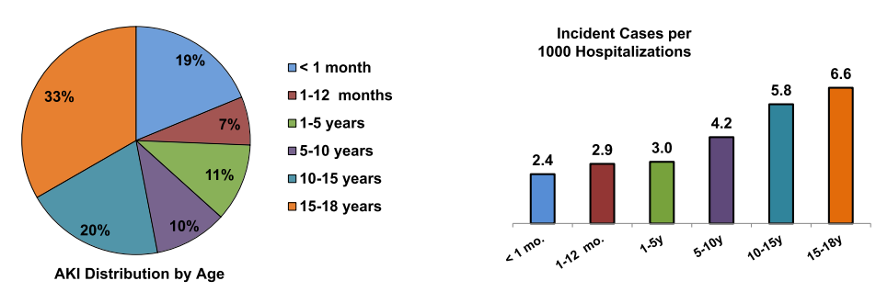
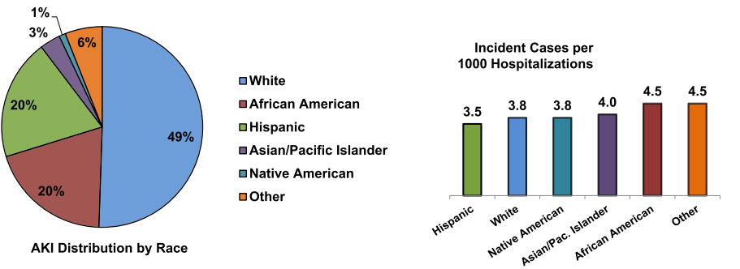
AKI Incidence in Pediatrics ¹
Largest epidemiologic study of AKI in children using the Kids’ Inpatient Database (KID), an all payer inpatient pediatric care database
Included 2,644,263 admissions of neonatal (≤ 1 month old) and children ( < 18 old) from over 4,000 hospitals in the United States.
Reported an AKI incidence of 3.9 cases per 1,000 admissions. AKI identified using ICD-9 codes.
Incidence increased with age: 6.6 events per 1000 admissions in 15-18 year olds
Mortality was 15.3% for children admitted with AKI compared to non-AKI admissions (0.6%)
Image Source: Sutherland et al. J Am Soc Nephrol. 2013

Slide 6
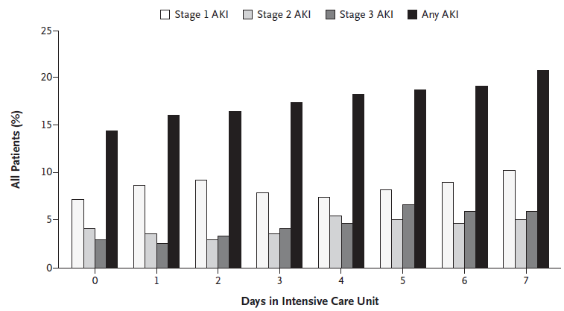
Pediatric AKI Multi-national Study ²
Assessment of Worldwide Acute Kidney Injury, Renal Angina and Epidemiology (AWARE) study
Cohort of 4,683 critically ill children and young adults (3 months to 25 years old) admitted to pediatric intensive care unit
30% were post-surgical patients
26.9% developed AKI; 3.4% died
Image Source: Kaddourah et al. N Engl J Med. 2017

Slide 7
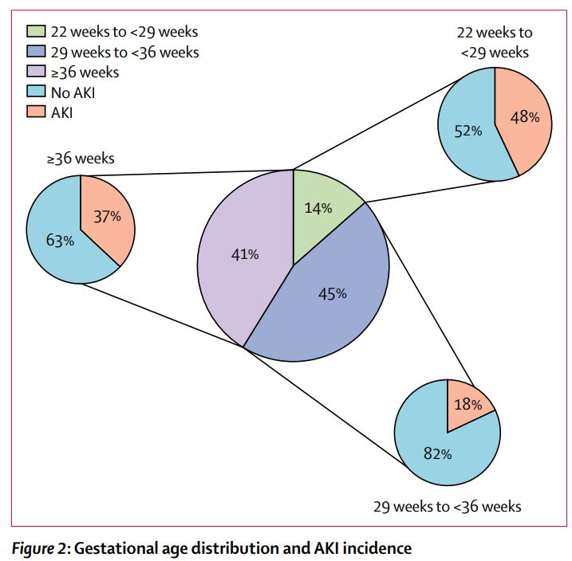
Neonatal AKI Multi-national Study ³
Assessment of Worldwide Acute Kidney Injury, Renal Angina and Epidemiology in Neonates (AWAKEN) study
2,022 neonates admitted to NICU
29.9% developed AKI - rates varied by gestational age
47.9% (22-29 weeks)
18.3% (29-36 weeks)
36.7% (> 36 weeks)
Infants with AKI had a higher mortality compared to those without AKI (9.7% vs. 1.4%)
Highest prevalence in white males with GA < 36 weeks
Image Source: Jetton et al. Lancet Child Adolesc Health. 2017

Slide 8
Chronic Kidney Disease (CKD) Incidence
~ 10,000 children in the United States have kidney failure ⁴
70% of children with CKD from diverse etiologies will progress to ESRD before reaching adulthood ⁵
30-50% of children and adults with congenital heart disease have CKD ⁶
The ESRD incidence in African American children is twice as that in caucasian children ⁶

Slide 9
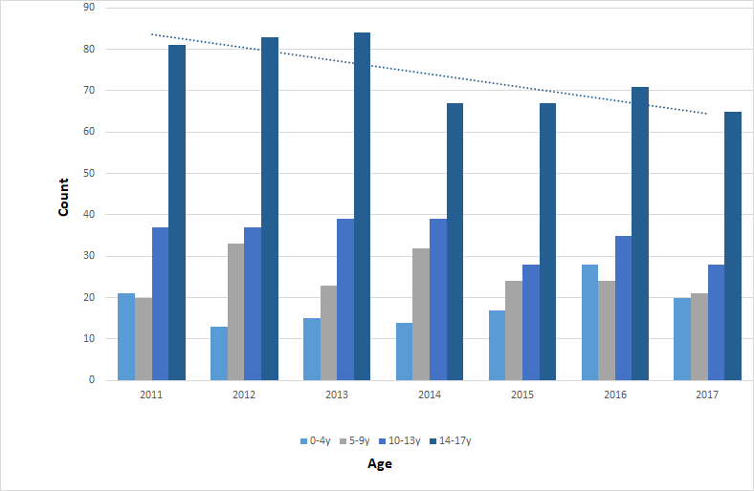
End Stage Renal Disease (ESRD)⁷
Leading causes of ESRD in children
0 - 4 year olds → Birth defects and hereditary diseases
5 - 14y → Hereditary diseases, nephrotic syndrome and systemic diseases
15 - 19y → Diseases of the glomeruli
One-Year mortality rate for pediatric patients with ESRD has decreased by 20.4% over the last decade with the most notable improvement in those 0-4 years of age
Reported ESRD in Children/Adolescents (U.S.)

Slide 10
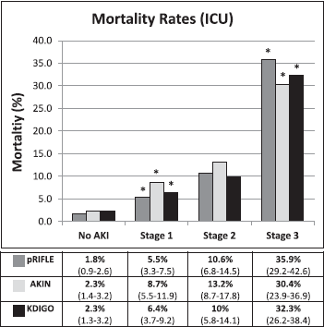
AKI Outcomes
Mortality increases from 5% to 18% in neonates who develop AKI after non-cardiac surgery ⁸
A prospective national cohort study of 1,343 events of AKI in patients less than 18 years old showed neonatal and pediatric 30 day mortality rates of 4.1%. and 1.2% respectively ⁹
In a retrospective cohort study of 2,041 non-cardiac surgical patients (<18 years old) admitted to the PICU, AKI was independently associated with an increase from 5 to 7 year mortality ¹⁰
Severe AKI is associated with an increased risk of death (11% vs. 2.5% w/o severe AKI). RRT is the second strongest predictor of death by day 28 after admission ²
Length of ICU stay increases in children with AKI from 4 to 10 days ¹¹
Image Source: Sutherland et al. Clin J Am Soc Nephrol, 2015

Slide 11
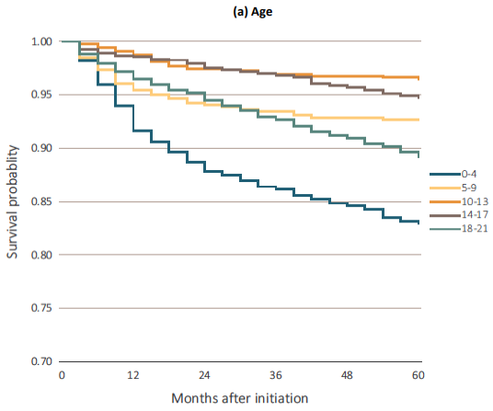
Mortality and Modality – CKD
The probability of surviving after RRT by age is the lowest for children 0-4 years old (0.83) and young adults 18-21 years old (0.89) ¹²
Patients who received a kidney transplant have a higher probability of surviving 5 years when compared to those treated with hemodialysis or peritoneal dialysis
In a study of 1,634 children and adolescents requiring RRT, the long-term survival rate was 79% at 10 years and 66% at 20 years. ¹³
There are a limited number of studies on the risk of CKD in children who experience AKI.
Image Source: USRDS, 2019

Slide 12
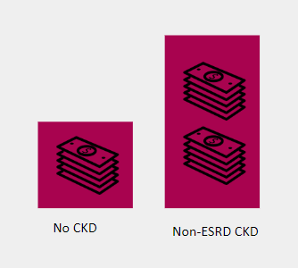
Financial Impact of Kidney Disease
Healthcare expenditures are 7.6x higher for children with CKD and increased by 50% over the last 10 years compared to a 25% increase in spending for children without CKD ¹⁴
The cost of dialysis for a neonate or infant compared to an adult patient with end stage renal disease is $75,000 to $43,000 respectively ¹⁵

Slide 13
Acute Kidney Injury Classification Systems

Slide 14
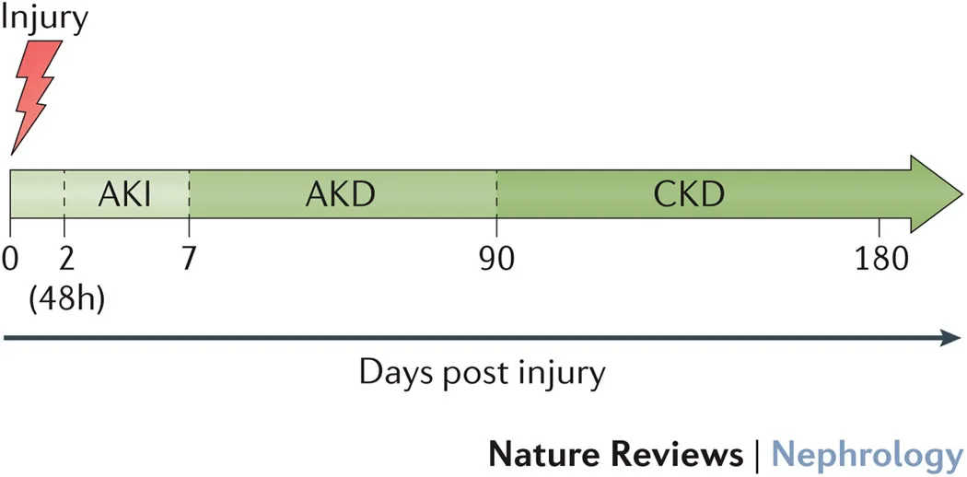
Acute Kidney Injury: General Definition ¹⁶⁻¹⁷
Several AKI Classification Systems exist:
RIFLE - Risk, Injury, Failure, Loss, End Stage - 2004
AKIN - Acute Kidney Injury Network – 2007
pRIFLE/nRIFLE – Pediatric and neonatal specific RIFLE criteria– 2008
KDIGO - Kidney Disease Improving Global Outcomes- 2012
Acute Kidney Injury
An abrupt decline in kidney function occurring over a period of 7 days or less, characterized by:
Reversible increase in serum blood creatinine and nitrogenous waste products
Inability of the kidney to appropriately regulate fluid and electrolyte homeostasis.

Slide 15
AKI Classification Systems: RIFLE
First attempt at a unifying definition for AKI (then called acute renal failure) ¹⁸
Published in 2004, RIFLE graded AKI Stages and provided taxonomies for both severity and recovery ¹⁹
Proposed 1 week timeframe for AKI Diagnosis ²⁰
Published in 2008, modifications for pediatrics (pRIFLE) and neonates (nRIFLE) include wider duration of decreased urine output. ²¹
Image Source: Ricci et al. Kidney Int. 2008

Slide 16
AKI Classification Systems: KDIGO Criteria ²²
 | GFR Criteria | Urine output criteria
1 | Increased creatinine x1.5-1.9 from baseline or ≥ 0.3 mg/dl | UO <0.5ml/kg/hr for 6-12hr
2 | Increased creatinine x2.0-2.9 from baseline | UO <0.5ml/kg/hr ≥ 12h
3 | Increased creatinine x3 from baseline OR SCr ≥ 4.0mg/dl OR RRT | UO < 0.3 ml/kg/hr for ≥ 24h or anuria ≥ 12h
 | Diagnostic criteria for AKI: SCr increase ≥0.3mg/dl within 48h OR SCr increase ≥1.5 times baseline, which is known or presumed to have occured within the last 7 days OR Urine volume < 0.5 ml/kg for 6h
UO criteria unchanged
SCr criteria mostly unchanged from AKIN
KDIGO has been validated as a clinically relevant AKI classification system in the pediatric population. There have been calls to utilize the KDIGO AKI definition as the standard for defining AKI in pediatrics ²³
Removed acute rise criteria. Kept RRT criteria from AKIN
Kept SCr increase of ≥ 0.3 mg/dl within 48 hours from AKIN
Used 7 day timeframe for 1.5X increase in SCr from RIFLE

Slide 17
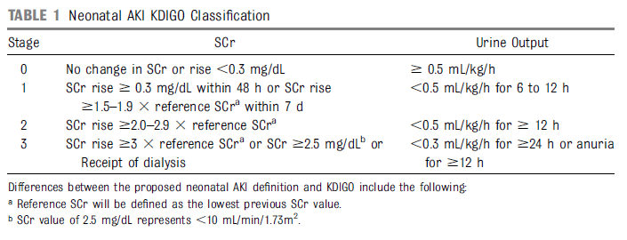
AKI Classification Systems: KDIGO in neonates
Serum creatinine is a suboptimal biomarker in the neonatal population due to presence of maternal creatinine, variable degree of creatinine reabsorption, low glomerular filtration rate and maturational differences. ³⁵
Modification of KDIGO criteria for neonates (nKDIGO) stages AKI based on an absolute rise in serum creatinine from a previous trough and should be used in children < 120 days of age. ³⁶
Severity of AKI based on neonatal KDIGO (nKDIGO) criteria was independently associated with ICU stay, renal replacement therapy and increased in-hospital mortality within 30 days after cardiac surgery.³⁷
Image Source: Selewski et al. Pediatrics. 2015

Slide 18
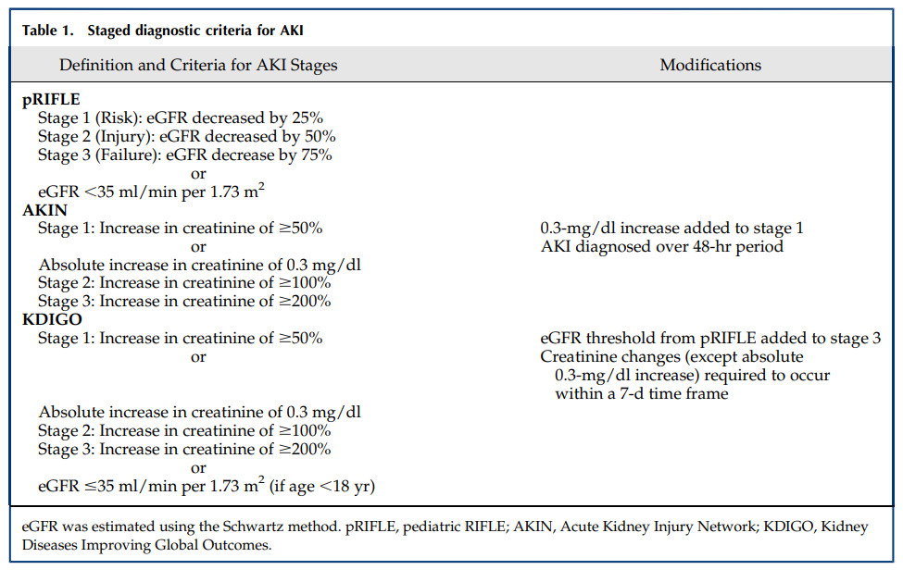
Image Source: Sutherland et al. Clin J Am Soc Nephrol. 2015

Slide 19
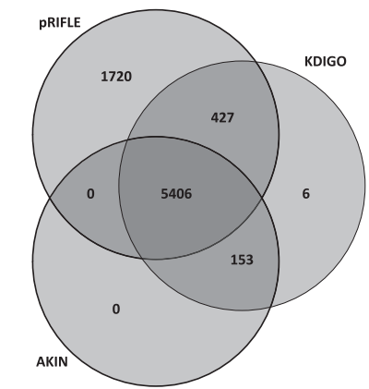
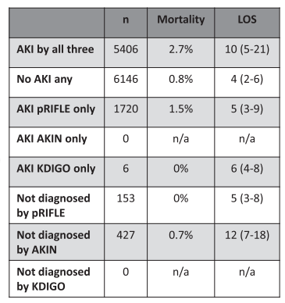
pRIFLE vs. AKIN vs. KDIGO ²⁴
pRIFLE provides more sensitivity to identifying a greater number of mild AKI cases children
Demonstrated that doubling of SCr in children associated with 27.4% mortality rate
75% of pediatric patients are admitted without a baseline SCr lab value
Using 120 mL/min/1.73m² in place of an actual baseline can lead to underdiagnosis of AKI using pRIFLE criteria
AKIN does not require height or baseline creatinine values - may be advantageous as baseline SCr values are rarely available in pediatrics
KDIGO is applicable to both pediatric and adult patients and has a less restrictive diagnostic timeframe than AKIN. Both pRIFLE and KDIGO determine stages of AKI by changes in serum creatinine (SCr)/estimated creatinine (eCCl) clearance and changes in urine output.
Image Source: Sutherland et al. Clin J Am Soc Nephrol. 2015

Slide 20
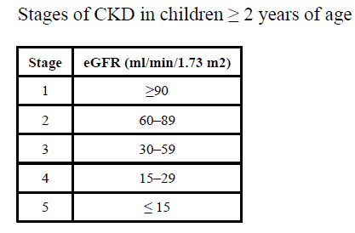
Estimated Glomerular Filtration Rate (eGFR)
Calculating an eGFR is necessary for accurate staging of CKD in children. Renal development and function is still maturing in children less than two years old ²⁵
Baseline SCr is often not available in pediatric patients making it difficult to estimate baseline kidney function.
Chronic Kidney Disease in Children (CKiD) study derived a Schwartz formula for patients 1-16 years of age ²⁶
eGFR (ml/min/1.73m²) = [height in cm x 0.413] / SCr in mg/dL
Image Source: Sutherland et al. J Am Soc Nephrol. 2015

Slide 21
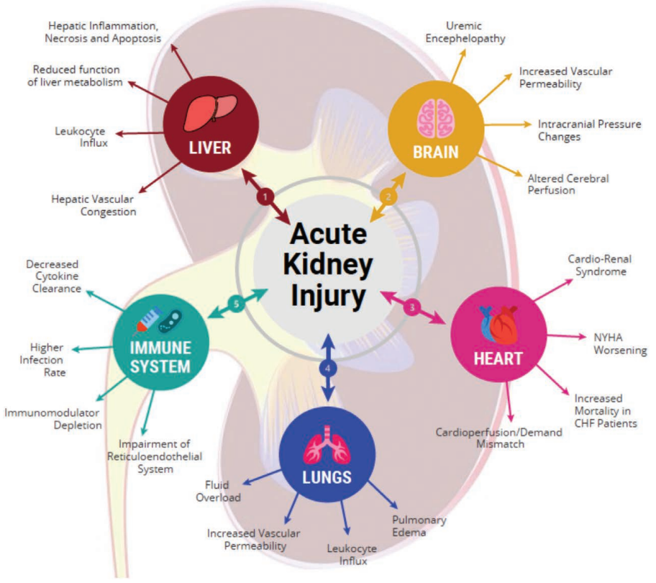
AKI Pathophysiology and Etiology
Image Source: Gumbert et al. Anesthesiology. 2020

Slide 22
Pathophysiology: Anesthetic Impact on AKI ²⁷⁻²⁸
Hypovolemia and venodilation
Positive pressure ventilation can impair venous return to the heart
Anesthetics can reduce arterial tone which decreases perfusion pressure.
Right sided hemodynamics are critical, as high venous pressure can cause kidney injury through organ congestion.
Cardiac surgery: right side of the heart may be compromised from cardioplegia.
Thoracic surgery: increased pleural pressure may increase venous “back pressure” on the liver and kidneys
Abdominal surgery: High insufflation pressure in the abdomen
Ischemia-reperfusion causes damage associated molecular pattern (DAMP) molecules to be released into circulation such as myoglobin and uric acid.

Slide 23
Etiology: Pre-renal ¹⁶
Renal Hypoperfusion due to true volume contraction: Hemorrhage, dehydration, increased insensible losses (burns) and other third space losses such as sepsis, nephrotic syndrome, traumatized tissue and capillary leak syndrome
Decreased effective intravascular volume: Renal perfusion decreased due to low cardiac output states, such as from congenital heart defects

Slide 24
Etiology: Renal (Intrinsic)
Results of injury to kidney structures: tubules, glomeruli, the interstitium, and intra-renal blood vessels ²⁹
Acute Tubulointerstitial nephritis
3 Main Causes in Children ³⁰
Acute Glomerulonephritis (stage 1)
Septicemia (stage 3)
Antibiotic drug-induced AKI (stage 3)

Slide 25
Etiology: Intrinsic Possible Causes ^{16,29}
Tubular:
Renal ischemia (shock, complication of surgery, hemorrhage, trauma, bacteremia),
Nephrotoxic drugs
Endogenous toxins such as uric acid excretion caused by tumor lysis syndrome in children with Leukemia
Interstitium:
Infectious (bacterial, viral)
Medications (antibiotics, diuretics, NSAIDs)
Acute Interstitial Nephritis (idiopathic or drug induced)
Vascular:
Cortical necrosis is common in young children, particularly neonates
Associated with ischemic insults due to perinatal anoxia, placenta abruption and twin-twin or twin-mother transfusions
Hemolytic uremic syndrome
Glomerular:
Acute post infectious glomerulonephritis
Lupus nephritis

Slide 26
Etiology: Postrenal
Caused by blockage of urinary flow in the urinary tract ³¹
Obstruction → ↑ intratubular pressure and ↓GFR ³²
Leads to build up in the kidney
Quick resolution = best chance of kidney recovery ²⁹

Slide 27
Etiology: Post Renal Possible Causes ^{16,29}
Extrarenal Obstruction: congenital malformations such as posterior urethral valves, bilateral ureteropelvic junction obstruction or bilateral obstructive ureteroceles
Intrarenal Obstruction: Nephrolithiasis, blood clots

Slide 28
AKI Risk Factors

Slide 29
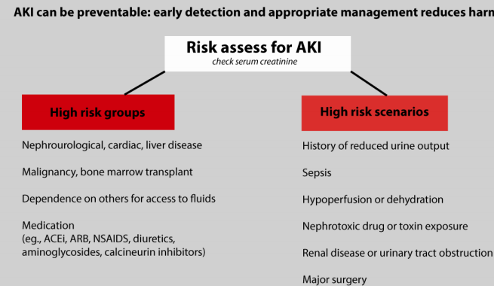
Anesthesia-related Risk Factors
Potentially modifiable AKI risk factors in both pediatric cardiac and noncardiac surgery ³³⁻³⁵
Hemodilution
Hemoglobin level
Intraoperative transfusion
Hypotension
Inadequate oxygen delivery
Use of diuretics
Use of vasopressors and inotropes
Selective renal ischemia
Ischemia reperfusion injury
Bleeding complications
Transfusion of allogeneic blood products
Intraoperative Hypertension
Nephrotoxic agents (eg abx, contrast agents)
Image Source: Think Kidneys 2019

Slide 30
AKI Risk Factors: Neonatal ⁸
Maternal
NSAID use
Perinatal
Gestational age under 32 weeks
Congenital heart defect
Postnatal
Low Apgar score (< 7)
Low birth weight (< 1500g)
Mechanical Ventilation
Surgical procedure longer than 120 min
Diagnosis of necrotizing enterocolitis
Resuscitation with epinephrine ¹²
Admission diagnosis of hyperbilirubinemia

Slide 31
AKI Risk Factors: Pediatric
Nephrotoxic Drugs
Administration of IV vancomycin with or without IV administration piperacillin/tazobactam ³⁶⁻³⁸
Aminoglycosides ³⁹⁻⁴²
Comorbidities ^{39-40, 43-45, 46}
Cystic fibrosis
Liver transplant recipients
Vaso-occlusive crisis
Diabetic ketoacidosis
Oncologic diagnosis
Age and sex - no consistent correlations ⁴⁷
Other associated factors ²
Sepsis
Heart failure
Tumor lysis syndrome

Slide 32
AKI Risk Factors: Cardiac Surgery
Independent risk factors for AKI identified in children undergoing cardiac surgery ⁴⁸
Young age (< 1 year)
Risk adjustment in Congenital Heart Surgery category (RACHS-1) ≥ 4
Cardiopulmonary Bypass time ≥ 90 minutes
Children with congenital heart disease have an increased risk of postoperative AKI ⁴
86% Incidence using KDIGO → Dependent on age, heart disease, cardiac status, CPB technique, management of anesthesia and postoperative care practices.
Other risk factors specific to children with congenital heart disease include previous cardiac surgery, univentricular anatomy, inotrope and captopril use or PICU admission preoperatively with or without mechanical ventilation
Wide fluctuations in blood glucose intraoperatively increases the risk of AKI (using AKIN criteria). ⁴⁹
Acute hyperglycemia insults alone does not increase the risk of AKI in this population

Slide 33
Registry Definitions: Kidney Disease

Slide 34
National Surgical Quality Improvement Program - Pediatrics
Progressive Renal Insufficiency:
Rise in creatinine of >1 mg/dl from preoperative value, but with no requirement for dialysis within 30 days of the operation.
Acute Renal Failure:
In a patient who did not require dialysis preoperatively, worsening of renal dysfunction postoperatively requiring hemodialysis, peritoneal dialysis, or ultrafiltration within 30 days of the operation.
Days from Operation until Acute Renal Failure Complication
Source: ACS-NSQIP-Pediatrics User Guide

Slide 35
STS - Congenital Heart Data Registry
Renal Failure requiring Dialysis
Oliguria with sustained urine output < 0.5 cc/kg/hr for 24 hours and/or a rise in creatinine >1.5x upper limits of normal for age (or 2x the most recent preop values if available), with need for dialysis (including peritoneal dialysis and /or hemodialysis) or hemofiltration
Requiring dialysis before hospital discharge (even if greater than 30 days after surgery)
OR
Requiring dialysis after hospital discharge but within 30 days after surgery
Source: STS Congenital Heart Surgery Database Data Specification

Slide 36
Children’s Hospital Solutions for Patient Safety
Nephrotoxic medication exposure is one of the most common causes of AKI in children
Defined as a Class 4 (significant temporary harm) Serious Safety Event by the Children’s Hospitals’ Solutions for Patient Safety
SPS has partnered with the NINJA program with plans to rollout to all 140 sites by 2020 ^{42,50}
NINJA - Nephrotoxic Injury Negated by Just-in-time Action
Uses KDIGO Diagnostic criteria
Proactively screens for nephrotoxic drug (NTMx) exposure in EHR
High risk patients are monitored via daily SCr lab orders
Source: Solutions for Patient Safety

Slide 37
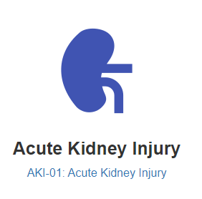
ASPIRE Measure Definition: AKI 01
Pediatric Patients ≤ 18 years old
KDIGO Criterion used
EGFR Calculation
Bedside Schwartz
EGFR = 0.413 x [(height in cm)/(serum creatinine in mg/dL)]
Exclusion criteria: baseline creatinine <0.2mg/dL
Baseline serum creatinine is defined as the most recent serum creatinine resulted in the last 60 days preoperatively
Success criteria:
The creatinine level does not go above 1.5x the baseline creatinine within 7 days post-op
The creatinine level does not increase by ≥ 0.3 mg/dL obtained within 48 hours after anesthesia end.
Source: ASPIRE Measures-Acute Kidney Injury

Slide 38
AKI Pediatric Recommendations

Slide 39
Pediatric and Neonate Recommendations
01
Identify patients at risk of developing AKI
Anesthesia related risk factors
Pediatric risk factors (neonates & children)
Risk factors specific to cardiac surgery
02
Prevention of AKI
Avoid nephrotoxins
Maintain Fluid Balance
Normalize preoperative nutrition status
03
Early recognition of AKI
Identify precipitating factors of AKI
Early recognition prevents further progression
Renal Angina Index
04
Treatment Considerations
Correct electrolytes
Avoid fluid overload
Consider Renal Replacement Therapy

Slide 40
Recommendation #1: Identify patients at risk for AKI

Slide 41
*See slides 28-32 for pediatric risk factors

Slide 42
Recommendation #2:
Prevention of AKI

Slide 43
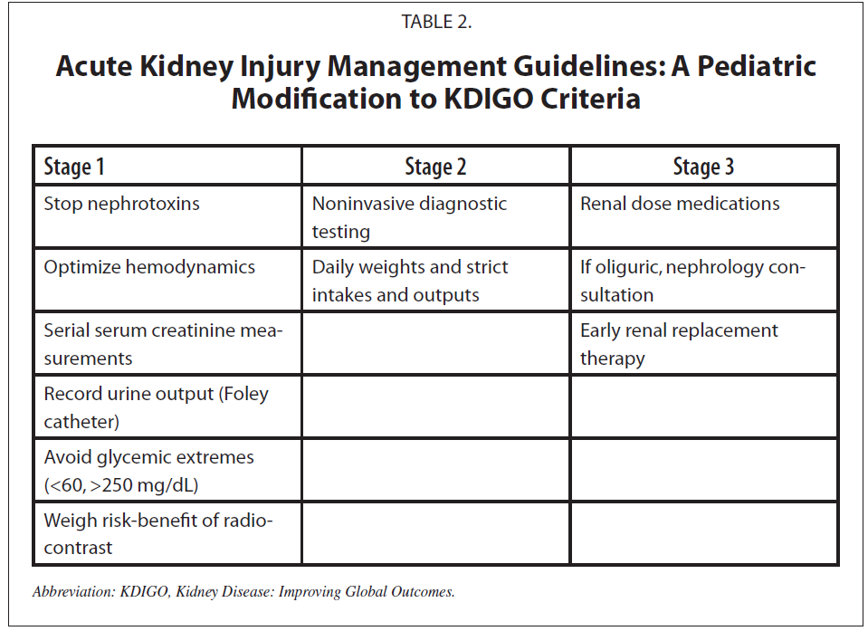
Prevention of AKI
Image Source: Basu et al. Clin J Am Soc Nephrol, 2018

Slide 44
Nephrotoxic Medication (NTMx) Exposure Defined ⁵¹
Nephrotoxic Medication exposure criteria
≥ 3 NTMx meds
≥ 3 days on any IV aminoglycosides
≥ 3 days on Vancomycin
AKI Criteria for NTMX exposed patients
At least 50% increase in SCr above baseline SCr (lowest SCr in the past 6 months), with the increased value above a threshold of 0.5 mg/dL
An absolute increase of 0.3 mg/dL in SCr within 48 hours, regardless of the maximum value (minimum threshold value must be 0.5 mg/dL for peak creatinine)
For NTMx-AKI events in NICU:
Screening begins on day of life 4 (after 72 hours of life)
Baseline determined by the lowest creatinine on record
Rationale: up until day ~4, creatinine is reflective of maternal creatinine and is unlikely to be at nadir
Notes:
Solutions for Patient Safety - Operational definition of Nephrotoxic Medication Associated AKI

Slide 45
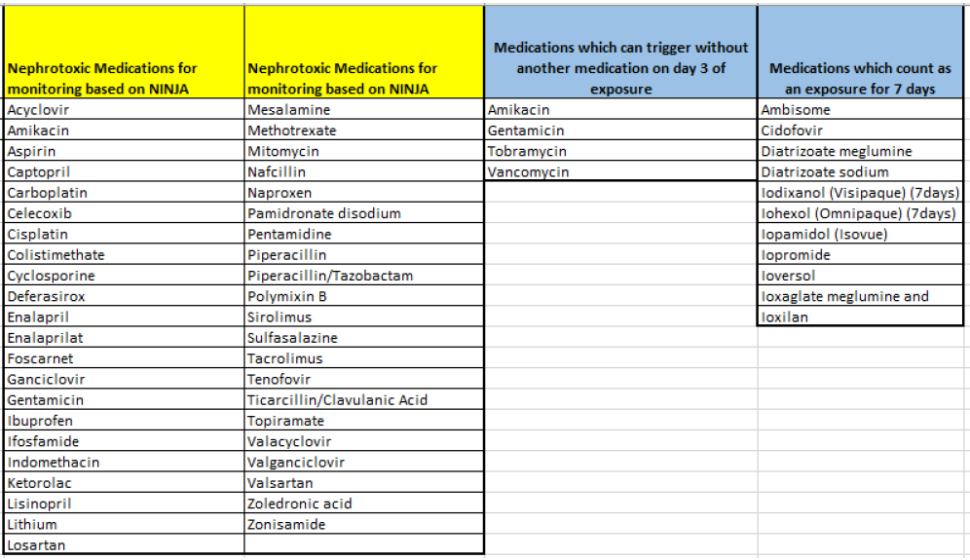
Nephrotoxic Medications for Monitoring
Image Source: Children’s Hospitals’ Solutions for Patient Safety

Slide 46
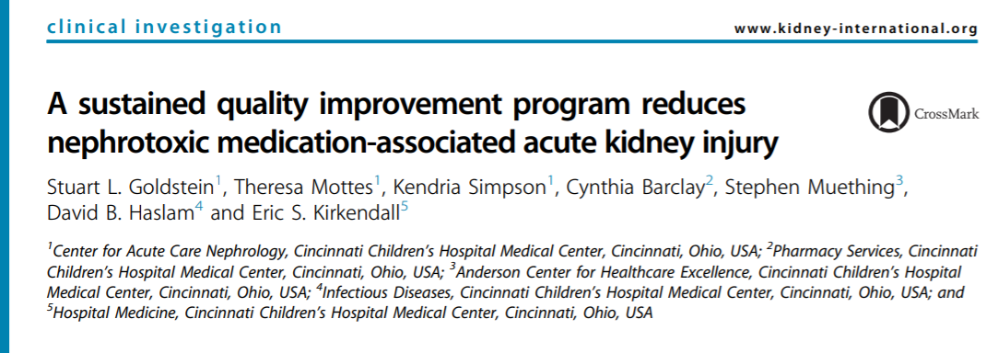
Avoid Nephrotoxic Medications
The Nephrotoxic Injury Negated by Just-in-time Action Program (NINJA) ⁵²⁻⁵³
Proactively screens for nephrotoxic drug (NTMx) exposure in EHR and flags patients at high risk for NTMx-AKI
High risk patients are monitored via daily SCr lab orders
Single-center implementation reduced exposure of nephrotoxic drugs in children by 38% and AKI rate was reduced by 64%
Multi-center preliminary data based on a 3 year implementation of NINJA is showing a 23.8% reduction in AKI rates across all nine centers.

Slide 47
Maintain Fluid Balance ⁵⁴
Avoid over transfusion during surgery
A single-center retrospective study (n=220) patients ages 10 days - 19 years who underwent cardiac surgery in 2012
41.8% developed AKI (KDIGO) and 8.2% required RRT within the first week after surgery. Majority of patients were AKI stage 1 (25.9%)
Hypovolemia
“The hypoperfusion due to decreased microvascular flow may contribute to the renal ischemic damage especially during cardiac surgery where low cardiac output and cardiogenic shock may frequently occur”
Treatment: infuse 10-20 ml/kg of normal saline
If urine output does not increase, consider CVP monitoring

Slide 48
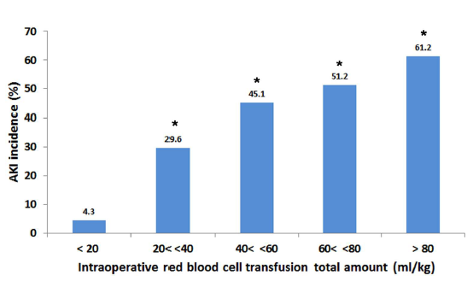
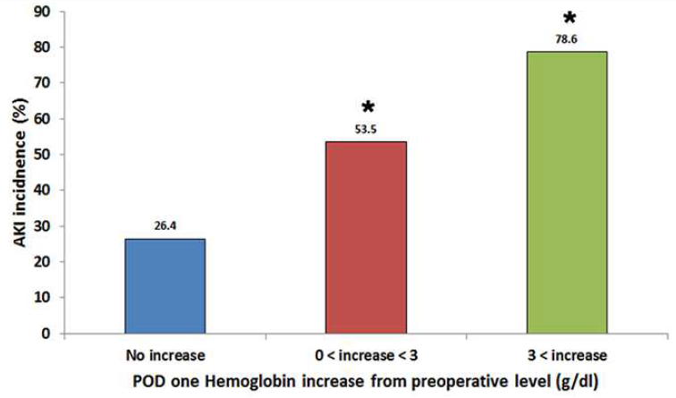
AKI Incidence: Correlation between transfusion volume, hemoglobin level, and AKI
Image Source: Park et al. PLoS One. 2016

Slide 49
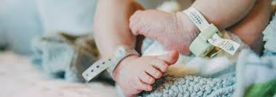
Optimize Nutrition Status Preoperatively ⁵⁵
In retrospective analysis of 95 neonates who had congenital heart surgery:
66 patients (69.5%) did not achieve preoperative caloric goal
29 patients (30.5%) did reach caloric goal
Higher incidence of stage 2 or 3 AKI postoperatively for those who did not reach caloric goal as compared to those who did (P=0.04; odds ratio, 4.48; 95% confidence interval, 1.02-19.63)

Slide 50
Recommendation #3: Early Recognition of AKI

Slide 51
Early Recognition of AKI
Identification of patients at risk facilitates early intervention with bundle implementation which has been shown to protect the kidneys and reduce mortality ⁵⁶⁻⁵⁸
American Society of Nephrology launched AKI!NOW initiative to promote early recognition and management of AKI which helps optimize treatment and prevent progression.⁵⁹
AKI!NOW Recommendations:
Provider education at all levels in healthcare regarding AKI, particularly around identifying patients at risk
Generate specific guidance on AKI evaluation and management
Develop global toolkit
Engage hospital administration and make AKI a part of quality initiative
Raise awareness of AKI as complication of other disease processes

Slide 52
Emerging Research - Biomarkers
The use of NGAL and Cystatin C to detect AKI in pediatrics after cardiac surgery has been reported as feasible. ^{4,60}
NGAL - tubular biomarker
Most studied in pediatrics, especially cardiac surgery population
Can detect changes as early as 2 hours after CPB
Associated with AKI severity, length of mechanical ventilation, and length of ICU stay ^{11, 61-62}
Superior to creatinine for detection of aKI ^{11,64-66}
Cystatin C - functional biomarker
Protease inhibitor that is released by nucleated cells at a constant rate → filtered by the glomeruli → reabsorbed in the renal tubules. ¹⁹
Reflects a decrease in GFR if found in urine. ⁴
Superior biomarker to serum creatinine in the assessment of GFR in premature infants ⁶⁷
Serum phosphorus - alternative biomarker that can be used for early prediction of AKI in pediatric cardiac surgery as early as 24 hours postoperatively ⁶⁸

Slide 53
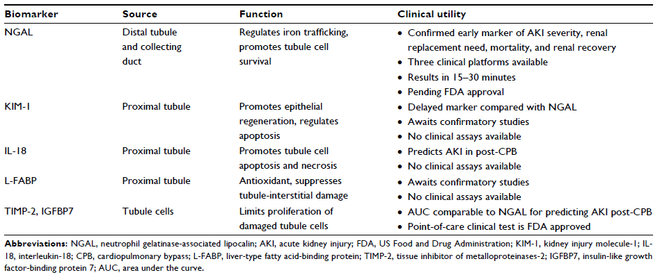
Emerging AKI Biomarker Research
Image Source: Ciccia & Devarajan. Int J Nephrol Renovasc Dis. 2017

Slide 54
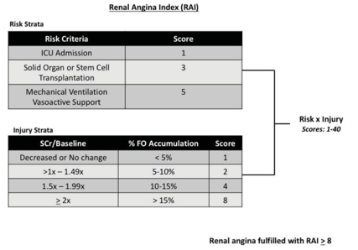
Renal Angina Index: Proactive Recognition of AKI ^{2,69}
Highly sensitive screening tool for AKI that combines risk factors and early signs of decreased kidney function (increased SCr or degrees of fluid overload) to stratify patients for risk of subsequent severe AKI.
Predictive efficacy of the RAI for development of severe AKI three days after admission to the ICU was tested in a multinational, multi-center prospective study of 5,237 children
AKI Incidence was significantly higher in the group assessed to have renal angina (RAI score of > 8).
Assessment of AKI according to SCr levels alone failed to identify AKI in 67.2% of patients with low urine output
Image Source: Ciccia & Devarajan. Int J Nephrol Renovasc Dis. 2017

Slide 55
Recommendation #4:
Treatment Considerations

Slide 56
Manage Acidosis & Electrolyte Imbalances ¹⁶
Kidneys excrete net acids generated by diet & metabolism
Acidosis is common in AKI and CKD
Treat with IV or oral sodium bicarbonate
Consider serum total and ionized calcium levels before treating acidosis
Hypocalcemia is common in AKI & treatment of acidosis can cause tetany or seizures due to drop in ionized calcium
Hyperphosphatemia is also common
Limit dietary phosphorus
Treat with oral calcium carbonate (to bind with phosphorus & prevention further absorption)
Must take into consideration acid-base balance

Slide 57
Hyperkalemia: Potentially life-threatening ¹⁶
Kidneys regulate potassium balance
90% of dietary potassium intake is excreted through kidneys
Hyperkalemia common in AKI and CKD due to:
Decreased filtration and tubular secretion
Altered distribution of potassium by acidosis → shifts potassium from intracellular to extracellular compartment
If potassium reaches levels > 6-7 mEq/L or cardiac conduction abnormalities occur, consider treatment:
Image Source: Andreoli. Pediatric Drugs. 2008

Slide 58
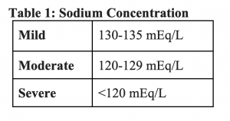
Assess for Hyponatremia ¹⁶
Hyponatremia is common in AKI as kidneys fail to excrete excess fluid leading to dilutional hyponatremia
Treatment requires fluid restriction or water removal by dialysis or hemofiltration; slow infusion of hypertonic saline solution may be necessary
If serum sodium level < 120mEq/L due to excess water retention, seizures may result
Image Source: Andreoli. Pediatric Drugs. 2008

Slide 59
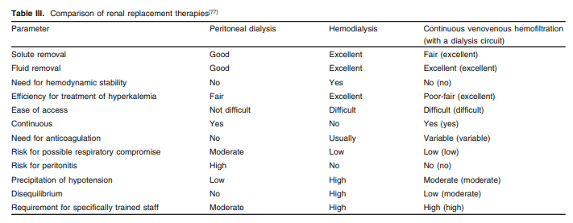
Renal Replacement Therapy in Children
The most common initial ESRD treatment modality among children is hemodialysis (56 percent) ⁷⁰
Factors to consider: ¹⁶
Age
Size of child
Cause of Renal Failure
Degree of metabolic derangements
Blood Pressure
Nutritional Needs
Peritoneal dialysis vs. intermittent hemodialysis vs. hemofiltration
Image Source: Andreoli. Pediatric Drugs. 2008

Slide 60
Peritoneal and Hemodialysis in Neonates
Unique challenges with managing AKI in neonates due to developing nephrons, small blood vessels (difficult hemo catheter access) and peritoneal space. ⁷³
Limited evidence that renal replacement therapy (RRT) in patients ≤ 1yo is effective or improves long term outcomes especially patients with:
History of abdominal surgeries
Surgical site infections
Require fluid removal faster than the peritoneal membrane allows
Peritoneal dialysis (PD) is used more often in children than in adults however, children with CKD are given hemodialysis (HD) more frequently than PD or kidney transplant. ⁸⁹
Cardio-Renal Pediatric Dialysis Emergency Machine (CARPEDIEM) ⁵⁵
Five year prospective study designed to develop and implement this machine which has an extracorporeal priming volume of < 30mL and accurate ultrafiltration to within 1g.
Used effectively in infants as small as 2.9 kg

Slide 61
Postoperative AKI
Cardiac, General and Liver

Slide 62
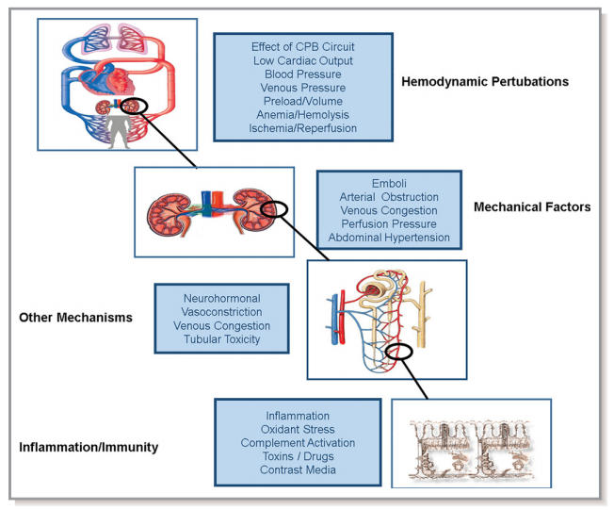
Pathophysiology of AKI related to Cardiopulmonary bypass ⁷¹
Nadim and colleagues depict the many variables associated with cardiac surgery & cardiopulmonary bypass:
Nonpulsatile blood flow
Extensive Hemodilution
Transfusion load
Release of free hemoglobin & free iron from hemolysis
Prolonged hypothermia
Inflammatory response
Venous congestion
All of these factors can contribute to acute kidney injury.
Image Source: Nadim et al. J Am Heart Assoc. 2018

Slide 63
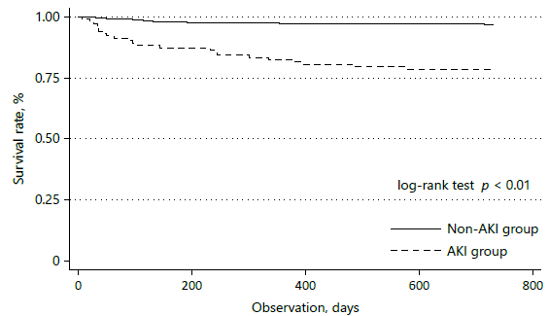
Peds Cardiac Surgery - AKI
AKIN definition modified for children 0-36 months old to greater than 0.1 mg/dL increase in SCr was required to assign cardiac surgery-associated acute kidney injury (n=799) ⁴⁸
36% of patients had AKI with the majority (76%) having stage II or III AKI.
A small rise (less than 50%) in SCr on postoperative day 1 predicted AKI within 48 hours after cardiac surgery using pRIFLE criteria ⁷²
Mortality rate is higher in patients following recovery from AKI, regardless of staging, compared to those without AKI after cardiac surgery ⁴⁸
Image Source: Hirano et al. Am J Nephrol. 2017

Slide 64
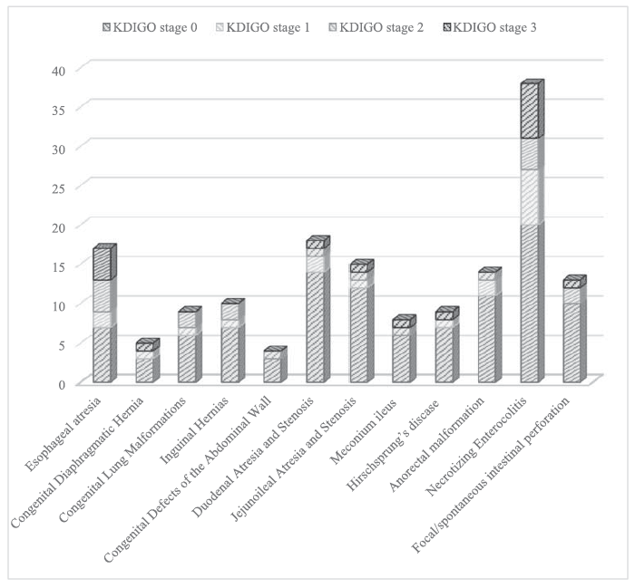
AKI after Pediatric General Surgery ⁸
Neonates undergoing non-cardiac surgical procedures with general anesthesia (n=160)
Using nKIDGO, 33.8% of neonates developed AKI
Higher mortality rate than those who did not develop AKI

Slide 65
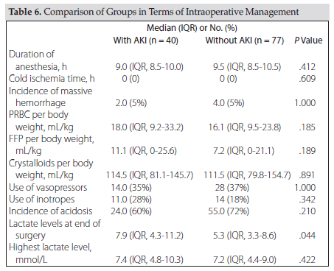
AKI after Pediatric Liver Transplant
Liver Transplant AKI Risk Factors ⁷³⁻⁷⁵
Hypoalbuminemia
High requirement for RBC and 20% human albumin transfusions
Elevated preop labs: serum sodium, aPTT, bilirubin, end of surgery lactate levels and BUN levels
High furosemide use and high flow of ascites
Need for open abdomen
Incidence of AKI after liver transplantation in pediatrics
pRIFLE is 20% more sensitive than AKIN when determining the severity of AKI (n=57) ⁷⁵
KDIGO staging has shown 35.8% of patients have AKI (n=117) and 15% of those children required RRT postoperatively. ⁷⁴
Another study has demonstrated 46.2% of patients develop AKI using KDIGO (n=156) ⁷³
Assessment of AKI according to SCr levels alone failed to identify AKI in 54.3% of patients with low urine output

Slide 66
Summary
Anesthesia providers should focus on reducing the anesthesia-related intraoperative risk factors associated with AKI such as:
Avoid nephrotoxins
Maintain Fluid Balance
Ensure preoperative nutrition status
Theophylline administration for neonates
Assessing risk factors preoperatively can assist anesthesia providers in identifying patients who may require additional interventions to prevent AKI.
Early Recognition of AKI optimizes treatment and reduces risk of progression to later stages of kidney disease.

Slide 67
References

Slide 68
References
1 Sutherland SM, Ji J, Sheikhi FH, et al. AKI in hospitalized children: epidemiology and clinical associations in a national cohort. Clin J Am Soc Nephrol. 2013;8(10):1661-1669.
2 Kaddourah A, Basu RK, Bagshaw SM, Goldstein SL, AWARE Investigators. Epidemiology of Acute Kidney Injury in Critically Ill Children and Young Adults. N Engl J Med. 2017;376(1):11-20.
3 Jetton JG, Boohaker LJ, Sethi SK, et al. Incidence and outcomes of neonatal acute kidney injury (AWAKEN): a multicentre, multinational, observational cohort study. Lancet Child Adolesc Health. 2017;1(3):184-194.
4 Toda Y, Sugimoto K. AKI after pediatric cardiac surgery for congenital heart diseases–recent developments in diagnostic criteria and early diagnosis by biomarkers-. J Intensive Care Med. 2017;5(1):49.
5 Kellum JA, Bellomo R, Ronco C. The Concept of Acute Kidney Injury and the RIFLE Criteria. In: Vol 156. ; 2007:10-16.
6 Cruz DN, Ricci Z, Ronco C. Clinical review: RIFLE and AKIN--time for reappraisal. Crit Care. 2009;13(3):211.
7 2019 USRDS Annual Data Report: Executive Summary. United States Renal Data System. https://www.usrds.org/2019/view/USRDS_2019_ES_final.pdf

Slide 69
References
8 Wu Y, Hua X, Yang G, Xiang B, Jiang X. Incidence, risk factors, and outcomes of acute kidney injury in neonates after surgical procedures. Pediatr Nephrol. March 2020. doi:10.1007/s00467-020-04532-4
9 Holmes J, Roberts G, May K, et al. The incidence of pediatric acute kidney injury is increased when identified by a change in a creatinine-based electronic alert. Kidney Int. 2017;92(2):432-439.
10 Hessey E, Morissette G, Lacroix J, et al. Long-term Mortality After Acute Kidney Injury in the Pediatric ICU. Hosp Pediatr. 2018;8(5):260-268.
11 Sutherland SM, Kwiatkowski DM. Acute Kidney Injury in Children. Adv Chronic Kidney Dis. 2017;24(6):380-387.
12 Chronic Kidney Disease Surveillance System. Centers for Disease Control and Prevention. https://nccd.cdc.gov/CKD/AreYouAware.aspx?emailDate=July_2017.
13 McDonald SP, Craig JC, Australian and New Zealand Paediatric Nephrology Association. Long-term survival of children with end-stage renal disease. N Engl J Med. 2004;350(26):2654-2662.
14 2018 USRDS Annual Data Report: Executive Summary. United States Renal Data System. https://www.usrds.org/2018/view/v1_00.aspx.
.

Slide 70
References
15 Lantos JD, Warady BA. The evolving ethics of infant dialysis. Pediatr Nephrol. 2013;28(10):1943-1947.
16 Andreoli SP. Management of Acute Kidney Injury in Children. Pediatric Drugs. 2008;10(6):379-390.
17 Cole SP. Stratification and Risk Reduction of Perioperative Acute Kidney Injury: An Update. Anesthesiol Clin. 2018;36(4):539-551.
18 Kellum JA, Bellomo R, Ronco C. The Concept of Acute Kidney Injury and the RIFLE Criteria. In: Vol 156. ; 2007:10-16.
19 Hobson C, Ruchi R, Bihorac A. Perioperative Acute Kidney Injury: Risk Factors and Predictive Strategies. Crit Care Clin. 2017;33(2):379-396.
20 Cruz DN, Ricci Z, Ronco C. Clinical review: RIFLE and AKIN--time for reappraisal. Crit Care. 2009;13(3):211.
21 Ricci Z, Cruz D, Ronco C. The RIFLE criteria and mortality in acute kidney injury: A systematic review. Kidney Int. 2008;73(5):538-546.

Slide 71
References
22 Khwaja A. KDIGO clinical practice guidelines for acute kidney injury. Nephron Clin Pract. 2012;120(4):c179-c184.
23 Selewski DT, Cornell TT, Heung M, et al. Validation of the KDIGO acute kidney injury criteria in a pediatric critical care population. Intensive Care Med. 2014;40(10):1481-1488.
24 Sutherland SM, Byrnes JJ, Kothari M, et al. AKI in hospitalized children: comparing the pRIFLE, AKIN, and KDIGO definitions. Clin J Am Soc Nephrol. 2015;10(4):554-561.
25 Basile DP, Anderson MD, Sutton TA. Pathophysiology of acute kidney injury. Compr Physiol. 2012;2(2):1303-1353.
26 Schwartz GJ, Schneider MF, Maier PS, et al. Improved equations estimating GFR in children with chronic kidney disease using an immunonephelometric determination of cystatin C. Kidney Int. 2012;82(4):445-453.
27 Anders H-J, Schaefer L. Beyond tissue injury-damage-associated molecular patterns, toll-like receptors, and inflammasomes also drive regeneration and fibrosis. J Am Soc Nephrol. 2014;25(7):1387-1400.
28 Zarbock A, Koyner JL, Hoste EAJ, Kellum JA. Update on Perioperative Acute Kidney Injury. Anesth Analg. 2018;127(5):1236-1245
29 Makris K, Spanou L. Acute Kidney Injury: Definition, Pathophysiology and Clinical Phenotypes. Clin Biochem Rev. 2016;37(2):85-98.

Slide 72
References
30 Li Z, Kang Z, Duan C, et al. Clinical and pathological features of acute kidney injury in children. Ren Fail. 2014;36(7):1023-1028.
31 Gumbert SD, Kork F, Jackson ML, et al. Perioperative Acute Kidney Injury. Anesthesiology. 2020;132(1):180-204.
32 Basile DP, Anderson MD, Sutton TA. Pathophysiology of acute kidney injury. Compr Physiol. 2012;2(2):1303-1353.
33 Meersch M, Volmering S, Zarbock A. Prevention of acute kidney injury. Best Pract Res Clin Anaesthesiol. 2017;31(3):361-370.
34 Meersch M, Schmidt C, Zarbock A. Perioperative Acute Kidney Injury: An Under-Recognized Problem. Anesth Analg. 2017;125(4):1223-1232.
35 Hobson C, Ruchi R, Bihorac A. Perioperative Acute Kidney Injury: Risk Factors and Predictive Strategies. Crit Care Clin. 2017;33(2):379-396.
36 Slater MB, Gruneir A, Rochon PA, Howard AW, Koren G, Parshuram CS. Identifying High-Risk Medications Associated with Acute Kidney Injury in Critically Ill Patients: A Pharmacoepidemiologic Evaluation. Paediatr Drugs. 2017;19(1):59-67.
37 Downes KJ, Cowden C, Laskin BL, et al. Association of Acute Kidney Injury With Concomitant Vancomycin and Piperacillin/Tazobactam Treatment Among Hospitalized Children. JAMA Pediatr. 2017;171(12):e173219.

Slide 73
References
38 Abouelkheir M, Alsubaie S. Pediatric acute kidney injury induced by concomitant vancomycin and piperacillin--tazobactam. Pediatr Int. 2018;60(2):136-141.
39 Downes KJ, Patil NR, Rao MB, et al. Risk factors for acute kidney injury during aminoglycoside therapy in patients with cystic fibrosis. Pediatr Nephrol. 2015;30(10):1879-1888. 40 Downes KJ, Rao MB, Kahill L, Nguyen H, Clancy JP, Goldstein SL. Daily serum creatinine monitoring promotes earlier detection of acute kidney injury in children and adolescents with cystic fibrosis. J Cyst Fibros. 2014;13(4):435-441.
41 Zappitelli M, Moffett BS, Hyder A, Goldstein SL. Acute kidney injury in non-critically ill children treated with aminoglycoside antibiotics in a tertiary healthcare centre: a retrospective cohort study. Nephrol Dial Transplant. 2011;26(1):144-150.
42 Goldstein SL, Kirkendall E, Nguyen H, et al. Electronic health record identification of nephrotoxin exposure and associated acute kidney injury. Pediatrics. 2013;132(3):e756-e767.
43 Hursh BE, Ronsley R, Islam N, Mammen C, Panagiotopoulos C. Acute kidney injury in children with type 1 diabetes hospitalized for diabetic ketoacidosis. JAMA Pediatr. 2017;171(5):e170020-e170020.
44 de Melo Bezerra Cavalcante CT, Castelo Branco KM, Pinto Júnior VC, et al. Syndecan-1 improves severe acute kidney injury prediction after pediatric cardiac surgery. J Thorac Cardiovasc Surg. 2016;152(1):178-186.e2.

Slide 74
References
45 Baddam S, Aban I, Hilliard L, Howard T, Askenazi D, Lebensburger JD. Acute kidney injury during a pediatric sickle cell vaso-occlusive pain crisis. Pediatr Nephrol. 2017;32(8):1451-1456.
46 Li S, Krawczeski CD, Zappitelli M, et al. Incidence, risk factors, and outcomes of acute kidney injury after pediatric cardiac surgery: a prospective multicenter study. Crit Care Med. 2011;39(6):1493-1499.
47 Chawla LS, Bellomo R, Bihorac A, et al. Acute kidney disease and renal recovery: consensus report of the Acute Disease Quality Initiative (ADQI) 16 Workgroup. Nat Rev Nephrol. 2017;13(4):241-257.
48 Hirano D, Ito A, Yamada A, et al. Independent Risk Factors and 2-Year Outcomes of Acute Kidney Injury after Surgery for Congenital Heart Disease. Am J Nephrol. 2017;46(3):204-209
49 Hu G-H, Duan L, Jiang M, Zhang C-L, Duan Y-Y. Wider intraoperative glycemic fluctuation increases risk of acute kidney injury after pediatric cardiac surgery. Ren Fail. 2018;40(1):611-617.
50 Goldstein SL, Mottes T, Simpson K, et al. A sustained quality improvement program reduces nephrotoxic medication-associated acute kidney injury. Kidney Int. 2016;90(1):212-221.
51 Children’s Hospitals for Patient Safety

Slide 75
References
52 Goldstein SL. Pediatric Acute Kidney Injury-The Time for Nihilism Is Over. Front Pediatr. 2020;8:16.
53 Goldstein SL, Mottes T, Simpson K, et al. A sustained quality improvement program reduces nephrotoxic medication-associated acute kidney injury. Kidney Int. 2016;90(1):212-221.
54 Park S-K, Hur M, Kim E, et al. Risk Factors for Acute Kidney Injury after Congenital Cardiac Surgery in Infants and Children: A Retrospective Observational Study. PLoS One. 2016;11(11):e0166328.
55 Piggott KD, Soni M, Decampli WM, et al. Acute Kidney Injury and Fluid Overload in Neonates Following Surgery for Congenital Heart Disease. World J Pediatr Congenit Heart Surg. 2015;6(3):401-406.
56 Meersch M, Schmidt C, Hoffmeier A, et al. Prevention of cardiac surgery-associated AKI by implementing the KDIGO guidelines in high risk patients identified by biomarkers: the PrevAKI randomized controlled trial. Intensive Care Med. 2017;43(11):1551-1561.
57 Göcze I, Jauch D, Götz M, et al. Biomarker-guided Intervention to Prevent Acute Kidney Injury After Major Surgery: The Prospective Randomized BigpAK Study. Ann Surg. 2018;267(6):1013-1020.
58 Gien J, Soranno D. Identifying the Patient at Risk for Acute Kidney Injury: Pediatric Sepsis Biomarker Risk Model Study. Am J Respir Crit Care Med. 2020;201(7):764-766.

Slide 76
References
59 Liu KD, Goldstein SL, Vijayan A, et al. AKI!Now Initiative: Recommendations for Awareness, Recognition, and Management of AKI. Clinical Journal of the American Society of Nephrology. 2020:CJN.15611219. doi:10.2215/cjn.15611219
60 Basu RK, Zappitelli M, Brunner L, et al. Derivation and validation of the renal angina index to improve the prediction of acute kidney injury in critically ill children. Kidney Int. 2014;85(3):659-667.
61 Bennett M, Dent CL, Ma Q, et al. Urine NGAL predicts severity of acute kidney injury after cardiac surgery: A prospective study. Clin J Am Soc Nephrol. 2008;3(3):665-673.
62 Krawczeski CD, Goldstein SL, Woo JG, et al. Temporal relationship and predictive value of urinary acute kidney injury biomarkers after pediatric cardiopulmonary bypass. J Am Coll Cardiol. 2011;58(22):2301-2309.
63 Sirota JC, Walcher A, Faubel S, et al. Urine IL-18, NGAL, IL-8 and serum IL-8 are biomarkers of acute kidney injury following liver transplantation. BMC Nephrol. 2013;14:17.
64 Mishra J, Ma Q, Kelly C, et al. Kidney NGAL is a novel early marker of acute injury following transplantation. Pediatr Nephrol. 2006;21(6):856-863.
65 Hirsch R, Dent C, Pfriem H, et al. NGAL is an early predictive biomarker of contrast-induced nephropathy in children. Pediatr Nephrol. 2007;22(12):2089-2095.

Slide 77
References
66 Wheeler DS, Devarajan P, Ma Q, et al. Serum neutrophil gelatinase-associated lipocalin (NGAL) as a marker of acute kidney injury in critically ill children with septic shock. Crit Care Med. 2008;36(4):1297-1303.
67 Abitbol CL, Seeherunvong W, Galarza MG, et al. Neonatal kidney size and function in preterm infants: what is a true estimate of glomerular filtration rate? J Pediatr. 2014;164(5):1026-1031.e2.
68 Burra V, Nagaraja PS, Singh NG, Prabhakar V, Manjunatha N. Early prediction of acute kidney injury using serum phosphorus as a biomarker in pediatric cardiac surgical patients. Ann Card Anaesth. 2018;21(4):455-459
69 Basu RK, Kaddourah A, Goldstein SL, AWARE Study Investigators. Assessment of a renal angina index for prediction of severe acute kidney injury in critically ill children: a multicentre, multinational, prospective observational study. Lancet Child Adolesc Health. 2018;2(2):112-120.
70 U.S. Department of Health and Human Services. Kidney Disease Statistics for the United States. National Institute of Diabetes and Digestive and Kidney Diseases. https://www.niddk.nih.gov/health-information/health-statistics/kidney-disease.
71 Nadim MK, Forni LG, Bihorac A, et al. Cardiac and Vascular Surgery-Associated Acute Kidney Injury: The 20th International Consensus Conference of the ADQI (Acute Disease Quality Initiative) Group. J Am Heart Assoc. 2018;7(11). doi:10.1161/JAHA.118.008834

Slide 78
References
72 Zappitelli M, Bernier P-L, Saczkowski RS, et al. A small post-operative rise in serum creatinine predicts acute kidney injury in children undergoing cardiac surgery. Kidney Int. 2009;76(8):885-892.
73 Hamada M, Matsukawa S, Shimizu S, Kai S, Mizota T. Acute kidney injury after pediatric liver transplantation: incidence, risk factors, and association with outcome. J Anesth. 2017;31(5):758-763.
74 Sahinturk H, Ozdemirkan A, Zeyneloglu P, Gedik E, Pirat A, Haberal M. Early Postoperative Acute Kidney Injury Among Pediatric Liver Transplant Recipients. Exp Clin Transplant. March 2019. doi:10.6002/ect.2018.0214
75 Ferah O, Akbulut A, Açik ME, et al. Acute Kidney Injury After Pediatric Liver Transplantation. Transplant Proc. 2019;51(7):2486-2491.

