Slide 1
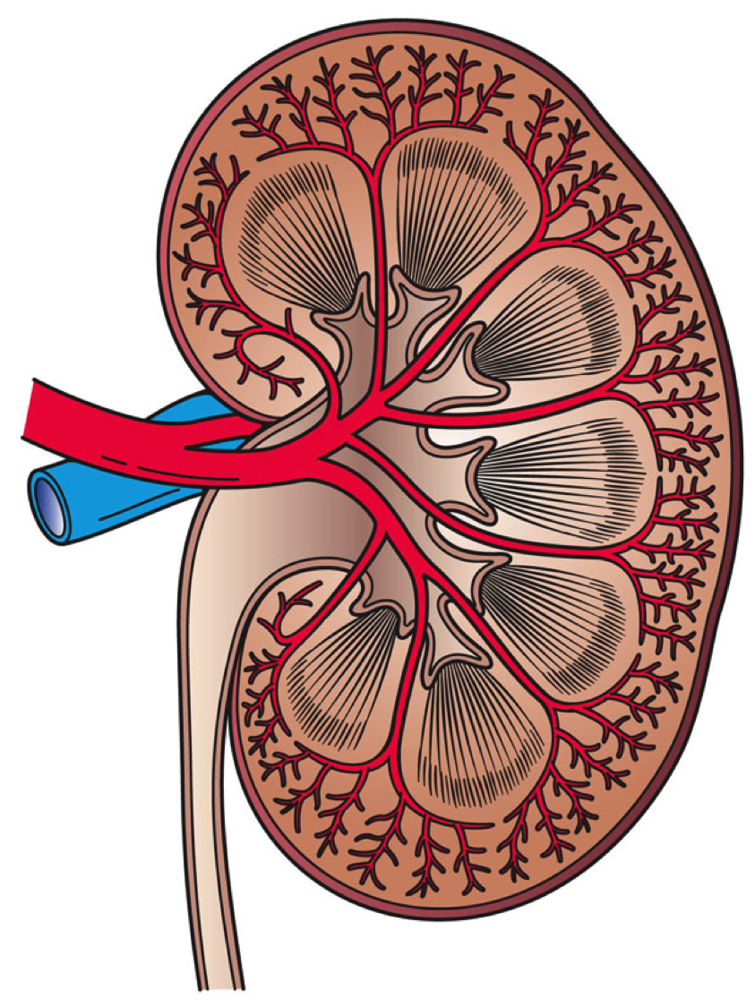
Avoiding Kidney Injury:
Overview,
Pathophysiology, &
Definitions

Slide 2
Objectives
Discuss incidence and impact of Acute Kidney Injury & Chronic Kidney Disease in surgical patients
Review the pathophysiology related to AKI and CKD
Identify definitions & stages of kidney disease
Share registry definitions of kidney injury or failure & review ASPIRE AKI 01 measure
For other recommendations to avoid AKI, reference additional toolkit components:
Avoiding Kidney Injury - Recommendations for Adult Surgical Patients
Avoiding Kidney Injury - Pediatrics
Avoiding Kidney Injury - Obstetrics
Avoiding Kidney Injury - Cardiac Surgery

Slide 3
AKI Incidence
13.3 million
Patients per year develop AKI worldwide ¹
1.7 million
Deaths per year worldwide attributed to AKI ¹
7-13%
Surgical patients suffer with AKI ²
70%
mortality rate for patients with sepsis and AKI ³
9%
Non-cardiac inpatient surgery patients develop AKI ⁴
25%
Of trauma patients develop AKI ⁵
52-56%
Of patients admitted to ICU after surgery ⁶

Slide 4
Impact of AKI
AKI can be an early indicator of multi-organ dysfunction with significant effects on mortality ⁷⁻⁹
Effects of AKI can last years and lead to development of chronic kidney disease or ESRD, even for patients whose creatinine improves at the time of discharge ^{2,5,10-11}
Cost of care for surgical patients with AKI: $42,600 ³⁸
Cost of care for surgical patients: $26,700 ³⁸

Slide 5
AKI Impact
In industrialized countries, acute kidney injury (all cause)...
Claims 300,000 lives annually
Contributes to 300,000 new CKD cases annually
Results in 170,000 end stage kidney disease diagnoses ¹²
In the United States alone, AKI costs an estimated $10 billion annually ¹³
Compared to postoperative patients without AKI, patients with AKI are associated with:
LOS increased from 8.6 to 15.8 days ³⁷
Mortality increased from 8% to 19% ³⁷
30 day readmission 13% vs 21% ³⁷
1yr ESRD .94% vs .05% ³⁷

Slide 6
CKD Incidence
Estimated global prevalence 11-13% ¹⁴
Over 1 in 7 adults in the United States have CKD ¹⁵
90% do not know that they have CKD ¹⁵
9th Leading cause of death in the US ¹⁶

Slide 7
CKD Impact
14.5% of Medicare patients age 65 and older have CKD ¹⁷
Medicare spent $120 billion on ESRD and CKD in 2019 (⅓ of all Medicare Fee for Service spending) ¹⁷
Yearly Medicare spending per beneficiary with non-ESRD CKD is over $23,500, nearly double than for average Medicare beneficiary ¹⁷
No CKD
Non-ESRD CKD

Slide 8
Pathophysiology of Kidney Disease

Slide 9
Kidney Disease Overview - Conditions that affect structure and function of the kidneys ¹⁸
Acute Kidney Injury
Acute Kidney Disease
Chronic Kidney Disease
End Stage Renal Disease
Notes:
Image from Chawla 2017

Slide 10
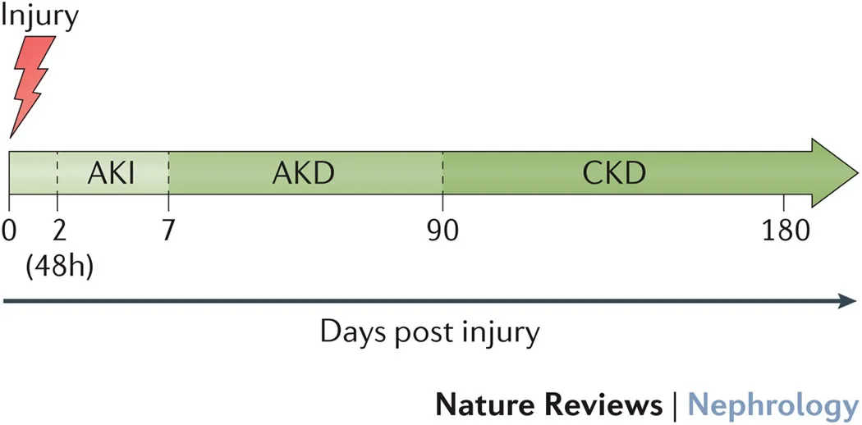
Conditions can be categorized by length of time
Acute Kidney Injury
An abrupt decline in kidney function occurring over a period of 7 days or less ¹⁹
Acute Kidney Disease When acute kidney injury persists > 7 days ²⁰
Chronic Kidney Disease Abnormalities in kidney structure or function that persist beyond 90 days ¹⁹

Slide 11
Acute Kidney Injury: General Definition
Several AKI Classification Systems Exist:¹⁸
RIFLE - Risk, Injury, Failure, Loss, End Stage - 2004
AKIN - Acute Kidney Injury Network - 2007
KDIGO - Kidney Disease Improving Global Outcomes- 2012
Acute Kidney Injury
An abrupt decline in kidney function occurring over a period of 7 days or less ¹⁹
*See slides 6-12 for classification system criteria & slide 21 for biomarker explanation.

Slide 12
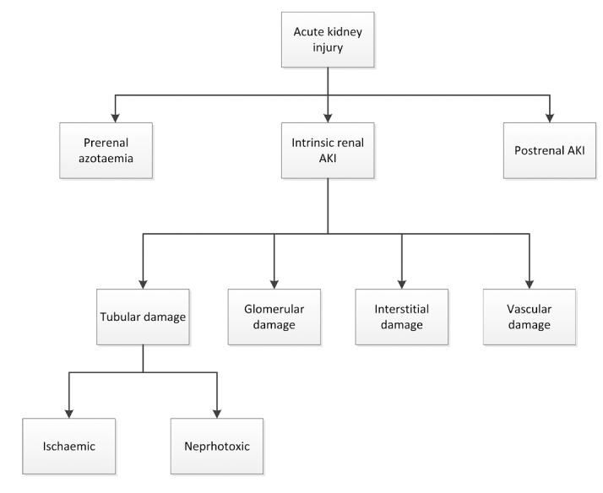
AKI Pathophysiology
Historically, cause of disease was divided into prerenal, renal (intrinsic), and post renal ¹⁸
This approach does not account for multifactorial causes ¹⁸
Image Source: Makris 2016

Slide 13
Etiology: Prerenal
Prerenal AKI is the result of hypovolemia or low cardiac output ¹⁸
No damage to renal parenchyma ⁷
Can progress to Intrinsic AKI if hypovolemia insult continues and damage occurs ²²
25% of cardiac output goes to the kidneys ⁷
Renal hypoperfusion leads to decreased GFR as an adaptive response. Water, sodium, and urea retained to conserve volume ²¹
*Adapted from Makris 2016

Slide 14
Etiology: Prerenal Possible Causes ⁷
Impaired Cardiac Function: Congestive heart failure, acute myocardial infarction, massive pulmonary embolism
Systemic Vasodilation: Anti-hypertensive medications, gram negative bacteremia, cirrhosis, anaphylaxis
Increased Vascular resistance: Anesthesia, surgery, hepatorenal syndrome, NSAID medications, drugs that cause renal vasoconstriction
Hypovolemia: Hemorrhage, volume depletion, renal fluid loss (over-diuresis), third space (burns, peritonitis, muscle trauma)

Slide 15
Etiology: Renal (Intrinsic)
Results of injury to kidney structures: tubules, glomeruli, the interstitium, and intra-renal blood vessels ⁷
Acute Tubular Necrosis (ATN) - AKI from damage to tubules. This is the most common type of Intrinsic AKI ⁷
*Adapted from Makris 2016

Slide 16
Etiology: Intrinsic Possible Causes ⁷
Tubular: Renal ischemia (shock, complication of surgery, hemorrhage, trauma, bacteremia, pancreatitis, pregnancy), nephrotoxic drugs (antibiotics, antineoplastic drugs, contrast media, organic solvents, anesthetic drugs, heavy metals) endogenous toxins (myoglobin, hemoglobin, uric acid)
Interstitium: Infectious (bacterial, viral), medications (antibiotics, diuretics, NSAIDs, etc)
Vascular: Large vessels (bilateral renal artery stenosis, bilateral renal vein thrombosis), small vessels (vasculitis, malignant hypertension, atherosclerotic or thrombotic emboli, hemolytic uremic syndrome, thrombotic thrombocytopenic purpura)
Glomerular: Acute post infectious glomerulonephritis, Lupus nephritis, IgA glomerulonephritis, infective endocarditis, Goodpasture syndrome, Wegener disease

Slide 17
Etiology: Postrenal
Caused by blockage of urinary flow in the urinary tract ¹⁸
Obstruction → ↑ intratubular pressure and ↓GFR ²²
Leads to build up in the kidney ²²
Quick resolution = best chance of kidney recovery ⁷

Slide 18
Etiology: Post Renal Possible Causes ⁷
Extrarenal Obstruction: Prostate hypertrophy, improperly placed catheter, bladder, prostate or cervical cancer, retroperitoneal fibrosis
Intrarenal Obstruction: Nephrolithiasis, blood clots, papillary necrosis

Slide 19
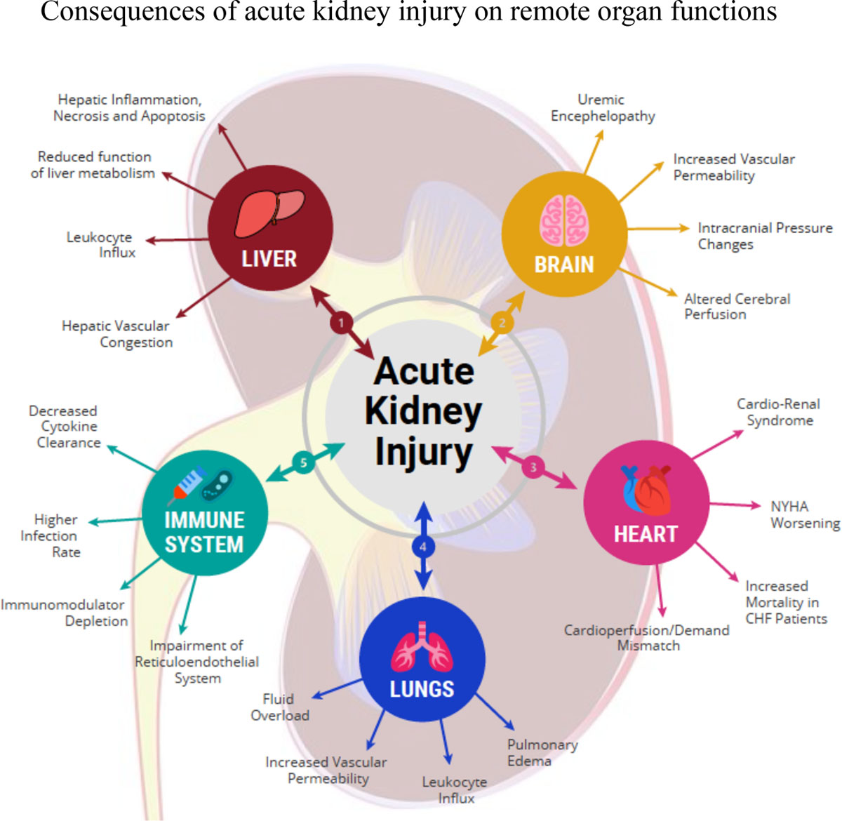
AKI Impact on Organ Function
*Image Source: Gumbert et al. Anesthesiology 2020
Notes:
Graphic from gumbert 2020

Slide 20
AKI Risk Factors

Slide 21
Categories of AKI Risk Factors
Patient-related, such as:
Diabetes
Hypertension
Sepsis
Procedure-related, such as:
Cardiopulmonary bypass & duration
Emergency Surgery
Organ Transplant
Anesthesia-specific, such as:
Vasopressor use
Diuretic use
Hypotension

Slide 22
Patient Risk Factors ²³⁻²⁵
Preoperative level of kidney function
Chronic Vascular Disease
Arterial Hypertension
Cardiac Failure/Cardiac Decompensation
Diabetes (insulin or oral therapy requirements)
Acute medical conditions (sepsis, major surgery, mechanical ventilation, hemodynamic instability)
Hypertension
Peripheral Vascular Disease
Congestive Heart Failure
Sepsis
Ascites
Cerebrovascular disease
Mild to Moderate preoperative renal insufficiency
Age >65
COPD
Chronic Kidney Disease
BMI ≥ 25 (Overweight) (Ju 2018)
Patient-related risk factors are more strongly associated with mortality than the type of procedure ²³

Slide 23
Procedure Related Risk Factors ^{10, 23, 25}
Gastric bypass surgery for morbid obesity- 8.5% incidence AKI Cardiopulmonary bypass (CPB) & duration Aortic cross clamping & duration Hemodilution (cardiac surgery) Duration of surgery Intraperitoneal surgery Repair of AAA | Organ transplant (non-renal also) Liver Transplant 33% develop AKI 17% require RRT Use of intra-aortic balloon pump Type of cardiac surgical procedure Intra-abdominal hypertension Emergency surgery Bleeding complications

Slide 24
Anesthesia-related Risk Factors
Potentially modifiable AKI risk factors in both cardiac and noncardiac surgery ^{10, 23, 25}
Hemodilution
Hemoglobin level
Intraoperative transfusion
Hypotension
Inadequate oxygen delivery
Use of diuretics
Selective renal ischemia
Ischemia reperfusion injury
Bleeding complications
Intraoperative Hypertension
Nephrotoxic agents (eg abx, contrast agents)

Slide 25
Acute Kidney Injury Classification Systems

Slide 26
AKI Classification Systems: RIFLE
 | GFR Criteria | Urine output criteria
Risk | Increased creatinine x1.5 or GFR decrease >25% | UO <0.5ml kg⁻¹h⁻¹x6h | High Sensitivity
Injury | Increased creatinine x2 or GFR decrease >50% | UO <0.5ml kg⁻¹h⁻¹x12h
Failure | Increased creatinine x3 or GFR decrease >75% or creatinine ≥4mg per 100mL (acute rise of ≥0.5mg per 100ml dl) | UO < 0.3 kg⁻¹h⁻¹x24h or anuria x12h (Oliguria) | High Specificity
 | Persistent ARF = complete loss of renal function >4 weeks
Loss
ESRD | End Stage Renal Disease (>3 months)
 | Diagnostic criteria: 1 week timeframe for AKI diagnosis Grades patients based on the worse category for GFR/UO
First attempt at a unifying definition for AKI (then called acute renal failure) ²⁶
Published in 2004, RIFLE graded AKI Stages and provided taxonomies for both severity and recovery ¹⁰
Proposed 1 week timeframe for AKI Diagnosis ²⁷
Image Source: Ricci, Cruz, & Ronco Kidney International 2008

Slide 27
AKI Classification Systems: RIFLE
Previously over thirty different definitions of acute renal failure were in use ²⁶
Caused shift in terminology: “Acute Renal Failure” → “Acute Kidney Injury”
Highlighted importance of identifying changes in kidney function earlier to prevent failure ²⁸
Validated in multiple studies for its ability to classify patients and was strongly tied to patient outcomes in the acutely ill ²⁸

Slide 28
AKI Classification Systems: RIFLE
Limitations
Smaller increases in SCr than those defined in “Risk” (<1.5x) are associated with poor outcomes ²⁷
Urine output component unreliable (may be influenced by other factors such as diuretic use) ²⁷
When using estimated GFR in place of a true baseline GFR, the formulas that estimate GFR presume a “steady state” for GFR that is absent in patients with acutely changing kidney function ²⁷
Urine output alone used for staging was not found to be an accurate predictor of AKI; Cr and urine output should be assessed together for accurate staging & as a predictor of ICU mortality ²⁹

Slide 29
AKI Classification Systems: Acute Kidney Injury Network (AKIN) ^{27,30}
RIFLE Criteria
 | GFR Criteria | Urine output criteria
Risk | Increased creatinine x1.5 or GFR decrease >25% | UO <0.5ml kg⁻¹h⁻¹x6h | High Sensitivity
Injury | Increased creatinine x2 or GFR decrease >50% | UO <0.5ml kg⁻¹h⁻¹x12h
Failure | Increased creatinine x3 or GFR decrease >75% or creatinine ≥4mg per 100mL (acute rise of ≥0.5mg per 100ml dl) | UO < 0.3 kg⁻¹h⁻¹x24h or anuria x12h (Oliguria) | High Specificity
 | Persistent ARF = complete loss of renal function >4 weeks
Loss
ESRD | End Stage Renal Disease (>3 months)
 | Diagnostic criteria: 1 week timeframe for AKI diagnosis Grades patients based on the worse category for GFR/UO
AKIN Criteria
Removed GFR
 | Cr Criteria | Urine output criteria
Stage 1 | Increased creatinine x1.5 or ≥ 0.3mg/dl | UO <0.5ml/kg/hr x6 hr
Stage 2 | Increased creatinine x2 | UO <0.5ml/kg/hrx12h
Stage 3 | Increased creatinine x3 or Cr ≥ 4 mg/dl (with acute rise of ≥0.5mg/dl) | UO < 0.3 ml/kg/hr x24h or anuria x12h (Oliguria)
 | Patients who receive renal replacement therapy (RRT) are considered to have met the criteria for stage 3 irrespective of the stage that they are in at the time of commencement of RRT
 | Diagnostic criteria: Serum creatinine measured over 48 hours Grades patients on urine output and change in SCr over 48 hours 7 day timeframe for staging AKI
New RRT Staging
Introduced 48h timeframe

Slide 30
AKI Classification Systems: AKIN
Introduced in 2007 to improve accuracy after RIFLE release ²⁷
Relies on serum creatinine measured over 48 hours but does not use GFR
Grades patients on urine output and change in SCr over 48 hours
Higher diagnostic accuracy than RIFLE ³⁰

Slide 31
AKI Classification Systems: AKIN
Limitations
48 hour timeframe for diagnosis of AKI may miss slowly progressing AKI ²⁷
While diagnosis of AKI is based on a change in SCr over 48 hours, a 1 week timeframe is used for staging AKI ²⁷

Slide 32
AKI Classification Systems: KDIGO Criteria (2012) ³¹
 | Cr Criteria | Urine output criteria
1 | Increased creatinine x1.5-1.9 from baseline or ≥ 0.3 mg/dl | UO <0.5ml/kg/hr for 6-12hr
2 | Increased creatinine x2.0-2.9 from baseline | UO <0.5ml/kg/hr ≥ 12h
3 | Increased creatinine x3 from baseline OR SCr ≥ 4.0mg/dl OR RRT | UO < 0.3 ml/kg/hr for ≥ 24h or anuria ≥ 12h
 | Diagnostic criteria for AKI: SCr increase ≥0.3mg/dl within 48h OR SCr increase ≥1.5 times baseline, which is known or presumed to have occured within the last 7 days OR Urine volume < 0.5 ml/kg for 6h
UO criteria unchanged
SCr criteria mostly unchanged from AKIN
Removed acute rise criteria. Kept RRT criteria from AKIN
Kept SCr increase of ≥ 0.3 mg/dl within 48 hours from AKIN
Used 7 day timeframe for 1.5X increase in SCr from RIFLE

Slide 33
RIFLE - 2004
AKIN - 2007
KDIGO - 2012 ³¹
 | GFR Criteria | Urine output criteria
Risk | Increased creatinine x1.5 or GFR decrease >25% | UO <0.5ml kg⁻¹h⁻¹x6h
Injury | Increased creatinine x2 or GFR decrease >50% | UO <0.5ml kg⁻¹h⁻¹x12h
Failure | Increased creatinine x3 or GFR decrease >75% or creatinine ≥4mg per 100mL (acute rise of ≥0.5mg per 100ml dl) | UO < 0.3 kg⁻¹h⁻¹x24h or anuria x12h (Oliguria)
 | Persistent ARF = complete loss of renal function >4 weeks
Loss
ESRD | End Stage Renal Disease (>3 months)
 | Diagnostic criteria: 7 day timeframe for AKI diagnosis Grades patients based on the worse category for GFR/UO
 | Cr Criteria | Urine output criteria
1 | Increased creatinine x1.5 or ≥ 0.3mg/dl | UO <0.5ml/kg/hr x6 hr
2 | Increased creatinine x2 | UO <0.5ml/kg/hrx12h
3 | Increased creatinine x3 or Cr ≥ 4 mg/dl (with acute rise of ≥0.5mg/dl) | UO < 0.3 ml/kg/hr x24h or anuria x12h (Oliguria)
 | Patients who receive renal replacement therapy (RRT) are considered to have met the criteria for stage 3 irrespective of the stage that they are in at the time of commencement of RRT
 | Diagnostic criteria: Serum creatinine measured over 48 hours Grades patients on urine output and change in SCr over 48 hours 7 day timeframe for staging AKI
 | GFR Criteria | Urine output criteria
1 | Increased creatinine x1.5-1.9 from baseline or ≥ 0.3 mg/dl | UO <0.5ml/kg/hr for 6-12hr
2 | Increased creatinine x2.0-2.9 from baseline | UO <0.5ml/kg/hr ≥ 12h
3 | Increased creatinine x3 from baseline OR SCr ≥ 4.0mg/dl OR RRT | UO < 0.3 ml/kg/hr for ≥ 24h or anuria ≥ 12h
 | Diagnostic criteria for AKI: SCr increase ≥0.3mg/dl within 48h OR SCr increase ≥1.5 times baseline, which is known or presumed to have occured within the last 7 days OR Urine volume < 0.5 ml/kg for 6h

Slide 34
Differences between RIFLE, AKIN, & KDIGO Staging/Criterion
RIFLE, AKIN, & KDIGO have been shown to have similar predictive ability for in-hospital mortality ³⁰
In one 2017 study, RIFLE and KDIGO diagnosed more patients with AKI than AKIN ³⁰
AKIN may under diagnose AKI as compared to RIFLE and KDIGO ³¹

Slide 35
Kidney Disease: Progression from AKI to CKD and/or Renal Failure
KDIGO Clinical Practice Guideline for AKI (2012) recommends patients follow-up within 3 months after experiencing AKI after surgery to assess for progression to CKD ³³
Patients who recover from AKI may not return to baseline kidney function - irreversible decline in kidney function is more likely for patients ≥ 65 years old ³⁴
Of CKD patients who experience an episode of AKI after cardiac surgery will progress to a worse CKD class ³²
Patients who develop AKI during surgery demonstrate an 8-fold increased risk of progression to CKD ²³
34-53%
8x

Slide 36
Chronic Kidney Disease

Slide 37
Chronic Kidney Disease Classification
CKD Classification based on:
Presence or absence of systemic disease
Location of pathology within kidney
Chronic Kidney Disease Abnormalities in kidney structure or function that persist beyond 90 days

Slide 38
Chronic Kidney Disease Definition
Abnormalities in kidney structure or function that persist beyond 90 days ¹⁹
Can result from a variety of causes of kidney damage
Higher risk of end stage renal disease (ESRD) ³³
Criteria for CKD (either of the following present for >3 months)
Markers of kidney damage (one or more) | Albuminuria (AER≥30mg/24h; ACR≥30mg/g [≥3mg/mmol]) Urine sediment abnormalities Electrolyte and other abnormalities due to tubular disorders Abnormalities detected by histology Structural abnormalities detected by imaging History of kidney transplantation
Decreased GFR | GFR<60ml/min/1.73m² (GFR categories G3a-G5)
KDIGO Criteria 2012

Slide 39
CKD Staging
GFR Categories in CKD
Category | GFR (ml/min/1.73m²) | Terms
G1 | >90 | Normal or high
G2 | 60-89 | Mildly decreased*
G3a | 45-59 | Mildly to moderately decreased
G3b | 30-44 | Moderately to severely decreased
G4 | 15-29 | Severely decreased
G5 | <15 | Kidney Failure
*Relative to young adult level In the absence of evidence of kidney damage, neither GFR category G1 or G2 fulfill the criteria for CKD
Albuminuria categories in CKD
Category | Albumin excretion rate | Albumin to creatinine ratio (Approximate equivalent) |  | Terms
A1 | <30 mg/24h | <3 mg/mmol | <30 mg/g | Normal to mildly increased
A2 | 30-300 mg/24h | 3-30 mg/mmol | 30-300 mg/g | Moderately increased*
A3 | >300 mg/24h | >30 mg/mmol | >300 mg/g | Severely increased**
*Relative to young adult level **Including nephrotic syndrome (albumin excretion usually >2200mg/34 hours [ACR>220mg/g; >220mg/mmol])
Figure Source: 2012 KDIGO Clinical Practice Guidelines for Chronic Kidney Disease

Slide 40
CKD Pathophysiology
 | Examples of systemic diseases affecting the kidney | Examples of primary kidney disease (absence of systemic disease affecting the kidney)
Glomerular diseases | Diabetes, systemic autoimmune diseases, systemic infections, drugs, neoplasia (including amyloidosis) | Diffuse, focal or crescentic proliferative GN; focal and segmental glomerulosclerosis, membranous nephropathy, minimal change disease
Tubulointerstitial diseases | Systemic infections, autoimmune, sarcoidosis, drugs, urate, environmental toxins (lead, aristolochic acid), neoplasia (myeloma) | Urinary-tract infections, stones, obstruction
Vascular diseases | Atherosclerosis, hypertension, ischemia, cholesterol emboli, systemic vasculitis, thrombotic microangiopathy, systemic sclerosis | ANCA-associated renal limited vasculitis, fibromuscular dysplasia
Cystic and congenital diseases | Polycystic kidney disease, Alport syndrome, Fabry disease | Renal dysplasia, medullary cystic disease, pondocytopathies
Figure Source: 2012 KDIGO Clinical Practice Guidelines for Chronic Kidney Disease
Notes:
KDIGO CKD 2012

Slide 41
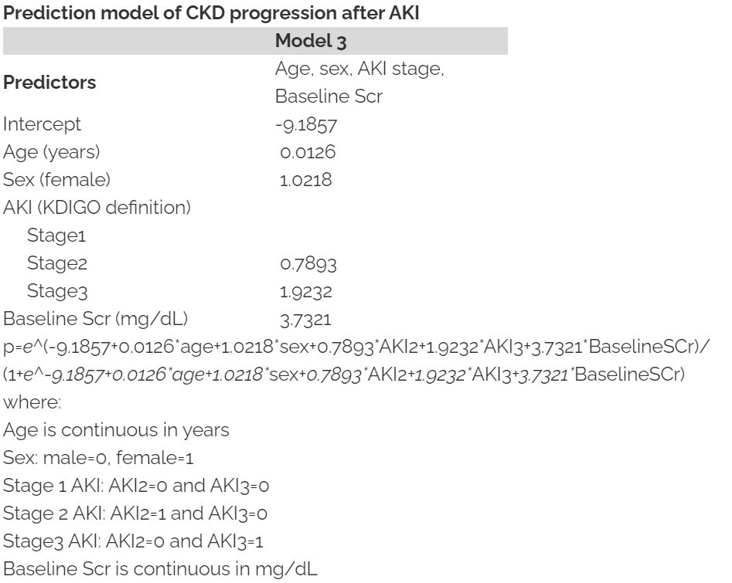
Risk of Progression of AKI to CKD
Risk of progression to advanced chronic kidney disease has been developed by an externally validated prediction model among hospital inpatients experiencing AKI, with all data available at the time of detection of acute kidney injury³⁹.

Slide 42
Emerging Research: Biomarkers

Slide 43
Biomarkers
Current research activities aim to identify new biomarkers, which are released before sCR increases and/or urinary output declines ²³
The production and release of possible biomarkers of early tubular stress is triggered by surgical trauma, cardiopulmonary bypass, or other noxious events
Several issues have to be addressed before these biomarkers can be introduced into daily clinical routine
Lack of sensitivity that is related to the etiological heterogeneity of AKI, and the lack of specificity that seems related to extrarenal causes for fluctuations in serum or urine concentration of the biomarkers
NGAL- neutrophil-gelatinase-associated lipcalin → considered the troponin of the kidneys, can only predict AKI in patients with prior normal kidney function
Tissues inhibitor of metalloproteinases-2 (TIMP-2)
Insulin-like growth factor binding protein (IGFBP7)

Slide 44
Subclinical AKI
Recently defined with the introduction of biomarkers
Increased biomarker presence without fulfilling KDIGO criteria is considered subclinical ³⁵
NGAL - neutrophil gelatinase-associated lipocalin
Excreted when there is tubular damage ³⁵
Proposed cut off for tubular damage 100-150 ng/mL
Functional AKI meets KDIGO criteria but does not have biomarker increase
Subclinical AKI are associated with adverse outcomes despite not meeting KDIGO AKI criteria ³⁶
 | KDIGO Criteria | Biomarker Increase
Functional AKI | YES | ❌
Subclinical AKI | ❌ | YES

Slide 45
Registry Definitions: Kidney Disease

Slide 46
American College of Surgeons (ACS) - NSQIP
Progressive Renal Insufficiency
A rise in creatinine of >2 mg/dl from preoperative value, but with no requirement for preoperative (within the 2 week timeframe prior to surgery) or postoperative dialysis
Acute Renal Failure Requiring Dialysis
In a patient who did not require dialysis preoperatively (within the 2 week timeframe prior to surgery), worsening of renal dysfunction postoperatively requiring dialysis (hemodialysis, peritoneal dialysis, hemofiltration, hemodiafiltration, or ultrafiltration)
Source: ACS NSQIP Variable Definitions

Slide 47
American College of Surgeons (ACS) - Trauma
Acute Kidney Injury- Stage 3*
3 times baseline (SCr) or
Increase in SCr to ≥ 4.0 mg/dl (≥ 353.6 µmol/l) or
Initiation of renal replacement therapy
*KDIGO Criterion Used
For patients < 18 years:
Decrease in eGFR to <35 ml/min per 1.73 m² or
Urine output <0.3 ml/kg/h for > 24 hours or
Anuria for > 12 hours
Source: NTDS 2020 Data Dictionary

Slide 48
Michigan Trauma Quality Improvement Program (MTQIP)
Acute Renal Insufficiency
Rise in creatinine of >2 mg/dl from baseline value, but with no requirement for dialysis. Assume a baseline value of 1.0 mg/dl in the absence of additional information regarding the patient’s pre-injury renal function.
Acute Kidney Injury*
Increase creatinine x3 or GFR decrease > 75% or
Urine output criteria: UO < 0.3ml/kg/hr x 24 hours or
Anuria x 12 hours or
Requirement of renal replacement therapy
*RIFLE criterion used
Source: Michigan Trauma Quality Improvement Program Data Dictionary

Slide 49
Society of Thoracic Surgeons- Cardiac
Post-op Renal Failure Definition:
1. Increase in serum creatinine level 3.0 x greater than baseline, or serum creatinine level ≥4 mg/dL (acute rise must be at least 0.5 mg/dl) or
2. A new requirement for dialysis postoperatively
*KDIGO Stage 3 Criterion Used
Post-Op-Renal-Dialysis: New requirement for dialysis postoperatively, which may include hemodialysis, peritoneal dialysis
Post-Op-Dialysis Required After Discharge
Post-Op-Dialysis Duration
Source: STS Adult Cardiac Surgery Database Data Specifications
Notes:
Lazar HL, McDonnell M, Chipkin SR, Furnary AP, Engelman RM, Sadhu AR, Bridges CR, Haan CK, Svedjeholm R, Taegtmeyer H, Shemin RJ, Society of Thoracic Surgeons Blood Glucose Guideline Task Force: The Society of Thoracic Surgeons practice guideline series: Blood glucose management during adult cardiac surgery. Ann Thorac Surg 2009; 87:663–9

Slide 50
Registry Definitions: STS- Thoracic
Renal Failure - KDIGO Stage 3 Criteria
1. Increase in serum creatinine level 3.0 x greater than baseline, or serum creatinine level >=4 mg/dL. Acute rise must be at least 0.5 mg/dl OR
2. A new requirement for dialysis postoperatively
Source: STS General Thoracic Surgery Database Data Specifications

Slide 51
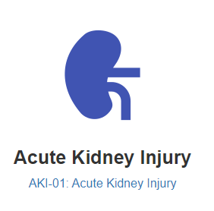
MPOG Measure Definition: AKI 01
ASPIRE Definition of AKI: Baseline creatinine increased more than 1.5 times within 7 postoperative days OR the baseline creatinine level increased by ≥ 0.3 mg/dL within 48 hours after anesthesia end.
Baseline serum creatinine is defined as the most recent serum creatinine resulted in the last 60 days preoperatively.
KDIGO Criterion used
Source: MPOG Measures-Acute Kidney Injury

Slide 52
Summary
Several definitions of AKI exist but KDIGO is most widely accepted
Adverse effects of AKI can last years, even for patients whose creatinine improves at the time of discharge ^{5,10-11}
Patient-related risk factors are more strongly associated with mortality than the type of procedure ²³
Surgical registries have begun to collect data regarding kidney injury, though definitions vary, these outcomes can be helpful for both quality improvement and research purposes.
For recommendations to avoid AKI, reference additional toolkit components:
Avoiding Kidney Injury - Recommendations for Adult Surgical Patients
Avoiding Kidney Injury - Pediatrics
Avoiding Kidney Injury - Obstetrics
Avoiding Kidney Injury - Cardiac Surgery

Slide 53
References
1 Mehta RL, Cerdá J, Burdmann EA, Tonelli M, García-García G, Jha V, Susantitaphong P, Rocco M, Vanholder R, Sever MS, Cruz D, Jaber B, Lameire NH, Lombardi R, Lewington A, Feehally J, Finkelstein F, Levin N, Pannu N, Thomas B, Aronoff-Spencer E, Remuzzi G: International Society of Nephrology’s 0by25 initiative for acute kidney injury (zero preventable deaths by 2025): a human rights case for nephrology. Lancet 2015; 385:2616–43
2 Turan A, Cohen B, Adegboye J, Makarova N, Liu L, Mascha EJ, Qiu Y, Irefin S, Wakefield BJ, Ruetzler K, Sessler DI: Mild Acute Kidney Injury after Noncardiac Surgery Is Associated with Long-term Renal Dysfunction: A Retrospective Cohort Study. Anesthesiology 2020; 132:1053–61
3 Schrier RW, Wang W: Acute renal failure and sepsis. N Engl J Med 2004; 351:159–69
4 Mathis MR, Naik BI, Freundlich RE, Shanks AM, Heung M, Kim M, Burns ML, Colquhoun DA, Rangrass G, Janda A, Engoren MC, Saager L, Tremper KK, Kheterpal S, Multicenter Perioperative Outcomes Group Investigators: Preoperative Risk and the Association between Hypotension and Postoperative Acute Kidney Injury. Anesthesiology 2019 doi:10.1097/ALN.0000000000003063
5 Bihorac A, Delano MJ, Schold JD, Lopez MC, Nathens AB, Maier RV, Layon AJ, Baker HV, Moldawer LL: Incidence, clinical predictors, genomics, and outcome of acute kidney injury among trauma patients. Ann Surg 2010; 252:158–65
6 Hoste EAJ, Bagshaw SM, Bellomo R, Cely CM, Colman R, Cruz DN, Edipidis K, Forni LG, Gomersall CD, Govil D, Honoré PM, Joannes-Boyau O, Joannidis M, Korhonen A-M, Lavrentieva A, Mehta RL, Palevsky P, Roessler E, Ronco C, Uchino S, Vazquez JA, Vidal Andrade E, Webb S, Kellum JA: Epidemiology of acute kidney injury in critically ill patients: the multinational AKI-EPI study. Intensive Care Med 2015; 41:1411–23

Slide 54
References
7 Makris K, Spanou L: Acute Kidney Injury: Definition, Pathophysiology and Clinical Phenotypes. Clin Biochem Rev 2016; 37:85–98
8 Kork F, Balzer F, Spies CD, Wernecke K-D, Ginde AA, Jankowski J, Eltzschig HK: Minor Postoperative Increases of Creatinine Are Associated with Higher Mortality and Longer Hospital Length of Stay in Surgical Patients. Anesthesiology 2015; 123:1301–11
9 O’Connor ME, Hewson RW, Kirwan CJ, Ackland GL, Pearse RM, Prowle JR: Acute kidney injury and mortality 1 year after major non-cardiac surgery. Br J Surg 2017; 104:868–76
10 Hobson CE, Yavas S, Segal MS, Schold JD, Tribble CG, Layon AJ, Bihorac A: Acute kidney injury is associated with increased long-term mortality after cardiothoracic surgery. Circulation 2009; 119:2444–53
11 O’Connor ME, Kirwan CJ, Pearse RM, Prowle JR: Incidence and associations of acute kidney injury after major abdominal surgery. Intensive Care Med 2016; 42:521–30
12 Kashani K, Shao M, Li G, Williams AW, Rule AD, Kremers WK, Malinchoc M, Gajic O, Lieske JC: No increase in the incidence of acute kidney injury in a population-based annual temporal trends epidemiology study. Kidney Int 2017; 92:721–8
13 Chertow GM, Burdick E, Honour M, Bonventre JV, Bates DW: Acute kidney injury, mortality, length of stay, and costs in hospitalized patients. J Am Soc Nephrol 2005; 16:3365–70
14 Hill NR, Fatoba ST, Oke JL, Hirst JA, O’Callaghan CA, Lasserson DS, Hobbs FDR: Global Prevalence of Chronic Kidney Disease - A Systematic Review and Meta-Analysis. PLoS One 2016; 11:e0158765

Slide 55
References
15 1 in 7 American Adults Estimated to Have Chronic Kidney Disease 2017 at <https://www.kidney.org/news/one-seven-american-adults-estimated-to-have-chronic-kidney-disease>
16 Chronic Kidney Disease Basics | Chronic Kidney Disease Initiative | CDC 2020 at <https://www.cdc.gov/kidneydisease/basics.html>
17 2019 ADR Reference Tables at <https://www.usrds.org/reference.aspx>
18 Gumbert SD, Kork F, Jackson ML, Vanga N, Ghebremichael SJ, Wang CY, Eltzschig HK: Perioperative Acute Kidney Injury. Anesthesiology 2020; 132:180–204
19 Cole SP: Stratification and Risk Reduction of Perioperative Acute Kidney Injury: An Update. Anesthesiol Clin 2018; 36:539–51
20 Chawla LS, Bellomo R, Bihorac A, Goldstein SL, Siew ED, Bagshaw SM, Bittleman D, Cruz D, Endre Z, Fitzgerald RL, Forni L, Kane-Gill SL, Hoste E, Koyner J, Liu KD, Macedo E, Mehta R, Murray P, Nadim M, Ostermann M, Palevsky PM, Pannu N, Rosner M, Wald R, Zarbock A, Ronco C, Kellum JA, Acute Disease Quality Initiative Workgroup 16.: Acute kidney disease and renal recovery: consensus report of the Acute Disease Quality Initiative (ADQI) 16 Workgroup. Nat Rev Nephrol 2017; 13:241–57
21 Blantz RC: Pathophysiology of pre-renal azotemia. Kidney Int 1998; 53:512–23
22 Basile DP, Anderson MD, Sutton TA: Pathophysiology of acute kidney injury. Compr Physiol 2012; 2:1303–53
23 Meersch M, Schmidt C, Zarbock A: Perioperative Acute Kidney Injury: An Under-Recognized Problem. Anesth Analg 2017; 125:1223–32

Slide 56
References
24 Romagnoli S, Ricci Z, Ronco C: Perioperative Acute Kidney Injury: Prevention, Early Recognition, and Supportive Measures. Nephron 2018; 140:105–10
25 Meersch M, Volmering S, Zarbock A: Prevention of acute kidney injury. Best Pract Res Clin Anaesthesiol 2017; 31:361–70
26 Bellomo R, Ronco C, Kellum JA, Mehta RL, Palevsky P, Acute Dialysis Quality Initiative workgroup: Acute renal failure - definition, outcome measures, animal models, fluid therapy and information technology needs: the Second International Consensus Conference of the Acute Dialysis Quality Initiative (ADQI) Group. Crit Care 2004; 8:R204–12
27 Cruz DN, Ricci Z, Ronco C: Clinical review: RIFLE and AKIN--time for reappraisal. Crit Care 2009; 13:211
28 Kellum JA, Bellomo R, Ronco C: The Concept of Acute Kidney Injury and the RIFLE Criteria 2007, pp 10–6
29 Cruz DN, Ronco C: Acute kidney injury in the intensive care unit: current trends in incidence and outcome 2007; 11:p 149
30 Pereira M, Rodrigues N, Godinho I, Gameiro J, Neves M, Gouveia J, Costa E Silva Z, Lopes JA: Acute kidney injury in patients with severe sepsis or septic shock: a comparison between the “Risk, Injury, Failure, Loss of kidney function, End-stage kidney disease” (RIFLE), Acute Kidney Injury Network (AKIN) and Kidney Disease: Improving Global Outcomes (KDIGO) classifications. Clin Kidney J 2017; 10:332–40
31 Fujii T, Uchino S, Takinami M, Bellomo R: Validation of the Kidney Disease Improving Global Outcomes criteria for AKI and comparison of three criteria in hospitalized patients. Clin J Am Soc Nephrol 2014; 9:848–54

Slide 57
References
32 Ishani A, Nelson D, Clothier B, Schult T, Nugent S, Greer N, Slinin Y, Ensrud KE: The magnitude of acute serum creatinine increase after cardiac surgery and the risk of chronic kidney disease, progression of kidney disease, and death. Arch Intern Med 2011; 171:226–33
33 KDIGO. 2012. “KDIGO 2012 Clinical Practice Guideline for the Evaluation and Management of Chronic Kidney Disease.” https://kdigo.org/wp-content/uploads/2017/02/KDIGO_2012_CKD_GL.pdf.
34 Coca SG, Singanamala S, Parikh CR: Chronic kidney disease after acute kidney injury: a systematic review and meta-analysis. Kidney Int 2012; 81:442–8
35 Geus HRH de, Ronco C, Haase M, Jacob L, Lewington A, Vincent J-L: The cardiac surgery-associated neutrophil gelatinase-associated lipocalin (CSA-NGAL) score: A potential tool to monitor acute tubular damage. J Thorac Cardiovasc Surg 2016; 151:1476–81
36 Haase M, Devarajan P, Haase-Fielitz A, Bellomo R, Cruz DN, Wagener G, Krawczeski CD, Koyner JL, Murray P, Zappitelli M, Goldstein SL, Makris K, Ronco C, Martensson J, Martling C-R, Venge P, Siew E, Ware LB, Ikizler TA, Mertens PR: The outcome of neutrophil gelatinase-associated lipocalin-positive subclinical acute kidney injury: a multicenter pooled analysis of prospective studies. J Am Coll Cardiol 2011; 57:1752–61
37 Grams ME, Sang Y, Coresh J, Ballew S, Matsushita K, Molnar MZ, Szabo Z, Kalantar-Zadeh K, Kovesdy CP: Acute Kidney Injury After Major Surgery: A Retrospective Analysis of Veterans Health Administration Data. Am J Kidney Dis 2016; 67:872–80

Slide 58
References
38 Hobson C., Ozrazgat-Baslanti T., Kuxhausen A., et. al.: Cost and mortality associated with postoperative acute kidney injury.Ann Surg 2015; 261: pp. 1207-1214.
39 James, Matthew T., Neesh Pannu, Brenda R. Hemmelgarn, Peter C. Austin, Zhi Tan, Eric McArthur, Braden J. Manns, et al. 2017. “Derivation and External Validation of Prediction Models for Advanced Chronic Kidney Disease Following Acute Kidney Injury.” JAMA: The Journal of the American Medical Association 318 (18): 1787–97.

