Slide 1
Avoiding Kidney Injury: Cardiac Surgery

Slide 2
Objectives
Discuss incidence and impact of cardiac surgery-associated acute kidney injury (CSA-AKI) & Chronic Kidney Disease in patients undergoing cardiac surgery
Review the pathophysiology related to cardiac surgery and risk for developing AKI
Summarize recommendations supported by the literature for recognizing and preventing CSA-AKI

Slide 3
For more information...
For a more in-depth overview of kidney disease, including staging and definitions, reference: MPOG Avoiding Kidney Injury - Overview, Pathophysiology, Definitions
For other specialty specific recommendations, reference the following sections of the toolkit:
Avoiding Kidney Injury - Pediatrics
Avoiding Kidney Injury - Obstetrics
Avoiding Kidney Injury - Recommendations for Adult Surgical Patients

Slide 4
Incidence of CSA-AKI
5-50% of patients develop AKI after cardiac surgery ^{1,5}
28% (287/1030) patients: 2013 single-center registry, AKIN criteria ²
36% (819/2,284) patients: 2018 single-center prospective cohort study, KDIGO criteria ³
36% (931/2,575) patients: 2017 single-center retrospective analysis, KDIGO criteria ⁴
50% (221/443) patients: 2015 single-center retrospective study, RIFLE definition ⁵
In a study of 3,869 cardiac surgery patients, 22% developed stage 1 AKI (AKIN definition) ⁶

Slide 5
Impact of CSA-AKI
2-5% of cardiac surgery patients require renal replacement therapy postoperatively ³
Five-year risk of death was 27% among cardiac surgery patients with AKI compared to 12.1% in patients without AKI ²
In a study of valve and valve+CABG operations, postoperative renal injury of AKI stage 1 or higher found to be associated with an increase in long-term mortality (HR: 2.27 for valve; HR: 1.65 for valve+CABG; HR: 1.56 for CABG) ⁷
Further, an increase in creatinine by only 10% during the first week after valve operation is associated with an increased risk for long-term mortality (≤ 18 years) ⁷

Slide 6
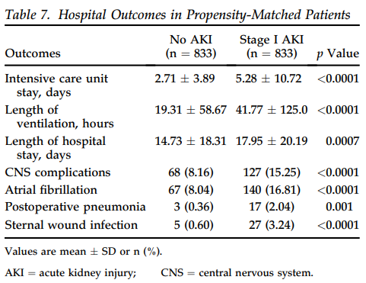
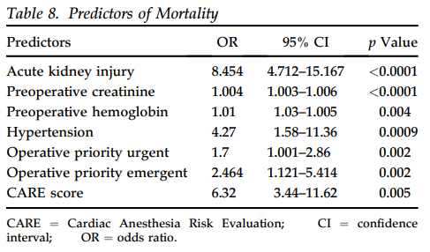
Impact of CSA-AKI
Cardiac surgery patients who developed Stage 1 AKI also experienced increased hospital mortality, post-op complications, & longer length of stay. ⁶

Slide 7
Impact of CSA-AKI
Mortality rates among cardiovascular patients requiring postoperative renal replacement therapy are between 40-70% ⁸
In a review of cases for 1,078,036 patients undergoing CABG, valve-replacement surgery or both from the Nationwide Inpatient Sample from 2008-2011 (United States only) ⁹
1 in every 10 patients developed AKI after cardiac operation
10-fold greater in-hospital mortality
Twofold greater length of stay
On average, $36,453 greater index hospitalization costs

Slide 8
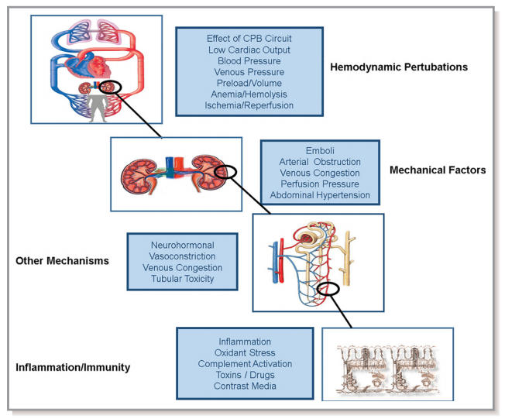
Pathophysiology of AKI related to Cardiopulmonary bypass
There are many variables associated with cardiac surgery & cardiopulmonary bypass:
Nonpulsatile blood flow
Hemodilution
Transfusion load
Release of free hemoglobin & free iron from hemolysis
Prolonged hypothermia
Inflammatory response
Venous congestion
All of these factors can contribute to acute kidney injury. ¹⁰

Slide 9
Incidence of CKD after Cardiac Surgery
In a review of 29,388 cardiac surgery patients using the VASQIP registry: ⁸
31% (9125) patients had CKD at time of surgery
CKD defined as average eGFR <60mL/min/1.73m² for at least 3 months
In remaining 20,263 patients without CKD at baseline:
25% of patients with NO increase in postop creatinine developed CKD
33% of patients with an increase of 1-24% in postop creatinine developed CKD
44% of patients with an increase of 25-49% in postop creatinine developed CKD
51% of patients with an increase of 50-99% in postop creatinine developed CKD
53% of patients with an increase of ≥100% in postop creatinine developed CKD

Slide 10
Considerations for Preventing CSA-AKI ¹⁰
Preop
Intraop
Postop
Assess Risk Factors
Statin initiation: not supported
Maintain normoglycemia
Hold ACE inhibitors & ARBs
Maintain Normoglycemia
Avoid hydoxyethyl starch
Use balanced crystalloid solutions to replace fluid losses
Avoid hyperthermic perfusion during CPB
Avoid significant hemodilution during CPB & limit blood transfusions
Avoid dopamine
Discontinue ACEIs & ARBs for the first 48 hours after surgery
Monitor sCr and urine output
Maintain normoglycemia
Avoid radiocontrast agents

Slide 11
Preoperative Considerations
Assess risk factors
Determine baseline kidney function
Assess for anemia
Assess for albuminuria
Statin initiation: Not proven to reduce risk of AKI¹⁰⁻¹²
High-dose atorvastatin did not reduce AKI overall after cardiac surgery (Statin AKI Cardiac Surgery RCT- 2016)¹³
Preop treatment with a statin was not associated with postop AKI, RRT, or mortality ¹⁴
Maintain Normoglycemia
Hold ACE inhibitors and ARBs ^{10-12; 15-16}
TRIBE-AKI study found increase in AKI in patients receiving ACEIs and ARBs (no ACEIs or ARBs: 31% incidence compared to 34% in held ACEIs/ARBs vs. 42% incidence with continued ACEIs/ARBs) ¹⁵
Large meta-analysis (29 studies) found preop use of ACE/ARB until day of surgery increased odds of developing AKI ¹⁶

Slide 12
CSA-AKI Risk Factors ¹⁷
Preop |  | Intraop |  | Postop
Advanced Age Female Hypertension Hyperlipidemia Chronic Kidney Disease Liver Disease Peripheral Vascular Disease Previous Stroke Smoking hx Diabetes Anemia |  | Complex surgery Cardiopulmonary bypass Low HCT in CPB Aortic cross clamp time* Hypoperfusion Hypovolemia Venous congestion Emboli Inotropes Exposure |  | Vasopressor exposure Inotrope exposure Blood transfusion Anemia Hypovolemia Venous congestion Cardiogenic shock
* Cardiopulmonary bypass lasting 3 hours or longer was associated with a nearly fourfold elevated risk in renal dysfunction (unadjusted relative risk, 3.7 [CI, 2.8 to 4.9]) compared with cardiopulmonary bypass lasting less than 2 hours. ¹⁸

Slide 13
Intraoperative Considerations
Maintain normoglycemia
Avoid hydroxyethyl starch
Use balanced crystalloid solutions & vasopressors to maintain hemodynamics
Avoid hyperthermic perfusion during CPB
Avoid significant hemodilution during CPB
Limit blood transfusions

Slide 14
Intraoperative Considerations:
Maintain normoglycemia
AKI may further complicate glycemic control as it is associated with insulin resistance and reduced renal clearance of insulin ¹⁹
Aortic cross-clamp time and blood transfusion as independent risk factors of postoperative hyperglycemia after cardiac surgery in non-diabetics ²⁰
In a study of 510 patients undergoing cardiovascular surgery and found the incidence of AKI to be higher in patients with high HbA1c levels preoperatively; Every 1% increase over 6% in HgA1c levels increased the risk of renal complications by 24% ²¹
Glycemic variability, a standard deviation of all POC-BG readings, is associated with increased postoperative LOS-ICU, rise in creatinine, and AKI ²²

Slide 15
Intraoperative Considerations:
Maintain normoglycemia (continued)
In a randomized controlled trial, moderate glucose control defined as 127-179 mg/dl was found to be preferable to tight control ≤ 126 in patients undergoing CABG ²³
Incidence of AKI was higher in patients with time-weighted average intraop glucose of >150mg/dl (8%) as compared to patients with blood glucose 110-150 mg/dl (3%) ²⁴
KDIGO - recommends maintaining blood glucose between 110 - 149 mg/dL in critically ill patients ²⁵
Tight glucose control (<150mg/dl) is seen as controversial as risks of hypoglycemia are significant: NICE-SUGAR meta-analysis ²⁶
Society of Thoracic Surgeons (STS) Practice Guidelines recommend maintaining serum glucose levels ≤ 180 mg/dL for at least 24 hours after cardiac surgery ²⁷

Slide 16
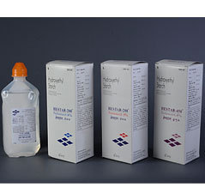
Intraoperative Considerations:
Hydroxyethyl Starch (HES) studies show mixed results
Hydroxyethyl starch-containing solutions may increase AKI occurrence
Scandinavian Starch for Severe Sepsis/Septic Shock (6S) Trial ²⁸
Crystalloid versus Hydroxyethyl Starch Trial (CHEST) published in 2012 initially found an increased need for renal replacement therapy in patients receiving HES vs. crystalloids; later analysis (2016) did not find this to be true- no difference in patient outcomes ²⁹
Need for further research, should be used cautiously

Slide 17
Intraoperative Considerations:
Use Vasopressors & crystalloids to maintain hemodynamic stability:
Either norepinephrine or vasopressin can be used for hemodynamic support in the patient post-cardiac surgery ³⁰
European Society of Intensive Care Medicine recommendations: ¹¹
Norepinephrine recommended as first-choice vasopressor to protect kidney function
(Grade 1B evidence)
Suggest vasopressin in patients with vasoplegic shock after cardiac surgery (Grade 2C evidence)
Controlled fluid resuscitation in volume depletion, while avoiding volume overload using balanced crystalloids (Grade 1C/2C)
American Heart Association - Cardiac and Vascular Surgery- Associated Acute Kidney Injury Consensus Guidelines recommend:¹⁰
Use of balanced crystalloid solutions guided by measures of fluid responsiveness (Grade 1B)

Slide 18
Goal-Directed Perfusion Trial (GIFT)³¹
Multicenter RCT conducted at 9 institutions in Europe, Australia, New Zealand, and the United States
350 cardiac surgery patients with cardiopulmonary bypass ≥ 90 minutes
Intervention group: Maintain DO₂ value ≥ 280mL・min⁻¹・m⁻² during CPB; Adjust arterial pump flow based on Hct value to maintain DO₂; Transfuse 1U PRBC if SvO₂ <68% and/or the oxygen extraction rate was >40%
Control group: Arterial pump flow based on body surface area and temp, target value of 2.4L・min⁻¹・m⁻² at normothermia. Transfusion trigger based on Hct value alone.
Lower incidence of AKIN Stage 1 AKI in GDP group; same incidence for stage 2 & 3

Slide 19
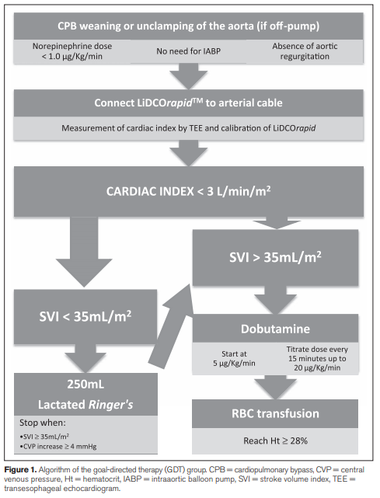
Goal Directed Resuscitation in Cardiac Surgery ³²
126 cardiac surgery patients undergoing CABG or valve surgery were randomized to two groups:
Control group: 64 patients receiving usual care
Goal directed therapy group: 62 patients receiving protocol-based care (see graphic)
Outcomes:
30-day mortality and major complications reduced in the GDT group (27% compared to 45% in the control) p=0.037
However, no significant difference in AKI requiring dialysis or hemofiltration
Notes:
1 Osawa EA, Rhodes A, Landoni G, Galas FRBG, Fukushima JT, Park CHL, Almeida JP, Nakamura RE, Strabelli TMV, Pileggi B, Leme AC, Fominskiy E, Sakr Y, Lima M, Franco RA, Chan RPC, Piccioni MA, Mendes P, Menezes SR, Bruno T, Gaiotto FA, Lisboa LA, Dallan LAO, Hueb AC, Pomerantzeff PM, Kalil Filho R, Jatene FB, Auler Junior JOC, Hajjar LA: Effect of Perioperative Goal-Directed Hemodynamic Resuscitation Therapy on Outcomes Following Cardiac Surgery: A Randomized Clinical Trial and Systematic Review. Crit Care Med 2016; 44:724–33

Slide 20
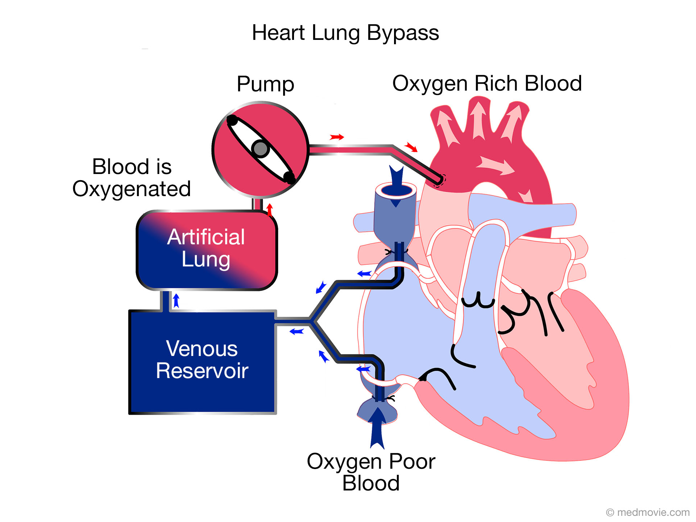
Intraoperative Considerations
Avoid periods of hyperthermic perfusion
CABG patients re-warmed on CPB to 37℃ had a higher incidence of renal dysfunction (17%) as compared to patients re-warmed to 34℃ (9%); n=223 ³³
Avoid significant hemodilution
Hemodilution during CPB is an independent risk factor for AKI in adult cardiac surgery ³⁴
In a retrospective analysis of 16,790 cardiac surgery patients, relative risk of AKI increased by 7% for every percentage point decrease in nadir HCT during CPB ³⁵
Limit blood transfusions
Transfusion of ≥ 2 units of packed red blood cells has been associated with higher incidence of AKI³⁶
In 2 different RCTs, patients were randomized to liberal (Hg<9.5) or restrictive (Hb<7.5) groups intraoperatively and postoperatively and there was no difference in postop AKI. ³⁷⁻³⁸

Slide 21
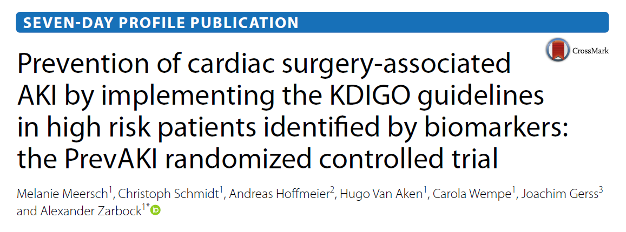
PrevAKI Study ³⁹
Optimized hemodynamics:
Dobutamine or epinephrine for cardiac index <3.0
Norepinephrine for MAP <65
Avoided hyperglycemia
Held ACEi/ARB for 48 hours after surgery
Cardiac surgery, n = 276
Successfully reduced AKI in cardiac population through 3 primary interventions:

Slide 22
Postoperative Considerations
Avoid low-dose dopamine to treat/prevent AKI
In a meta-analysis of 58 studies examining dopamine use, 24 studies included outcomes: low-dose dopamine was not associated with the prevention of acute renal failure ⁴⁰
A second meta-analysis of 61 studies established similar findings: low-dose dopamine increased urine output but did not prevent renal dysfunction ⁴¹
Monitor sCr and urine output for early detection of AKI¹⁰
Maintain blood glucose
Society of Thoracic Surgeons (STS) Practice Guidelines recommend maintaining serum glucose levels ≤ 180 mg/dL for at least 24 hours after cardiac surgery ²⁷
Avoid radiocontrast agents
Contrast dose > 240 mg/kg resulted in greater incidence of CSA-AKI for patients who underwent cardiac catheterization ≤7 days before cardiac surgery than those > 7 days before cardiac surgery (39% vs. 29%, p = 0.025) ⁴²

Slide 23
Interventions requiring more research
Beta-blockers may lead to decreased risk of renal dysfunction after cardiac surgery
Preop beta-blocker use was not associated with postop AKI ⁴³
In a large North American observational analysis (629,877 patients), preoperative beta-blocker therapy was associated with a slightly lower risk of renal failure in patients undergoing CABG (3% vs. 4%) ⁴⁴
Unclear if fenoldopam reduces risk of AKI in patients undergoing cardiac surgery ⁴⁵⁻⁴⁶
Meta-analysis including 7 trials and 1,107 patients undergoing cardiac surgery: fenoldopam associated with decreased incidence of AKI but increased incidence of hypotension; no change in hospital mortality or RRT requirements ⁴⁵
A multicenter, randomized, double-blind, placebo controlled, parallel-group study was stopped for futility as fenoldopam did not reduce 30-day mortality or need for RRT but was associated with increased rate of hypotension ⁴⁶

Slide 24
Interventions requiring more research
Volatile anesthetics may protect against AKI ⁴⁷⁻⁴⁸
A meta-analysis of 10 trials with 1600 patients found that volatile anesthetics significantly reduced AKI incidence compared with control data (relative risk: 0.65; 95% CI, 0.43-0.97; P=0.04) ⁴⁷
Remote Ischemic Preconditioning ⁴⁹⁻⁵¹
Application of controlled ischemia to remote tissues or organs to create a protective adaptive response in distant organs
Mixed results in studies -> differing protocols, patient populations, and study design
Further investigation needed before adopting into practice

Slide 25
Interventions requiring more research
Alpha-2 agonists
A study in pediatric patients undergoing congenital cardiac surgery showed that dexmedetomidine was associated with lower instances of acute kidney injury ⁵²
A meta-analysis stated that dexmedetomidine may be promising as an agent to prevent postoperative renal dysfunction after cardiac surgery ⁵³
Intraoperative FiO2
The ROCS trial is examining the impact of hyperoxia on end organ injury during cardiac surgery ⁵⁴
A subanalysis of an ongoing RCT did not find a significant increase in AKI with intraoperative hyperoxia during non-cardiac surgery ⁵⁵

Slide 26
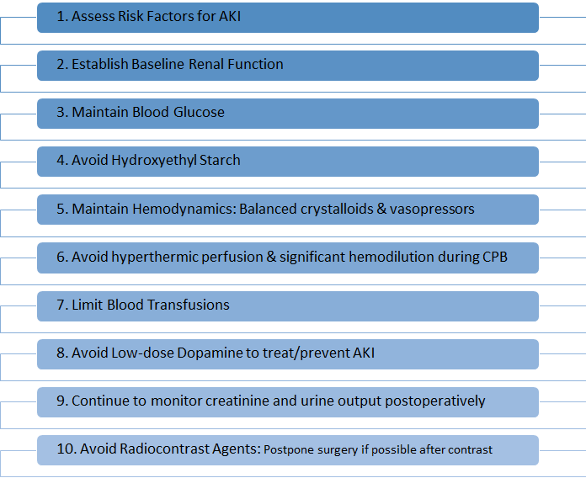
Summary of Considerations for preventing AKI after Cardiac Surgery

Slide 27
References
1 Wang Y, Bellomo R: Cardiac surgery-associated acute kidney injury: risk factors, pathophysiology and treatment. Nat Rev Nephrol 2017; 13:697–711
2 Hansen MK, Gammelager H, Mikkelsen MM, Hjortdal VE, Layton JB, Johnsen SP, Christiansen CF: Post-operative acute kidney injury and five-year risk of death, myocardial infarction, and stroke among elective cardiac surgical patients: a cohort study. Crit Care 2013; 17:R292
3 Howitt SH, Grant SW, Caiado C, Carlson E, Kwon D, Dimarakis I, Malagon I, McCollum C: The KDIGO acute kidney injury guidelines for cardiac surgery patients in critical care: a validation study. BMC Nephrol 2018; 19:149
4 Xie X, Wan X, Ji X, Chen X, Liu J, Chen W, Cao C: Reassessment of Acute Kidney Injury after Cardiac Surgery: A Retrospective Study. Intern Med 2017; 56:275–82
5 Lagny M-G, Jouret F, Koch J-N, Blaffart F, Donneau A-F, Albert A, Roediger L, Krzesinski J-M, Defraigne J-O: Incidence and outcomes of acute kidney injury after cardiac surgery using either criteria of the RIFLE classification. BMC Nephrol 2015; 16:76
6 Elmistekawy E, McDonald B, Hudson C, Ruel M, Mesana T, Chan V, Boodhwani M: Clinical impact of mild acute kidney injury after cardiac surgery. Ann Thorac Surg 2014; 98:815–22

Slide 28
References
7 Bouma HR, Mungroop HE, Geus AF de, Huisman DD, Nijsten MWN, Mariani MA, Scheeren TWL, Burgerhof JGM, Henning RH, Epema AH: Acute Kidney Injury Classification Underestimates Long-Term Mortality After Cardiac Valve Operations. Ann Thorac Surg 2018; 106:92–8
8 Ishani A, Nelson D, Clothier B, Schult T, Nugent S, Greer N, Slinin Y, Ensrud KE: The magnitude of acute serum creatinine increase after cardiac surgery and the risk of chronic kidney disease, progression of kidney disease, and death. Arch Intern Med 2011; 171:226–33
9 Alshaikh HN, Katz NM, Gani F, Nagarajan N, Canner JK, Kacker S, Najjar PA, Higgins RS, Schneider EB: Financial Impact of Acute Kidney Injury After Cardiac Operations in the United States. Ann Thorac Surg 2018; 105:469–75
10 Nadim MK, Forni LG, Bihorac A, Hobson C, Koyner JL, Shaw A, Arnaoutakis GJ, Ding X, Engelman DT, Gasparovic H, Gasparovic V, Herzog CA, Kashani K, Katz N, Liu KD, Mehta RL, Ostermann M, Pannu N, Pickkers P, Price S, Ricci Z, Rich JB, Sajja LR, Weaver FA, Zarbock A, Ronco C, Kellum JA: Cardiac and Vascular Surgery-Associated Acute Kidney Injury: The 20th International Consensus Conference of the ADQI (Acute Disease Quality Initiative) Group. J Am Heart Assoc 2018; 7
11 Joannidis M, Druml W, Forni LG, Groeneveld ABJ, Honore PM, Hoste E, Ostermann M, Oudemans-van Straaten HM, Schetz M: Prevention of acute kidney injury and protection of renal function in the intensive care unit: update 2017 : Expert opinion of the Working Group on Prevention, AKI section, European Society of Intensive Care Medicine. Intensive Care Med 2017; 43:730–49
12 Rao SN, Shenoy M P, Gopalakrishnan M, Kiran B A: Applicability of the Cleveland clinic scoring system for the risk prediction of acute kidney injury after cardiac surgery in a South Asian cohort. Indian Heart J 2018; 70:533–7

Slide 29
References
13 Billings FT 4th, Hendricks PA, Schildcrout JS, Shi Y, Petracek MR, Byrne JG, Brown NJ: High-Dose Perioperative Atorvastatin and Acute Kidney Injury Following Cardiac Surgery: A Randomized Clinical Trial. JAMA 2016; 315:877–88
14 Lewicki M, Ng I, Schneider AG: HMG CoA reductase inhibitors (statins) for preventing acute kidney injury after surgical procedures requiring cardiac bypass. Cochrane Database Syst Rev 2015:CD010480
15 Coca SG, Garg AX, Swaminathan M, Garwood S, Hong K, Thiessen-Philbrook H, Passik C, Koyner JL, Parikh CR, TRIBE-AKI Consortium: Preoperative angiotensin-converting enzyme inhibitors and angiotensin receptor blocker use and acute kidney injury in patients undergoing cardiac surgery. Nephrol Dial Transplant 2013; 28:2787–99
16 Yacoub R, Patel N, Lohr JW, Rajagopalan S, Nader N, Arora P: Acute kidney injury and death associated with renin angiotensin system blockade in cardiothoracic surgery: a meta-analysis of observational studies. Am J Kidney Dis 2013; 62:1077–86
17 Romagnoli S, Ricci Z, Ronco C: Perioperative Acute Kidney Injury: Prevention, Early Recognition, and Supportive Measures. Nephron 2018; 140:105–10
18 Mangano CM, Diamondstone LS, Ramsay JG, Aggarwal A, Herskowitz A, Mangano DT: Renal dysfunction after myocardial revascularization: risk factors, adverse outcomes, and hospital resource utilization. The Multicenter Study of Perioperative Ischemia Research Group. Ann Intern Med 1998; 128:194–203
19 Fiaccadori E, Sabatino A, Morabito S, Bozzoli L, Donadio C, Maggiore U, Regolisti G: Hyper/hypoglycemia and acute kidney injury in critically ill patients. Clin Nutr 2016; 35:317–21

Slide 30
References
20 Moorthy V, Sim MA, Liu W, Chew STH, Ti LK: Risk factors and impact of postoperative hyperglycemia in nondiabetic patients after cardiac surgery: A prospective study. Medicine 2019; 98:e15911
21 Gumus F, Polat A, Sinikoglu SN, Yektas A, Erkalp K, Alagol A: Use of a lower cut-off value for HbA1c to predict postoperative renal complication risk in patients undergoing coronary artery bypass grafting. J Cardiothorac Vasc Anesth 2013; 27:1167–73
22 Bansal B, Carvalho P, Mehta Y, Yadav J, Sharma P, Mithal A, Trehan N: Prognostic significance of glycemic variability after cardiac surgery. J Diabetes Complications 2016; 30:613–7
23 Bhamidipati CM, LaPar DJ, Stukenborg GJ, Morrison CC, Kern JA, Kron IL, Ailawadi G: Superiority of moderate control of hyperglycemia to tight control in patients undergoing coronary artery bypass grafting. J Thorac Cardiovasc Surg 2011; 141:543–51
24 Song JW, Shim JK, Yoo KJ, Oh SY, Kwak YL: Impact of intraoperative hyperglycaemia on renal dysfunction after off-pump coronary artery bypass. Interact Cardiovasc Thorac Surg 2013; 17:473–8
25 KDIGO. 2012. “KDIGO 2012 Clinical Practice Guideline for the Evaluation and Management of Chronic Kidney Disease.” https://kdigo.org/wp-content/uploads/2017/02/KDIGO_2012_CKD_GL.pdf.
26 NICE-SUGAR Study Investigators, Finfer S, Chittock DR, Su SY-S, Blair D, Foster D, Dhingra V, Bellomo R, Cook D, Dodek P, Henderson WR, Hébert PC, Heritier S, Heyland DK, McArthur C, McDonald E, Mitchell I, Myburgh JA, Norton R, Potter J, Robinson BG, Ronco JJ: Intensive versus conventional glucose control in critically ill patients. N Engl J Med 2009; 360:1283–97

Slide 31
References
27 Lazar HL, McDonnell M, Chipkin SR, Furnary AP, Engelman RM, Sadhu AR, Bridges CR, Haan CK, Svedjeholm R, Taegtmeyer H, Shemin RJ, Society of Thoracic Surgeons Blood Glucose Guideline Task Force: The Society of Thoracic Surgeons practice guideline series: Blood glucose management during adult cardiac surgery. Ann Thorac Surg 2009; 87:663–9
28 Perner A, Haase N, Guttormsen AB, Tenhunen J, Klemenzson G, Åneman A, Madsen KR, Møller MH, Elkjær JM, Poulsen LM, Bendtsen A, Winding R, Steensen M, Berezowicz P, Søe-Jensen P, Bestle M, Strand K, Wiis J, White JO, Thornberg KJ, Quist L, Nielsen J, Andersen LH, Holst LB, Thormar K, Kjældgaard A-L, Fabritius ML, Mondrup F, Pott FC, Møller TP, et al.: Hydroxyethyl starch 130/0.42 versus Ringer’s acetate in severe sepsis. N Engl J Med 2012; 367:124–34
29 Myburgh JA, Finfer S, Bellomo R, Billot L, Cass A, Gattas D, Glass P, Lipman J, Liu B, McArthur C, McGuinness S, Rajbhandari D, Taylor CB, Webb SAR, CHEST Investigators, Australian and New Zealand Intensive Care Society Clinical Trials Group: Hydroxyethyl starch or saline for fluid resuscitation in intensive care. N Engl J Med 2012; 367:1901–11
30 Thiele RH, Isbell JM, Rosner MH: AKI associated with cardiac surgery. Clin J Am Soc Nephrol 2015; 10:500–14
31 Ranucci M, Johnson I, Willcox T, Baker RA, Boer C, Baumann A, Justison GA, Somer F de, Exton P, Agarwal S, Parke R, Newland RF, Haumann RG, Buchwald D, Weitzel N, Venkateswaran R, Ambrogi F, Pistuddi V: Goal-directed perfusion to reduce acute kidney injury: A randomized trial. J Thorac Cardiovasc Surg 2018; 156:1918–27.e2

Slide 32
References
32 Osawa EA, Rhodes A, Landoni G, Galas FRBG, Fukushima JT, Park CHL, Almeida JP, Nakamura RE, Strabelli TMV, Pileggi B, Leme AC, Fominskiy E, Sakr Y, Lima M, Franco RA, Chan RPC, Piccioni MA, Mendes P, Menezes SR, Bruno T, Gaiotto FA, Lisboa LA, Dallan LAO, Hueb AC, Pomerantzeff PM, Kalil Filho R, Jatene FB, Auler Junior JOC, Hajjar LA: Effect of Perioperative Goal-Directed Hemodynamic Resuscitation Therapy on Outcomes Following Cardiac Surgery: A Randomized Clinical Trial and Systematic Review. Crit Care Med 2016; 44:724–33
33 Boodhwani M, Rubens FD, Wozny D, Nathan HJ: Effects of mild hypothermia and rewarming on renal function after coronary artery bypass grafting. Ann Thorac Surg 2009; 87:489–95
34 Karkouti K, Beattie WS, Wijeysundera DN, Rao V, Chan C, Dattilo KM, Djaiani G, Ivanov J, Karski J, David TE: Hemodilution during cardiopulmonary bypass is an independent risk factor for acute renal failure in adult cardiac surgery. J Thorac Cardiovasc Surg 2005; 129:391–400
35 Ranucci M, Aloisio T, Carboni G, Ballotta A, Pistuddi V, Menicanti L, Frigiola A, Surgical and Clinical Outcome REsearch (SCORE) Group: Acute Kidney Injury and Hemodilution During Cardiopulmonary Bypass: A Changing Scenario. Ann Thorac Surg 2015; 100:95–100
36 Khan UA, Coca SG, Hong K, Koyner JL, Garg AX, Passik CS, Swaminathan M, Garwood S, Patel UD, Hashim S, Quantz MA, Parikh CR: Blood transfusions are associated with urinary biomarkers of kidney injury in cardiac surgery. J Thorac Cardiovasc Surg 2014; 148:726–32

Slide 33
References
37 Mazer CD, Whitlock RP, Fergusson DA, Hall J, Belley-Cote E, Connolly K, Khanykin B, Gregory AJ, Médicis É de, McGuinness S, Royse A, Carrier FM, Young PJ, Villar JC, Grocott HP, Seeberger MD, Fremes S, Lellouche F, Syed S, Byrne K, Bagshaw SM, Hwang NC, Mehta C, Painter TW, Royse C, Verma S, Hare GMT, Cohen A, Thorpe KE, Jüni P, et al.: Restrictive or Liberal Red-Cell Transfusion for Cardiac Surgery. N Engl J Med 2017; 377:2133–44
38 Murphy GJ, Pike K, Rogers CA, Wordsworth S, Stokes EA, Angelini GD, Reeves BC, TITRe2 Investigators: Liberal or restrictive transfusion after cardiac surgery. N Engl J Med 2015; 372:997–1008
39 Meersch M, Schmidt C, Hoffmeier A, Van Aken H, Wempe C, Gerss J, Zarbock A: Prevention of cardiac surgery-associated AKI by implementing the KDIGO guidelines in high risk patients identified by biomarkers: the PrevAKI randomized controlled trial. Intensive Care Med 2017; 43:1551–61
40 Kellum JA, M Decker J: Use of dopamine in acute renal failure: a meta-analysis. Crit Care Med 2001; 29:1526–31
41 Friedrich JO, Adhikari N, Herridge MS, Beyene J: Meta-analysis: low-dose dopamine increases urine output but does not prevent renal dysfunction or death. Ann Intern Med 2005; 142:510–24
42 Jiang W, Yu J, Xu J, Shen B, Wang Y, Luo Z, Wang C, Ding X, Teng J: Impact of cardiac catheterization timing and contrast media dose on acute kidney injury after cardiac surgery. BMC Cardiovasc Disord 2018; 18:191
43 O’Neal JB, Billings FT 4th, Liu X, Shotwell MS, Liang Y, Shah AS, Ehrenfeld JM, Wanderer JP, Shaw AD: Effect of Preoperative Beta-Blocker Use on Outcomes Following Cardiac Surgery. Am J Cardiol 2017; 120:1293–7

Slide 34
References
44 Ferguson TB Jr, Coombs LP, Peterson ED, Society of Thoracic Surgeons National Adult Cardiac Surgery Database: Preoperative beta-blocker use and mortality and morbidity following CABG surgery in North America. JAMA 2002; 287:2221–7
45 Sun H, Xie Q, Peng Z: Does Fenoldopam Protect Kidney in Cardiac Surgery? A Systemic Review and Meta-Analysis With Trial Sequential Analysis. Shock 2019; 52:326–33
46 Bove T, Zangrillo A, Guarracino F, Alvaro G, Persi B, Maglioni E, Galdieri N, Comis M, Caramelli F, Pasero DC, Pala G, Renzini M, Conte M, Paternoster G, Martinez B, Pinelli F, Frontini M, Zucchetti MC, Pappalardo F, Amantea B, Camata A, Pisano A, Verdecchia C, Dal Checco E, Cariello C, Faita L, Baldassarri R, Scandroglio AM, Saleh O, Lembo R, et al.: Effect of fenoldopam on use of renal replacement therapy among patients with acute kidney injury after cardiac surgery: a randomized clinical trial. JAMA 2014; 312:2244–53
47 Cai J, Xu R, Yu X, Fang Y, Ding X: Volatile anesthetics in preventing acute kidney injury after cardiac surgery: a systematic review and meta-analysis. J Thorac Cardiovasc Surg 2014; 148:3127–36
48 Yoo Y-C, Shim J-K, Song Y, Yang S-Y, Kwak Y-L: Anesthetics influence the incidence of acute kidney injury following valvular heart surgery. Kidney Int 2014; 86:414–22
49 Zarbock A, Kellum JA, Van Aken H, Schmidt C, Küllmar M, Rosenberger P, Martens S, Görlich D, Meersch M: Long-term Effects of Remote Ischemic Preconditioning on Kidney Function in High-risk Cardiac Surgery Patients: Follow-up Results from the RenalRIP Trial. Anesthesiology 2017; 126:787–98

Slide 35
References
50 Pierce B, Bole I, Patel V, Brown DL: Clinical Outcomes of Remote Ischemic Preconditioning Prior to Cardiac Surgery: A Meta-Analysis of Randomized Controlled Trials. J Am Heart Assoc 2017; 6
51 Murphy N, Vijayan A, Frohlich S, O’Farrell F, Barry M, Sheehan S, Boylan J, Conlon N: Remote ischemic preconditioning does not affect the incidence of acute kidney injury after elective abdominal aortic aneurysm repair. J Cardiothorac Vasc Anesth 2014; 28:1285–92
52 Kwiatkowski DM, Axelrod DM, Sutherland SM, Tesoro TM, Krawczeski CD. Dexmedetomidine Is Associated With Lower Incidence of Acute Kidney Injury After Congenital Heart Surgery. Pediatr Crit Care Med. 2016;17(2):128-134.
53 Shi, R., Tie, H. Dexmedetomidine as a promising prevention strategy for cardiac surgery-associated acute kidney injury: a meta-analysis. Crit Care 21, 198 (2017).
54 Lopez MG, Pretorius M, Shotwell MS, et al. The Risk of Oxygen during Cardiac Surgery (ROCS) trial: study protocol for a randomized clinical trial. Trials. 2017;18(1):295.
55 Ruetzler K, Cohen B, Leung S, et al. Supplemental Intraoperative Oxygen Does Not Promote Acute Kidney Injury or Cardiovascular Complications After Noncardiac Surgery: Subanalysis of an Alternating Intervention Trial. Anesth Analg. 2020;130(4):933-940.

