Slide 1
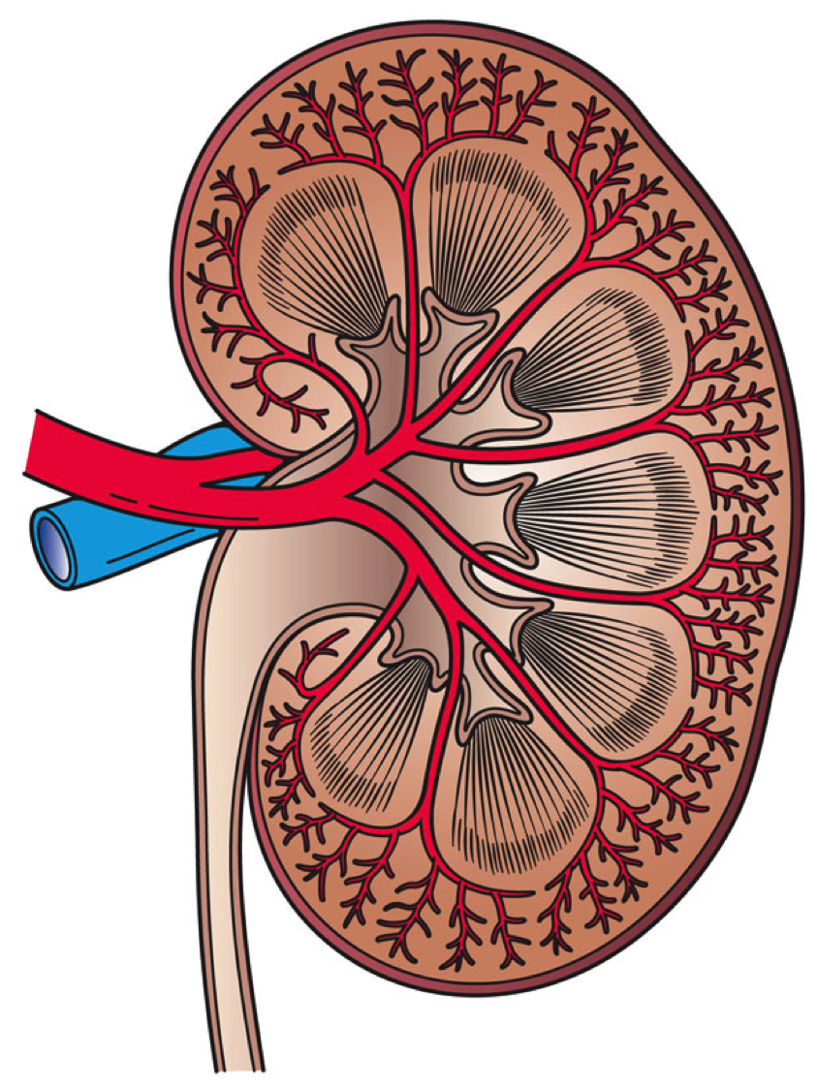
Avoiding Kidney Injury:
Recommendations for
Adult Surgical Patients

Slide 2
Objectives
Provide an overview of the literature regarding the prevention and recognition of kidney injury
Summarize recommendations to prevent & identify AKI as outlined in the literature
For an overview of kidney disease, reference:
MPOG Avoiding Kidney Injury - Overview, Pathophysiology, Definitions
For specialty specific recommendations, reference the following sections of the toolkit:
Avoiding Kidney Injury - Pediatrics
Avoiding Kidney Injury - Obstetrics
Avoiding Kidney Injury - Cardiac Surgery

Slide 3
Recommendations for Avoiding AKI

Slide 4
KDIGO Stage Based Recommendations

Slide 5
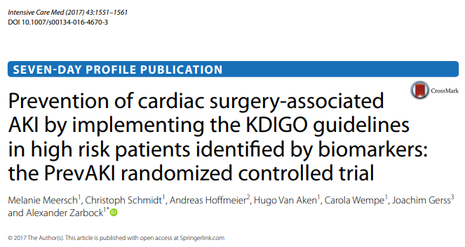
KDIGO Guideline Bundles
Single center trial
Implemented “bundle” of KDIGO guidelines³
Optimization of volume state and hemodynamics
Avoidance of nephrotoxic drugs
Normoglycemic management
Randomized high risk patients undergoing cardiac surgery
↓AKI in patients receiving the bundled protocol
Need for further multi-center adequately powered studies

Slide 6
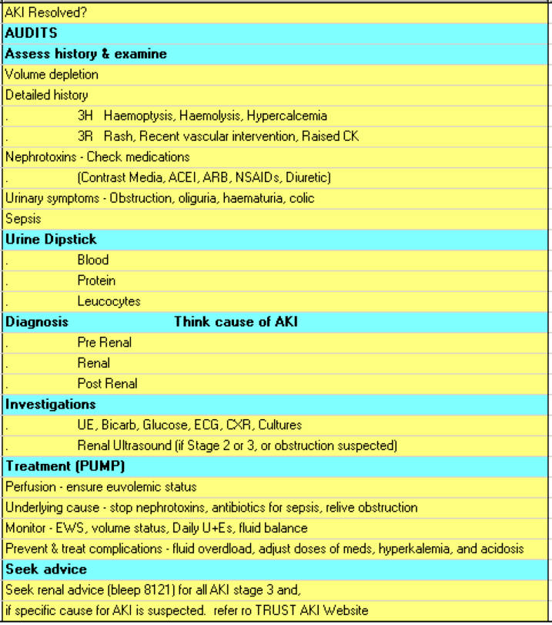
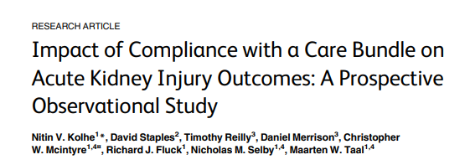
KDIGO Guideline Bundles
Single center study, adult patients >18 years⁴
Utilized an AKI care bundle, an electronic recognition of AKI based on KDIGO Criteria, and an EHR alert
Compared patients who received the AKI care bundle vs. those who did not" to save some space
10 fold increase in care bundle usage after integration of EHR alert
Completion of an AKI CB within 24 hours of abnormal blood test was associated with less progression to higher AKI stages and significantly lower in-hospital, 30-day and 60-day case fatality.
Used “AUDITS” bundle

Slide 7
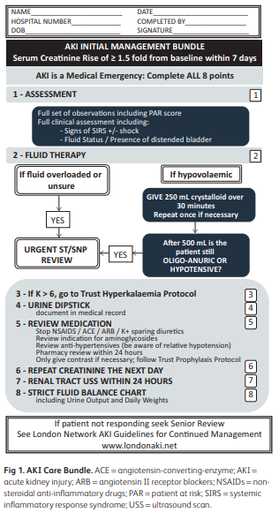
Implementation of AKI Care Bundle in NHS hospital⁵
London hospital implemented daily audit process to assess care for patients with AKI
2011: Pre-intervention audit of 100 patients with AKI (KDIGO definition used)
2012: Intervention applied- AKI Care Bundle implemented
2013: Post-intervention audit of 92 patients with AKI
Outcomes:
Hospital mortality decreased in the post-intervention group (10% post vs. 12% pre)
AKI was recognized more often in the post-intervention group (68% post vs 51% pre)
Higher rates of nephrotoxic medication discontinuation post-intervention (73% post vs. 29% pre)

Slide 8
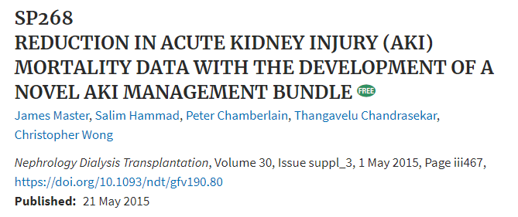
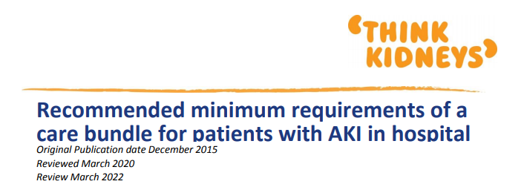
More AKI Bundles for Review
Aintree University Hospital
Please contact MPOG to share your AKI Prevention Bundle & Quality Improvement story!
NHS Think Kidneys

Slide 9
Recommendations
01
Identify patients at risk of developing AKI
Patient risk factors
Procedure risk factors
Anesthesia related risk factors
02
Avoid hypotension
Relative vs. absolute hypotension
Restrictive vs. Liberal Fluid Therapy
Vasopressor use
Sepsis Implications
03
Avoid hyperglycemia
Patient Risk Factors
Glycemic Range Targets
Insulin Therapy
04
Avoid nephrotoxins
Antimicrobials
Contrast
NSAIDs
05
Early recognition of AKI
Optimizes treatment and prevents progression
EHR alerts/AI/Diagnostic Tools
Provider education

Slide 10
Recommendation #1: Identify patients at risk for AKI

Slide 11
Categories of AKI Risk Factors
Patient-related, such as:
Diabetes
Hypertension
Sepsis
Procedure-related, such as:
Cardiopulmonary bypass & duration
Emergency Surgery
Organ Transplant
Anesthesia-specific, such as:
Vasopressor use
Diuretic use
Hypotension

Slide 12
Patient Risk Factors⁶⁻⁸
Preoperative level of kidney function
Chronic Vascular Disease
Arterial Hypertension
Cardiac Failure/Cardiac Decompensation
Diabetes (insulin or oral therapy requirements)
Acute medical conditions (sepsis, major surgery, mechanical ventilation, hemodynamic instability)
Hypertension
Peripheral Vascular Disease
Congestive Heart Failure
Sepsis
Ascites
Cerebrovascular disease
Mild to Moderate preoperative renal insufficiency
Age >65
COPD
Chronic Kidney Disease
BMI ≥ 25 (Overweight) (Ju 2018)
Patient-related risk factors are more strongly associated with mortality
than the type of procedure.⁶

Slide 13
Procedure Related Risk Factors^{6,8-9}
Gastric bypass surgery for morbid obesity- 8.5% incidence AKI Cardiopulmonary bypass (CPB) & duration Aortic cross clamping & duration Hemodilution (cardiac surgery) Duration of surgery Intraperitoneal surgery Repair of AAA | Organ Transplant (non-renal also) Liver transplant: 33% AKI 17% require renal replacement therapy Use of intra-aortic balloon pump Type of cardiac surgical procedure Intra-abdominal hypertension Emergency surgery Bleeding complications

Slide 14
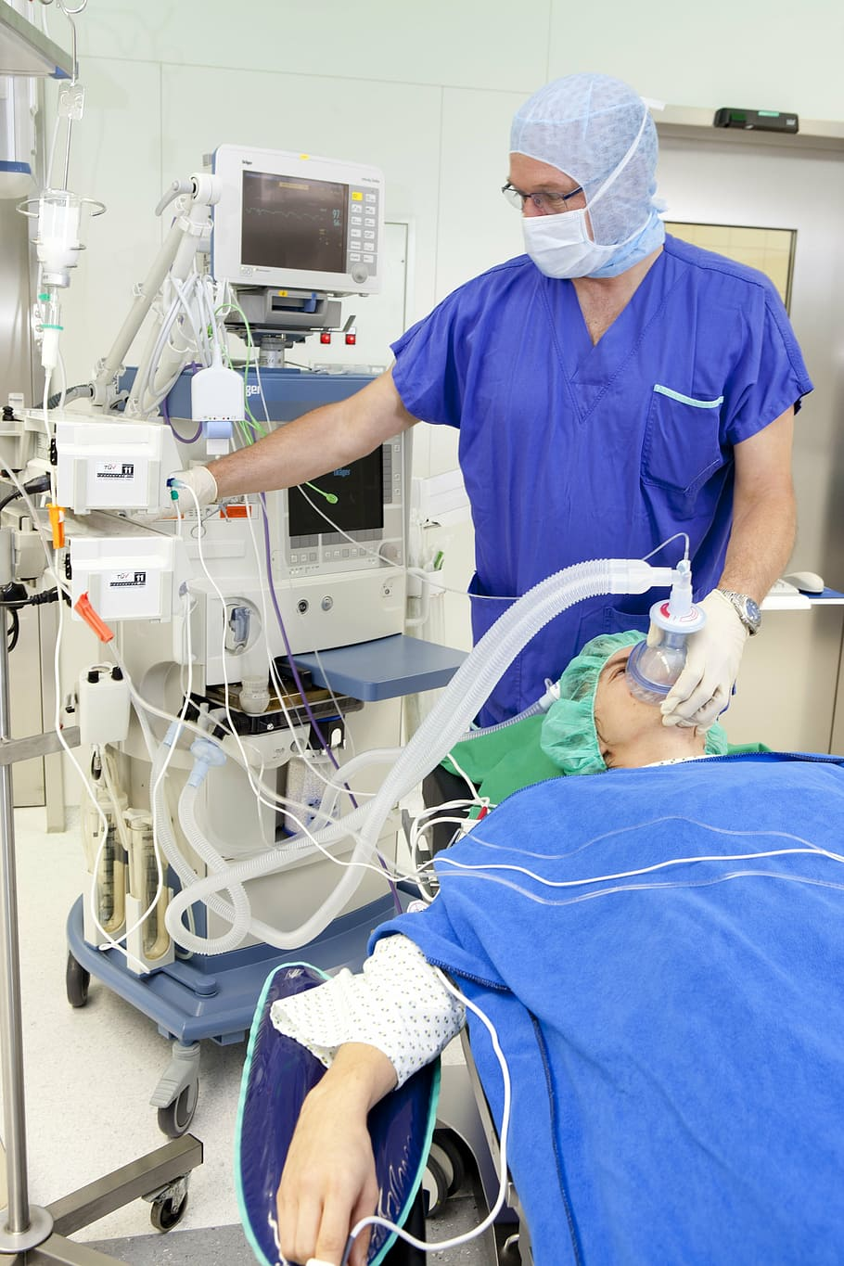
Anesthesia-related Risk Factors^{6,8-9}
Potentially modifiable AKI risk factors in both cardiac and noncardiac surgery
Hemodilution
Hemoglobin level
Intraoperative transfusion
Hypotension
Inadequate oxygen delivery
Use of diuretics
Selective renal ischemia
Ischemia reperfusion injury
Bleeding complications
Intraoperative Hypertension
Nephrotoxic agents (eg abx, contrast agents)

Slide 15
Novel Predictive Techniques
Use of predictive analytics and machine learning techniques present new opportunities to identify risk and potentially prevent AKI:¹¹
Thottakara et al recently used a machine-learning computational approach to develop a KDIGO AKI preoperative forecasting model
Used 59 variables from the electronic health record
Included patients undergoing any type of major surgery
Reported an AUC of 0.86 in the internal validation cohort

Slide 16
Recommendation #2:
Avoid Hypotension

Slide 17
Pathophysiology: How Hypotension contributes to AKI
Kidneys able to compensate for hypoperfusion to a certain extent
↓ renal perfusion → ↓GFR (without damage to parenchyma) as adaptive response¹²
Prostaglandin signaling → ↓ afferent arteriole resistance and ↑ blood flow to glomeruli and maintains capillary pressure²
Renin-angiotensin-aldosterone system and release of angiotensin II → ↑efferent arteriole resistance²
Once hypoperfusion drops below compensatory range, vasoconstrictors released by renal sympathetic nerves →↑afferent arteriole resistance→↓in GFR and renal blood flow→tubular cell damage and cell death²

Slide 18
Image Source: Gumbert et al. Anesthesiology 2020

Slide 19
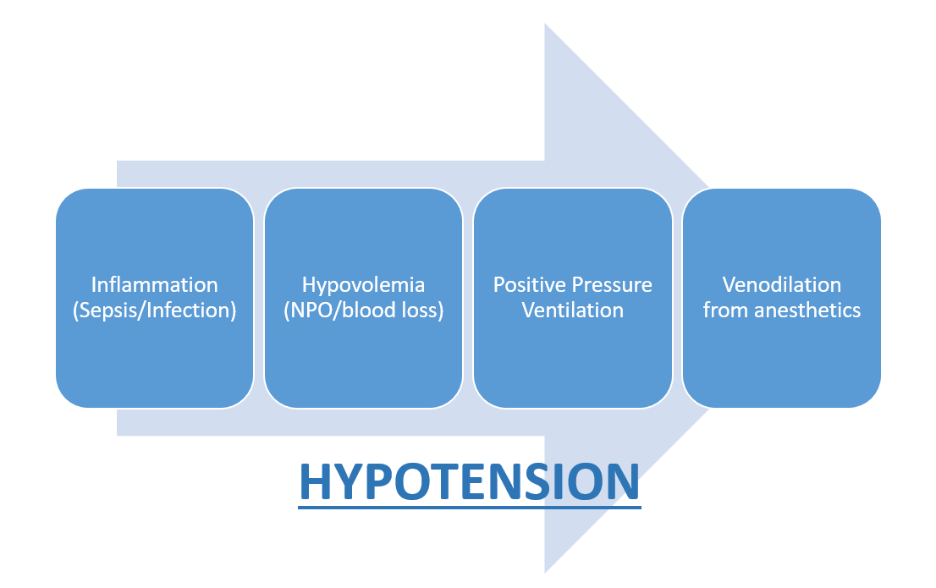
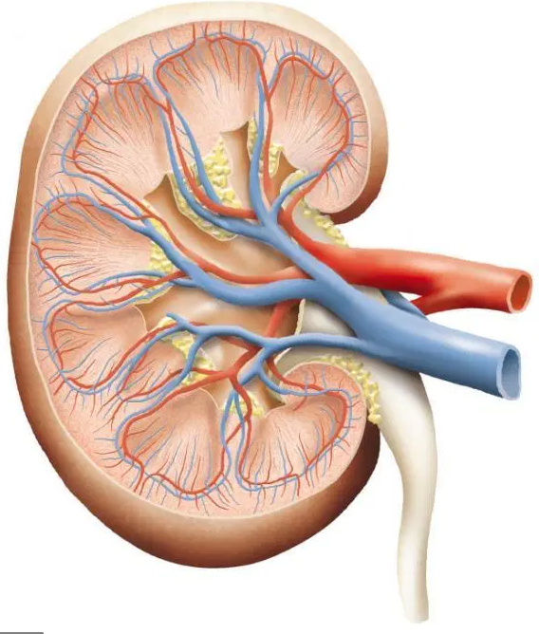
Intraoperative Hypotension: Contributing Factors¹³
HYPOPERFUSION
Renal Ischemia
& Decreased Glomerular Filtration

Slide 20
Hypotension and AKI
Intraoperative hypotension, even for short durations is associated with postoperative acute kidney injury¹⁴⁻¹⁸
Individualized management strategy aimed at achieving SBP within 10% of baseline resulted in lower incidence of AKI as compared to the control group (treat SBP<80 mmHg OR lower than 40% from baseline)¹⁹
Associations based on relative hypotension and AKI are no stronger than associations based on absolute hypotension- anesthetic management of hypotension can be based on intraop values alone¹⁶

Slide 21
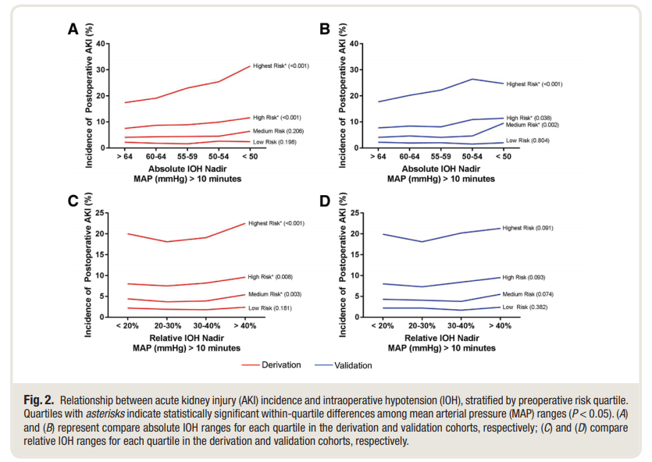
Hypotension and AKI
Associations between intraoperative hypotension and AKI are dependent upon patient’s baseline risk for AKI¹⁸
Patients with low baseline risk demonstrated no associations between intraop hypotension and AKI
Patients with medium risk demonstrated associations between hypotension (MAP<50) and AKI
Patients with high risk demonstrated associations between hypotension (MAP<60) and AKI

Slide 22
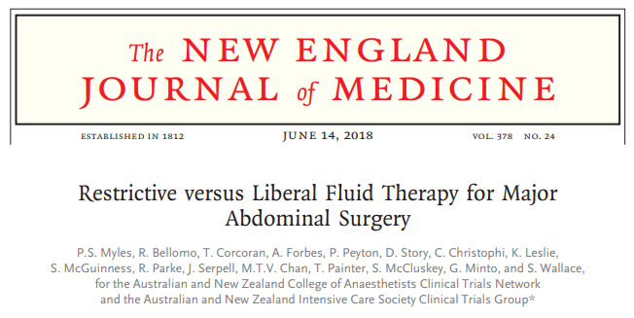
Restrictive Fluid Protocols may lead to AKI
RELIEF Study²⁰
3000 patients undergoing abdominal surgery
1490 patients in restrictive fluid therapy group (median 3.7L in 24 hours postop)
1493 patients in liberal fluid therapy group (median 6.1L in 24 hours postop)
AKI incidence of 8.6% in restrictive vs. 5.0% in liberal
Restrictive fluid protocols in abdominal surgery → higher chance for AKI with no benefit to survival

Slide 23
Cardiac Output directed fluid therapy: Controversial
Use cardiac output to guide fluid resuscitation efforts → improve perfusion without fluid overload
Supported by meta-analysis of 65 studies including 9308 patients in total²¹
Found GDFT using fluid and inotropes & targeting cardiac output and oxygen delivery (DO₂) was most effective in reducing AKI incidence
Benefits more significant for high risk patients undergoing orthopedic or major abdominal surgery
OPTIMISE Trial: Did not find significant difference in outcomes for GDFT group²²
Pragmatic, multicenter, randomized, observer-blinded
734 high-risk patients undergoing major abdominal surgery
Need for further research as GDFT protocols vary widely and could explain the variance in results²

Slide 24
Using hemodynamic parameters to reduce AKI
Large meta-analysis including 65 RCTs and 9308 patients conducted to examine the effects of hemodynamic goal-directed therapy (GDT) on morbidity (including AKI)²¹
All procedure types included
Major abdominal & orthopedic surgeries benefit most from GDT in reducing AKI
Intraoperative management through 8 hours after surgery
741 patients in the combined studies developed AKI
421 were in the control group
320 were in the goal-directed therapy group
Fluids + inotropes significantly reduced AKI
Using CO or DO₂ as hemodynamic target showed significant reduction in AKI
Fluid administration alone did not reduce AKI

Slide 25
Perioperative Fluid Management
Balanced crystalloid solutions with electrolyte compositions are the preferred fluid for resuscitation⁸
Isotonic Solutions and Major Adverse Renal Events Trial (SMART)²³
Saline against Lactated Ringer’s or Plasma-Lyte in the Emergency Department (SALT-ED)²⁴
0.9% Normal saline may cause adverse effects related to acid-base balance, renal vasoconstriction ↓glomerular filtration, ↑ risk of AKI²

Slide 26
Hydroxyethyl Starch (HES)
Hydroxyethyl starch-containing solutions may increase AKI occurrence
Scandinavian Starch for Severe Sepsis/Septic Shock (6S) Trial²⁶
Need for further research, should be used cautiously²
In a study comparing the use of HES vs. crystalloids for GDFT in 202 high risk patients undergoing colorectal surgery:²⁷
No difference in postoperative complication rates
HES group had lower 24h fluid balance (+3610 ml vs. +4226 ml in the crystalloid group)
Crystalloid versus Hydroxyethyl Starch Trial (CHEST) published in 2012 initially found an increased need for renal replacement therapy in patients receiving HES vs. crystalloids;²⁸ Later analysis (2016) did not find this to be true- no difference in patient outcomes²⁹

Slide 27
Vasopressor Use
Majority of vasopressor studies focus on patients in the ICU (not intraoperatively)
European Society of Intensive Care Medicine recommendations:³⁰
Norepinephrine recommended as first-choice vasopressor to protect kidney function (Grade 1B evidence)
Suggest vasopressin in patients with vasoplegic shock after cardiac surgery (Grade 2C evidence)
INPRESS Randomized Controlled Trial¹⁹
298 patients randomized to receive norepinephrine to maintain SBP within +/-10% of baseline OR to standard management maintaining SBP>80 or within 40% of baseline
Norepinephrine infusion group resulted in less renal dysfunction (38.1% vs. 51.7%)
Large RCT compared dopamine and norepinephrine as initial vasopressor in patients with shock: no difference in renal function or mortality but dopamine caused more arrhythmic events in patients with cardiogenic shock³¹
Farag et al. (2019) study concluded that vasopressor infusions given during complex spine surgery were not associated with kidney injury³²

Slide 28
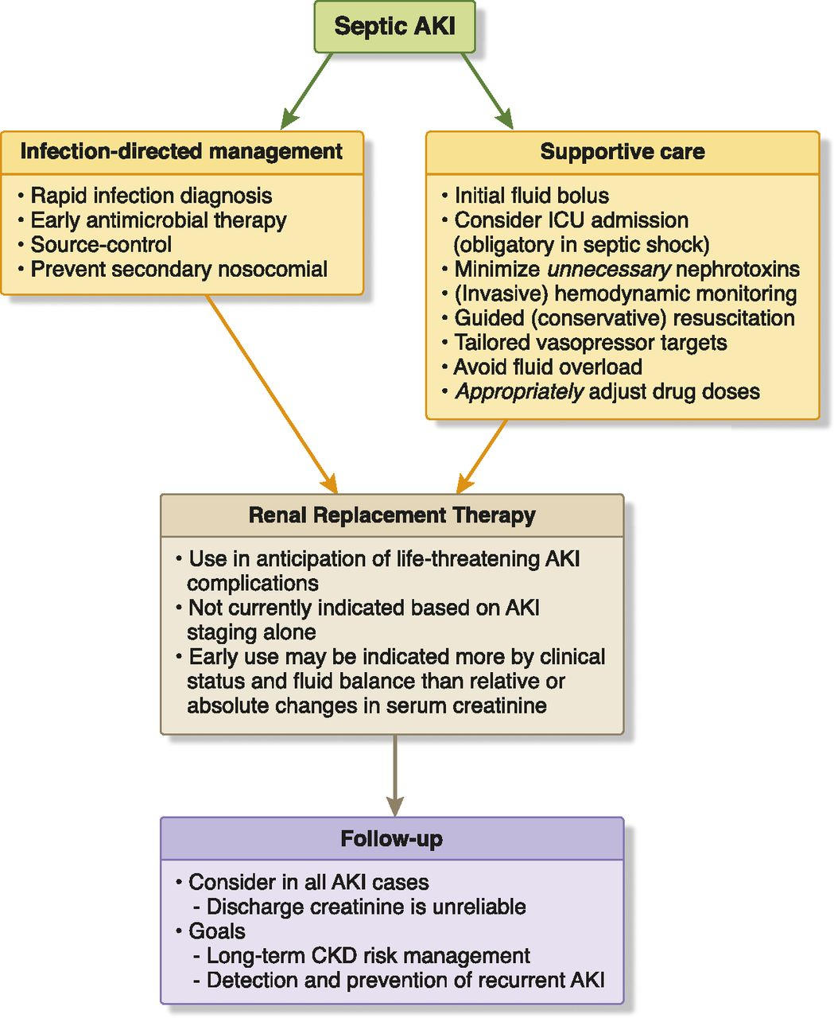
AKI and Sepsis
1 in 3 patients with sepsis will develop AKI³⁴
Most common cause of AKI in critically ill³⁴
Fluid overload associated with worse outcomes³³
Vasopressors key to treating refractory hypotension³³
Norepinephrine favorable choice
Vasopressin in septic shock not associated with improved kidney outcomes but may decrease need for RRT
Nephrotoxins should be avoided but may be essential for management of underlying infection causing sepsis³³
Image Source: Prowle JR Clin J Am Soc Nephrol 2018 ³³

Slide 29
Recommendation #3: Glycemic Control

Slide 30
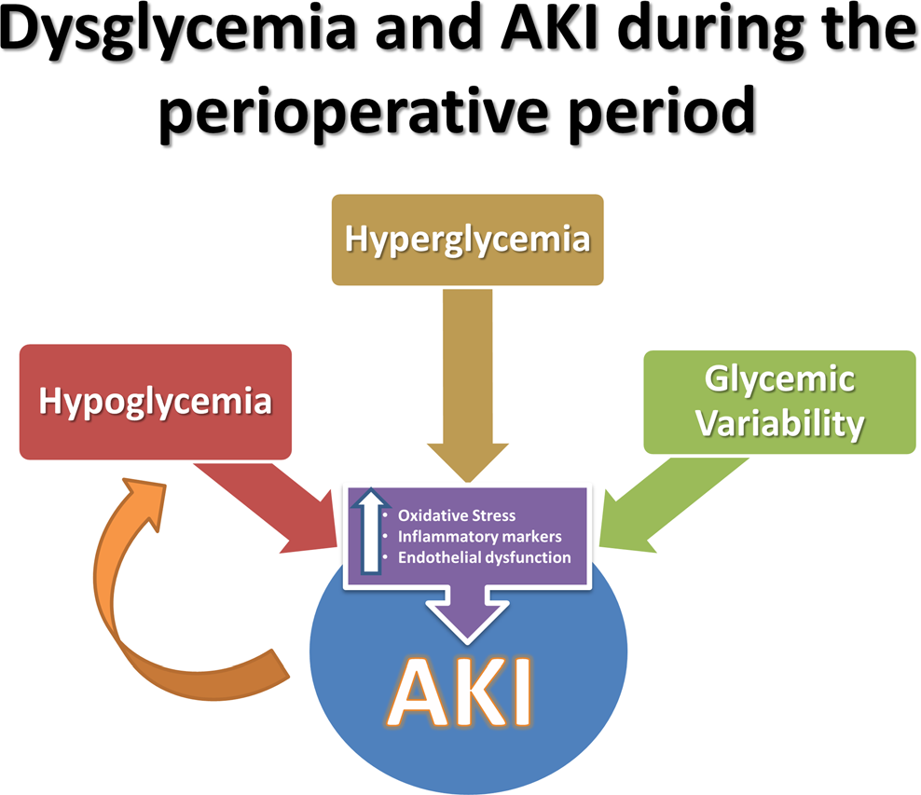
Pathophysiology: How Dysglycemia causes AKI
Hyperglycemia occurs in 40% of non-cardiac surgeries and 80% of cardiac surgeries.³⁵
Hyperglycemia leads to tissue injury through:³⁵
Oxidative Stress
Inflammatory Marker Release
Vascular permeability
Kidney specific damage has been seen in animal studies exposing subjects to transient hyperglycemia:³⁶
Severe kidney damage
Decreased renal cortical perfusion and oxygen delivery
Elevated plasma creatinine
Image Source: Mendez et al. Current Diabetes Reports 2016

Slide 31
Risk Factors predicting Hyperglycemia
Patients without diabetes:³⁷
Black ethnicity
Female
Immunosuppression
High BMI
Renal failure
Hypertension
Hypercholesterolemia
Patients with diabetes:³⁸
Older Age
Minority Ethnic Group
Male
High BMI
High Risk Surgical Procedure

Slide 32
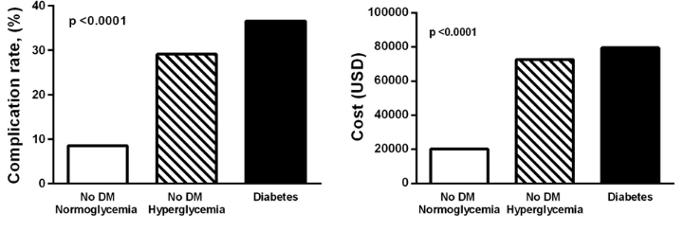
Impact of Hyperglycemia
Increased BMI may predispose patients to AKI due to difficult volume assessment and resuscitation risking pre-renal AKI.³⁹
In a 2 center study of gastrointestinal surgery, average cost of hospitalization and complications, including AKI (p= <0.0001) for non diabetic patients with normoglycemia was $20,273 compared to $72,675 for non-diabetic patients with hyperglycemia³⁹

Slide 33
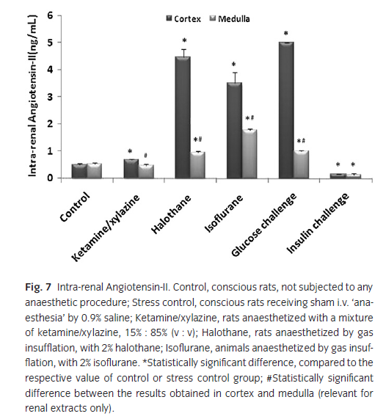
Role of Anesthetics and Hyperglycemia in Renal Injury⁴⁰
Surgery induced stress may disguise the role of anesthesia in postoperative renal complications.
Acute hyperglycemia, intra-renal inflammation and Renin Angiotensin System activation were independently triggered in rats receiving 1 hour of anesthesia.
Blood glucose significantly increased within 10 minutes of receiving anesthesia
Acute hyperglycemia affects inflammation more potently than chronic hyperglycemia
RAS activation causes significant renal injury in patients with acute and chronic hyperglycemia.

Slide 34
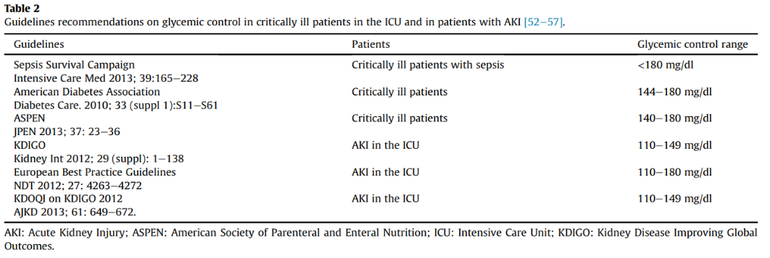
‘Perfect’ Glycemic Range⁴¹
Glycemic control is an independent, and modifiable, predictor of poor outcomes in surgical patients
AKI may further complicate glycemic control as it associated with insulin resistance and reduced renal clearance of insulin.
Maintaining a blood glucose of 80-110 mg/dL has not proven to have protective effects on the kidneys in patients who already have AKI.
Multiple Recommendations for ‘Perfect’ Glycemic Range

Slide 35
Source | Recommended Glucose Range
KDIGO (2012) controversial recommendation as these thresholds have not been examined in a randomized controlled trial and the risks of hypoglycaemia are significant⁴² | 110 - 149 mg/dL
NICE-SUGAR (2009): Normoglycemia in Intensive Care Evaluation: Survival Using Glucose Algorithm Regulation - randomized control trial suggests adopting higher glycemic values in critically ill patients to avoid the risks of tight glycemic benchmarks. A blood glucose target of 81 - 108 mg/dL resulted in higher mortality than a target of < 180 mg/dL without preventing AKI⁴³ | < 180 mg/dL
ERPB (2009): European Renal Best Practice statement on KDIGO Guidelines (Systematic Review) There is benefit in avoiding hyperglycemia > 210 mg/dL however, the relative risk of death is much higher in patients with hypoglycemia and thus offsets the small benefit of targeting a lower blood glucose⁴⁴ | 110 - 180 mg/dL

Slide 36
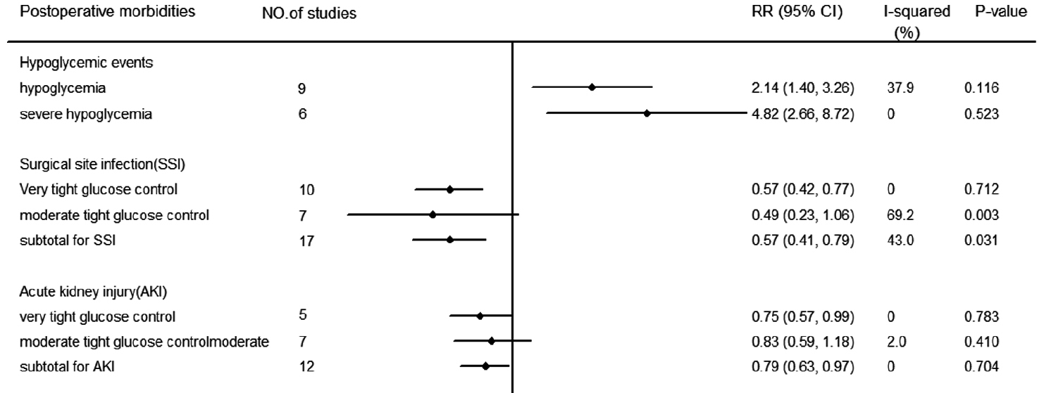
Perioperative Glucose Control: Tight vs. Moderate⁴⁵
Meta Analysis of 12 RCT showed a decreased relative risk of AKI with glucose controlled <150 mg/dL with an increased risk of hypoglycemic events
Very Tight Glucose Control ( < 110 mg/dL)
Moderate Tight Glucose Control (111 - 150 mg/dL)

Slide 37
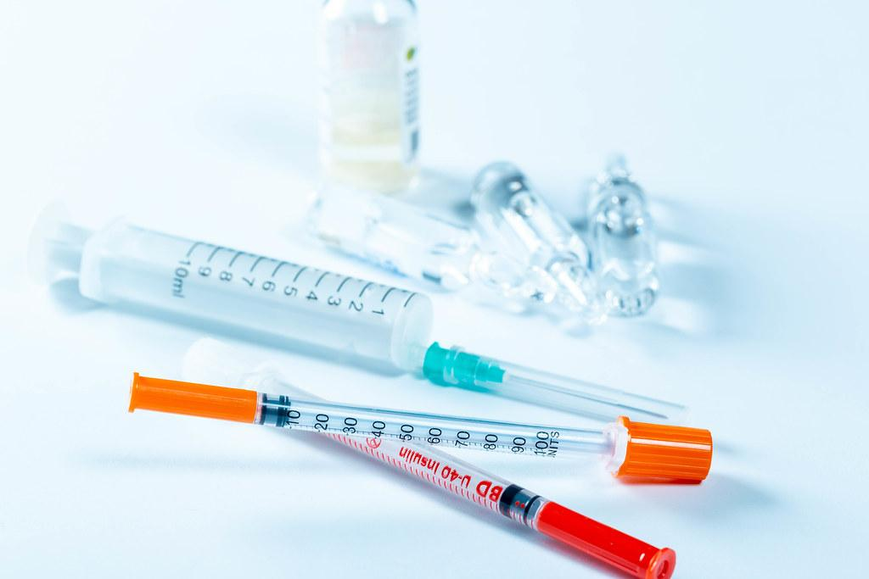
Intensive Insulin Therapy
Systematic review of 5 RCTs demonstrated intensive insulin therapy reduced the incidence of AKI in adult surgical patients by 38%.⁴⁶
When compared to a liberal glycemic control strategy (>200), moderate glucose control (150-200) for diabetics undergoing surgery was associated with a significantly lower risk of mortality.
No difference was found between strict (<150) vs moderate (150-200)⁴⁷
Intensive insulin therapy and a carbohydrate-restrictive strategy were comparable in their effects on the incidence of acute kidney injury evaluated using the RIFLE criteria⁴⁸
Oral antidiabetic medication are not recommended based on limited efficacy and adverse effects including hypoglycemia and lactic acidosis with metformin.³⁵

Slide 38
Summary: Hyperglycemia and AKI
Increased risk of AKI at both high and low blood glucose range. Treat hyperglycemia while avoiding glycemic variability and hypoglycemia. KDIGO recommends moderate targets for glycemic control.⁴²
Utilize insulin therapy to manage hyperglycemia during the perioperative period in diabetic and non-diabetic surgical patients.⁴²
Treat hyperglycemia with moderate glycemic targets.⁴¹

Slide 39
Recommendation #4: Avoid Nephrotoxins

Slide 40
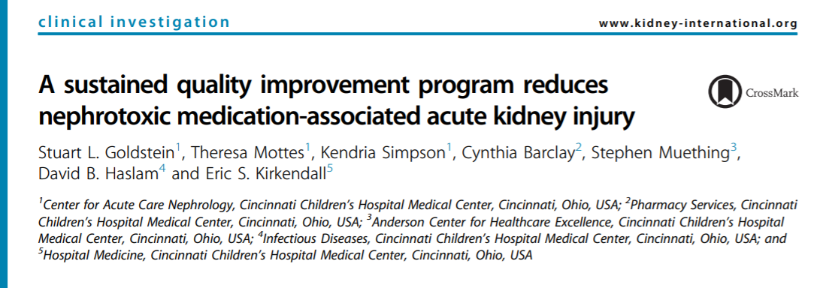
Avoiding Nephrotoxic Drugs
Nephrotoxic drugs are associated with increased risk of AKI^{2,8,42,49}
Cincinnati Children’s avoidance of AKI quality improvement program⁵⁰
Proactively screened for nephrotoxic drug exposure in EHR
Monitored daily SCr for patients exposed
Reduced exposure rate to nephrotoxic drugs by 38%
Reduced AKI rate by 64%

Slide 41
Avoidance of Nephrotoxic Drugs
Antimicrobials
Contrast
NSAIDs
- Avoid use of aminoglycosides unless no other suitable options, use topical/local administrations if possible, and avoid dosing with multiple administrations per day.⁴²
- Avoid amphotericin B, use antifungals as appropriate. Use lipid formulation of amphotericin B if applicable.⁴²
- Assess risk for contrast induced AKI prior to study. Explore alternatives if patient is at risk.⁴²
- For patients at risk, use lowest possible dose of iso-osmolar or low-osmolar iodinated contrast and utilize isotonic sodium chloride or sodium bicarbonate IV fluid solutions.⁴²
- Concurrent use of other nephrotoxic drugs with contrast increases risk for CI-AKI.⁴²
- NSAID use can increase AKI risk close to twofold⁵¹
- GFR is reduced with NSAID use d/t loss of vasodilatory prostaglandin²

Slide 42
Nephrotoxic Drugs- Indirect
Antibiotics ⟶ breakdown of bacteria ⟶ bacteria cell products in circulation ⟶ systemic inflammation and damage to kidneys and/or kidney injury⁵²
Allergic interstitial nephritis may cause damage to kidneys without other signs of allergy⁵²

Slide 43
Recommendation #5: Early Recognition of AKI

Slide 44
Early Recognition of AKI
Early recognition of AKI patients through EHR alerts is associated with lower in-hospital mortality, lower risk of death, and lower risk of progression to later AKI stages⁴
Proactive screening for nephrotoxic drugs and regular SCr monitoring in patients receiving nephrotoxic drugs reduced exposure by 38% and AKI by 64%⁵⁰
American Society of Nephrology launched AKI!NOW initiative to promote early recognition and management of AKI which help optimize treatment and prevent progression.⁵³
AKI!NOW Recommendations:
Provider education at all levels in healthcare regarding AKI, particularly around identifying patients at risk
Generate specific guidance on AKI evaluation and management
Develop global toolkit
Engage hospital administration and make AKI a part of quality initiative
Raise awareness of AKI as complication of other disease processes

Slide 45
Interventions under Research

Slide 46
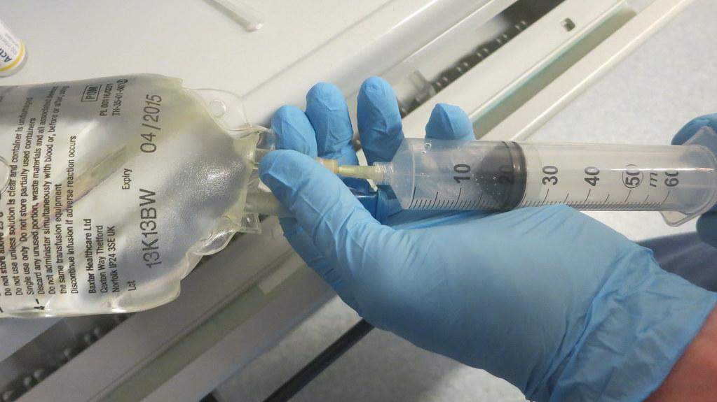
Other Proposed Pharmacologic Interventions
Low dose “renal dopamine” prophylaxis
Theorized to prevent renal vasoconstriction
More harm than good³⁰
High dose furosemide
Literature does not support loop diuretics for kidney protection only³⁰
N-acetylcysteine/supplements such as selenium, zinc, vitamin C, E, and B1
Antioxidants
Not currently supported in literature²
Statin therapy
Potential anti inflammatory, antioxidative, and endothelial protective properties
Not currently supported in literature, may actually worsen AKI²
Dexmedetomidine
Theory: ↑renal blood flow, ↓ oxidative insult to kidney
Preliminary research shows dexmedetomidine may be helpful, need for further research²

Slide 47
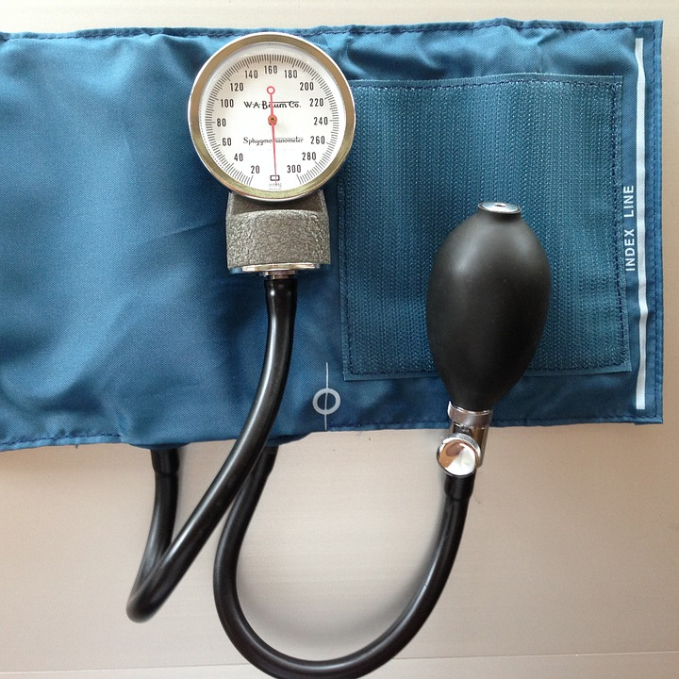
Remote Ischemic Preconditioning²
Application of controlled ischemia to remote tissues or organs to create a protective adaptive response in distant organs
Typical protocol for AKI prevention includes inflating a blood pressure cuff around the upper arm to 200-300 mmHg for five minutes and released. Cycle is repeated several times
Mixed results in studies -> differing protocols, patient populations, and study design
Protective effect may be lessened in cases with propofol
Conclusion: Further investigation needed before adopting into practice

Slide 48
Summary
Anesthesia providers should focus on reducing the anesthesia-related intraoperative risk factors associated with AKI such as:
Hypotension
Hyperglycemia
Use of nephrotoxic agents
Assessing risk factors preoperatively can assist anesthesia providers in identifying patients who may require additional interventions to prevent AKI.
Early Recognition of AKI optimizes treatment and reduces risk of progression to later stages of kidney disease.

Slide 49
References
1 KDIGO. 2012. “KDIGO 2012 Clinical Practice Guideline for the Evaluation and Management of Chronic Kidney Disease.” https://kdigo.org/wp-content/uploads/2017/02/KDIGO_2012_CKD_GL.pdf.
2 Gumbert SD, Kork F, Jackson ML, Vanga N, Ghebremichael SJ, Wang CY, Eltzschig HK: Perioperative Acute Kidney Injury. Anesthesiology 2020; 132:180–204
3 Meersch M, Schmidt C, Hoffmeier A, Van Aken H, Wempe C, Gerss J, Zarbock A: Prevention of cardiac surgery-associated AKI by implementing the KDIGO guidelines in high risk patients identified by biomarkers: the PrevAKI randomized controlled trial. Intensive Care Med 2017; 43:1551–61
4 Kolhe NV, Staples D, Reilly T, Merrison D, Mcintyre CW, Fluck RJ, Selby NM, Taal MW: Impact of Compliance with a Care Bundle on Acute Kidney Injury Outcomes: A Prospective Observational Study. PLoS One 2015; 10:e0132279
5 Joslin J, Wilson H, Zubli D, Gauge N, Kinirons M, Hopper A, Pile T, Ostermann M: Recognition and management of acute kidney injury in hospitalised patients can be partially improved with the use of a care bundle. Clin Med 2015; 15:431–6
6 Meersch M, Schmidt C, Zarbock A: Perioperative Acute Kidney Injury: An Under-Recognized Problem. Anesth Analg 2017; 125:1223–32
7 Romagnoli S, Ricci Z, Ronco C: Perioperative Acute Kidney Injury: Prevention, Early Recognition, and Supportive Measures. Nephron 2018; 140:105–10
8 Meersch M, Volmering S, Zarbock A: Prevention of acute kidney injury. Best Pract Res Clin Anaesthesiol 2017; 31:361–70

Slide 50
References
9 Hobson CE, Yavas S, Segal MS, Schold JD, Tribble CG, Layon AJ, Bihorac A: Acute kidney injury is associated with increased long-term mortality after cardiothoracic surgery. Circulation 2009; 119:2444–53
10 Bahrainwala JZ, Gelfand SL, Shah A, Abramovitz B, Hoffman B, Leonberg-Yoo AK: Preoperative Risk Assessment and Management in Adults Receiving Maintenance Dialysis and Those With Earlier Stages of CKD. Am J Kidney Dis 2020; 75:245–55
11 Thottakkara P, Ozrazgat-Baslanti T, Hupf BB, Rashidi P, Pardalos P, Momcilovic P, Bihorac A: Application of Machine Learning Techniques to High-Dimensional Clinical Data to Forecast Postoperative Complications. PLoS One 2016; 11:e0155705
12 Blantz RC: Pathophysiology of pre-renal azotemia. Kidney Int 1998; 53:512–23
13 Zarbock A, Koyner JL, Hoste EAJ, Kellum JA: Update on Perioperative Acute Kidney Injury. Anesth Analg 2018; 127:1236–45
14 Walsh M, Devereaux PJ, Garg AX, Kurz A, Turan A, Rodseth RN, Cywinski J, Thabane L, Sessler DI: Relationship between intraoperative mean arterial pressure and clinical outcomes after noncardiac surgery: toward an empirical definition of hypotension. Anesthesiology 2013; 119:507–15
15 Sun LY, Wijeysundera DN, Tait GA, Beattie WS: Association of intraoperative hypotension with acute kidney injury after elective noncardiac surgery. Anesthesiology 2015; 123:515–23
16 Salmasi V, Maheshwari K, Yang D, Mascha EJ, Singh A, Sessler DI, Kurz A: Relationship between Intraoperative Hypotension, Defined by Either Reduction from Baseline or Absolute Thresholds, and Acute Kidney and Myocardial Injury after Noncardiac Surgery A Retrospective Cohort Analysis. Anesthesiology 2017; 126:47–65

Slide 51
References
17 Maheshwari K, Turan A, Mao G, Yang D, Niazi AK, Agarwal D, Sessler DI, Kurz A: The association of hypotension during non-cardiac surgery, before and after skin incision, with postoperative acute kidney injury: a retrospective cohort analysis. Anaesthesia 2018; 73:1223–8
18 Mathis MR, Naik BI, Freundlich RE, Shanks AM, Heung M, Kim M, Burns ML, Colquhoun DA, Rangrass G, Janda A, Engoren MC, Saager L, Tremper KK, Kheterpal S, Multicenter Perioperative Outcomes Group Investigators: Preoperative Risk and the Association between Hypotension and Postoperative Acute Kidney Injury. Anesthesiology 2019 doi:10.1097/ALN.0000000000003063
19 Futier E, Lefrant J-Y, Guinot P-G, Godet T, Lorne E, Cuvillon P, Bertran S, Leone M, Pastene B, Piriou V, Molliex S, Albanese J, Julia J-M, Tavernier B, Imhoff E, Bazin J-E, Constantin J-M, Pereira B, Jaber S, INPRESS Study Group: Effect of Individualized vs Standard Blood Pressure Management Strategies on Postoperative Organ Dysfunction Among High-Risk Patients Undergoing Major Surgery: A Randomized Clinical Trial. JAMA 2017; 318:1346–57
20 Myles PS, Bellomo R, Corcoran T, Forbes A, Peyton P, Story D, Christophi C, Leslie K, McGuinness S, Parke R, Serpell J, Chan MTV, Painter T, McCluskey S, Minto G, Wallace S, Australian and New Zealand College of Anaesthetists Clinical Trials Network and the Australian and New Zealand Intensive Care Society Clinical Trials Group: Restrictive versus Liberal Fluid Therapy for Major Abdominal Surgery. N Engl J Med 2018; 378:2263–74
21 Giglio M, Dalfino L, Puntillo F, Brienza N: Hemodynamic goal-directed therapy and postoperative kidney injury: an updated meta-analysis with trial sequential analysis. Crit Care 2019; 23:232

Slide 52
References
22 Pearse RM, Harrison DA, MacDonald N, Gillies MA, Blunt M, Ackland G, Grocott MPW, Ahern A, Griggs K, Scott R, Hinds C, Rowan K, OPTIMISE Study Group: Effect of a perioperative, cardiac output-guided hemodynamic therapy algorithm on outcomes following major gastrointestinal surgery: a randomized clinical trial and systematic review. JAMA 2014; 311:2181–90
23 Semler MW, Self WH, Wang L, Byrne DW, Wanderer JP, Ehrenfeld JM, Stollings JL, Kumar AB, Hernandez A, Guillamondegui OD, May AK, Siew ED, Shaw AD, Bernard GR, Rice TW, Isotonic Solutions and Major Adverse Renal Events Trial (SMART) Investigators, Pragmatic Critical Care Research Group: Balanced crystalloids versus saline in the intensive care unit: study protocol for a cluster-randomized, multiple-crossover trial. Trials 2017; 18:129
24 Self WH, Semler MW, Wanderer JP, Wang L, Byrne DW, Collins SP, Slovis CM, Lindsell CJ, Ehrenfeld JM, Siew ED, Shaw AD, Bernard GR, Rice TW, SALT-ED Investigators: Balanced Crystalloids versus Saline in Noncritically Ill Adults. N Engl J Med 2018; 378:819–28
25 SAFE Study Investigators, Australian and New Zealand Intensive Care Society Clinical Trials Group, Australian Red Cross Blood Service, George Institute for International Health, Myburgh J, Cooper DJ, Finfer S, Bellomo R, Norton R, Bishop N, Kai Lo S, Vallance S: Saline or albumin for fluid resuscitation in patients with traumatic brain injury. N Engl J Med 2007; 357:874–84
26 Perner A, Haase N, Guttormsen AB, Tenhunen J, Klemenzson G, Åneman A, Madsen KR, Møller MH, Elkjær JM, Poulsen LM, Bendtsen A, Winding R, Steensen M, Berezowicz P, Søe-Jensen P, Bestle M, Strand K, Wiis J, White JO, Thornberg KJ, Quist L, Nielsen J, Andersen LH, Holst LB, Thormar K, Kjældgaard A-L, Fabritius ML, Mondrup F, Pott FC, Møller TP, et al.: Hydroxyethyl starch 130/0.42 versus Ringer’s acetate in severe sepsis. N Engl J Med 2012; 367:124–34

Slide 53
References
27 Yates DRA, Davies SJ, Milner HE, Wilson RJT: Crystalloid or colloid for goal-directed fluid therapy in colorectal surgery. Br J Anaesth 2014; 112:281–9
28 Myburgh JA, Finfer S, Bellomo R, Billot L, Cass A, Gattas D, Glass P, Lipman J, Liu B, McArthur C, McGuinness S, Rajbhandari D, Taylor CB, Webb SAR, CHEST Investigators, Australian and New Zealand Intensive Care Society Clinical Trials Group: Hydroxyethyl starch or saline for fluid resuscitation in intensive care. N Engl J Med 2012; 367:1901–11
29 Hydroxyethyl Starch or Saline for Fluid Resuscitation in Intensive Care. N Engl J Med 2016; 374:1298
30 Joannidis M, Druml W, Forni LG, Groeneveld ABJ, Honore PM, Hoste E, Ostermann M, Oudemans-van Straaten HM, Schetz M: Prevention of acute kidney injury and protection of renal function in the intensive care unit: update 2017 : Expert opinion of the Working Group on Prevention, AKI section, European Society of Intensive Care Medicine. Intensive Care Med 2017; 43:730–49
31 De Backer D, Biston P, Devriendt J, Madl C, Chochrad D, Aldecoa C, Brasseur A, Defrance P, Gottignies P, Vincent J-L, SOAP II Investigators: Comparison of dopamine and norepinephrine in the treatment of shock. N Engl J Med 2010; 362:779–89
32 Farag E, Makarova N, Argalious M, Cywinski JB, Benzel E, Kalfas I, Sessler DI: Vasopressor Infusion During Prone Spine Surgery and Acute Renal Injury: A Retrospective Cohort Analysis. Anesth Analg 2019; 129:896–904
33 Prowle JR: Sepsis-Associated AKI. Clin J Am Soc Nephrol 2018; 13:339–42
34 Peerapornratana S, Manrique-Caballero CL, Gómez H, Kellum JA: Acute kidney injury from sepsis: current concepts, epidemiology, pathophysiology, prevention and treatment. Kidney Int 2019; 96:1083–99

Slide 54
References
35 Mendez CE, Der Mesropian PJ, Mathew RO, Slawski B: Hyperglycemia and Acute Kidney Injury During the Perioperative Period. Curr Diab Rep 2016; 16:10
36 Hirose R, Xu F, Dang K, Liu T, Behrends M, Brakeman PR, Wiener-Kronish J, Niemann CU: Transient hyperglycemia affects the extent of ischemia-reperfusion-induced renal injury in rats. Anesthesiology 2008; 108:402–14
37 Moorthy V, Sim MA, Liu W, Chew STH, Ti LK: Risk factors and impact of postoperative hyperglycemia in nondiabetic patients after cardiac surgery: A prospective study. Medicine 2019; 98:e15911
38 Frisch A, Chandra P, Smiley D, Peng L, Rizzo M, Gatcliffe C, Hudson M, Mendoza J, Johnson R, Lin E, Umpierrez GE: Prevalence and clinical outcome of hyperglycemia in the perioperative period in noncardiac surgery. Diabetes Care 2010; 33:1783–8
39 Buehler L, Fayfman M, Alexopoulos A-S, Zhao L, Farrokhi F, Weaver J, Smiley-Byrd D, Pasquel FJ, Vellanki P, Umpierrez GE: The impact of hyperglycemia and obesity on hospitalization costs and clinical outcome in general surgery patients. J Diabetes Complications 2015; 29:1177–82
40 Efrati S, Berman S, Abu Hamad R, El Nakib R, Chanimov M, Siman-Tov Y, Weissgarten J: Hyperglycaemia, inflammation, RAS activation: three culprits to blame for acute kidney injury emerging in healthy rats during general anaesthesia. Nephrology 2012; 17:591–602
41 Fiaccadori E, Sabatino A, Morabito S, Bozzoli L, Donadio C, Maggiore U, Regolisti G: Hyper/hypoglycemia and acute kidney injury in critically ill patients. Clin Nutr 2016; 35:317–21

Slide 55
References
42 KDIGO. 2012. “KDIGO 2012 Clinical Practice Guideline for Acute Kidney Injury.” https://kdigo.org/wp-content/uploads/2016/10/KDIGO-2012-AKI-Guideline-English.pdf>
43 NICE-SUGAR Study Investigators, Finfer S, Chittock DR, Su SY-S, Blair D, Foster D, Dhingra V, Bellomo R, Cook D, Dodek P, Henderson WR, Hébert PC, Heritier S, Heyland DK, McArthur C, McDonald E, Mitchell I, Myburgh JA, Norton R, Potter J, Robinson BG, Ronco JJ: Intensive versus conventional glucose control in critically ill patients. N Engl J Med 2009; 360:1283–97
44 Ad-hoc working group of ERBP, Fliser D, Laville M, Covic A, Fouque D, Vanholder R, Juillard L, Van Biesen W: A European Renal Best Practice (ERBP) position statement on the Kidney Disease Improving Global Outcomes (KDIGO) clinical practice guidelines on acute kidney injury: part 1: definitions, conservative management and contrast-induced nephropathy. Nephrol Dial Transplant 2012; 27:4263–72
45 Kang Z-Q, Huo J-L, Zhai X-J: Effects of perioperative tight glycemic control on postoperative outcomes: a meta-analysis. Endocr Connect 2018; 7:R316–27
46 Thomas G, Rojas MC, Epstein SK, Balk EM, Liangos O, Jaber BL: Insulin therapy and acute kidney injury in critically ill patients a systematic review. Nephrol Dial Transplant 2007; 22:2849–55
47 Sathya B, Davis R, Taveira T, Whitlatch H, Wu W-C: Intensity of peri-operative glycemic control and postoperative outcomes in patients with diabetes: a meta-analysis. Diabetes Res Clin Pract 2013; 102:8–15
48 Azevedo JRA de, Araujo LO de, Silva WS da, Azevedo RP de: A carbohydrate-restrictive strategy is safer and as efficient as intensive insulin therapy in critically ill patients. J Crit Care 2010; 25:84–9

Slide 56
References
49 Rossaint J, Zarbock A: Acute kidney injury: definition, diagnosis and epidemiology. Minerva Urol Nefrol 2016; 68:49–57
50 Goldstein SL, Mottes T, Simpson K, Barclay C, Muething S, Haslam DB, Kirkendall ES: A sustained quality improvement program reduces nephrotoxic medication-associated acute kidney injury. Kidney Int 2016; 90:212–21
51 Zhang X, Donnan PT, Bell S, Guthrie B: Non-steroidal anti-inflammatory drug induced acute kidney injury in the community dwelling general population and people with chronic kidney disease: systematic review and meta-analysis. BMC Nephrol 2017; 18:256
52 Zarbock A, Koyner JL, Hoste EAJ, Kellum JA: Update on Perioperative Acute Kidney Injury. Anesth Analg 2018; 127:1236–45
53 Liu KD, Goldstein SL, Vijayan A, Parikh CR, Kashani K, Okusa MD, Agarwal A, Cerdá J, AKI!Now Initiative of the American Society of Nephrology*: AKI!Now Initiative: Recommendations for Awareness, Recognition, and Management of AKI. Clin J Am Soc Nephrol 2020 doi:10.2215/CJN.15611219

